Slide 1
Unemployment and the New Deal

Slide 2
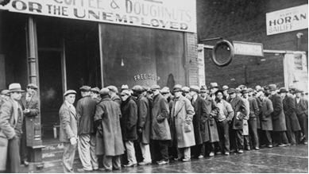

Slide 3
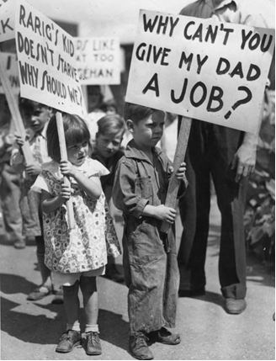

Slide 4
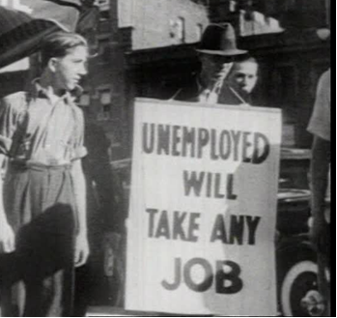

Slide 5
Unemployment and the New Deal
“… a host of unemployed citizens face the grim problem of existence, and an equally great number toil with little return. Only a foolish optimist can deny the dark realities of the moment.”
President Franklin D. Roosevelt - 1st Inaugural Address, March 4, 1933

Slide 6
Unemployment and the New Deal
 |  | Number of Unemployed Civilians ^{- a} | Unemployment rate ^{- a}
1929 |  | 1,550,000 | 3.15
1930 |  | 4,340,000 | 8.71
1931 |  | 8,020,000 | 15.91
1932 |  | 12,060,000 | 23.65
1933 |  | 12,830,000 | 24.87
a - | https://www.bls.gov/opub/mlr/1948/article/pdf/labor-force- employment-and-unemployment-1929-39-estimating-methods.pdf

Slide 7
Group Activity: Analyzing the New Deal Programs

Slide 8
FDR, 1st Inaugural Address, March 4, 1933
“Our greatest primary task is to put people to work. This is no unsolvable problem if we face it wisely and courageously. It can be accomplished in part by direct recruiting by the Government itself, treating the task as we would treat the emergency of a war, but at the same time, through this employment, accomplishing greatly needed projects to stimulate and reorganize the use of our national resources.”
How did these programs address this issue?

Slide 9
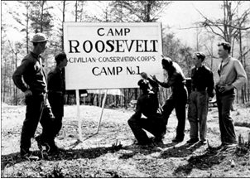
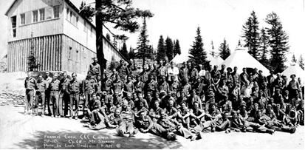
Civilian Conservation Corps
The Civilian Conservation Corps (CCC) put 3 million unemployed young men to work in the nation’s forests and parks over a 9-year period. The men of the CCC plant 3 billion trees and create, develop, or improve 800 state parks. It started March 31, 1933 and ended June 30, 1942.
https://livingnewdeal.org/what-was-the-new-deal/timeline/
Photos courtesy of the Library of Congress - https://www.loc.gov/

Slide 10
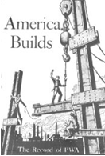
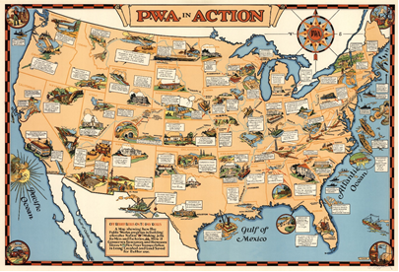
Public Works Administration
The Public Works Administration (PWA) was in place from June 16, 1933 to June 30, 1943. During that ten-year span, it contributed $4 billion dollars towards tens of thousands of infrastructure projects all across the nation and employed about 2 million workers.
https://livingnewdeal.org/what-was-the-new-deal/timeline/
Photos courtesy of the Library of Congress - https://www.loc.gov/

Slide 11
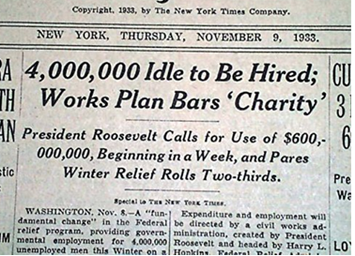
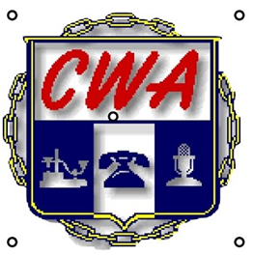
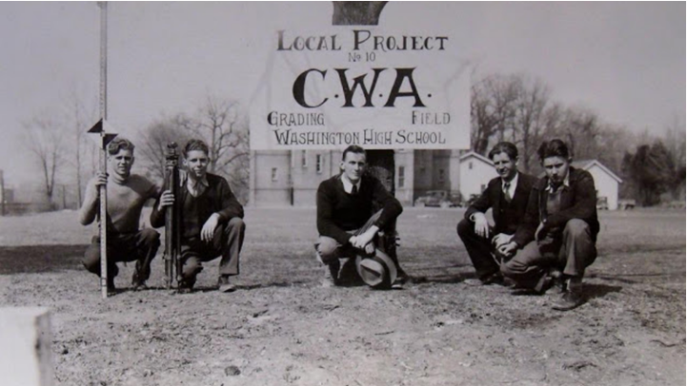
Civilian Works Administration
The Civil Works Administration (CWA) operated from November 9, 1993 to July 14, 1934. By January 1934, over 4 million formerly-jobless Americans were employed by the CWA. During the eight-month program, over $800 million was spent employing men to build 44,000 miles of new roads, install 1,000 miles of new water mains, construct or improve 4,000 schools, and complete many other projects.
https://livingnewdeal.org/what-was-the-new-deal/timeline/
Photos courtesy of the Library of Congress - https://www.loc.gov/

Slide 12
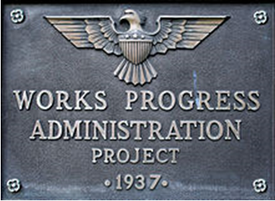
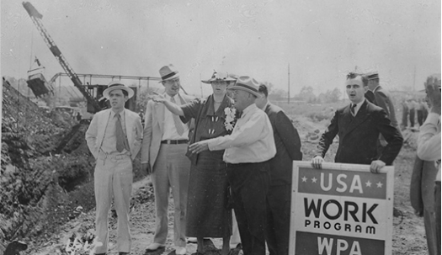
Works Progress Administration
The Works Progress Administration (WPA) was created to provide jobs for unemployed Americans and to improve the nation’s infrastructure. The WPA employed over 8.5 million jobless Americans during its eight years of operation. During its existence the WPA greatly modernizes and expands America’s infrastructure. The agency operated from May 6, 1935 to June 30, 1943.
https://livingnewdeal.org/what-was-the-new-deal/timeline/
Photos courtesy of the Library of Congress - https://www.loc.gov/

Slide 13
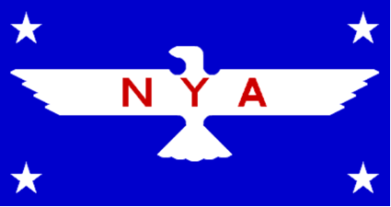
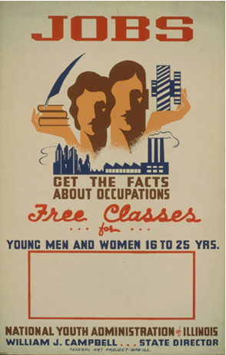
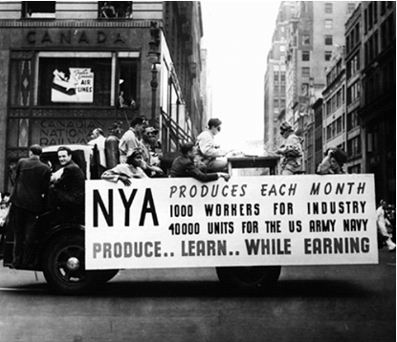
National Youth Administration
Another agency, the National Youth Administration (NYA), was created to provide work, education, and job training for unemployed young men and women. It employs 4.7 million young Americans between June 26, 1935 and January 1, 1944.
https://livingnewdeal.org/what-was-the-new-deal/timeline/
Photos courtesy of the Library of Congress - https://www.loc.gov/

Slide 14
Reviewing the lesson
How did the New Deal impact unemployment?
It decreased unemployment from almost 25% in 1933 to about 2% in 1943.
How did it work?
The New Deal created government-sponsored jobs that allowed people to return to work. As people earned an income and started spending again, the government gradually reduced those programs as more jobs were created in the economy.

