Slide 1
Resource Allocation in Product Markets
This lesson supports Lesson 1 in Unit 2: Nature and Function of Product Markets in CEE's Advanced Placement Microeconomics (4th Edition).

Slide 2
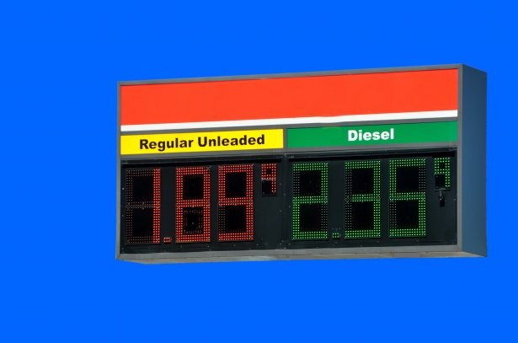
Warm-up
What goods or services could be affected by a rapid rise in the price of gasoline?

Slide 3
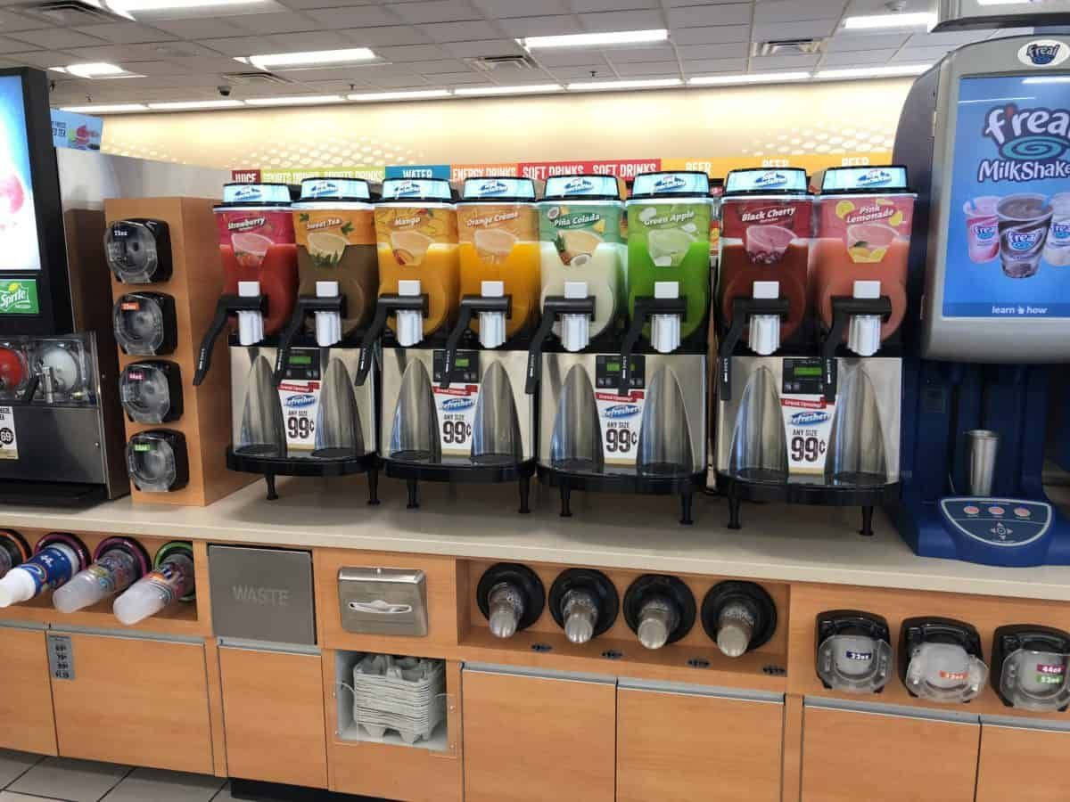
Warm-up
How would these products be affected if gasoline prices rapidly rise?
How do price changes change the quantity demanded or the quantity supplied?
Vacation Cabin Rentals
Gas Station Food Sales
New tires
Public Transportation
Notes:
Suggested responses:
New tires- if gasoline prices increase buyers may postpone purchases for new tires because of budgetary constraints related to increased transportation expenses.
Vacation Cabin Rentals- owners of cabin rentals are likely to see a decline in revenues as people may travel less.
Public transportation- a likely increase in demand for public transport may put upward pressures on quantities demanded and prices to travel via public transportation.
Gas Station Food Sales- revenues from gas station foods and drinks may decrease as gas and gas station refreshments are complementary goods.
In general, prices have an inverse relationship with quantity demanded (increase P/decrease QD and decrease P/increase QD) and a direct relationship with quantity supplied (increase P/Increase QS and decrease P/decrease QS).

Slide 4
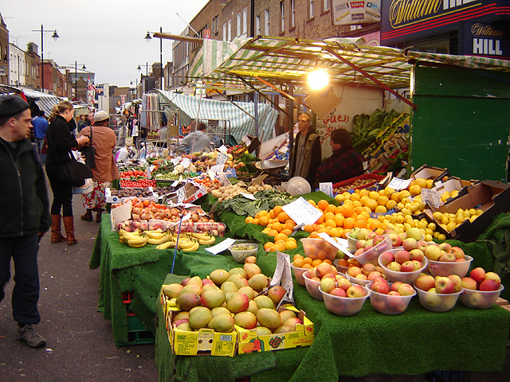
A Market Economy’s Price System
Markets provide the opportunity for buyers and sellers to exchange goods and services.
Demand is the quantity that consumers are willing and able to buy at given prices during a period of time. Supply is the quantity that producers are willing and able to sell at given prices during a period of time.
In a market economy, prices are set when buyers and sellers agree to make an exchange at a specific price for a specific quantity. Price is the point where QD=QS.

Slide 5
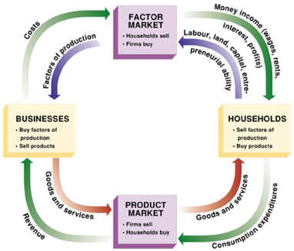
Circular Flow Model for a Market Economy
An economy is an endless flow of money facilitating the exchange of products and resources.
Resources are exchanged in the Factors Market. Products are exchanged in the Product Market.
Exchanges are made by Businesses and Households, who are buyers and sellers in the two markets.
Resources (the factors of production) are allocated to produce the goods and services consumers want to buy.

Slide 6
News Article
Gas-Price Drop Takes Americans’ Interest in Fuel Economy Down with It
The Wall Street Journal, Sept. 4, 2015

Slide 7
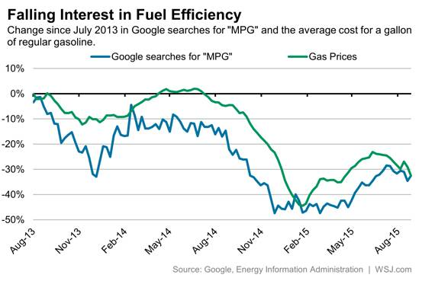
Comparing Falling Interest in Fuel Efficiency with Gas Prices

Slide 8
Article Summary
Households demanded more larger vehicles in the Product Market.
Businesses produced more larger vehicles for the Product Market.
This exchange increased the demand and supply of other related products.
Businesses re-allocated resources to meet consumers’ demands for larger vehicles.

Slide 9
Law of Demand
An economic principle stating that consumers will purchase less of a good or service at higher prices and more at lower prices.
Does consumer demand for larger vehicles that are more expensive than smaller cars defy the law of demand?

Slide 10
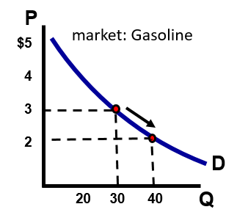
What Happened
A change in the price of gasoline caused the demand or supply of a related good (vehicles) to shift the demand curves. It reduced the demand for fuel efficient cars and increased the demand for larger vehicles.
P _{(thousands)}
market: Fuel-efficient cars
$50
40
30
20
D₁
D₂
Q _{(10,000s)}

Slide 11
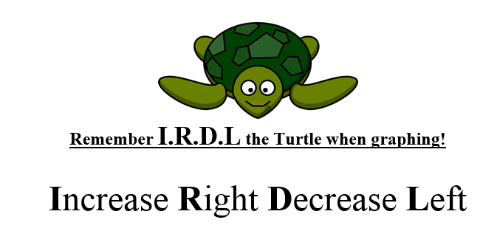
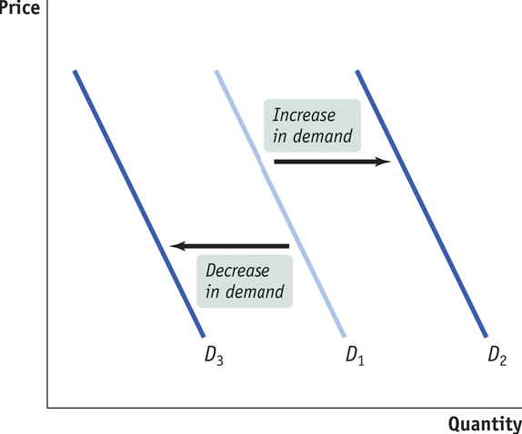
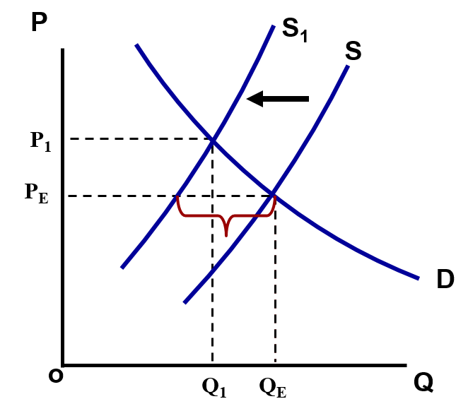
Graphing Supply & Demand
Notes:
Students often are confused initially when it comes to shifting the supply and demand curves. A shift to the left of the supply curve is always a decrease in supply, just as a shift left of the demand curve represents a new demand schedule with smaller quanitites demanded.
I.R.D.L. is a fun econ acronym which the author here is crediting to teacher Chris Cannon of the Georgia Council on Economic Education.

Slide 12
Article Determinants of Demand
M.E.R.I.T. shifts the demand curve
Market size (# of consumers)
Expectations (anticipated price changes)
Related prices (substitutes & complements)
Income (consumers demand more normal goods when their income increases)
Tastes and preferences

Slide 13
Related Prices in the Article Assume the larger vehicle was the consumers’ first choice
Substitute Goods
A rise in the price of one product (gasoline) may increase the demand for the substitute (smaller, fuel efficient cars) This is a direct relationship:
Price of gas Demand for small cars
Substitute Goods
A decrease in the price of one product (gasoline) may increase the demand for the substitute (smaller, fuel efficient cars) This is a direct relationship:
Price of gas Demand for small cars

Slide 14
At the same time… Assume the larger vehicle was the consumers’ first choice
Substitute Goods
A decrease in the price of one product (gasoline) may increase the demand for the consumers’ first choice:
Price of gas
Demand for larger vehicles

Slide 15
Related Prices in the Article Assume the larger vehicle was the consumers’ first choice
Complementary Goods
An increase in the price of one good (gasoline) will decrease the demand for the complementary good (tires for large vehicles). This is an inverse relationship:
Complementary Goods
A decrease in the price of one good (gasoline) will increase the demand for the complementary good (tires for large vehicles). This is an inverse relationship:
Price of gas
Demand for large vehicle tires
Price of gas
Demand for large vehicle tires

Slide 16
At the same time… Assume the larger vehicle was the consumers’ first choice
Complementary Goods
A decrease in the price of one product (gasoline) may increase the demand for the consumers’ first choice:
Demand for large vehicles tires
Price of gas
Demand for larger vehicles

Slide 17
Shifts in Supply Curve
T.R.I.C.E.(G.) Shifts the Supply Curve
Technology
Related prices (producers supply more of goods or services which generate more profit)
Input prices (resources, the ingredients of production)
Competition (number of sellers)
Expectations (producers anticipate price changes, producing more when prices rise)
Government Action (taxes and subsidies)

Slide 18
Conclusion
Price affects the Quantity Demanded and the Quantity Supplied
Changes in price do not shift the demand or supply curve for the product you are analyzing.
Changes in price represent a movement on a demand or supply curve.
Non-price determinants affect Demand and Supply
Changes in demand and supply shift the entire curve left or right
Demand and Supply of goods and services determine how resources are allocated in a market economy

Slide 19
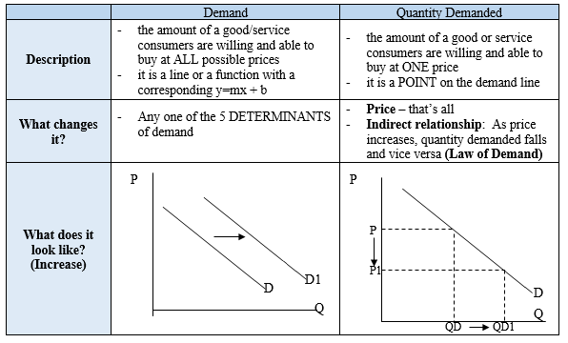
Differences in Demand and Quantity Demanded

Slide 20
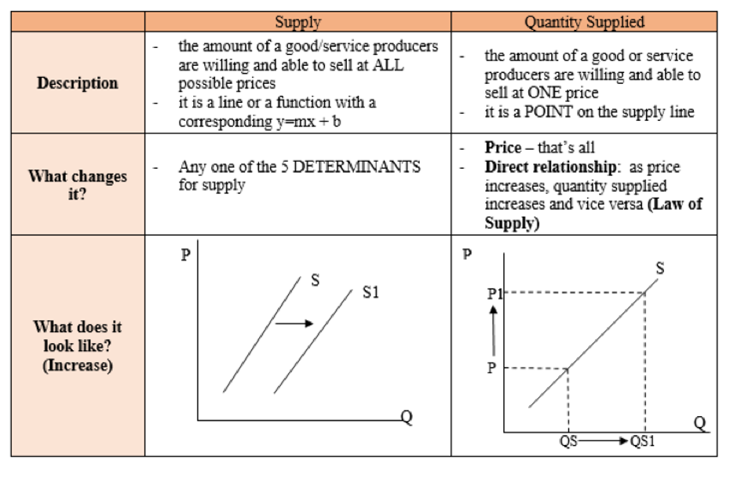
Differences in Supply and Quantity Supplied

