Slide 1
Booker T. Washington: “Fifty Cents and a Dream”

Slide 2
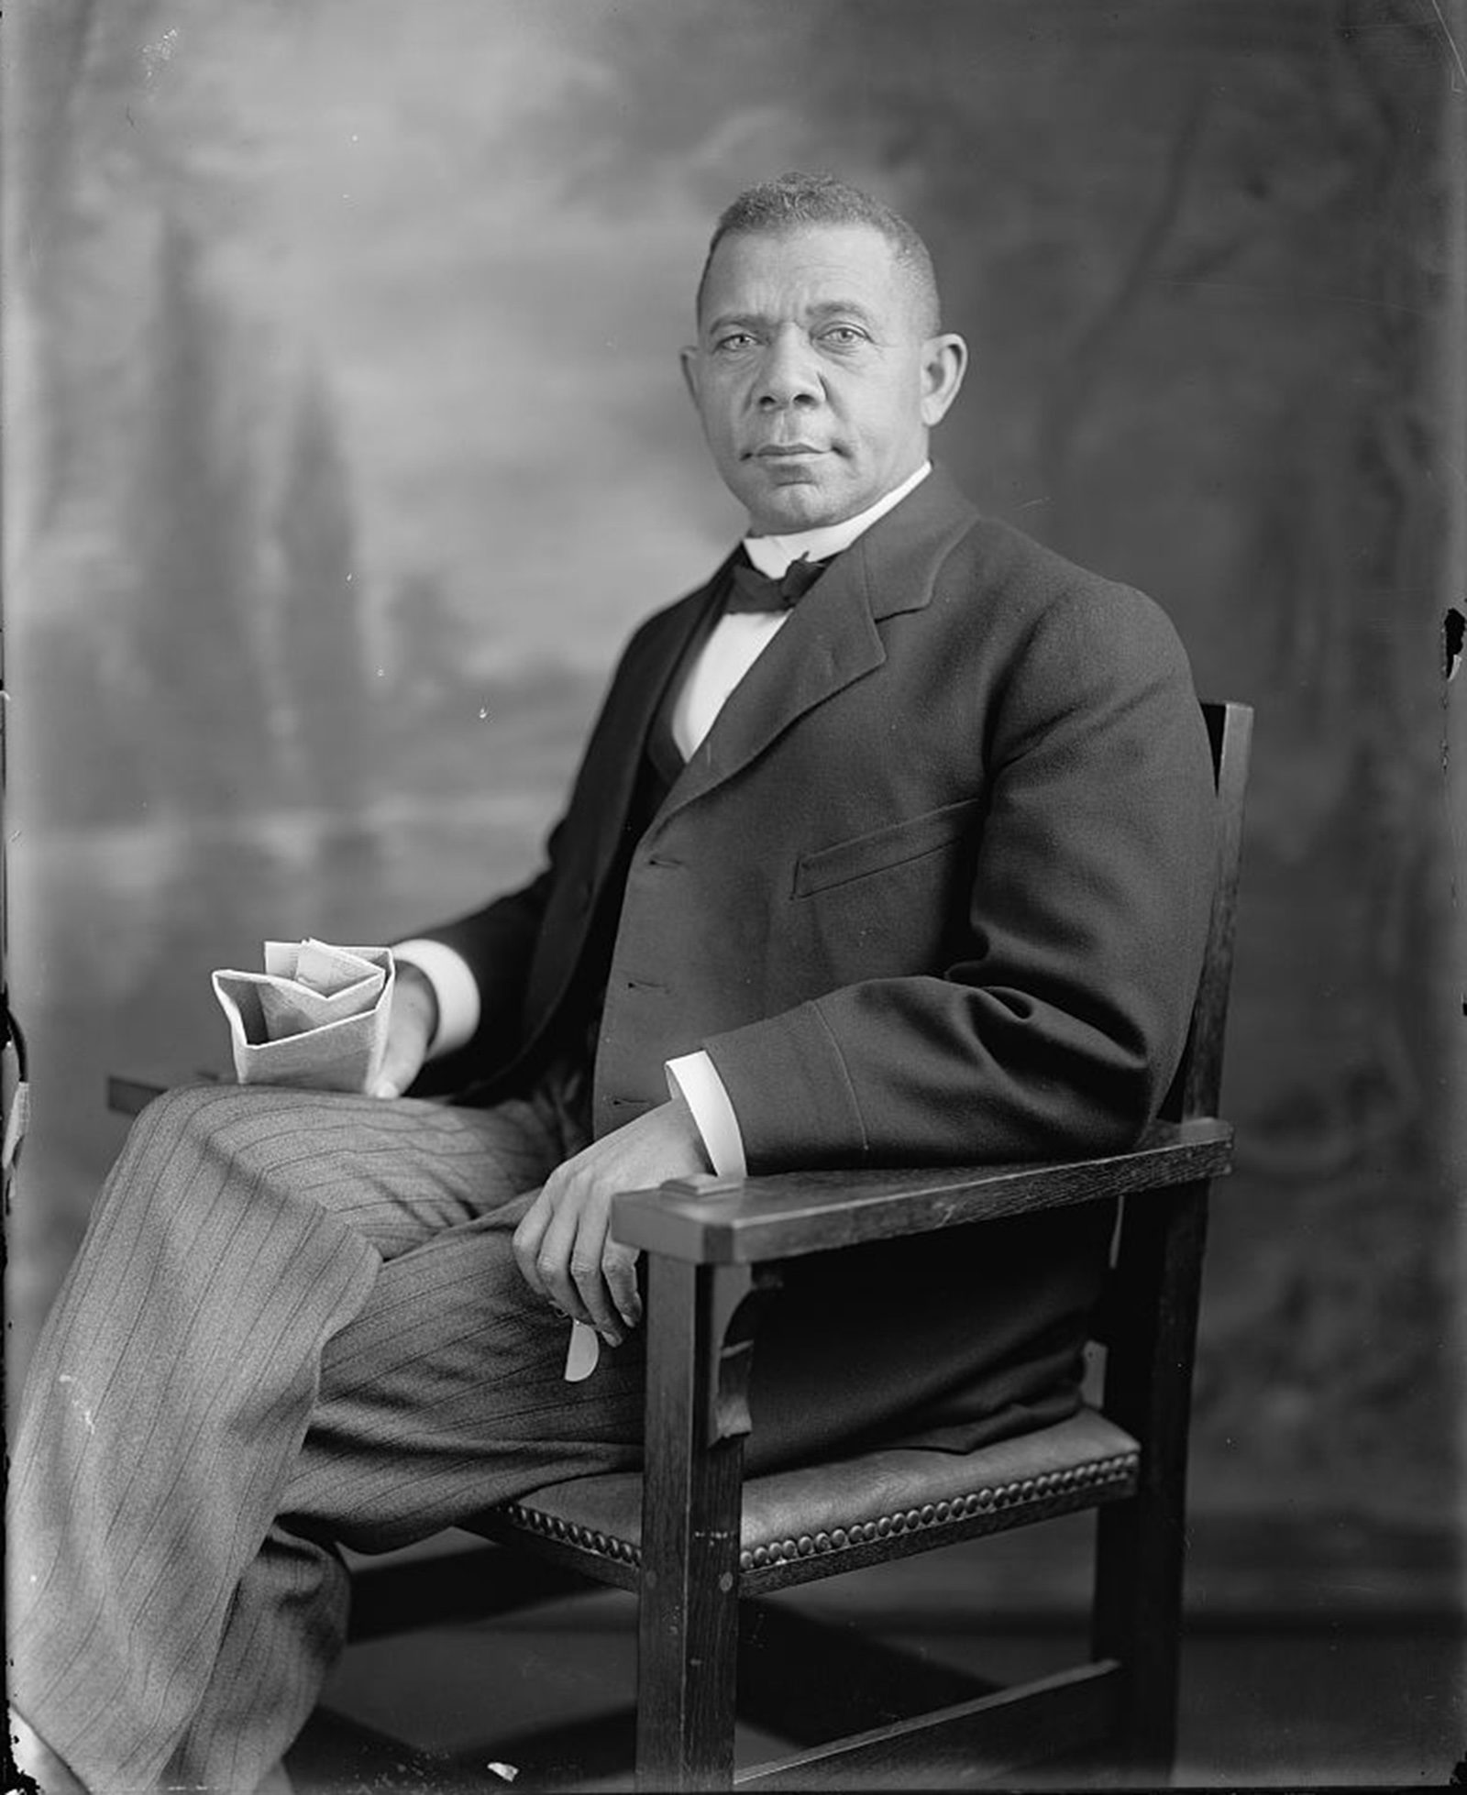
Booker T. Washington

Slide 3
Calculating Simple Interest
Human Resources - people working to produce goods and services (farmers, builders, firefighter, doctors, painters)
Human Capital - the health, education, experience, training, skills and values of people. Also known as human resources.
Capital Resources - goods used to produce other goods and services (hammers, computers, trucks, lawn mowers, factory buildings, machines, tools) *
*Hint: An easy way to remember what a capital resource is to think of it as a cap-i-TOOL resource.

Slide 4
Human and Capital Resources
What is the human resource in the illustration doing?
What capital resources is he using?
What skills does a person need to do this job?
Would this person need training or education to do this job?
What goods or services is he producing?

Slide 5
What is a job?
Work usually done on order at an agreed-upon rate. Also a paid position of regular employment.

Slide 6
Booker T. Washington’s Jobs
Book Carrier: Carried the schoolbooks to school for his master’s daughter. (He was enslaved and did not get paid money for this job.)
Salt Furnace Worker: Shoveled, packed, and hauled salt in a hot factory. (He joined his stepfather at this job.)
Coal Miner: Went underground to dig coal. (This was a dangerous job for a man, yet he and his brothers worked hard mining coal to make money for the family.)
Dock Worker: Hauled cargo off barges. (He used the money he earned from this job to help him get to Hampton, Virginia to go to school.)
School Janitor: Cleaned classrooms, washed windows, and scrubbed floors. (This job helped him pay his school tuition.)
Teacher: Taught students. (The money he earned was used to pay for his brothers’ tuition at Hampton Institute.)
Author: Wrote books. (His autobiography “Up from Slavery” becomes a bestseller.)

Slide 7
Booker T. Washington’s Jobs
Book Carrier: Carried the schoolbooks to school for his master’s daughter. (He was enslaved and did not get paid money for this job.) [Skills required include: physical strength and trustworthiness]
Salt Furnace Worker: Shoveled, packed, and hauled salt in a hot factory. (He joined his stepfather at this job.) [Skills required include: physical strength, ability to use necessary tools and dependability]
Coal Miner: Went underground to dig coal. (This was a dangerous job for a man, yet he and his brothers worked hard mining coal to make money for the family.) [Skills required include: physical strength, ability to use mining tools, bravery and dependability]
Dock Worker: Hauled cargo off barges. (He used the money he earned from this job to help him get to Hampton, Virginia to go to school.) [Skills required include: physical strength, problem solving abilities and communication skills]
School Janitor: Cleaned classrooms, washed windows, and scrubbed floors. (This job helped him pay his school tuition.) [Skills required include: physical strength and ability to use cleaning supplies]
Teacher: Taught students. (The money he earned was used to pay for his brothers’ tuition at Hampton Institute.) [Skills required include: ability to read and write, communication skills and reliability]
Author: Wrote books. (His autobiography “Up from Slavery” becomes a bestseller.) [Skills required include: ability to read and write, communication skills and creativity]

