Slide 1




Monkey Business:
Using Curious George to Teach Personal Finance
Presented by John Kruggel
James Madison University Center for Economic Education
August 4, 2020 kruggejb@jmu.edu

Slide 2
EconEdLink Membership
You can now access CEE’s professional development webinars directly on EconEdLink.org! To receive these new professional development benefits, become an EconEdLink member. As a member, you will now be able to:
Automatically receive a professional development certificate via e-mail within 24 hours after viewing any webinar for a minimum of 45 minutes
Register for upcoming webinars with a simple one-click process
Easily download presentations, lesson plan materials, and activities for each webinar
Search and view all webinars at your convenience
Save webinars to your EconEdLink dashboard for easy access to the event
You may access our new Professional Development page here

Slide 3
Professional Development Certificate
To earn your professional development certificate for this webinar, you must:
Watch a minimum of 45-minutes and you will automatically receive a professional development certificate via e-mail within 24 hours.
Accessing resources:
You can now easily download presentations, lesson plan materials, and activities for each webinar from EconEdLink.org/professional-development/

Slide 4

CEE Affiliates
https://www.councilforeconed.org/resources/local-affiliates/

Slide 5
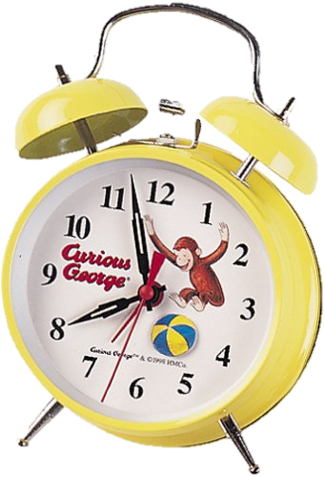
Agenda
Introduction and announcements
General Resources for using Curious George
Curious George Gets a Job
Curious George Saves His Pennies
Curious George Rides a Bike
CFPB resources
Additional Curious George resources with econ

Slide 6

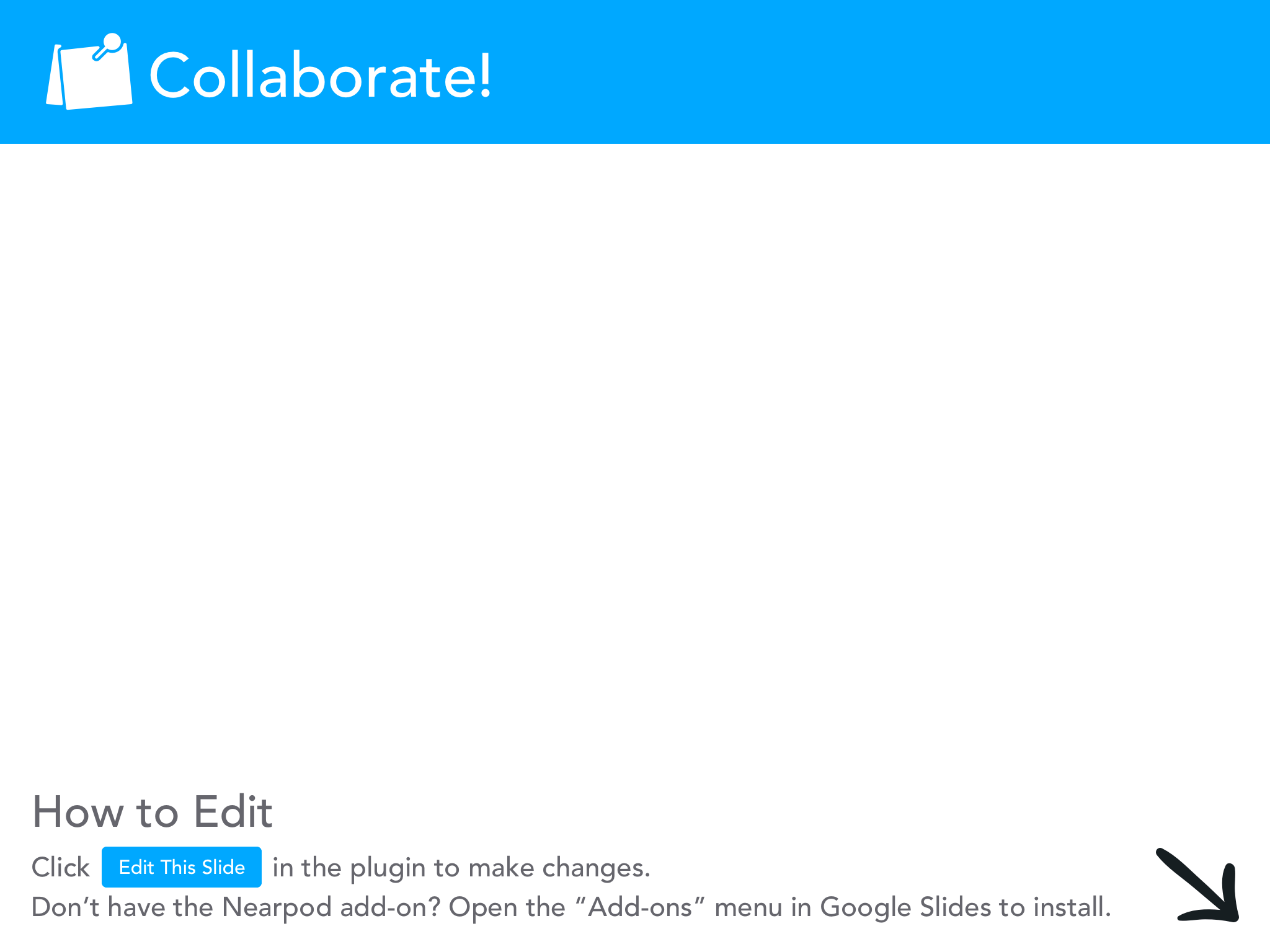

Slide 7

Objectives
I can:
Explain the P.A.C.E.D. decision-making process.
Define savings goal.
Discuss different ways individuals earn income.
Explore additional resources available for teaching Curious George.

Slide 8
National Standards
Standard 2: Decision Making
Effective decision making requires comparing the additional costs of alternatives with the additional benefits. Many choices involve doing a little more or a little less of something: few choices are all or nothing decisions.
Standard 13: Income
Students will understand that: Income for most people is determined by the market value of the productive resources they sell. What workers can earn primarily depends on the market value of what they produce.

Slide 9

Essential Question
What can Curious George teach us about economics and personal finance?

Slide 10
Essential Content
P.A.C.E.D. Decision Making Model
Goods and Services
Scarcity
Opportunity Cost/Trade-offs
Saving
Earning Income
Factors of production
Specialization and Interdependence

Slide 11
Key Terms
Goods: objects people want that they can touch or hold.
Services: an action that a person does for someone else.
Savings Goal: a good or service you want to buy in the future.
Income: payment people earn for the work they do.
Scarcity: economic condition of not being able to have all of the goods and services you want.
Factors of Production: human, natural, and capital resources used to produce goods and services.
Specialization: when producers make only one type of good or provide only one type of service.
Interdependence: when producers begin to specialize, they rely on other producers to help create goods and services they do not make for themselves.

Slide 12
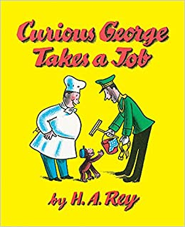
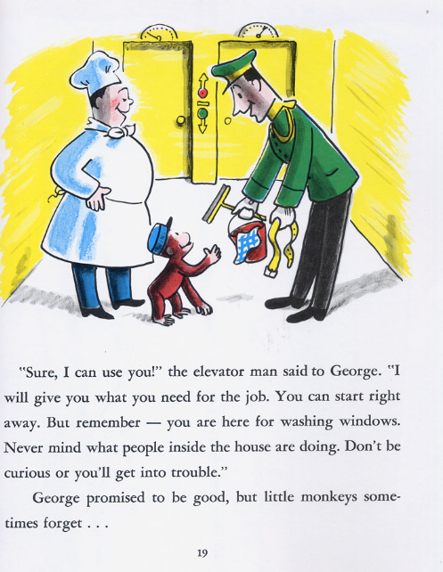
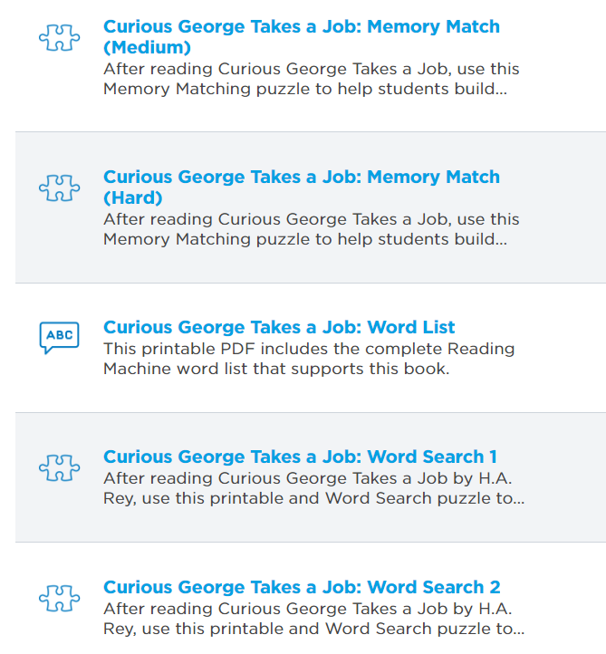
Curious George Takes a Job:

Slide 13


https://www.rif.org/literacy-central/book/curious-george-takes-job

Slide 14
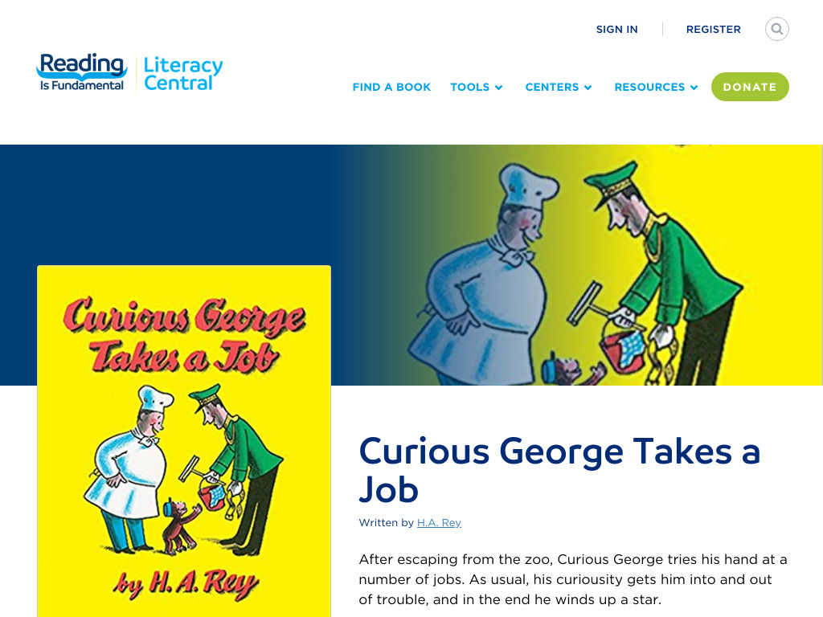


Slide 15
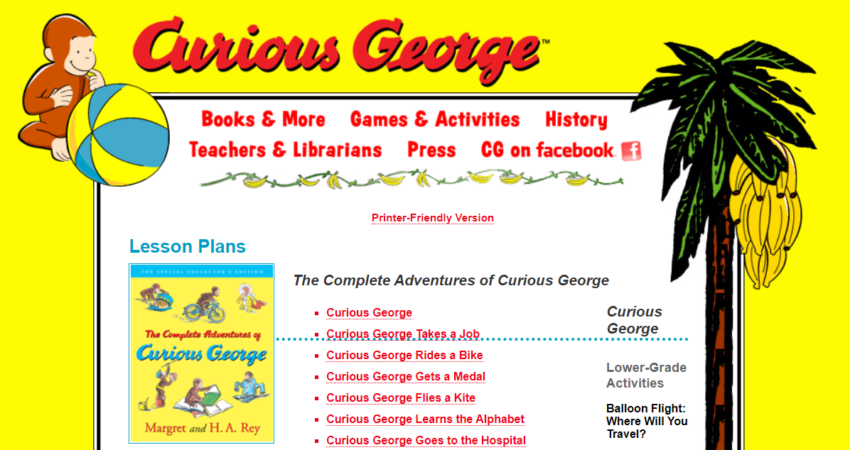
Lessons & Activities from the Publisher
http://www.houghtonmifflinbooks.com/features/cgsite/complete_adv_lp.shtml

Slide 16


Slide 17

Sample Activity from Houghton Mifflin Books
In this book, George gets to try out lots of different jobs.
Young children will enjoy researching different jobs in your community.
You may choose to invite parents into your class to talk about their jobs, and you may even choose to take neighborhood field trips in order to observe and interview community workers doing their jobs.
Police and fire stations, post offices, bookstores, restaurants, and law firms are all good places to go.
Then ask students to imagine their own jobs.
Have them write and draw about what they imagine themselves doing as adults.

Slide 18
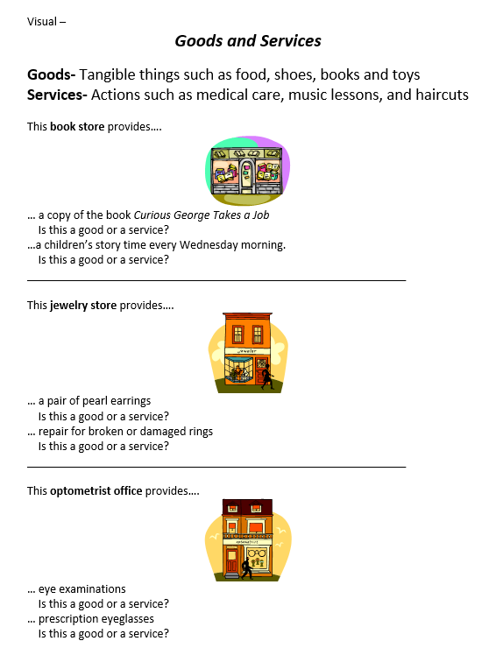
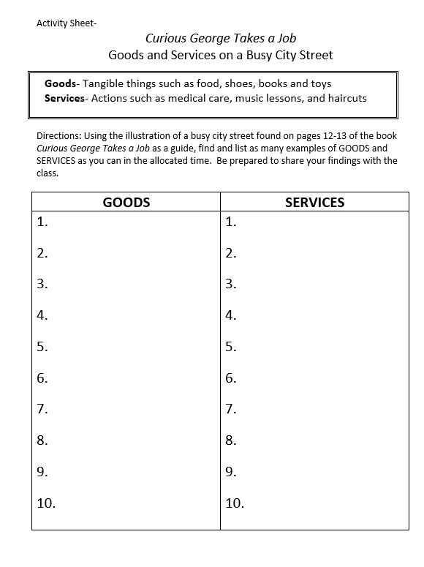

Goods and Services Lesson

Slide 19
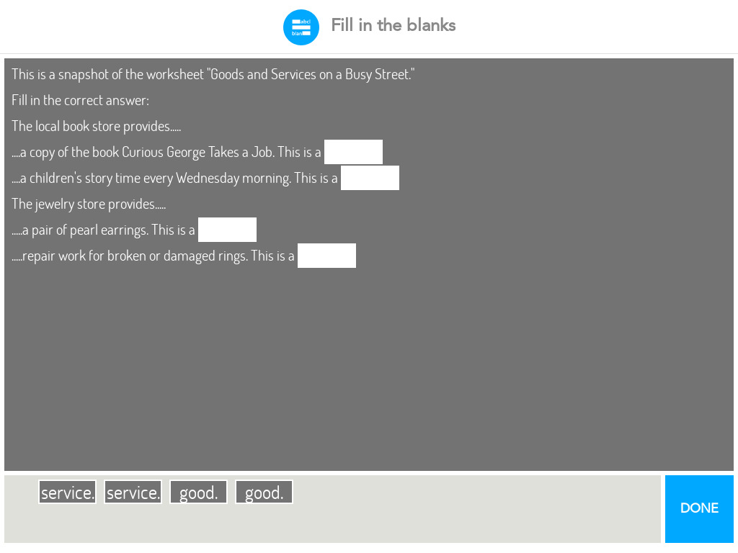


Slide 20
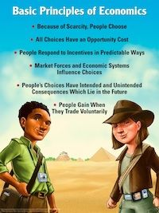
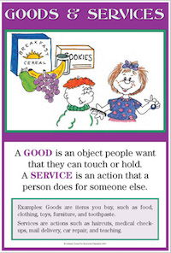
Posters and Ancillary Materials for Terms/Content
Kids Econ Posters is a GREAT source for classroom sets of posters with simple definitions and pictures for econ and personal finance content.
The site also has copies of the Econ Songbook which has collection of sing-a-longs you can use with your students to help reinforce the concepts.
https://www.kidseconposters.com/

Slide 21
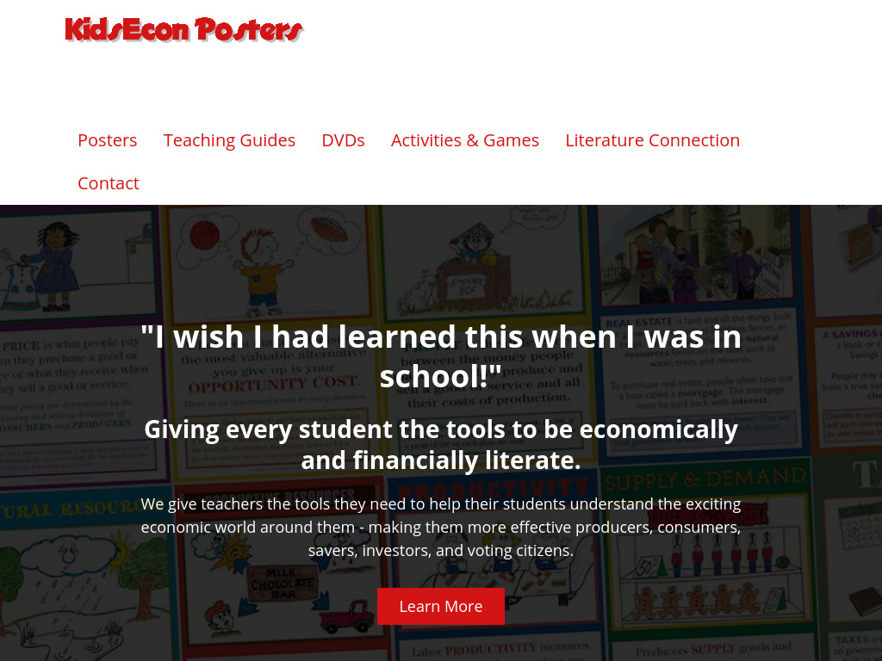

Slide 22
Curious George Saves His Pennies:
Is there something you would like, but do not have enough money to buy?
Many people use a piggy bank to save for things they want.
Saving means keeping some of your income to buy things in the future.
A saving goal is a good or service that you want to buy in the future. Think of a saving goal.
  Be careful what you choose, we will come back to these later.
Next we’ll find out more about saving and income with Curious George.

Slide 23
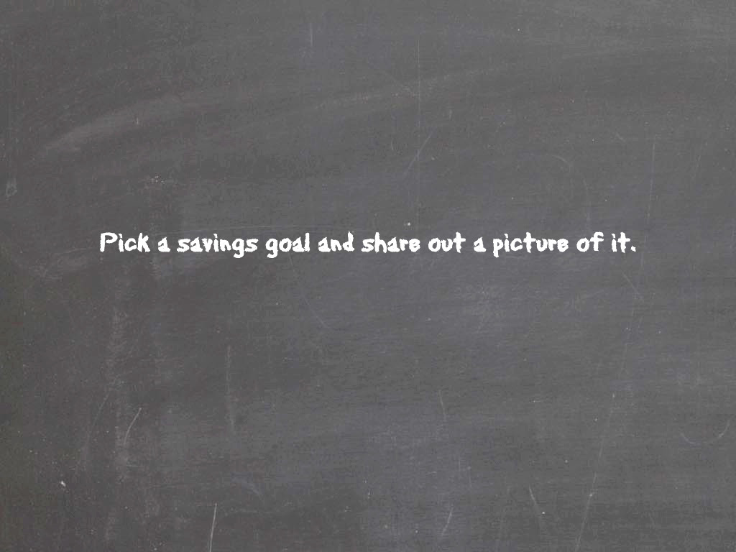

Slide 24
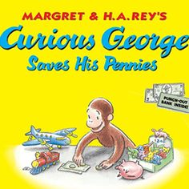

Story Time!

Slide 25
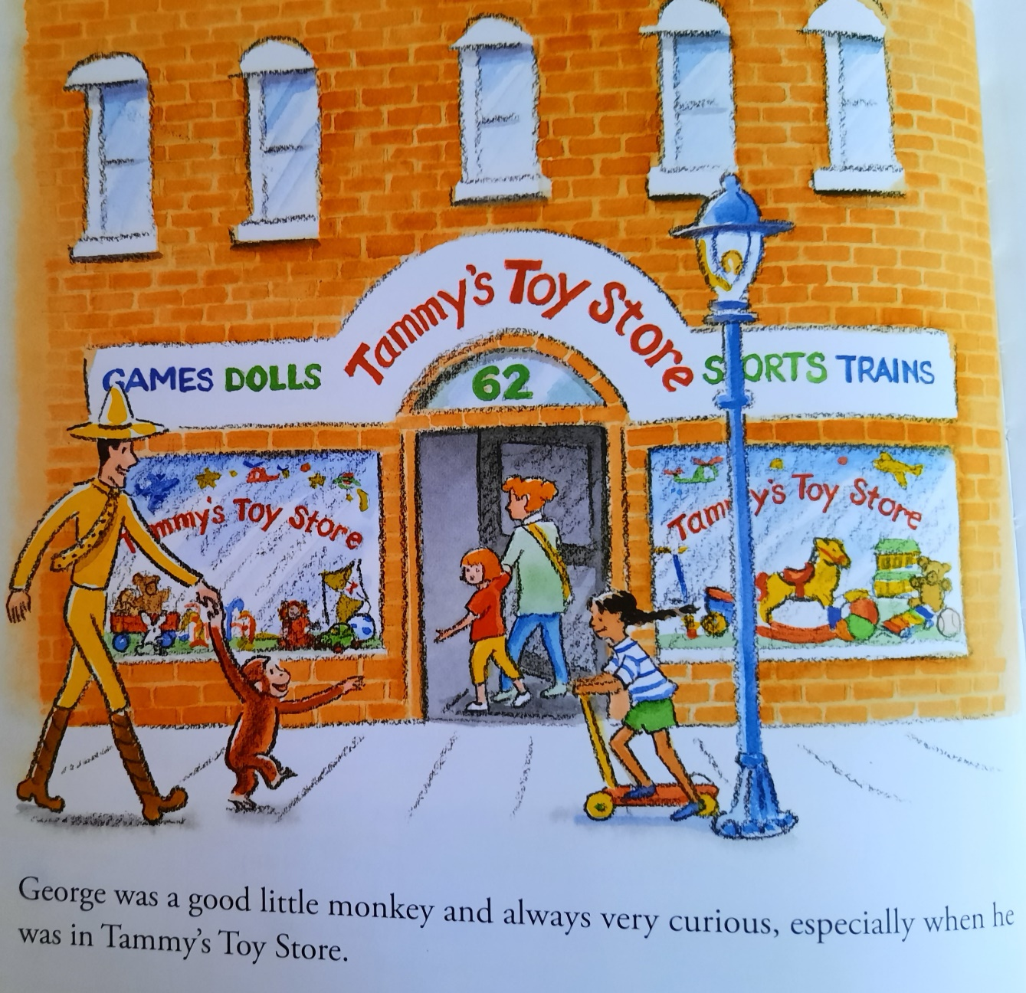

Slide 26
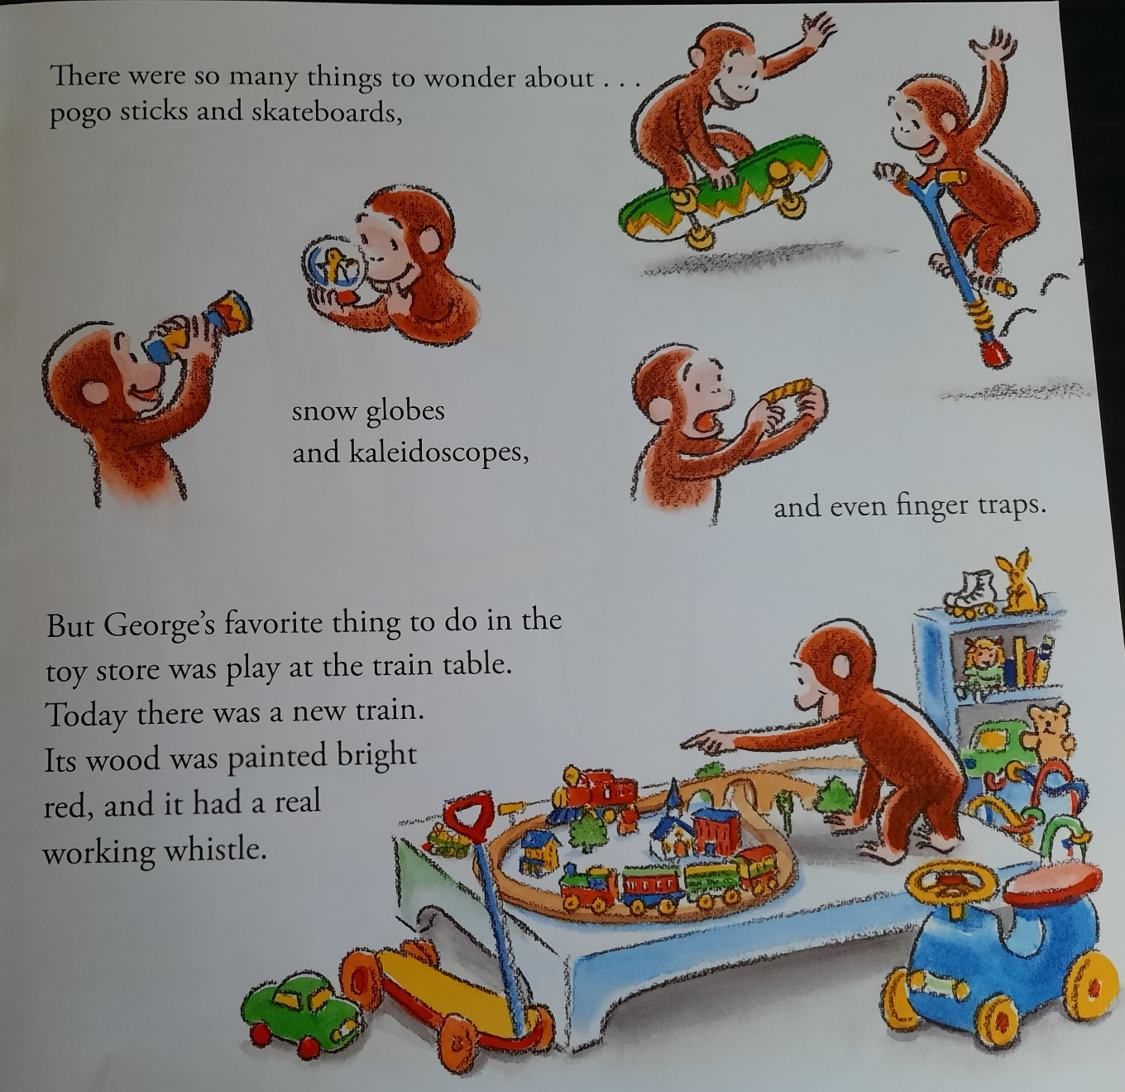

Slide 27
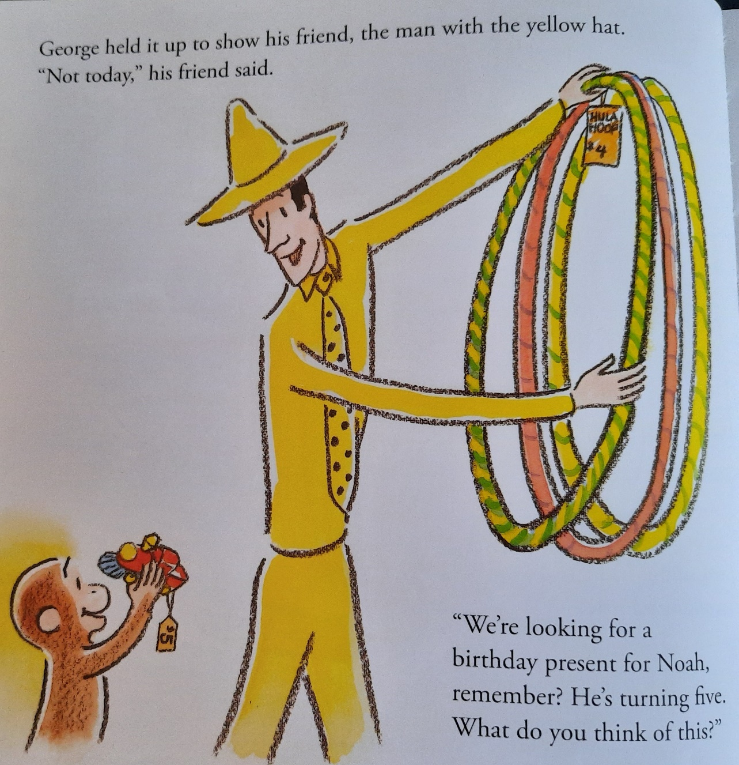

Slide 28
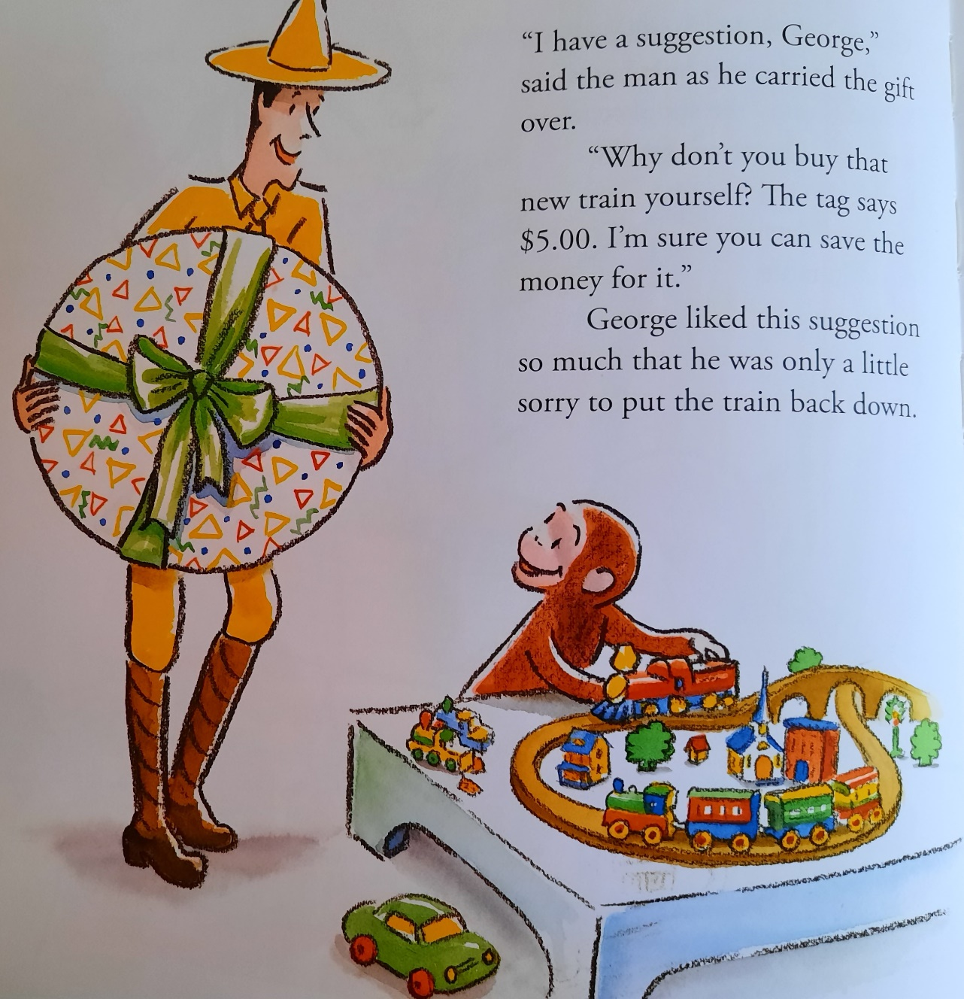

Slide 29
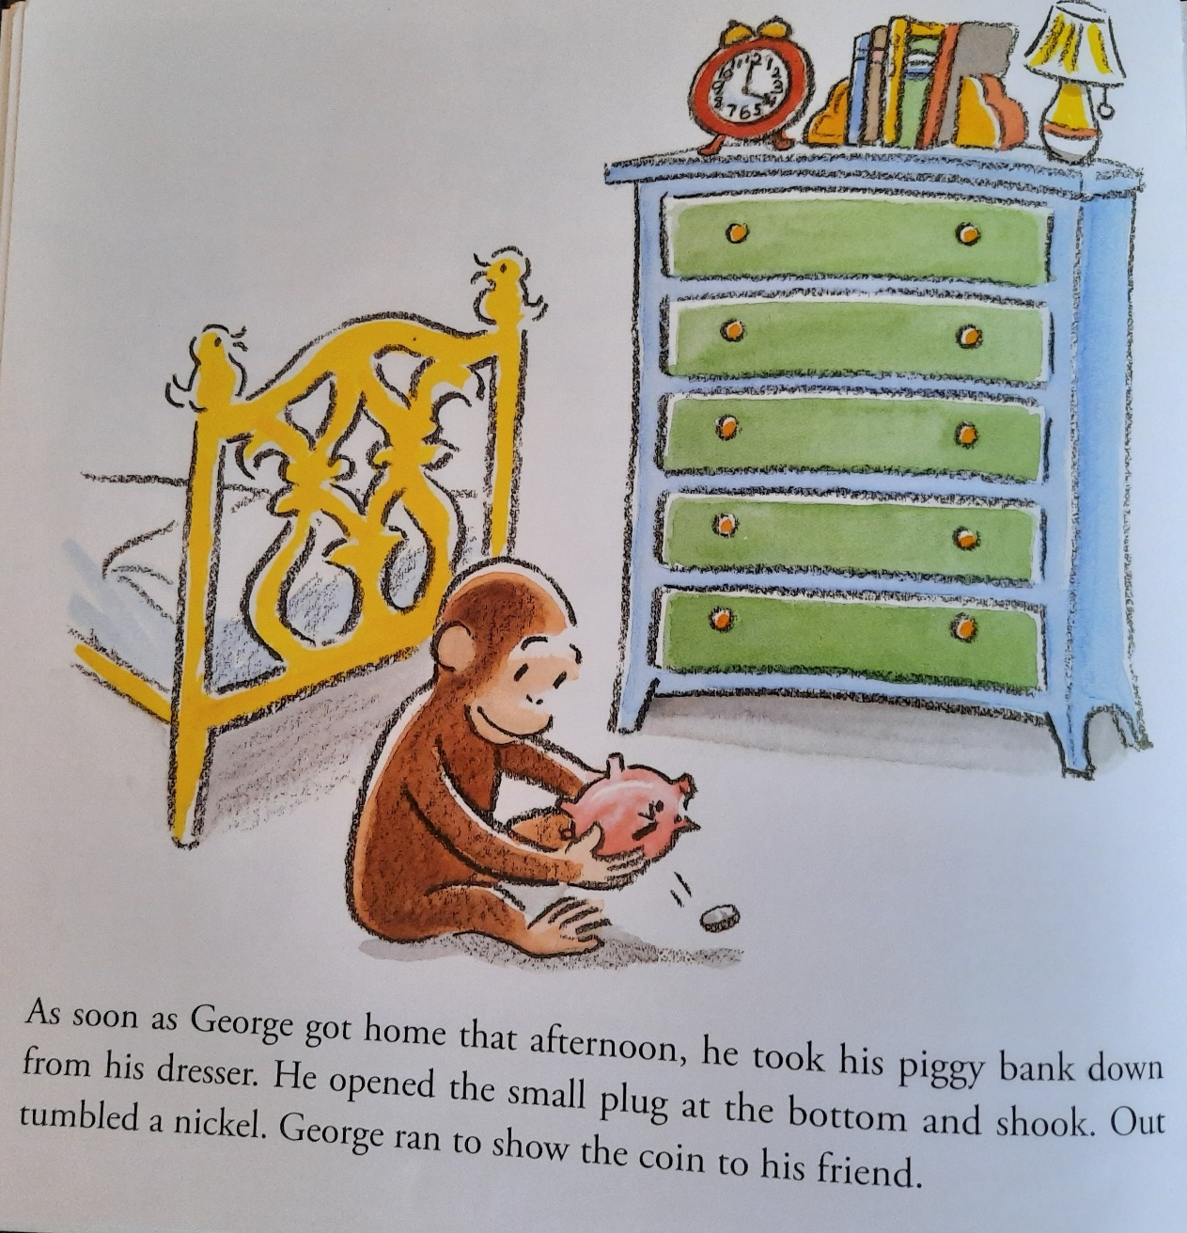

Slide 30
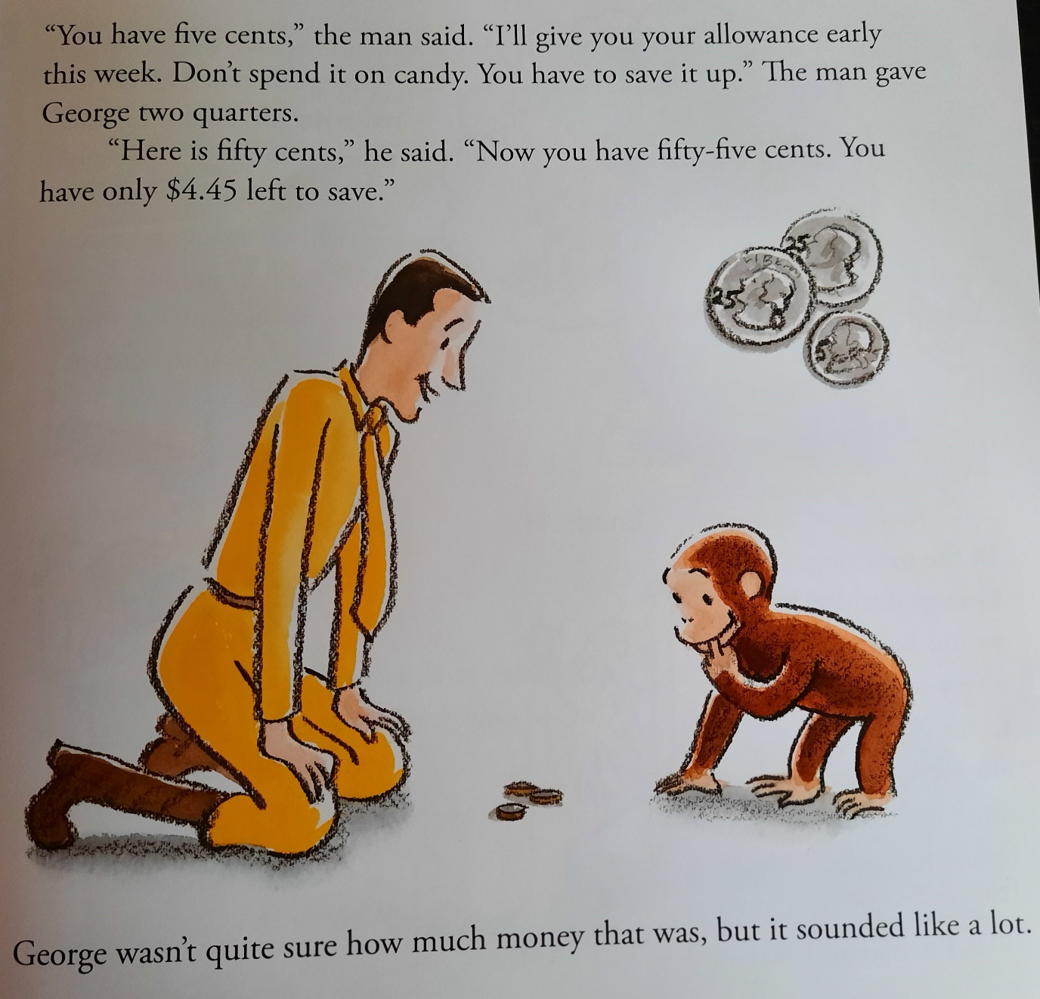

Slide 31
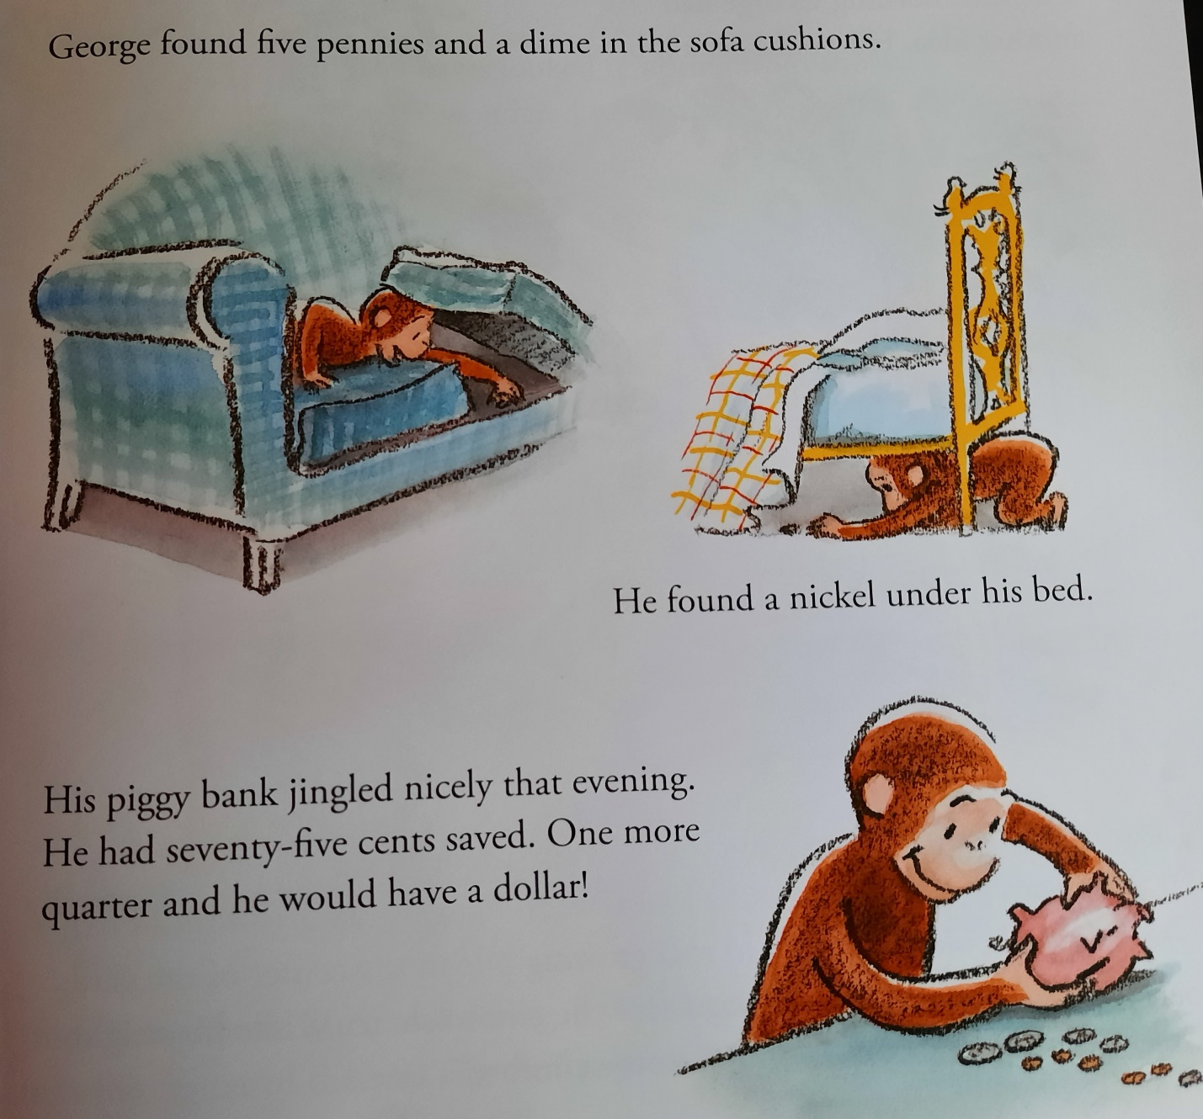

Slide 32
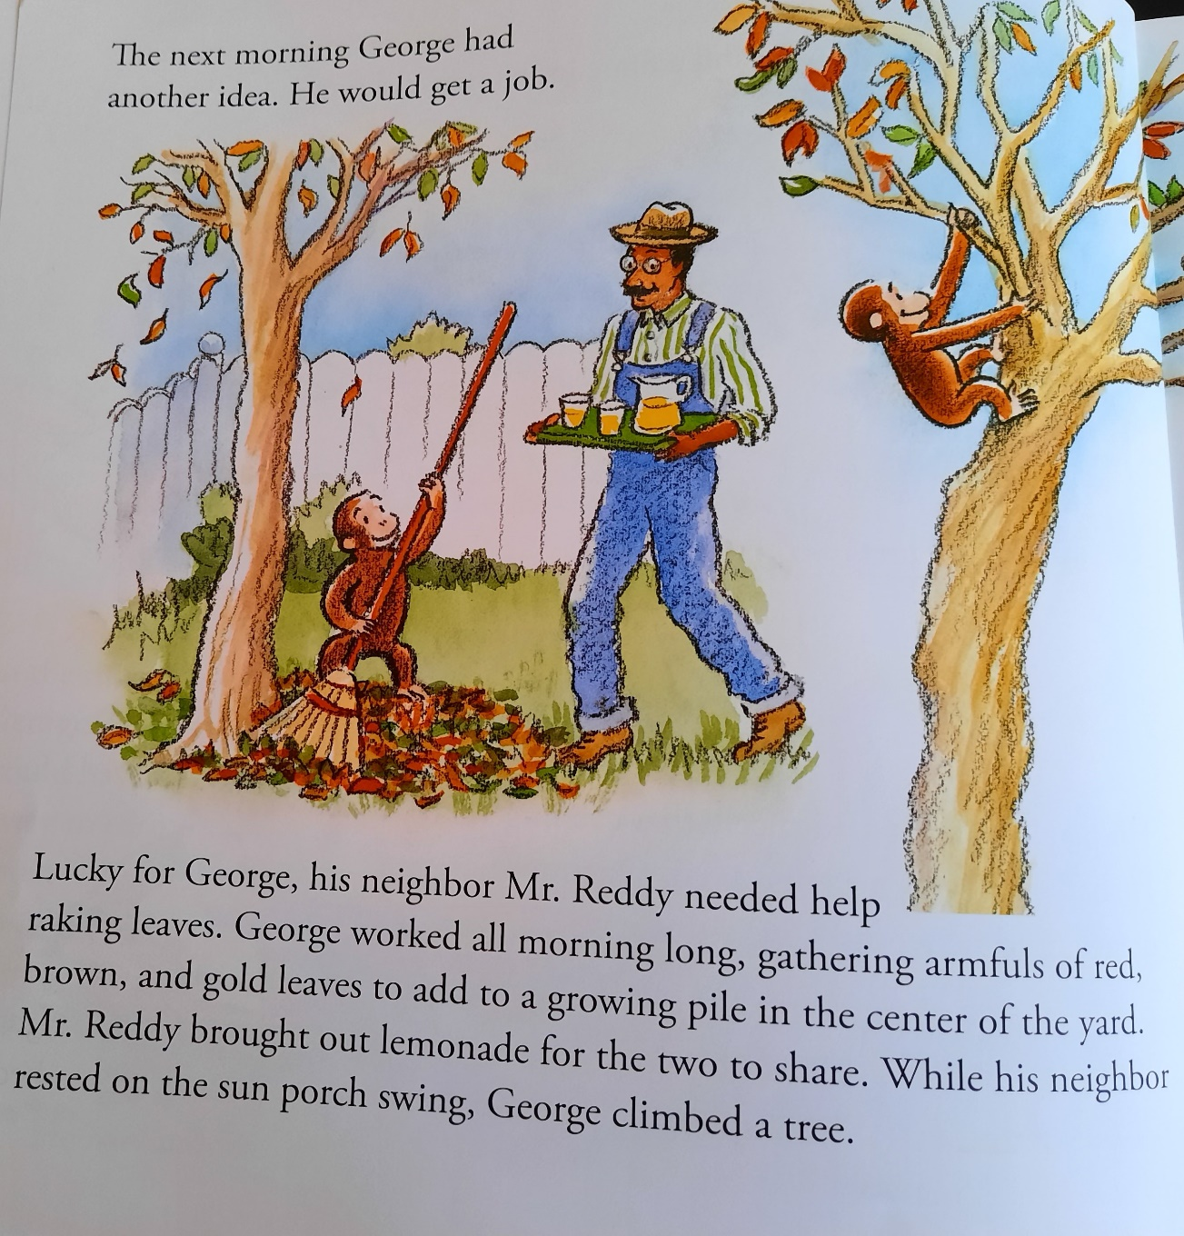

Slide 33
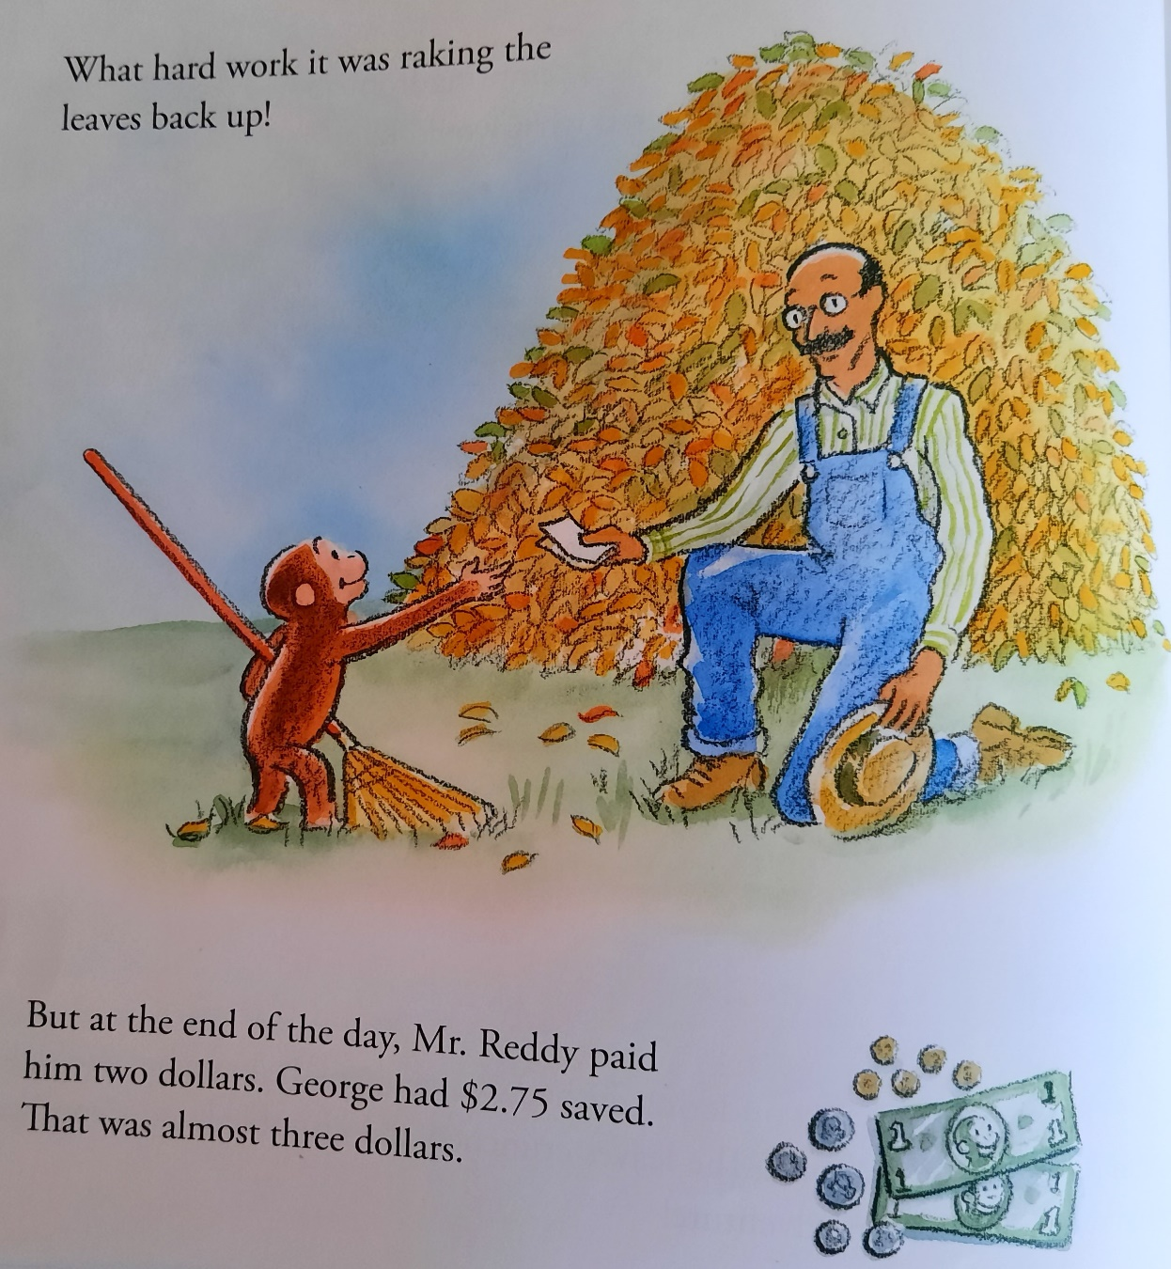

Slide 34
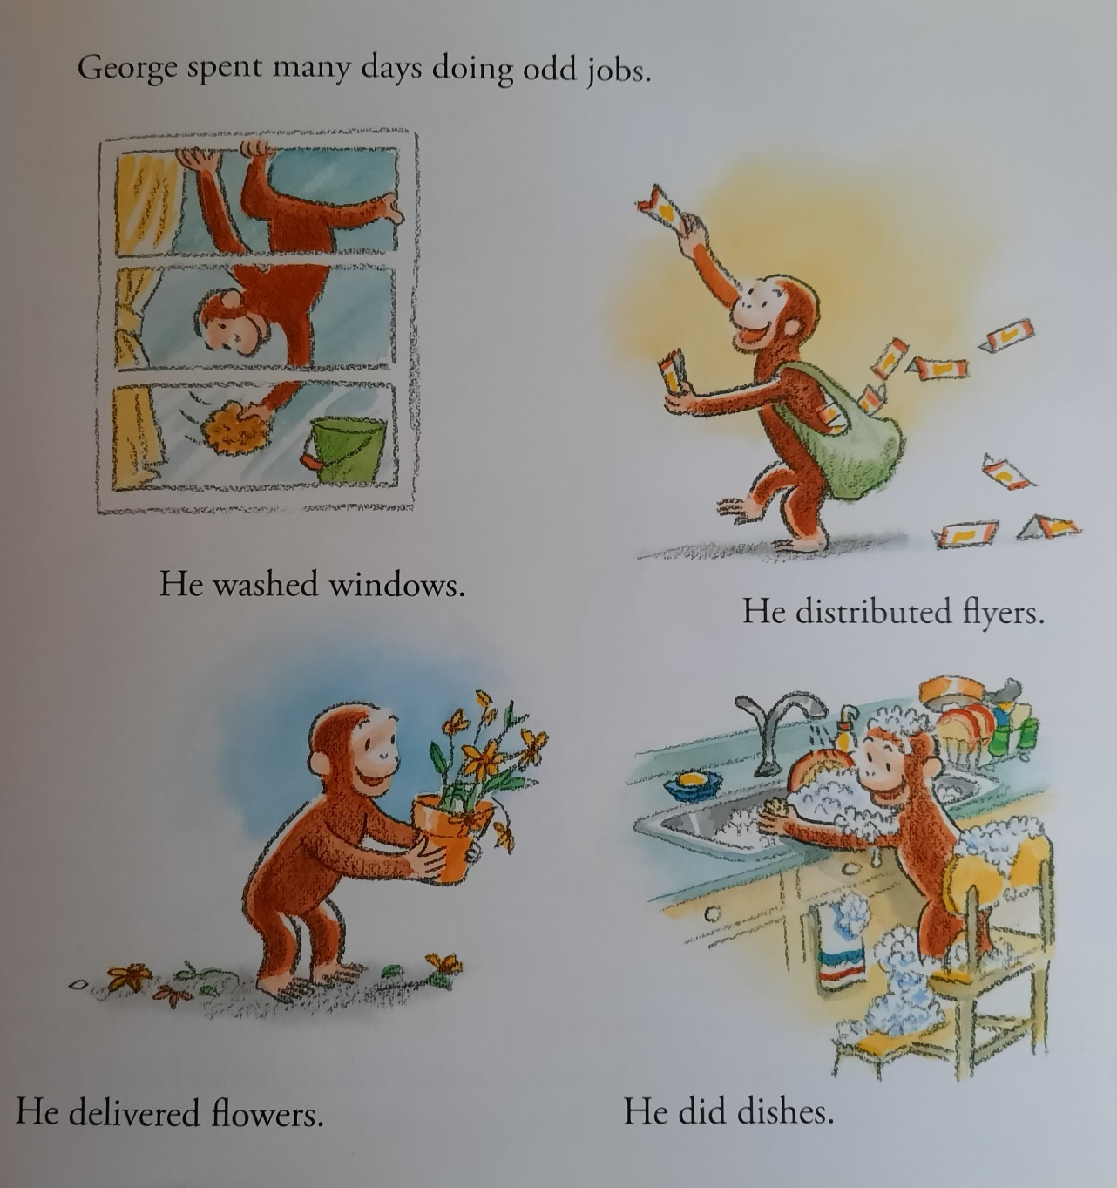

Slide 35
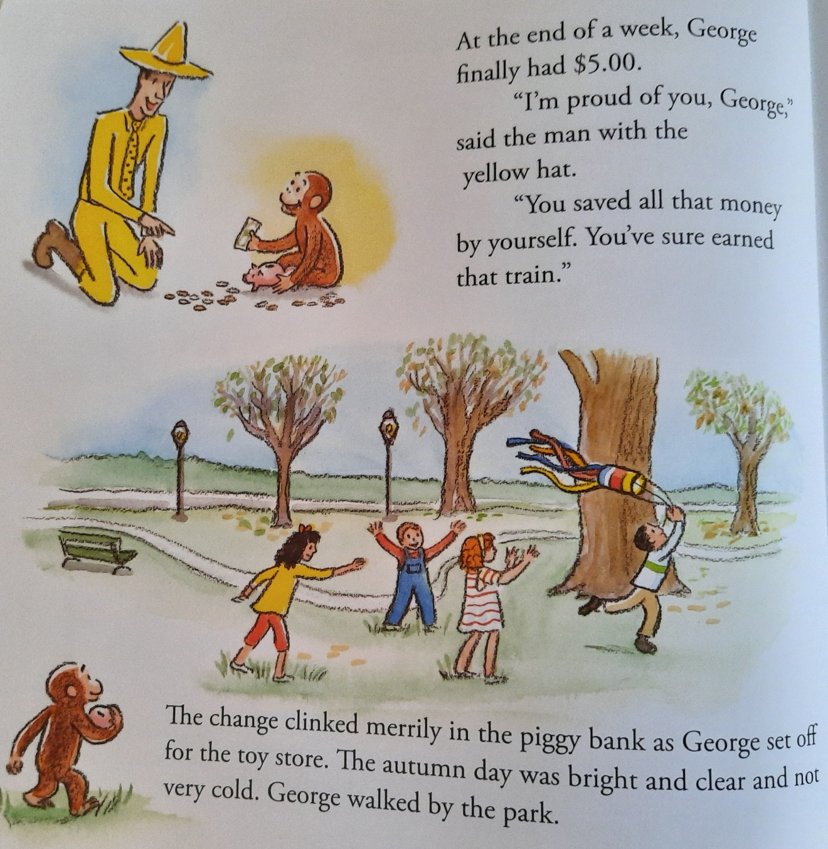

Slide 36
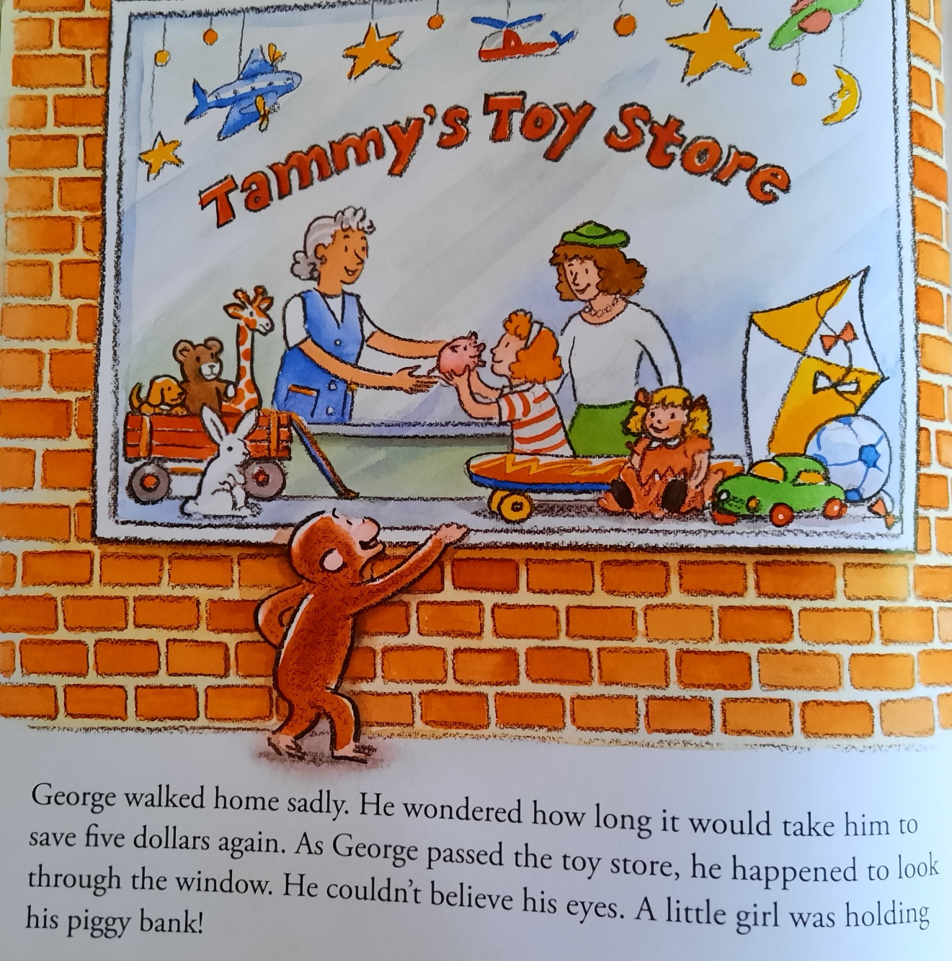

Slide 37
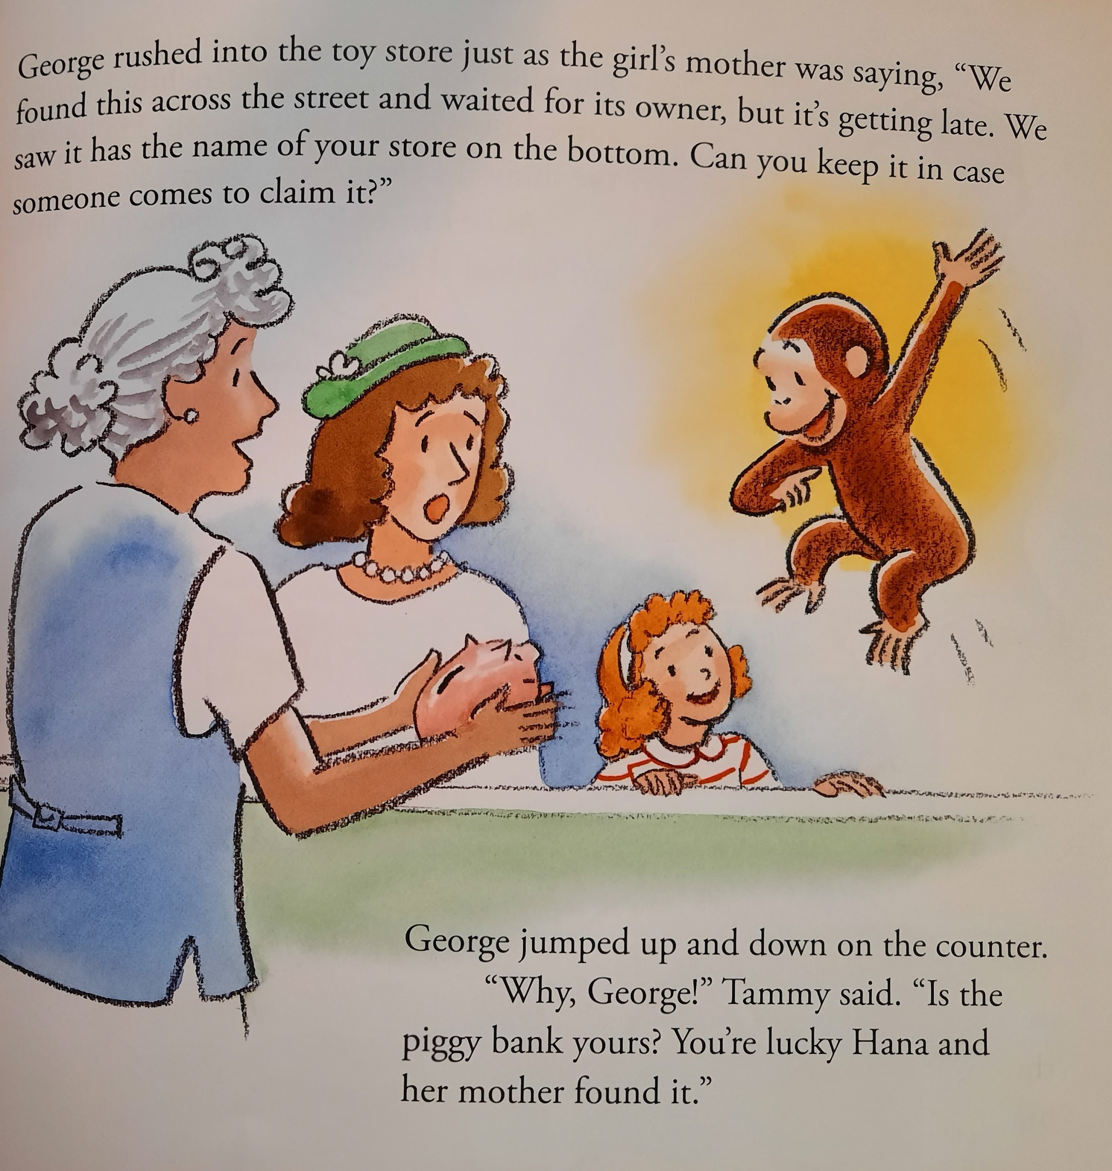

Slide 38
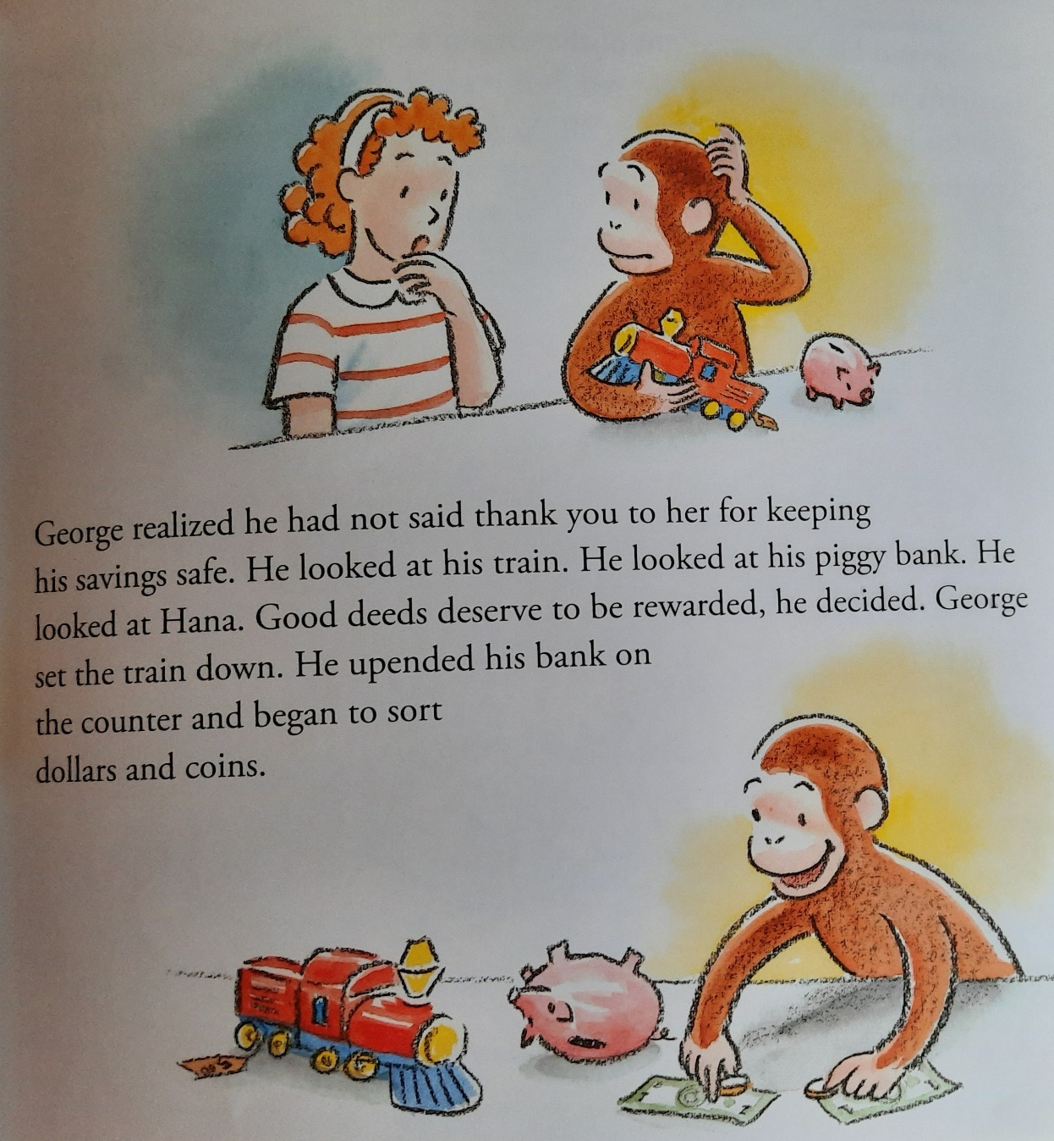

Slide 39
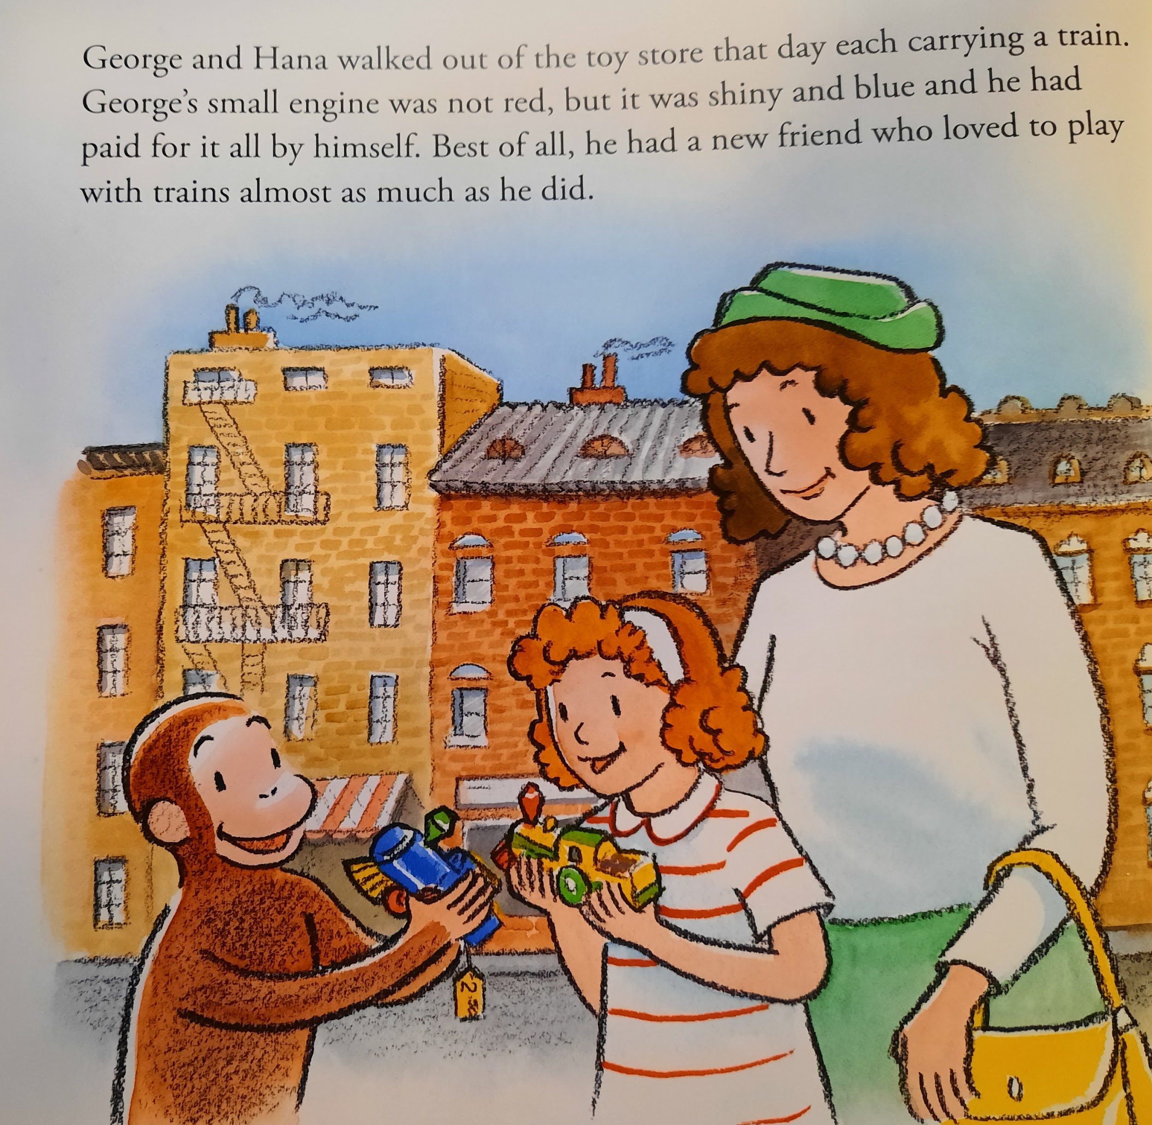

Slide 40
Discussion Board
Remember your saving goal from earlier?
What are some ways you could earn income to reach your goal?

Slide 41
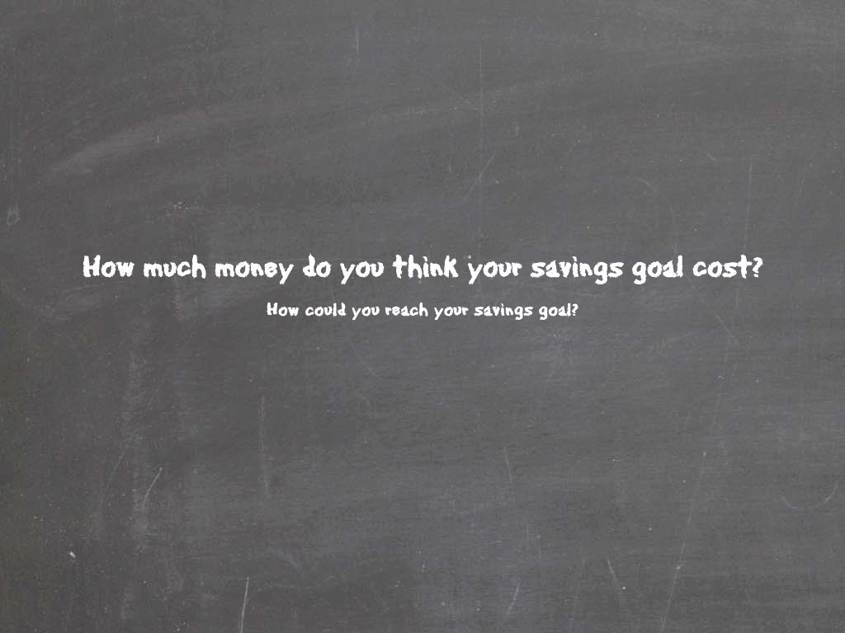

Slide 42

Quick Check for Understanding

Slide 43
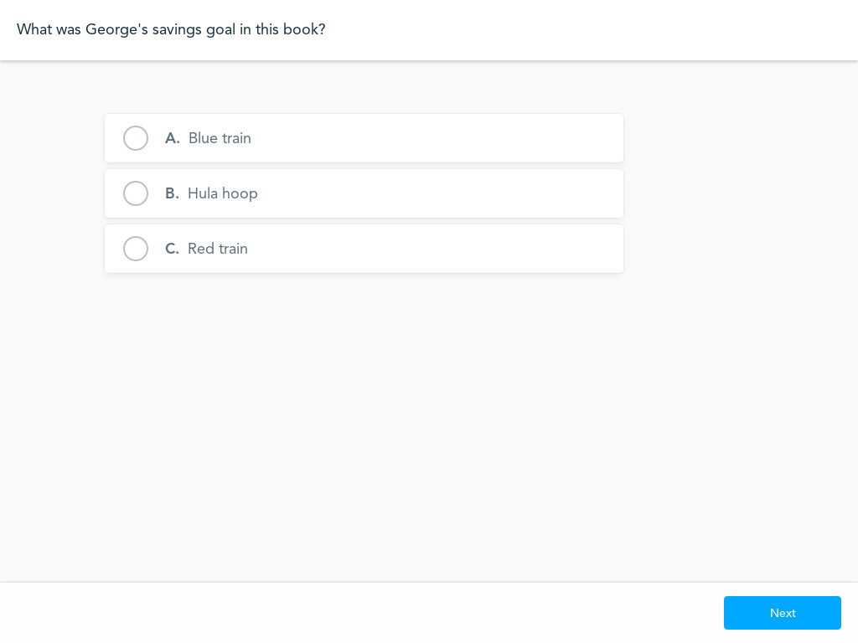
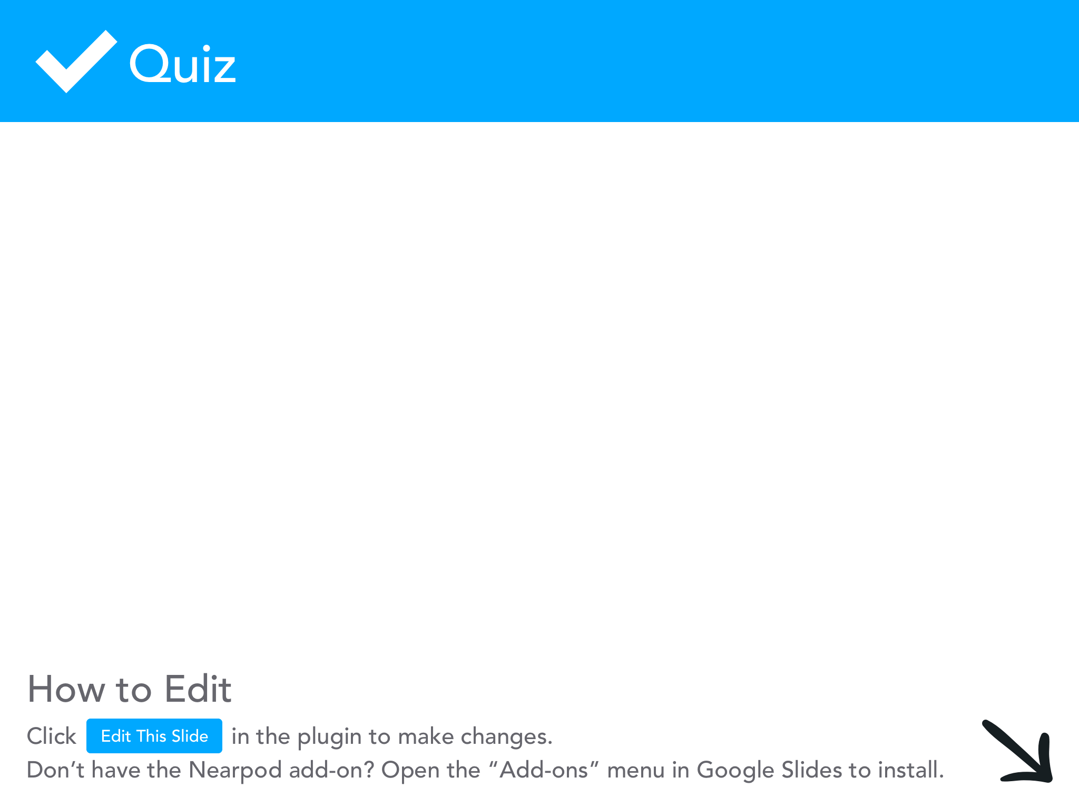

Slide 44
Extension Activities
Money Wheel:
  Look at your saving goal, determine how much money you will need to reach your goal.
Write how much money you think you will need in the chat.
  We are going to use a Money Wheel to help determine how quickly you get to your saving goal. How many spins will it take you to achieve your goal?

Slide 45
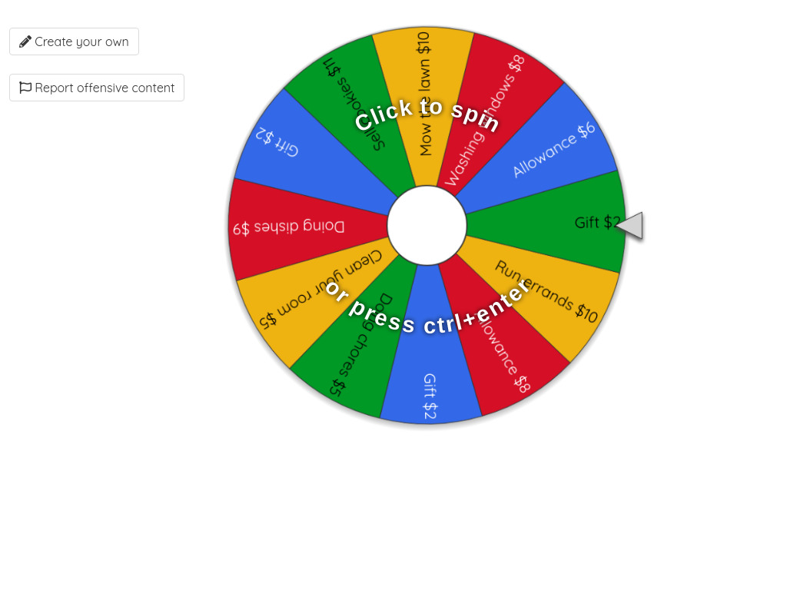

Slide 46
Extension Activity
Decision-Making Apron:
This is another activity you could use to help students with the decision-making process.
In this case you could use the apron to help students with George’s decision to buy the red train or reward Hana for finding his piggy bank.

Slide 47
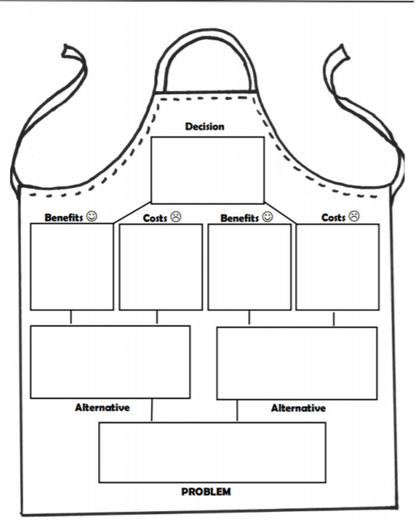
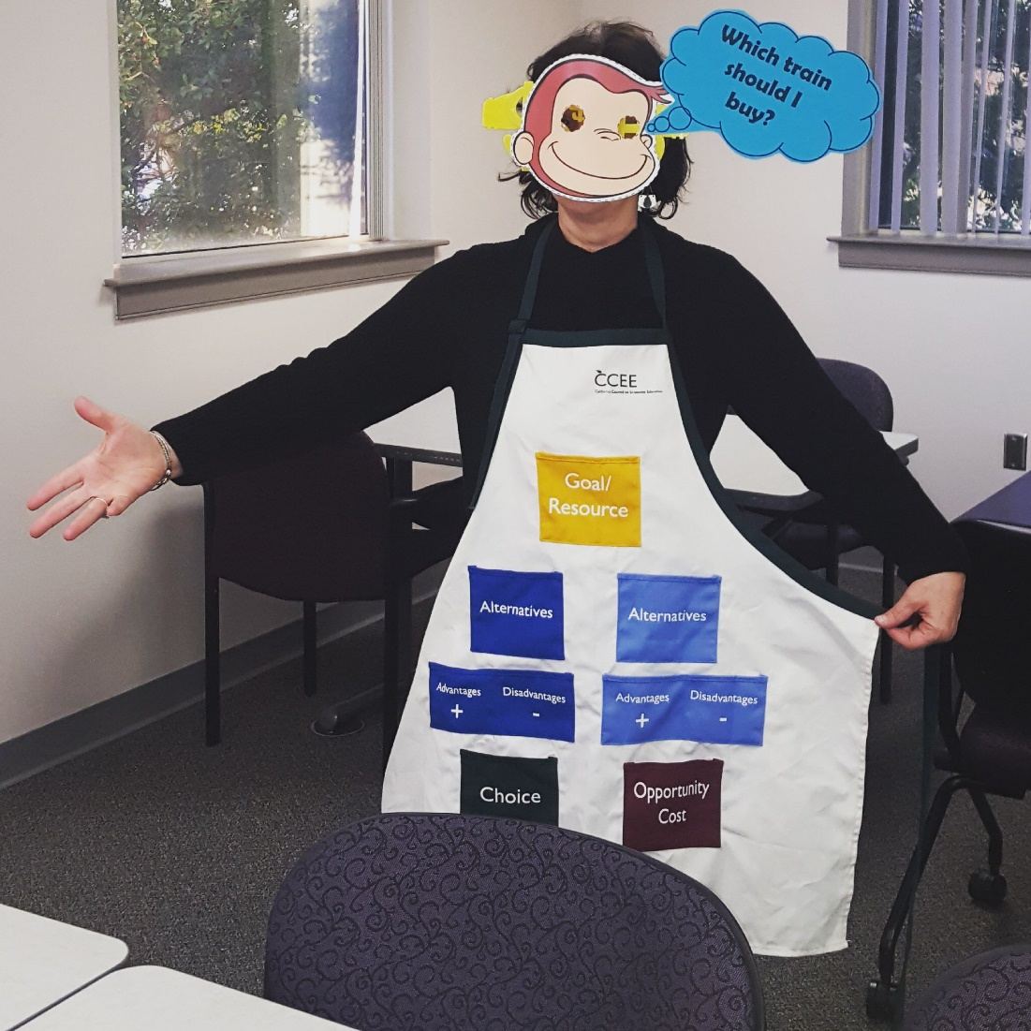

Slide 48
Consumer Finance Protection Bureau
The CFPB has created parent reading guides to accompany 18 books.
The guide for Curious George Saves His Pennies includes:
  Key ideas
    Making decisions, Sharing and borrowing, Self-control.
  Something to think about
    Tips for parents to think about before they read the book to their children.
  Before you read
    Tips for parents to successfully set the stage for reading this book to their children.
  Something to talk about
    Tips for what parents can talk about while reading the book/questions to ask.
  Something to do
    Activities parents can do with their children after they have read the book to reinforce the concepts the children should have learned.

Slide 49
CFPB Materials
Here’s the CFPB Money as You Grow site:
https://www.consumerfinance.gov/consumer-tools/money-as-you-grow/bookshelf/
Here’s where you go to order the material:
https://pueblo.gpo.gov/CFPBLibs/CFPBLibsPubs.php?NavCode=XA&CatID=3&PHPSESSID=gb4iuua64h8qupp4lg3ocggii4

Slide 50
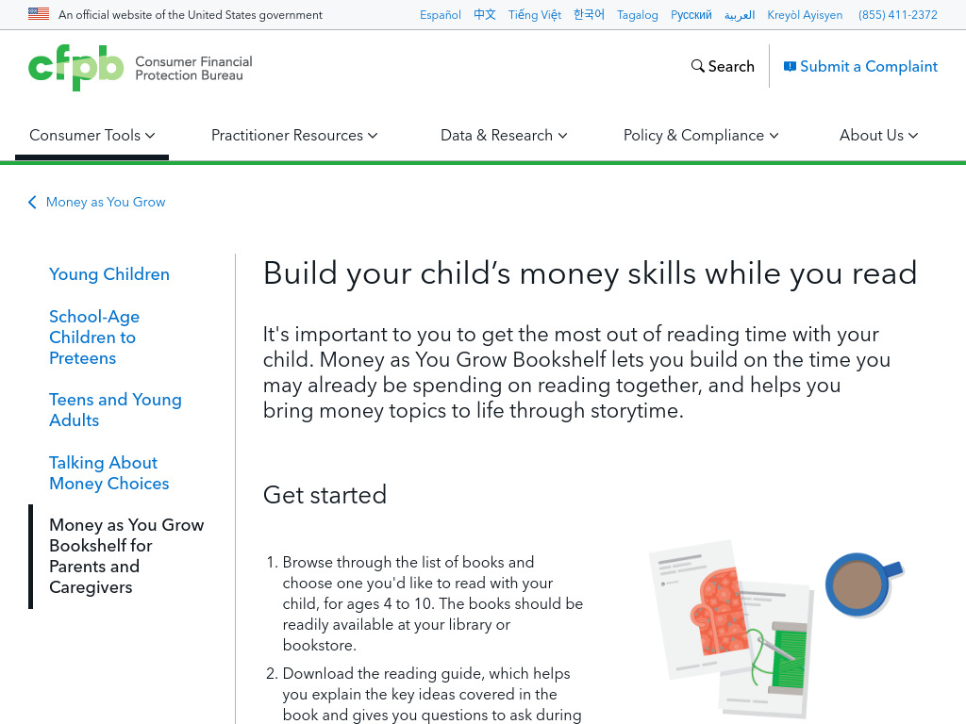

Slide 51
Curious George Rides a Bike
At one point in this story George gets distracted and plays in a river, making paper boats.
You can use the activity of making paper boats to illustrate specialization and interdependence.

Slide 52
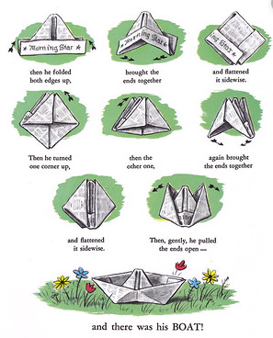
Specialization Activities
Two ways to do this activities:
Group students in groups of 4. Tell them they have 5 minutes to make as many boats as possible.
Divide class into 2 groups. Group one each student gets a specific job for creating a paper boat. Group two students have to make the boats as individuals. Give them 5 minutes to make as many boats as possible.

Slide 53
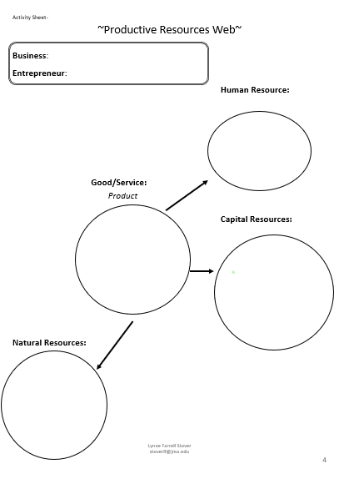
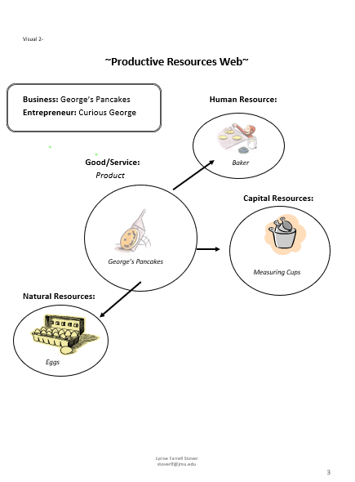
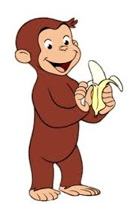
More Curious George Econ!
Curious George Makes Pancakes:
Curious George Goes to a Chocolate Factory:
  Both of these lessons use food to illustrate productive resources.
  You can use a productive resources web to help explain productive resources.

Slide 54
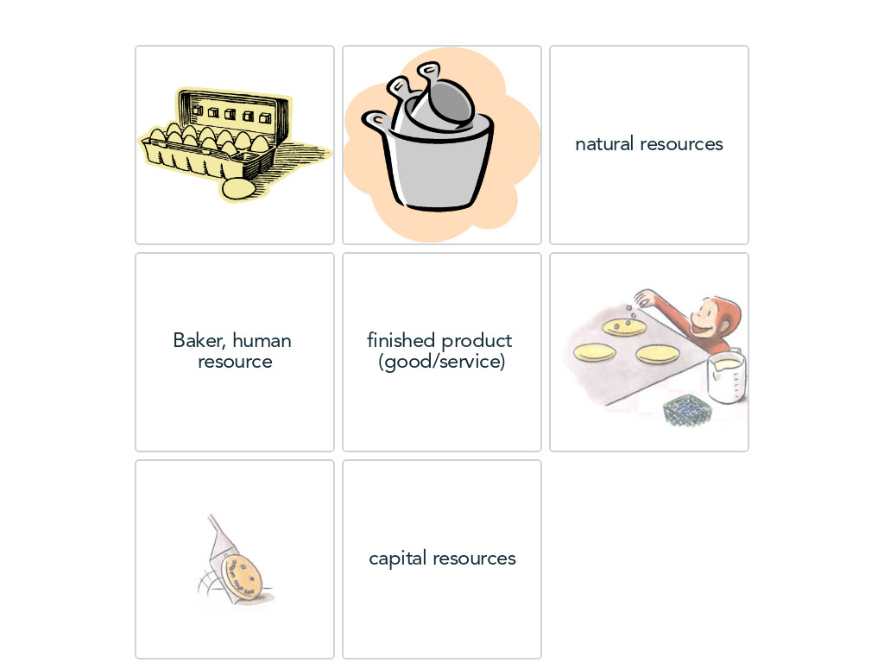


Slide 55
More Curious George
Curious George Visits a Toy Store:
  This lesson uses a trip to the toy store to illustrate wants, opportunity cost, choice, scarcity, etc.
  https://pbskids.org/curiousgeorge/printables/maple.html
George Helps Allie Make a Care Wash (TRT: 5:20):
  This clip can be used to illustrate problem solving skills needed by entrepreneurs and business owners.
  https://www.youtube.com/watch?v=FyyWMQAYzSs

Slide 56
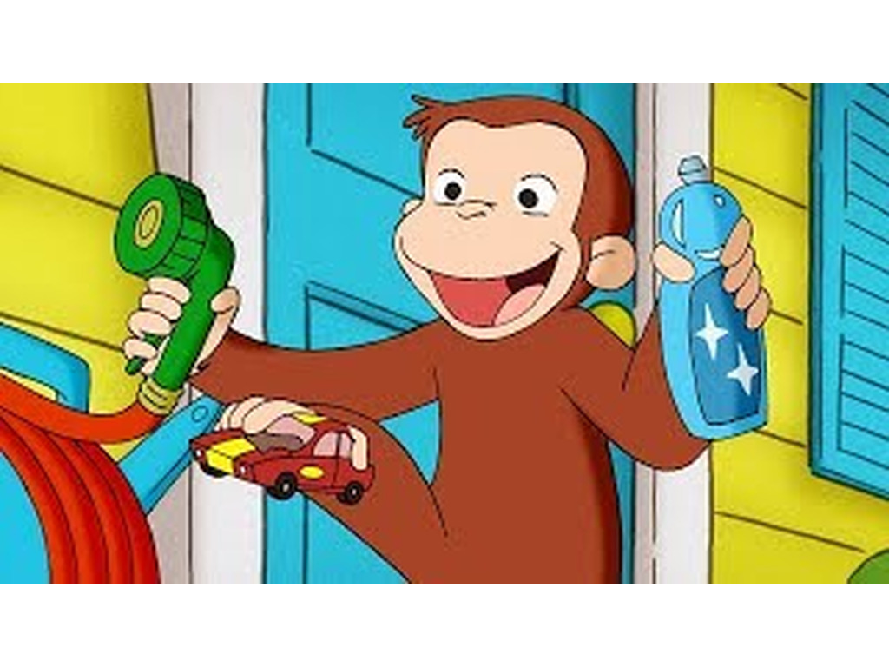


Slide 57

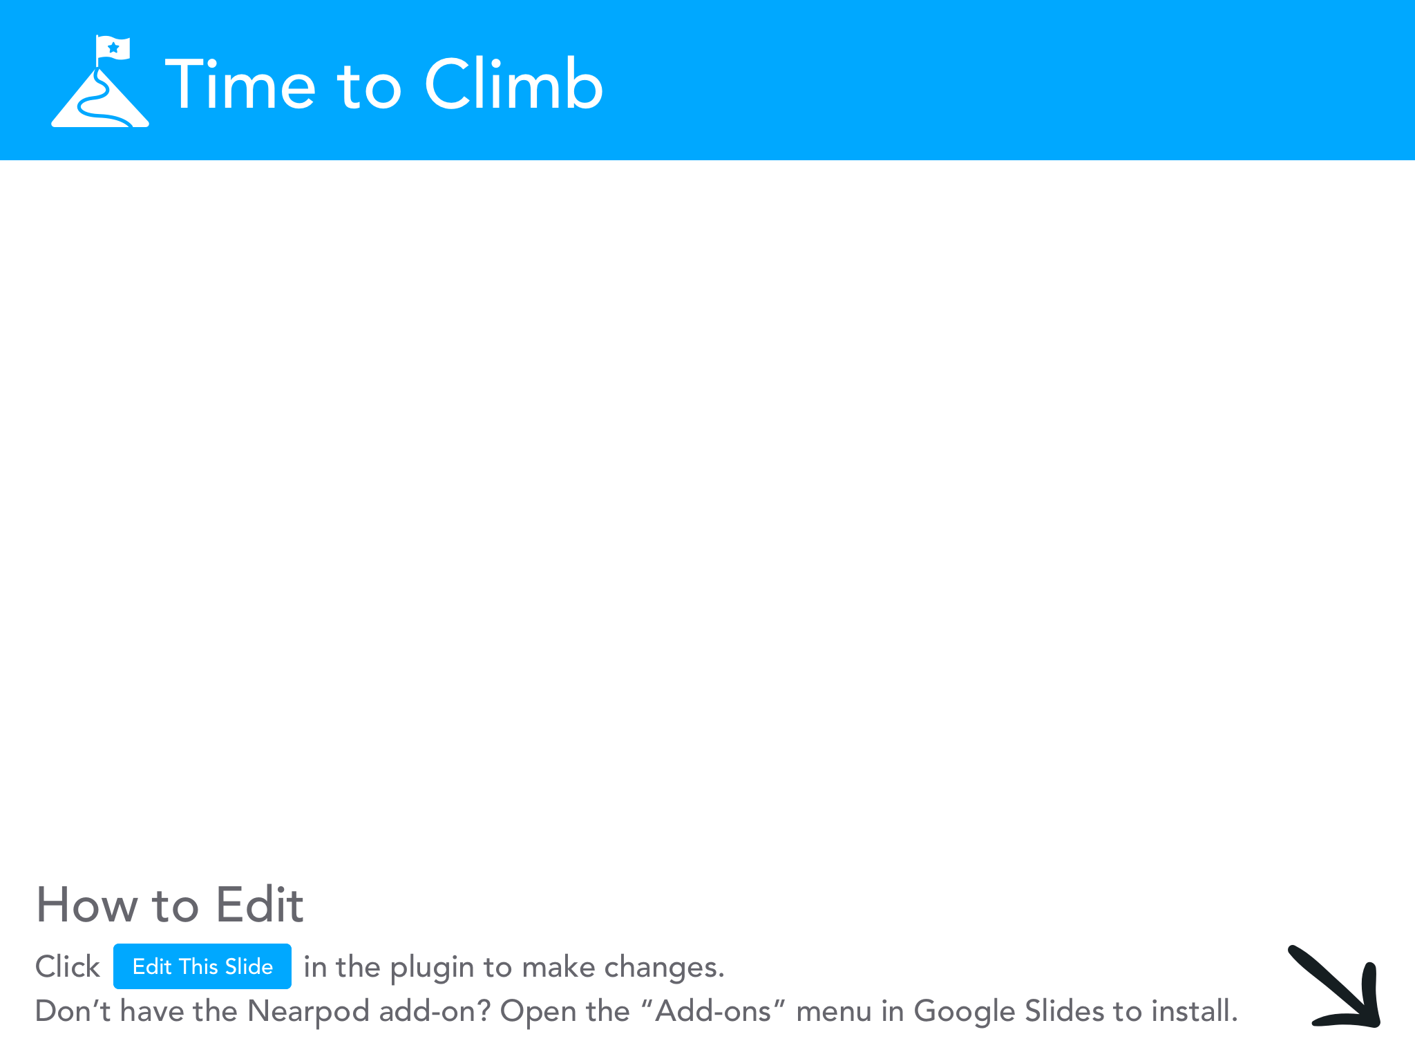

Slide 58

Final Thoughts
Thank you so much for giving up your time to come to this session!
Hopefully the MB>MC!

Slide 59


Thank You to Our Sponsors!

