Slide 1
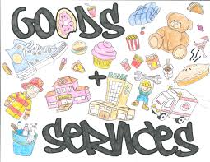

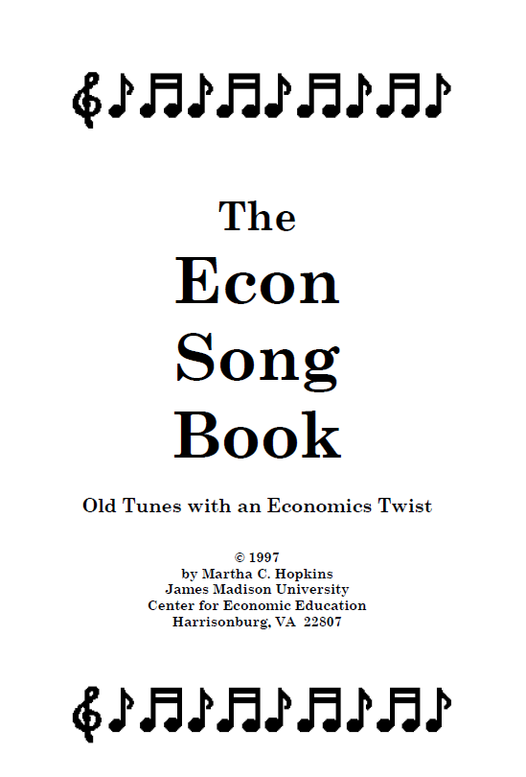


Goods and Services:
Lessons, Activities, and Enrichment
Lynne Farrell Stover
August 20, 2020 stoverlf@jmu.edu

Slide 2
EconEdLink Membership
You can now access CEE’s professional development webinars directly on EconEdLink.org! To receive these new professional development benefits, become an EconEdLink member. As a member, you will now be able to:
Automatically receive a professional development certificate via e-mail within 24 hours after viewing any webinar for a minimum of 45 minutes
Register for upcoming webinars with a simple one-click process
Easily download presentations, lesson plan materials and activities for each webinar
Search and view all webinars at your convenience
Save webinars to your EconEdLink dashboard for easy access to the event
You may access our new Professional Development page here

Slide 3
Professional Development Certificate
To earn your professional development certificate for this webinar, you must:
Watch a minimum of 45-minutes and you will automatically receive a professional development certificate via e-mail within 24 hours.
Accessing resources:
You can now easily download presentations, lesson plan materials, and activities for each webinar from EconEdLink.org/professional-development/

Slide 4
Goods & Services
Agenda
In this webinar we will:
Review main economic concepts using ECON 101 Slides
Explore creative methods of teaching goods & services
Examine available websites and resources
Answer attendees’ questions and comments

Slide 5
Objectives
In this webinar teachers will learn:
To teach students to describe and identify the differences between goods (tangible things such as food, clothing, and cars) and services (physically intangible things such as medical care, haircuts, and education).
To teach students to identify workers that provide goods and services.
To introduce students to the concepts of trade, distribution, and consumption as related to goods and services.

Slide 6

National Standards
Content Standard 1: Scarcity
Students will understand that: Productive resources are limited. Therefore, people can not have all the goods and services they want; as a result, they must choose some things and give up others. Students will be able to use this knowledge to: Identify what they gain and what they give up when they make choices.

Slide 7

State Standards
1.7 The student will explain the difference between goods and services and describe how people are consumers and producers of goods and services.
2.10 The student will explain that scarcity (limited resources) requires people to make choices about producing and consuming goods and services.
3.8 The student will demonstrate an understanding of different cultures and the natural, human, and capital resources they used in the production of goods and services.

Slide 8
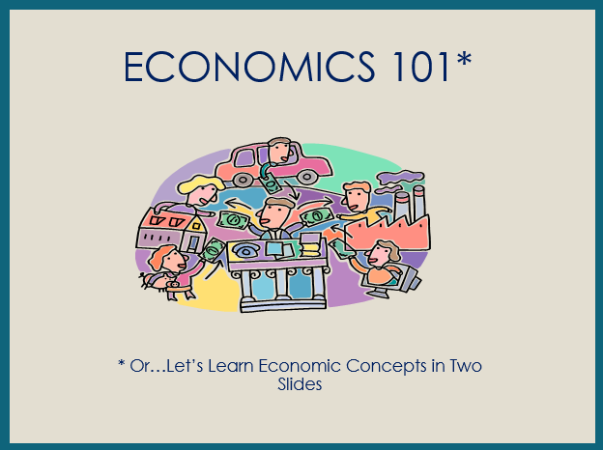

Slide 9
ECONOMICS 101
Economics is the study of _________
(as they pertain to _________, _________, and the _________).
choices
consumers
producers
government
Every nation has productive resources
__________________
Resources from the earth, unaltered by man
__________________
People’s effort, skills, and knowledge
__________________
Man-made resources
used over and over
natural
human
capital
__________________
Goods used in production to become part of a product
intermediate
which are used to produce
goods
and
services
to be __________________ or __________________ with money (savings).
bartered
purchased

Slide 10
however
Productive resources, and therefore, goods and services, are limited
Human wants (needs)
are basically unlimited
resulting in
SCARCITY
Consequently, buyers (consumers) and sellers (producers) have to make
economic __________________ (resulting in
__________________ __________________)
choices
opportunity
cost
when answering
three basic economic questions
__________ ___________
Buyers and sellers answer ?’s
___________ goods and
services will be produced?
___________ will the goods and services be produced?
___ _______ will the goods and services be distributed?
___________ ___________
Government answers ?’s
What
How
To whom
command economy
market economy
Answering these questions most efficiently creates the need for
___________________ and ___________________ resulting in trade.
specialization
interdependence
decision
making
scarcity
Economics: ___________ - __________ under ___________.

Slide 11

https://www.econedlink.org/resources/what-pet-should-i-get-dr-seuss-and-decision-making/
Word Count: 621
Reading Level: 1.9
Interest Level: PK-3

Slide 12

What Pet Should I Get?
Recently published, but likely written between 1958 and 1962, What Pet Should I Get? is the delightful tale of a definitive childhood event: selecting a family pet.
The text, told in the classic Seuss cadence and rhyme scheme, does an excellent job a describing the many choices the siblings encounter while trying to pick the perfect pet in a limited amount of time.
With the repeating line “MAKE UP YOUR MIND” this picture book is a great tool for teaching choices and decision-making.
http://www.econedlink.org/teacher-lesson/1263/

Slide 13
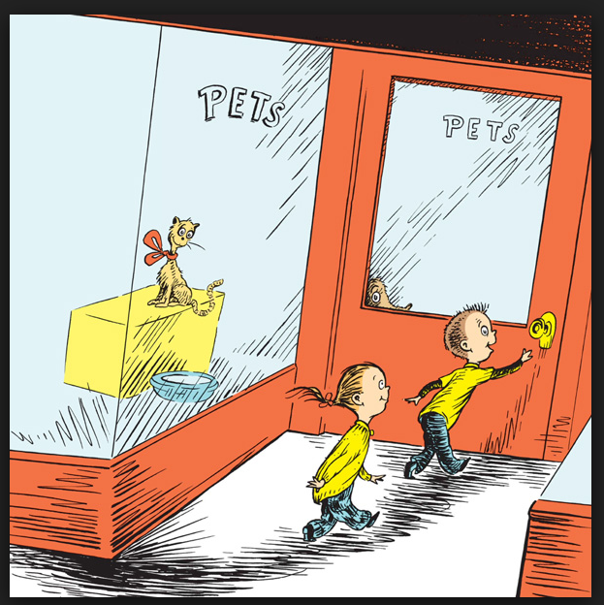
What Pet Should I Get?
Students Will
Describe why wanting more than a person can have requires making choices.
Discover that resources are scarce and as a result, choices must be made.
Identify the concept of economic choice and apply this concept while participating in the creation of a classroom P.A.C.E.D decision-making grid.
Distinguish the difference between goods and services.

Slide 14
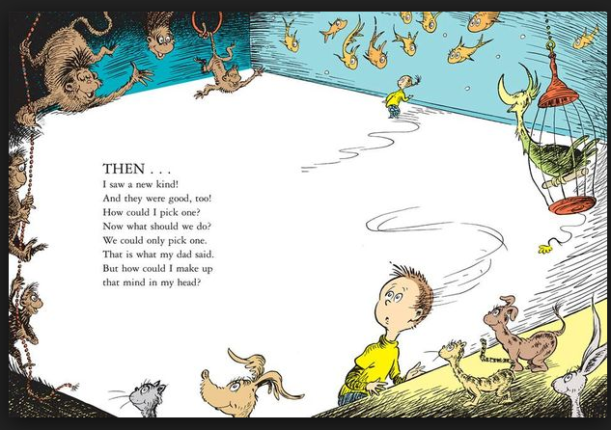
What Pet Should I Get?
Please help me make up my mind.

Slide 15
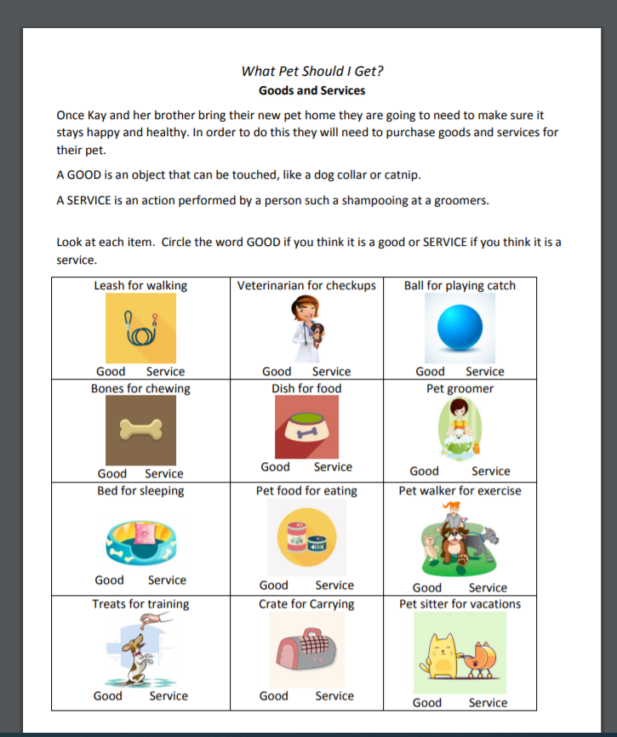

What Pet Should I Get?

Slide 16
Bonus
Activity Sheet Extensions:
Write a story about a new pets first day at home. Include at least three goods and two services in your story.
Create a list of at least ten goods veterinarians use to do their jobs.
(Using cards created from the activity sheet) Sort the cards into groups other than goods and services. Examples:
  necessary items/jobs and fun items/jobs
  expensive items/jobs and inexpensive items/jobs
  Items that need to be purchased and items on hand at home

Slide 17

Cloudy With a Chance of Meatballs
Written by Judi Barrett & Illustrated by Ron Barnett
Introduction
In the imaginary town of Chewandswallow the availability of food is dependent on climatic conditions. Soon the town’s citizens learn that there can be “too much of a good thing”. First published in 1978 this wonderfully illustrated picture book is as applicable today as it was forty years ago…maybe more so!

Slide 18
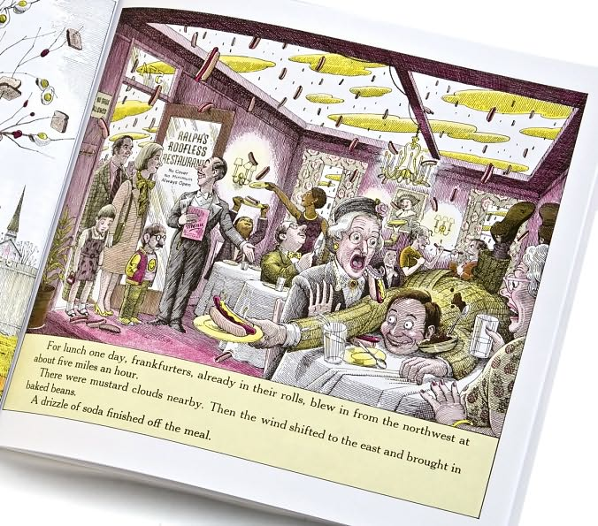
Goods and Services in Chewandswallow
Lesson II
Introduction: Chewandswallow’s main street is a busy place full of shops offering many kinds of goods and services. However, there is not a grocery store, bakery, or candy shop to be seen. There is, however, a “roofless restaurant”!

Slide 19

Providing Goods and Services
Lesson II
Goods- Tangible things such as food, shoes, books and toys
Services- Actions such as medical care, music lessons, and haircuts
This book store provides….
… a copy of the book Cloudy with a Chance of Meatballs
Is this a good or a service?
…a children’s story time every Wednesday morning.
Is this a good or a service?

Slide 20
Goods & Services
Lesson II
Directions: Using the illustration of Chewandswallow’s Main Street found on page six of the book Cloudy With a Chance of Meatballs as a guide, locate and list as many examples of GOODS and SERVICES as you can in the allocated time. Be prepared to share your findings with the class.

Slide 21
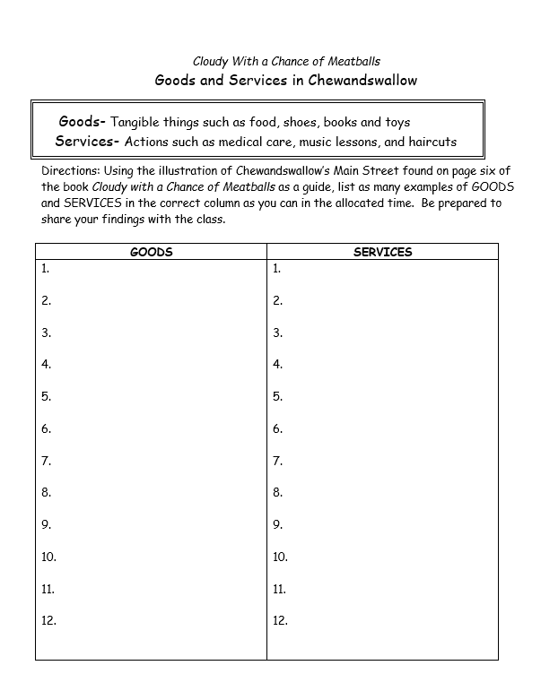
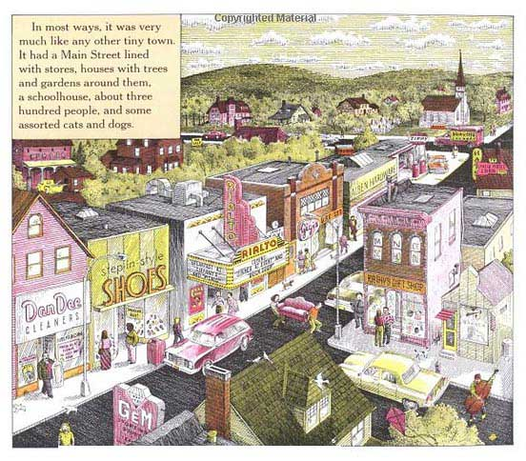
Goods and Services

Slide 22
https://www.stlouisfed.org/~/media/education/curriculum/pdf/kiddynomics-curriculum-unit.pdf?la=en
Concepts Include:
Banking
Choices
Consumers
Money
Producers
Saving
Scarcity
Spending

Slide 23



Slide 24
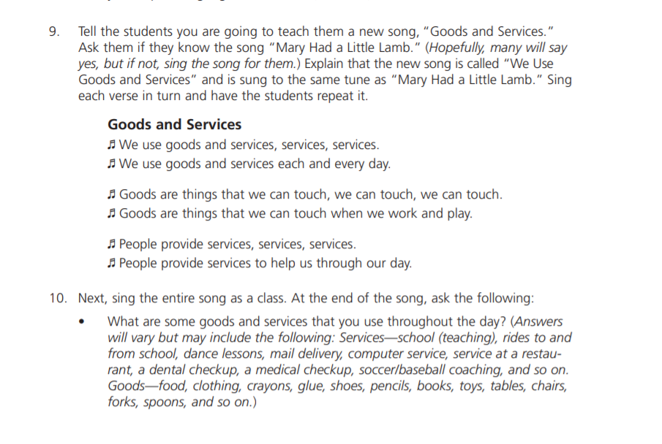

Slide 25
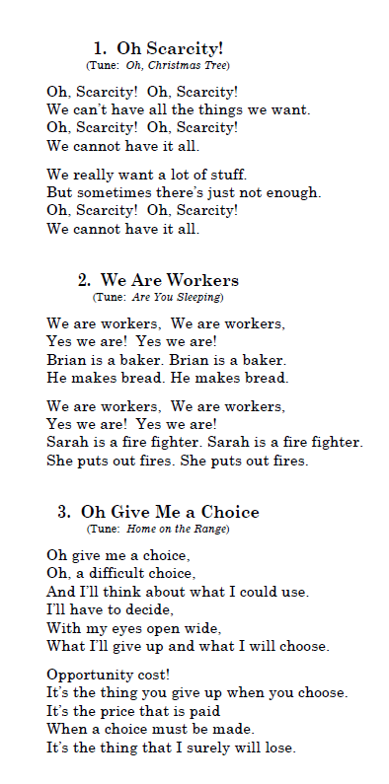

Bonus Resource
https://www.jmu.edu/cob/centers/center-for-economic-education/_files/econ-songbook.pdf

Slide 26
Ancient Civilizations
Resource Review Relay Race
Introduction: This lesson reviews productive resources as
well as the cultures of Egypt, Greece, Rome and Mali. It can be used as a quick introduction or a culminating activity.
Either way, the students should enjoy the competitive nature of the activity.

Slide 27
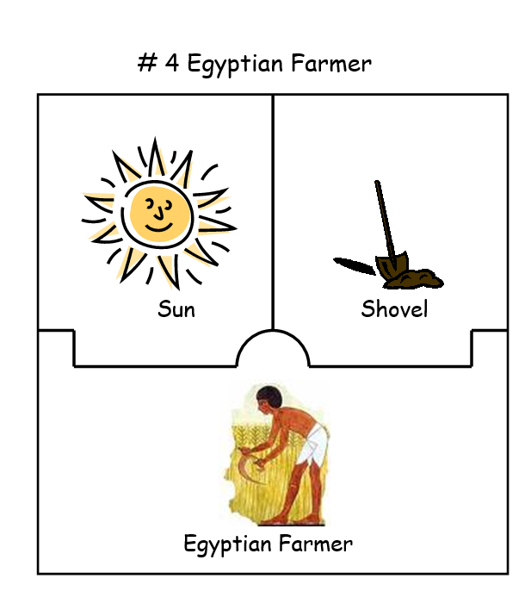
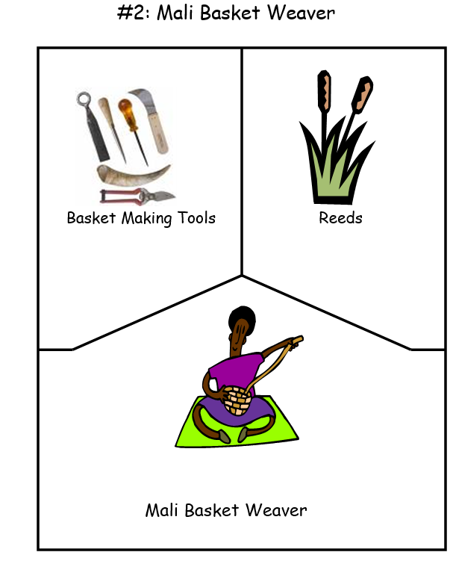
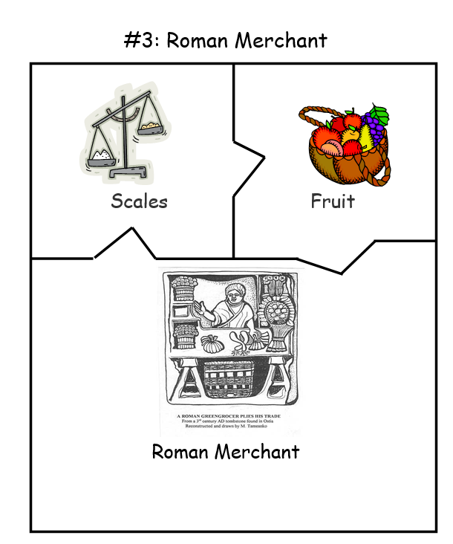
Ancient Civilizations
Resource Review Relay Race
What are the goods?
Who preforms the service?

Slide 28
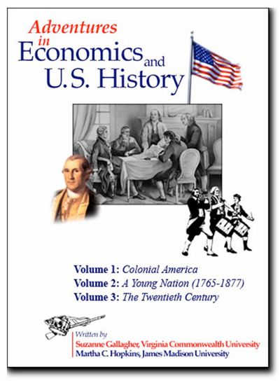

https://econ-fun.com/

Slide 29
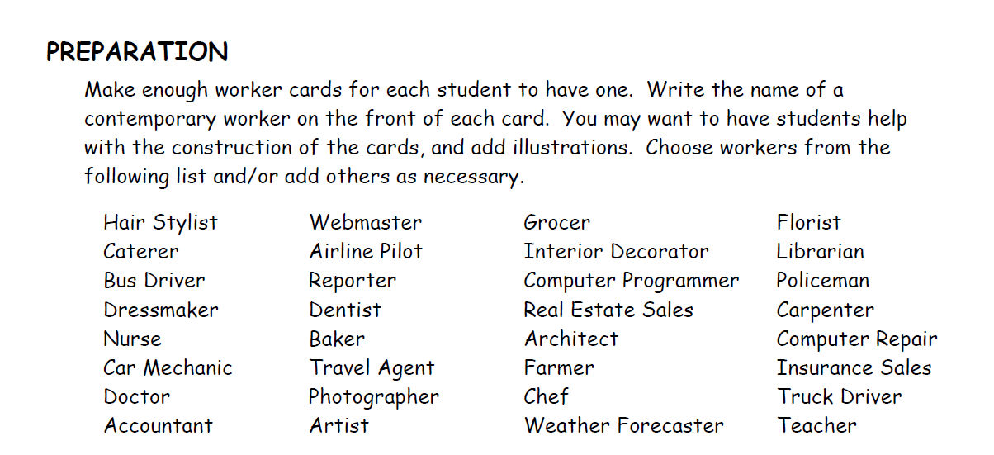
The Colonial Workers Web

Slide 30

The Colonial Workers Web
Distribute one prepared worker card to each student. Give students small strips of masking tape and instruct them to tape the cards to their clothing, so that others can identify them. The teacher also needs a worker card.
Have students sit in a circle on the floor.
Explain that we all use goods and services, both in our career roles as producers and in our roles as consumers. Instruct students to look around the circle and choose two or three workers that produce a good or service that they might need
Model the process for the game. While holding onto the end of a large ball of yarn, roll it to someone in the circle who produces a good or service that your worker uses, either on their jobs or at home, and explain the use. The person who receives the ball of yarn, selects another worker who produces a desired good or service, and explains how this new good or service will be used. Then holding onto the yarn, he or she rolls the ball to that worker. e. Continue rolling the ball of yarn until a nice “web,” is formed and all students have had a turn. This activity is called the Workers Web.*

Slide 31
Review & Assessment
GOODS
People often purchase goods and services to satisfy their wants.
Goods are tangible things that satisfy people’s wants.
Examples of goods include: food, clothing, toys, school supplies, and kitchen tools.
Can you add five more examples to this list?
Do you think some of these goods are more important than others?
If so, which ones and why?

Slide 32
Review & Assessment
SERVICES
People often purchase services to satisfy their wants.
Services are activities that are performed by workers to satisfy people’s wants.
Examples of services include: doctor visits, haircuts, piano lessons, and pet grooming.
Can you add five more examples of services to this list?
Do you think some of these services are more important than others?
If so, which ones and why?

Slide 33
Links to Lessons and Resources
EconEdLink Lesson: What Pet Should I Get?
https://www.econedlink.org/resources/what-pet-should-i-get-dr-seuss-and-decision-making/
St. Louis FED Lesson: Kiddynomics Curriculum
https://www.stlouisfed.org/~/media/education/curriculum/pdf/kiddynomics-curriculum-unit.pdf?la=en
The Economics Songbook
https://www.jmu.edu/cob/centers/center-for-economic-education/_files/econ-songbook.pdf
Econ-fun Website: The Colonial Workers’ Web
https://econ-fun.com/

Slide 34
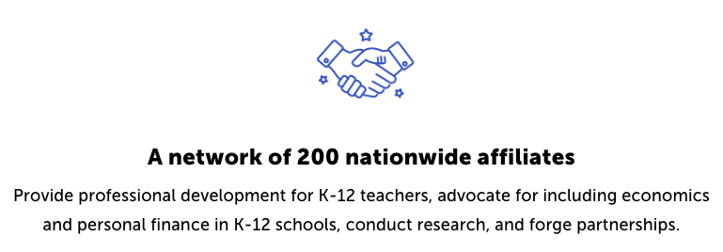
CEE Affiliates
https://www.councilforeconed.org/resources/local-affiliates/

Slide 35



Thank You to Our Sponsors!

Slide 36

The Conference is your pathway to learn about the opportunities to incorporate personal finance and economics into your K-12 classroom and to exchange ideas with hundreds of peers.
Register by August 15, 2020 to receive the early bird special discount:
$79 Early Bird ($99 thereafter)
Register Today >>>
https://www.councilforeconed.org/events/conference

