Slide 1
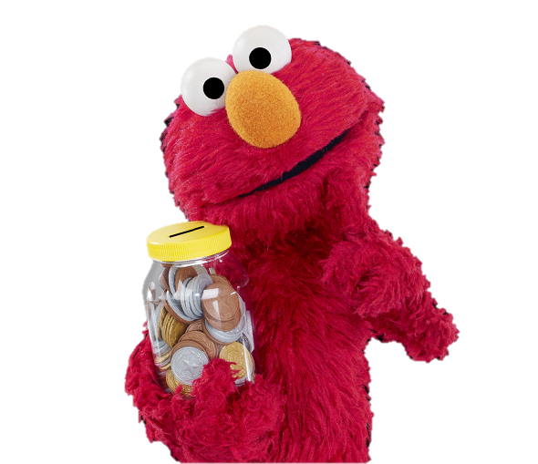
Elmo-Nomics Using Sesame Street to Teach Financial Literacy John Kruggel Associate Director for Program JMU Center for Economic Education 8/13/2020 kruggejb@jmu.edu

Slide 2
EconEdLink Membership
You can now access CEE’s professional development webinars directly on EconEdLink.org! To receive these new professional development benefits, become an EconEdLink member. As a member, you will now be able to:
Automatically receive a professional development certificate via e-mail within 24 hours after viewing any webinar for a minimum of 45 minutes
Register for upcoming webinars with a simple one-click process
Easily download presentations, lesson plan materials and activities for each webinar
Search and view all webinars at your convenience
Save webinars to your EconEdLink dashboard for easy access to the event
You may access our new Professional Development page here

Slide 3
Professional Development Certificate
To earn your professional development certificate for this webinar, you must:
Watch a minimum of 45-minutes and you will automatically receive a professional development certificate via e-mail within 24 hours.
Accessing resources:
You can now easily download presentations, lesson plan materials, and activities for each webinar from EconEdLink.org/professional-development/

Slide 4
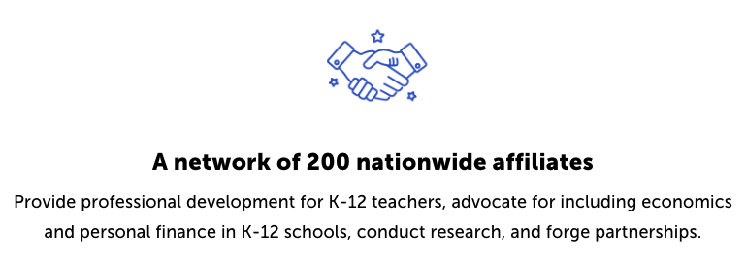
CEE Affiliates
https://www.councilforeconed.org/resources/local-affiliates/

Slide 5
Agenda
Introductions, general overview of why personal finance education at the K-5 level matters.
Sesame Street curriculum: For Me, For You, For Later and additional Sesame Street videos on personal finance.
ABCs of Saving lesson.
Paced Decision Making activity.
Budgeting Activity from the Minnesota Council on Economic Education and St. Louis Federal Reserve.
Race to the Top

Slide 6
Objectives
At the end of this webinar, participants will:
Understand how to use the PACED Decision Making Model.
Learn how they can implement the Sesame Street program, For Me, For You, For Later in a virtual or hybrid classroom.
Gain access to ancillary materials to reinforce the content in the For Me, For You, For Later curriculum.

Slide 7
National Standards
Standard 2: Decision Making:
Effective decision making requires comparing the additional costs of alternatives with the additional benefits. Many choices involve doing a little more or a little less of something: few choices are “all or nothing” decisions.
Standard 4: Incentives:
People usually respond predictably to positive and negative incentives.

Slide 8
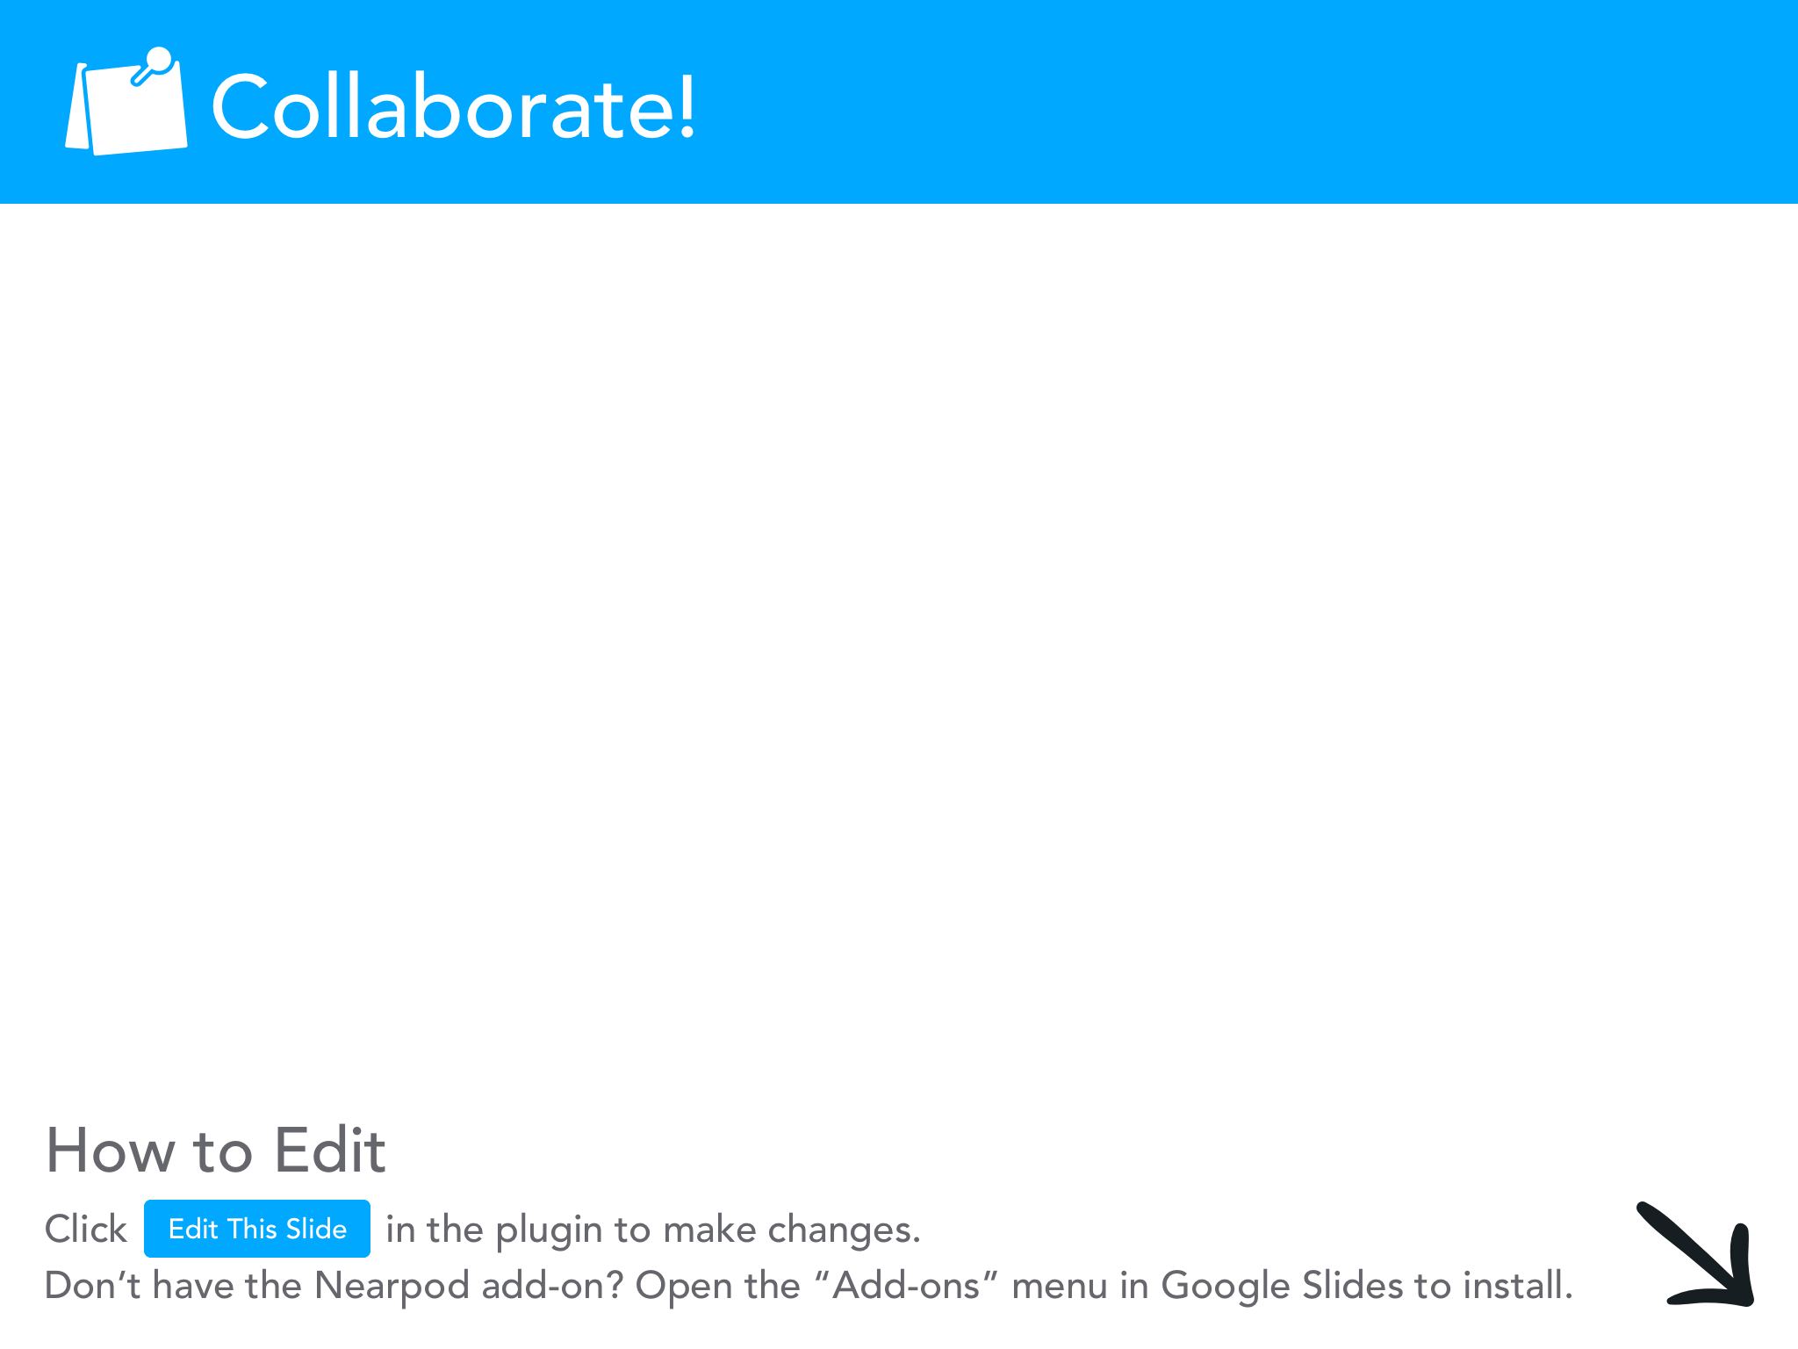

Slide 9
Why Teach Personal Finance/Econ to Kids?
Some studies have shown that people’s spending/saving habits start to develop as early as 4 years old.
Additional research is starting to show that spending habits can start to solidify by as early as 3rd or 4th grade.
Whitebread and Bingham, Cambridge Study:
https://mascdn.azureedge.net/cms/the-money-advice-service-habit-formation-and-learning-in-young-children-may2013.pdf

Slide 10
Sesame Street Videos for Personal Finance
Decision Making: Cookie Choosing (trt: 1:37)
Cookie Monster must decide between a bag with many cookies and a bag with one cookie.
https://www.youtube.com/watch?v=AYFPOS44dMw
Jobs: Grover’s Jobs Through the Years: (trt: 2:47)
This video is a montage of Grover’s jobs throughout the years.
https://www.youtube.com/watch?v=smMJew9yl1w
Saving: Ian McCellan Teaches Cookie Monster the Word Resist: (trt: 3:29)
This video would pair well with the marshmallow test.
https://www.youtube.com/watch?v=GxCplsdCwxY
Earning Money: Davey and Joey Look for a Job: (trt: 19:33)
Davey and Joey want bananas, but they don’t have money for one, decide to get a job.
https://www.youtube.com/watch?v=e1x7yM1czIc
Money/Introduction: Dr. Teeth-Money: (trt: 2:28)
Dr. Teeth sings about wanting money on the old Muppet Show.
https://www.youtube.com/watch?v=8nrSfC76lLI

Slide 11
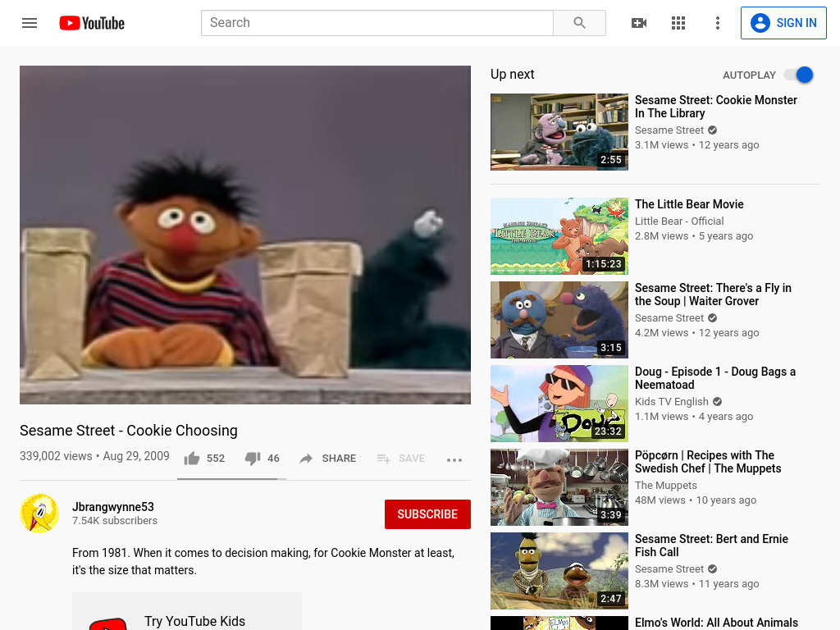

Slide 12
Sesame Street Savings Tips for Students
Sesame Street teamed up with PNC Bank to create a resource titled
For Me, For You, for Later
Highlights from the resource:
Things we value (page 3)
Elmo’s Choices (pages 4&5)
Earn and Save Buddy Walk (pages 6&7)
Make a Saving, Spending, Sharing Mini-Book (pages 11&12)

Slide 13
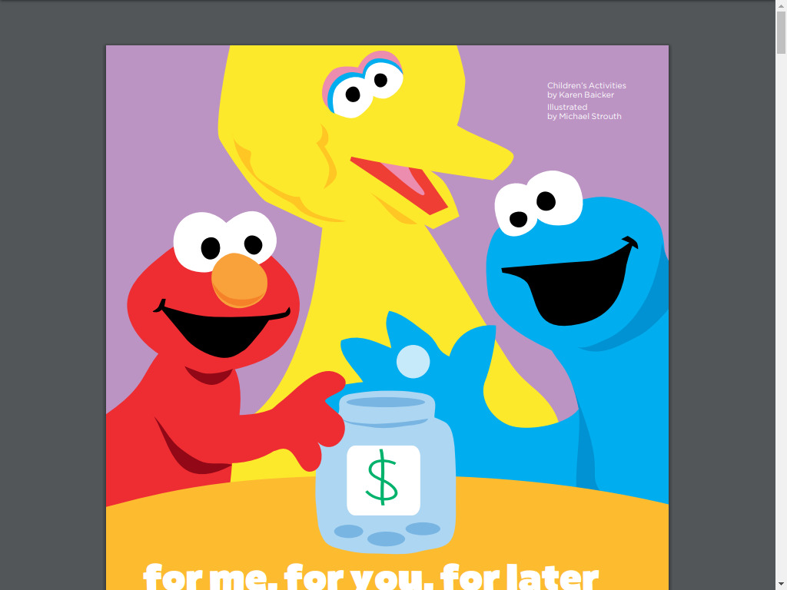

Slide 14
3 Jars
These Sesame Street lessons revolve around the 3 jars mindset:
One jar for Saving
One jar for Spending
One jar for Sharing

Slide 15
Tips for using the 3 jars:
Have the students decorate their jars.
Use clear jars.
Have students create savings goals.
Have students pick a local charity they can share with.
Use the jars to discuss ways to earn money/how to get a job.

Slide 16
Parent Guide
There is also a parent guide to help parents navigate the lessons.
https://cdn.sesamestreet.org/sites/default/files/media_folders/Media%20Root/Finance_CGG_ENG_F.pdf?_ga=2.264806794.402461771.1596990080-2004292834.1596990080

Slide 17
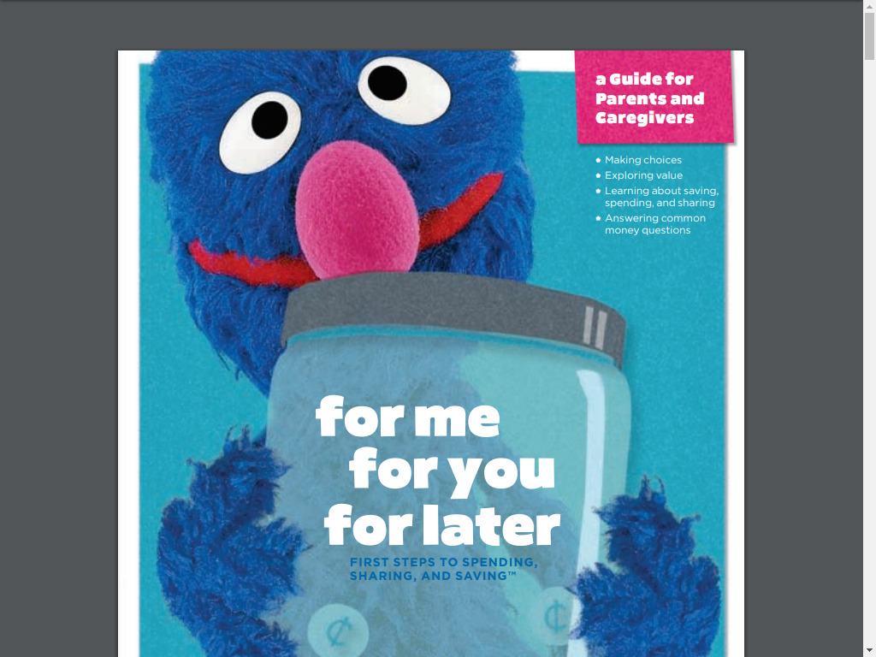

Slide 18
Beth Kobliner and Elmo
Here’s a great video with financial expert Beth Kobliner and Elmo discussing the 3 Jars. (TRT: 4:36)
https://www.youtube.com/watch?v=ZrsWh7Bo97A

Slide 19
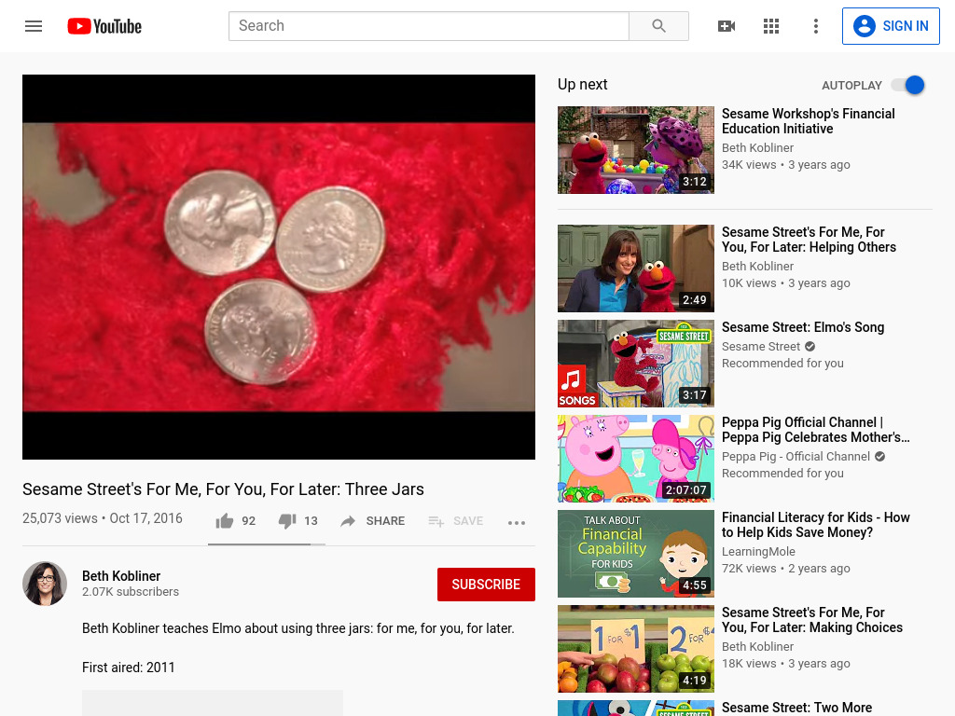

Slide 20
Paul Solman Videos:
Paul Solman is an economic correspondent for PBS News. His series, Making Sen$e covers a LOT of econ and personal finance concepts.
EconEdLink has a significant amount of videos from the Making Sen$e series already compiled for you.
https://www.econedlink.org/?s=paul+solman&post_type=post

Slide 21
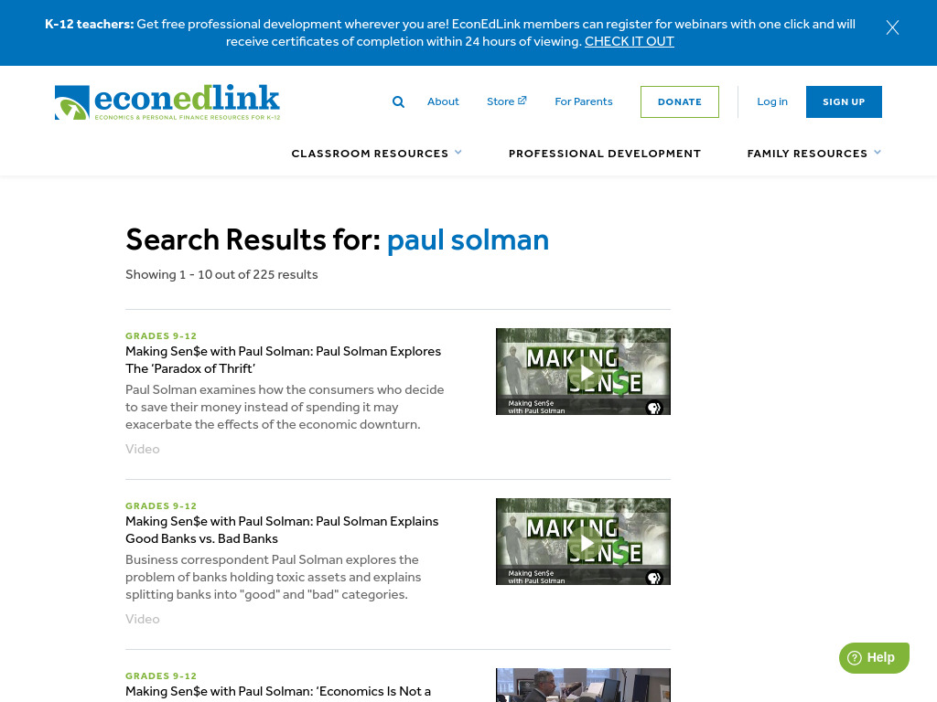

Slide 22
Teaching Kids About Money
Here’s a video you can watch to get some more ideas on what to discuss with your students.
Paul Solmon and Beth Koblinger talk to kids about money and Beth gives some tips and tricks. (TRT: 8:46)
https://www.youtube.com/watch?v=bmyzRf3bV3k&t=2s

Slide 23
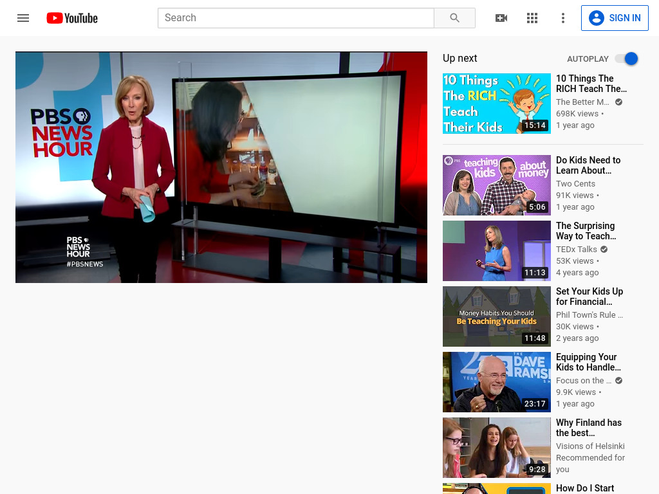

Slide 24
ABCs of Saving Lesson
https://www.econedlink.org/resources/the-abcs-of-saving/
AIM: The first step to saving is deciding on a savings goal.
Short-term goals: Things that don’t cost much and won’t take long to save for.
Long-term goals: Things that cost more and will take longer to save for.

Slide 26
ABCs of Saving Lesson
Bank: Once you have decided to save money, it is very important to have a safe place to store that money.
Coins/Currency: How do you get money? Do you have an allowance, a job, do you get money for birthdays?
--See handout and quiz--

Slide 27
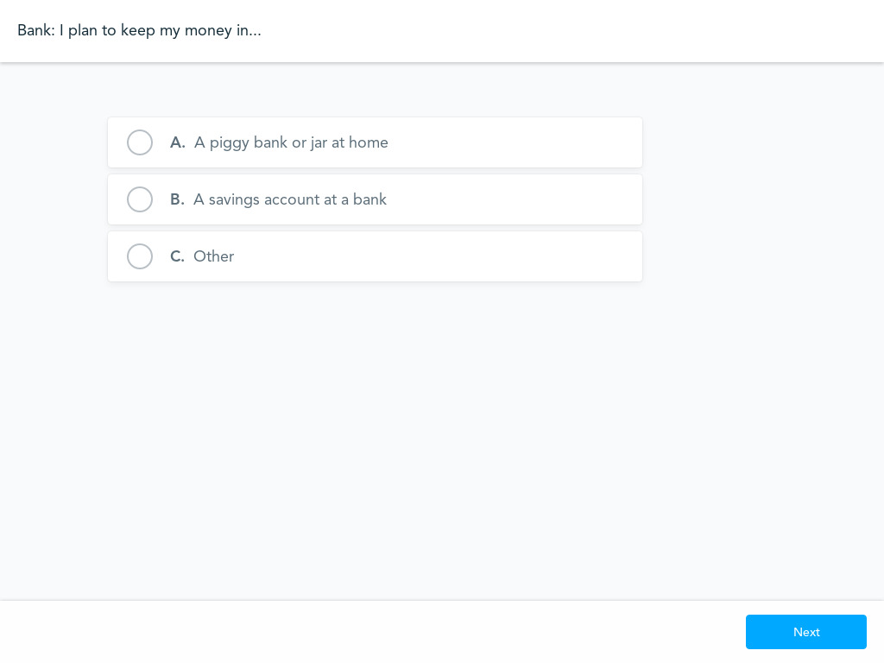
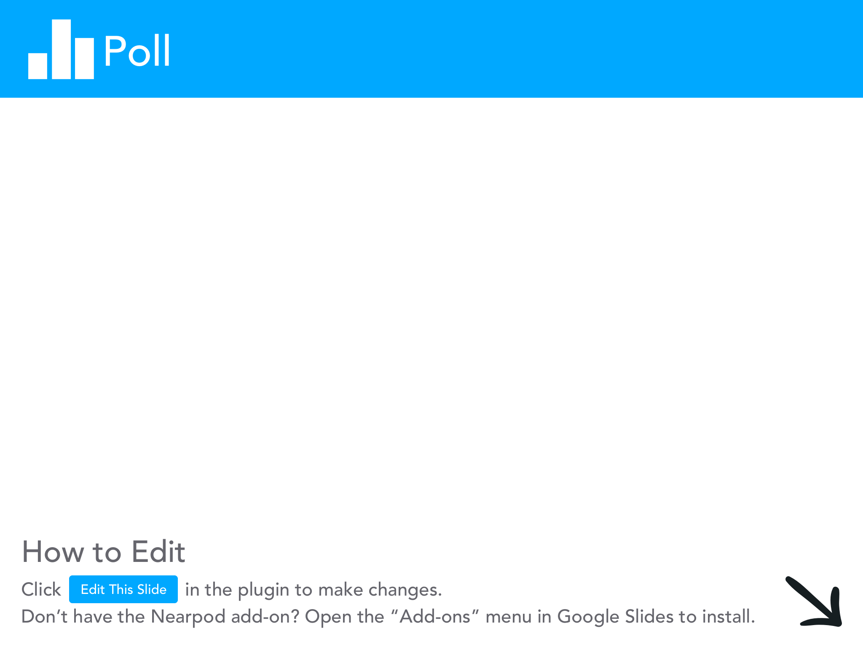

Slide 29
PACED Decision Making Activity
Many of the idea of saving vs. spending involves making decisions.
The PACED Model is a great way to walk students through being a conscientious decision maker.
P: State the Problem
A: List Alternatives
C: Identify Criteria
E: Evaluate alternatives based on criteria
D: Make a Decision

Slide 30
Sample PACED Model
Problem: I don’t have enough time to finish two big assignments.
Alternatives: I can do my math homework OR finish my science project.
Criteria: I have an A average in math and a C average in science.
The math assignment is worth 10% of my math grade; the science project is worth 35% of my science grade.
I’ve missed two assignments in math; I haven’t missed any assignments in science.
Evaluate: Because I’m not doing so well in science, and the science project is worth more, it’s more important to me to finish the science project.
Decision: I’ll finish the science project.

Slide 31
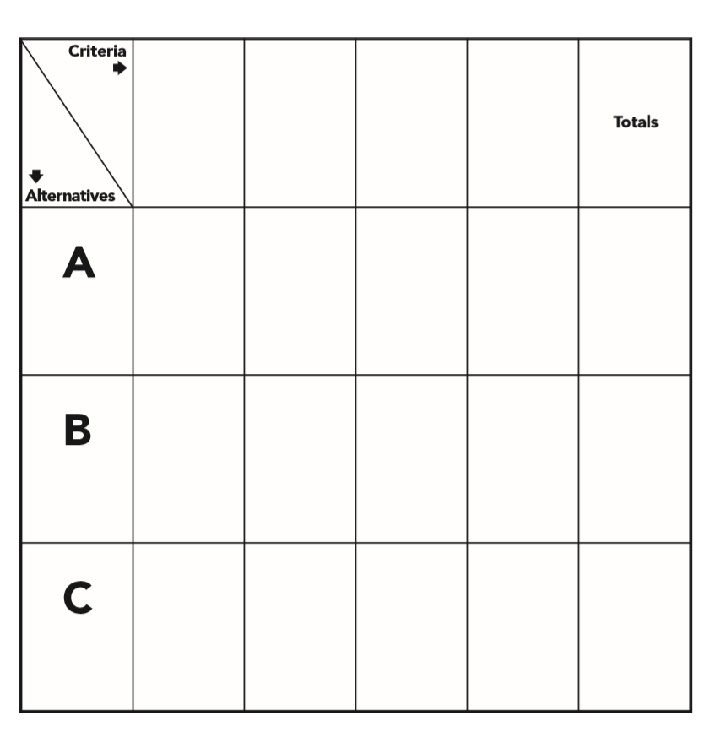
Sample Grid
Here is a sample grid you can give to students to help them with the PACED Model.

Slide 32
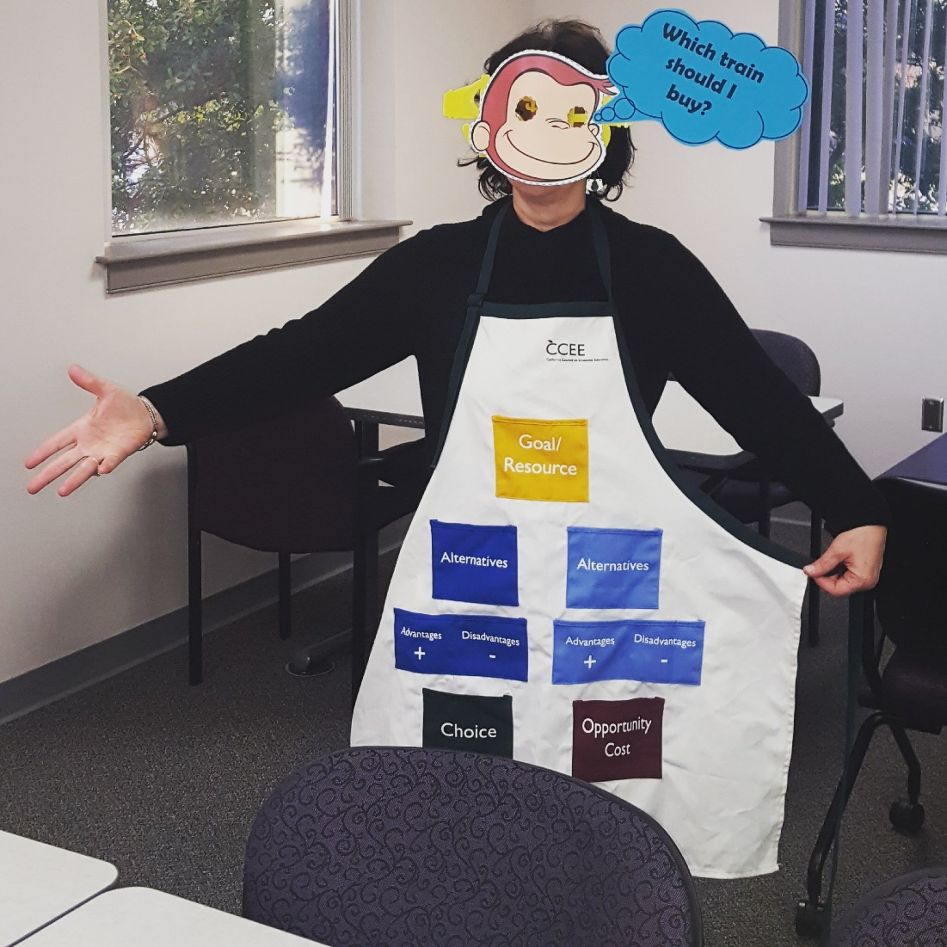

Slide 33
Budgeting Activity
Here’s a budgeting activity you can use to help students think about saving and spending using 24 pennies.
Each penny represents $100. The 24 pennies represent their monthly income (after deductions).
The activity is meant for middle/high school students, BUT it can be scaled to elementary students with minimal effort.
https://www.stlouisfed.org/~/media/education/curriculum/pdf/making-personal-finance-decisions-lesson-5b.pdf?la=en

Slide 35
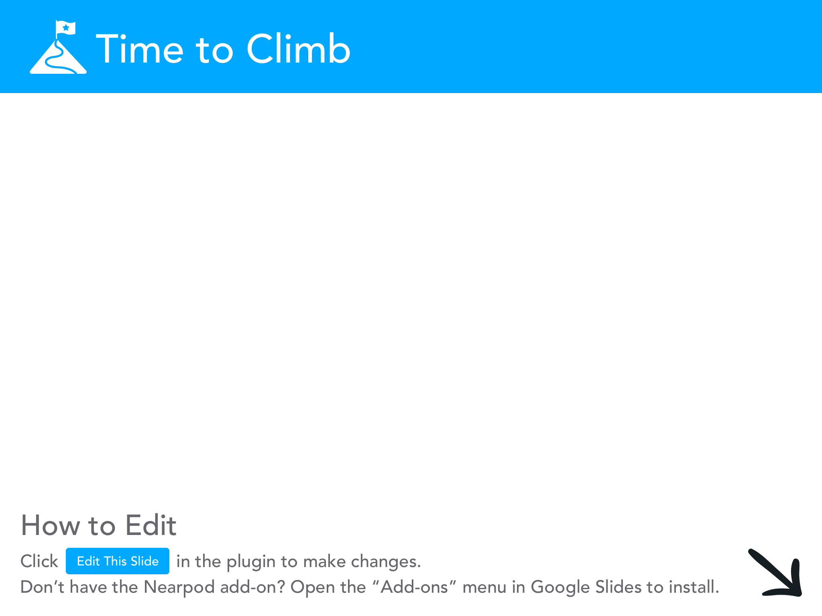

Slide 36
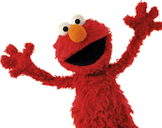
Thanks!
Thank you all for attending, hopefully your MB › MC!

Slide 37
Thank You to Our Sponsors!

