Slide 1
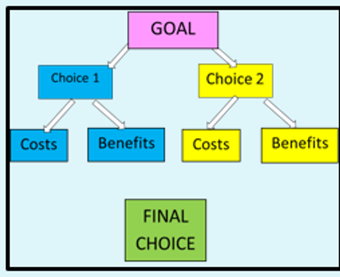
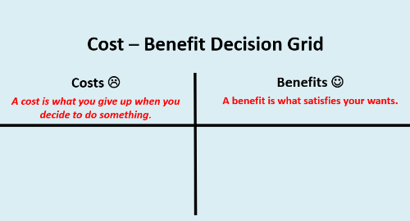

Empowering Young Students During Uncertain Times
June 25, 2020ne Farrell Stover
Presented by Lynne Stover
James Madison University Center for Economics
June 25, 2020
stoverlf@jmu.edu

Slide 2
EconEdLink Membership
You can now access CEE’s professional development webinars directly on EconEdLink.org! To receive these new professional development benefits, become an EconEdLink member. As a member, you will now be able to:
Automatically receive a professional development certificate via e-mail within 24 hours after viewing any webinar for a minimum of 45 minutes
Register for upcoming webinars with a simple one-click process
Easily download presentations, lesson plan materials, and activities for each webinar
Search and view all webinars at your convenience
Save webinars to your EconEdLink dashboard for easy access to the event
You may access our new Professional Development page here

Slide 3
Professional Development Certificate
To earn your professional development certificate for this webinar, you must:
Watch a minimum of 45-minutes and you will automatically receive a professional development certificate via e-mail within 24 hours.
Accessing resources:
You can now easily download presentations, lesson plan materials, and activities for each webinar from EconEdLink.org/professional-development/

Slide 4

Agenda
Quickly examine “uncertain times” as they relate to young students.
Provide decision-making tools to help foster problem solving skills and promote planning and good choices.
Consider related sources for lesson plans and activities.
Review a bibliography of children’s books where characters must make important choices.

Slide 5

Objectives
This presentation will provide:
Connections to present day situations and established lessons and activities.
Definitions and examples of decision-making models.
Classroom-ready interactive slides for a PACED grid that may be used for instructional purposes.
Attached documents including children’s literature bibliography and worksheets based on decision-making activities that may be used for assessment.

Slide 6

National Standards
Content Standard 2: Decision Making
Students will understand that: Effective decision making requires comparing the additional costs of alternatives with the additional benefits. Many choices involve doing a little more or a little less of something: few choices are “all or nothing” decisions.
Students will be able to use this knowledge to: Make effective decisions as consumers, producers, savers, investors, and citizens.

Slide 7

Virginia History & Social Science Standards of Learning
K.1,2,3 The student will demonstrate skills for historical thinking, geographical analysis, economic decision making, and responsible citizenship by: h) using a decision-making model to make informed decisions
USI.1 & USII.1 The student will demonstrate skills for historical thinking, geographical analysis, economic decision making, and responsible citizenship by: h) using a decision-making model to identify costs and benefits of a specific choice made
CE.1 The student will demonstrate skills for historical thinking, geographical analysis, economic decision making, and responsible citizenship by: h) using a decision-making model to analyze and explain the costs and benefits of a specific choice

Slide 8

Cost: A cost is what you give up when you decide to do something. L
Benefit: A gain received because of an action taken of a decision made. J
Opportunity Cost: What is given up when a choice is made
Definitions
Economic Concepts

Slide 9

Why is this Skill Important?
Economic decision making helps students focus on making a choice BEFORE it is made
It helps students be more thoughtful about all the possibilities and consequences before they make a choice
Making a choice because the benefits outweigh the costs has life-long benefits
Considering past decisions using the same thought processes helps to understand why the choice was made, and to critically evaluate whether it was a good one. It can be
  viewed from their perspective at the time
  viewed in hindsight, from your perspective, what would you have done then—or now

Slide 10
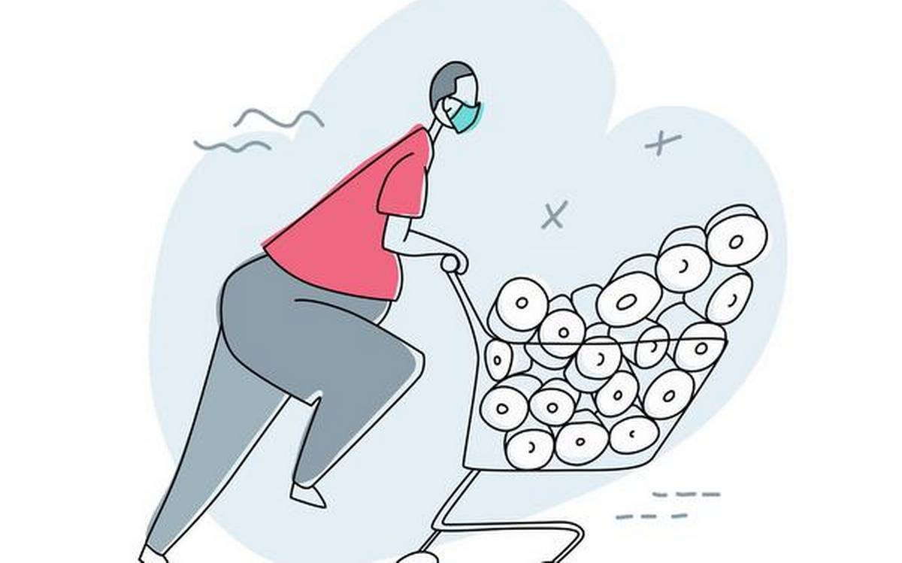
What happens if I or my parents get sick?
Will school open next year?
Why can’t I visit my grandparents?
My parents are working from home and don’t have time for me.
Can I do anything to help?
Will there be enough food? What if we run out of toilet paper?
Kids’ Questions and Concerns

Slide 11
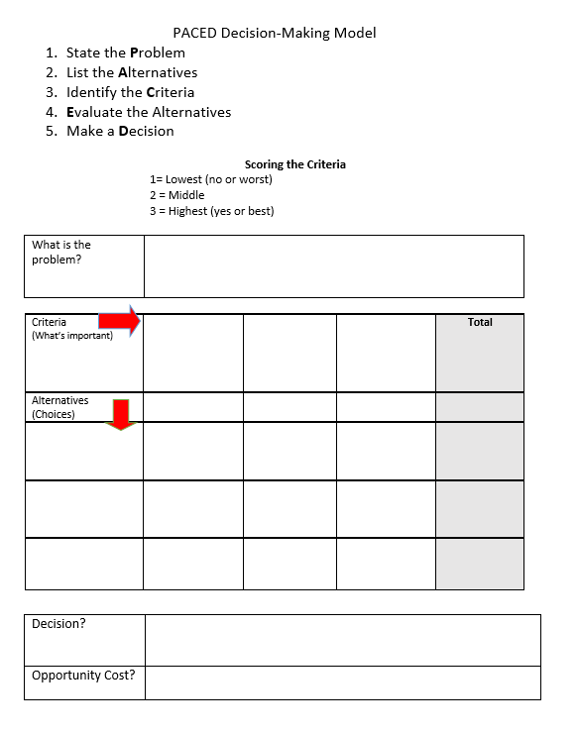

Decision Models
Defined
Cost-Benefit Decision Model. To decide whether or not to do something—when the choice is either “yes” or “no”
Cost-Benefit Decision Tree. To help you decide between two choices. In essence, it combines two Cost-Benefit models.
PACED Decision Model. A more advanced model used when you have various options/alternatives but also certain things/criteria that are important to you.

Slide 12
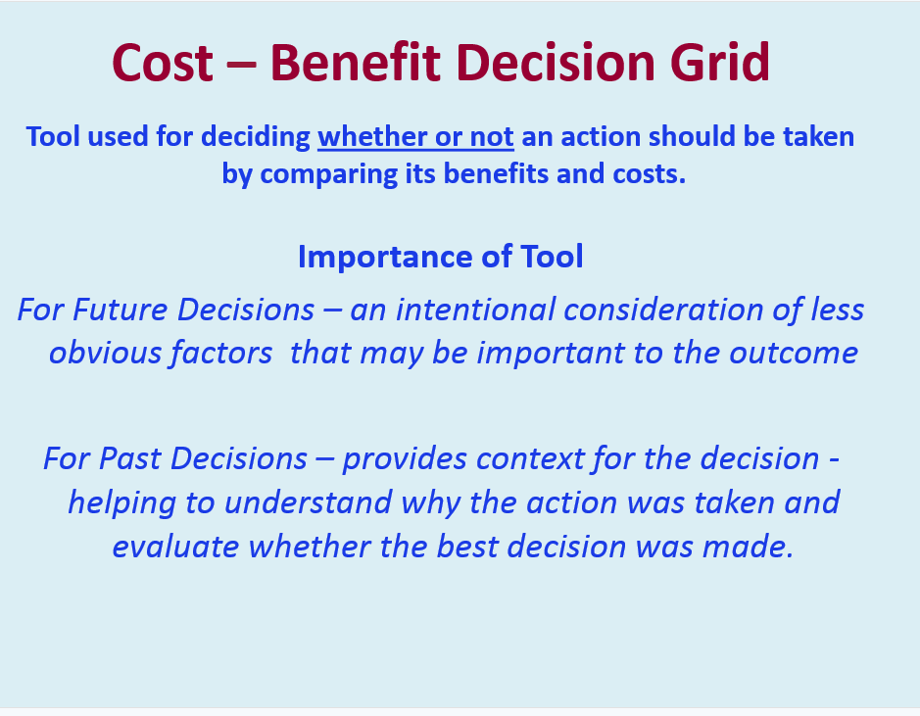


Slide 13
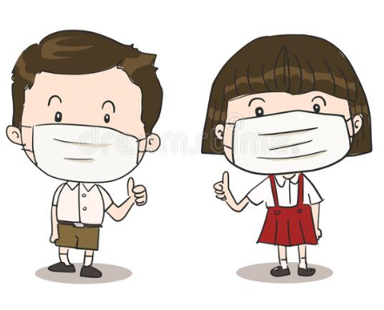
Decisions to be made
Should I visit my grandmother?
Should I wear a mask when leaving the house?
Should I do my lessons in the morning?

Slide 14

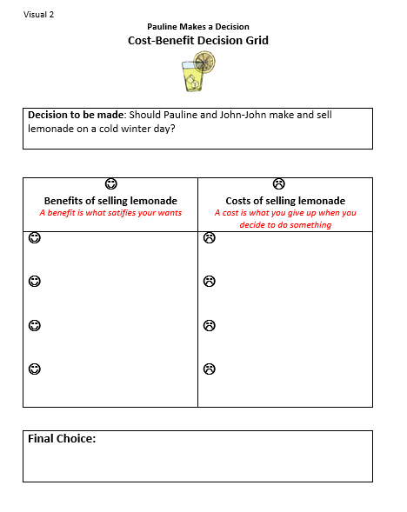
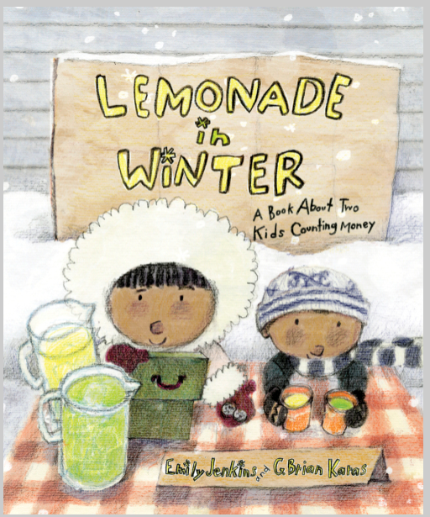
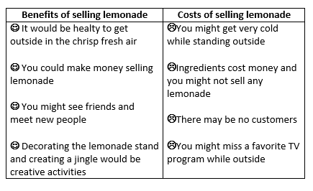

Slide 15
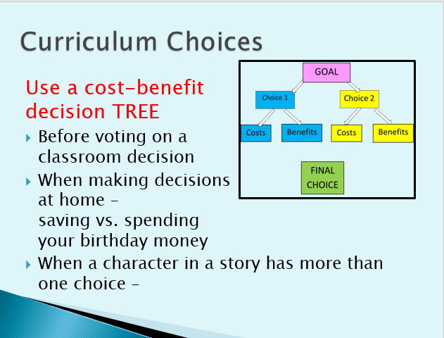

Slide 16
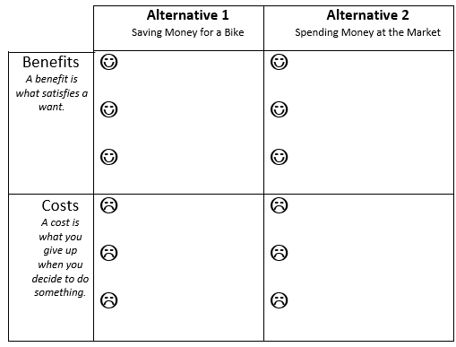
Another model to use when deciding between two choices

Slide 17

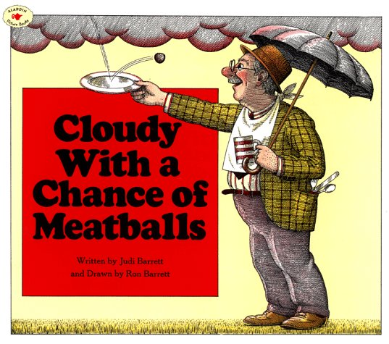
Cloudy With a Chance of Meatballs
Making Choices

Slide 18
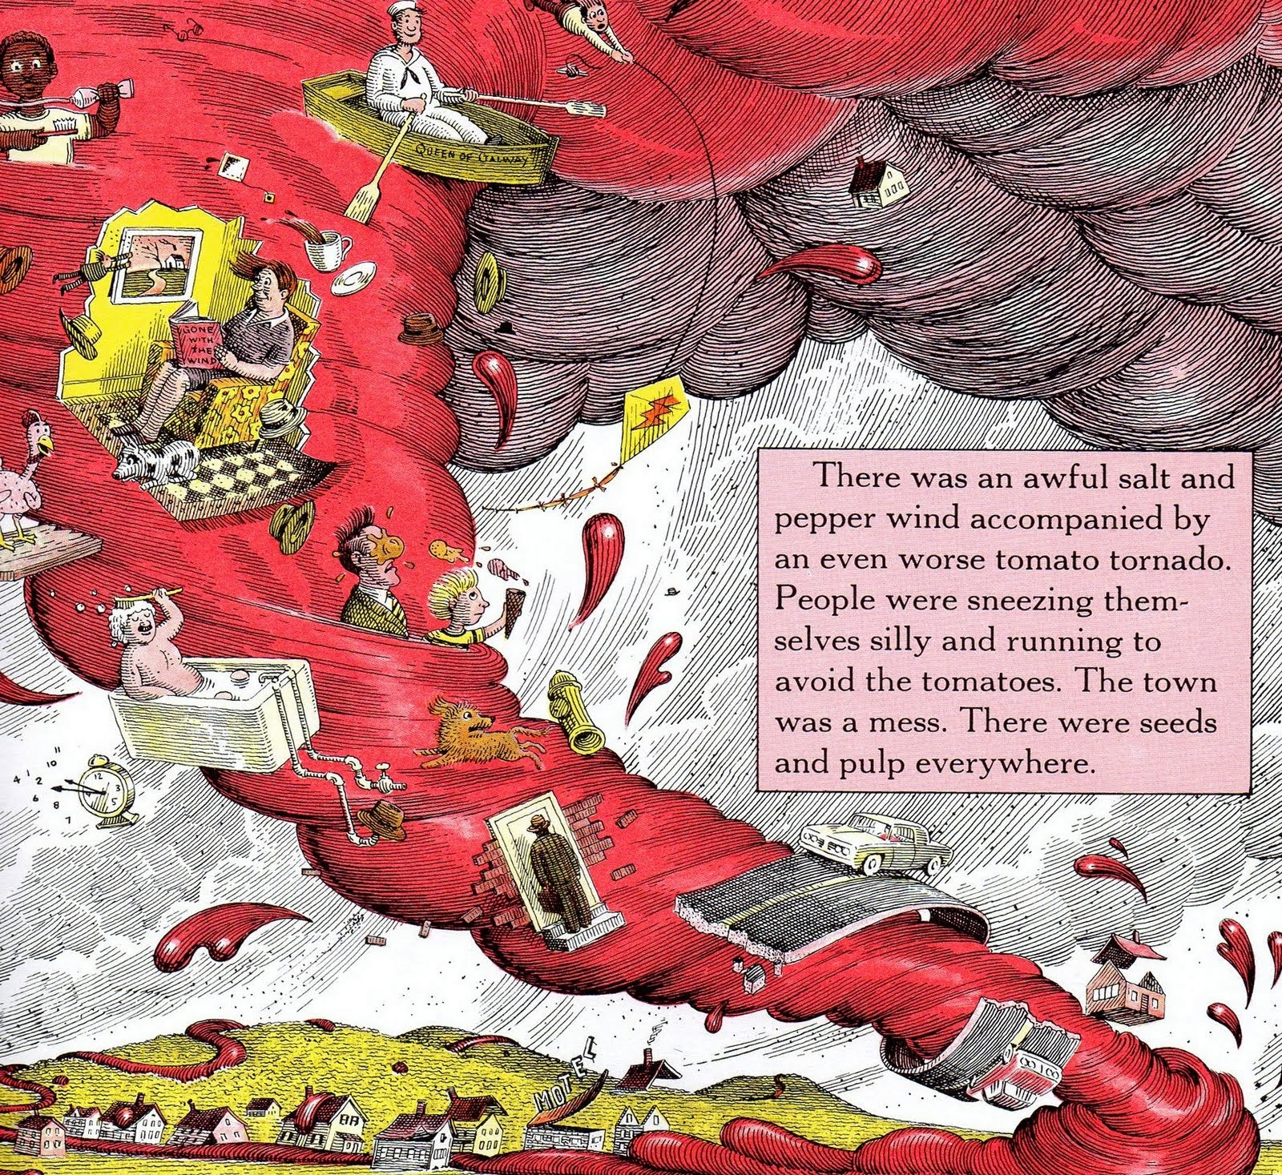
Cloudy with a Chance of Meatballs by Judi Barrett
Reading Level 4.3
Introduction
In the imaginary town of Chewandswallow the availability of food is dependent on climatic conditions. Soon the town’s citizens learn that there can be “too much of a good thing”. First published in 1978 this wonderfully illustrated picture book is as applicable today as it was forty years ago…maybe more so!

Slide 19
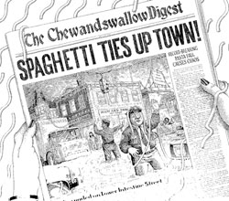
.
FOR DISCUSSION:
What current event is causing the citizens of Chewandswallow to become concerned for their safety?
How are the goods and services in Chewandswallow different from that of an ordinary town?
What jobs would NOT be necessary in Chewandswallow?
Chewandswallow is a fictional place. Can comparisons be made to current climate and environmental situations? What are they?
Assessment Questions
Food for Thought!

Slide 20
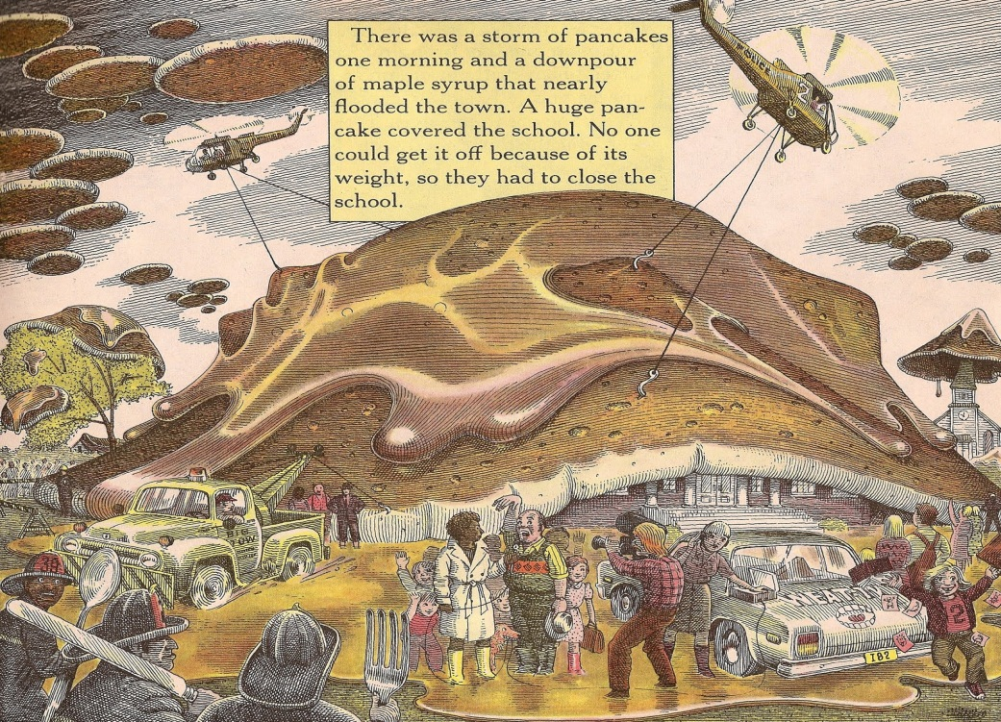
Pancake Problems !
(History repeats itself)

Slide 21
Cost-Benefit Analysis
Directions: What should the citizens of Chewandswallow do?
Help them decide by filling in this chart with some of the advantages and disadvantages of their two possible alternatives (choices).
 | Alternative 1 Stay in Chewandswallow | Alternative 2 Leave Chewandswallow
Benefits Advantages or Good Points | ☺ ☺ ☺ ☺ | ☺ ☺ ☺ ☺
Costs Disadvantages or Bad Points | ☹ ☹ ☹ ☹ | ☹ ☹ ☹ ☹

Slide 22
Possible Responses
Lesson I
 | Alternative 1 Stay in Chewandswallow | Alternative 2 Leave Chewandswallow
Benefits Advantages or Good Points | ☺ Free Food ☺ Friends ☺ Familiarity ☺ Easy | ☺ Safety ☺ Adventure ☺ Meet new people ☺ Choice of food
Costs Disadvantages or Bad Points | ☹ Dangerous ☹ Pollution Problems ☹Weird food choices ☹ Homes destroyed | ☹ No free food ☹ Dangerous trip ☹ Leave home ☹ Strange place

Slide 23

Make a Choice
Stay in Chewandswallow and hope for the best.
Stay in Chewandswallow and build stronger structures.
Pack up and get out of Chewandswallow as soon as possible.
Leave Chewandswallow but return with a salvage company to collect and sell the extra food.

Slide 24
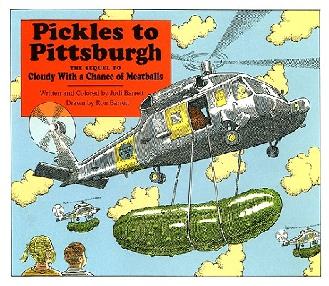
“Leave Chewandswallow but return with a salvage company to collect and sell the extra food.”

Slide 25
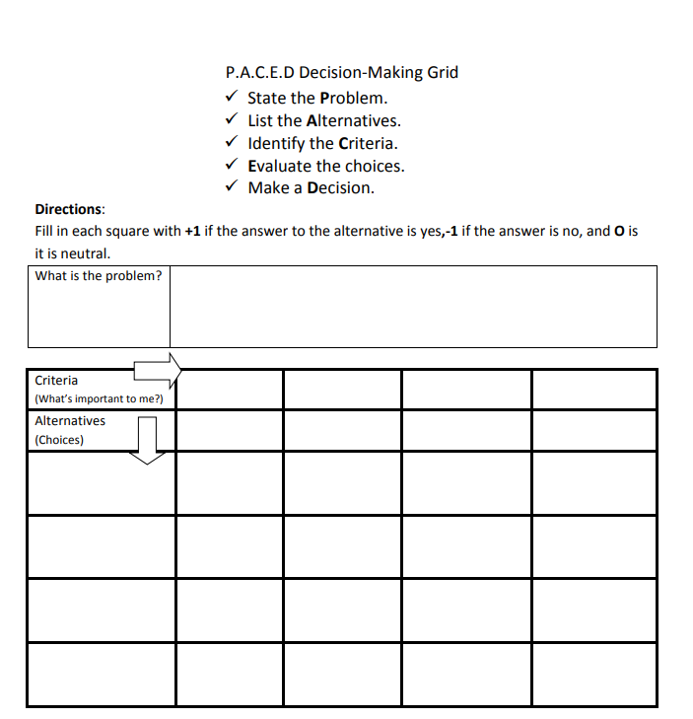
PACED Decision Model
State the problem
List the alternatives
Identify the criteria
Evaluate the alternatives
Make a decision

Slide 26
P: STATE THE PROBLEM
What should I have for lunch?

Slide 27


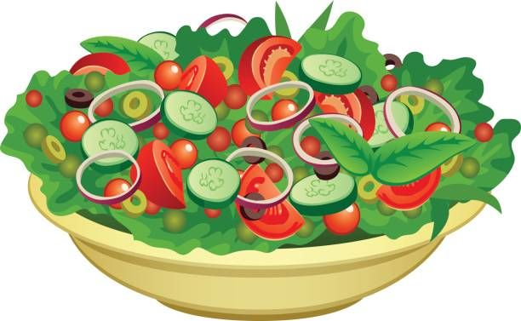
A: LIST THE ALTERNATIVES
Problem: What should I have for lunch?
Sandwich from home
Pizza and fries
Salad bar

Slide 28
C: STATE THE CRITERIA
Problem: What should I have for lunch?
Cheap
Quick
Tastes good
Healthy
Sandwich from home
Pizza and fries
Salad bar

Slide 29
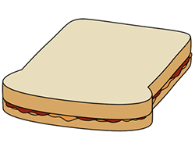
E: EVALUATE THE ALTERNATIVES
Rate On A Scale From 3 (Best) to 1 (Worst)
Problem: What should I have for lunch?
Cheap
Quick
Tastes good
Healthy
Sandwich from home
3
2
2
2
2
3
2
1
Pizza and fries
1
1
2
3
Salad bar

Slide 30
D: MAKE A DECISION
Problem: What should I have for lunch?
Cheap
Quick
Tastes good
Healthy
?
Sandwich from home
3
2
2
2
= 9
2
3
2
1
= 8
Pizza and fries
1
1
2
3
= 7
Salad bar

Slide 31

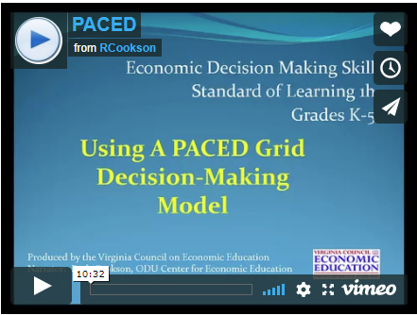
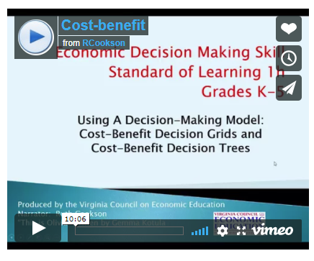
References for
Extension Resources
http://vcee.org/economic-decision-making/
http://vcee.org/economic-decision-making/

Slide 32
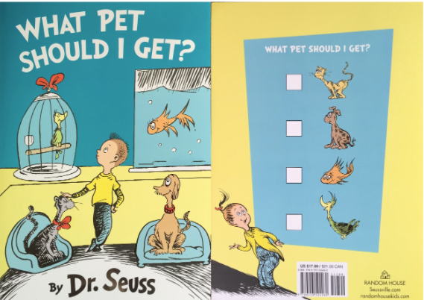
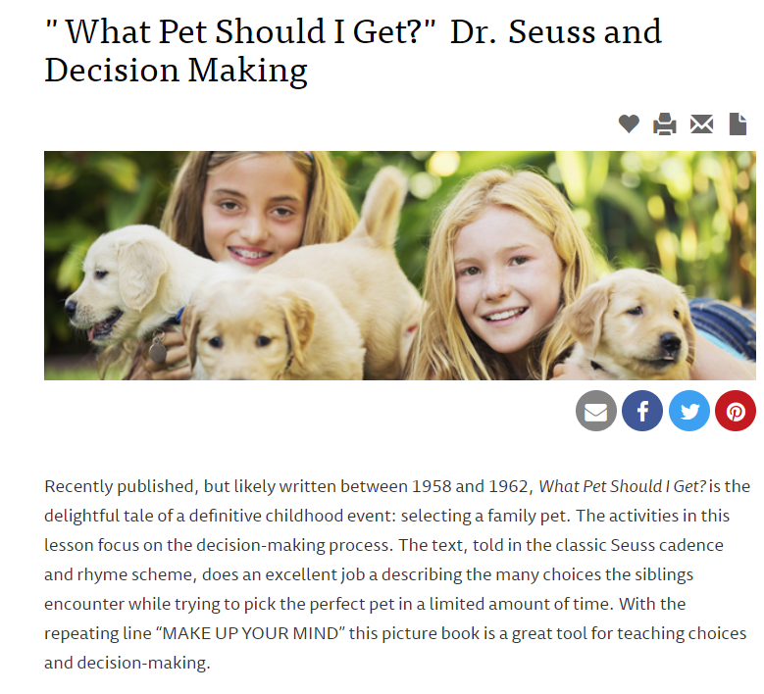
PACED Decision Model
https://www.econedlink.org/resources/what-pet-should-i-get-dr-seuss-and-decision-making/

Slide 33

How to help students make thoughtful choices?
Consider the costs and benefits of each decision
If they have to make a choice, it is due to scarcity. What is scarce?
What am I giving up (opportunity cost)?
Notes:
Whenever you make a choice you are actually making two choices—you are choosing to do one thing and also choosing not to do something else. What you choose not to do is your opportunity cost.

Slide 34

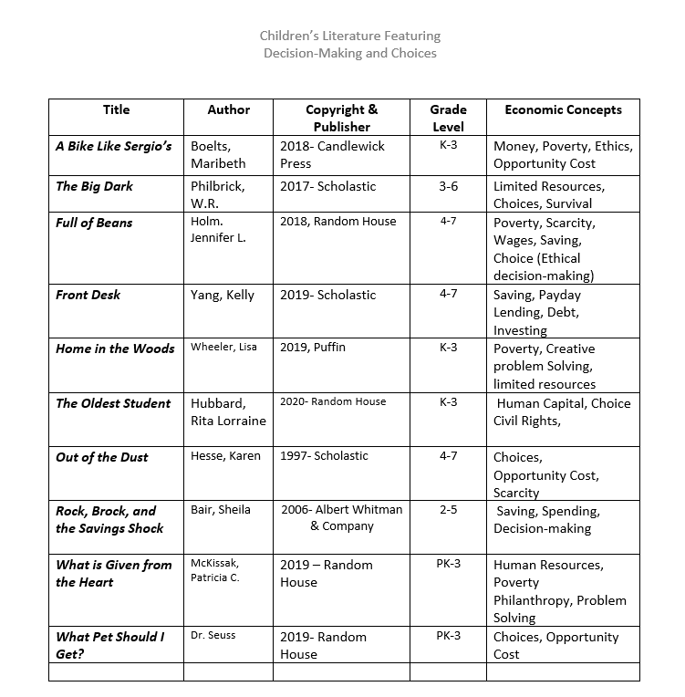
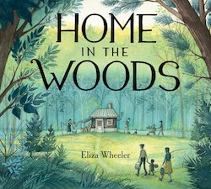
Related Children’s Books

Slide 35

CEE Affiliates
https://www.councilforeconed.org/resources/local-affiliates/

Slide 36
Thank You to Our Sponsors!

