Slide 1
Using Active Learning Techniques to Explore the Deficit Controversies Presented by Tawni Hunt Ferrarini, PhD July28, 2020 Tferrarini@Lindenwood.edu * Tawni.org

Slide 2
EconEdLink Membership
You can now access CEE’s professional development webinars directly on EconEdLink.org! To receive these new professional development benefits, become an EconEdLink member. As a member, you will now be able to:
Automatically receive a professional development certificate via e-mail within 24 hours after viewing any webinar for a minimum of 45 minutes
Register for upcoming webinars with a simple one-click process
Easily download presentations, lesson plan materials, and activities for each webinar
Search and view all webinars at your convenience
Save webinars to your EconEdLink dashboard for easy access to the event
You may access our new Professional Development page here

Slide 3
Professional Development Certificate
To earn your professional development certificate for this webinar, you must:
Watch a minimum of 45-minutes and you will automatically receive a professional development certificate via e-mail within 24 hours.
Accessing resources:
You can now easily download presentations, lesson plan materials, and activities for each webinar from EconEdLink.org/professional-development/

Slide 4
Agenda
Welcome
Macroeconomics objectives
Six online practices for good teaching applied to economics
Deep dive into the macroeconomic topics (budget deficit, federal debt, financing the debt and consequences)
Review
Conclusion and references
Thanks to you and our sponsors

Slide 5
Two webinar options
1. Sit back and passively listen to the webinar and take notes
2. Actively participate in the webinar and learn-by-doing

Slide 6
Macro Objectives
Distinguish between deficits and debt
Explain that federal deficits are financed through higher taxes, the sale of government securities, the issuance of new government securities, and purchase of bonds held by the public with new money
Analyze the impact of each on real output and price levels

Slide 7
Good Online Teaching Practices
peardeck.com (Level 1, $0)

Slide 8
Voluntary National Content Standards in Economics

Slide 9
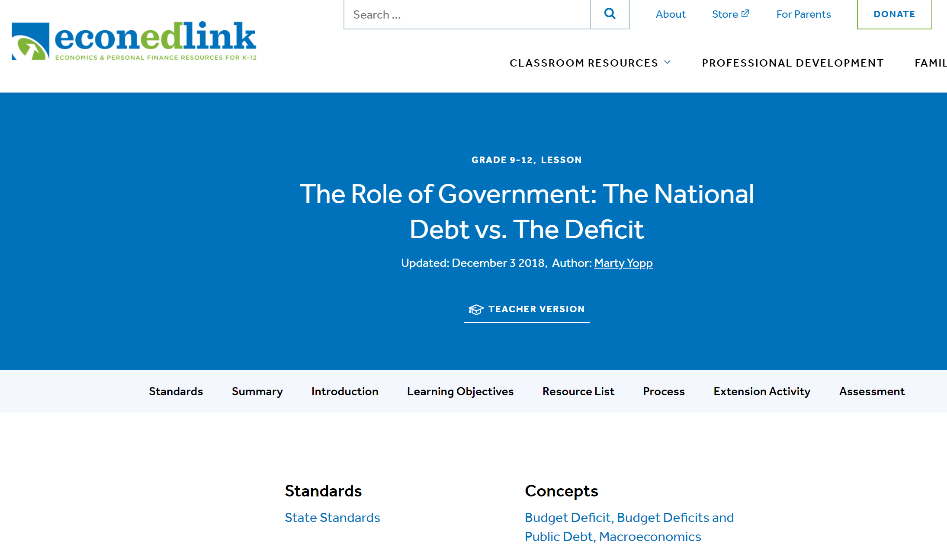
State Standards
Connect to regional and state standards at EconEdLink.org
Search for “deficit”
Choose a lesson
Click on State Standards
NYSed.gov

Slide 10
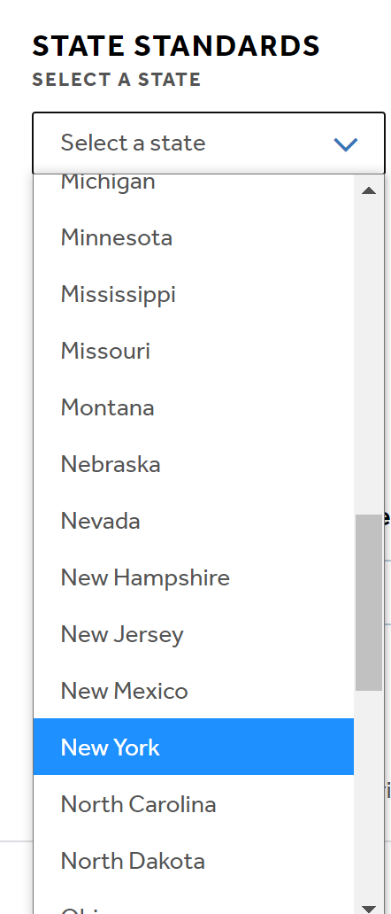
State Standards
Connect to regional and state standards at EconEdLink.org
Search for “deficit”
Choose a lesson
Click on State Standards
NYSed.gov

Slide 11
Bell Ringer
Do the benefits of deficit spending today outweigh the future costs during a recessions? Yes * No * It depends * I don’t know
(Reply in PearDeck or the GoTo chat box)
SEE BITMOJI. TAKE ACTION!!!!

Slide 12
Active Learning
Activities will lead you to do the following:
Identify relevancy
Define a budget deficit, budget surplus, and federal debt
Distinguish between the federal debt and a budget deficit or budget surplus
Describe options to fund the deficit and debt
Investigate the long-run consequences with respect to production, employment, and prices

Slide 13
Did You Know?
6:12 PM EDT 2020 July 27

Slide 14
That’s $27 Trillion in Debt!!!!

Slide 15
Putting these trillions into perspective
Webster’s Dictionary defines a trillion as “a really, really big number”
Trillion = 1,000 Billion
What happened
1 million seconds ago took place 12 days ago
1 billion seconds ago took place 32 years ago
1 trillion seconds ago took place 32,000 years ago

Slide 16
Read & Write
Instructions: Grab a pencil and paper or use your device to take notes.
A student volunteer will read one of three slides. Please write what you hear. Prepare to define a balanced budget, budget deficit, budget surplus, and state what economic conditions contribute to each.

Slide 17
Read & Write
The two primary tools of discretionary fiscal policy are government spending (G) and taxes (T).
G vs T
*Assume just discretionary policy

Slide 18
Read & Write
When government spending (G) aligns with tax revenues decrease (T), the budget is balanced.
Balanced Budget
G = T

Slide 19
Read & Write
When government conducts expansionary fiscal policy to counteract a recession, government spending increases (G ) and/or taxes decrease (T ).
Budget Deficit
G > T

Slide 20
Read & Write
When government conducts expansionary fiscal policy to counteract a recession, government spending increases (G ) and/or taxes decrease (T ).
Budget Deficit
G > T

Slide 21
Read & Write
When the government conducts contractionary fiscal policy to alleviate inflationary pressures, government spending decreases (G ) and/or taxes increase (T ).
Budget Surplus
G > T

Slide 22
Practice Time on Task
Visit: https://h5p.org/node/975657 ($0, Level 1)
Notes:
https://h5p.org/node/975657

Slide 23
Practice Time on Task

Slide 24
Practice Time on Task

Slide 25
Definitions
Definition | Government spending versus tax revenues | Duration (Fiscal Year)
Balance budget | Government’s budget is balanced when | G = T
Budget deficit | Government spending increases and/or tax revenues decrease | G > T
Budget surplus | Government spending decreases and/or tax revenues increase | G < T

Slide 26
Transition
From the budget deficit or surplus to the public debt…

Slide 27
Public Debt
Public debt, also known as the government’s debt or sovereign’s debt, is a flow. It is the amount government owes its lenders plus interest.
Deficits add to the debt.
Surpluses help pay it off.

Slide 28
Demonstrate
Analyze the federal surplus [+]/deficit [-] data retrieved from the Federal Reserve Economic Database (FRED).
Look at the data that provides the amount in which the government ran a budget deficit or surplus in a specific year.
Identify whether it will contribute to the debt and interest due or will help pay down the debt.

Slide 29
Federal Surplus [+] or Deficit [-]

Slide 30
Budget Deficits and Surpluses
Notes:
The U.S. government has run a budget _____________ since 1970 for all but four years (1998–2001). During this period, ____________ was greater than __________________. During this period Bill Clinton (Democrat) was president. His term ran from January 20, 1993 – January 20, 2001

Slide 31
Summary
Definition | Government spending versus tax revenues | Impact on National Debt
Balance budget | Government’s budget is balanced when spending and revenues align | No change
Budget deficit | Government spending increases and/or tax revenues decrease | Adds to the debt
Budget surplus | Government spending decreases and/or tax revenues increase | Pays down the debt

Slide 32
How do they do that?
Government deficit spends (G > T) by issuing bonds or promises to repay in the future plus interest.
The sum of past deficits is the U.S. national debt.
The debt incurs annual interest charges.
A government budget deficit results in an increase in the demand for loanable funds.
A surplus does the opposite.

Slide 33
Public Debt
As stated previously, the U.S. public debt is almost $27 trillion.
Biggest contributors to the deficits that add to the debt are Medicare/Medicaid, social security, and military defense.

Slide 34
Public Debt to GDP
The nation’s debt is now bigger than its gross domestic product (GDP).

Slide 35
Debtors and Creditors
Creditors allow deficit spending by government. They earn interest on what they lend.
Government spends more than it receives in tax revenue for multiple reasons.
Recessions, falling tax revenue, unfunded liabilities, short-sightedness, and other factors help explain why.

Slide 36
Who holds our debt?
2018/19
Source: https://www.visualcapitalist.com/foreign-countries-holding-most-u-s-debt/

Slide 37
Which Countries Own the Most U.S. Debt
Citation: Jeff Desjardins
Notes:
https://www.visualcapitalist.com/foreign-countries-holding-most-u-s-debt/

Slide 38
U.S. Economy Today?
Real GDP
Real income
Employment
Industrial production
Wholesale-retail sales

Slide 39
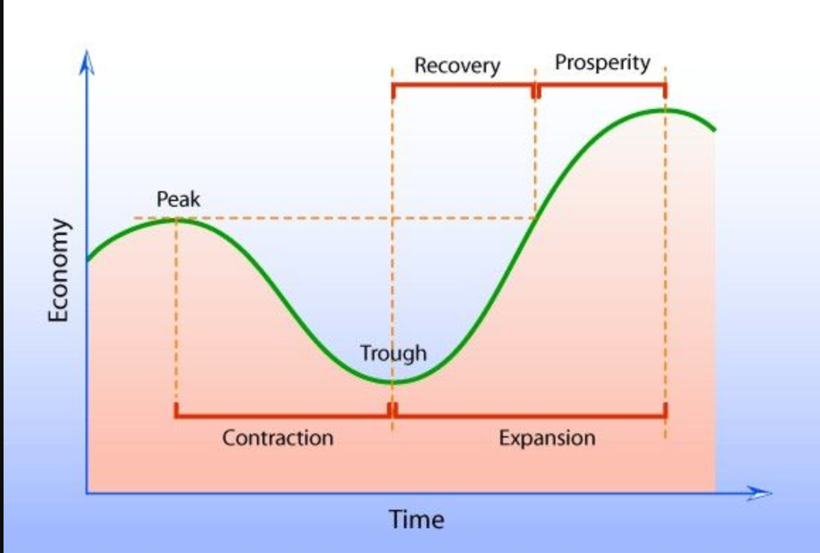
Business Cycle
Citation: https://www.pinterest.com/pin/570549846513119766/ (Seeking permission to use from Mindlever Education.)

Slide 40
Business Cycle
Business cycles are recurrent expansions and contractions that are common to large parts of the economy. The National Bureau of Economic Research (NBER)—the private organization that is the de facto arbiter of U.S. business cycle dating—defines a recession as “a significant decline in economic activity spread across the economy, lasting more than a few months, normally visible in real GDP, real income, employment, industrial production, and wholesale-retail sales.”
Philadelphia FED

Slide 41
Deficit Spending…
Deficit spending, for better or worse, is in our future.
What impact will it have on future production, employment, and prices?

Slide 42
Teaching and Learning Econ Resource Hub

Slide 43
Summative Assessment
Citation: Maier, Mark. Glendale Community College. Impact of the Federal Deficit. Retrieved from https://serc.carleton.edu/econ/tbl-econ/activities/197778.html

Slide 44
Which ending?
Notes:
Which ending most closely corresponds the U.S. economy today?
A) Keynesian (also called crowding in)
B) Crowding out
C) External debt
D) Monetizing the debt

Slide 45
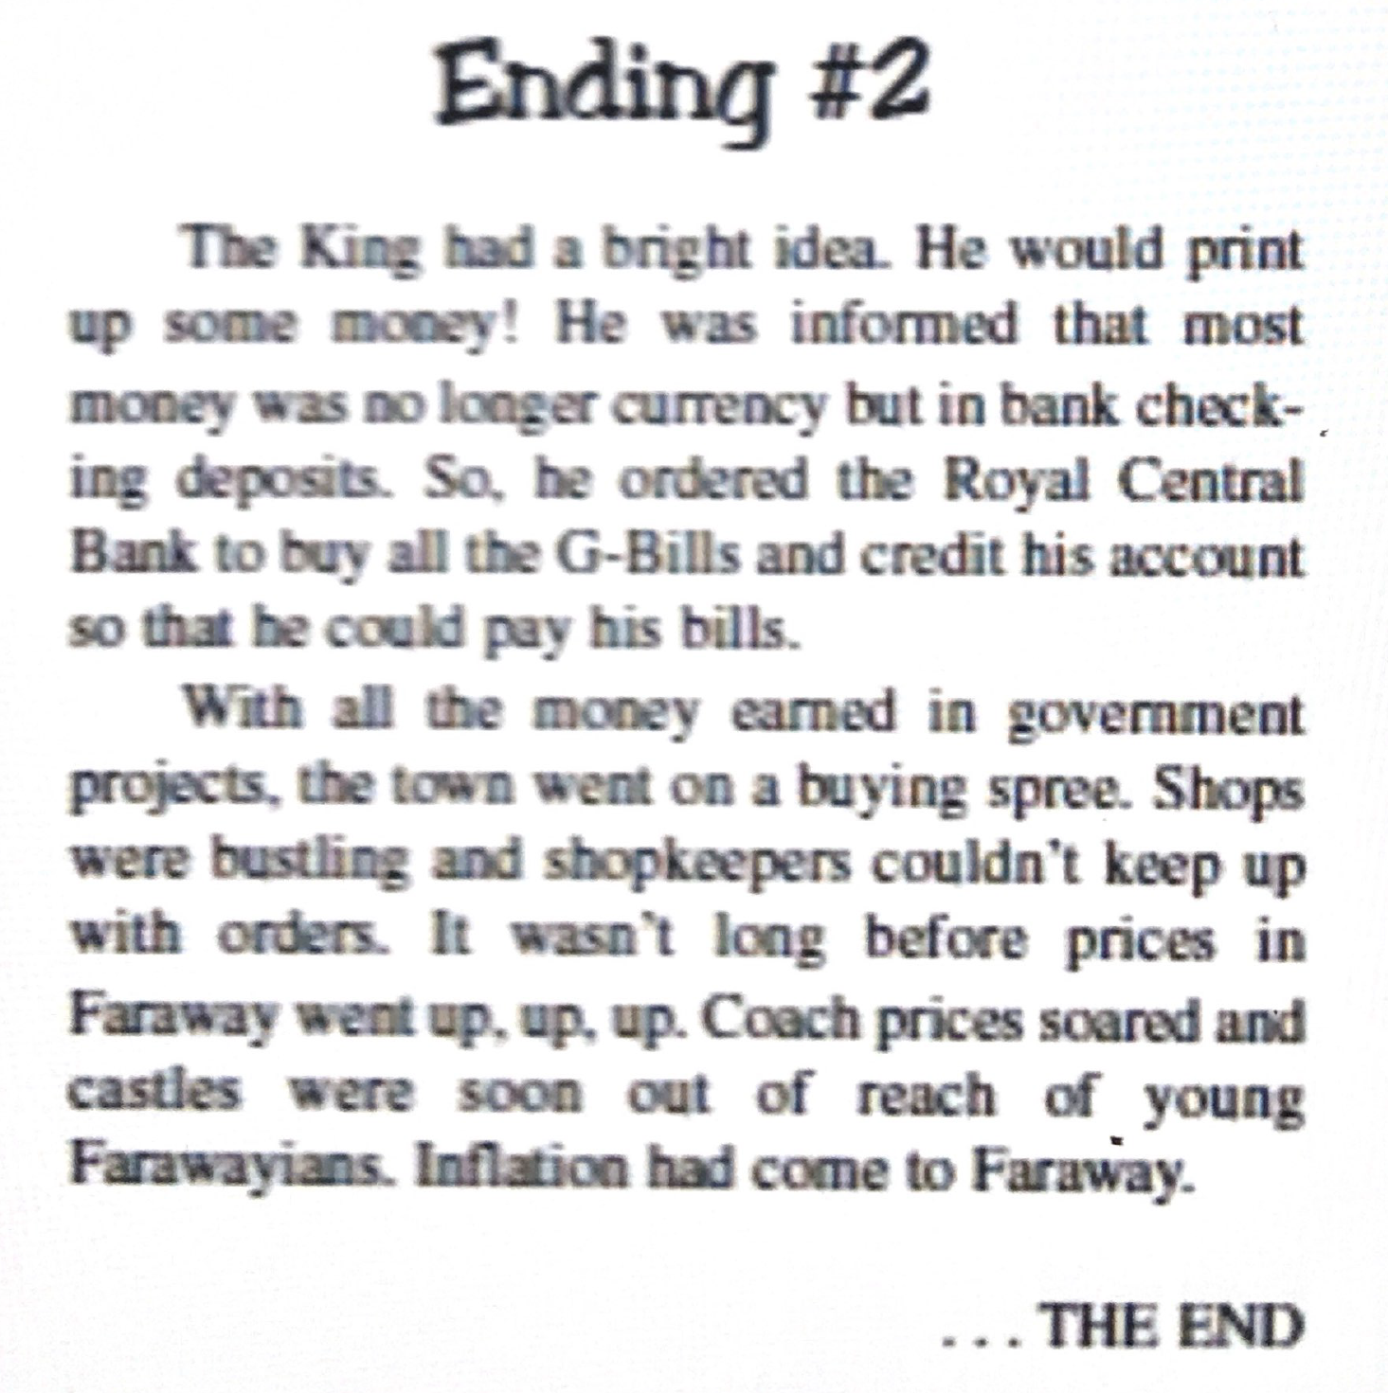
Which ending?
Notes:
Which ending most closely corresponds the U.S. economy today?
A) Keynesian (also called crowding in)
B) Crowding out
C) External debt
D) Monetizing the debt

Slide 46
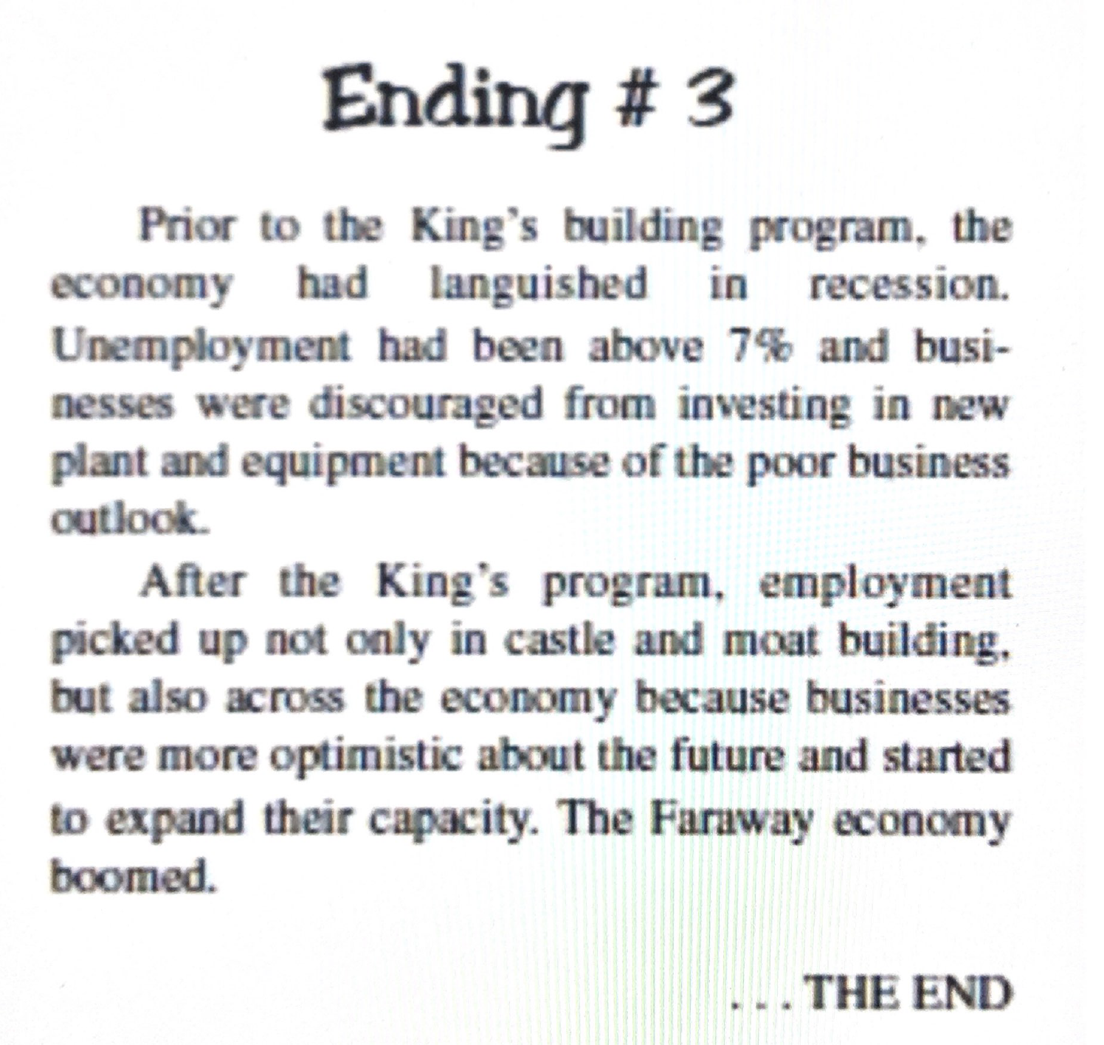
Which ending?
Notes:
Which ending most closely corresponds the U.S. economy today?
A) Keynesian (also called crowding in)
B) Crowding out
C) External debt
D) Monetizing the debt

Slide 47
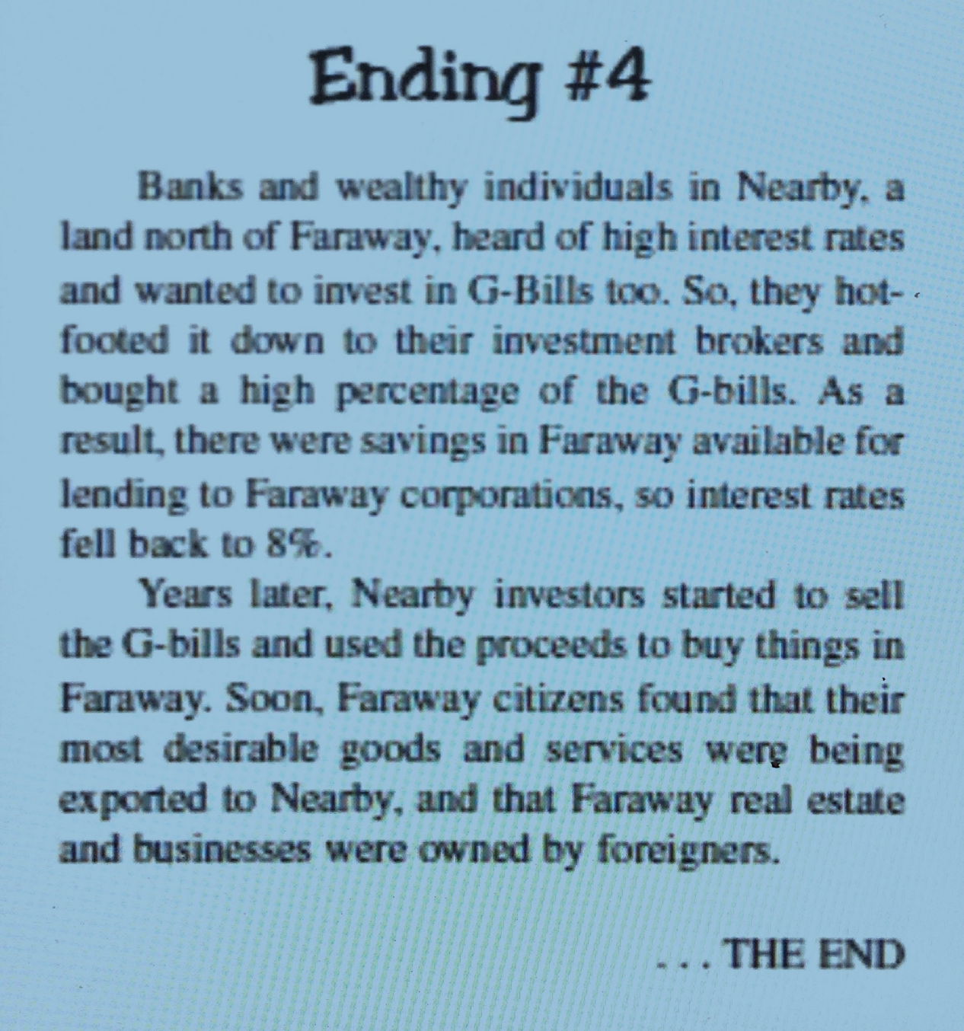
Which ending?
Notes:
Which ending most closely corresponds the U.S. economy today?
A) Keynesian (also called crowding in)
B) Crowding out
C) External debt
D) Monetizing the debt

Slide 48
References
Audio Does the Deficit Matter @ PlanetMoney (09:27)
Interactives (Virtual classroom activities, preparatory interactives, or follow-up reinforcements) H5P Deficits, surpluses, and debt** EconEdLink Resources AP Macroeconomics – The Deficit and the Debt * SERC Teaching and Learning ECON Impact of the Federal Deficit
Learning Activity Suggestions Critical Review of Podcast ** Short Essay Assignment Summarizing the Controversies on How Economic Booms and Busts Contribute to the Public Debt ** Case Study – Compare and Contrast Budget Surpluses and Budget Deficit Years
Videos Intro to Fiscal Policy @ Marginal Revolution University (03:26) ** Deficits and Debts @ Kahn Academy (07:40)
Visuals and Data FRED St. Louis, FED (Current) ** MeasuringWorth.com (Historic Data) ** Visual Capitalist US Debt: Who Owns It?
Notes:
https://www.investopedia.com/terms/b/bureau_of_public_debt.asp
https://h5p.org/
https://www.treasurydirect.gov/govt/resources/faq/faq_publicdebt.htm#DebtMakeup
https://www.pgpf.org/national-debt-clock
https://www.pewresearch.org/fact-tank/2019/07/24/facts-about-the-national-debt/

Slide 49
Wrapping Up
Covered our macroeconomics objectives
Used the most of the six online practices for good teaching applied to economics
Took a deep dive into the macroeconomic topics (budget deficit, federal debt, financing the debt, and consequences)
Provided references
Time to conclude and give thanks

Slide 50
CEE Affiliates
https://www.councilforeconed.org/resources/local-affiliates/

Slide 51
Using Active Learning Techniques to Explore the Deficit Controversies Presented by Tawni Hunt Ferrarini, PhD July28, 2020 Tferrarini@Lindenwood.edu * Tawni.org

Slide 52
Thank You to Our Sponsors!

