Slide 1
Media Perception and COVID – 19
CEE Webinar
Presented by Amanda Stiglbauer
May 19, 2020
Amanda.Stiglbauer@moore.sc.edu

Slide 2
EconEdLink Membership
You can now access CEE’s professional development webinars directly on EconEdLink.org! To receive these new professional development benefits, become an EconEdLink member. As a member, you will now be able to:
Automatically receive a professional development certificate via e-mail within 24 hours after viewing any webinar for a minimum of 45 minutes
Register for upcoming webinars with a simple one-click process
Easily download presentations, lesson plan materials, and activities for each webinar
Search and view all webinars at your convenience
Save webinars to your EconEdLink dashboard for easy access to the event
You may access our new Professional Development page here

Slide 3
Professional Development Certificate
To earn your professional development certificate for this webinar, you must:
Watch a minimum of 45-minutes and you will automatically receive a professional development certificate via e-mail within 24 hours.
Accessing resources:
You can now easily download presentations, lesson plan materials, and activities for each webinar from EconEdLink.org/professional-development/

Slide 4
Agenda
Social Media Polls & Data
Where do students get their news?
Ways to detect fake news
Finding balanced news – All Sides
Conspiracy Theories & COVID – 19
  EdPuzzle from Trevor Noah’s the Daily Show
Time to Climb
Rhetoric & COVID – 19

Slide 5

Objectives
I can:
Learn tools for detecting media bias and fake news.
Evaluate the pros and cons of controversial issues rather than becoming distracted by rhetorical technique or political spin.

Slide 6
National Standards
Standard 2: Decision Making
Effective decision making requires comparing the additional costs of alternatives with the additional benefits. Many choices involve doing a little more or a little less of something: few choices are “all or nothing” decisions.

Slide 7
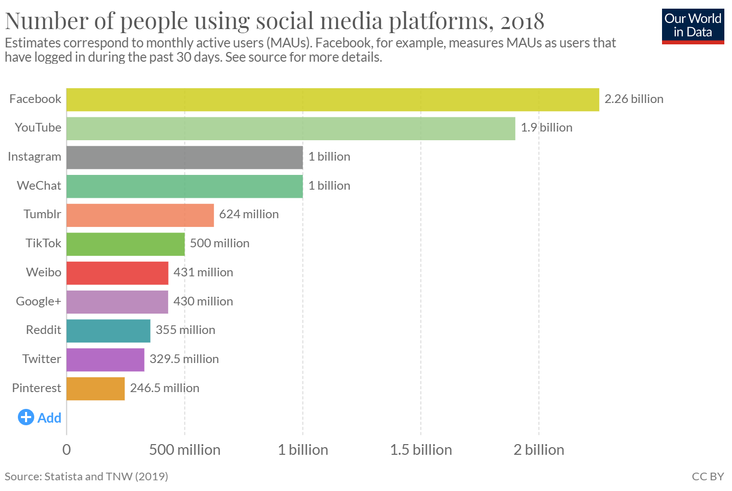

Slide 8
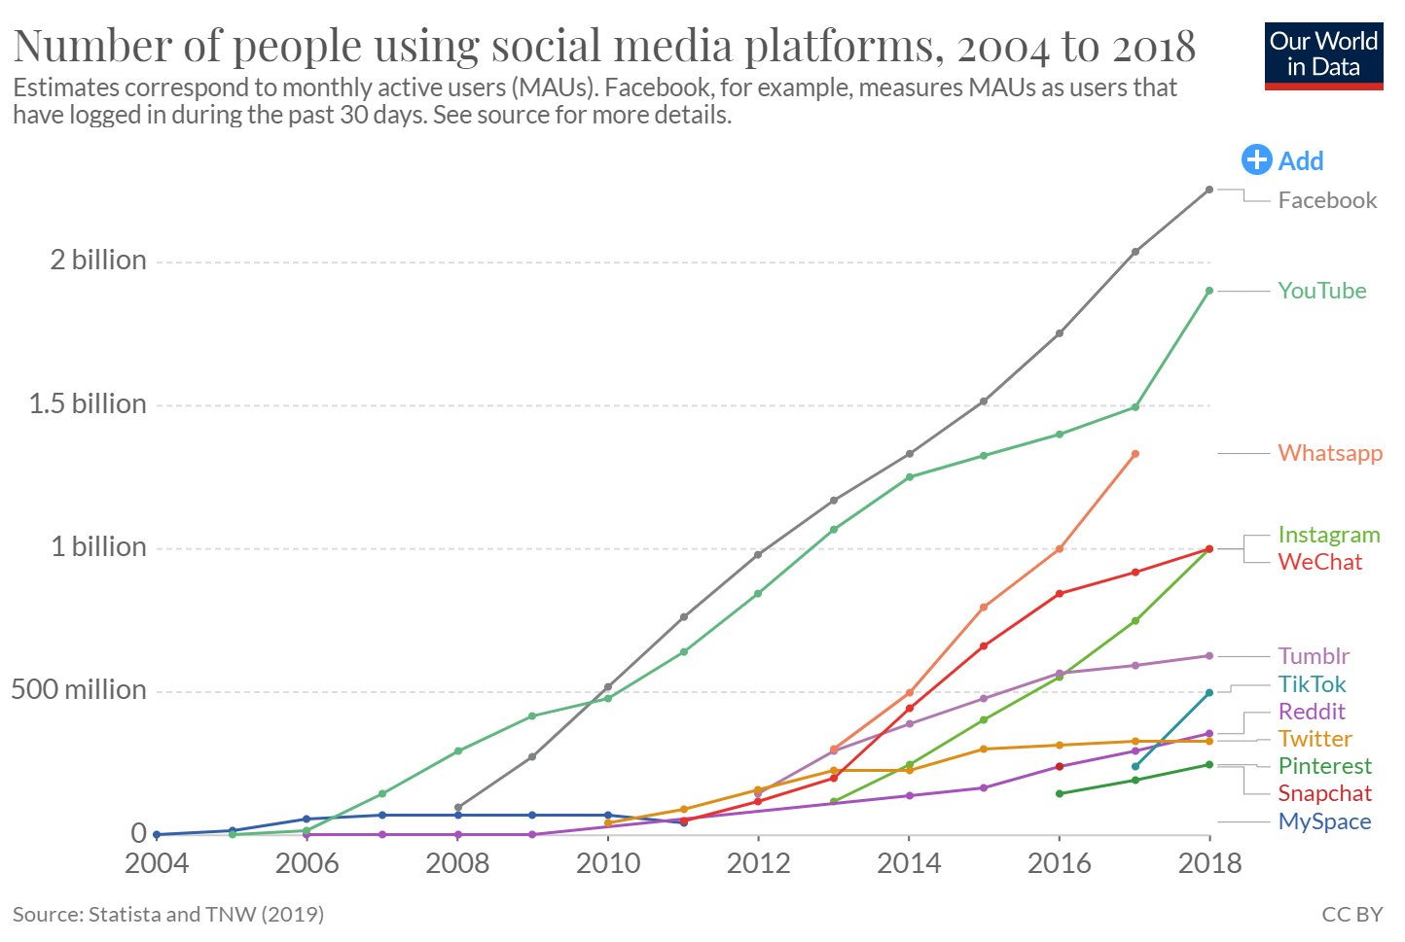

Slide 9
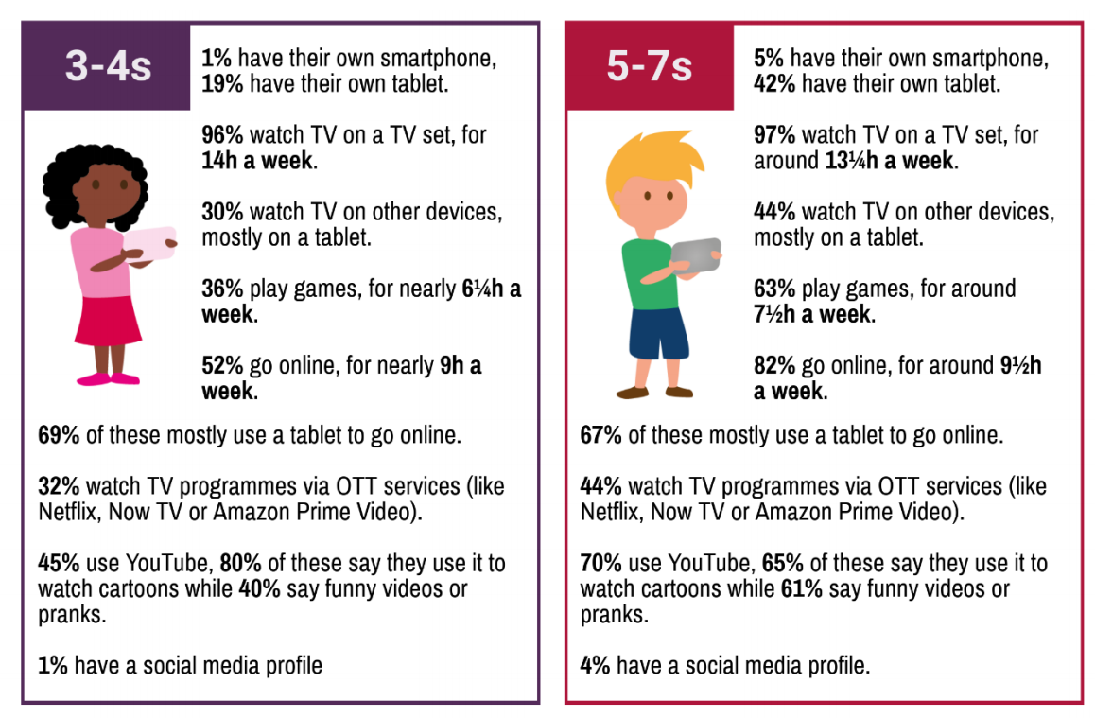

Slide 10
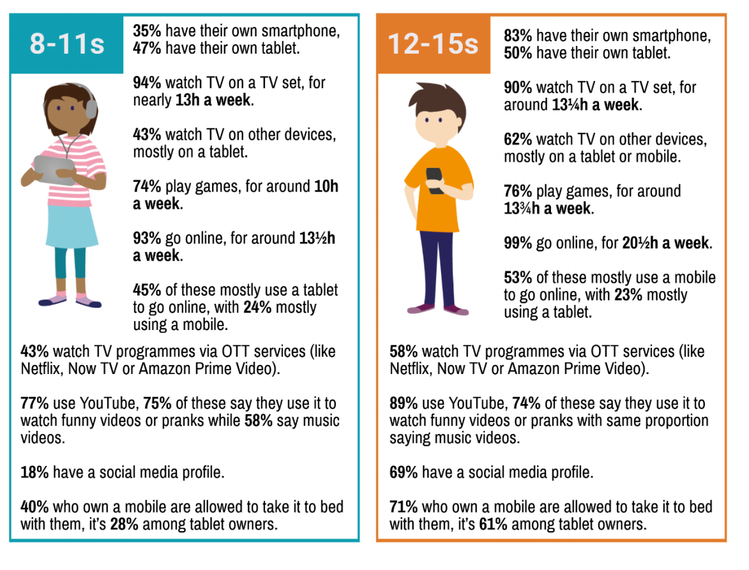

Slide 11
Where do today’s teens get their news?
More than 50% get news from social media platforms at least 3 times per week.
½ get their news from YouTube
6/10 - celebrities, social media influencers & personalities
More confident of news they get from actual news outlets
Two great references!
https://www.eschoolnews.com/2019/09/09/where-do-todays-teens-get-their-news/
https://www.commonsensemedia.org/about-us/news/press-releases/new-survey-reveals-teens-get-their-news-from-social-media-and-youtube

Slide 12


Slide 13

Social Media Claims
Twitter, Facebook, Instagram, etc. are filled with individuals and groups seeking to further their agendas.
Students need to be able to weigh the strengths and weaknesses of a tweet or post. This all starts with considering the source…

Slide 14
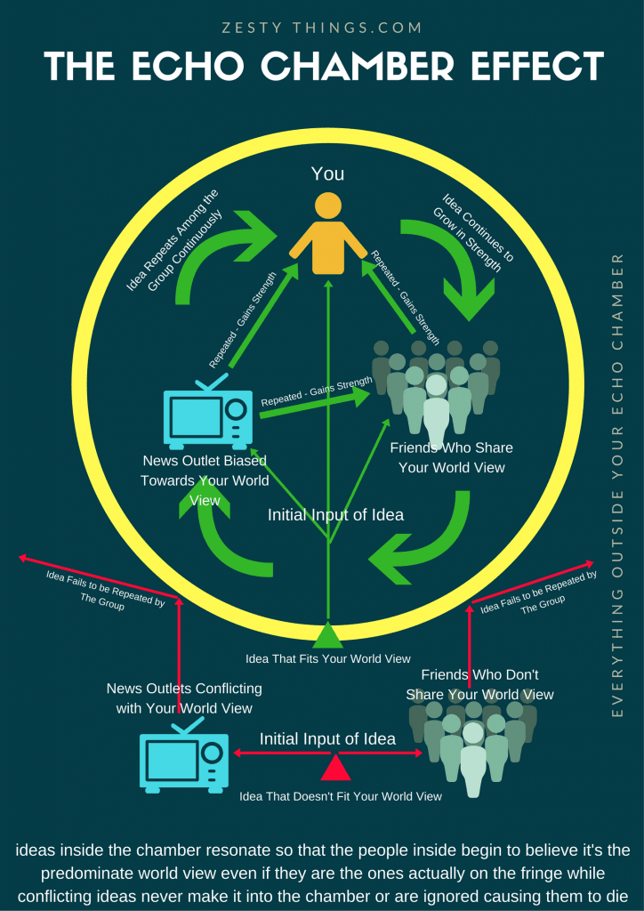
What is an echo chamber?

Slide 15
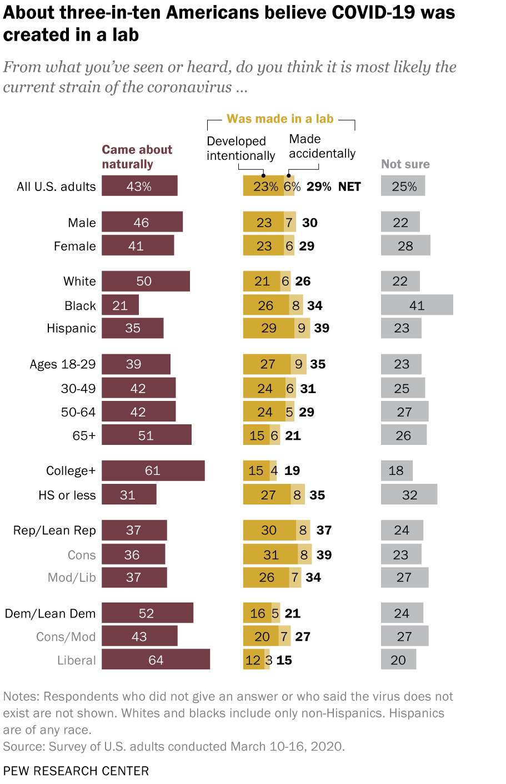
Notices and Wonders
Why do 3 in 10 Americans believe Coronavirus was created in a lab?

Slide 16
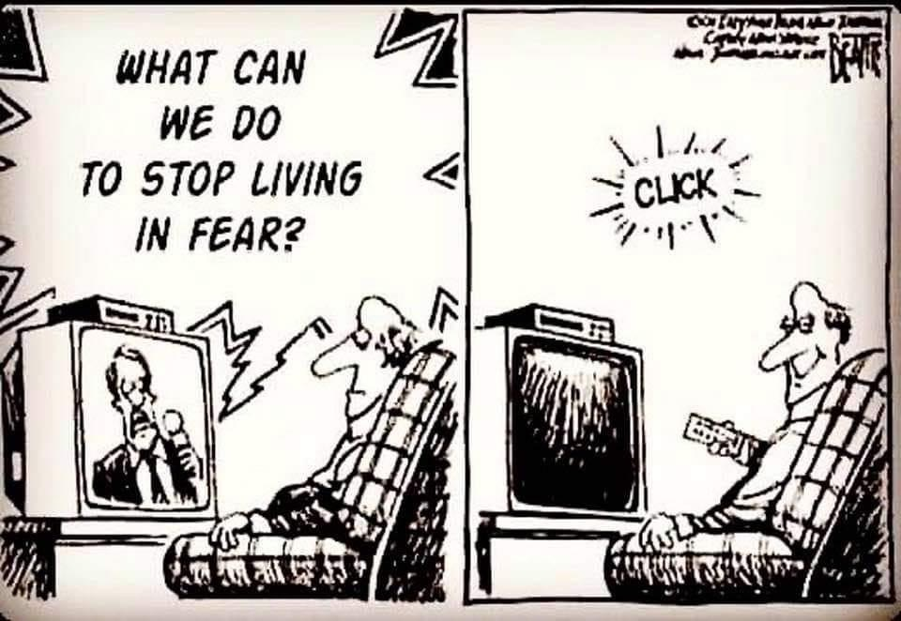

Slide 17
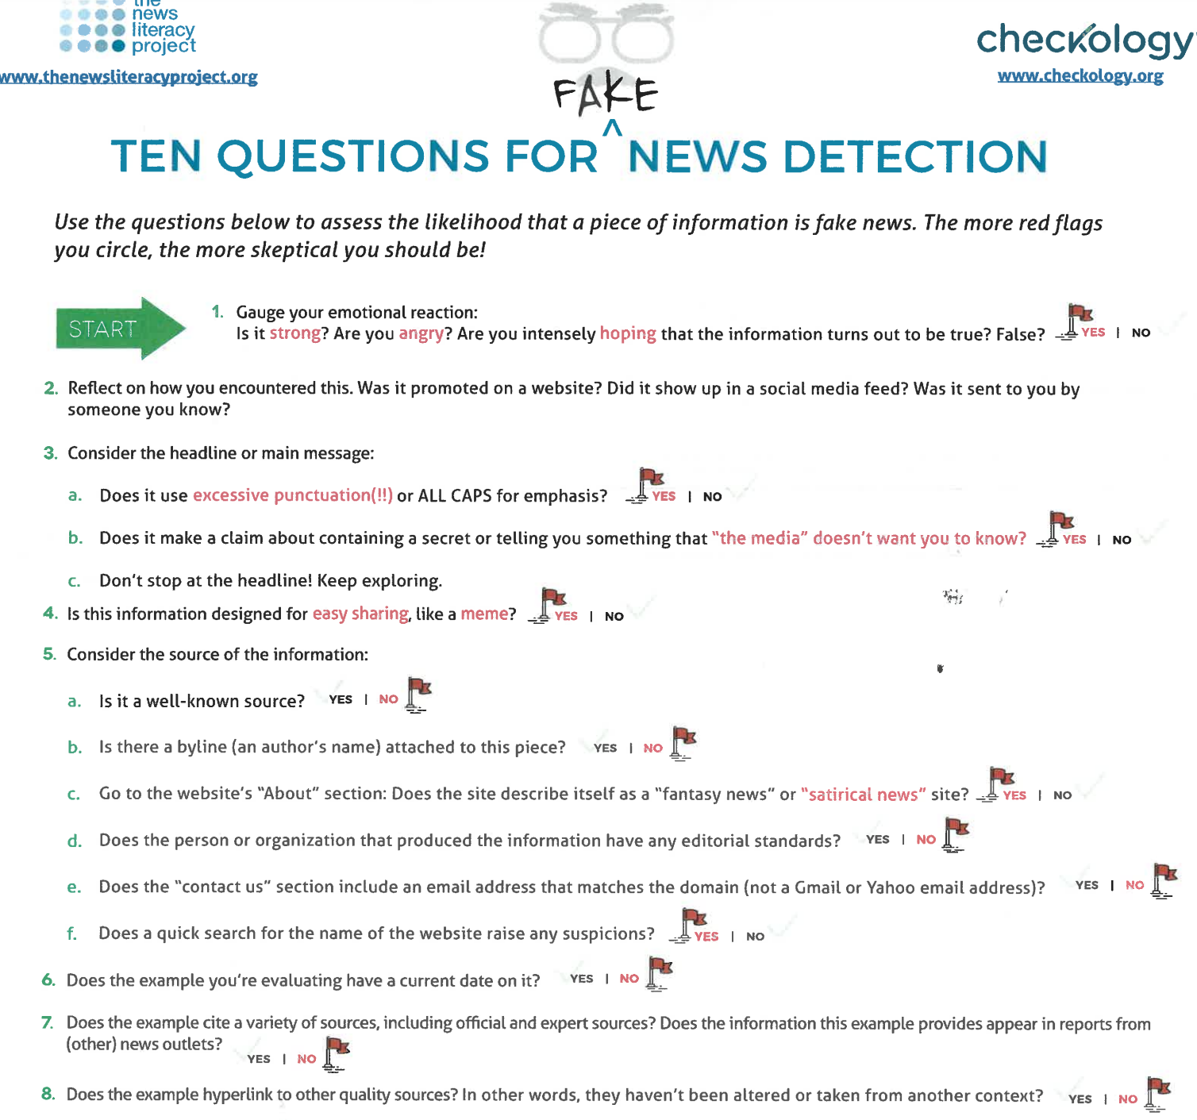
https://www.courts.ca.gov/documents/BTB24-PreCon2G-3.pdf

Slide 18
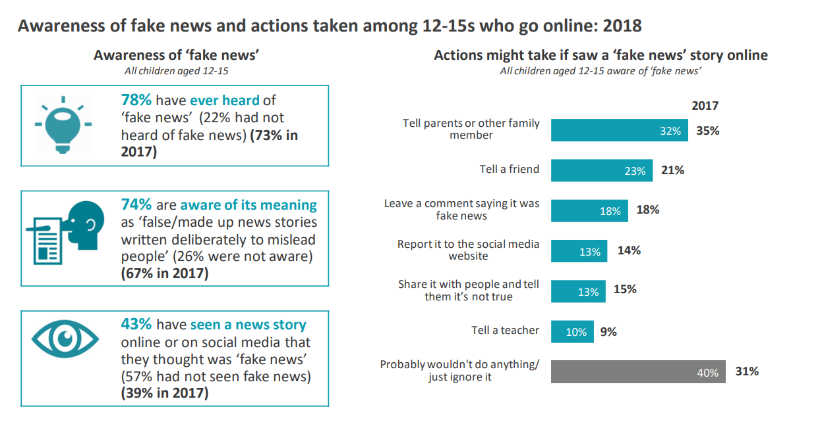

Slide 19
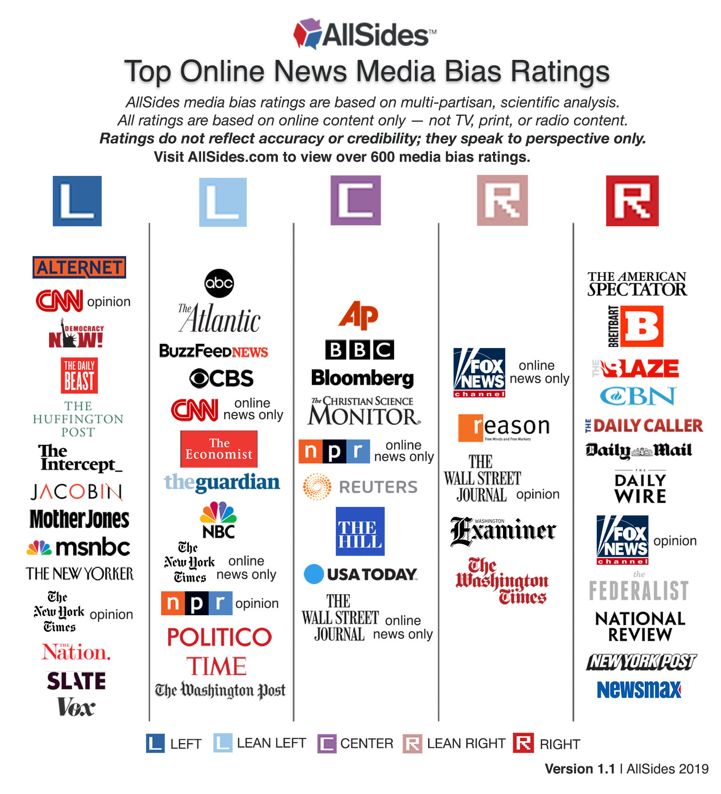

Slide 20
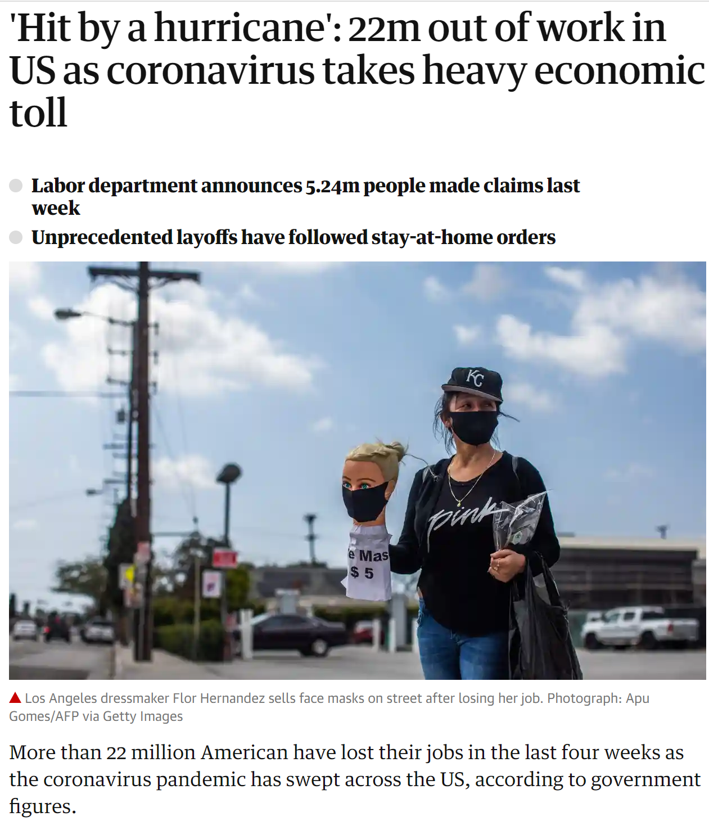
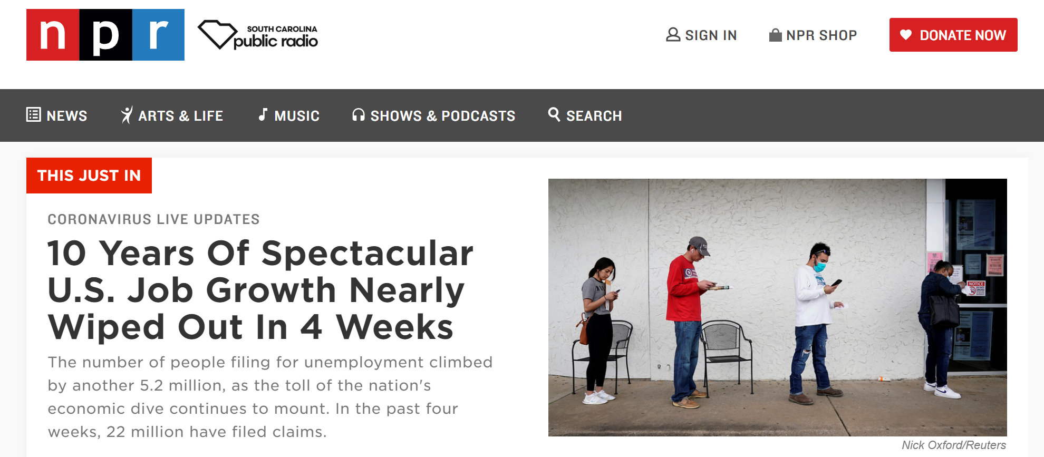
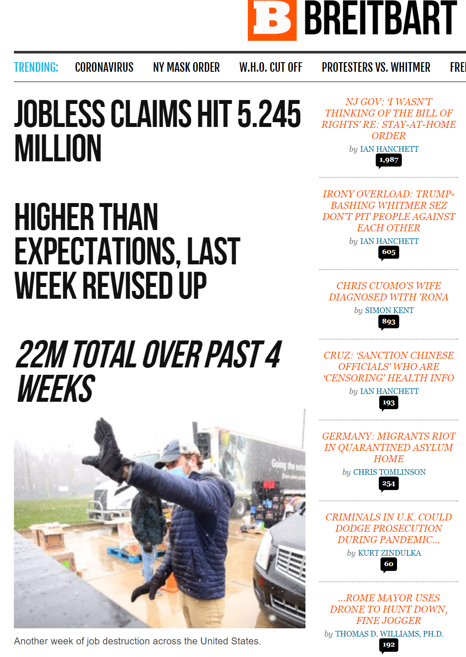
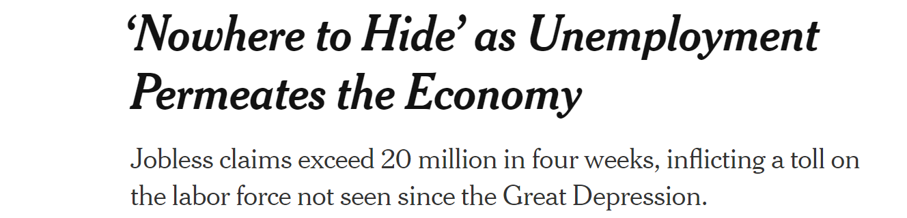
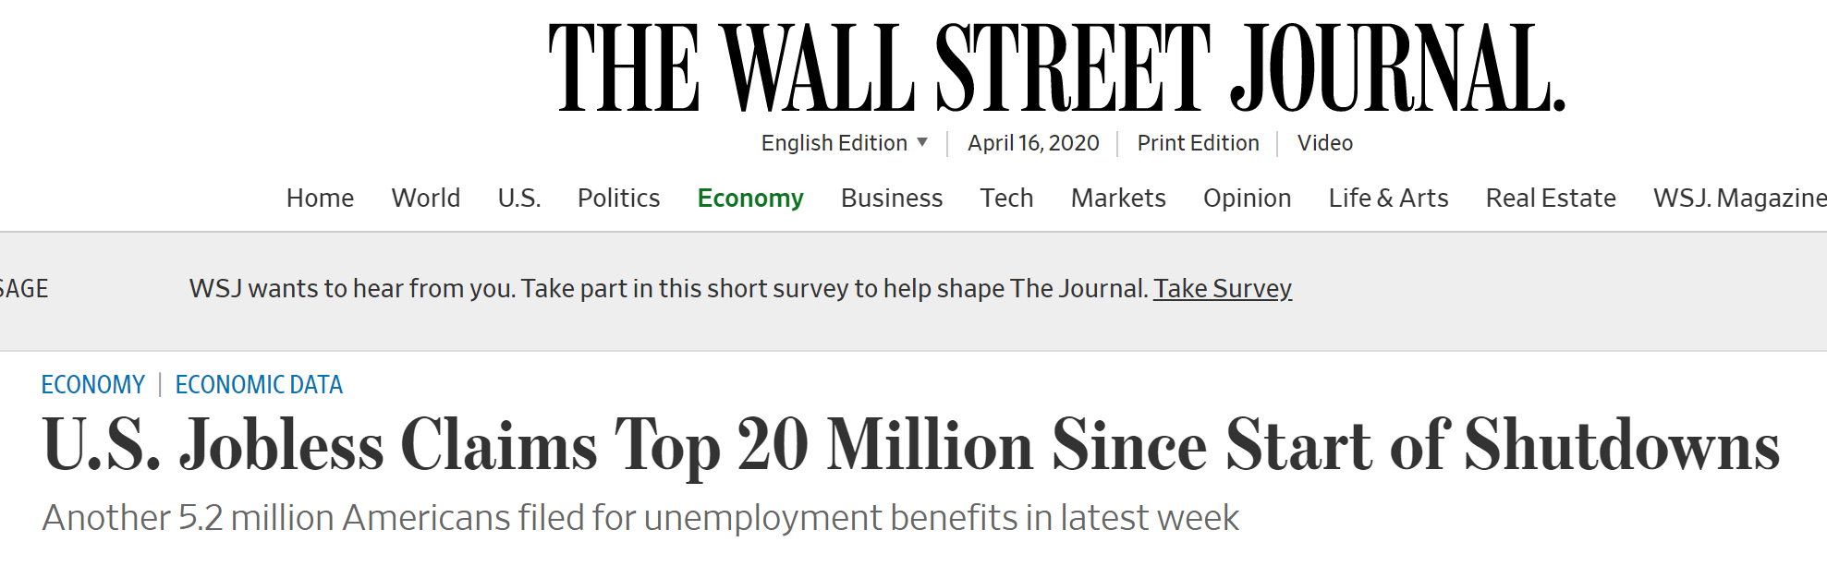
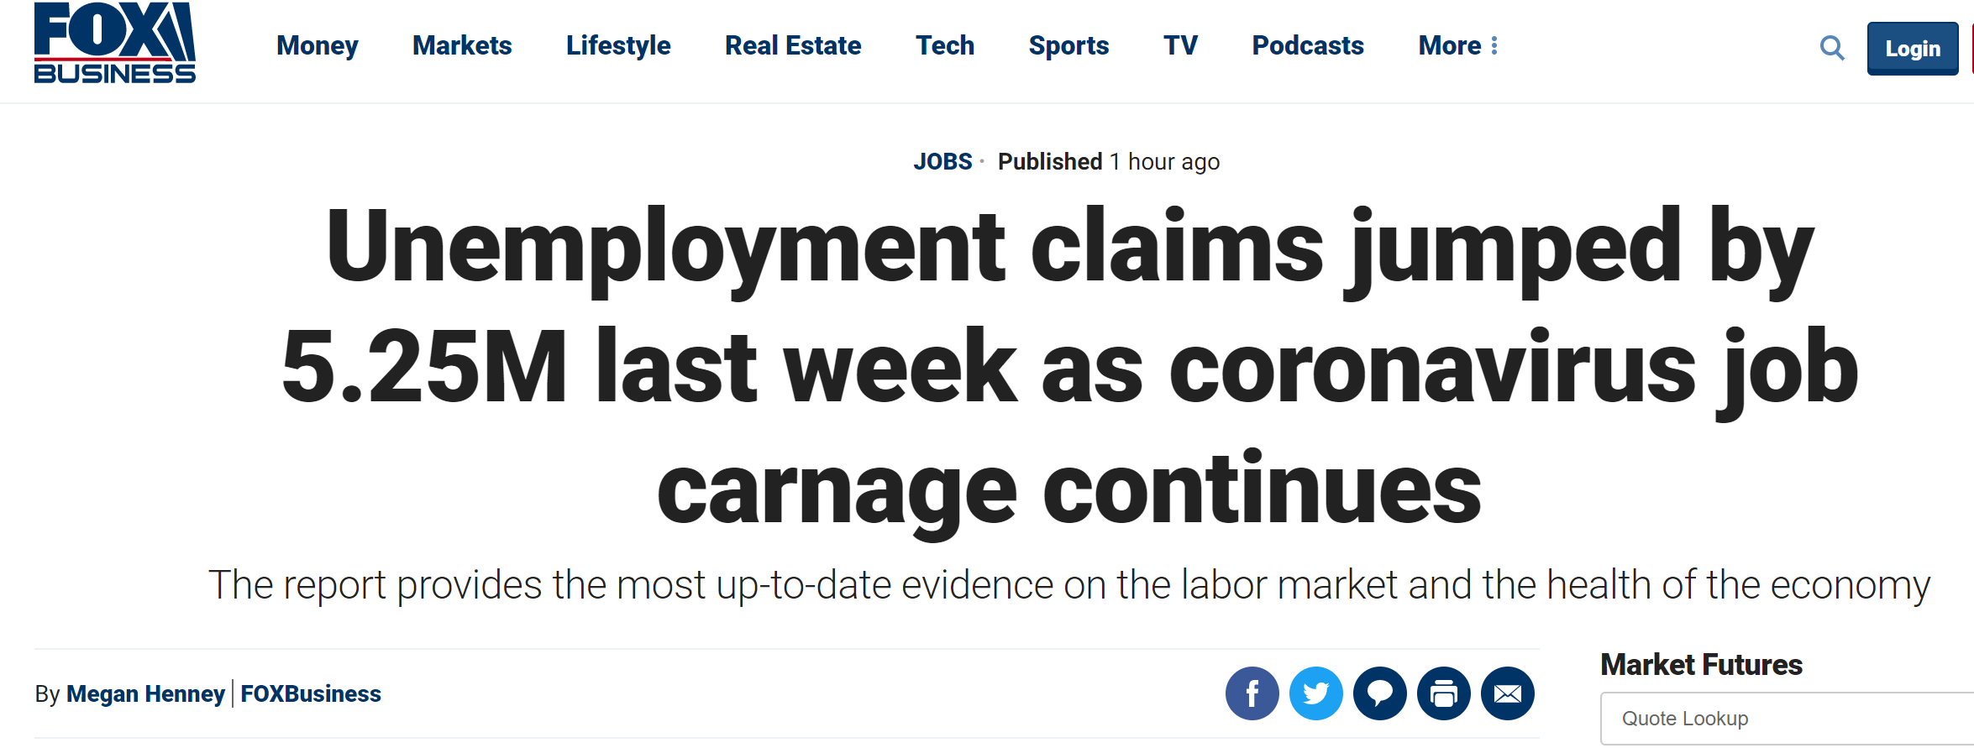

Slide 21
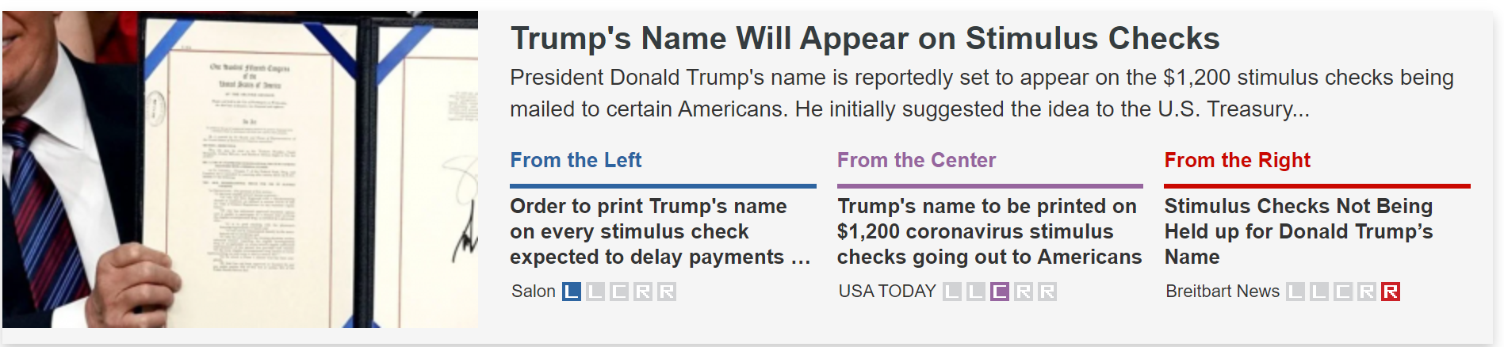
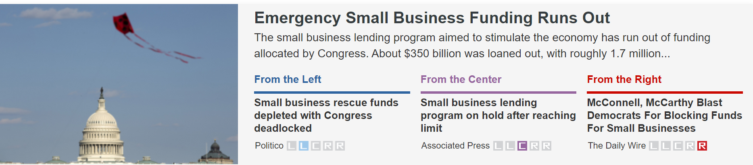
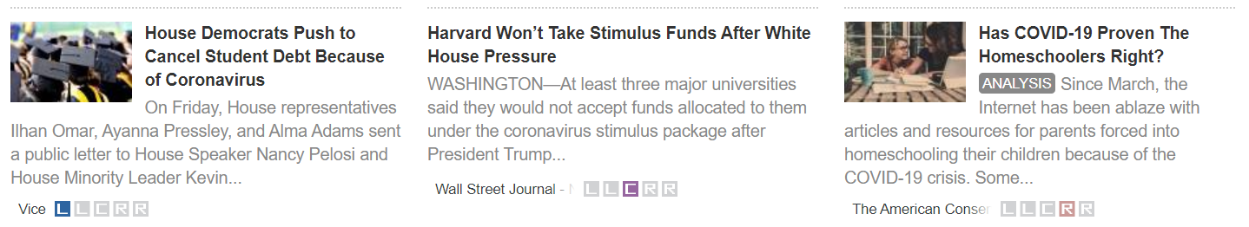

Slide 22
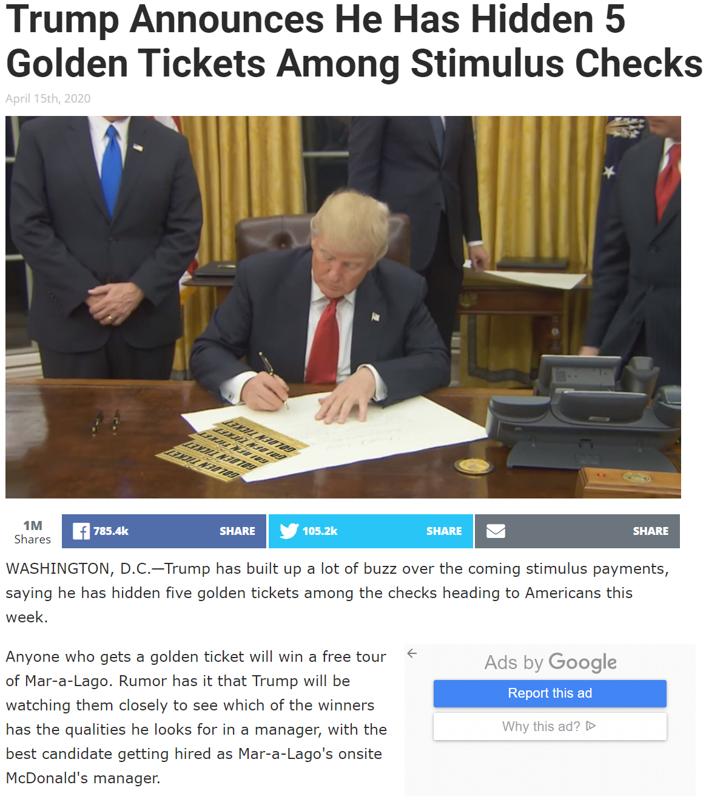

https://babylonbee.com/news/trumps-says-5-golden-tickets-to-be-hidden-among-stimulus-checks

Slide 23

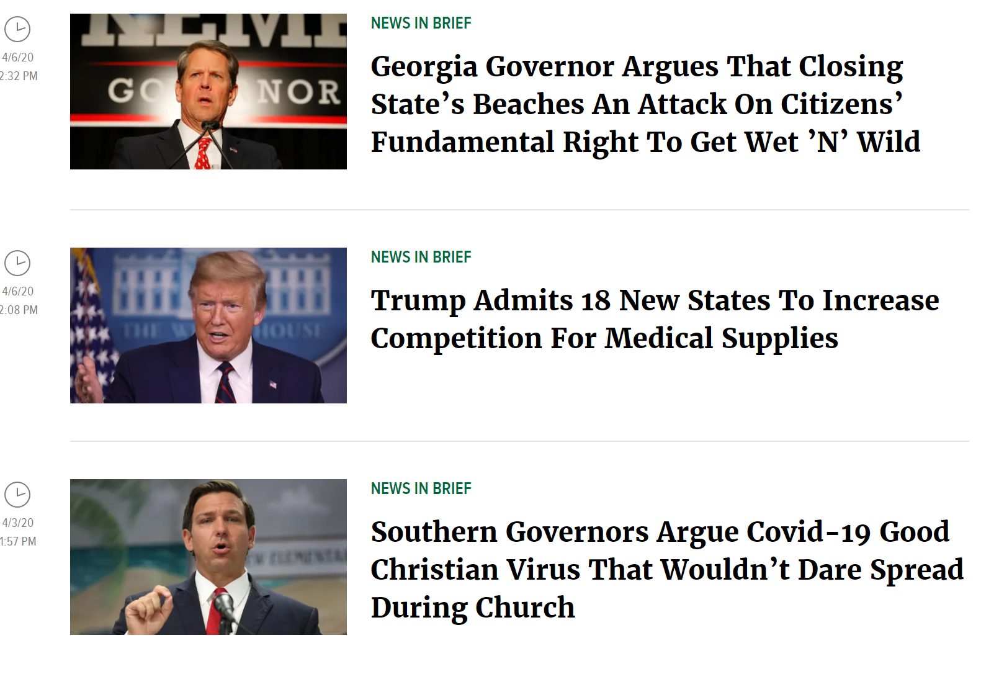

Slide 24
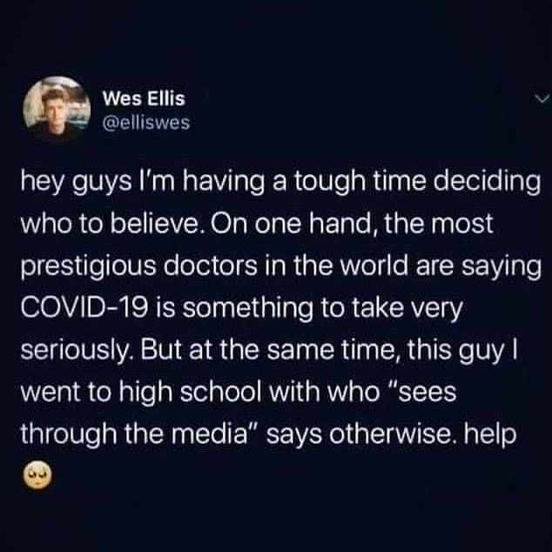

Slide 25
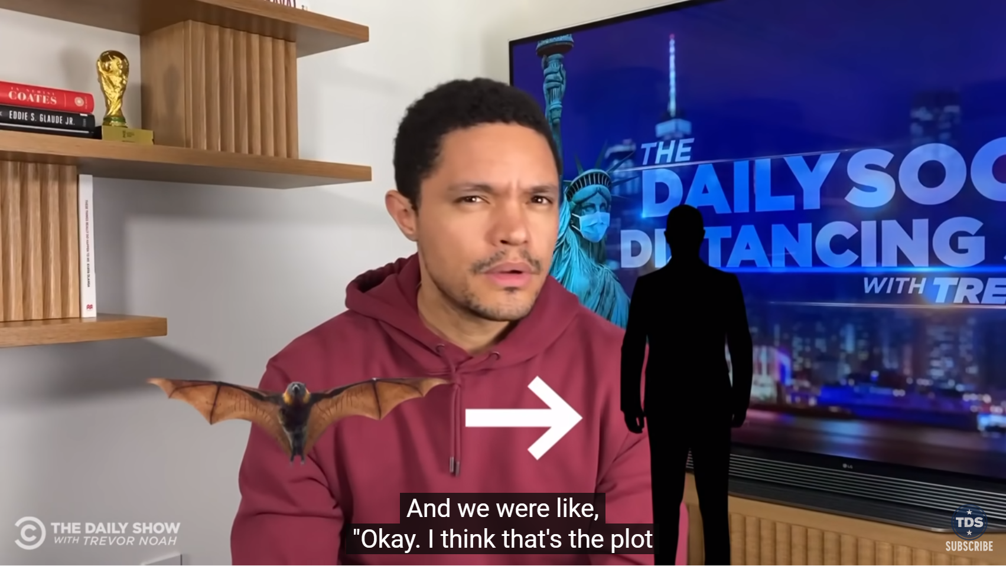
Conspiracy Theories

Slide 26
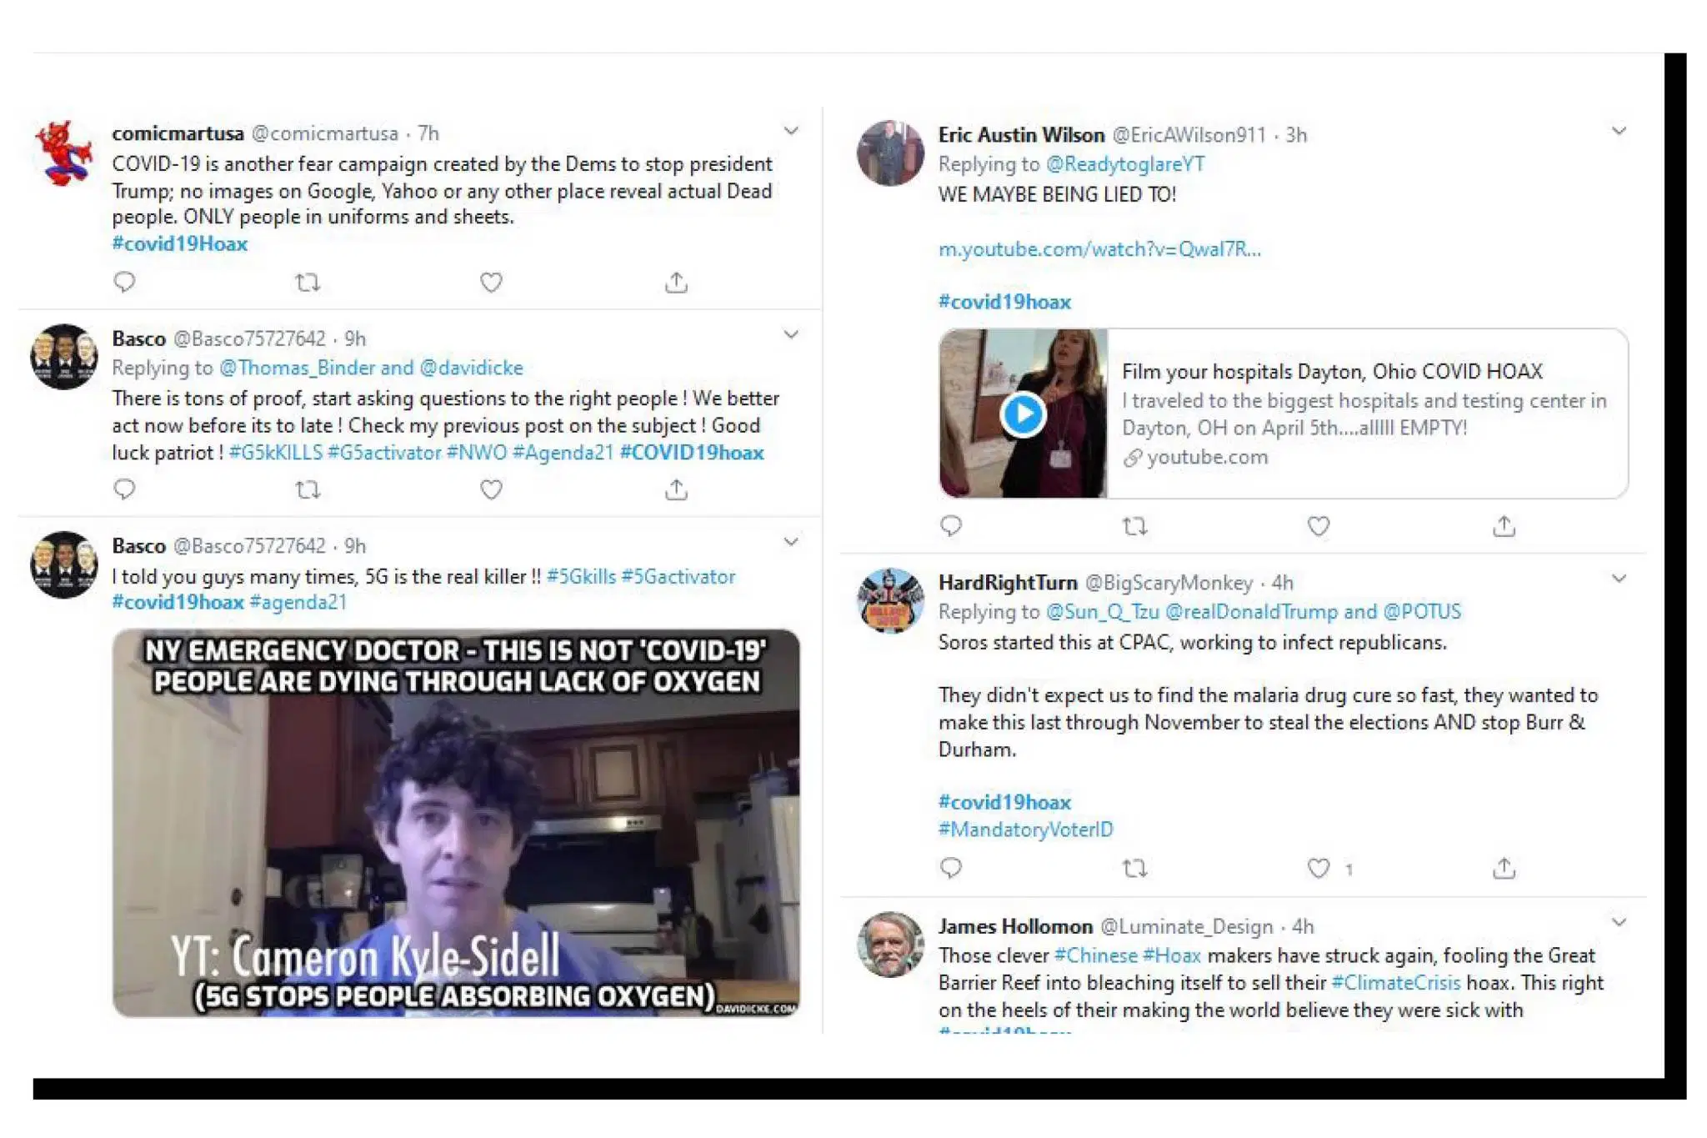

Slide 27
Rhetoric: noun
The art of using language effectively so as to persuade or influence others, especially the exploration of figures of speech and other compositional techniques to this end.
Is rhetoric good or bad?

Slide 28
Rhetoric in “I Have a Dream”
Minus the Rhetoric
Dr. Martin Luther King Jr.’s
“I Have a Dream Speech”
“I have a dream that my four little children will one day live in a nation where they will not be judged by the color of their skin but by the content of their character.”
I hope that in the future my heirs will not be judged by their racial identity but by criteria common to all Americans.

Slide 29
Rhetoric
It is a politician's job to convince other people of his or her ideas.
To get elected
To get support from his/her peers
To explain the rationale behind his/her decision
Rhetoric often communicates a level of meaning that a simple statement cannot.

Slide 30
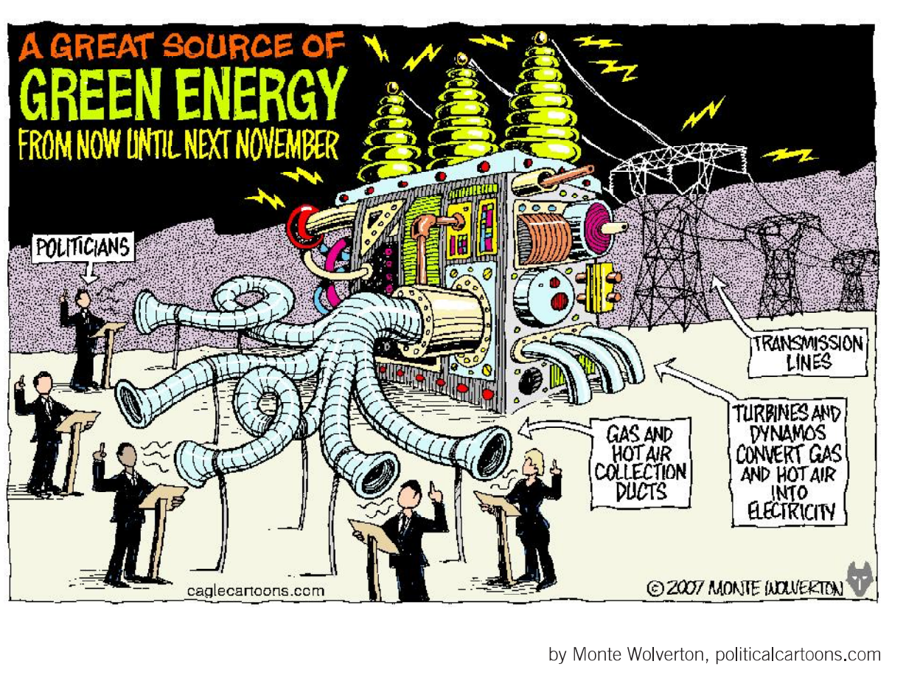

Slide 31
Coronavirus Rhetoric
“The availability of credit gave us an opportunity with a great hangover. It made nice homes, flashy cars, and expensive consumer products within reach for earners across income levels.” The Hill
But White House press secretary Stephanie Grisham sought to clarify when one report said he was seeking to cut entitlements. “Fake news — POTUS was talking about cutting deficits, NOT entitlements,” Grisham tweeted. Market Watch
““I’m doing everything I can not to contract debts, because just imagine we get the country into debt,” he said on Saturday. “No.”......That’s the core of his debt phobia,” he said. “The debt was so as not to change anything.” and “To Andres Manuel, contracting debt means ceding sovereignty,” Ortega said. Reuters

Slide 32
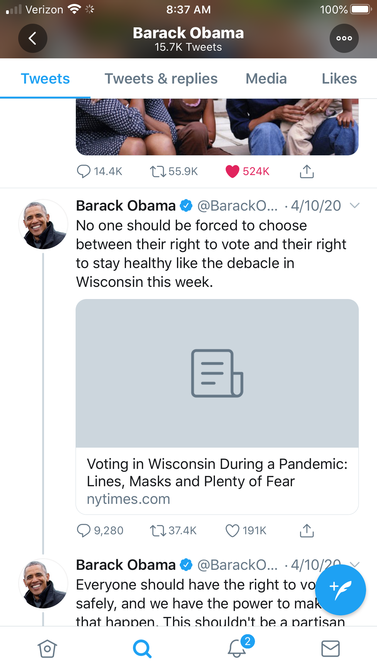
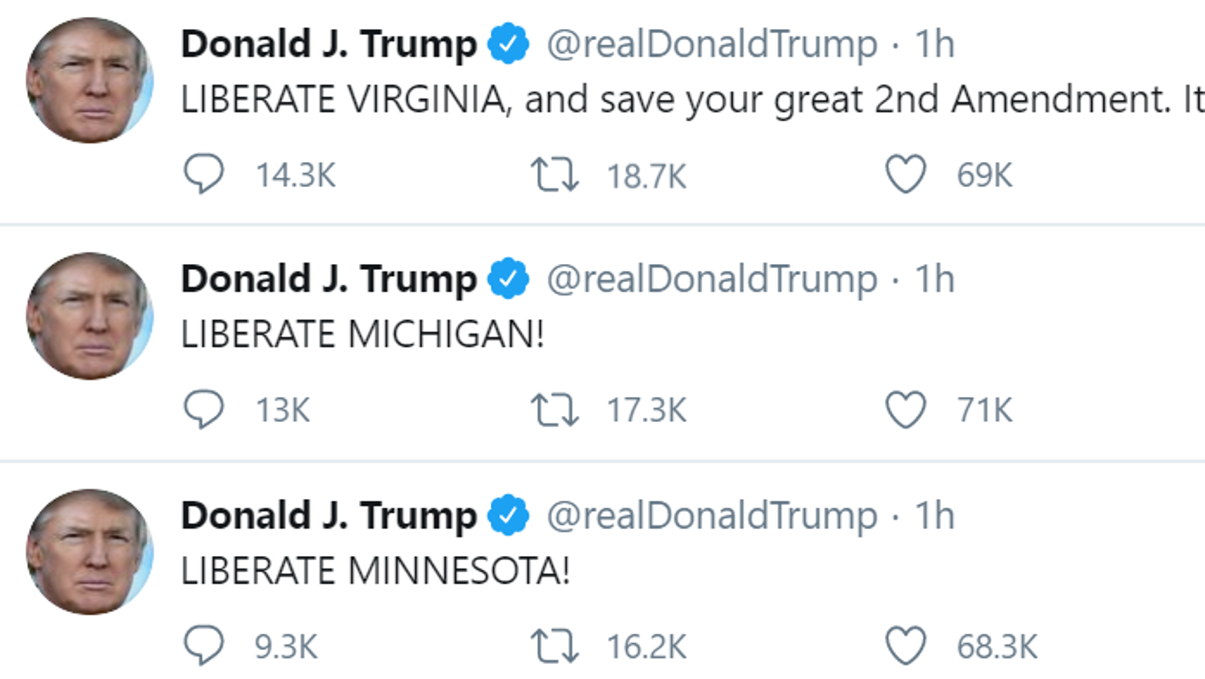
Rhetoric from Both Sides

Slide 33
Assessment Questions
An environment in which a person encounters only beliefs or opinions that coincide with their own is known as...
According to All Sides, which news sources are considered moderate/central?
What are some of the popular conspiracy theories related to COVID-19?
Is rhetoric good or bad? Provide examples to support your claim.
How can we help students identify fake news and rhetoric?

Slide 34
Conspiracy Theories
Pew Research https://www.pewresearch.org/fact-tank/2020/04/08/nearly-three-in-ten-americans-believe-covid-19-was-made-in-a-lab/
Pew Research quoted on Journalism.org : https://www.journalism.org/2020/04/01/cable-tv-and-covid-19-how-americans-perceive-the-outbreak-and-view-media-coverage-differ-by-main-news-source/
CNN 30% https://www.cnn.com/2020/04/13/us/coronavirus-made-in-lab-poll-trnd/index.html

Slide 35
Rhetoric Sources
Trump Rhetoric
https://www.cnn.com/2020/03/19/politics/donald-trump-coronavirus-rhetoric/index.html
Media Rhetoric https://www.foxnews.com/politics/from-new-york-to-canada-to-the-white-house-initial-coronavirus-responses-havent-aged-well

Slide 36

CEE Affiliates
https://www.councilforeconed.org/resources/local-affiliates/

