Slide 1

Presentation 1:
Venture Capital

Slide 2


Introduction
Kaitlyn Henry
Investor at OpenView, a venture capital firm in downtown Boston.

Slide 3
What is venture capital?
Venture capital is a type of private equity capital where money is exchanged for ownership in a company.
Typically it is provided by outside investors (called venture capitalists) to new startups that promise to grow fast.
Venture capital investments are usually high risk, but offer the potential for above-average returns.

Slide 4
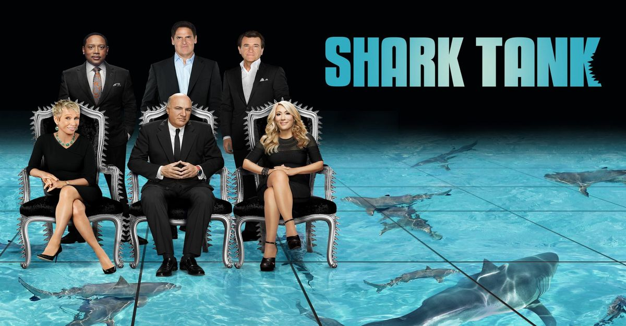
In other words…

Slide 5
What do venture capitalists (VCs) do all day?
A VC is responsible for evaluating startups and deciding if the venture capital firm should make an investment.
The process is simple, but requires a lot of research:
  Startups will share information about their business with the VC, usually in a pitch presentation and financial documents.
  The VC then needs to do their own research on the company to determine if the company is likely to grow quickly and would be a good investment.
  If the VC decides that they want to make the investment, the VC and the startup need to agree on how much money the VC will pay for a certain percent ownership of the company. This is called setting the price of the round.

Slide 6
How do venture capitalists make money?
When venture capitalists make an investment, they pay the owner of the business money in exchange for a percentage of their business.
If the company’s value increases after the venture capital investment is made, then the value of the venture capitalist’s shares increase.
  For example, if I invest $200,000 in a business that is valued at $1M today, I own 20% of the company.
  If that business grows and gets valued at $2M next year, my 20% stake (which I paid $200,000 to get) is worth $400,000. I made a 2X return.

Slide 7
Questions?
Notes:
https://www.youtube.com/watch?v=5iKitGJeAZ4&t=100s

Slide 8
What do VCs care about when evaluating an investment?
Market Size
Customer Profile
Value Proposition
Economic Model and Momentum
Go To Market Model
CEO & Team
Deal Dynamics
Exit Landscape
Defensible Competitive Advantage
Notes:
Reduce this to Customer Profile, Value Proposition, Market Size, DCA
Come up with 4 questions and my answers

Slide 9
Let’s evaluate an investment!
Notes:
https://www.youtube.com/watch?v=5iKitGJeAZ4&t=100s

Slide 10
Value Proposition
What is the customer’s problem today? How does the company’s product solve their problem?
Why is this a problem worth solving? How big of a priority is this for the customer?

Slide 11
What is Brightwheel’s main value proposition?
Give parents more information about what their kids are learning at preschool.
Make preschool more fun for kids.
Make it easier for preschool teachers to keep track of what kids are doing.
A and C

Slide 12
What is Brightwheel’s main value proposition?
Give parents more information about what their kids are learning at preschool.
Make preschool more fun for kids.
Make it easier for preschool teachers to keep track of what kids are doing.
A and C

Slide 13
Customer Profile & Market Size
Customer Profile: Who is the user and buyer of the product?
  What demographic does the customer belong to? What characteristics are most important to consider?
  Age? Gender? Geography? Income? What other ones can you think of?
Market Size: How many of these potential customers exist? If you sell to all of them, how big could the business get?
  (Price) X (# of addressable customers)?

Slide 14
Who is the buyer of Brightwheel?
Parents
Preschool teachers & administrators
Kids
None of the above

Slide 15
Who is the buyer of Brightwheel?
Parents
Preschool teachers & administrators
Kids
None of the above

Slide 16
Defensible Competitive Advantage
What is unique about the company or product?
What about their product or business would be hard to replicate?
  Does the company have a patent? Was the product built by an expert? Strong brand?
Are there other products like this out on the market (direct competitors)?
Are there other ways to solve this problem today with a totally different product or solution (indirect competitors)?

Slide 17
Which of these would be considered an indirect competitor to Brightwheel?
Another app with the same features as Brightwheel
Report cards
Having teachers text parents what their kids did at school today

Slide 18
Which of these would be considered an indirect competitor to Brightwheel?
Another app with the same features as Brightwheel
Report cards
Having teachers text parents what their kids did at school today

Slide 19
Go-to-Market Model
How do they make money?
  Direct sale, marketplace, advertising revenue, etc.
How much money do they spend on marketing or sales to acquire a customer? How many units will the customer need to buy in order for the company to make that money back?
What are the unit economics? What does it cost to make the product? How much do they sell it for?

Slide 20
How does Brightwheel make money?
They don’t have a way to make money today
Direct sale (selling subscription to preschool teachers & administrators)
Advertising revenue (from brands advertising to teachers and parents)

Slide 21
How does Brightwheel make money?
They don’t have a way to make money today
Direct sale (selling subscription to preschool teachers & administrators)
Advertising revenue (from brands advertising to teachers and parents)

Slide 22
Would you invest in Brightwheel?
Notes:
https://www.youtube.com/watch?v=5iKitGJeAZ4&t=100s

Slide 23
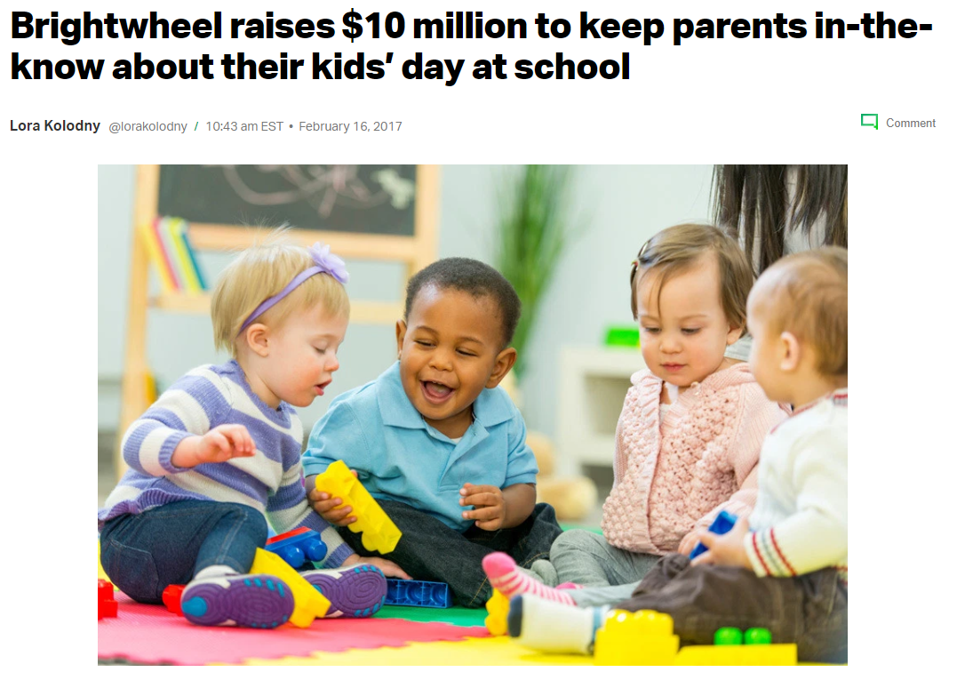
They said yes!
“Brightwheel’s basic value is universal. Everyone cares about their kids! And they’re going to small and medium sized daycares with a tool that can help them deliver better service to their customers, the parents. They’re going after a huge market relatively untouched by software. ”
- Jeff Richards, Venture Capitalist (Investor in Brightwheel)
Notes:
https://www.youtube.com/watch?v=5iKitGJeAZ4&t=100s

Slide 24
Q&A
Notes:
https://www.youtube.com/watch?v=5iKitGJeAZ4&t=100s

