Slide 1
COVID-19 Impact on Global Trade
April 20, 2020
Nino Kvaraia

Slide 2
Agenda
Introduction to Customs and International Trade
Impact of COVID-19 on International Trade
Changes in the Consumer Pricing
Prediction for the Future
Best/Worst Case Scenarios
Notes:
https://www.youtube.com/watch?v=Tzjn-v99fZw

Slide 3
Impact of Covid-19 on Global Trade

Slide 4
Customs & International Trade amidst the Pandemic
Customs-related expenses can be a significant operating cost for companies that import products into the United States and other parts of the world.
Due to the ongoing pandemic, the United States now permits the deferral of tariffs for 90 days on imported goods.
The European Union imposed EU-wide export restrictions with respect to some personal medical protective equipment — e.g., gloves, face shields, and protective garments — in an effort to keep sufficient supplies within the EU.

Slide 5
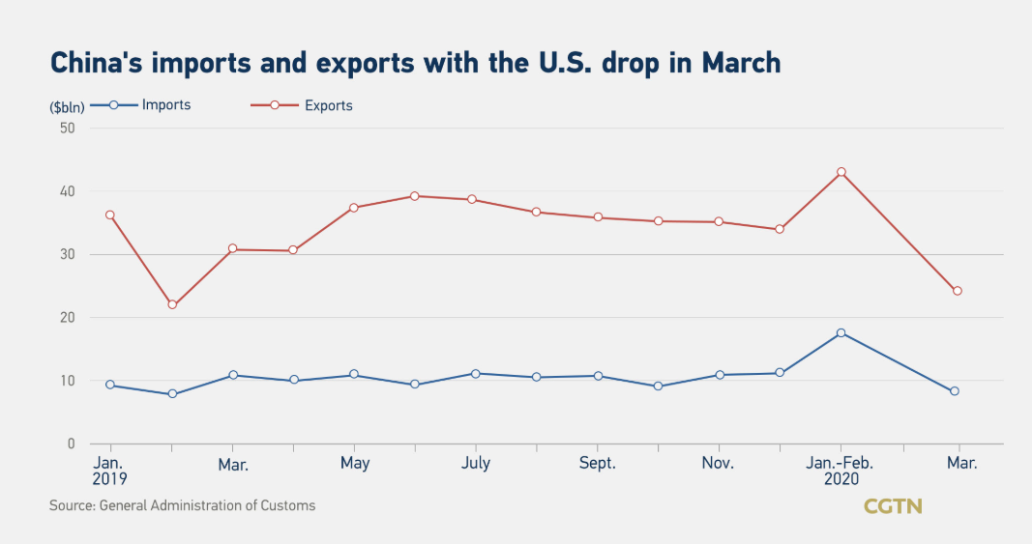
Rapid Decline in the Import/Export Activity
The drop in China-U.S trade volume is affected by the pandemic as imports of agricultural products face stricter inspection and quarantine measures due to hygiene concerns
Also, with the spread of the pandemic in the United States and accompanied restrictions, production has stalled in the U.S., so supply cannot be guaranteed
Notes:
In the first quarter, imports of agricultural products such as soybeans, pork and cotton from the U.S. have grown rapidly

Slide 6
Port Congestions and Logistics Issues
Estimated March imports hit five-year low, declines expected to continue amid pandemic
Port congestion is still high, reflecting levels seen in prior port shutdowns; labor / transport are still issues
Estimates show that imports at major U.S. retail container ports dropped to their lowest level in five years in March.
“Many stores are closed, and consumer demand has been impacted with millions of Americans out of work. However, there are still many essential items that are badly needed and because of store closures cargo may sit longer than usual and cause other supply chain impacts.”- NFR VP
Source: NFR
Source: Refinitiv, Capital Economics
6
Notes:
National Retail Federation
A TEU is one 20-foot-long cargo container or its equivalent.

Slide 7
Changes in the Consumer Pricing

Slide 8
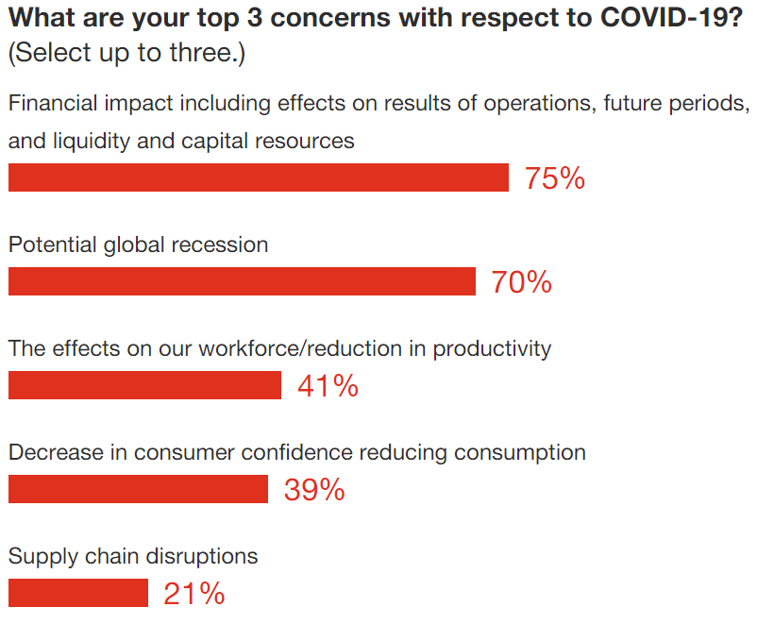
PwC’s COVID-19 CFO Pulse Survey
This survey, our third since emergency lockdowns took effect in the US, reflects the views of 313 US finance leaders during the week of April 6
As the depth and breadth of the impact becomes clearer, more executives are able to base their outlooks on facts rather than sentiment. Two weeks ago, 87% of CFOs in the US and Mexico expected a “significant” impact
Currently, with China slowly coming out of lockdown, finance leaders are gaining insights into a post-COVID-19 world, which includes changes in consumer behaviors

Slide 9
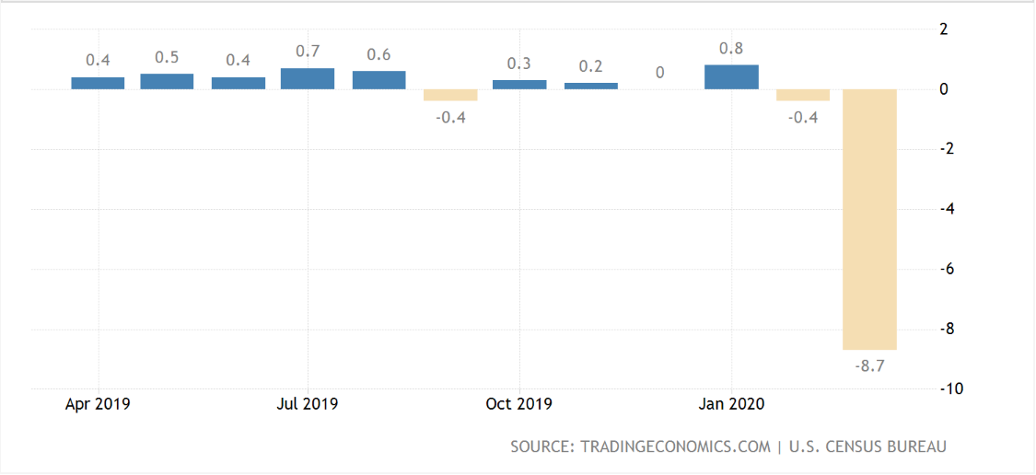
US Retail Sales Fall at a Record Pace
Notes:
Retail sales fell 8.7 percent in March, the largest-ever decline on record, according to Census Bureau data released Wednesday morning. In dollar terms, the decline was nearly triple the previous worst month on record, from the fall of 2008.
t was the largest decline in trade since December 2018 as consumers cut back spending on a range of products, including motor vehicles & parts (-0.9 percent vs 0.8 percent), furniture (-0.4 percent vs 3.2 percent), electronics & appliances (-1.4 percent vs 0.6 percent), building materials (-1.3 percent vs 3.3 percent), health & personal care products (-0.1 percent vs 0.8 percent) and clothing (-1.2 percent vs -1.4 percent). Receipts also declined at gasoline stations (-2.8 percent vs -0.4 percent), restaurants & bars (-0.5 percent vs 0.8 percent) and general merchandise stores (-0.1 percent vs 0.5 percent). Excluding automobiles, gasoline, building materials and food services retail sales were unchanged last month after increasing by 0.4 percent in Januar
But the basic story is clear — people bought way less stuff in March than they normally do.

Slide 10
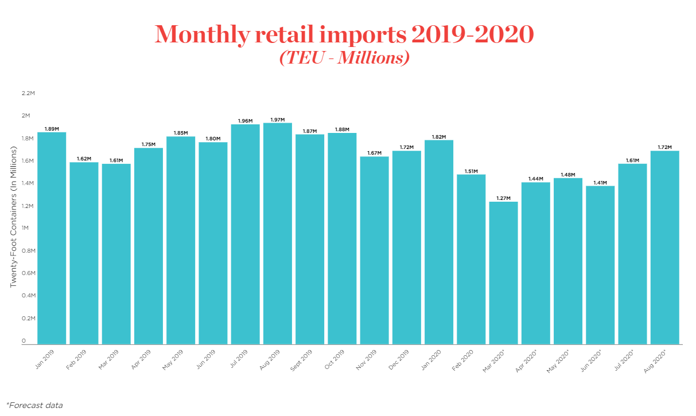
Source: NFR
Notes:
A TEU is one 20-foot-long cargo container or its equivalent.

Slide 11
Prediction for the Future

Slide 12
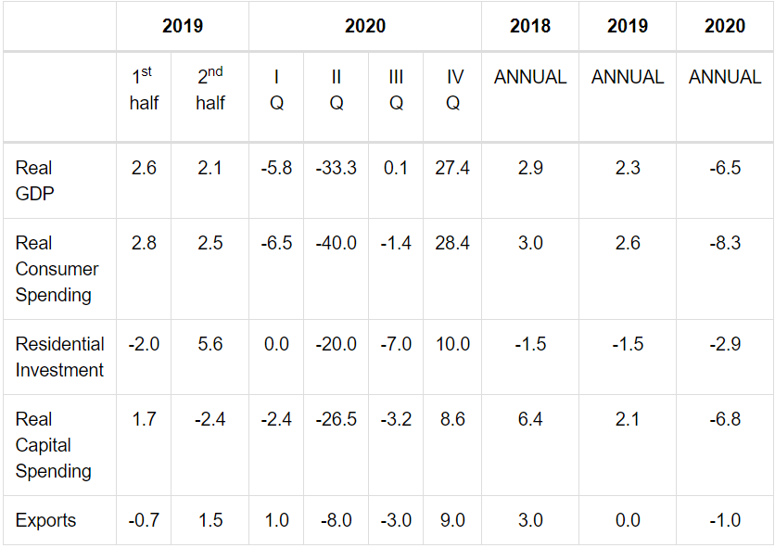
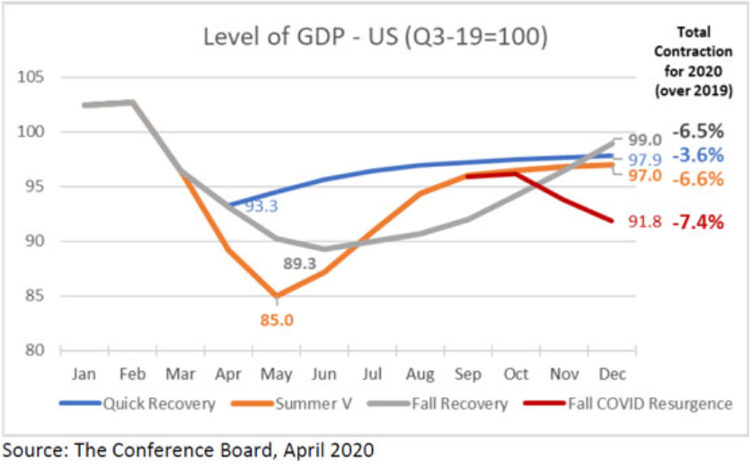
The Conference Board Economic Outlook

Slide 13
Navigating Trade and Customs Issues
Near-term activities to minimize the COVID-19 impact
Companies must analyze multiple business, operations, and tax and tariff scenarios; understand the costs of different supply chain configurations, as well as opportunities; and make informed decisions quickly.
Business leaders may have to deal with short-term customs issues, such as navigating processes to send goods into affected areas or obtaining appropriate clearances to move manufactured goods out of a country.
Companies will need to monitor tariffs and other customs implications.
13

Slide 14
Best & Worst Case Scenarios

Slide 15
Investment in supply chain capabilities to prepare for the worst
Agile logistics and distribution
Enhanced supply chain visibility
Diversified consumer reach and
delivery options
1
2
3
Diversify geographic footprint of warehousing and distribution and ensure there is limited overlap in supply chain risks across the board
Build flexibility to shift between global strategic partners and geographies for various scenarios
Implement proactive risk management practices and develop mitigation approaches
Build greater visibility across supply chain and enable real-time tracking and evaluation of supply chain risks
In case of road shutdowns and store closures, develop capabilities to directly reach end-consumers (e.g. using drones for delivery)
Continue to enhance usability and accessibility of eCommerce stores
15

Slide 16
Best Case Scenario
In the best case scenario, everything will start going back to normal in the near future
While it is impossible not to feel the impact of this pandemic, the sooner we are able to return to normal, the easier it will be for companies to resume their regular operations
This will mean rapid increase in import/export activities and decongestion of the ports

Slide 17
Thank You

