Slide 1
Project Based Economics and Remote Learning Activities
May 5, 2020
Matthew Gherman
Edward R. Murrow H.S.
mgherman@schools.nyc.gov

Slide 2
Project #1: Socio-Economics Project https://ermurrowhs.libguides.com/politics

Slide 3
Project #1: Socio-Economics Project
“We have just examined the fundamental economic and theoretical differences between Republicans and Democrats. However, there are also socio-economic issues (issues that go across social, economic and political values) that divide us politically as well. This project aims to examine their importance, where political parties stand and where you ultimately stand.”

Slide 4
Socio-Economic Project
Project Part I: 100 points
Complete the Graphic Organizer for each issue:
Universal Health Care
Higher minimum wage
Drilling and Pipelines
Privatization of Social Security
Military Spending
Tariffs on Imports
Graphic Organizer

Slide 5
Socio Economics Project
Part II: Essay: 100 points
Which 2 issues are the most important to you as a future voter? (1 paragraph each issue)
Which political party do you agree with more on these issues? (1 paragraph each issue)
Based on the first two projects, if you were to fill out a voting card, which political party will you choose? Explain in 1-2 paragraphs.

Slide 6
Socio-Economics Project
Research Component:
Find 4 scholarly articles about each sides stance on two of your issues. (2 that explain where Democrats stand and 2 that explain where Republicans stand).
Make sure to use these articles in your essay with proper MLA or APA citations in your essay and as a works cited page.

Slide 7
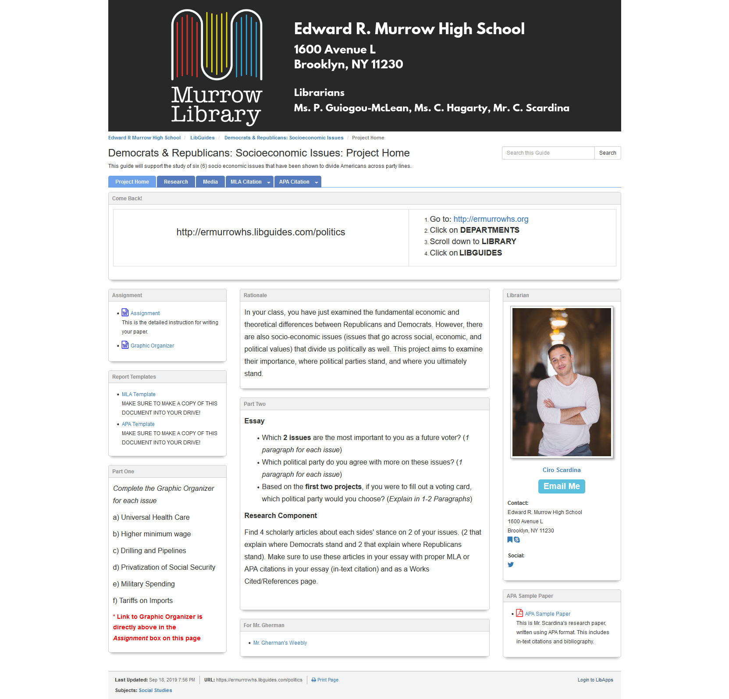
Murrow “Lib-Guide”
https://ermurrowhs.libguides.com/politics

Slide 8
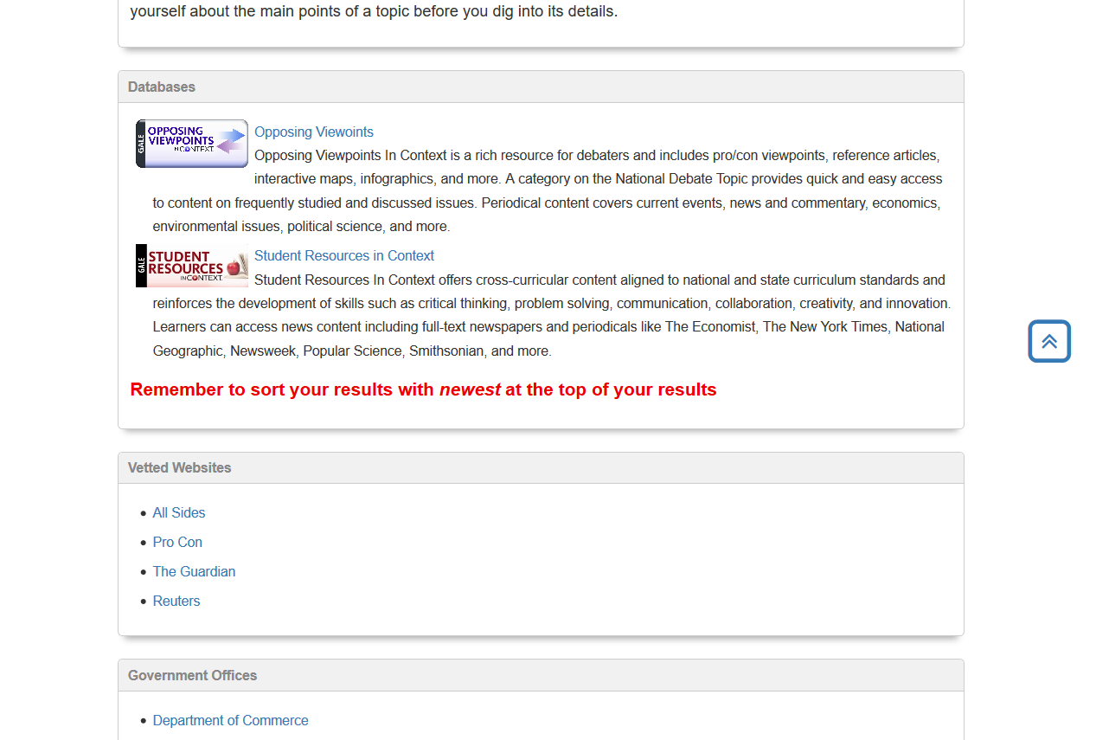
Research Tab

Slide 9
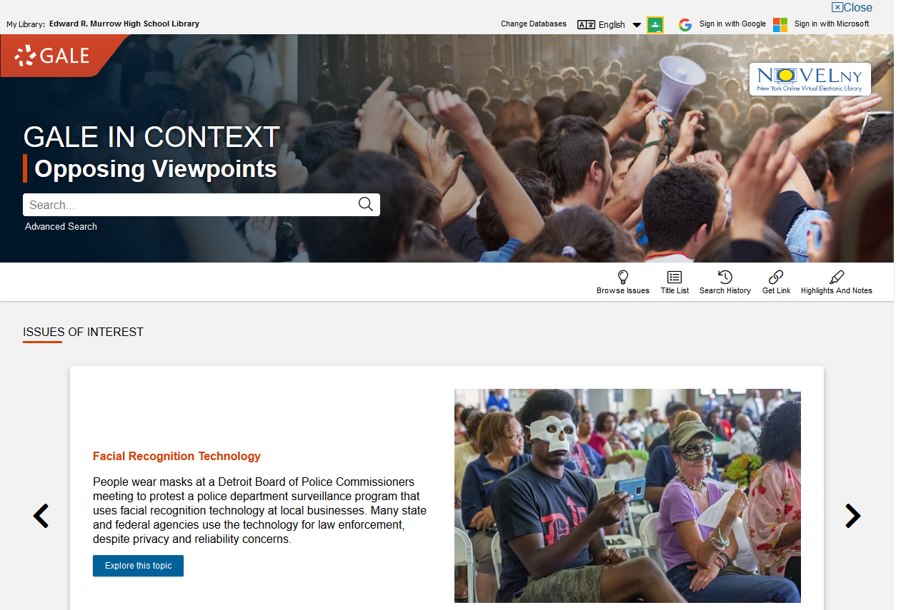
Opposing Viewpoints

Slide 10
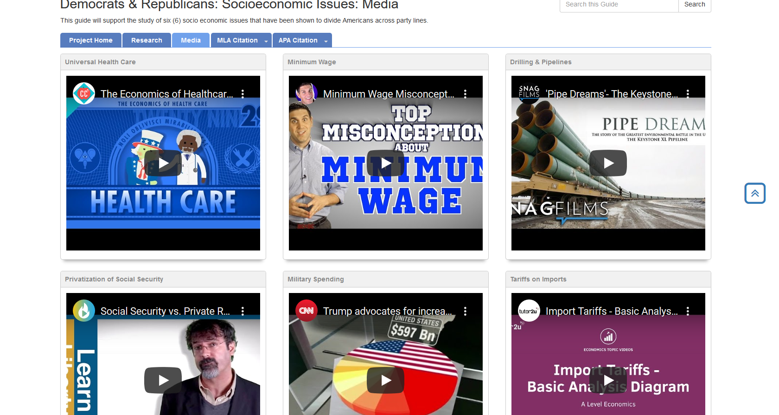
Media Tab
Help students with video understanding

Slide 11
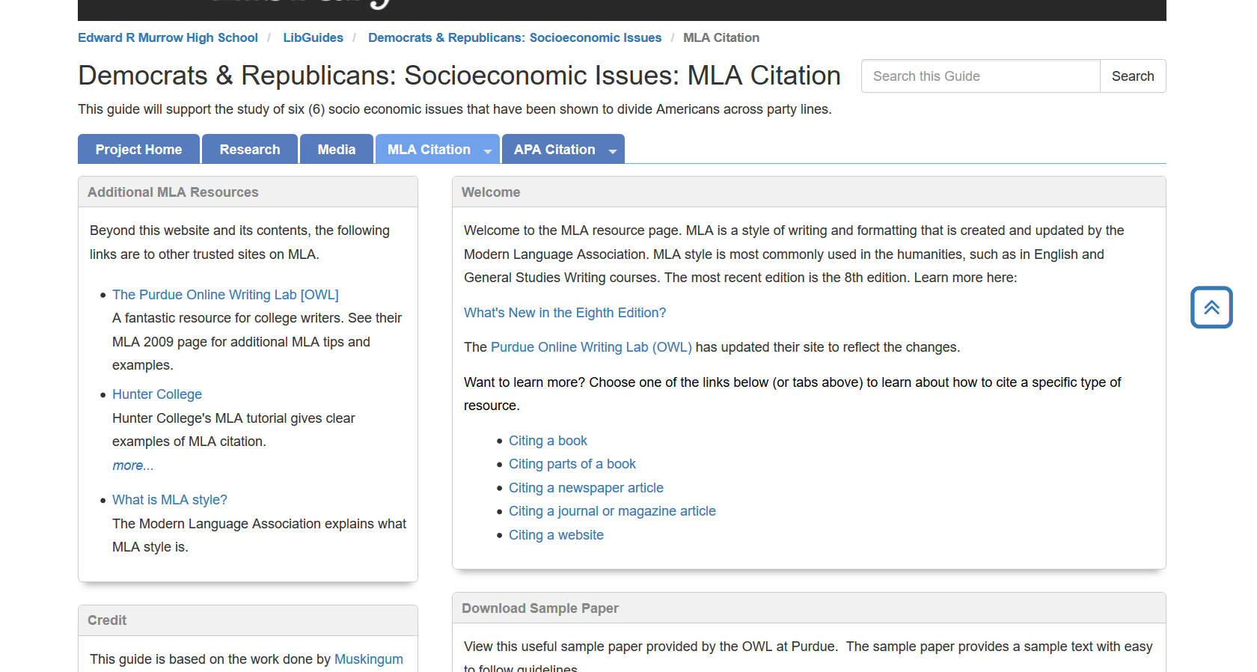
MLA Citation Tab

Slide 12
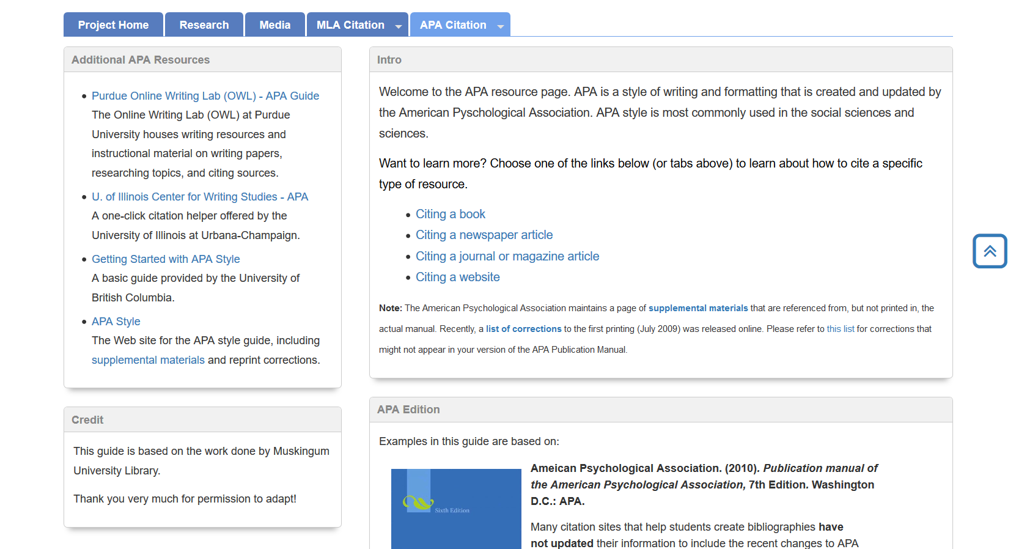
APA Citation Tab

Slide 13
Project #2
Economics of Politics
Objectives: This is a more economics-intense approach to the previous project
Applies core economic concepts and has students demonstrate an understanding of those concepts in how they are illustrated and built on by each political party.

Slide 14
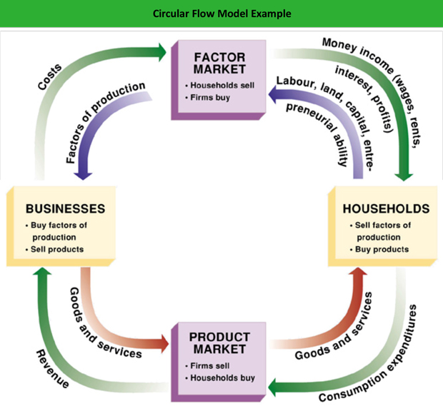

Slide 15
Project #3
Personal Finance Webquest
https://ermurrowhs.libguides.com/finance
https://apps.irs.gov/app/understandingTaxes/student/simulations.jsp

Slide 16
Guidelines
Find a partner to complete this project.
Use https://ermurrowhs.libguides.com/finance 2-3 sentences / bullet points per question
Use and properly cite at least one source per part.
Submit your work through Google Classroom or Pupil Path
Due Dates:
Part I (A – F) _______
Part I (G – N) _______
Part II/ III _______
Part IV _______

Slide 17
Part 1A: Living on your own
What should you have financially in place for you to move out on your own?
What is the difference between variable and fixed expenses?
What questions should you think about when looking for an apartment?
What does “living paycheck to paycheck” mean? Why is this not ideal?
Find an apartment rental listing in the city you would like to live in after you graduate from college. How much is your monthly rent?
Make an itemized list with prices of furniture you will need to start out (Go to the Ikea website). What else will you need to start out (microwave, hangers, curtains, etc.)? Overall, approximately how much money will you need initially to live on your own?
What is the minimum wage in the state you would like to live in after college? How many hours of minimum wage will you need to work to pay for your rent?
What is good budgeting advice to live by yourself comfortably?

Slide 18
Part 1B: Banking
What is the difference between a checking account, savings account and certificate of deposit?
Why is it important to have all 3?
What are strategies to save money? Offer specific advice.
Based on the information you researched about this topic, create 3 rules of advice that young adults must follow.

Slide 19
Part 1C: Credit Cards
What is an APR?
What is a grace period?
Why is it important to pay your full bill within the grace period?
What other hidden fees are associated with credit cards?
What criteria should you use in choosing a credit card?
What are some different types of rewards programs for credit cars?
What is a department store credit card? How is it different than a mainstream credit card? What are the positives and negatives of owning a department store card?
Choose one of the following companies: Bank of America, Capital One, Chase, American Express and Discover. Which of their credit cards is best for you?
Compare and contrast two or more of the companies: which has the best credit cards for you?
Based on the information you researched about this topic, create 3 rules of advice that young adults must follow.

Slide 20
Part 1D: Credit Score
What is a credit score? Why is it important?
What is considered an excellent, good, bad credit score?
How is it calculated? What are the components of it? For each component: what is considered good/bad?
What is the consequence of a poor credit score?
How do you improve your credit score?

Slide 21
Your Agenda
Examine hands-on and self-guided projects
Socio-Economic Issues Project
Personal Finance Project

Slide 22
Part 1E: Taxes
What are the differences between a W2, W4, 1040 and 1099 tax form?
What are dependents, deductions, allowances and tax credits? What can be used for each?
Why might people put a smaller amount of dependents/allowances on their W4 than they actually have?
Why might people hold additional income on their W4?
How has the new Trump Tax Plan affected how people do their taxes?
How are people in New York State affected by the Trump Tax Plan?

Slide 23
Part 1F: Health Insurance
Why is having a comprehensive health insurance plan important?
What type of health insurance plans are there?
Go to the NY “State of Health” website and choose a health insurance option. Why did you select this coverage? How much will your plan cost each year?
What do the cheaper plans fail to cover?
Based on the information you researched about this topic, create 3 rules of advice that young adults must follow.

Slide 24
Part 1G: Cars
What is the difference between leasing and buying?
What are the advantages and disadvantages of each?
What is the minimum car insurance you must have in NYS? How much will insurance cost you?
What raises and lowers your car insurance?
Choose a car you want to buy in the next ten years – identify the lease and purchase payment differences.
What are other maintenance costs of owning a car?

Slide 25
Part 1H: Marriage and Kids
What are the financial advantages and disadvantages of being married?
What is the marriage tax penalty?
Why is it crucially important to know your fiancé’s credit score before getting married?
How much does it cost raise a child in New York City? What are the main financial expenditures associated with raising a child? Per Year? Cumulative until they turn 18?
Compare and contrast a 529 Plan and an UGMA for saving money for your kids’ college. Which is the better option? Explain.

Slide 26
Part 1I: Mixed Bag
Explain the difference between Good Debt and Bad Debt.
Add up rent, health insurance, car payments, car insurance, and apartment startup costs. Not even including your day to day living expenses (food, utilities, clothing, entertainment, etc.), how much will it cost you to live on your own?

Slide 27
Part 1J: Homeownership
What is a mortgage?
What is a pre-approval?
What percentage of the mortgage should the down payment be? Why?
What is an amortization schedule?
What is a PMI (private mortgage insurance)?
What fees/expenses besides the mortgage is involved in owning a home?
What should you financially have in place before you buy a home? (credit score, savings, etc.)

Slide 28
Part 1K: Life Insurance
What is a premium?
What is the difference between Whole, Universal and Term Life Insurance? Which do you think is better? Why?
When should you get life insurance? When do you need to get life insurance?
How much life insurance coverage do you need?
How are life insurance costs calculated?

Slide 29
Part 1L: Retirement Funds
Define: IRA, Roth IRA and 401K. What are advantages and disadvantages of each?
What is compounding interest?
When should you begin investing for retirement? Why?
How much of your salary should you put toward retirement, why?

Slide 30
Part 1M: Legal Documents
What is a Will? When should you make one?
What is an Estate Plan? When should you get one?
What is a Pre-Nuptial agreement? What does it do? What does it not do? Should people get it?

Slide 31
Part 1N: Investment Options (Extra Credit)
For each of the following:
penny stock common stock bonds mutual funds
Exchange Traded Fund (ETF) Unit Investment Trust (UIT)
a) define them in two-three sentences
b) how is money made off each of them and are there any associated costs to owning one?
c) explain how each is unique/the main differences between them
d) explain the advantages and disadvantages of investing in each?
e) rank them in order of what you think is the safest investment to the most riskiest investment.
f) Do you think one of or more of these options are right for you? Why? If you don’t want to invest based on what you read, why not?

Slide 32
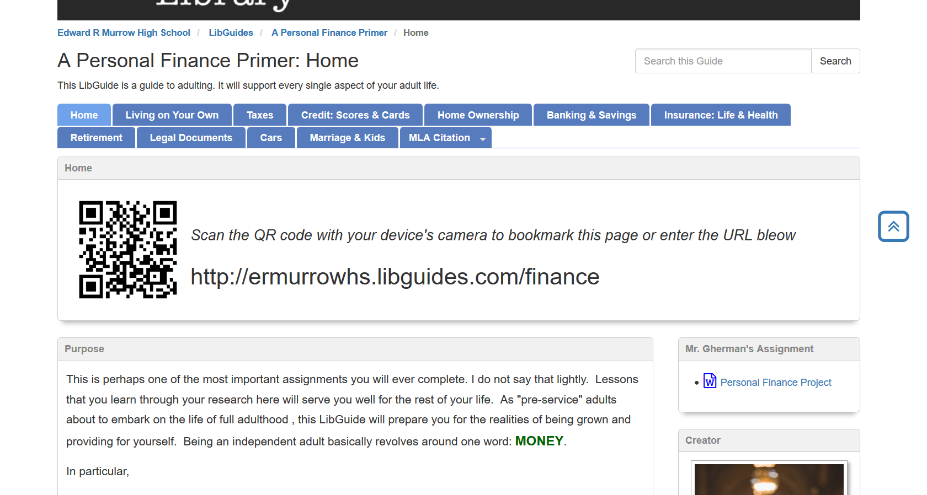
Website Home

Slide 33
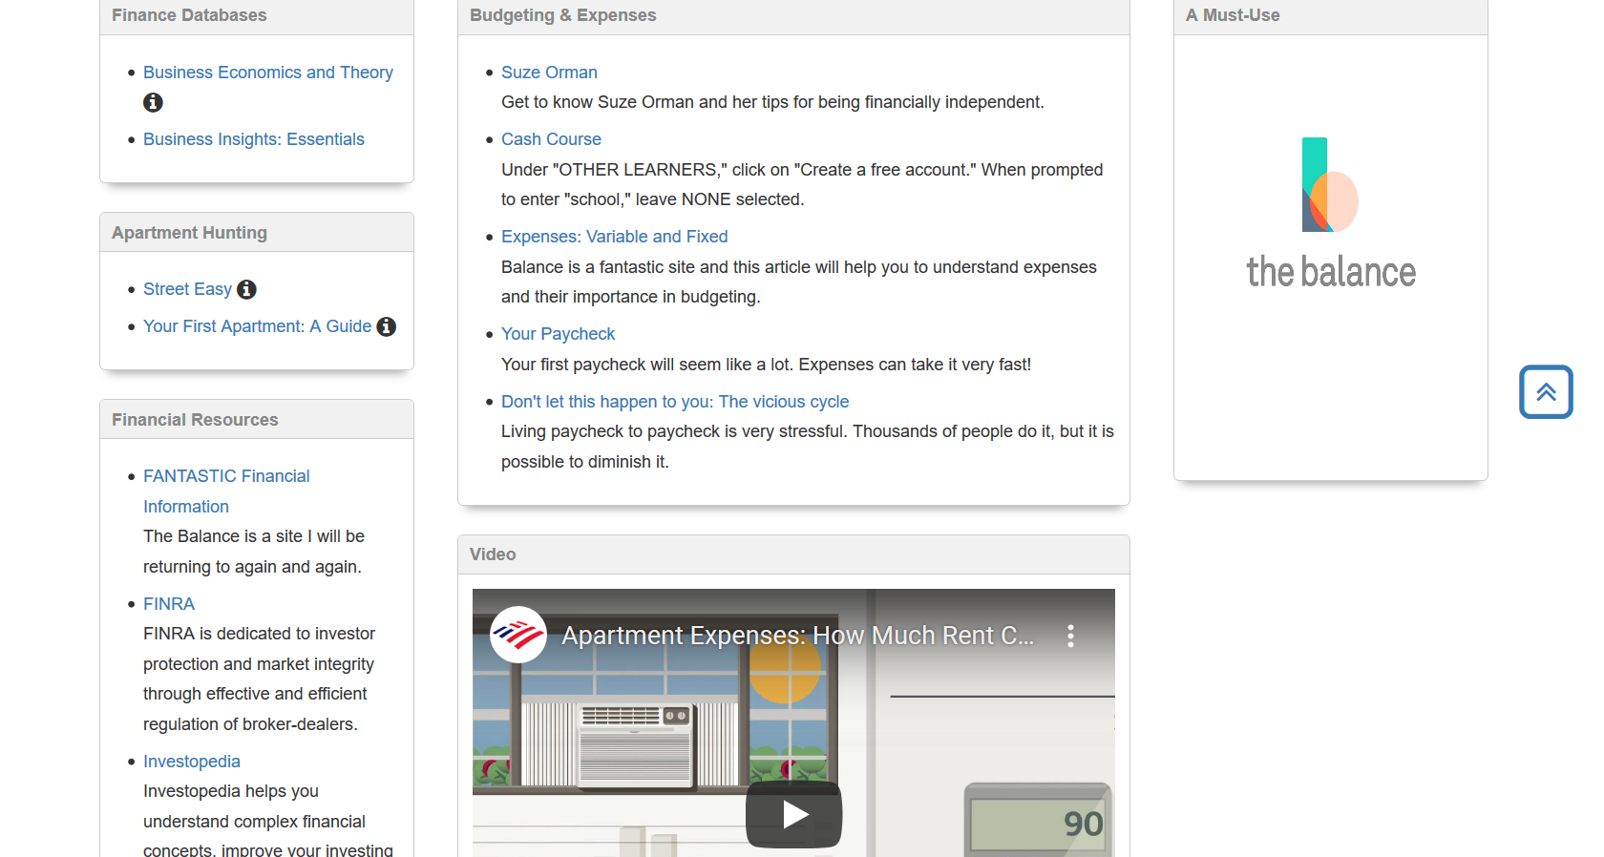
Living on your own tab

Slide 34
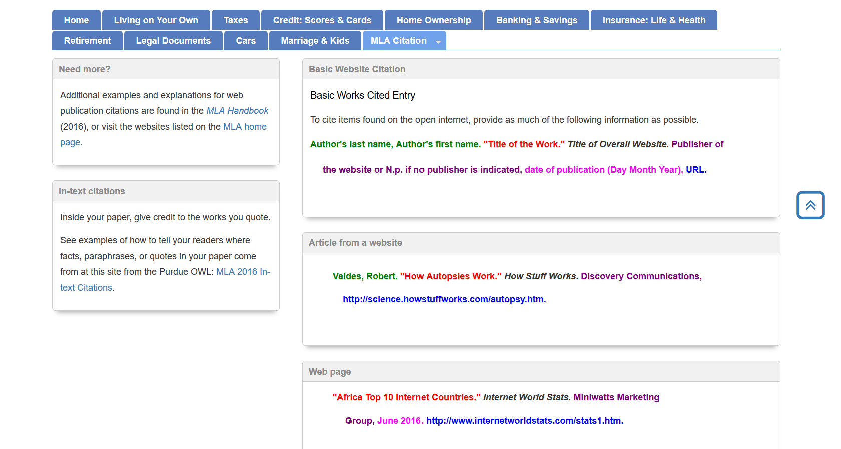
MLA Citation Websites

Slide 35
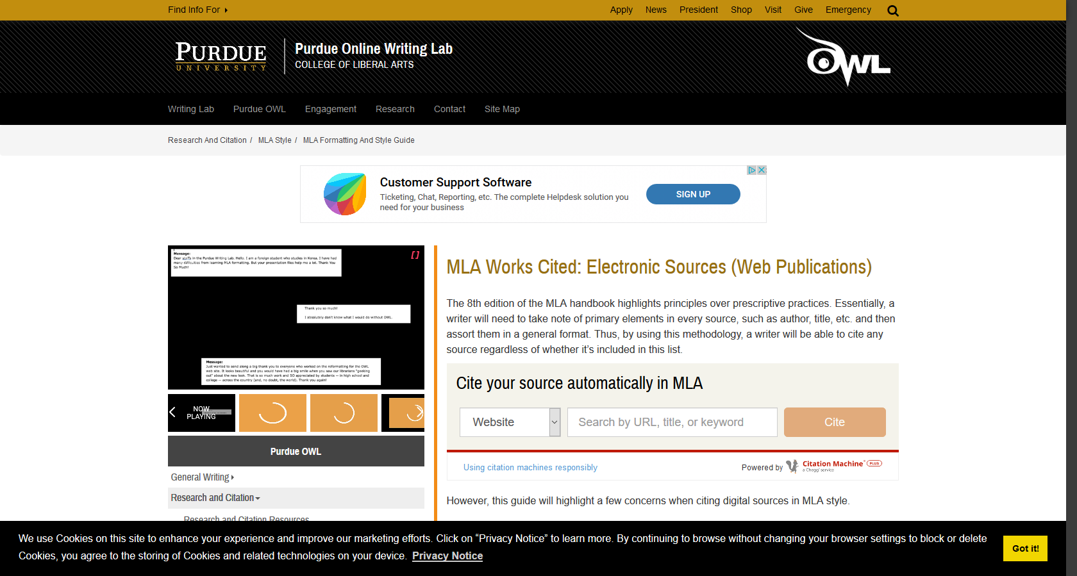
MLA Citation Videos

Slide 36
Part II: Navigating the IRS
https://apps.irs.gov/app/understandingTaxes/student/simulations.jsp
Complete the simulations for the following people:
Lawrence Red Owl, Cicely King, Tasha Miller,
Monica Lindo, John Stillman, Seth Wiggins,
Rita Bently, James King
1) Write a brief paragraph (3-4) sentences about what you learned about the tax system for each person.
2) What are some difficulties with navigating the tax system?
3) If you were the head of the IRS, how would you change America’s taxation system?

Slide 37
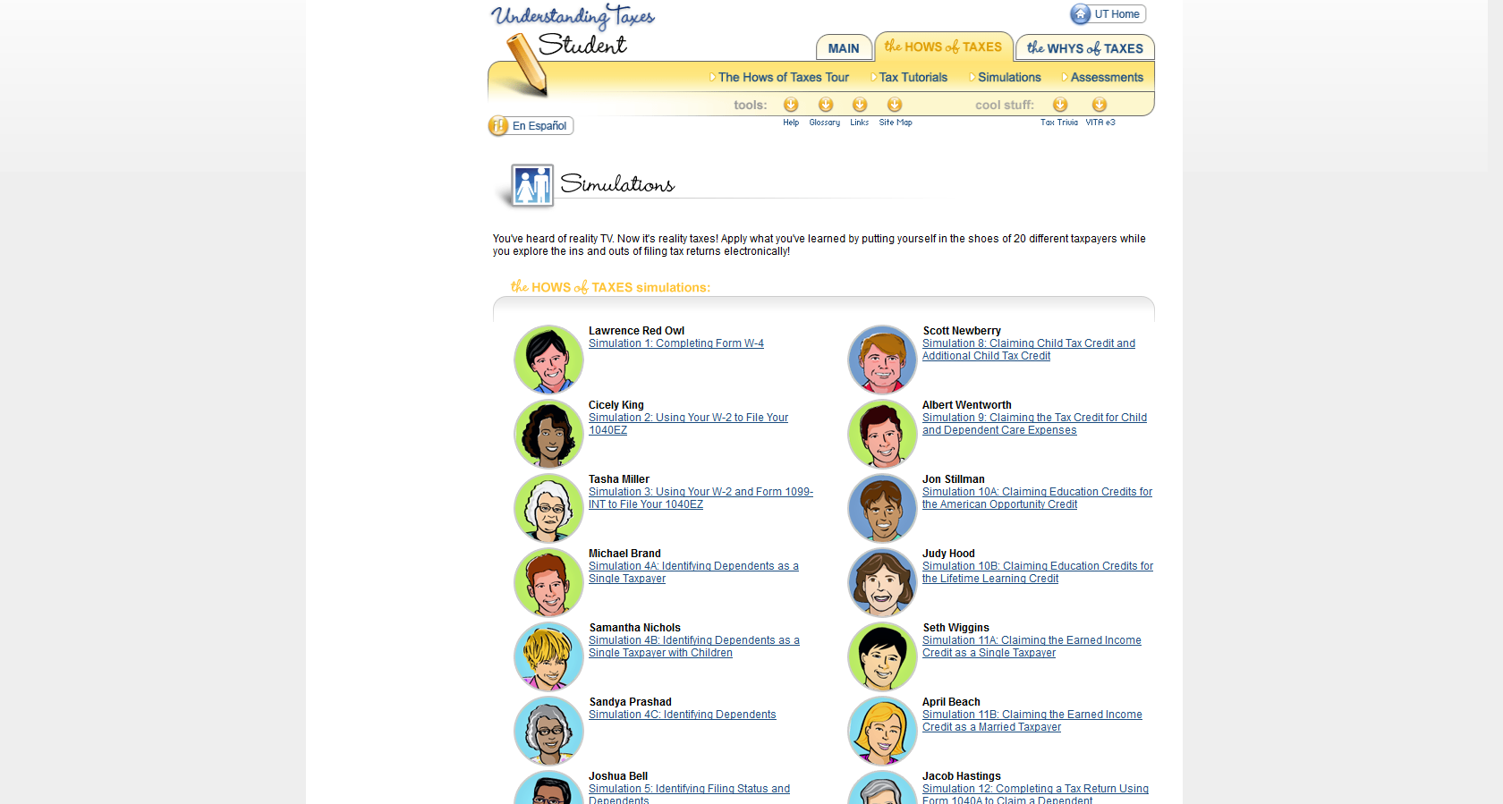
Website

Slide 38
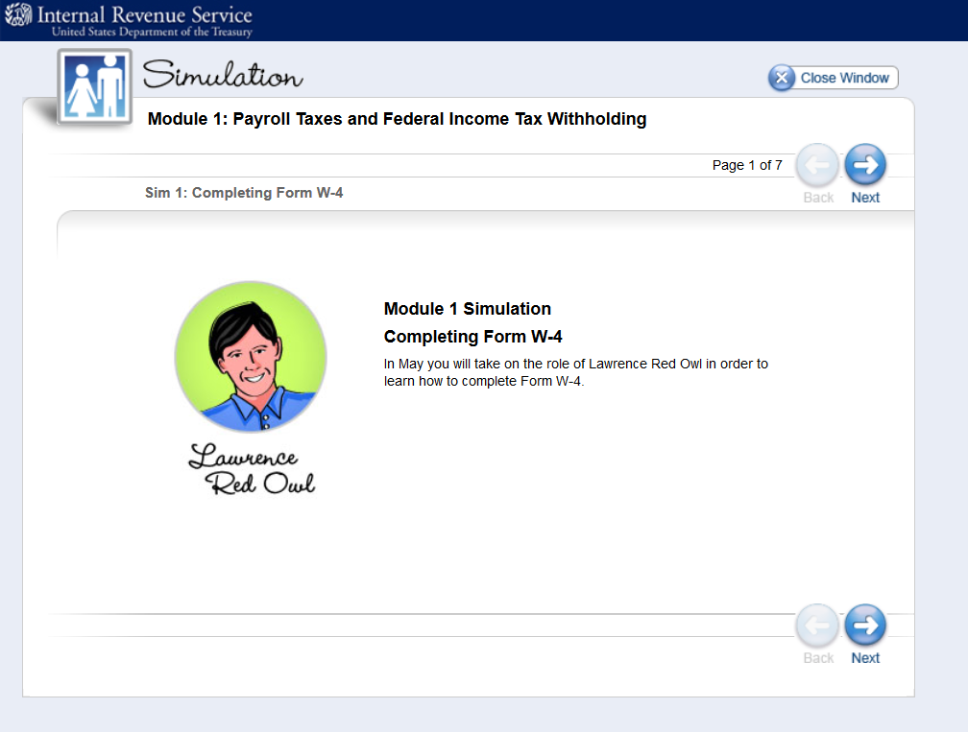
Lawrence Red Owl Example

Slide 39
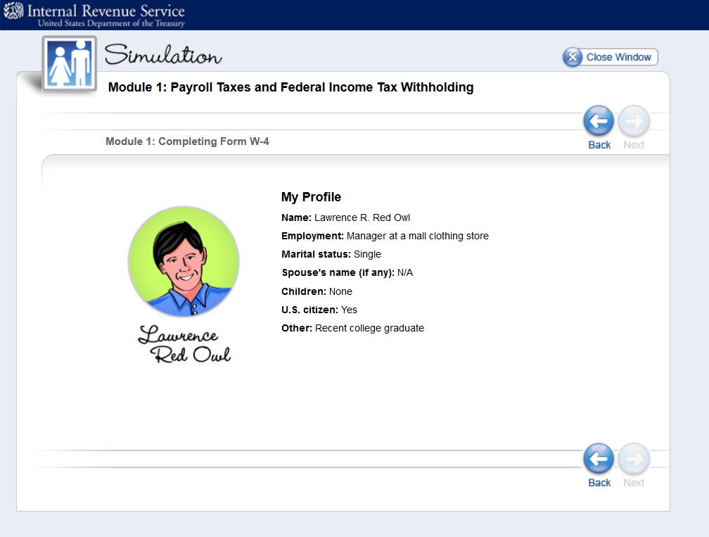
Lawrence Red Owl Example

Slide 40
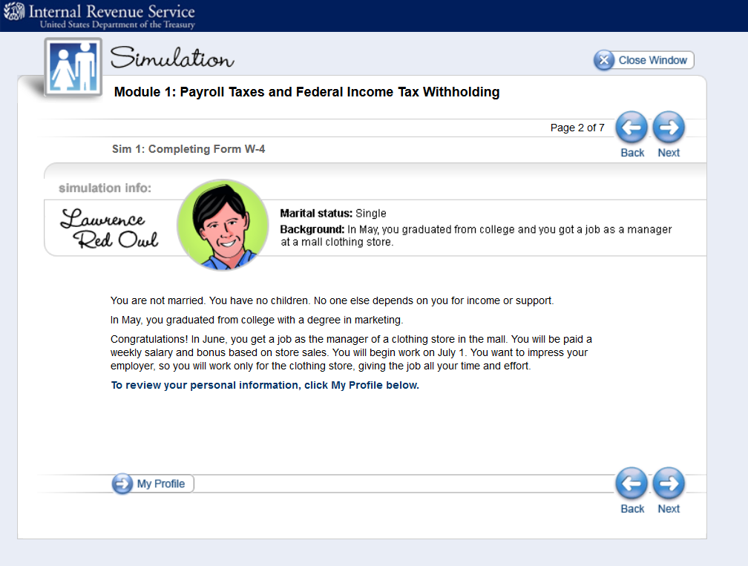

Slide 41
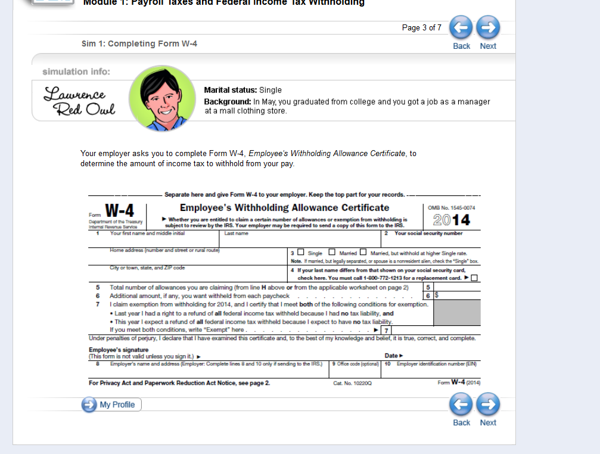

Slide 42
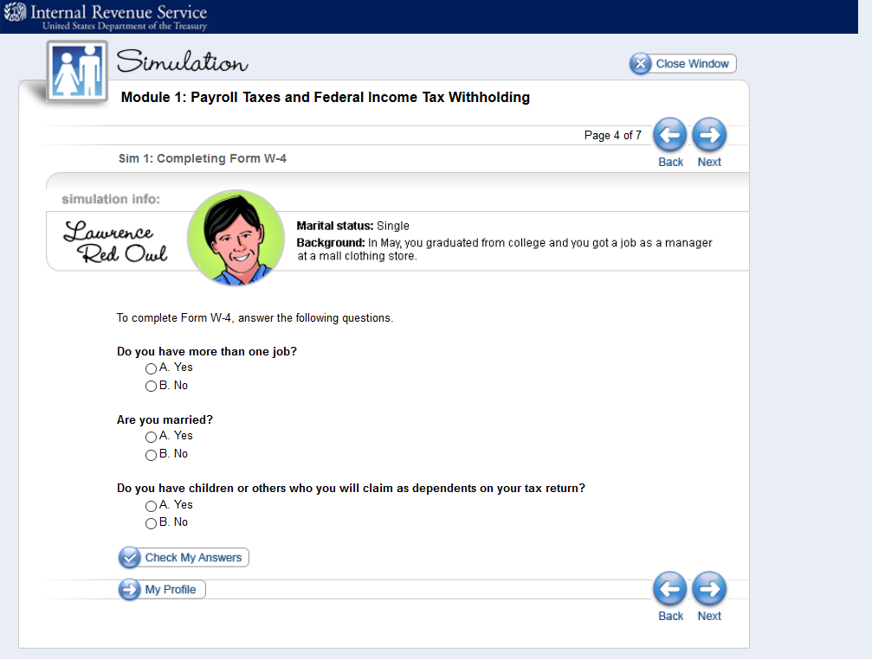

Slide 43
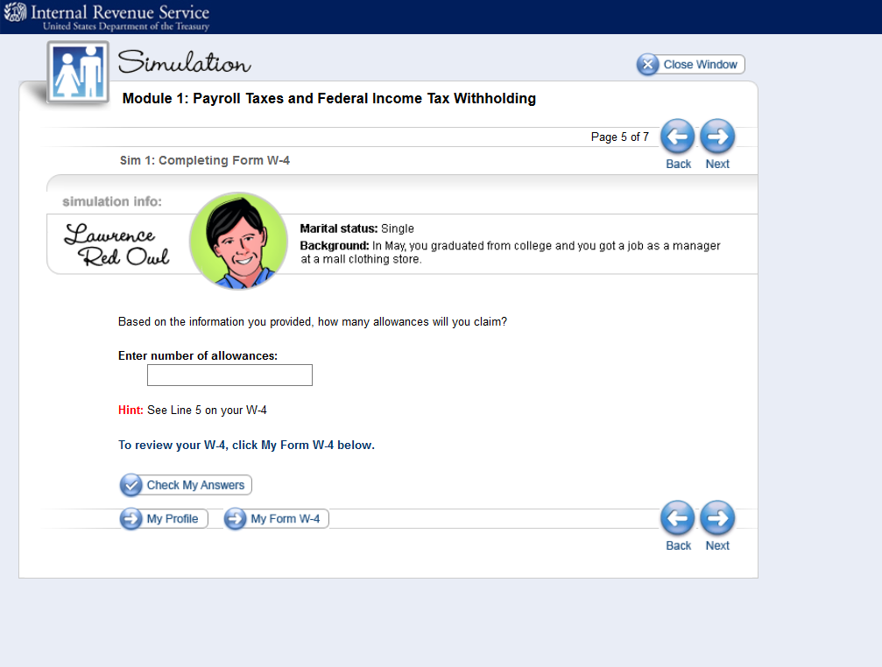

Slide 44
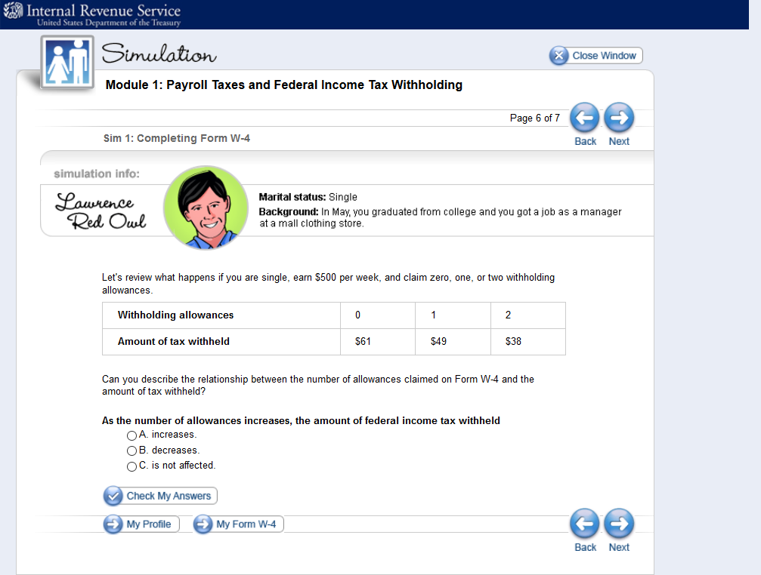

Slide 45
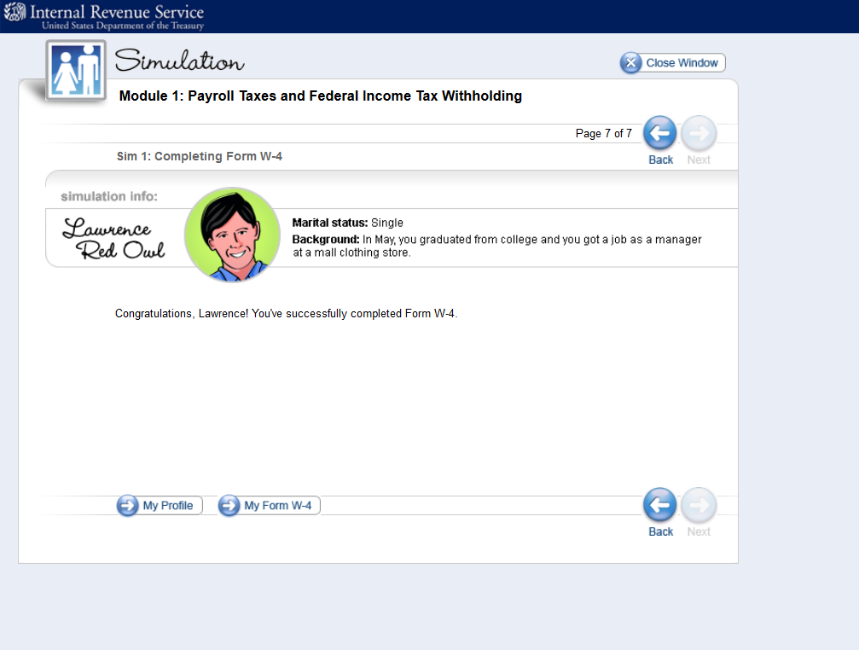

Slide 46
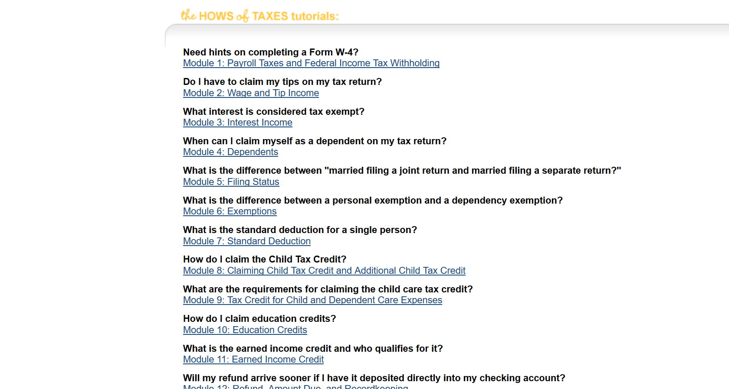
Tax Tutorial

Slide 47
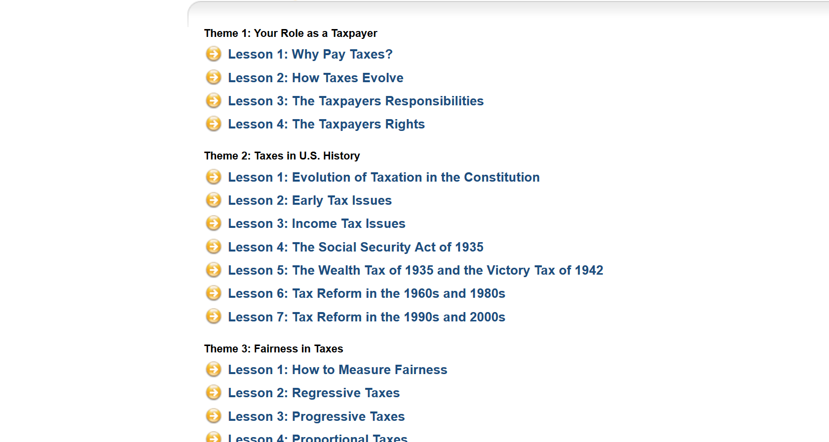
Whys of Taxes

Slide 48
Part III: Personal Finance Commandments
Create 10 general “Personal Finance Commandments” for young adults.

Slide 49
Part IV: Personal Finance Powerpoint or Jamboard
Remote Learning Edit of Part IV
1) Create a personal finance pamphlet giving brief information and advice for 18 year olds.
2) Your power point should concisely summarize the main ideas of your section.
3) Include important websites that students can use to further their knowledge of your topic.
4) Include helpful quotes for your topic
5) Be Creative.
Jamboard.google.com

Slide 50
Simple Sole Proprietorship Project
Learning Objectives:
    Demonstrate Understanding of Basics of Introductory Business and Marketing Concepts
    Apply basics to a simple created “brick and mortar” business
    Demonstrate ability to analyze successful Strategies within context of your industry component and SWOT.

Slide 51
COVID-19 and the Business World
Learning Objectives:
Understand how the Covid-19 virus has altered the business landscape.
Analyze a variety of sources
Create a response that compares and contrasts different points of view and shows an ability to evaluate economic developments.

Slide 52
COVID-19 and American Economy and Response
Assessment Questions:
  To what extent are the economic circumstances and impacts more similar or different to:
    A) Great Depression?
    B) Great Recession?
    Compare/Contrast Economic Responses of President Roosevelt, President Obama and President Trump to the economic crises. To what extent are they more similar/different?
    History of Stimulus Payments

Slide 53
Stock Market Crash Comparison
https://www.investmentwatchblog.com/comparison-of-1929-2008-2020-spx/
https://www.thebalance.com/what-is-black-monday-in-1987-1929-and-2015-3305818
https://www.forbes.com/sites/greatspeculations/2020/03/13/market-crashes-compared28-coronavirus-crash-vs-4-historic-market-crashes/#946ceef4ee83
https://www.thebalance.com/fundamentals-of-the-2020-market-crash-4799950

Slide 54
Additional Resources
https://www.washingtonpost.com/opinions/2020/04/11/great-depression-didnt-have-happen-neither-does-covid-19-depression/
https://www.forbes.com/sites/phillipbraun/2020/04/10/why-covid-19-wont-trigger-another-great-depression/#105ed2ed8ba9
https://www.forbes.com/sites/lizfrazierpeck/2020/04/21/how-covid-19-is-leading-the-us-into-a-new-type-of-recession-and-what-it-means-for-our-future/#25cb89ef618c
https://www.brookings.edu/blog/the-avenue/2020/03/25/what-the-great-recession-can-tell-us-about-the-covid-19-small-business-crisis/
https://www.weforum.org/agenda/2020/04/covid-19-coronavirus-economic-crisis-great-recession/
https://www.brookings.edu/blog/up-front/2020/03/12/how-does-the-coronavirus-pandemic-compare-to-the-great-recession-and-what-should-fiscal-policy-do-now/

