Slide 1
Cost of Production and Perfect Competition
June 23, 2020
Theresa Fischer ecofisch@gmail.com

Slide 2
EconEdLink Membership
You can now access CEE’s professional development webinars directly on EconEdLink.org! To receive these new professional development benefits, become an EconEdLink member. As a member, you will now be able to:
Automatically receive a professional development certificate via e-mail within 24 hours after viewing any webinar for a minimum of 45 minutes
Register for upcoming webinars with a simple one-click process
Easily download presentations, lesson plan materials, and activities for each webinar
Search and view all webinars at your convenience
Save webinars to your EconEdLink dashboard for easy access to the event
You may access our new Professional Development page here

Slide 3
Professional Development Certificate
To earn your professional development certificate for this webinar, you must:
Watch a minimum of 45-minutes and you will automatically receive a professional development certificate via e-mail within 24 hours.
Accessing resources:
You can now easily download presentations, lesson plan materials, and activities for each webinar from EconEdLink.org/professional-development/

Slide 4
Objectives for This Lesson
1. How to present costs to your students in the class
2. How to get students to UNDERSTAND the importance of costs for a business.
3. Get students to learn the cost curves and their relations to each other.
4. Understand the characteristics of perfect competition firm
5. How to use the cost curves they learns and apply them to perfect competition.
6. Sources to use for this topic

Slide 5
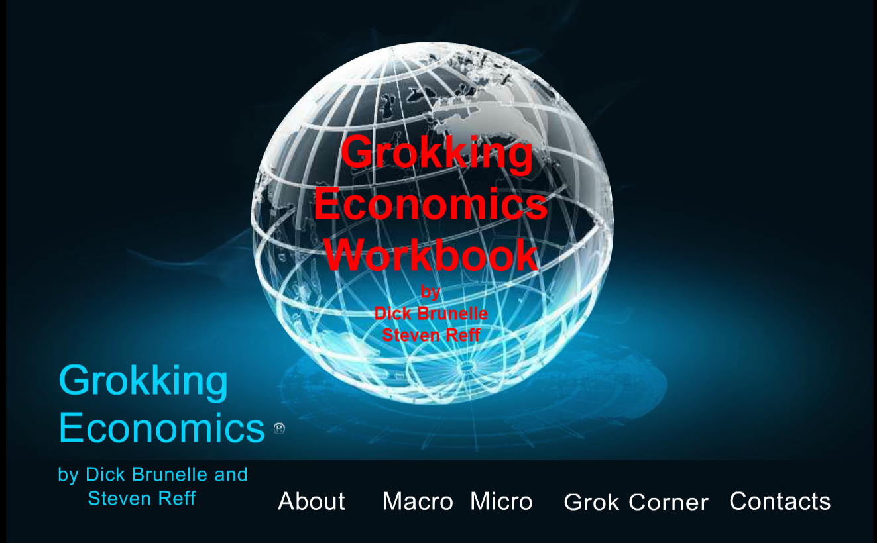

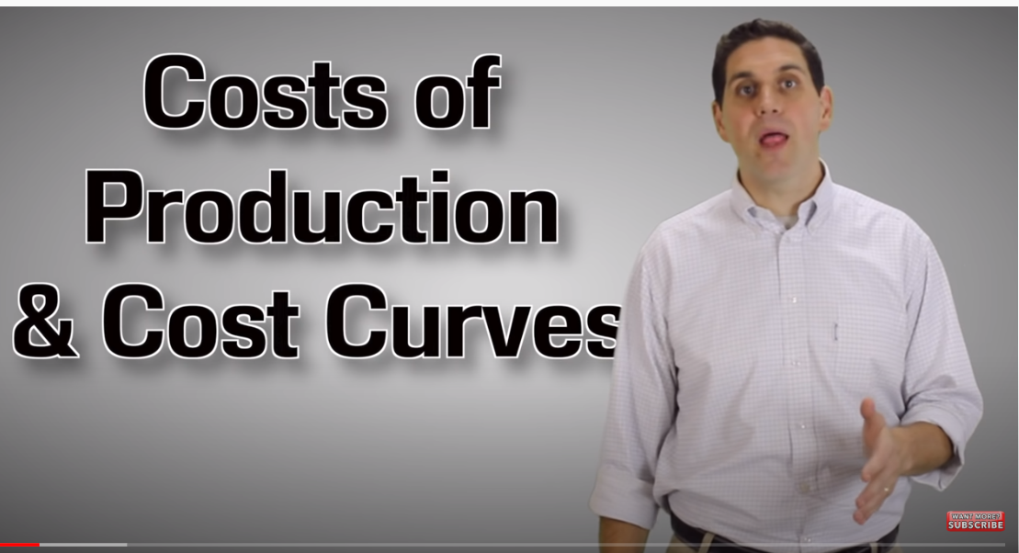
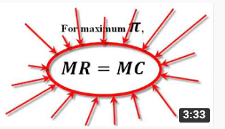
ACDC CLIFFORD
MJMFOODIE.COM
GROKKINGECON.COM

Slide 6

How I Built This with Guy Raz

Slide 7
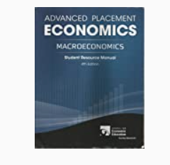

CEE Publications
HIGH SCHOOL ECONOMICS – Chapter 7.8.9
Advanced Placement ECONOMICS (Microeconomics)
Student and Teacher Resource Manual

Slide 8


Junior Achievement

Slide 9

DECA https://www.deca.org/high-school-programs/
Distributive Education Clubs of America
DECA prepares emerging leaders and entrepreneurs in marketing, finance, hospitality and management in high schools and colleges around the globe. ... DECA prepares the next generation to be academically prepared, community-oriented, professionally responsible, experienced leaders.

Slide 10

Shark Tank

Slide 11
SHARK TANK
Assignment:
Listen to or Watch a Shark Tank episode…
A. Describe the product they are pitching
B. What are their costs, total revenue, profits? (State the numbers.)
C. Would YOU invest in this company? Explain. ( I do not want to know whether the SHARKS invested, I want to know if you had the $ would you invest.)
D. Min. 250 words

Slide 12

Scrub Daddy https://www.youtube.com/watch?v=ggi3yfUv0Mo
Season 4, Episode 7

Slide 13
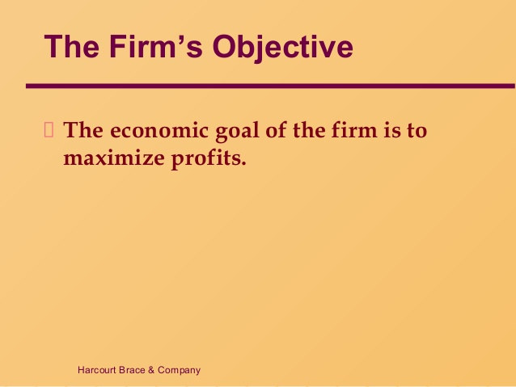
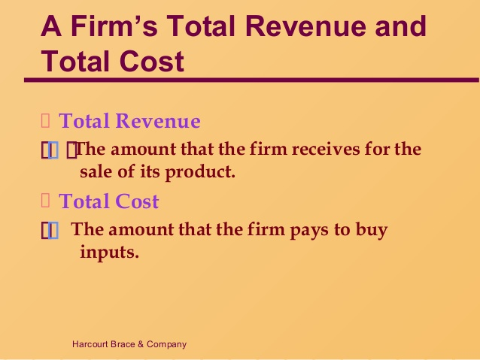
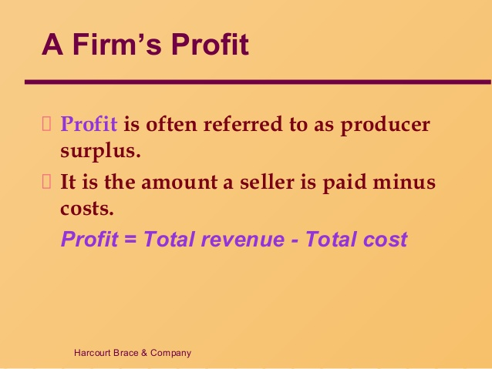
The Firm’s Goal

Slide 14
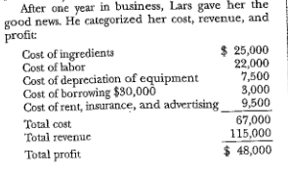
Explicit Costs – costs that require an outlay of money by the firm
“Eleanor’s Catering Company”
Explicit Costs

Slide 15
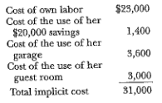
do not require an outlay of money but is the opportunity costs
Implicit Costs

Slide 16
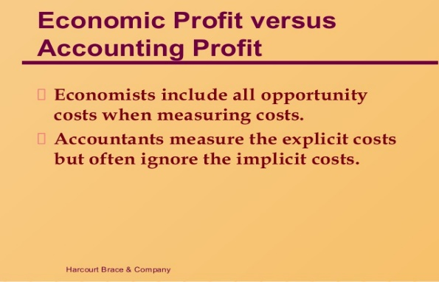

Did Eleanor make an Accounting Profit?
Did Eleanor make an Economic Profit?
Accounting Profit = total monetary revenue - total costs (Explicit costs)
Economic Profit = An economic profit or loss is the difference between the revenue received from the sale of an output MINUS the costs of all inputs (EXPLICIT COSTS) used and any opportunity costs(Implicit costs)
ANSWER: Accounting Profit-------YES
Economic Profit-------YES

Slide 17
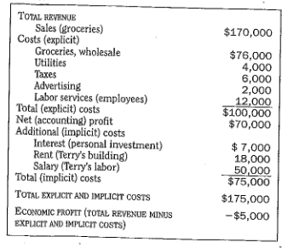
Jerry and His Supermarket
SHOULD JERRY STAY IN BUSINESS?

Slide 18
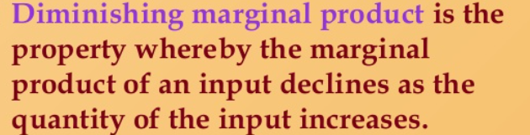
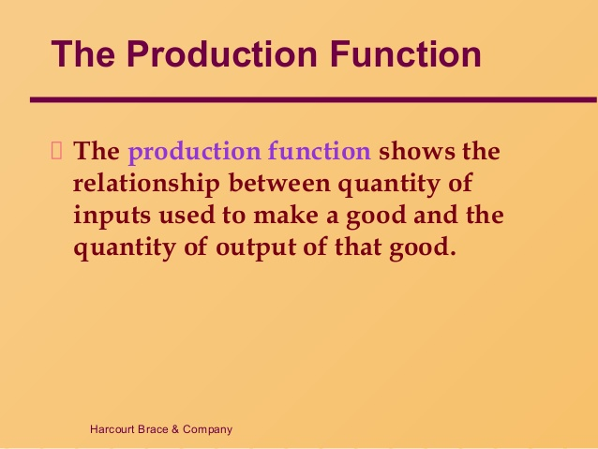
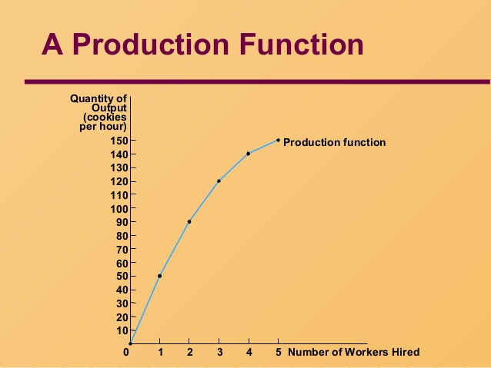
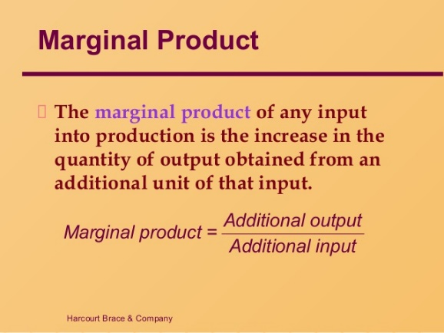
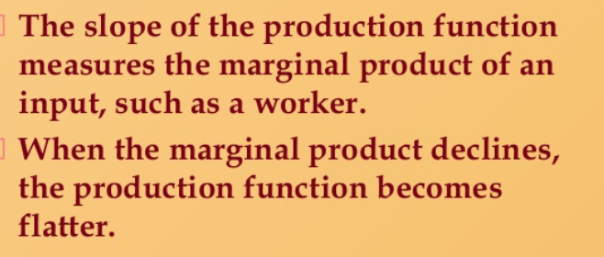
PRODUCTION FUNCTION

Slide 19
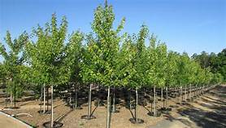
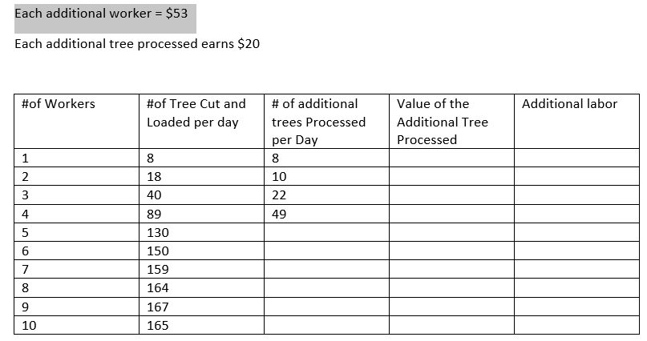
Tree Production

Slide 20
Tree Production
#of Workers | #of Tree Cut and Loaded per day | # of additional trees Processed per Day | Value of the Additional Tree Processed | Additional labor
1 | 8 | 8 | $160 | $53
2 | 18 | 10 | $200 | $53
3 | 40 | 22 | $440 | $53
4 | 89 | 49 | $980 | $53
5 | 130 | 41 | $420 | $53
6 | 150 | 20 | $400 | $53
7 | 159 | 9 | $180 | $53
8 | 164 | 5 | $100 | $53
9 | 167 | 3 | $60 | $53
10 | 165 | 2 | $40 | $53
–There are three parts of the Production Function
Increasing returns
Decreasing returns
Negative returns
How many numbers of workers to increasing returns?____________________
How many numbers of workers to decreasing returns?____________________
Is there any worker with negative returns? ____________________Why_________________

Slide 21
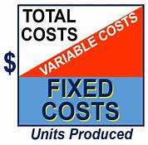

Slide 22


Slide 23
Total Product Cups Per minute | Total FIXED COSTS (TFC) | TOTAL VARIABLE COSTS (TVC) | TOTAL COST (TC)
0 | $6 | 0 | $6
1 |  | $5
2 |  | $8
3 |  | $13
4 |  | $19
5 |  | $26
6 |  | $34
7 |  | $43

Slide 24
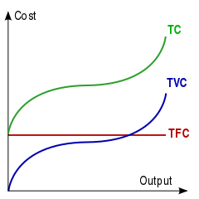
Draw the graph of FC, VC and TC
What is the difference between TC and TVC?

Slide 25
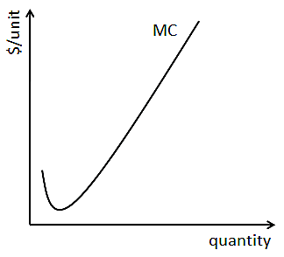
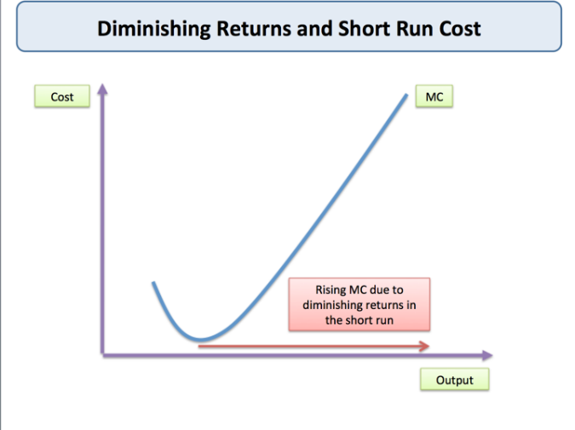
MARGINAL COST
The cost added by producing one additional unit of a product or service
For example, if a company needs to build an entirely new factory in order to produce more goods, the cost of building the factory is a marginal cost

Slide 26
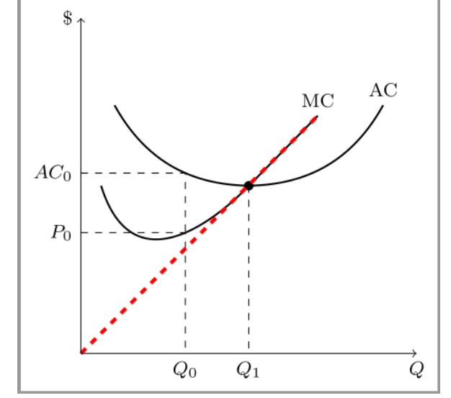
Why is Marginal Cost Important?
Marginal Cost mimics the supply line
It determines the cost for one extra production of a good or service.

Slide 27
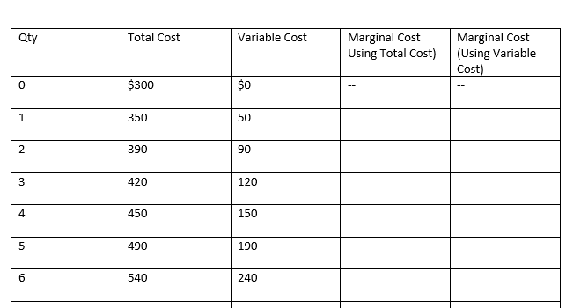
How do we Calculate
Marginal Cost?

Slide 28
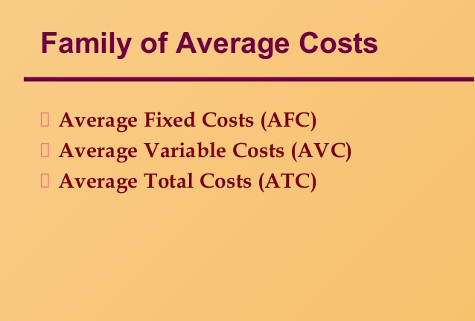
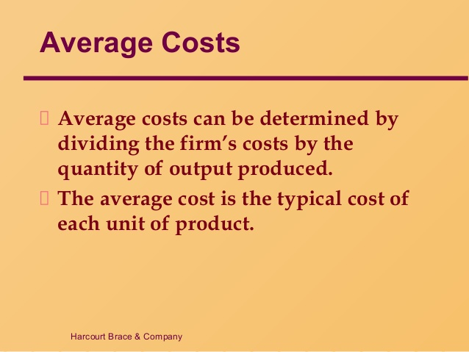
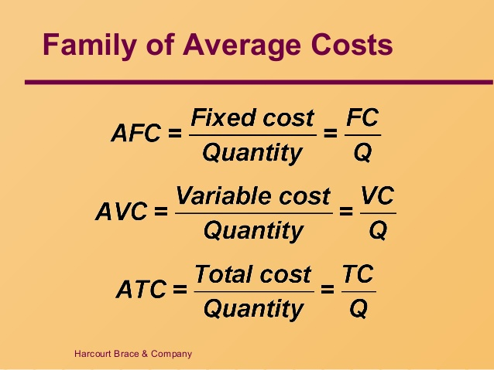
AVERAGE COSTS
Average total cost is also known as unit cost, since it is cost per unit of output produced

Slide 29
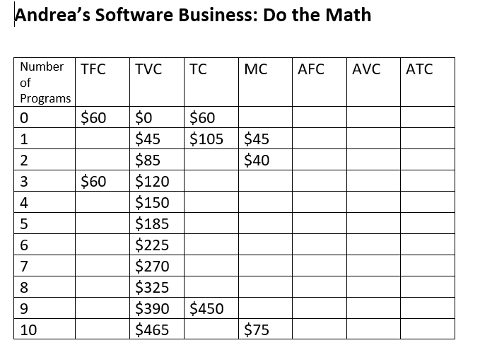
Let’s now calculate per unit costs…

Slide 30
Andrea’s Software Business
Number of Programs | TFC | TVC | TC | MC | AFC | AVC | ATC
0 | $60 | $0 | $60 |  |  |  | $60
1 | $60 | $45 | $105 | $45 | $60 | $45 | $105
2 | $60 | $85 | $145 | $40 | $30 | $42.50 | $72.50
3 | $60 | $120 | $180 | $35 | $20 | $40 | $60
4 | $60 | $150 | $210 | $30 | $15 | $37.50 | $52.50
5 | $60 | $185 | $245 | $35 | $12 | $37 | $49
6 | $60 | $225 | $285 | $40 | $10 | $37.50 | $47.50
7 | $60 | $270 | $330 | $45 | $8.50 | $38.50 | $47
8 | $60 | $325 | $385 | $55 | $7.50 | $40 | $47.50
9 | $60 | $390 | $450 | $65 | $6.60 | $42.30 | $48.90
10 | $60 | $465 | $525 | $75 | $6 | $46.50 | $52.50
Andrea’s Software Business- Answers

Slide 31
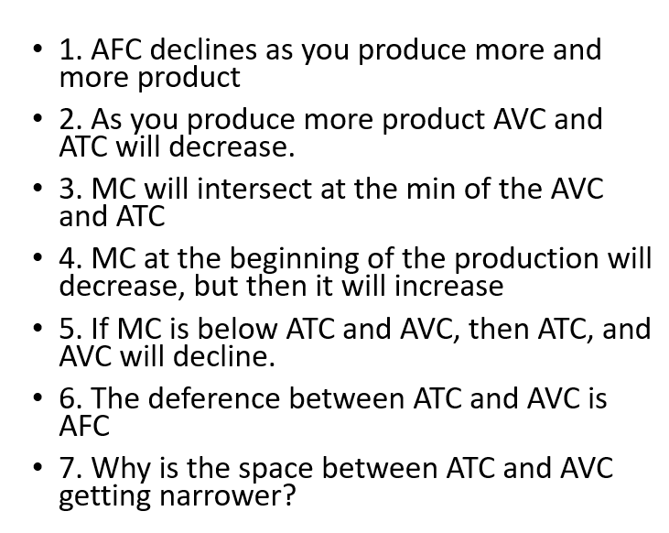
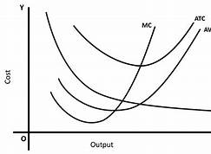
Graphs of ATC, AVC, AFC and MC
True - False

Slide 32
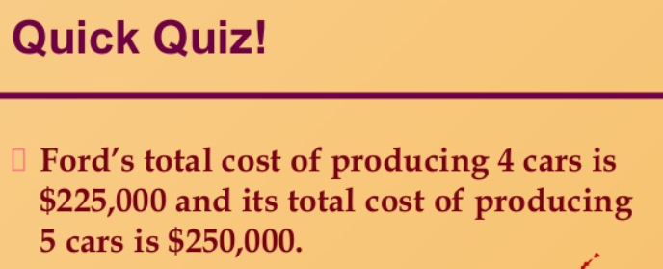
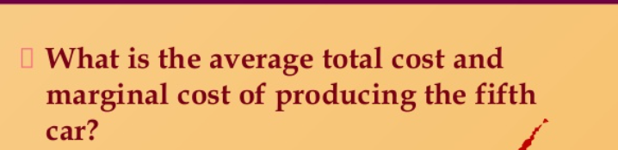
Marginal Cost of the 5th car is $25,000 and the average total cost of the 5th car is $50,000.

Slide 33
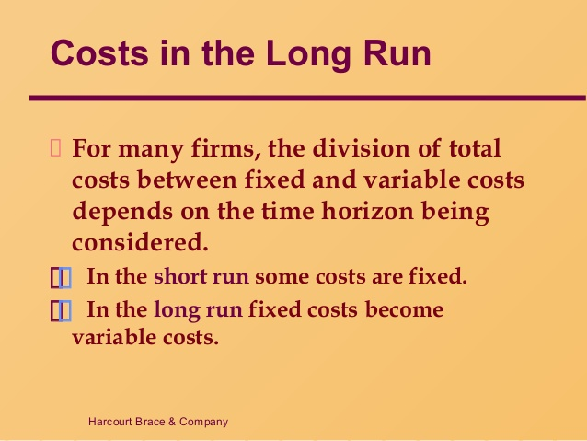
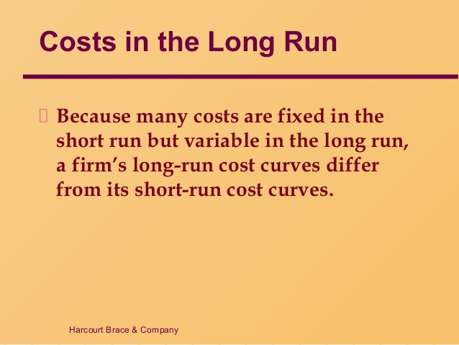
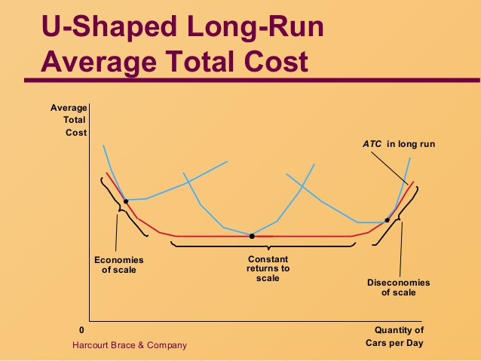

Slide 34
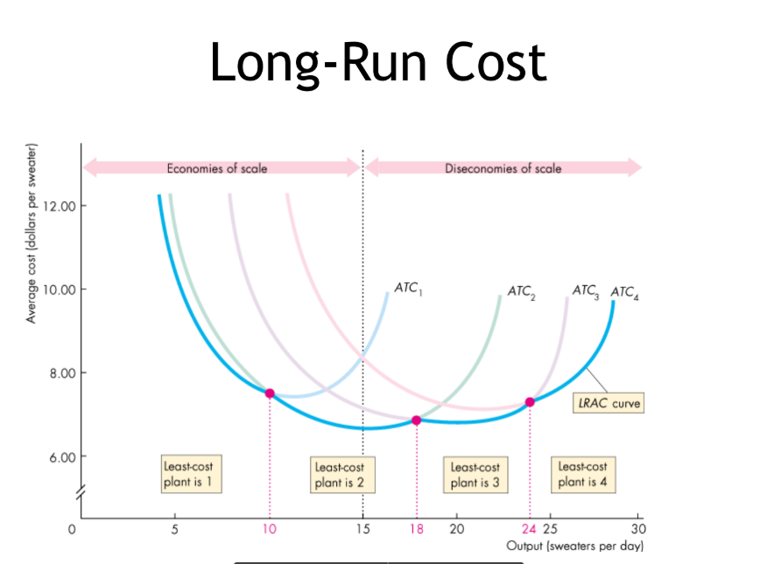

Slide 35
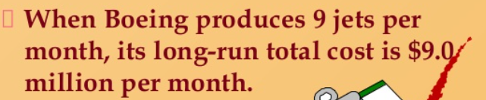
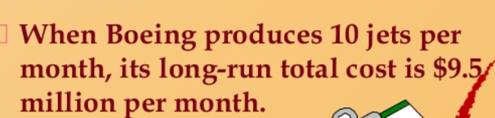

Take A Quiz
Economies of scale because 9 jets/$9 = $1 million each.
10 jets/$9.5 = < $1 million per jet

Slide 36


Where does a Company Produce?
1. Where they make the most profit
2. Where MR= MC

Slide 37
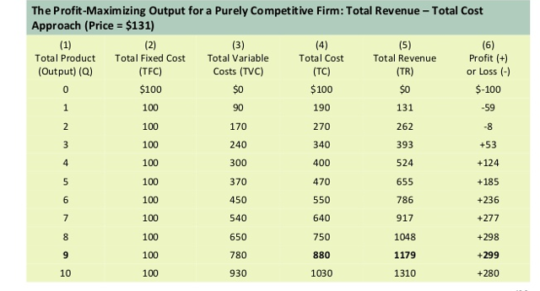
Profits?
Total Revenue - Total Cost = Profits

Slide 38
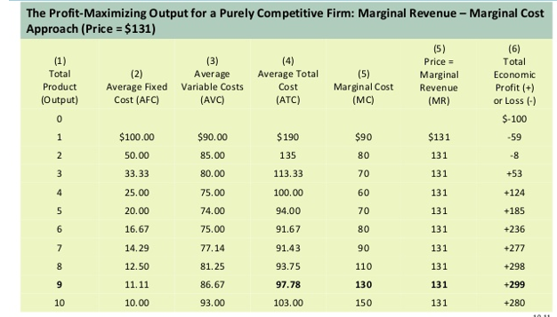
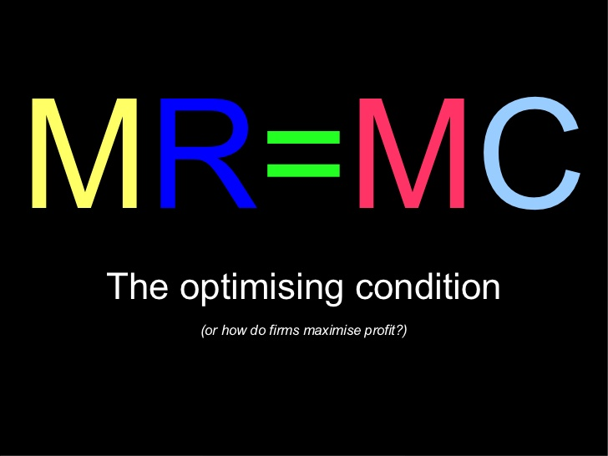
MR=MC

Slide 39
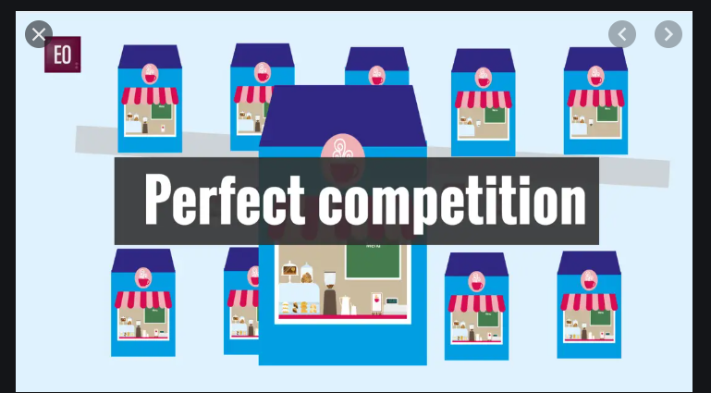
PERFECT COMPETITION

Slide 40
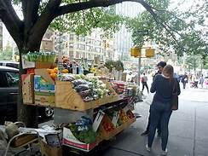
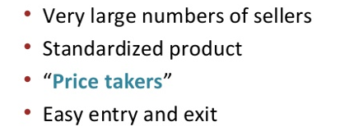
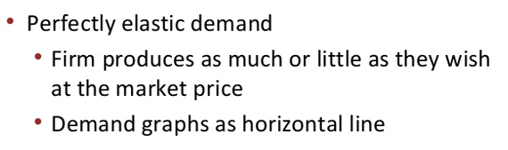
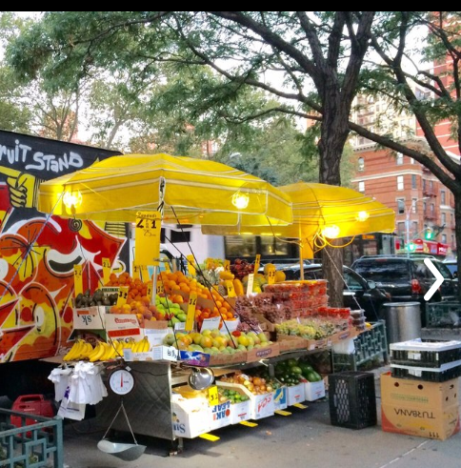
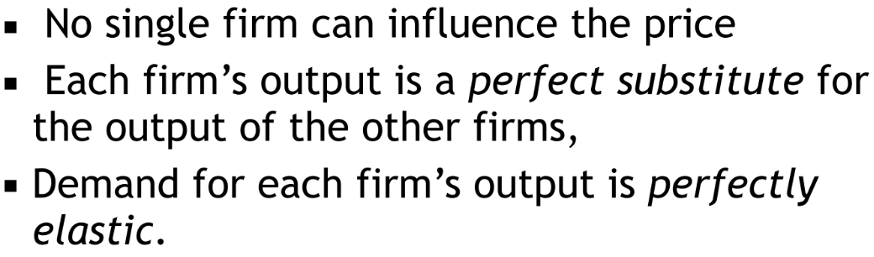
Characteristics of Pure Competition

Slide 41
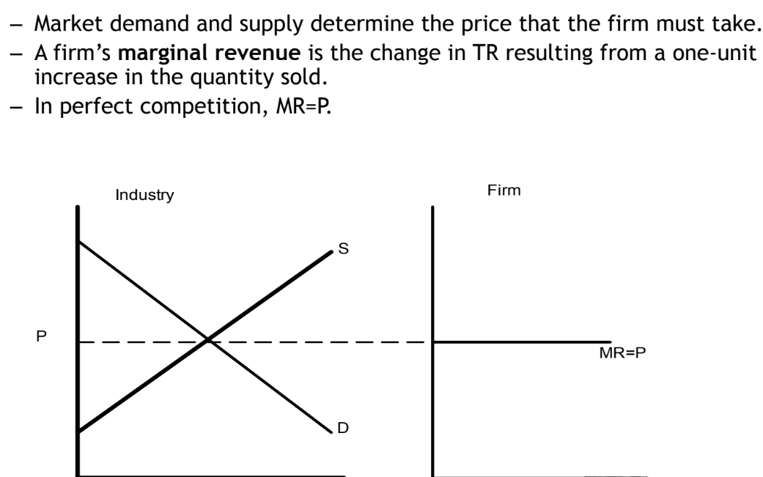
MARKET
FIRM

Slide 42
Why is the Horizontal Line MR=D=AR=P?
QTY TR MR AR
1 $5
2 $10
3 $15
4 $20
5 $25
Therefore --→ MR=D=AR=PRICE!!
They are Price Takers

Slide 43
Check this out… https://www.youtube.com/watch?v=Z9e_7j9WzA0 https://www.youtube.com/watch?v=SjZmnOAPKUM&list=PLE70CA726102FB294&index=14
As a result of the video, answer the following question:
Explain MR = D = AR = P
QTY P TR MR AR
1 $5 $5 0 $5
2 $5 $10 $5 $5
3 $5 $15 $5 $5
4 $5 $20 $5 $5

Slide 44
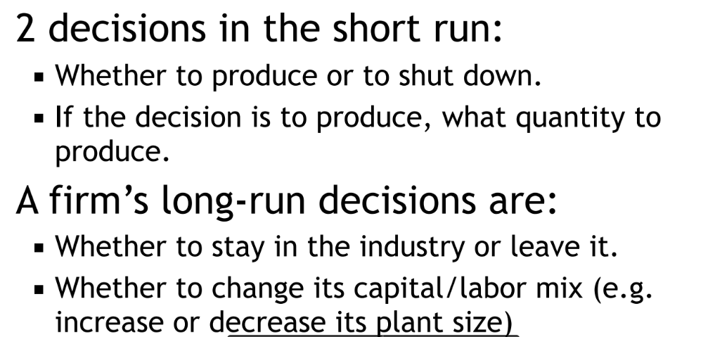
Decisions?

Slide 45

Forrest Gump and the Shrimp Boat Scene
https://www.youtube.com/watch?v=TjcK-LGgtLA

Slide 46
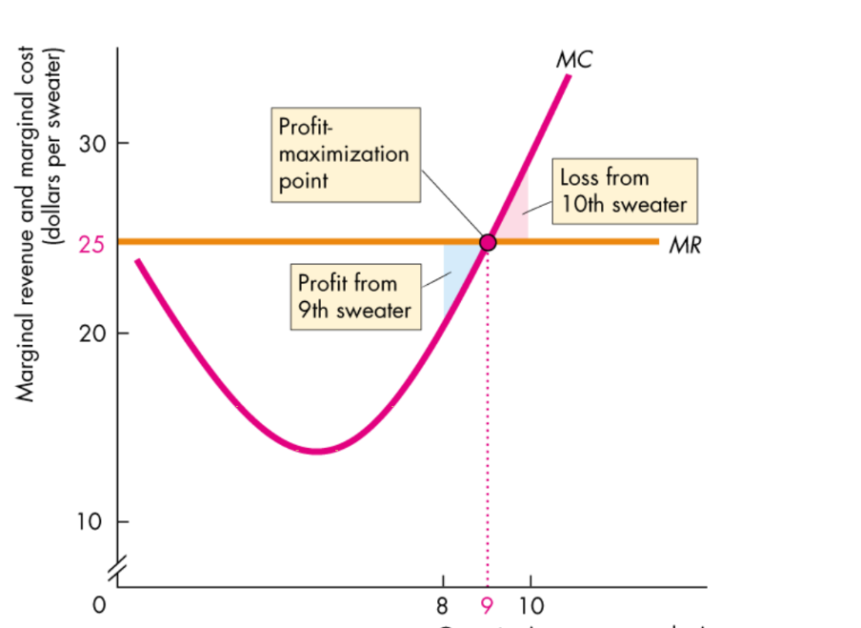

Slide 47

What is the price of each unit sold in this firm?
What is the per unit profit of this firm?
What is the per unit cost of the firm?
What is the total cost of the firm?
Where does the MC cross AVC and ATC?
Explain why there is a profit.
What is your total revenue? Total cost?

Slide 48


Pure Competition: Short Run→Long Run
(Profit)

Slide 49


Slide 50


Pure Competition: Short Run->Long Run
(Loss)

Slide 51

Why must this firm shut down? Explain

Slide 52


Slide 53

Review of Pure Competition

Slide 54

CEE Affiliates
https://www.councilforeconed.org/resources/local-affiliates/

Slide 55
Thank you for sharing the evening with me
I hope that the information that I presented helps you in the classroom with your students when studying Cost of Production and Perfect Competition

