Slide 1

Investing in the Future with Renewable Energy
3/11/20
Theodore Opderbeck

Slide 2
Ted Opderbeck
Teacher at Waldwick High School 1996 - Present
Social Studies/Economics:
  AP Economics
  Honors Economics I and II
  Introduction to Economics and Personal Finance
  U.S. History I and II
  Introduction to Law
  Criminal Procedure
Coach varsity tennis and volleyball
Graduated from Gordon College in Wenham MA
Masters’ Degree in Teaching Montclair State University
Attended Seton Hall Law School
Enjoy photography, hiking, travelling, spending time with wife and two teenage children.

Slide 3

Question of the Day Activity
Which of the following nations operates on 100% renewable energy sources?
Germany
Iceland
Costa Rica
Sweden
*Note: Students are in teams for one week intervals. Each day I project a question such as the one above related to our task at hand. They huddle and provide an answer. At week’s end the group with the most correct answers wins.
https://www.resilience.org/stories/2018-05-24/a-100-renewable-grid-isnt-just-feasible-its-already-happening/

Slide 4

Bonus Question
The United States currently utilizes what percentage of total energy consumption from renewable sources?
27%
35%
11%
8%
Notes:
8%

Slide 5
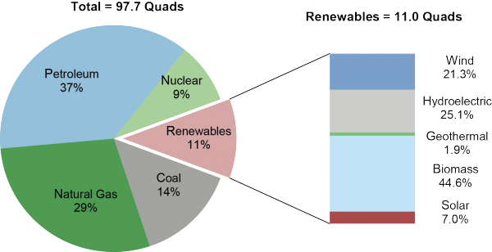
U.S. Energy Utilization

Slide 6
Objectives
Discuss sources of alternative energy and compare to non-renewable sources.
Explore national and global trends regarding energy production and consumption.
Examine the economic benefits and consequences of increasing renewable/alternative energy sources
Frame some of the big economic questions related to energy policy.
Introduce lesson plans and projects to guide students as they explore the economic issues concerning renewable/alternative energy
Explore learning extensions and current applications.

Slide 7
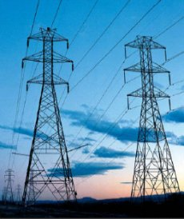
Key Vocabulary/Concepts
Renewable Energy: energy that is derived from natural sources that are constantly replenished
Non-renewable Energy: energy that is derived from sources that are depleted and cannot be replaced for a long period of time, perhaps millions of years.
Fossil Fuels: natural fuels formed from the remains of living organisms in the geologic past (ex: coal, oil, natural gas)
Energy Policy: actions governments take to affect the supply of and demand for energy within a nation.

Slide 8

Connections to Economics/Finance Units of Study
Scarcity/ Resource Allocation
Fiscal Policy/ Government Budget
Supply/Demand
Environmental Economics
Private and Public Investment
Cross Curricular Applications: Science, Political Science, Architecture, Sociology

Slide 9
History of Energy Production and Use
Pre Industrial Revolution Energy Sources (Prior to 18th Century): wood, dung, straw, sun, animals, water, wind
Industrial Revolution (18th, 19th Centuries):
coal (steam engines), electric generators, hydroelectric power plants
Late Industrial Revolution/ Modern Period (late 19th, 20th Centuries):
coal, petroleum, gasoline, combustion engines, electric power grid, nuclear
20th Century: electricity use doubled every 10 years
Post Modern Period (late 20th, early 21st Centuries):
non-renewable sources plus growth of renewables: solar, wind, geothermal, tidal, etc. Also growth of natural gas (fracking)
https://www.worldometers.info/world-population/

Slide 10
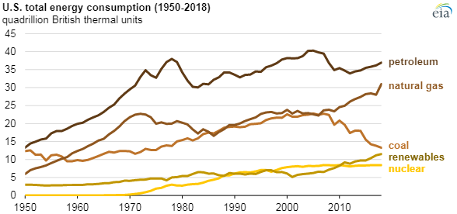

Slide 11
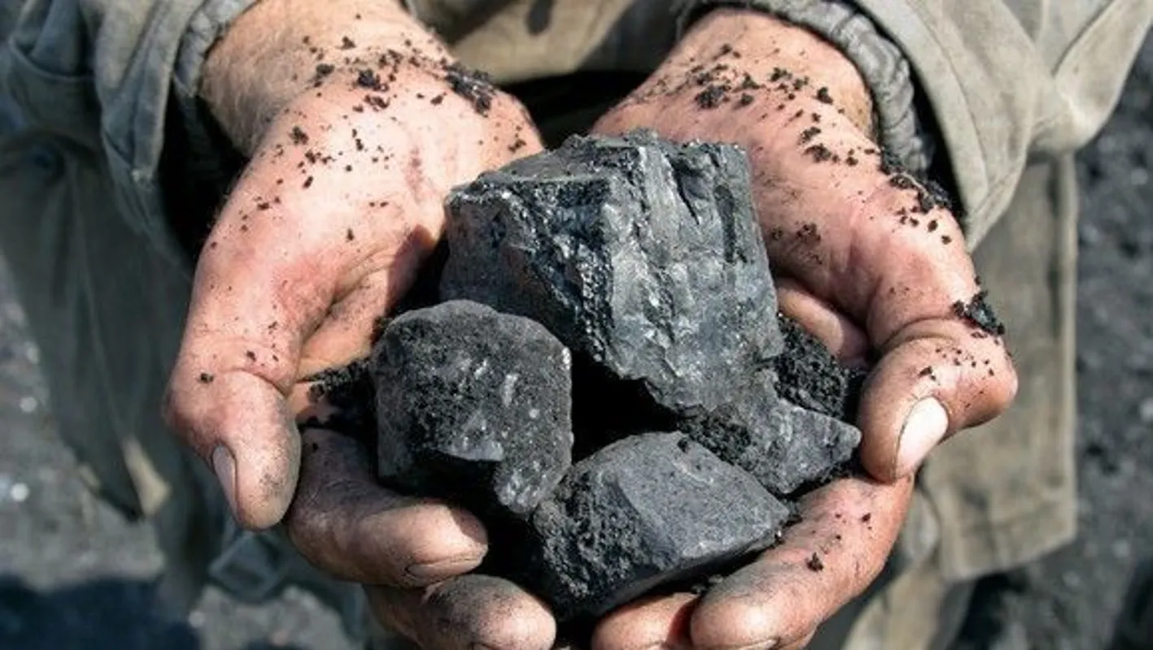
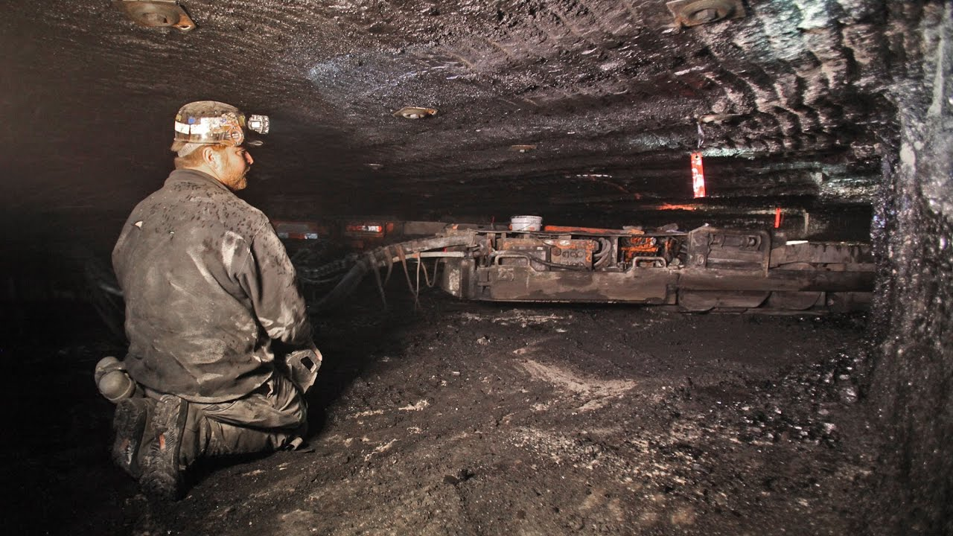
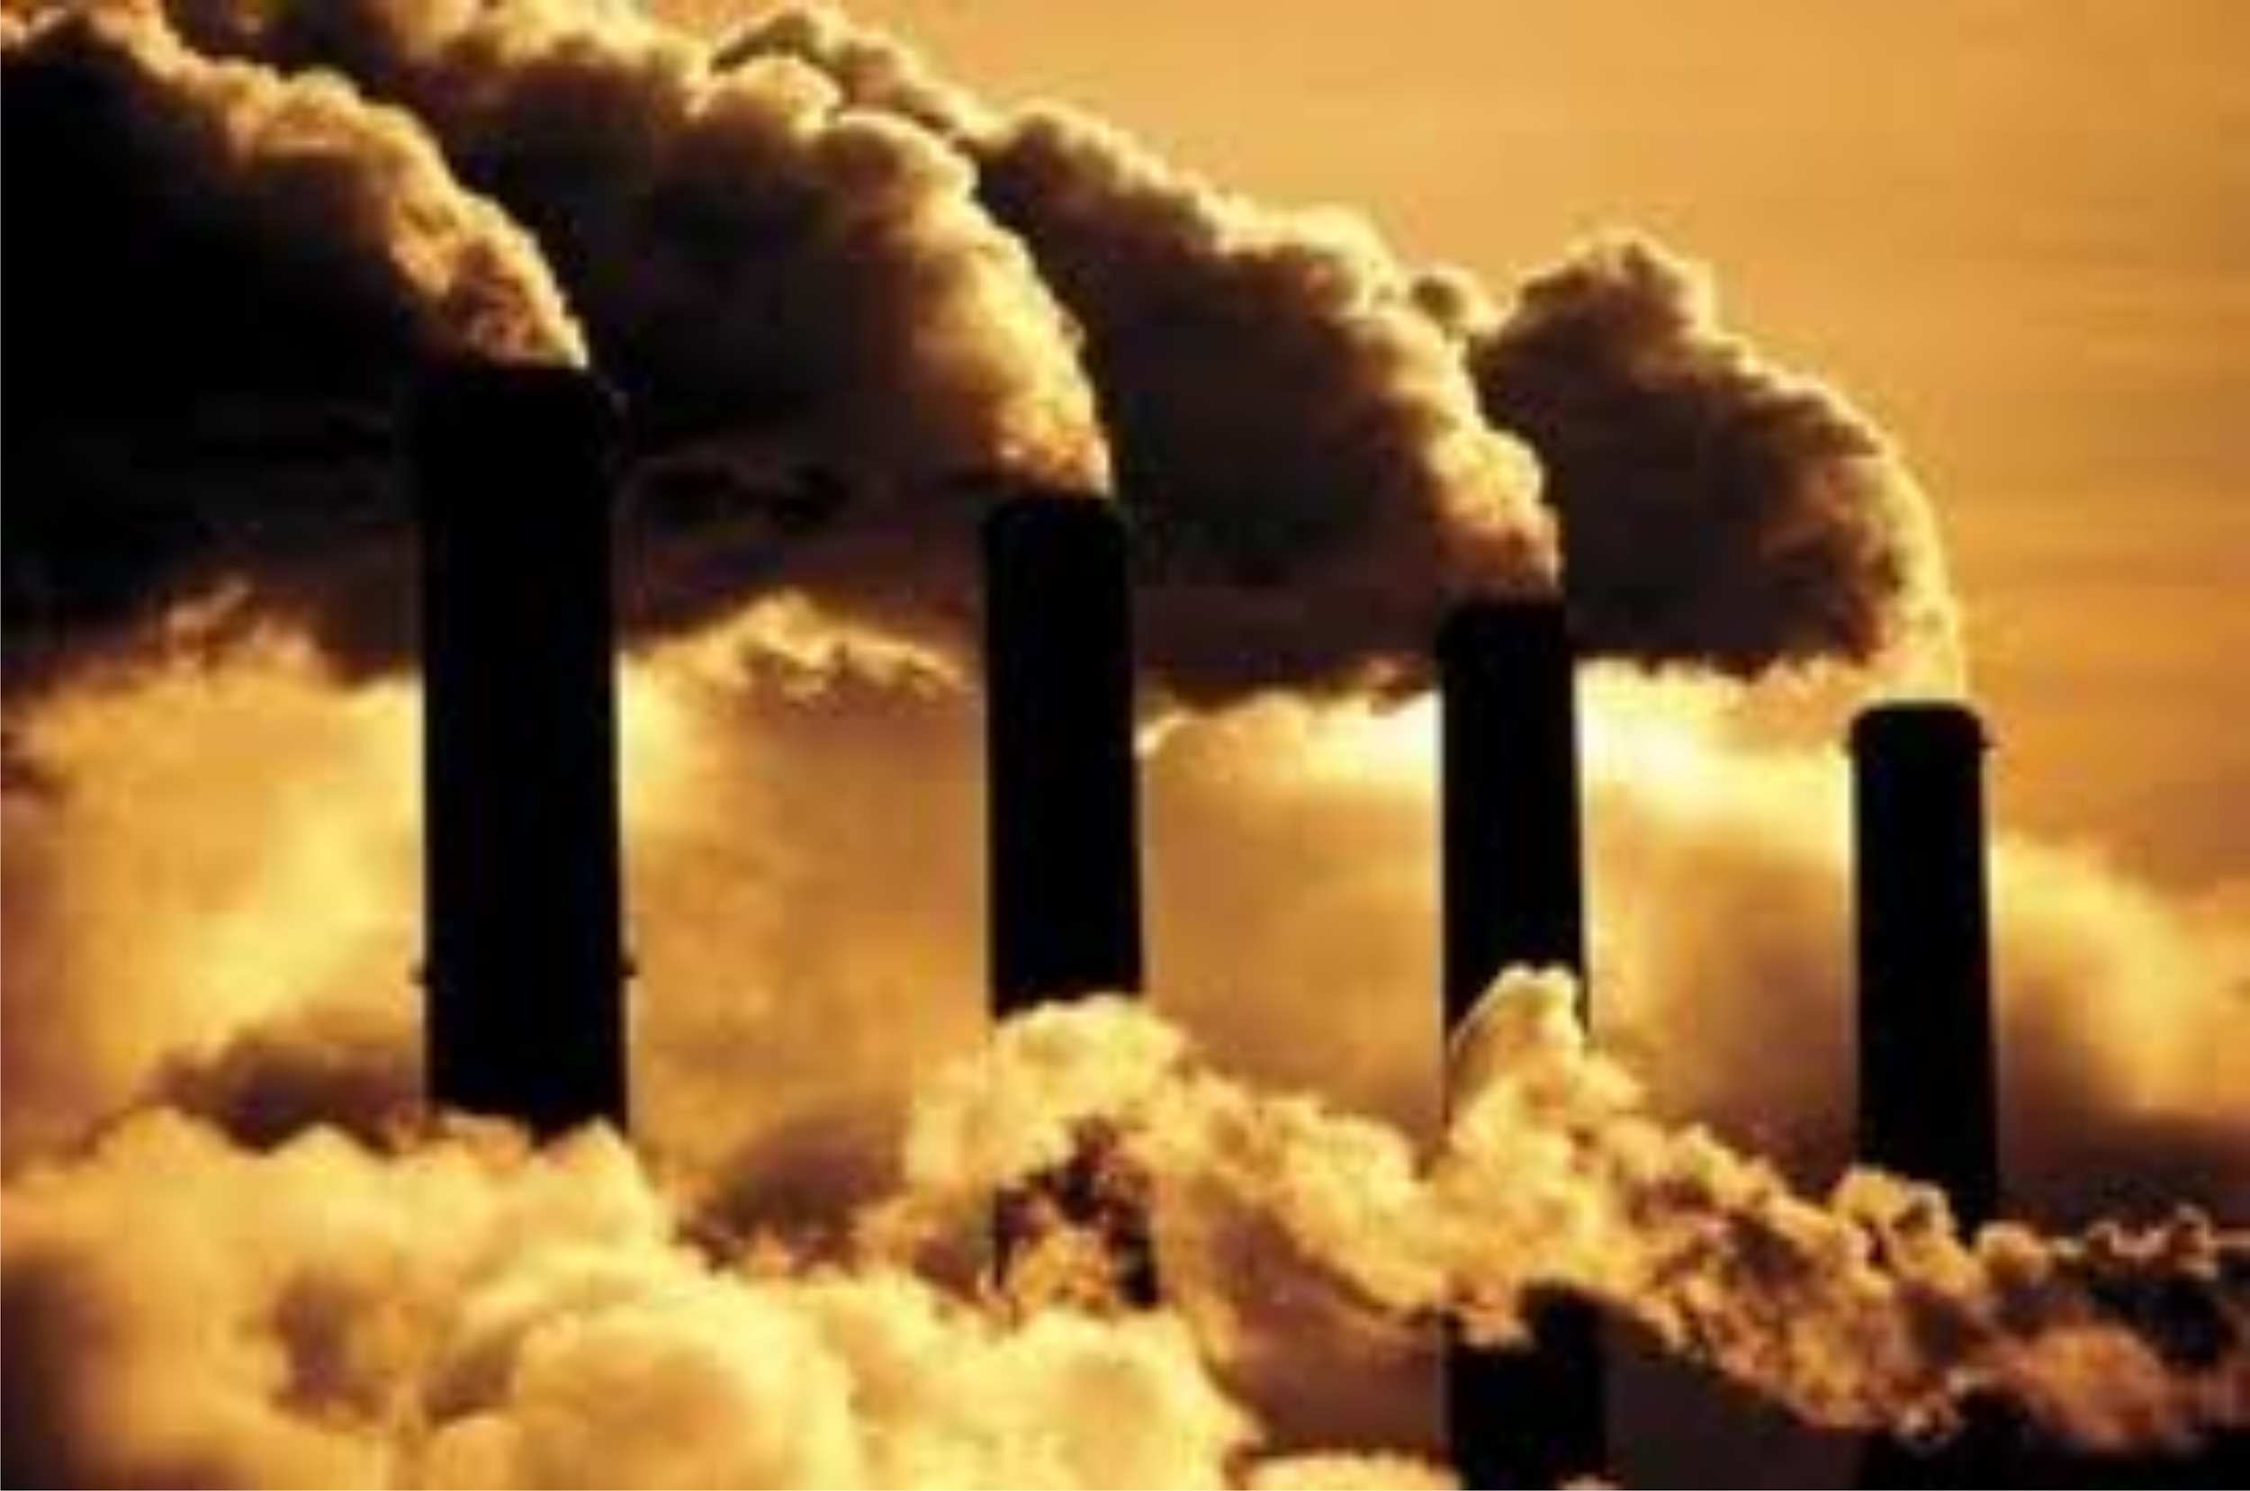
Non Renewable Energy Sources
Coal - solid, carbonized remains of ancient organisms
Advantages - cheap, readily available, extractable
Disadvantages - dangerous to mine, toxic pollution, carbon dioxide emissions
“Clean Coal” - capturing carbon emissions from burning coal and storing them under them under the earth. CCS - Carbon capture and storage.

Slide 12
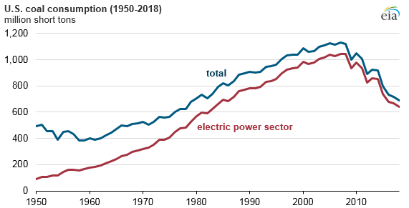
Non Renewable Energy Sources

Slide 13
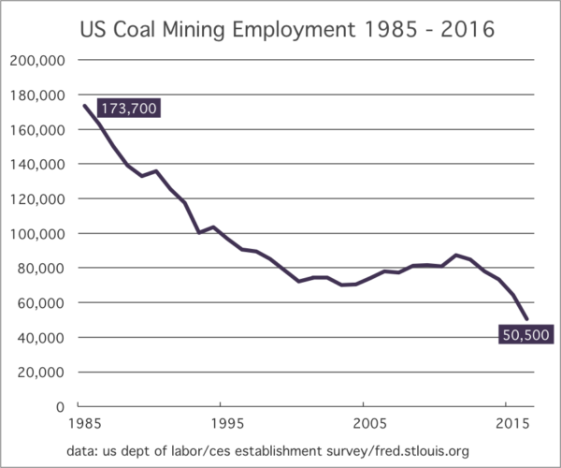

Slide 14
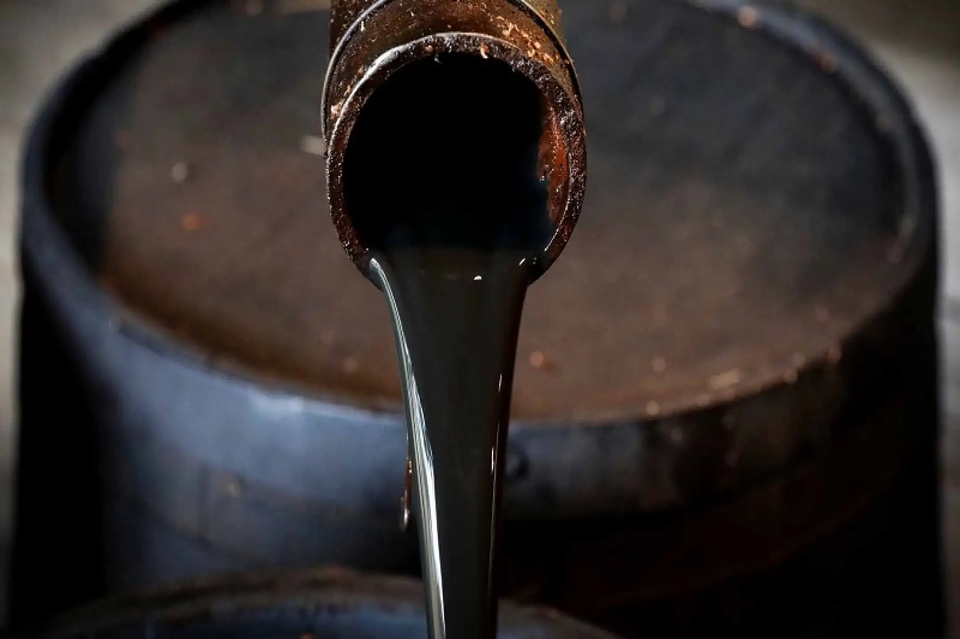


Non Renewable Energy Sources
Petroleum - liquid fossil fuel typically trapped under rock formations
Half the world’s petroleum is refined into gasoline, also heating oil, petrochemicals
Half is refined into materials used in products (asphalt, plastics, lubricants, tires, inks, etc,)
Advantages: relatively inexpensive to extract, reliable, transportable, easy to contain
Disadvantages: environmental pollution, carbon emissions, oil spills, explosions, unstable global price fluctuations.

Slide 15
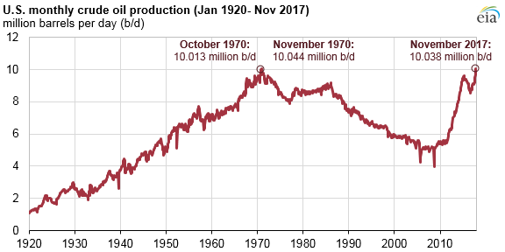

Slide 16
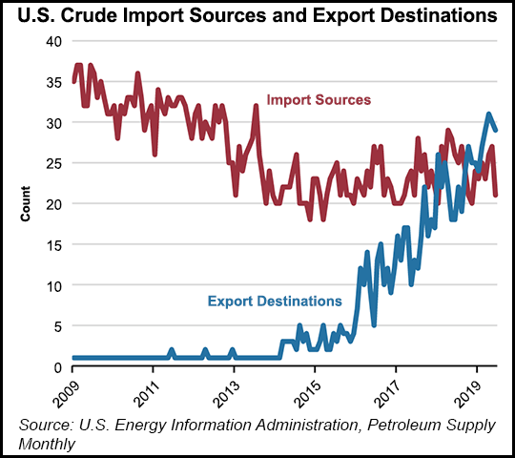

Slide 17
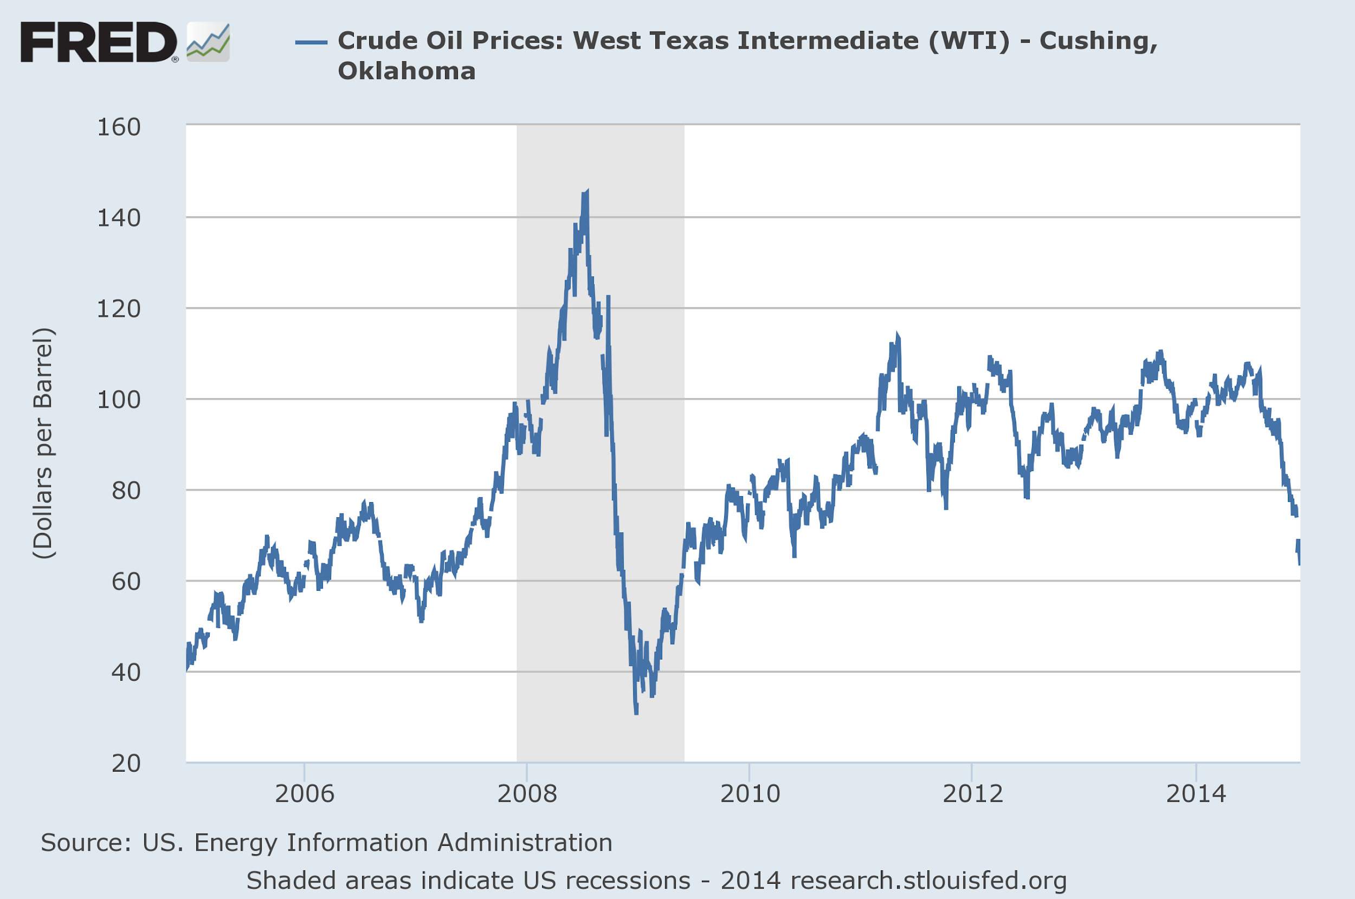

Slide 18
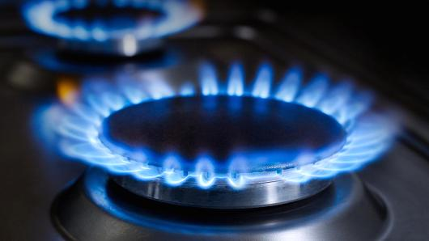
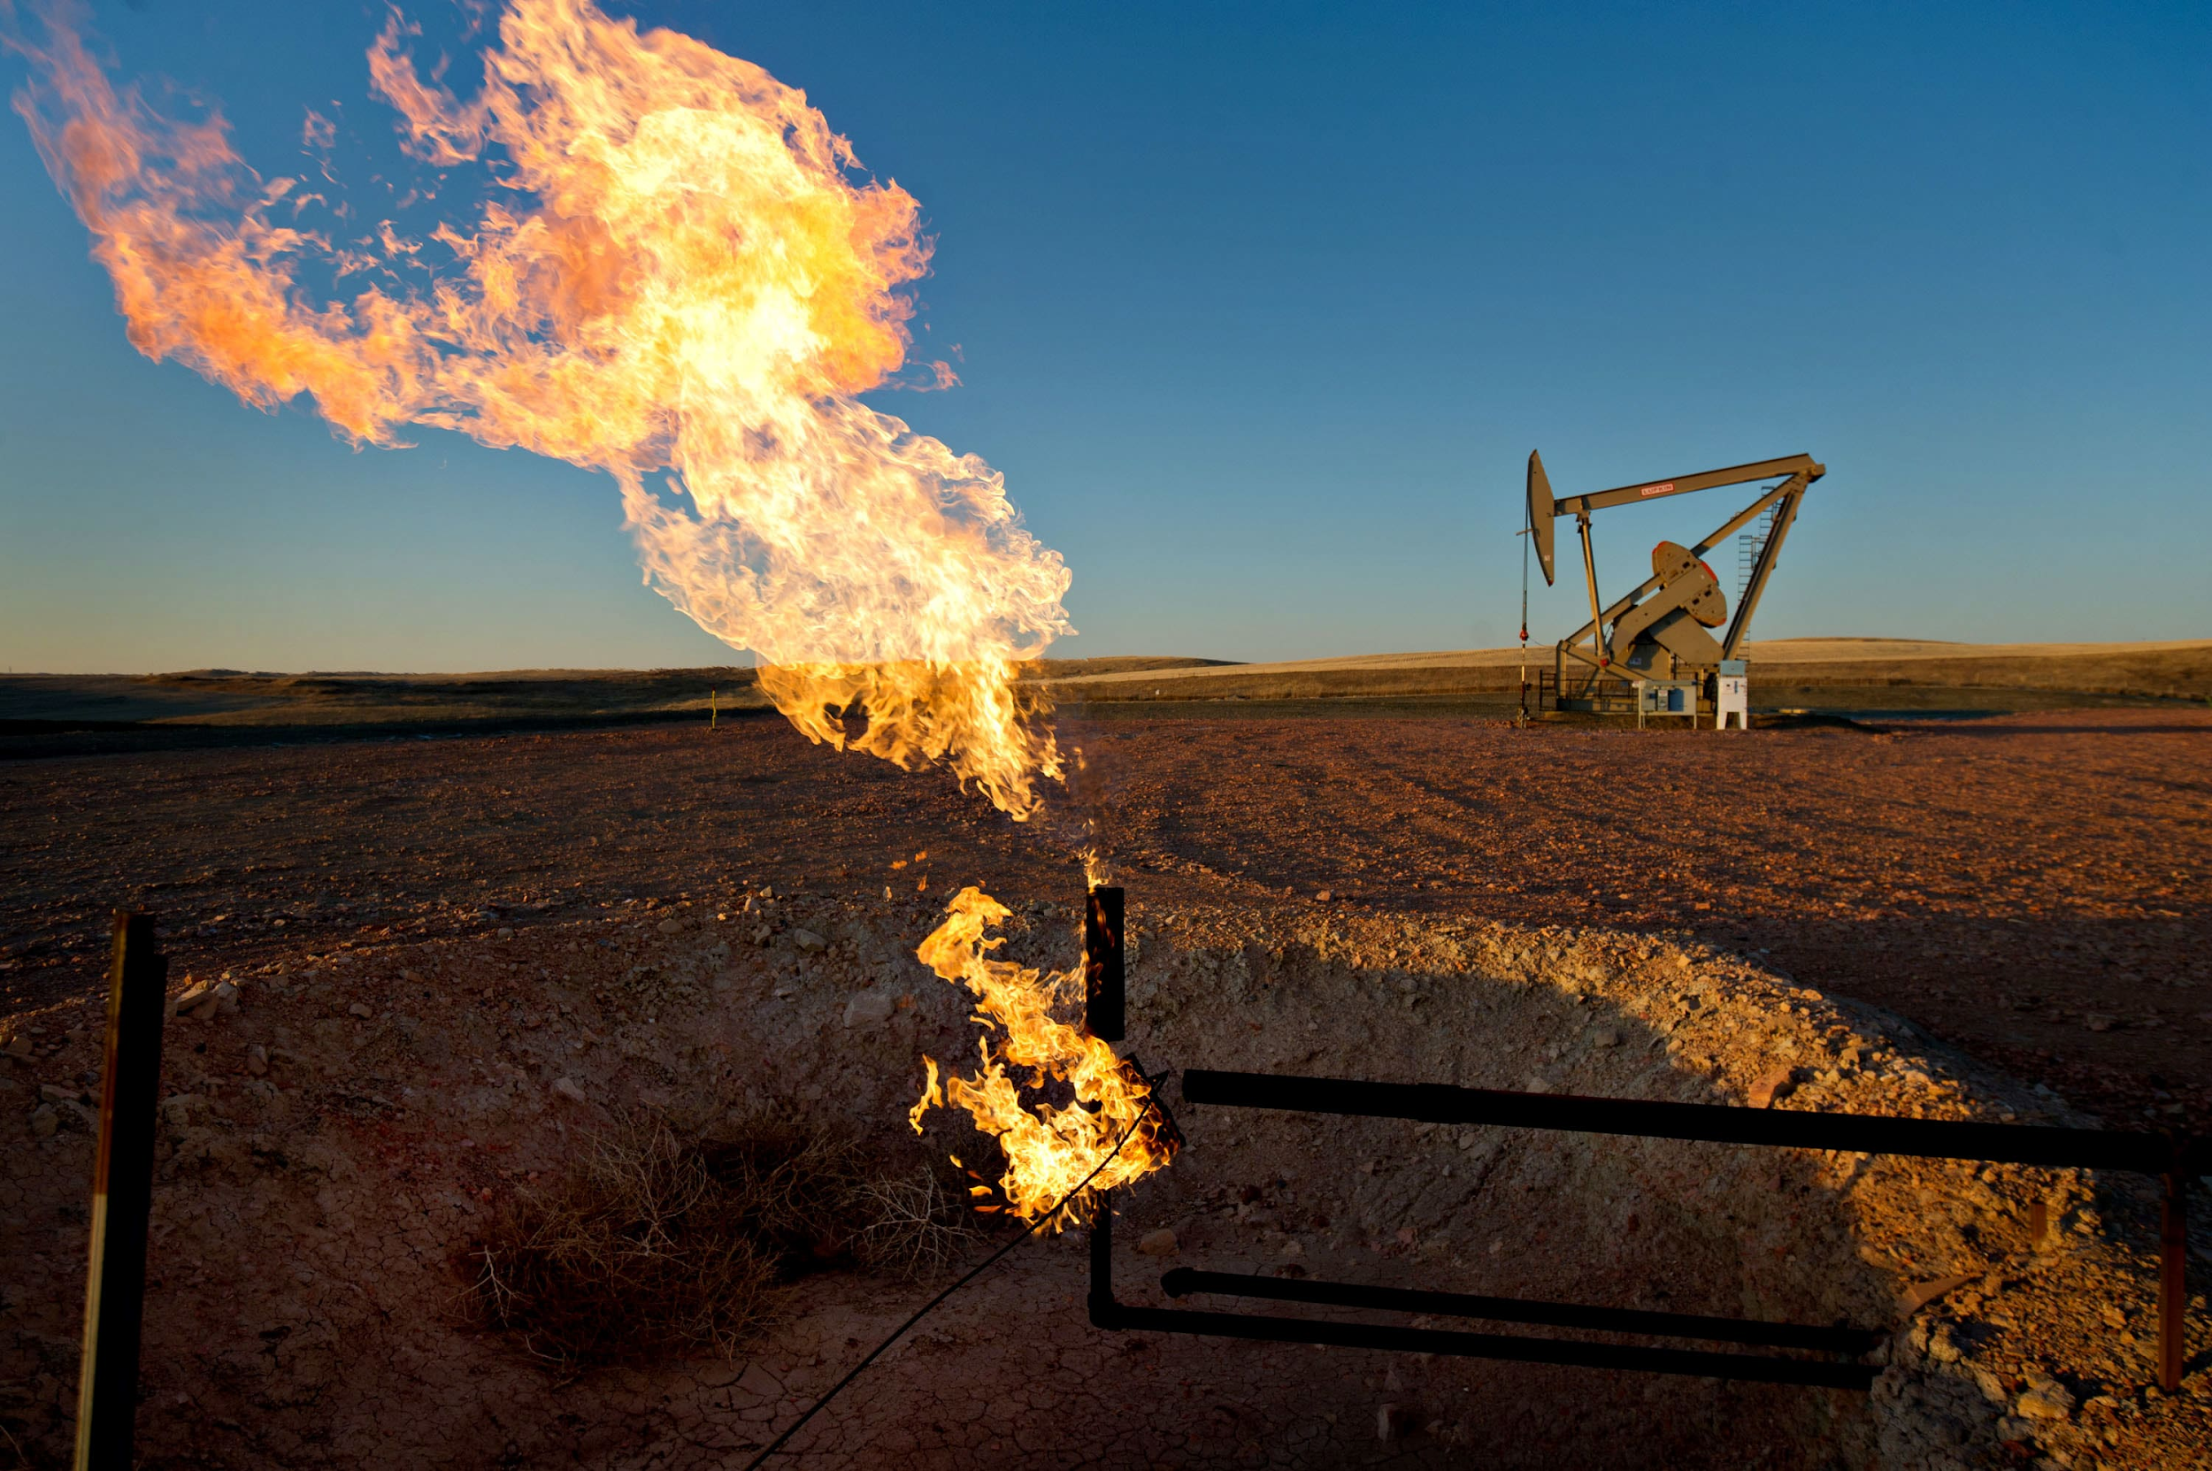

Non Renewable Energy Sources
Natural Gas: methane gas that is trapped underground in shale rock reservoirs from decomposed organic matter millions of years ago.
Some is liquified - LNG - Liquid Natural Gas
Advantages: trillions of cubic meters, relatively inexpensive to extract, “cleaner” than other fossil fuels
Disadvantages: fracking (“hydraulic fracturing”) method can cause minor earthquakes and groundwater contamination, still emits carbon dioxide although less than other fuels,

Slide 19
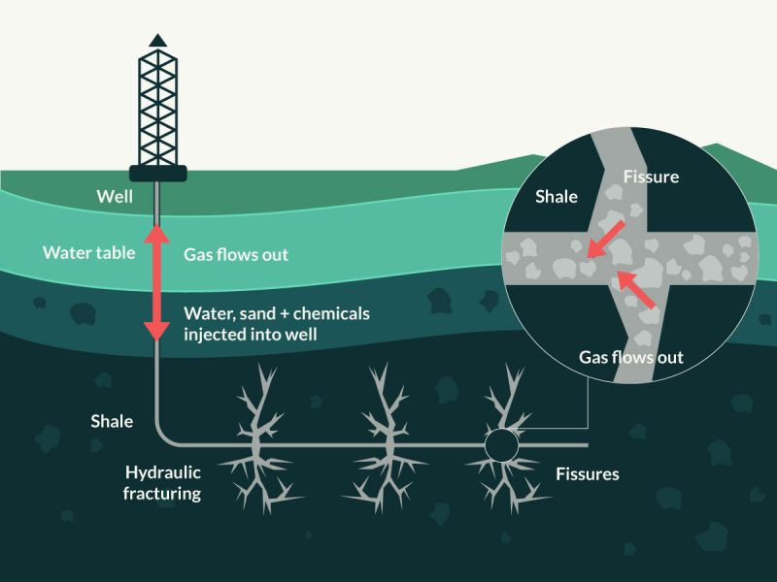
Natural Gas “Fracking”

Slide 20
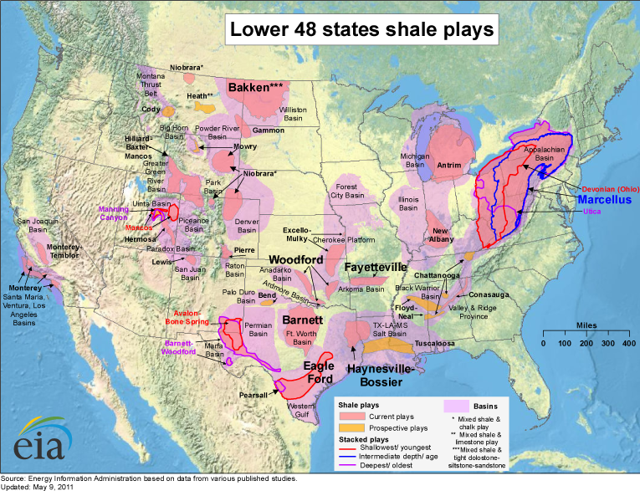

Slide 21
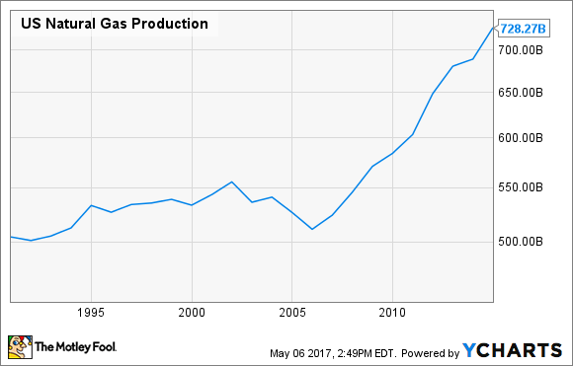

Slide 22
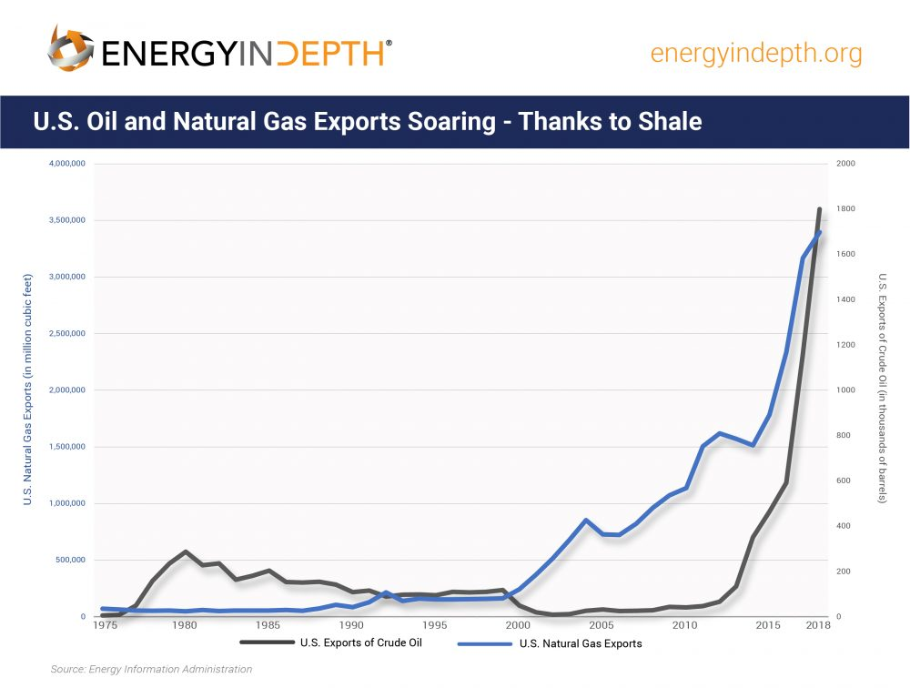

Slide 23
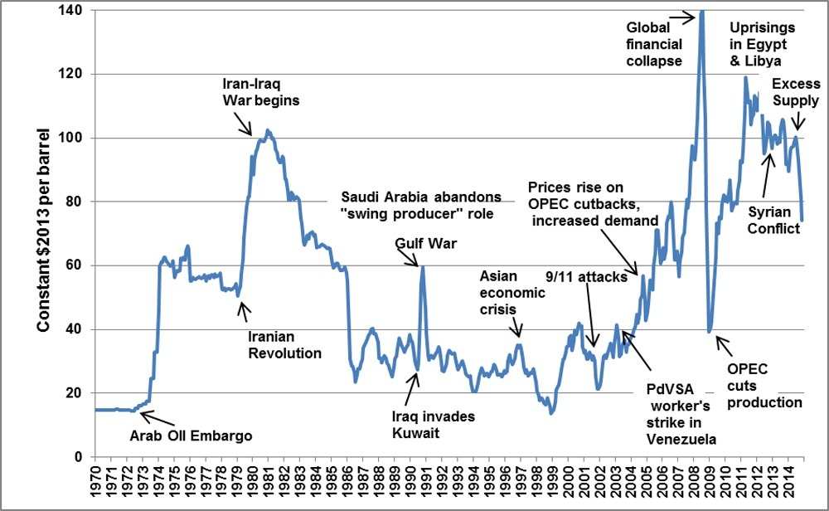
Volatile Prices in Oil Markets
https://www.washingtonpost.com/politics/2020/03/09/this-is-biggest-oil-price-crash-decades-that-may-not-be-great-us-economy/

Slide 24
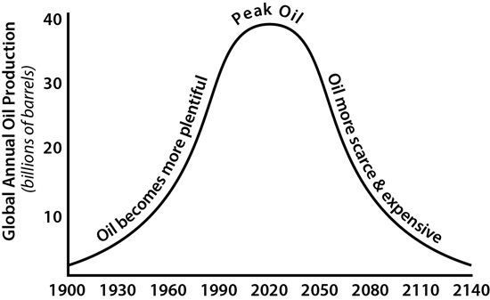
“Peak” Oil?

Slide 25
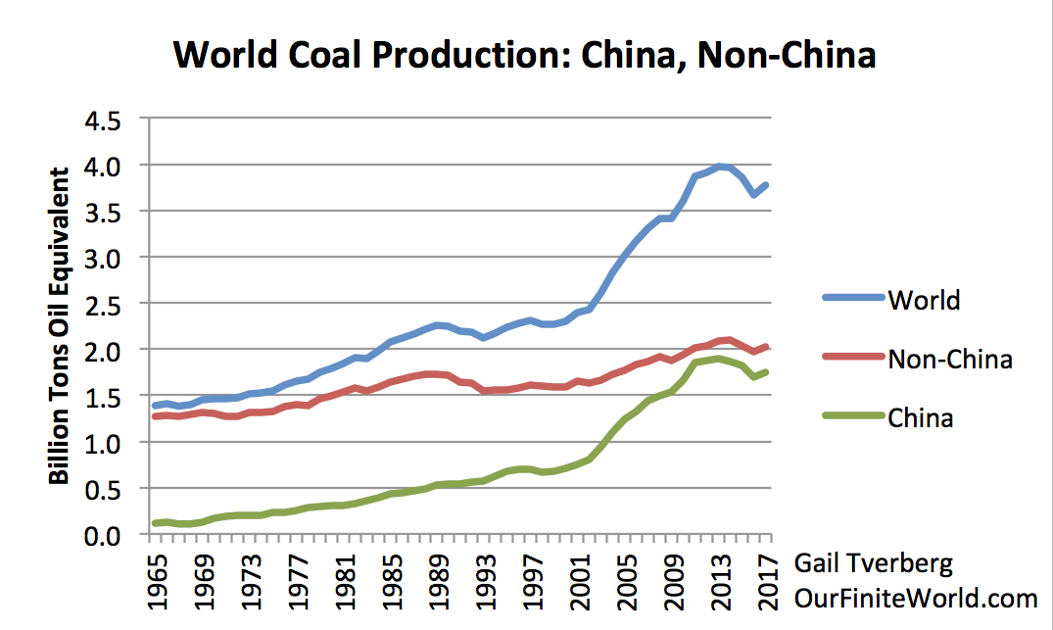
“Peak” Coal

Slide 26


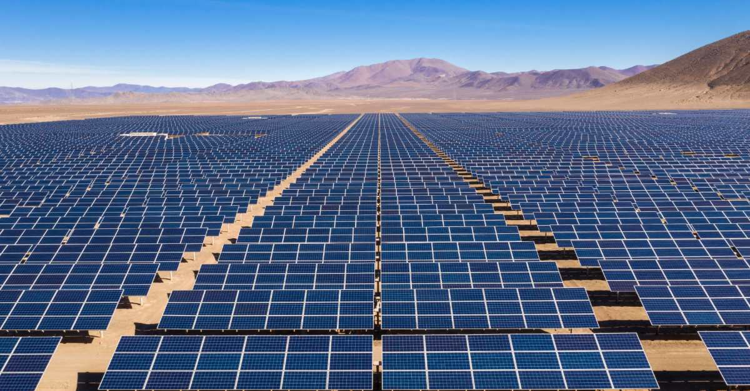
Renewable Energy Sources
Solar: the use of photovoltaic cells to capture the sun’s energy and convert to electrical power.
Enough energy from the sun falls on the earth in one hour to supply all the world’s energy needs for an entire year!
Solar “farms” set up in areas with abundant sunshine can distribute power to local homes and businesses.
Accounts for 1% of all U.S. power generation
Advantages: clean energy (no emissions except in manufacturing the cells), cost is decreasing, 100% renewable
Disadvantages: high set up costs, weather-dependant

Slide 27
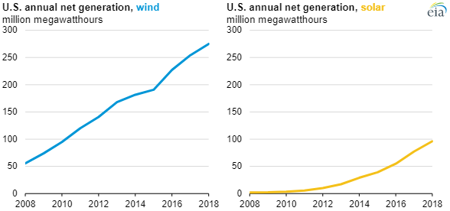

Slide 28
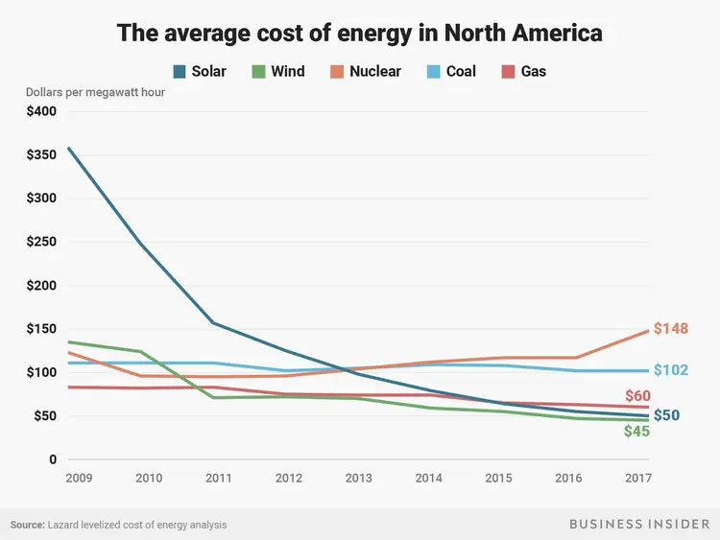

Slide 29
Renewable Energy Sources
Wind: the use of wind currents to spin turbine blades in order to feed electrical generators
Accounts for 6% of U.S. energy production and rising
Top wind power states: California, Texas, Kansas, Iowa, Oklahoma
Cheapest form of energy production
Advantages: clean energy (no emissions except in manufacturing turbines), cost is decreasing rapidly, 100% renewable, more potential areas
Disadvantages: some environmental concerns (bird migrations), weather-dependant, visual aesthetics

Slide 30
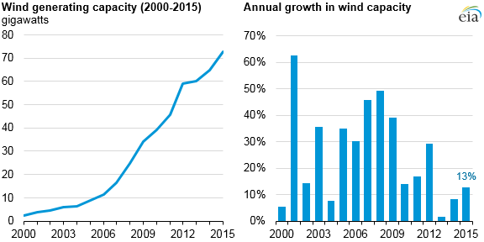

Slide 31
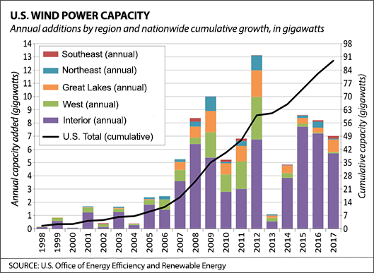

Slide 32
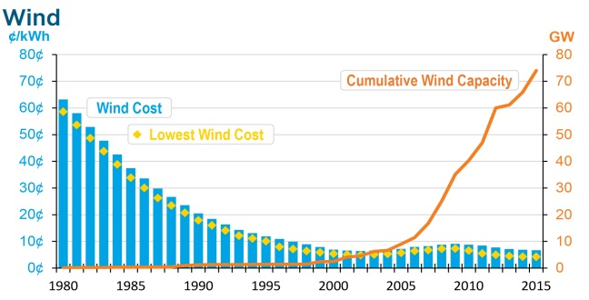

Slide 33


Book Suggestion . . .

Slide 34
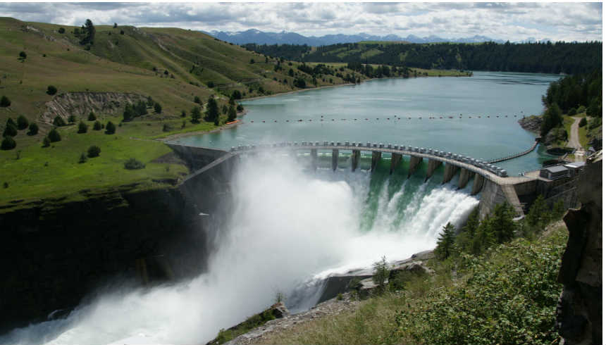
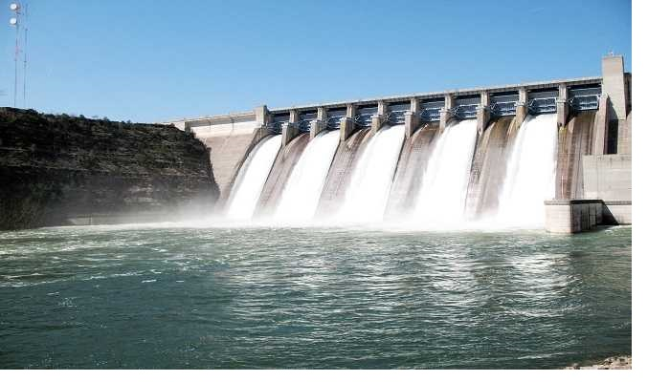
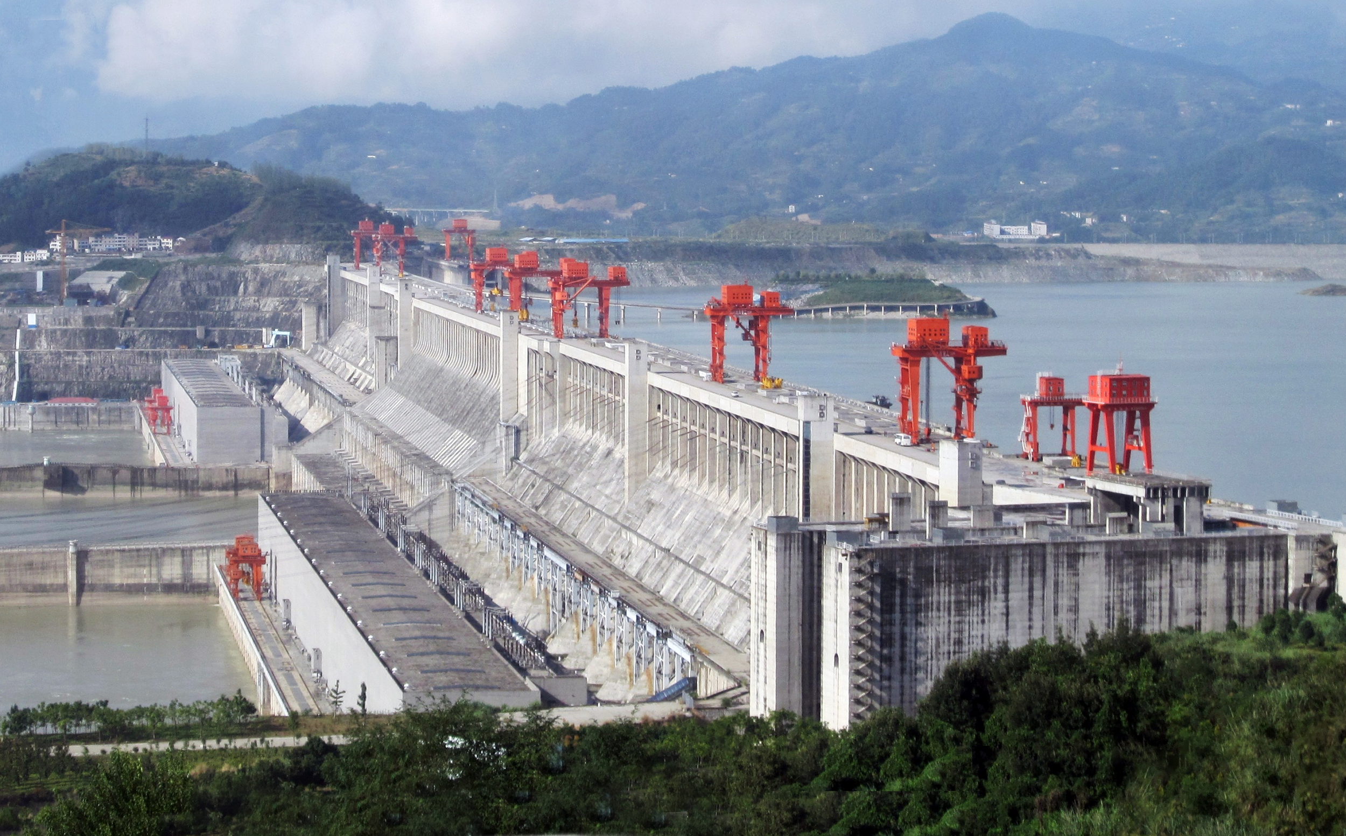
Renewable Energy Sources
Hydro Power: the use of rapidly descending water to spin a turbine and generate electricity. Usually set up through a dam
Currently the largest source of renewable energy - 52% of all renewables
Advantages: clean energy (no emissions except in manufacturing turbines), low operating costs, 100% renewable
Disadvantages: environmental concerns (fish migrations), only possible where water flows, high start up cost.

Slide 35
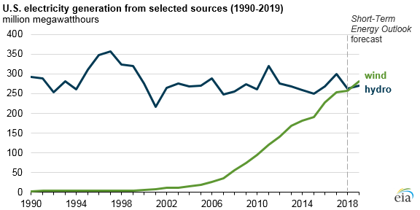

Slide 36
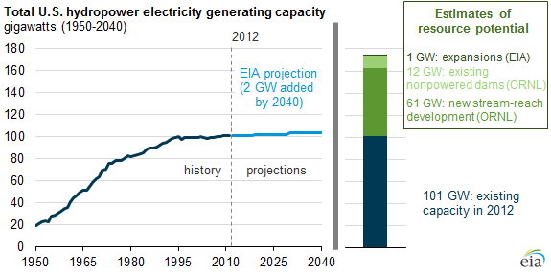

Slide 37
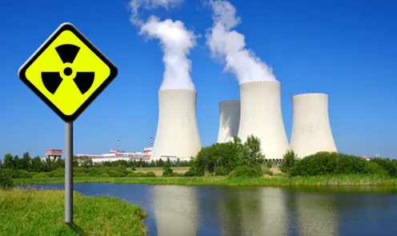
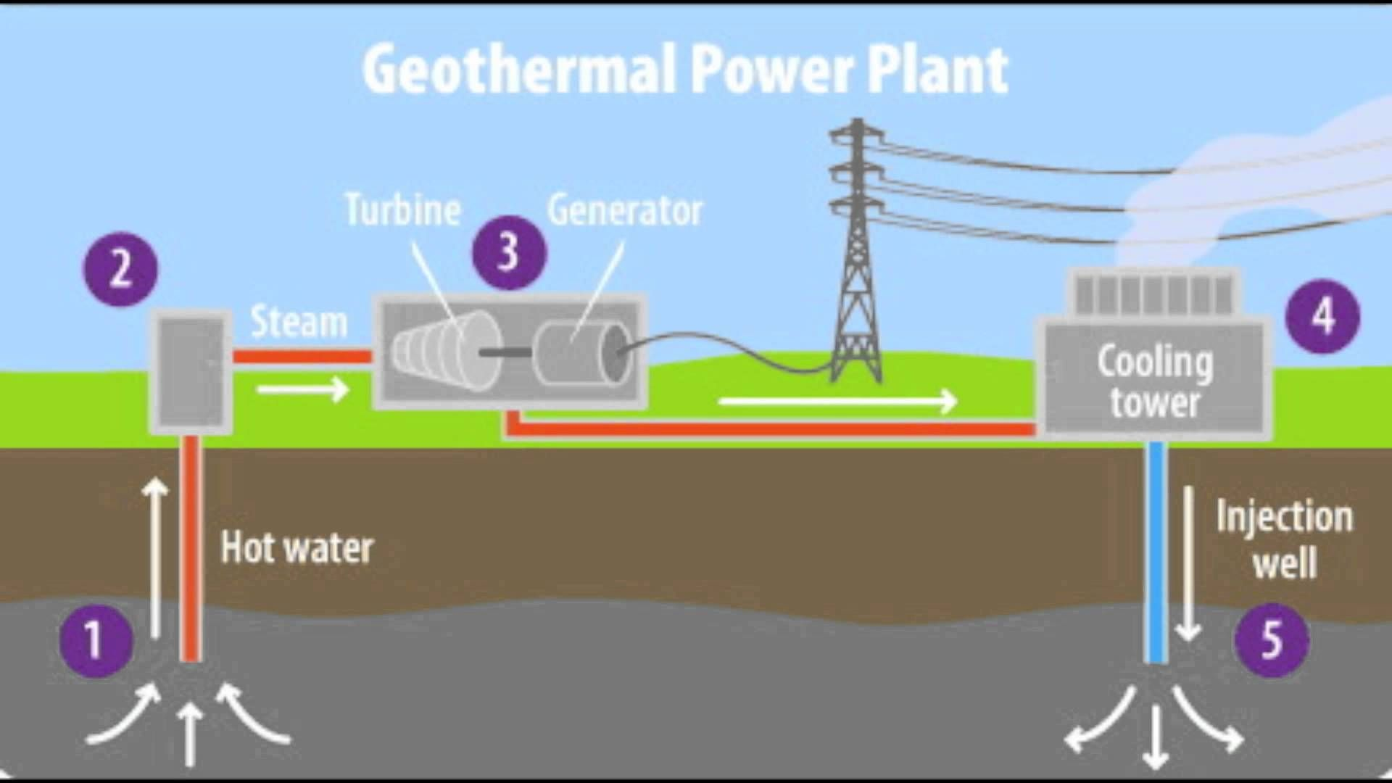
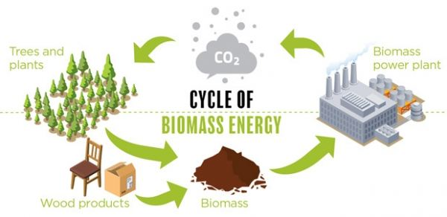
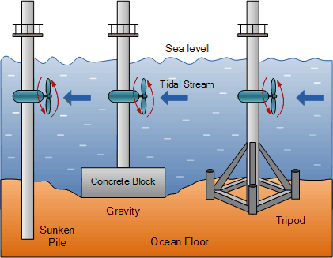
Renewable Energy Sources
Other Renewable Energy Soures:
Biomass
Nuclear
Tidal/ Ocean
Geothermal

Slide 38
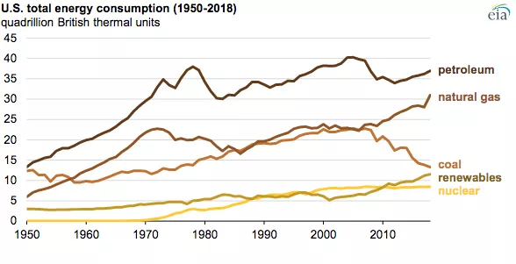

Slide 39
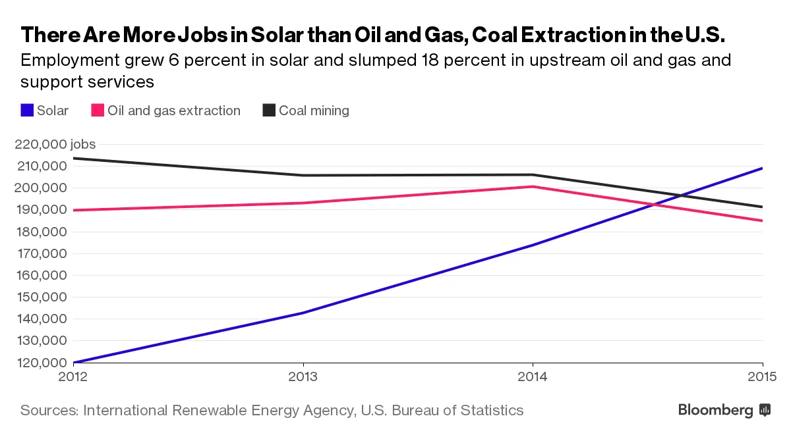
Renewable Energy and Job Creation

Slide 40
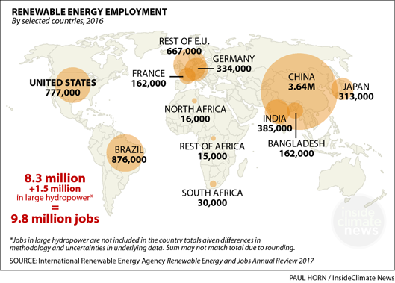

Slide 41
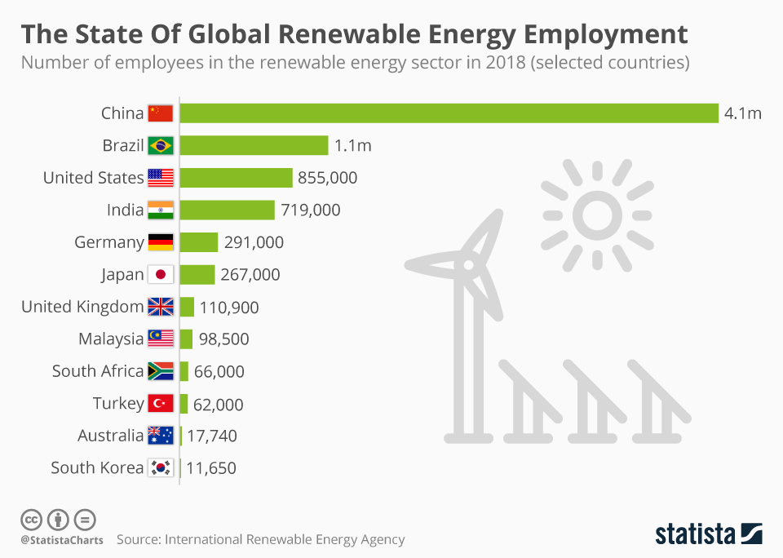

Slide 42
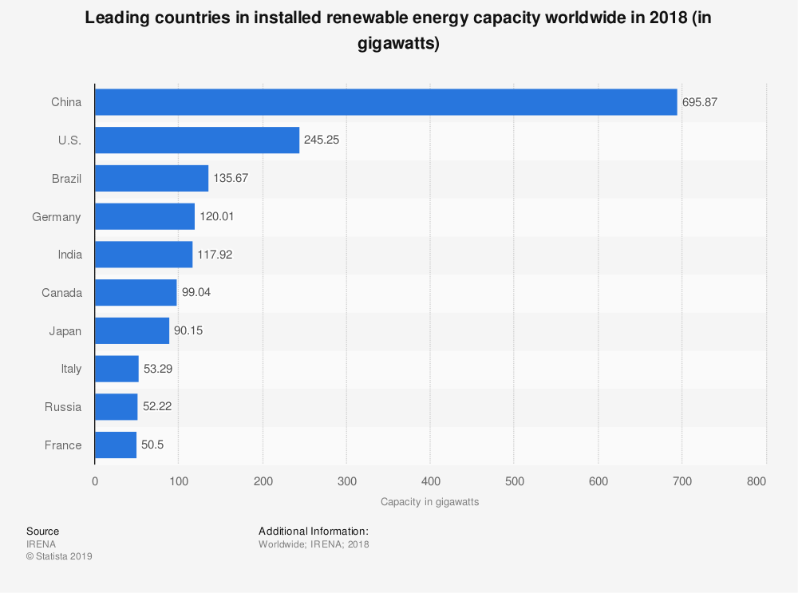

Slide 43
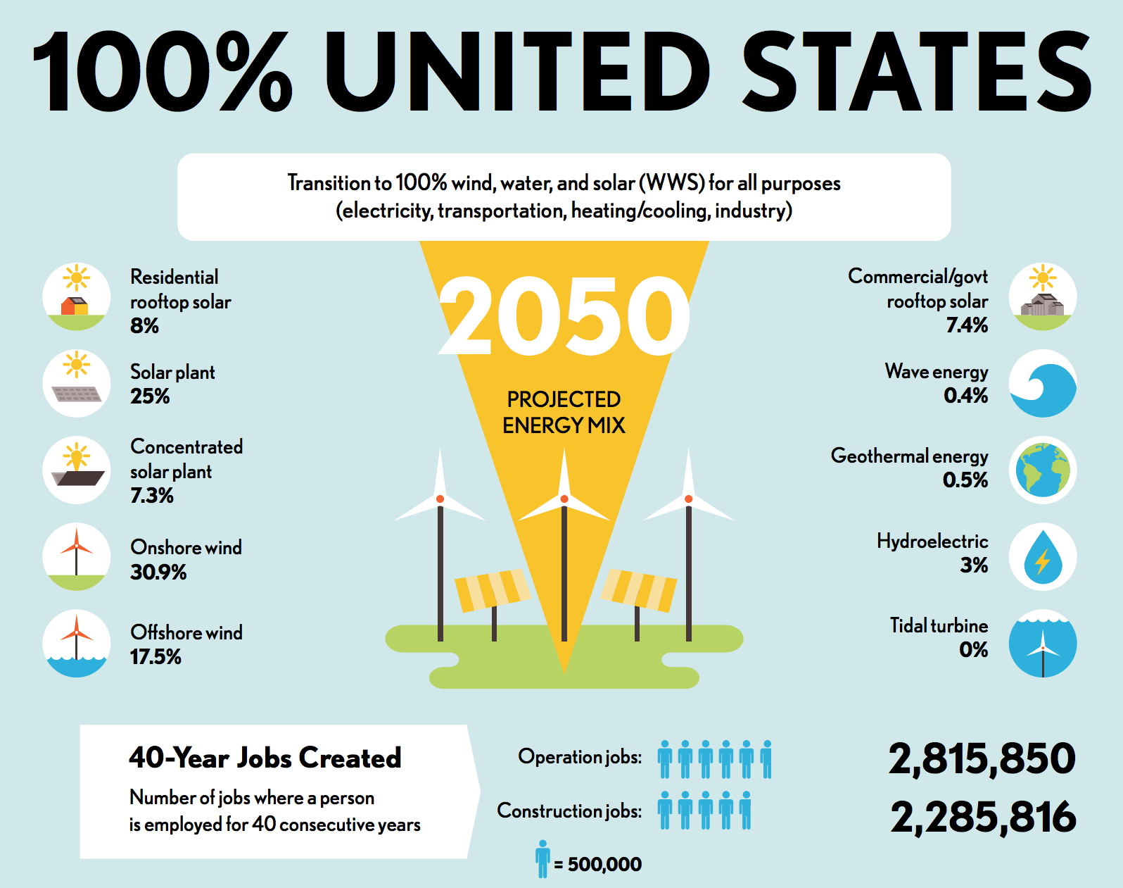

Slide 44
International Renewable Production
https://www.climatecouncil.org.au/11-countries-leading-the-charge-on-renewable-energy/
Video: https://www.cnbc.com/2019/12/05/renewable-energy-which-countries-are-leading-the-clean-energy-race.html

Slide 45
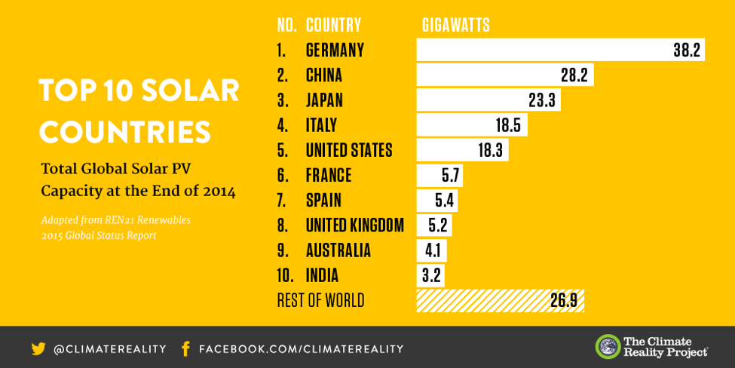

Slide 46
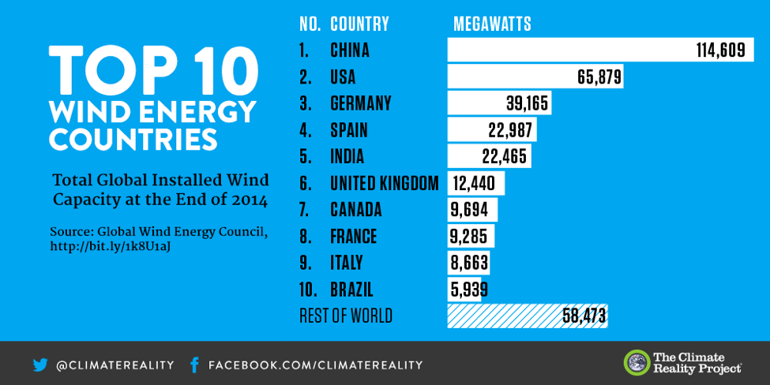

Slide 47
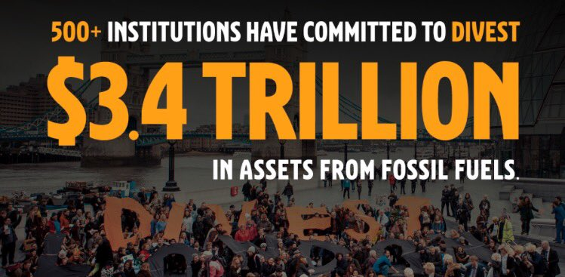
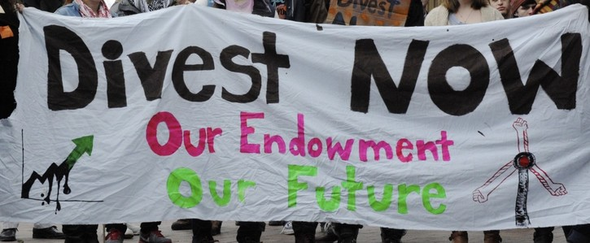
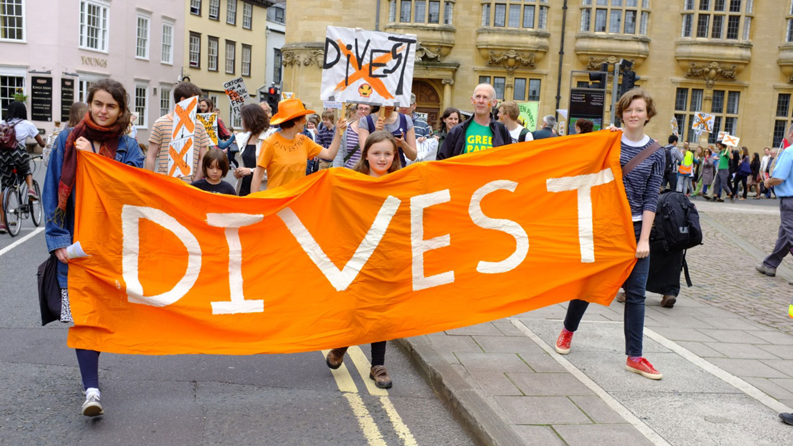
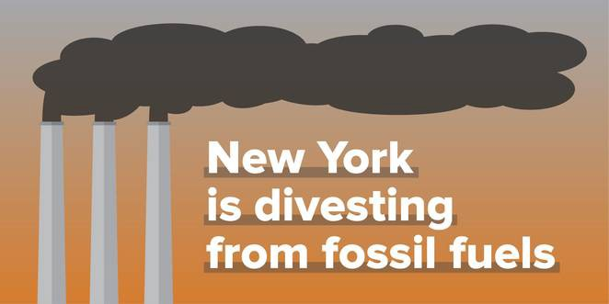
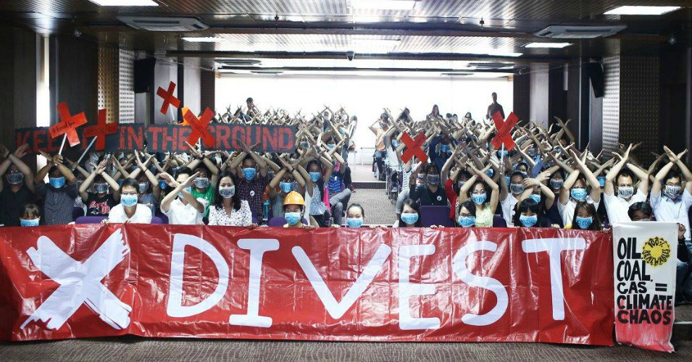
Divestment Movements

Slide 48
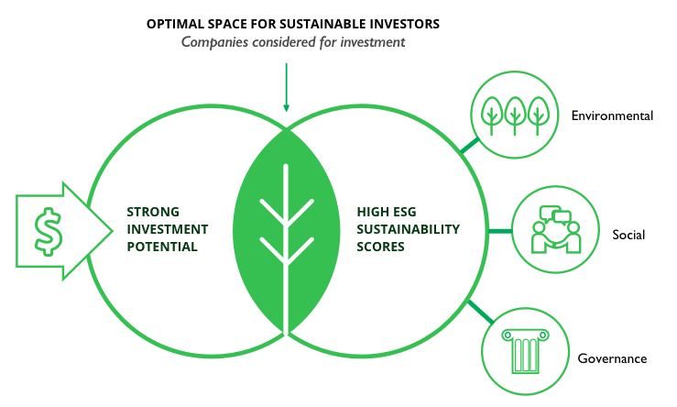
ESG Investing (Environment, Social, Governance)

Slide 49
Big Questions for Students to Consider
What are the costs and benefits of traditional fossil fuels and the costs and benefits of alternative, renewable energy sources?
From an economic standpoint, should governments invest in policies that promote more renewable energy development? Does alternative energy make economic sense?
Will investment in renewable energy create more job prospects in the future?
What are the most cost effective and economically beneficial sources of renewable energy?
Should our government actively pursue policies that promote renewable energy or should we allow private free market forces to dictate the path forward?
From a finance perspective, does divestment from fossil fuel companies make sense?

Slide 50
Interactive Resources/ Simulations
National Geographic Simulation: https://www.nationalgeographic.org/game/national-geographic-energy/
Smithsonian:
https://www.smithsonianmag.com/innovation/interactive-mapping-renewable-energy-around-world-180947914/
NASA:
https://climatekids.nasa.gov/power-up/

Slide 51

Econ EdLink Resources:
Wind Energy: https://www.econedlink.org/resources/blowing-in-the-wind/
Solar Energy: https://www.econedlink.org/resources/fewer-watts-and-fatter-wallets/

Slide 52
Resources for Teachers and Students
https://www.forbes.com/sites/andystone/2019/04/30/clean-energy-is-an-investment-not-a-cost/#7dcf88c83c82
https://fortune.com/2019/07/02/renewable-solar-wind-energy-investment/
https://economictimes.indiatimes.com/small-biz/productline/power-generation/global-investment-in-renewable-energy-to-triple-this-decade-says-un/articleshow/71006320.cms?from=mdr

Slide 53
Other External Lesson Plan Ideas
NY Times Learning Network:
https://learning.blogs.nytimes.com/2016/03/23/demography-is-destiny-teaching-about-cause-and-effect-with-global-population-trends/
Retro Reports: Short Film: “The Unrealized Horrors of Population Explosion”
https://www.nytimes.com/2015/06/01/us/the-unrealized-horrors-of-population-explosion.html
World of 7 Billion.org: https://www.worldof7billion.org/teacher-resources/high-school-activities/
World Population History: https://worldpopulationhistory.org/teachers-resources/
NOVA: The Population Paradox: https://www.youtube.com/watch?v=xAXLZ8A6L-A
PRB: https://www.prb.org/humanpopulation/

Slide 54

PROJECT / LESSON PLAN IDEAS

Slide 55

Lesson #1: Article Review/Discussion “Quiz”
https://docs.google.com/document/d/1Iae51lKxX2oB4cRxccWHrT99M-6O075-8M5dbAOO_Ms/edit?usp=sharing

Slide 56
Lesson #2: Mock Congressional Hearing
Stage a mock Congressional Hearing answering this big question: To what extent should the U.S. Government invest in renewable energy?
Groups of students research the costs and benefits of various types of fossil fuels and costs and benefits of renewable energy sources.
They assemble a presentation to be delivered to a group of congressmen/women with a policy recommendation. See here for further instructions.
A panel acting as congressmen/women evaluate the merit of the student presentations and decide whether to adopt the students recommendations.
The “congressmen/women” can be other teachers, classmates, or fellow students.

Slide 57

Lesson #3: “Town Hall” Role Playing Simulation
Sample Roles: https://docs.google.com/document/d/1B43XdCp83VIg2EuB8TVAxenbOGnYs-uDvbt1wzRI9jI/edit?usp=sharing
Research Guideline:
https://docs.google.com/document/d/1gEt8K_5kgJBb852bblAR3Veqh5Oc55oSLsO1teGkqrs/edit?usp=sharing

Slide 58

Lesson #4: Digital Collage
Students create a “digital collage” showing the costs and benefits of fossil fuel production and consumption and the costs and benefits of renewable energy costs and benefits.
Students create a series of slides with images only.
Students conclude with one slide of text expressing their opinion on the topic.

Slide 59
Lesson #5: International Research
Students choose a foreign nation
They research statistics regarding fossil fuel production/consumption and renewable energy production/consumption.
Students research government programs/ action plans regarding energy policy.
Students compile a presentation on a series of slides and present their research to classmates.
Alternative Presentation Format - “Circle in a circle (See next slide)” or “Socratic Seminar” (See two slides ahead)

Slide 60
CIrcle in a Circle Presentation Format
Create an inner circle of the research groups and and a corresponding outer circle with the same number of groups. For instance, three inner groups and a circle of three outer groups around them.
Have the outer and inner groups face each other and give them 10 minutes to present their research to each other. When ten minutes is up, have the outer group rotate so they face a new inner group. Repeat the presentation process until all the groups have met up with each other.

Slide 61

Socratic Seminar Format
Here is a good guideline on how to set up an effective Socratic Seminar:
https://www.nwabr.org/sites/default/files/SocSem.pdf

Slide 62

Lesson #6: Design a “Green” City of the Future
“Green” Urban Planning with Google Sketchup

Slide 63
Lesson Plan # 7: To Divest or Not to Divest
Use the following resources to learn about the “divestment” movement:
https://gofossilfree.org/divestment/what-is-fossil-fuel-divestment/
https://www.newyorker.com/news/dispatch/the-divestment-movement-to-combat-climate-change-is-all-grown-up
https://www.theguardian.com/commentisfree/2018/dec/16/divestment-fossil-fuel-industry-trillions-dollars-investments-carbon
https://www.commondreams.org/news/2019/09/09/people-power-winning-fossil-fuel-divestment-movement-celebrates-11-trillion
Assume you are enrolled in a college/university. Write a letter to your college administration either in favor of or opposed to fossil fuel divestment.

Slide 64

Lesson Plan #8: (Finance Application)
Research some of the “Green” mutual funds/ investment options.
Complete this chart:
https://docs.google.com/document/d/1SobKw24ad44vSDpHTYJWCNkJJ1yajMC0bjA8CgO_i1o/edit?usp=sharing

Slide 65
Inquiry Based Lesson
STEPS:
1. Students develop questions that they wish to investigate centered on the issue of immigration and the economy. Encourage students to think big!
2. Provide time for students to conduct research that addresses the question.
3. Students create a culminating product (a website, a Google slide presentation, a lesson plan with activities) that they share with the class which addresses the initial question.
4. Students reflect on the process and assess the effectiveness. Metacognition: Think about the process of thinking.
Benefits: Learning that is “Deep and Wide”; Students become experts; High degree of motivation; Fosters intellectual curiosity

Slide 66
Lesson Extensions
Students investigate the economic benefits of renewable energy. They then contact their state or national legislative representatives sharing their views on energy policy.
Students contact local businesses that specialize in renewable energy production or installation. They interview owners/employees about the challenges/rewards they encounter. With permission students can film interviews or alternatively record responses in writing to share with the class.
Students research the costs and incentives involved with converting to residential solar. They compile statistics on a spreadsheet and conduct a financial cost/benefit analysis. How long to “break even” and how long for “profitablility?”

Slide 67

Formative Assessment Option
b.socrative.com
Room Name: Opderbeck

Slide 68

Contact Information
Ted Opderbeck
Waldwick High School, Waldwick, NJ
Email: opderbeckt@waldwickschools.org

