Slide 1
Interest Rates and Investments
4/16/20
Matthew Gherman
Edward R. Murrow High School
mgherman@schools.nyc.gov

Slide 2
Goals
To understand the role of inflation in interest rates
To understand different vehicles that earn interest
To look at more aggressive forms of investments.

Slide 3
Motivation #1: College Loans
Part I: Composition of a loan
Handout Activity: Students read the passage and complete the fill-in the blanks to start our understanding of loans.
Principal: Amount of loan
Interest: Extra percentage you must pay to the bank
Balance: Amount remaining on a loan

Slide 4
Motivation
Part II: How do banks make money?
Part I: Interest: profit of the bank for loaning money
Part II: Amortization Schedule
https://www.bankrate.com/calculators/mortgages/loan-calculator.aspx
Amortization: Paying off debt over time with fixed regular installments
Amortization Schedule: Allocation of payments between interest and principle. Early payments have a higher percentage of interest and less principle.

Slide 5
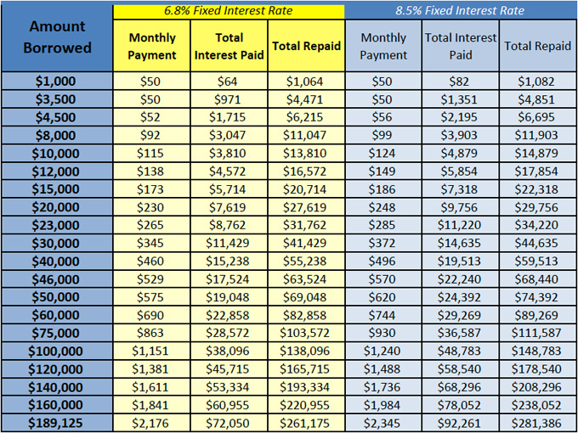

Slide 6
Motivation
Why is paying off loans so hard?
Answer: Inflation and Fisher’s hypothesis
Fisher’s Hypothesis: loans are over a long period of time, so over this time, inflation will set in…
First…what is inflation?

Slide 7
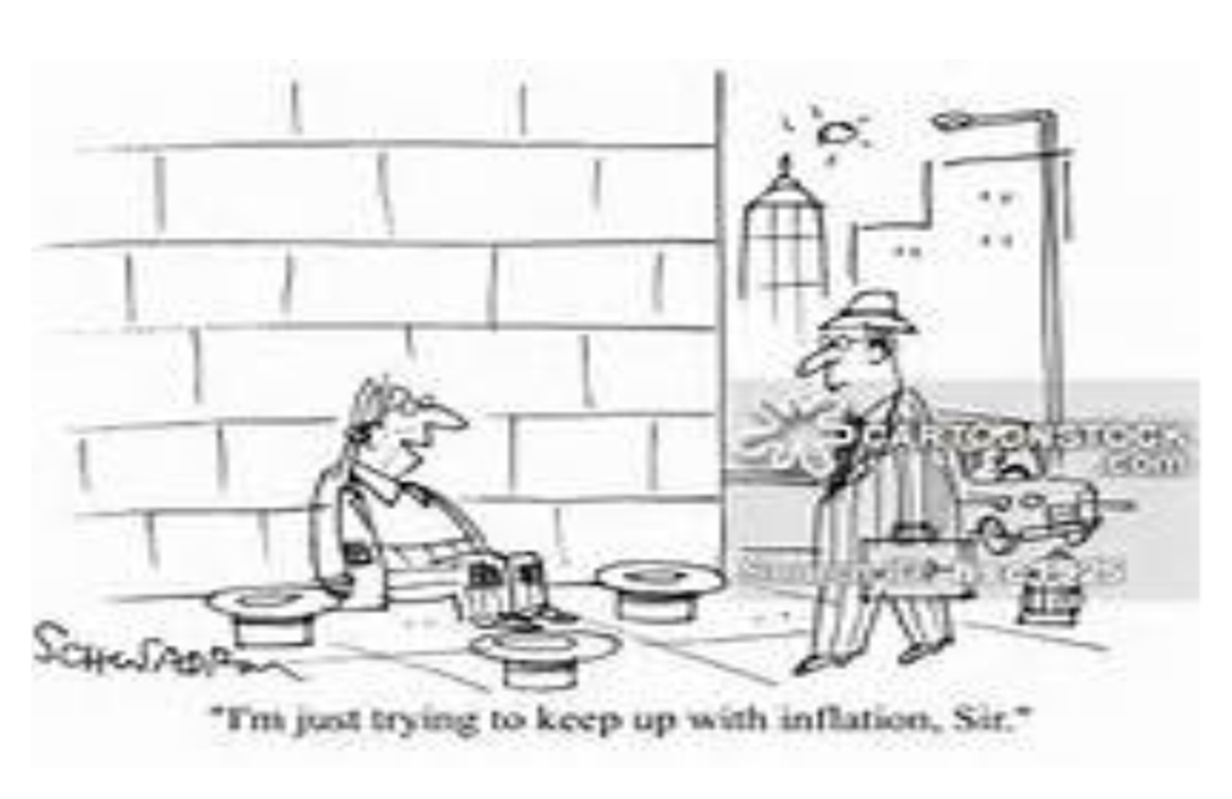
Cartoon
D.etails I.dentify the Conflict G.ather the author’s message

Slide 8
Inflation Definition
Inflation is the decrease in the purchasing power of our dollar. How much money it takes to buy one good from one year to the next. Essentially it is paying more for the same/less goods/services from one year to the next.
Symptom: Higher Prices

Slide 9
Return to Fisher’s Hypothesis
If inflation is the decrease in purchasing power, then over time, banks will be paid back with money that is worth less
In order to maintain a bank’s real profit (adjusted for inflation profit), banks should add expected inflation into the loans
The loans we pay (the nominal loan) looks like this:
Nominal = real + expected inflation

Slide 10
Fisher’s Hypothesis
Nominal = real + expected inflation
6% = 4% + 2%
So when inflation happens…
Real = nominal – inflation
4%= 6% - 2%
The bank maintains its % real profit from the outset of the loan.

Slide 11
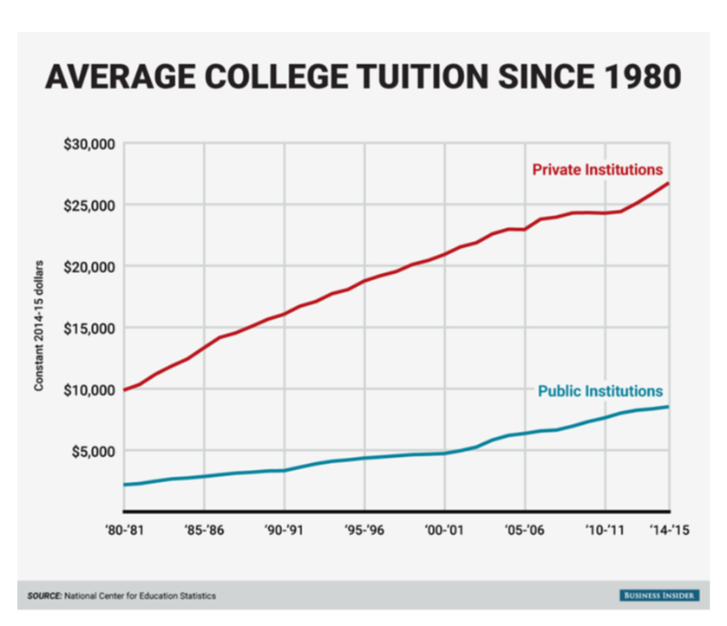
Return to College

Slide 12
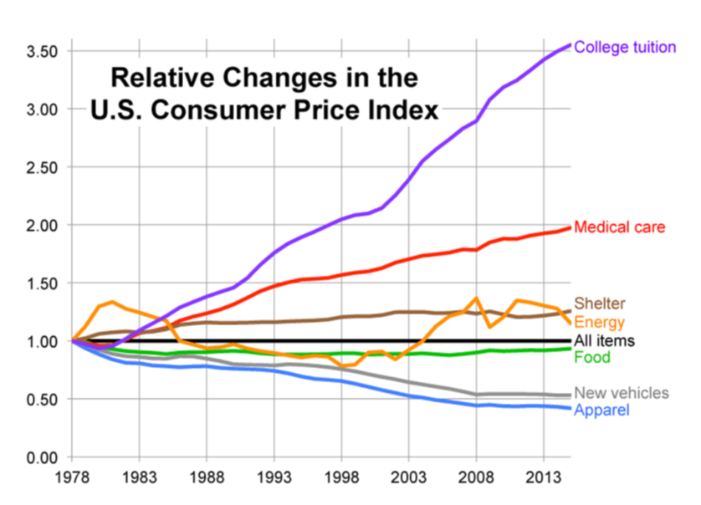
Return to College

Slide 13
College vs. Inflation
“…if the cost of college tuition was $10,000 in 1986, it would now cost the same student over $21,500 if education had increased as much as the average inflation rate but instead education is $59,800 or over 2 ½ times the inflation rate.” – The College Trap
According to the College Board, tuition and fees at private universities have risen to an average of $34,740 per year. J.P. Morgan predicts four years at a private college could cost as much as $487,004 in 2035

Slide 14
Return to Inflation…
How is it measured?
Price Stability
CPI
MARKET BASKET
INFLATION RATE

Slide 15

Consumer Price Index
Price stability measures the change in the price level.
The price level measures the average change over time in the prices paid by urban consumers for a market basket (collection of goods) of consumer goods and services (how much it would cost today, for last year’s goods). This is also known as the Consumer Price Index.
300 goods and services broken into different categories and weighted.

Slide 16
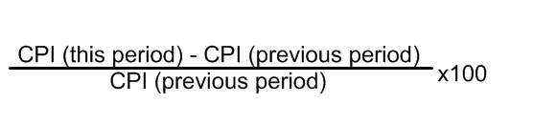
Inflation Rate
The rate of change of one period to another period is known as the inflation rate.
When inflation increases or decreases this is referred to as a change in the price level.
This is percentage change in the market basket/price index.

Slide 17
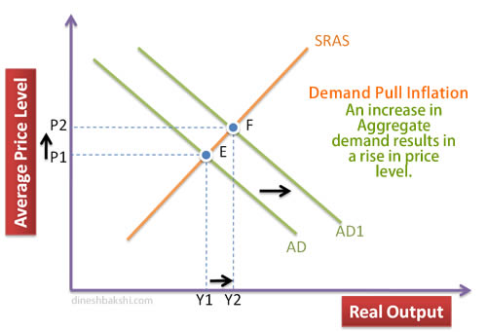
What are the causes?
Demand Pull Inflation
Graph
Increase in total spending (AD) in the economy
Not necessarily bad at first
Increase in ability and willingness to spend = increase in production and rise in prices
Becomes bad when too much money starts to chase too few goods and services…Spending is greater than production

Slide 18
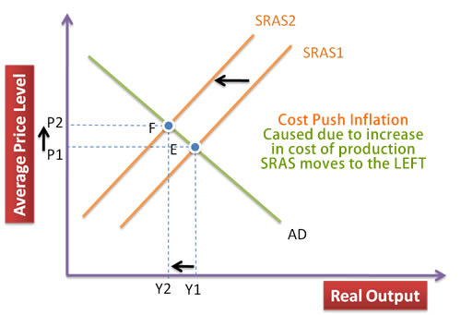
What are the causes?
Cost-Push Inflation
Bad
Increase in the cost of resources
Increase in expectation of prices
Decrease in businesses ability and willingness to produce
Decrease in production leads to higher prices and more unemployment
STAGFLATION! Worst economic condition

Slide 19
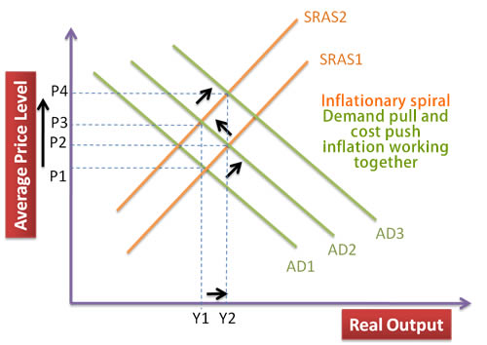
The Inflation “Spiral”
Graph
Self-sustaining upward trend in general price levels due to interaction of demand pull and cost push inflation.
“Wage-price spiral”
High cost of living prompts demands for higher wages
This pushes production costs up forcing firms to increases prices
This in turn triggers calls for fresh wage increases ... and so on.

Slide 20
Effects
Erosion Formula
Real (true value/adjusted for inflation value)
Nominal (on paper/unadjusted value)
Real _____ = nominal ______ - inflation rate

Slide 21
Effects
Activity: Read the handout and create a graphic organizer of effects of inflation
Banks | Consumers | Businesses | Government and International
Inflation Tax | Real = nominal – inflation Erodes purchasing power Erodes Savings Erodes Fixed income Erodes wage gains Erodes Bond Values Expected vs. unexpected inflation | Unit of Account Effect Menu Costs Elastic Businesses lose money | Inflation Temptation Depreciation of currency Lack of foreign capital

Slide 22
Motivation #2: Risk Assessment
Simple Motivation: On a scale of 1-5 what is your risk tolerance?
Advanced Motivation: Risk Assessment Quiz

Slide 23
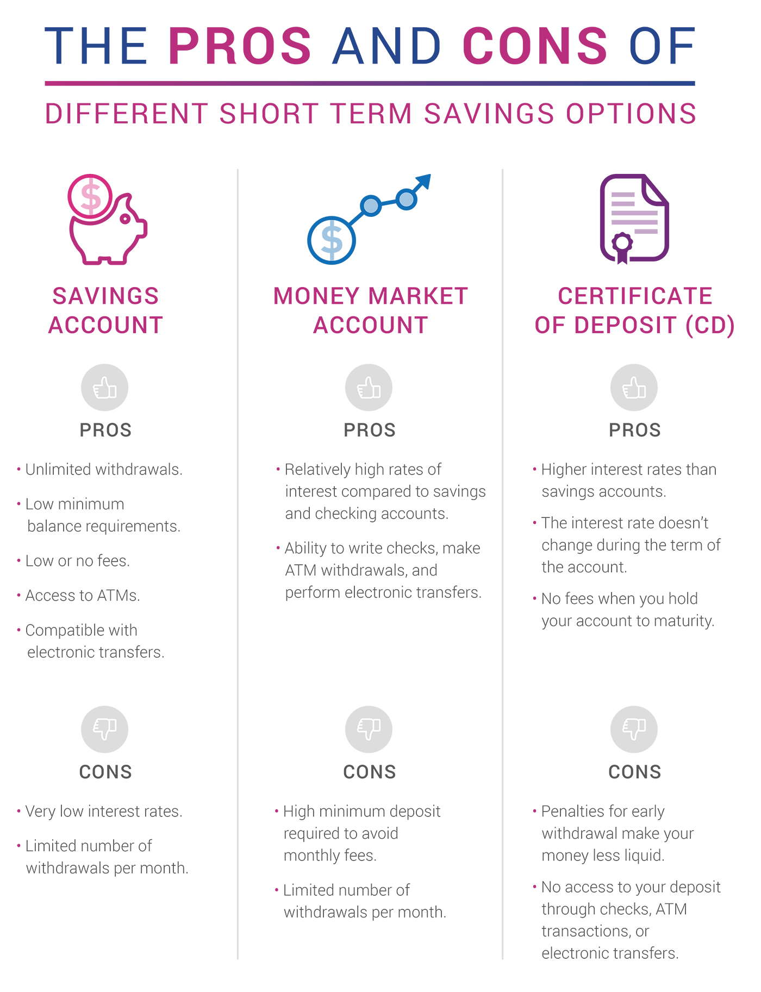

Slide 24
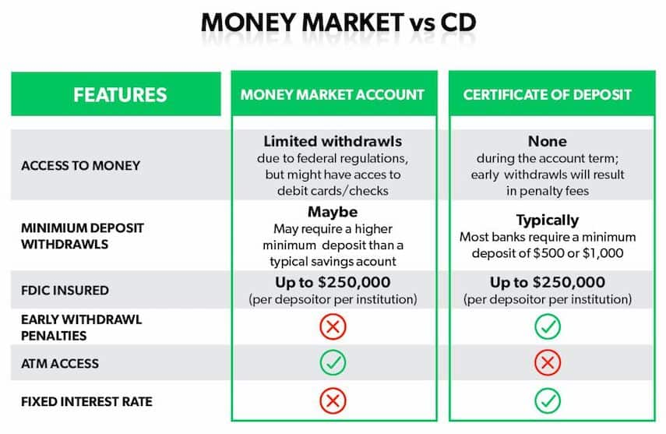
Interest Bearing Assets

Slide 25
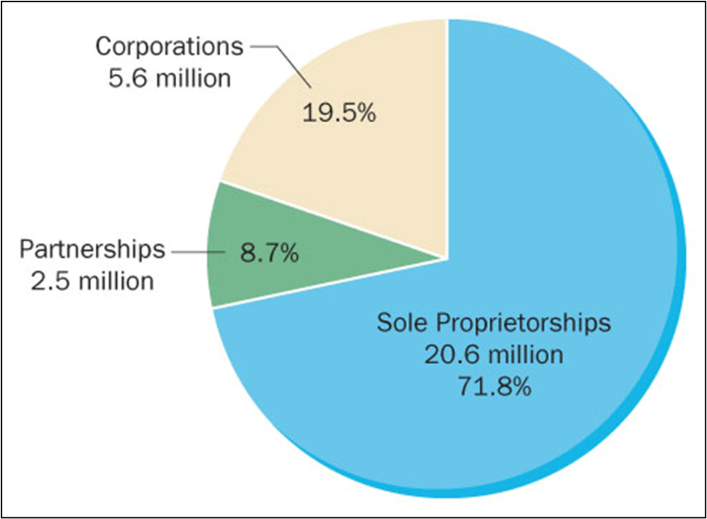
What are stocks handout
Introduction:

Slide 26
What are stocks
Stocks video: https://www.youtube.com/watch?v=fn3y1hNVgA4

Slide 27
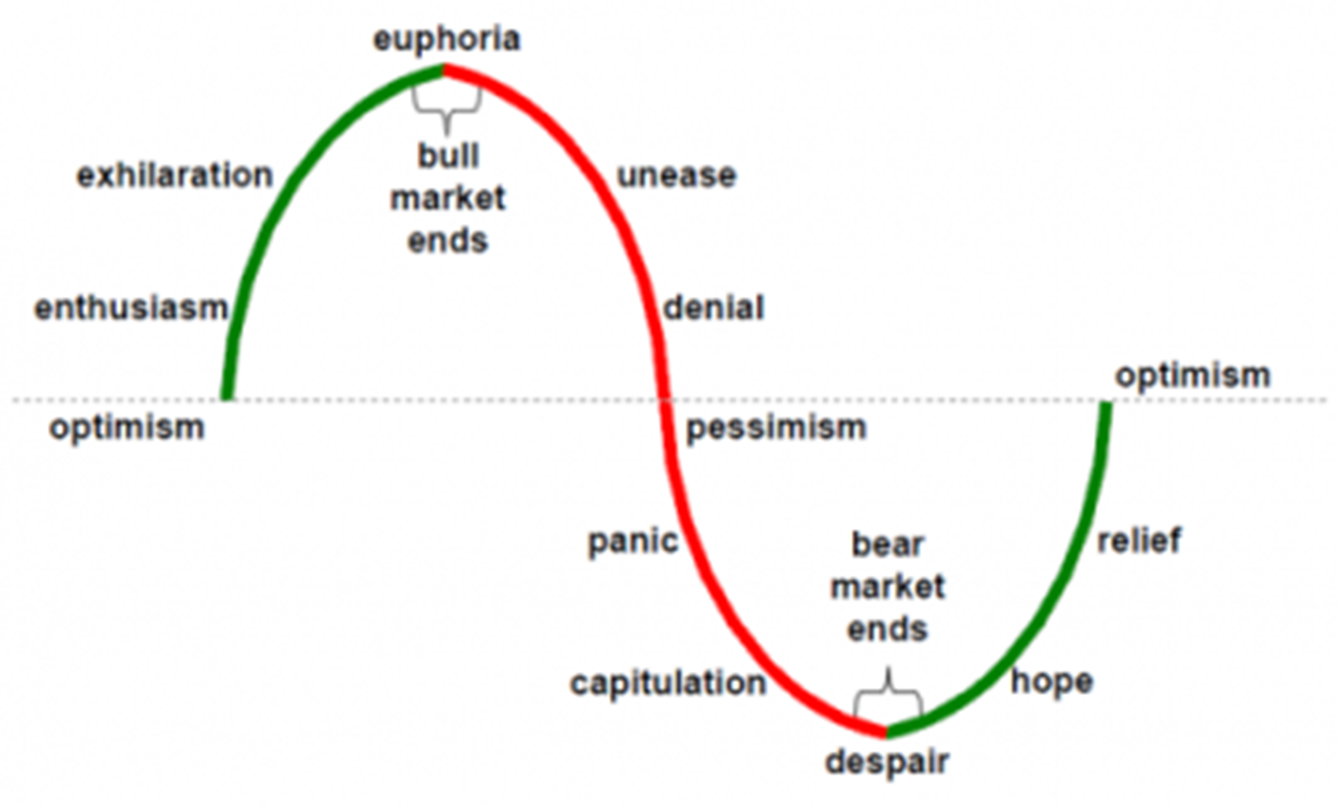
Bull vs. Bear Markets

Slide 28
How to make money in a bear market
“Quick buck artists come and go with every bull market, but the steady players make it through the bear market.” -- Lou Manneheim, Wallstreet
Short sell: A short sell is a trade that consists of borrowing stock you don't own, selling it, waiting for the price to fall, then buying it back at a lower price, thus obtaining a profit.
Invest in U.S. Treasury bonds: Bond interest rates tend to rise during bear markets, which makes for an attractive opportunity during a time of uncertainty
Buy defensive stocks: This is a low-risk way for investors to keep their money in the stock market. A defensive stock is so named because its value doesn't fluctuate much. Utility stocks (energy, water, etc.) are popular defensive stocks.

Slide 29
Bonds
https://www.youtube.com/watch?v=IuyejHOGCro
For bonds, assume:
  1) bonds’ interest rate is non-variable (does not change);
  2) bonds are traded like stocks – they can increase and decrease in value.
Bonds are “IOU’s” from the government, corporations and the Federal Reserve. People give these entities loans and are paid back after a certain period of time (called a maturity date) with the principal (initial amount) plus a yearly compounded interest. For example, a $1,000 5% bond over the course of 5 years = year 1: 1,050; year 2: 5% interest of$1,050 = $1,152 and so forth up until year 5.
OR
the bond rate (or coupon rate) creates a yearly income; so a $1,000 bond with a 5% coupon rate will give you an income of $50 per bond.

Slide 30
Investing for our kids

Slide 31
529’s
“"If your goal is to save for college, a 529 plan is where you should put your money." -- Marcus Cordero, CEO Gradvisor
“A 529 plan can be a smart way to save for college expenses, and has some clear advantages over using a standard brokerage account. With a 529, you can grow your savings tax-free, and may even get some nice state tax incentives for your contributions.” – The Motley Fool

Slide 32
529’s pros/cons
Pros
Cons
Investments are allowed to grow on a tax-deferred basis
Withdrawals will be 100% tax-free, as long as the proceeds are used for qualifying education expenses.
Tax deduction if the 529 is run by the state you live in
Age-based growth
Unlimited/very high contribution
Electronic Transfers/Gift Transfers
Parental Control
Can transfer to other children
Penalties for early withdrawal
Penalties for non-education withdrawal
Limited investment options
Age-Based Growth

Slide 33
Other Options
Education Savings Account (ESA) or Education IRA
UTMA or UGMA (Uniform Transfer/Gift to Minors Act)
An ESA allows you to save $2,000 (after tax) per year, per child
Pros: tax free growth and withdrawal for education, variety of investment options
Cons: hard allowance limit ($2,000), hard withdrawal age (30), income limit to qualify
An UTMA/UGMA differs from ESAs and 529 Plans in how they aren’t designed just for education savings.
The account is in the child’s name but is controlled by a custodian (usually a parent or grandparent). This person manages the account until the child reaches age 21.
At age 21 (age 18 for the UGMA), control of the account transfers to the child to use any way they choose.
Pros:
Funds can be used for more than just college expense, tax advantages for the contributor
Cons:
Beneficiary can use money however they choose once of legal age (pay for college or a sports car)
Beneficiary can’t be changed after selected

Slide 34
Savings vs. Stocks/Mutual Funds
Savings | Stocks/Mutual Funds
Pros: Most liquid No restrictions Cons: Low interest rates Tax penalty for interest rates No Parental control after 18 | Pros: Liquid No restrictions Growth Dividend/income potential Any investment option you want Parental control? Cons: Tax penalty for dividends Tax penalty for withdrawal Parental control?

Slide 35
Return to Motivation
Return to “What can we do to pay off quicker?”
Make sure loan is fixed!
fixed vs. variable
Pay more than minimum
reduces the length of your loan
Split the loan
13 payments per year instead of 12!

Slide 36
What we can do to save for college?
Savings Account
Mutual funds/stocks/private broker
529s
Education Savings Account
Uniform Transfer/Gift to Minors Act
“A dollar saved is a dollar not in debt”

Slide 37
Before you save for your kids…
Did you pay yourself?
  Paid off any debt (this includes things like your credit card debt, your own student loan debt, etc.)
  Set up an emergency fund of 3 to 6 months of expenses to cover any unexpected costs
  Put 10-15% of your income toward retirement savings through your employer-sponsored retirement plan, like a 401(k) and/or a Roth IRA

Slide 38
Saving while in College
https://www.collegeavestudentloans.com/blog/creative-ways-to-save-money-in-college/
DON’T buy new textbooks
DON’T leave home without your student ID.
DO limit meals out
DO choose housing wisely.
DO explore campus amenities
DON’T own a car.
DO visit your local bank.
DO monitor cell phone usage
DON’T be careless with credit cards
DO stay focused on your studies!
Buy in bulk
Meet application deadlines.
Start paying off interest now

Slide 39
Resources
https://www.collegedata.com/cs/content/content_payarticle_tmpl.jhtml?articleId=10064
https://www.usnews.com/education/best-colleges/paying-for-college/articles/what-you-need-to-know-about-college-tuition-costs
http://college.usatoday.com/2017/06/09/private-college-tuition-is-rising-faster-than-inflation-again/
https://www.forbes.com/sites/steveodland/2012/03/24/college-costs-are-soaring/#5c92fb891f86
https://moisandfitzgerald.com/pros-and-cons-of-529-college-savings-plans/
https://www.fool.com/retirement/2017/06/10/should-you-use-a-529-plan-to-save-for-college.aspx
https://studentloanhero.com/news/student-loan-interest-rates-rising-need-know/
https://www.amortization-calc.com/
https://www.investopedia.com/terms/a/amortization.asp
https://www.daveramsey.com/baby-steps?int_cmpgn=no_campaign&int_dept=dr_blog_bu&int_lctn=Blog-Text_Link&int_fmt=text&int_dscpn=saving_for_college_blog-inline_link_baby_step_5#baby_step_5
https://www.daveramsey.com/blog/saving-for-college-is-easier-than-you-think
http://time.com/money/collection-post/4161051/invest-for-college/
https://www.fool.com/retirement/2017/03/31/your-2017-guide-to-saving-for-college-with-a-cover.aspx

Slide 40
Resources
https://www.experian.com/blogs/ask-experian/whats-the-difference-between-money-market-accounts-cds-and-savings-accounts/

