Slide 1

Comparative Economic Systems
3/25/20
Theodore Opderbeck

Slide 2
Ted Opderbeck
Teacher at Waldwick High School 1996 - Present
Social Studies/Economics:
  AP Economics
  Honors Economics I and II
  Introduction to Economics and Personal Finance
  U.S. History I and II
  Introduction to Law
  Criminal Procedure
Coach varsity tennis and volleyball
Graduated from Gordon College in Wenham MA
Masters’ Degree in Teaching Montclair State University
Attended Seton Hall Law School
Enjoy photography, hiking, travelling, spending time with wife and two teenage children.

Slide 3


Slide 4


Slide 5
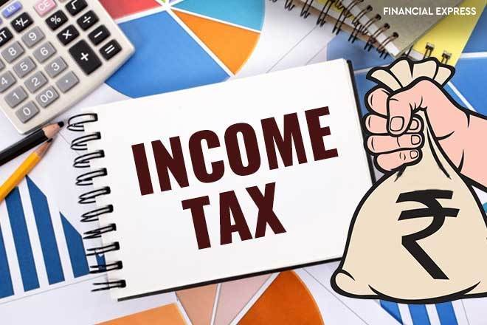
Question of the Day Activity
Which of the following nations has the highest top progressive income tax rate at 57%?
Canada
Sweden
Denmark
Norway
*Note: Students are in teams for one week intervals. Each day I project a question such as the one above related to our task at hand. They huddle and provide an answer. At week’s end the group with the most correct answers wins.

Slide 6
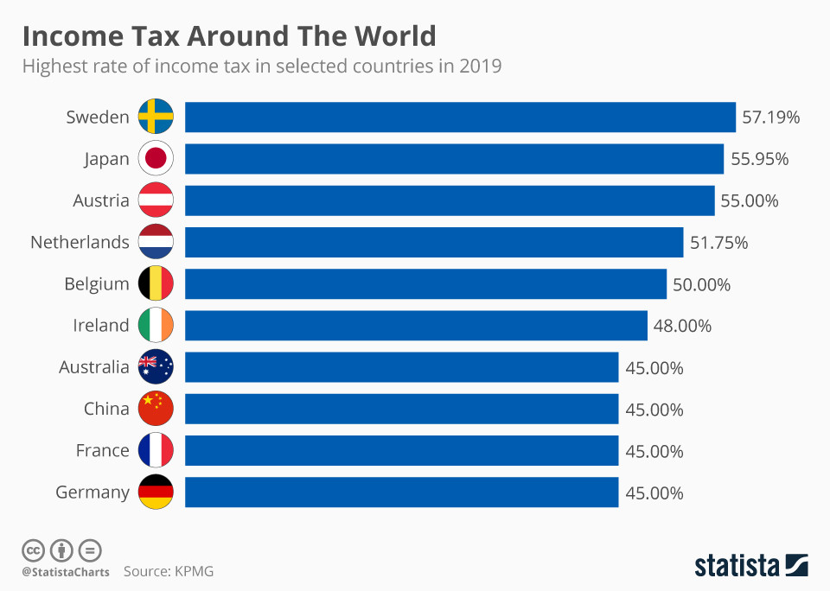

Slide 7
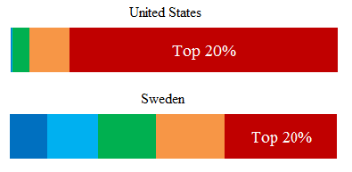

Slide 8

Bonus Question
Of the following, which nation has a 0% income tax?
Mongolia
Guatemala
Macau
Bahamas
Notes:
8%

Slide 9


Slide 10
Objectives
Provide a brief introduction of the characteristics of various economic systems.
Examine some of the costs and benefits of each system with an analysis of the degree of government involvement in each.
Frame some of the big economic questions related to economic systems.
Introduce lesson plans and projects to guide students as they explore how economic systems meet people’s needs and wants in different ways.
Explore learning extensions and current applications.

Slide 11
Key Vocabulary/Concepts
Economic System: the way in which a group of people living in a society or nation decide to produce and distribute resources, goods, and services.
Types of Economic Systems:
  Market Economy
  Traditional Economy
  Command “Centrally Planned” Economy
  Mixed Economy
Socialism, Capitalism, Communism

Slide 12

Connections to Economics/Finance Units of Study
Scarcity/ Resource Allocation
Fiscal Policy/ Government Budget
Economic Development
Private and Public Investment, Finance
Cross Curricular Applications: Political Science, History, Sociology

Slide 13

The Three Big Economic Questions
What gets produced?
How does it get produced?
For whom is it produced?

Slide 14
Lesson #1: The Three Questions - Lollipop Activity
At the beginning of class, display half the amount of lollipops as are students in the class. Explain that these are for the class and they must devise their own method for distributing them. Only method that is forbidden is force! :)
Teacher gives ownership to students - don’t direct them!
Students have as much time as they need to decide on an “economic system”
Once they have decided, lollipops are distributed according to their system.
Continued on next slide:

Slide 15
Lesson Plan Idea:
The Three Questions - Lollipop Activity
Teacher led debrief:
  What was the underlying philosophy of your allocation system?
    Competition?
    Equity/sharing?
    Luck/ lottery system?
    Democratic voting?
    Skill/ personal characteristics?
    Command/ Control?
  How did your system answer the three economic questions?
  Discuss some of the other types of systems they could have used and the pros and cons of each.
  Discuss if their system is similar to or different than the U.S. economic system and begin to introduce some vocab.

Slide 16

Lesson #1: The Three Questions - Lollipop Activity

Slide 17
Poll Everywhere
Which of the three questions is the most important when considering quality of life within a nation?

Slide 18
Major Economic Systems Defined
Traditional Economy: a system of production and allocation that depends on customs, history, and honored beliefs and values.
Characteristics:
  Little change or innovation
  High degree of craftsmanship
  Reliance on habit and ritual
  Strong gender roles
  Usually characterized by higher degrees of poverty, illiteracy, infant mortality and lower life expectancy.
  Typically utilized by subsistence-based societies

Slide 19
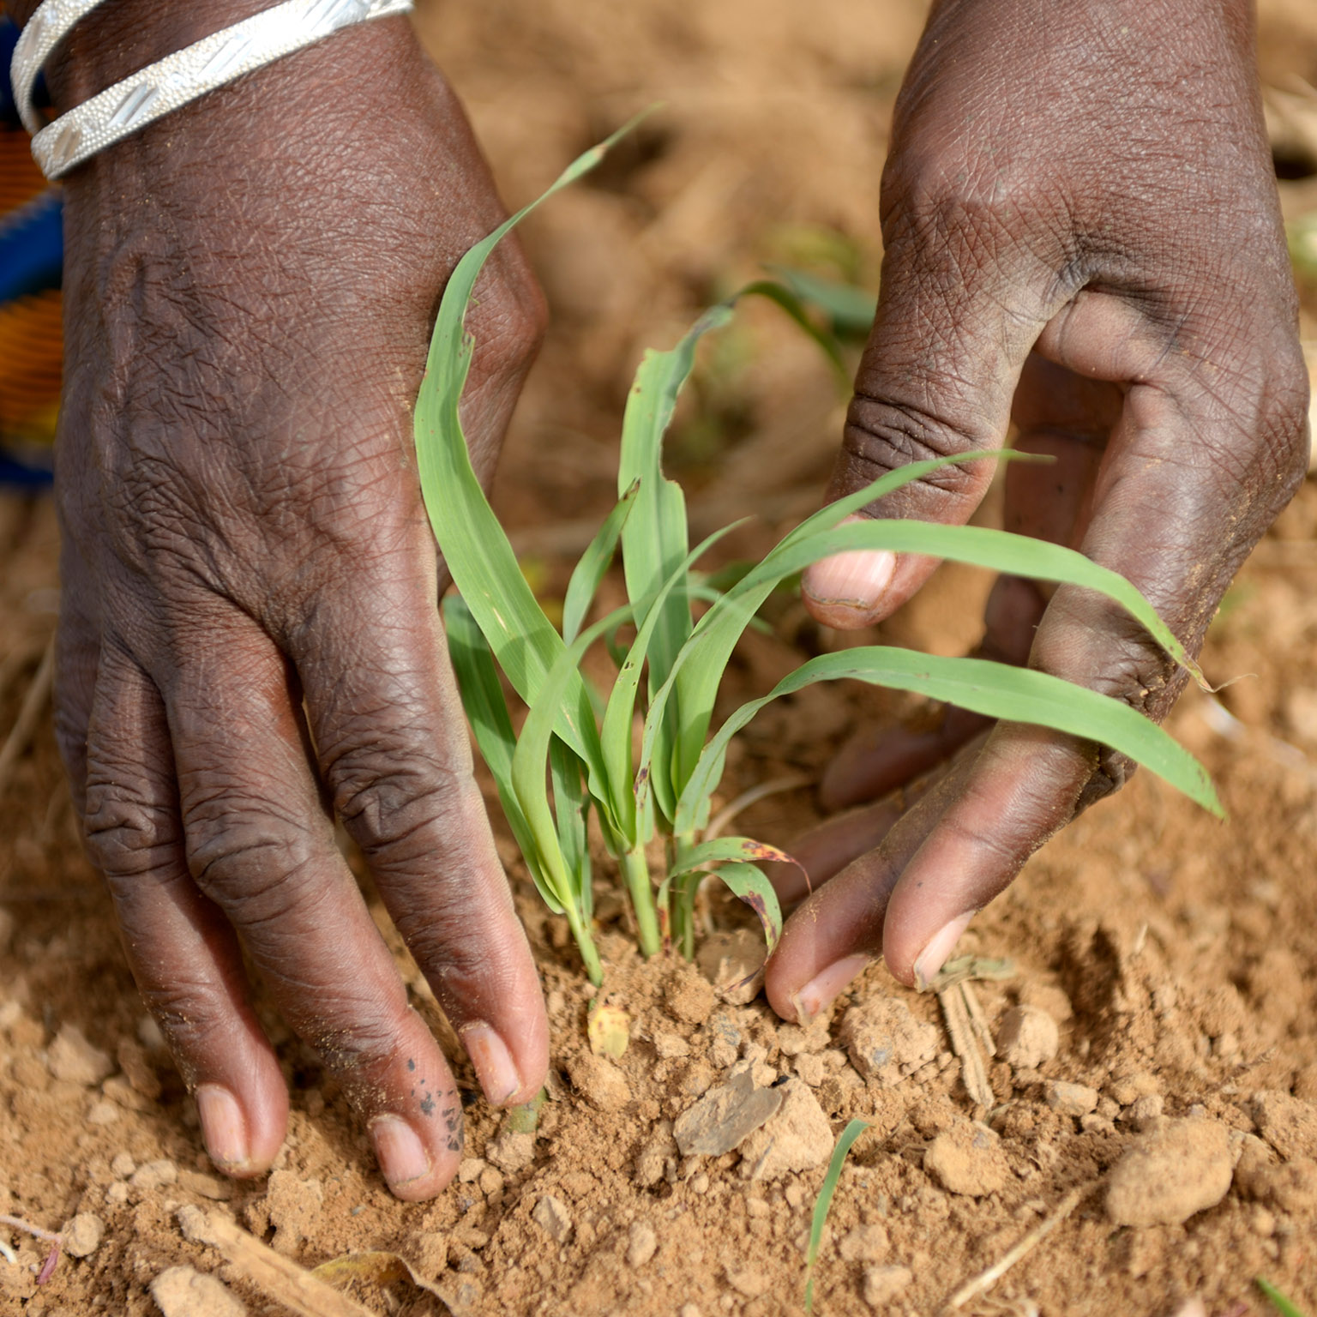
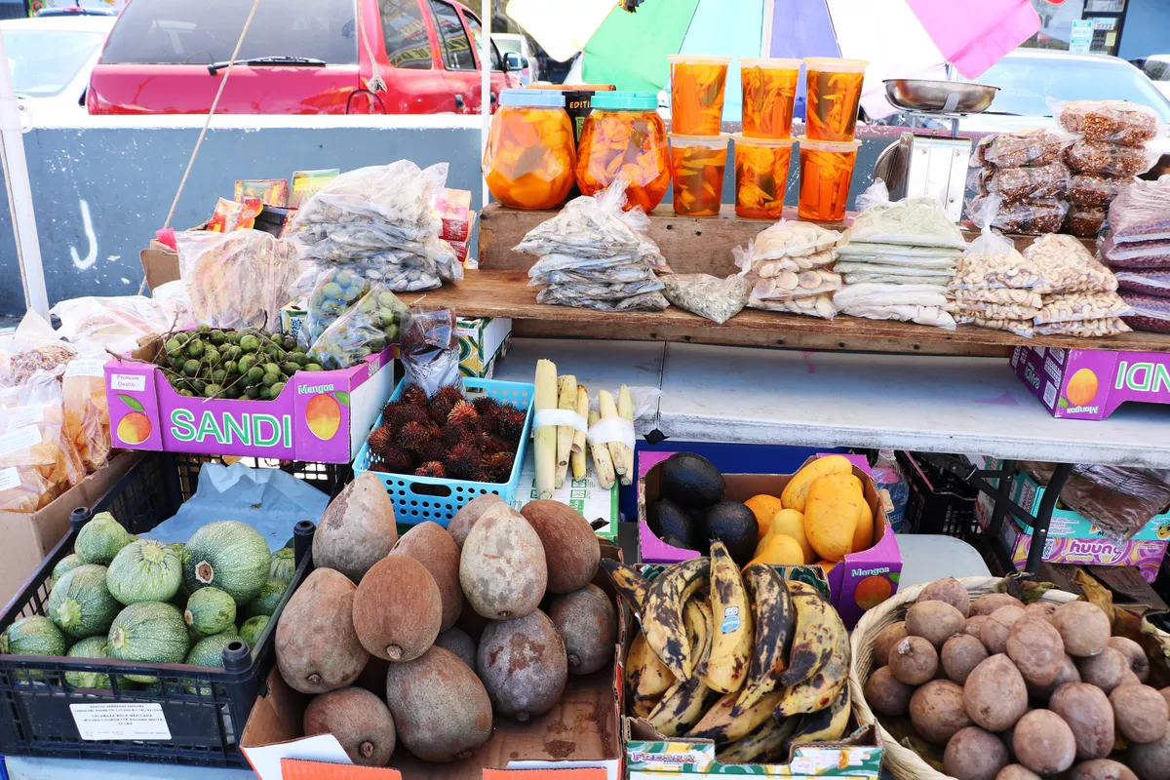
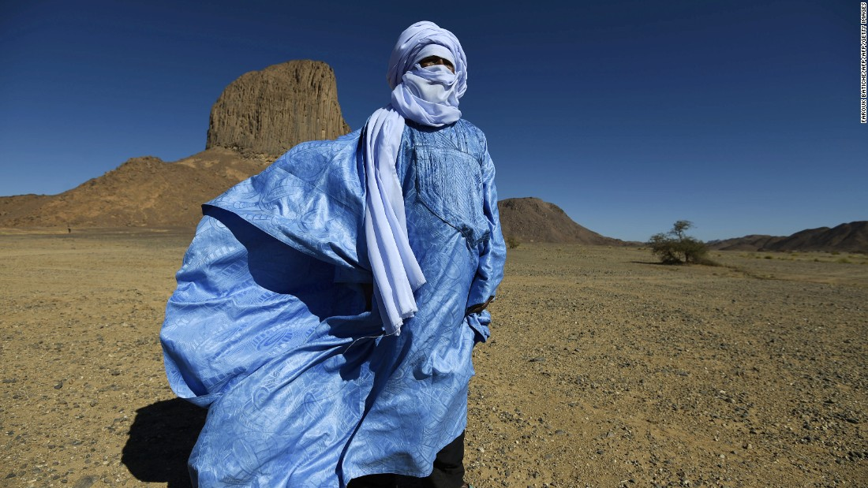
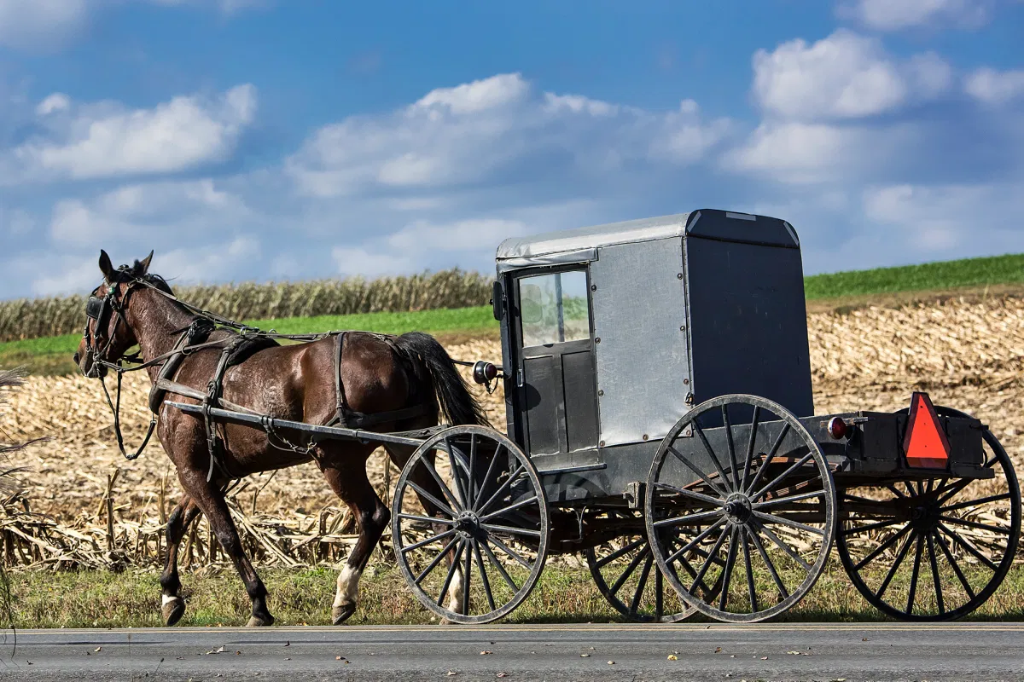
Examples of Traditional Economies

Slide 20
Traditional Economies - Questions to Consider
Note: Can be used for think-pair-shares, polling questions, or small group discussions.
What are some of the pros and cons of traditional economies?
Do traditional economies choose a traditional economic system or are there barriers to change?
Can you think of any “traditional” aspects of the U.S. economy?

Slide 21
Major Economic Systems Defined
Command Economy: an economic system where the government dictates the means of production and distribution.
Characteristics:
  No private ownership of resources or property
  The government makes all decisions regarding production and distribution
  Usually associated with totalitarian political systems
  Lack of basic human rights and freedoms
  In theory: the elimination of social classes
  High degree of specialization of labor

Slide 22
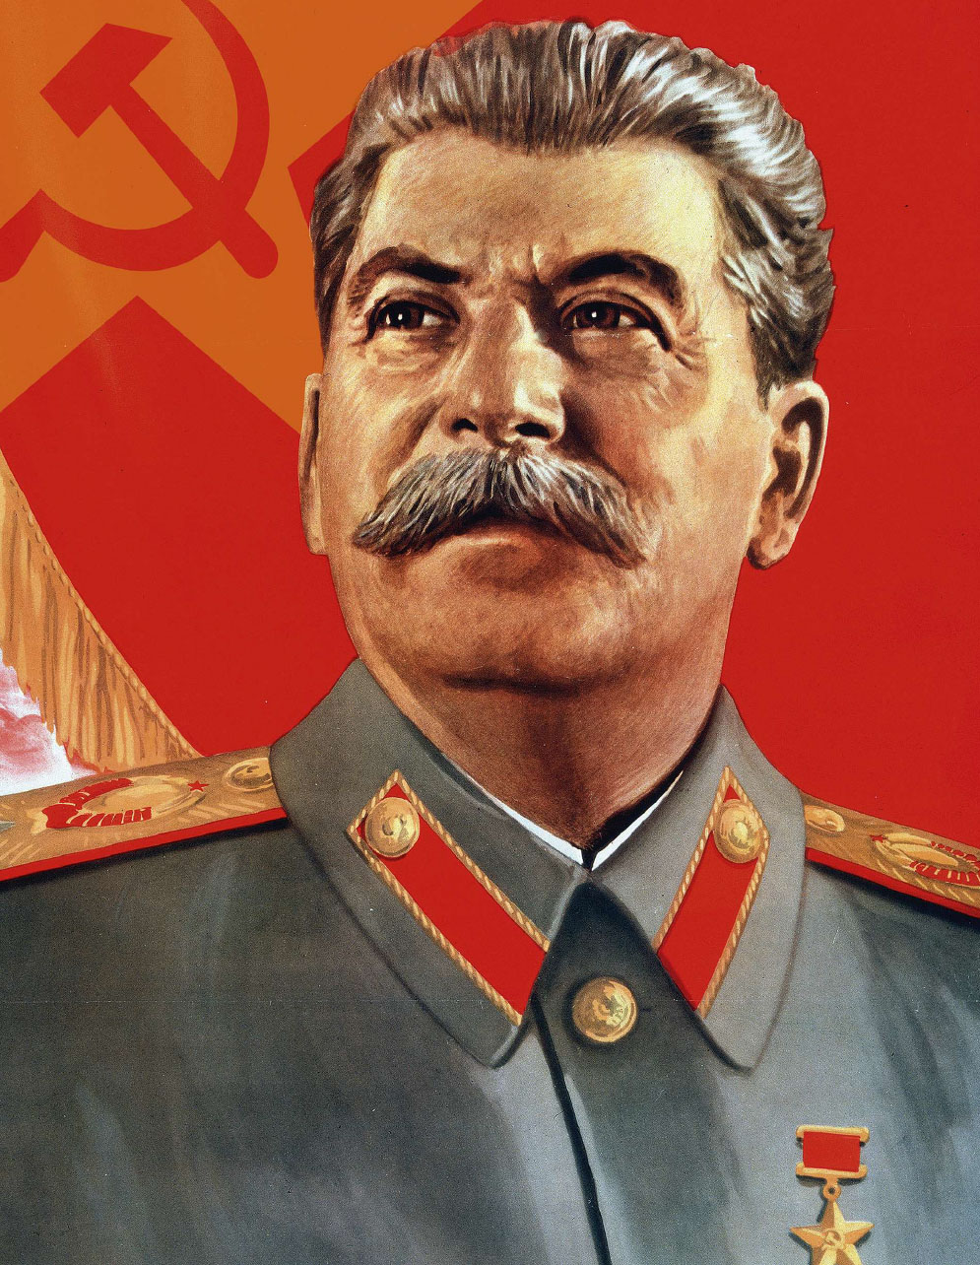
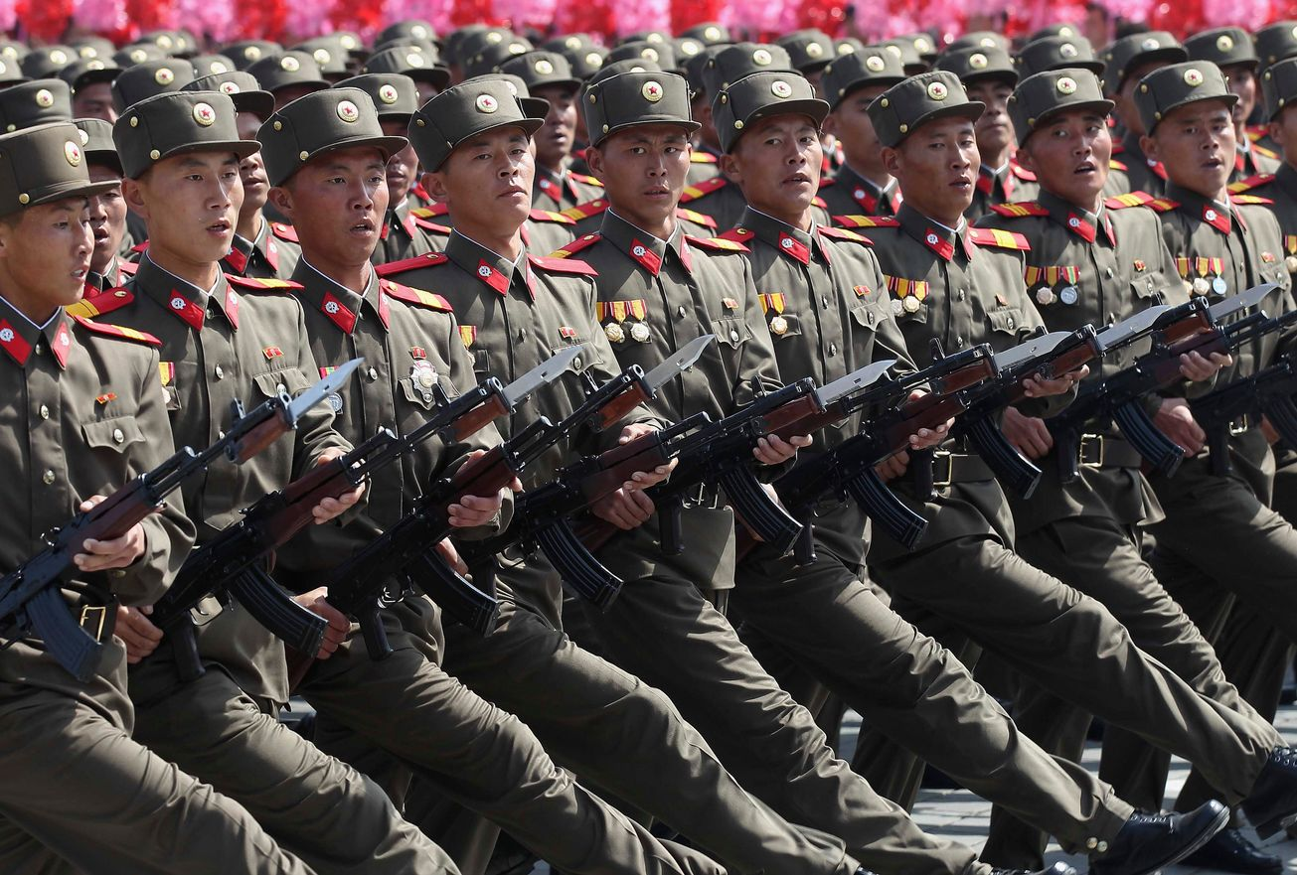

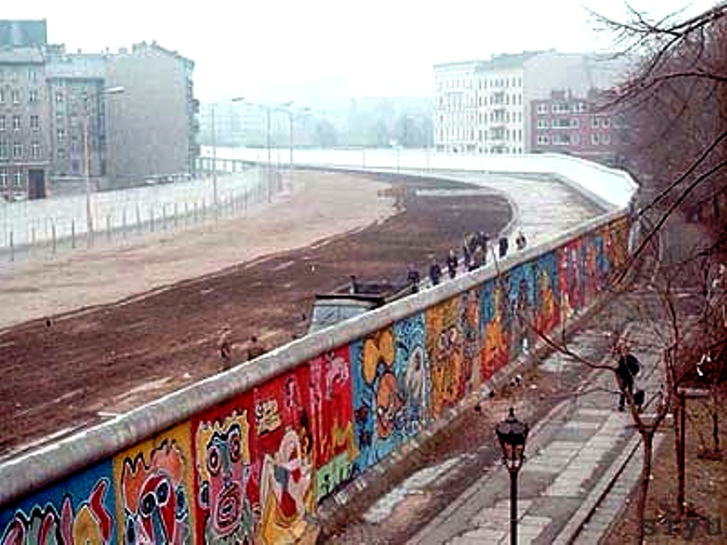

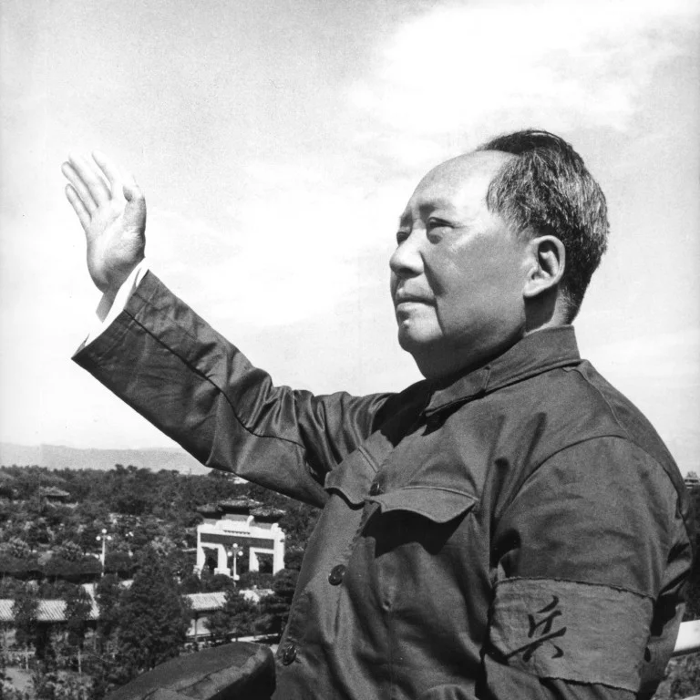

Slide 23
Command Economies - Questions to Consider
Note: Can be used for think-pair-shares, polling questions, or small group discussions.
What are some of the pros and cons of command economies?
Why do command economies typically lead to a denial of human rights and freedom?
Can you think of any “command” aspects of the U.S. economy?

Slide 24
Major Economic Systems Defined
Free Market Economy: a system that relies on the free exchange between buyers and sellers with little or no government intervention.
Characteristics:
  Constant change and innovation
  Prices and production dictated by supply and demand
  Laissez Faire - hands off by the government
  Economic and political freedom
  Little security and predictability
  High degree of competition

Slide 25
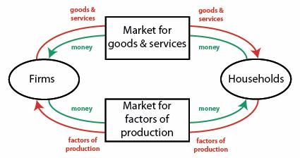
Market Economy and “Circular Flow”

Slide 26
Lesson Plan Idea: Circular Flow Activity
Randomly choose two or three students to represent a “firm”
The rest of the class represents “households”
The firms produce and sell a product such as pretzels and purchase labor
The households produce and sell labor and purchase pretzels.
Give the firm and the students who represent households some fake money. The households purchase pretzels but in order to sell them the firm must purchase labor to deliver them to the households. The price of the pretzels and the price of the labor are determined by free market forces of supply and demand.
As long as households are purchasing money flows to firms which is used to purchase labor.
Take note of any factors that could lead to a slowdown (recession) of spending on either end and debrief.

Slide 27


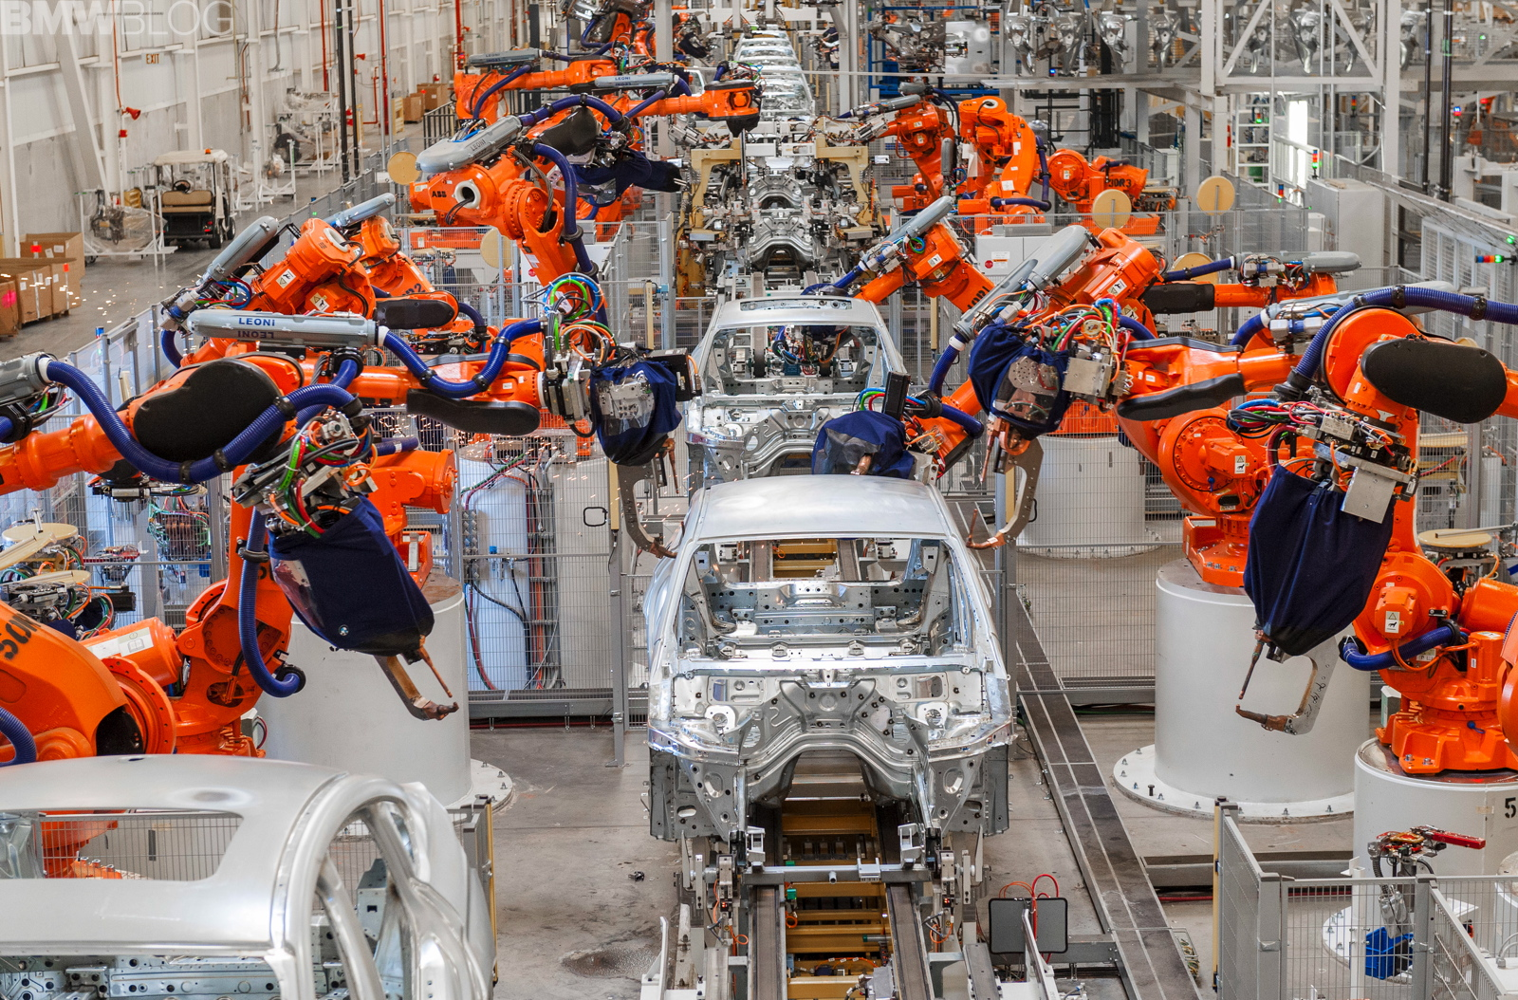
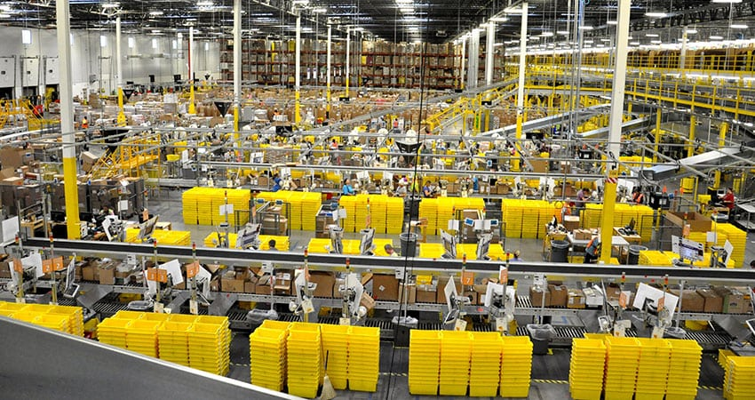

Slide 28
Background Slides on Economic Systems
https://docs.google.com/presentation/d/1LHTn8XnpEp1TrPLJybkM1sEkWIbSTQ48gm2VmcLdqXU/edit?usp=sharing

Slide 29
Market Economy - Questions to Consider
Note: Can be used for think-pair-shares, polling questions, or small group discussions.
What are some of the pros and cons of market economies?
Is competition more of a beneficial or harmful force in an economic system?
Why do market systems sometimes lead to higher degrees of income inequality? Is it worth it?

Slide 30
Lesson Plan Idea: Pasta Necklace Simulation
Divide students into teams of 5-6 students per group.
Distribute a box of each type of pasta to each group: ditalini, rigatoni, ziti, penne
Distribute a ruler, dental floss, and a scissors to each group.
Explain that they will compete to see how much money they can make by producing necklaces and bracelets out of pasta and dental floss by progressing through each economic system.
Project the following or give as a handout: https://docs.google.com/document/d/1L4rMbcBefKi-EYvP-Mtt0VMaENigUW8-IR3wbMoEljw/edit?usp=sharing

Slide 31
Lesson Plan Idea: Pasta Necklace Simulation
First round: 15 minutes. Each group MUST abide strictly to the rules for a traditional economy. At end of 15 mins. each group adds up the total production ($5 per bracelet completed)
Second round: 15 minutes. Each group MUST abide strictly to the rules for a command economy. At end of 15 mins. each group adds up the total production ($50 for a quota of 5 necklaces)
Third round: 15 minutes. Each group cqn now produce any combination in any way according to the rules for a market economy. At end of 15 mins. each group adds up the total production ($5 per bracelet completed and $10 per necklace completed)
NOTE: See handout on previous page for rules.

Slide 32
Lesson Plan Idea: Pasta Necklace Simulation
After three rounds groups add up total dollar amount of production. The group with the most cumulative total after three rounds wins!
Debrief with this organizer:
https://docs.google.com/document/d/1zzhBSBT7loN2FX5JvMUl3sGxgasCa9tDZcmWJgdrcrU/edit?usp=sharing

Slide 33



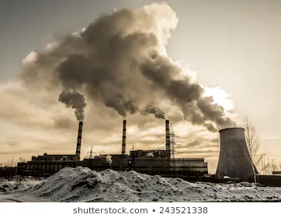
Lesson Plan Idea: Digital Collage
Economic Systems Digital Collage:
Students reflect on the pros and cons of each of the three major economic systems.
They explore images that symbolize their views
Students assemble a digital collage with images only.

Slide 34
Mixed Economies
Mixed Economy: an economic system that balances a free market with some degree of government control/ involvement.
Most modern economies are “mixed” with some degree of government involvement
Some economies lean more to the free market side and some lean more towards the “command” side
Can you think of any examples of the “mixed” nature of the U.S. economy?

Slide 35
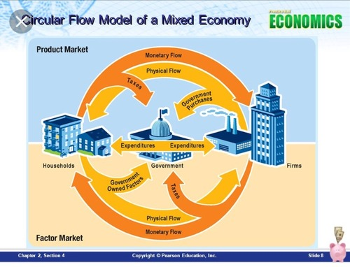
Circular Flow: Mixed Economy

Slide 36
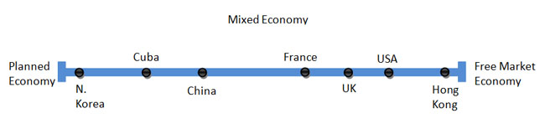
Mixed Economy Continuum
https://www.statista.com/statistics/256965/worldwide-index-of-economic-freedom/

Slide 37
Lesson Plan Idea: Economic System Research
Jigsaw
In groups students choose a country. They analyze that nation’s economic system using the following as a guide: https://docs.google.com/document/d/1pv556AbnbdIDWEB5nVZCC16By4_c-ElqVfOwowvs6kY/edit?usp=sharing
Students then participate in a “circle in a circle” jigsaw:
Directions on the next slide:

Slide 38
Create an inner circle of the research groups and and a corresponding outer circle with the same number of groups. For instance, three inner groups and a circle of three outer groups around them.
Have the outer and inner groups face each other and give them 10 minutes to present their research to each other. When ten minutes is up, have the outer group rotate so they face a new inner group. Repeat the presentation process until all the groups have met up with each other.
Debrief with a whole group discussion and use big focusing questions as prompts.

Slide 39
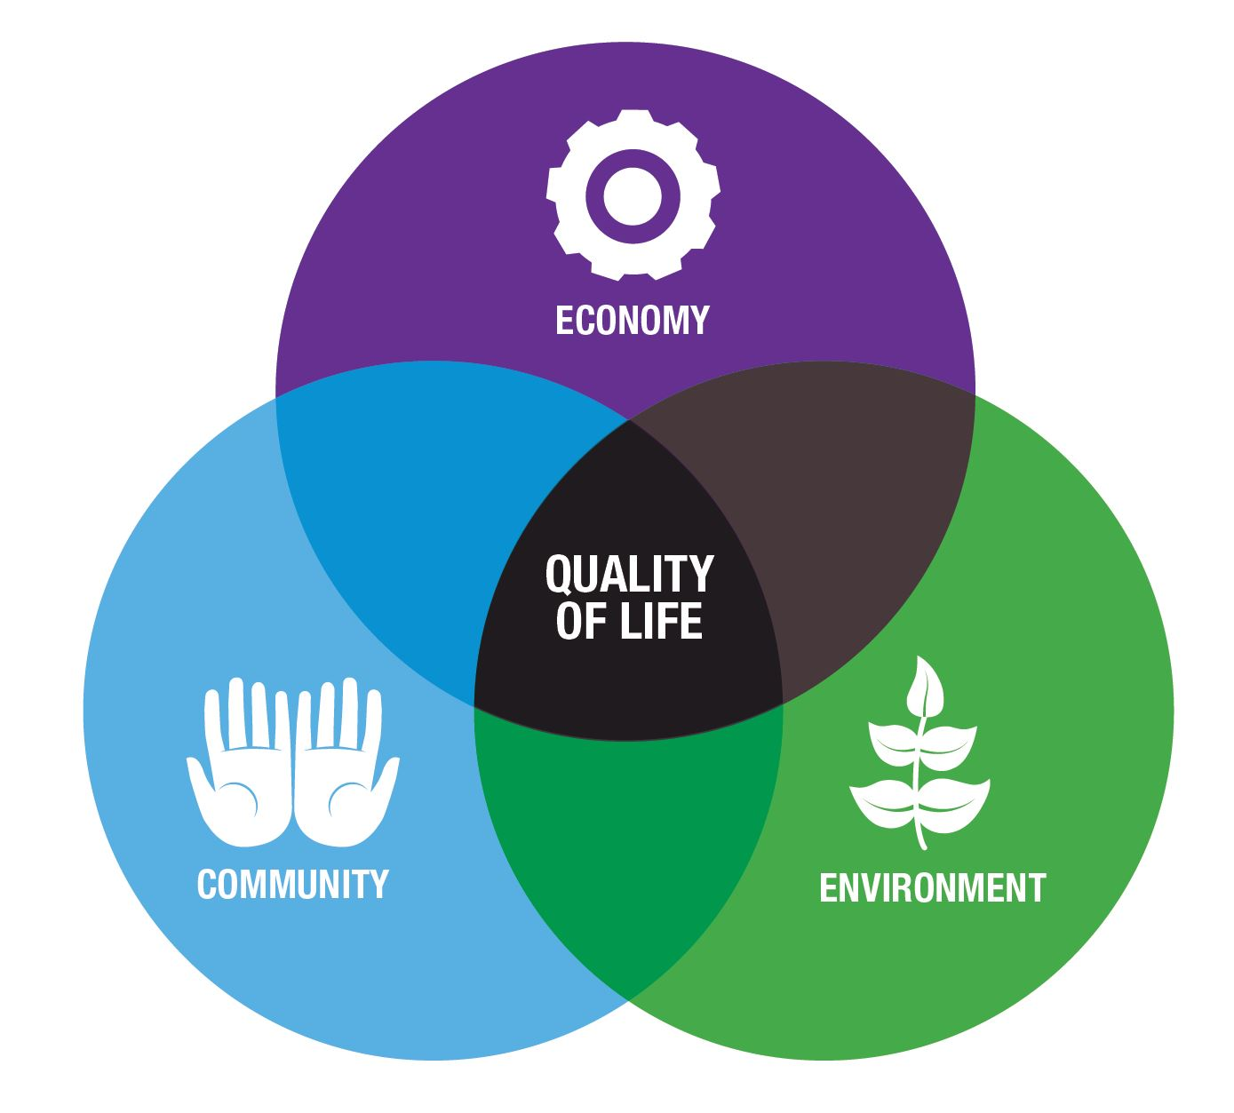
Variation on Lesson:
Economic Systems and Quality of Life
https://www.usnews.com/news/best-countries/quality-of-life-rankings
Have students choose a nation on the list and summarize the major indicators to share with the class.
Students can act as “representatives” and present why their nation has the highest quality of life.

Slide 40
The U.S. Economy - Role of the Govt.
How does the U.S. government get involved in our economy?
Background Slides: https://docs.google.com/presentation/d/1ZjN9OnQPCGLMA-2zHYGOjDiXBlBt3nMO2PksJozxcug/edit?usp=sharing
Corresponding Worksheet: https://docs.google.com/document/d/1tngM-zEzP-1JYRlqQb1_9Mdla6HTgzuVZWLrmhxiC5s/edit?usp=sharing

Slide 41
Lesson Idea: Government’s Role in the Economy
“Value Line”
Value Line Activity: Project a series of value based statements (one at a time)
On a paper or using a digital tool, students place an x on a “value line” with DISAGREE on one end and AGREE on the other end. They then record one reason for their position.
After a minute or so, students get up and stand on an “imaginary value line” in your classroom with DISAGREE on one side and AGREE on the other. They can stand on any point of the continuum even right in the middle if that’s where they fall.
Have students discuss their reasoning with someone close to them. Then have them find a new person from the other side of the line and discuss their reasoning. Come together after each statement and discuss as a class.

Slide 42

Lesson Idea: Government’s Role in the Economy
“Value Line”
EXAMPLE OF VALUE LINE STATEMENTS:
https://docs.google.com/presentation/d/1h_h9lYQU7qDY-fi4tM0lxWDrG71he5djxuPmDsyO_9g/edit?usp=sharing

Slide 43



Remote Learning Tools
Screen Castify: https://www.screencastify.com/
Google “Meet”: https://gsuite.google.com/products/meet/
Zoom: https://zoom.us/

Slide 44

Formative Assessment Option
b.socrative.com
Room Name: Opderbeck

Slide 45
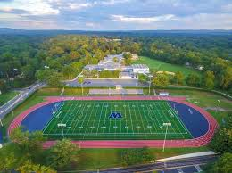
Contact Information
Ted Opderbeck
Waldwick High School, Waldwick, NJ
Email: opderbeckt@waldwickschools.org

