Slide 1
Circular Flow, the Global Economy and Economic Systems
Prof. Theresa Fischer
May 2020

Slide 2
EconEdLink Membership
You can now access CEE’s professional development webinars directly on EconEdLink.org! To receive these new professional development benefits, become an EconEdLink member. As a member, you will now be able to:
Automatically receive a professional development certificate via e-mail within 24 hours after viewing any webinar for a minimum of 45 minutes
Register for upcoming webinars with a simple one-click process
Easily download presentations, lesson plan materials, and activities for each webinar
Search and view all webinars at your convenience
Save webinars to your EconEdLink dashboard for easy access to the event
You may access our new Professional Development page here

Slide 3
Professional Development Certificate
To earn your professional development certificate for this webinar, you must:
Watch a minimum of 45-minutes and you will automatically receive a professional development certificate via e-mail within 24 hours.
Accessing resources:
You can now easily download presentations, lesson plan materials, and activities for each webinar from EconEdLink.org/professional-development/

Slide 4
Objectives
Understand the circular flow and help students see the importance of this diagram at the outset of the course in Economics
How does Adam Smith and John M. Keynes face the economy with its challenges and solutions?
How does the political arena address the circular flow diagram in the United States?
How important is participating in the global economy to contribute to world growth?

Slide 5
National Content Standards in Economics
STANDARD 5: TRADE . . Voluntary exchange occurs only when all participating parties expect to gain. This is true for trade among individuals or organizations within a nation, and among individuals or organizations in different nations.
STANDARD 6: SPECIALIZATION . When individuals, regions, and nations specialize in what they can produce at the lowest cost and then trade with others, both production and consumption increase.

Slide 6
The Economic Way of Thinking
Everything has a cost
People choose for good reasons
Incentives matter
People create economic systems to influence choice and incentives
Economic thinking is marginal thinking
The value of a good or service is affected by people’s choices
Economic actions create secondary effects
The test of the theory is its ability to predict correctly

Slide 7
FACTORS OF PRODUCTION
LAND
LABOR
CAPITAL

Slide 8
SO WHAT IS ECONOMICS?
SCARCITY
CHOICES
DECISIONS

Slide 9
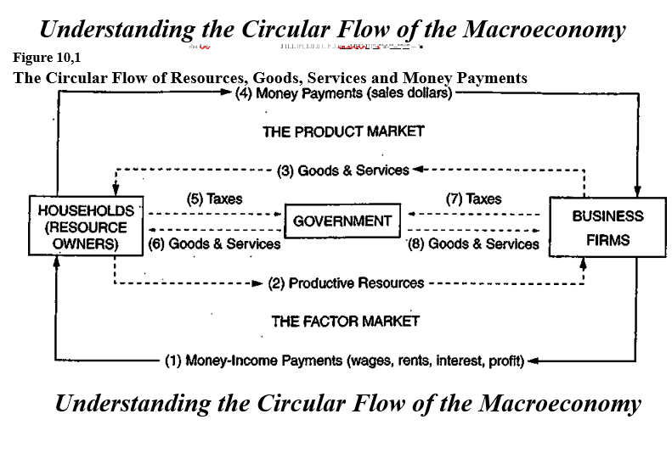

Slide 10
Questions on the Flowchart
Keisha makes decorative pillows that she sells for $30.00…
Mammoth Toys Inc. hires 100 new employees…
Emily earns $6.50 per hour entering data at the music conservatory…
The National Park Service opens two new campgrounds in Yellowstone National Park…
(T-F) The resource market determines the price per acre of farmland.
(T-F) The product market determines the salary of the C.E.O. of a firm

Slide 11
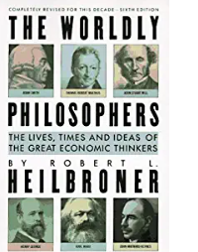
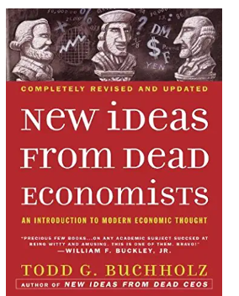
Economic Philosophers— Adam Smith and John M. Keynes.
Great sources for students in High School to read and find the essence of their theories and philosophies

Slide 12
Adam Smith and The Wealth of Nations

Slide 13
Adam Smith, Father of Modern Capitalism
1. Self interest drives the economy
2. Limited government
3. Competition give the economy the best products
4. The economy will self adjust no need to worry
5. The economy is run by the “ invisible hand”

Slide 15
Keynes Theory in a Nutshell
Aggregate demand is volatile and unstable.
A market economy will be unstable with inefficient outcomes in the for of economic recessions and inflation.
The difficult economic conditions can be resolved through government action of fiscal policy and monetary policy.
Government needs to have an active role especially during recessions and depressions.
Too much savings can stifle the economy.
We cannot look at the long run because in the long run we are all dead.
Does not believe that wages are flexible → menu costs and sticky wages
As people spend and companies invest in capital expenditures the circular flow creates a multiplier effect. Spending becomes someone’s income and their income becomes their expenditure
The money supply is a determinant of the state of the real economy.

Slide 16
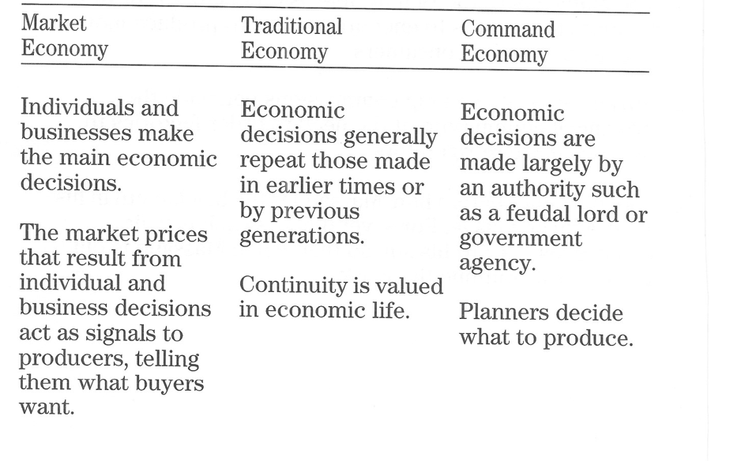

Slide 17
Economic System questions…
Based off how the questions are answered, you determine the economic systems
Traditional System
Command System
Market System
Mixed System
Questions –
What to produce?
How to produce?
For whom?

Slide 18
How do the three economies answer the critical questions?
Questions | Command | Traditional | Market
What to Produce?
How to Produce?
For Whom?

Slide 19
How do the three economies answer the critical questions?
Questions | Command | Traditional | Market
What to Make? | Government | Traditional | Consumer
How to Make it? | Government | Traditional | Efficient and Least costly manner
For Whom? | Government | Traditional | $

Slide 20
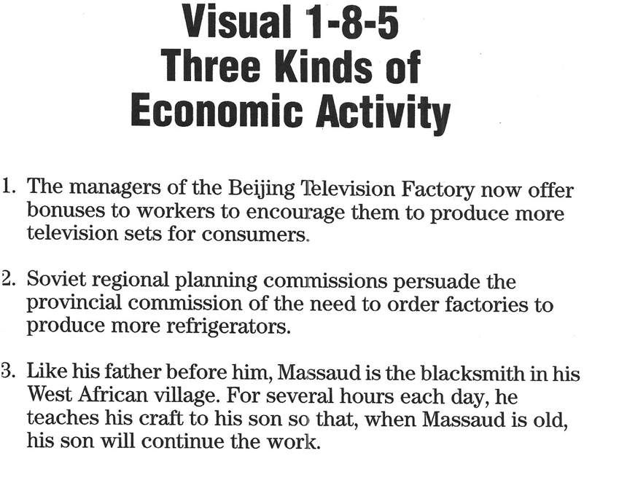

Slide 21
What Makes the United States a Mixed Economy?
Command economy
Traditional Economy
Market Economy

Slide 22
Economic Reasons for Trade →
True/False Exercise
1. The economic goals of international trade is to provide jobs for workers
2. If the US imports more from Japan than it exports to Japan, the total numbers of jobs will decline
3. Tariffs protect our standard of living by reducing competition from cheap foreign labor
4. A STRONG DOLLAR CURRENCY in Forex Exchange Market is good for the US because it reduces the amount of imports purchased by Americans
5. The existence of large, rapidly growing population is the principal reasons for poverty in the third world nations.

Slide 23
Trade & Comparative Advantage
Absolute Advantage
Comparative Advantage
Lower Domestic Opportunity Costs
Specialization
PPC Curves

Slide 24
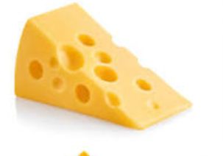
Comparative Advantage, Continued
What nation has an Absolute Advantage in Cheese? Explain
What nation has an Absolute advantage in wine? Explain
What nation has a lower opportunity cost in Cheese?
What nation has a lower opportunity cost in wine?
Who will IMPORT cheese?
If the terms of trade was 1 wine for 2 cheese. Who would be satisfied with the trade?
 | Cheese | Wine
Spain | 150 | 100
Italy | 300 | 100

Slide 25
The Soviet Union and The United States want to Trade
Cars Planes
Soviet Union 1 5
United States 4 20
What nation has an absolute advantage in cars? Explain
What nation has an absolute advantage in planes? Explain
Will these two countries trade? Who will export cars?

Slide 26
Tariffs : The Good, the Bad and the Ugly

Slide 27
Advantages and Disadvantages to Free Trade
Advantages to Free Trade | Disadvantages to Free Trade
1. More variety of products | 1. Unfair trade competition
2. Higher Standard of Living | 2. Protect infant industries
3. Create good relations with nations | 3. Tariffs raise revenue for governments

Slide 28
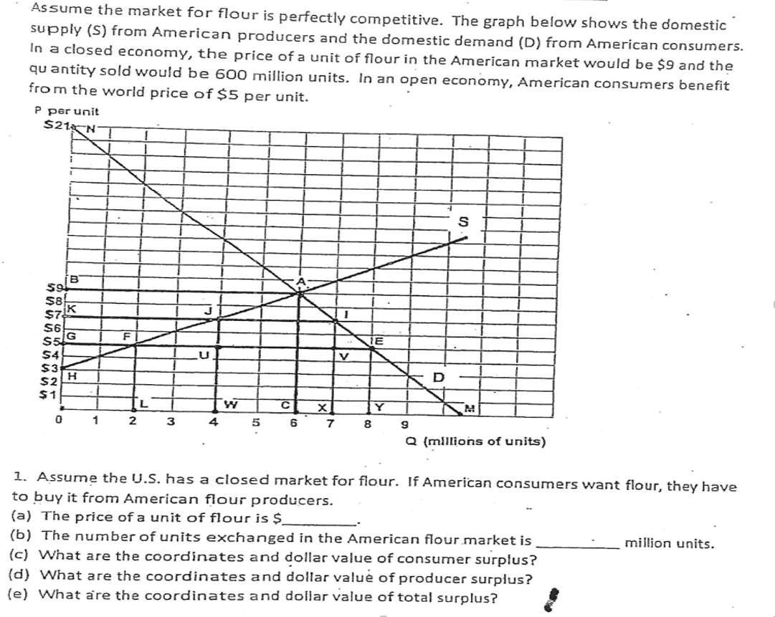
Dr. Gary Stone

Slide 29
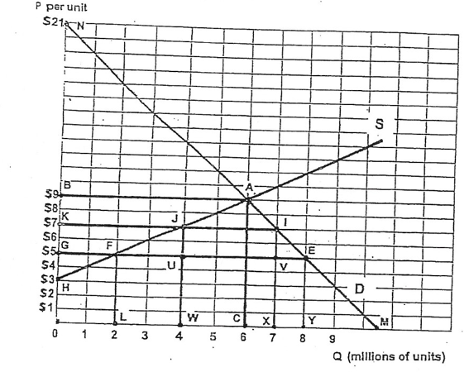

Slide 30
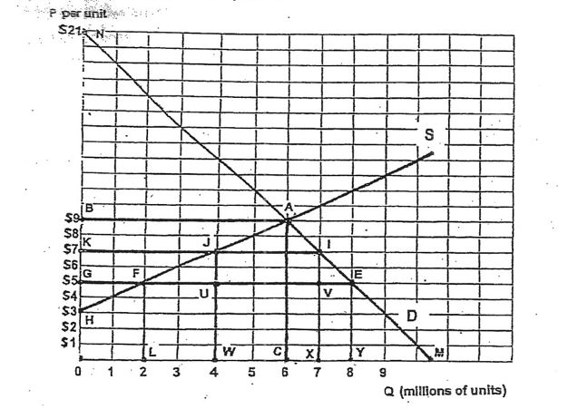
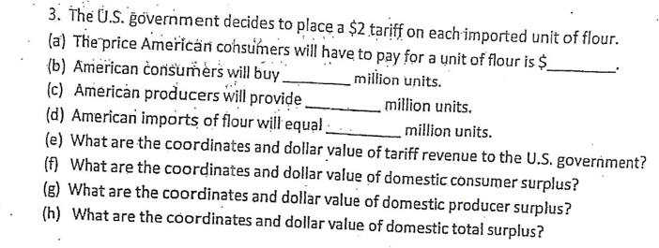

Slide 31
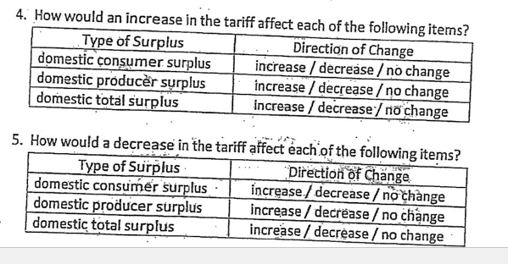
Conclusion on Tariffs

Slide 32
Thank you. I hope the you have a better understanding of these several topics and that you will use the material I have shared with you in your classroom.
Theresa Fischer

Slide 33
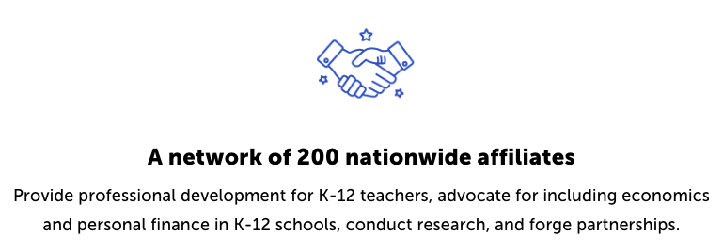
CEE Affiliates
https://www.councilforeconed.org/resources/local-affiliates/

