Slide 1
Personal Finance 101: Budgeting and Banking Presented by Amanda Stiglbauer SC Economics Blythewood High School Amanda.Stiglbauer@moore.sc.edu April 6, 2020

Slide 2
EconEdLink Membership
You can now access CEE’s professional development webinars directly on EconEdLink.org! To receive these new professional development benefits, become an EconEdLink member. As a member, you will now be able to:
Automatically receive a professional development certificate via e-mail within 24 hours after viewing any webinar for a minimum of 45 minutes
Register for upcoming webinars with a simple one-click process
Easily download presentations, lesson plan materials, and activities for each webinar
Search and view all webinars at your convenience
Save webinars to your EconEdLink dashboard for easy access to the event
You may access our new Professional Development page here

Slide 3
Professional Development Certificate
To earn your professional development certificate for this webinar, you must:
Watch a minimum of 45-minutes and you will automatically receive a professional development certificate via e-mail within 24 hours.
Accessing resources:
You can now easily download presentations, lesson plan materials, and activities for each webinar from EconEdLink.org/professional-development/

Slide 4
Agenda
Personal Finance Case Study
Suggested Links to Share with Students
Great e-learning Personal Finance Resources and Games
Banking
Kahoot

Slide 5
Objectives
I can create a personal finance strategy for my life after high school.
I can outline the process for opening a bank account.
I can evaluate the advantages and disadvantages of banks and credit unions.

Slide 6
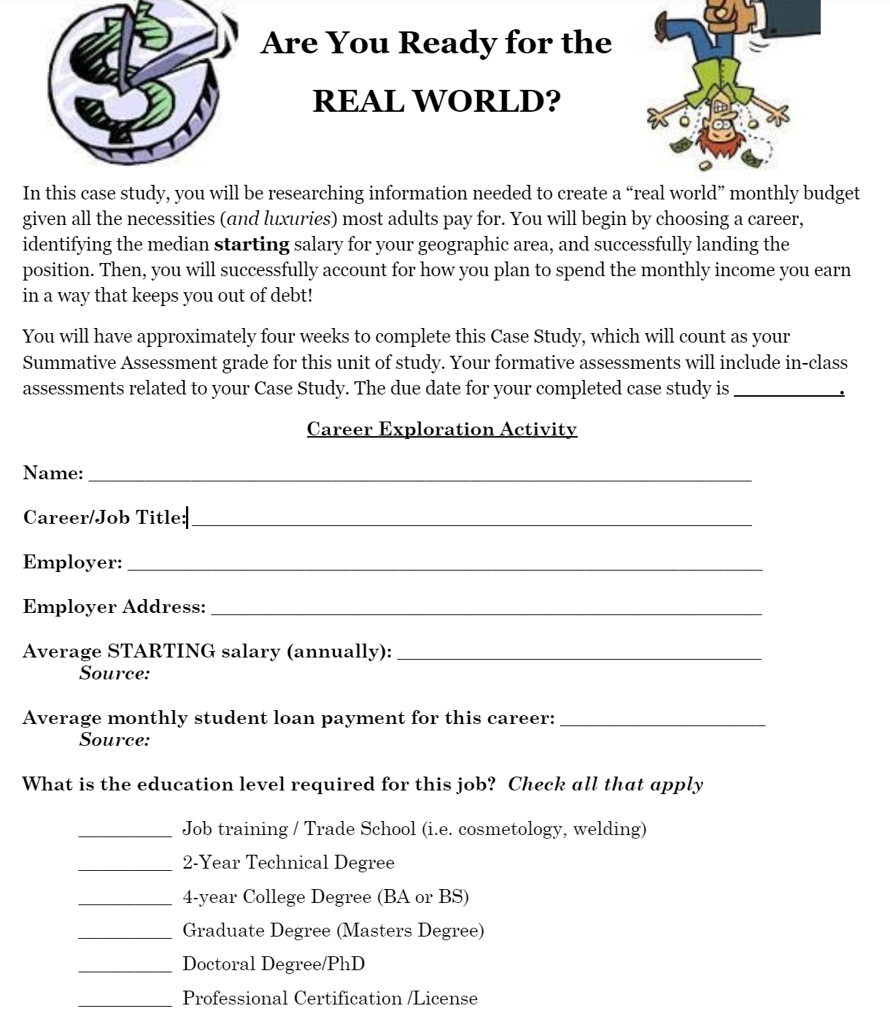
Personal Finance Case Study

Slide 7
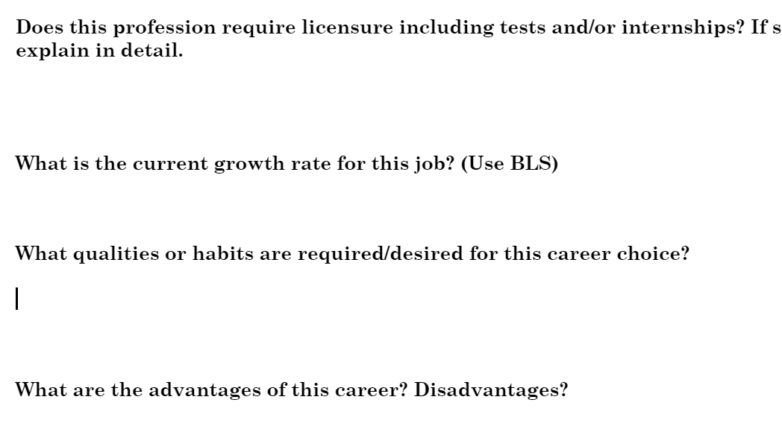
Career Exploration Reflection

Slide 8
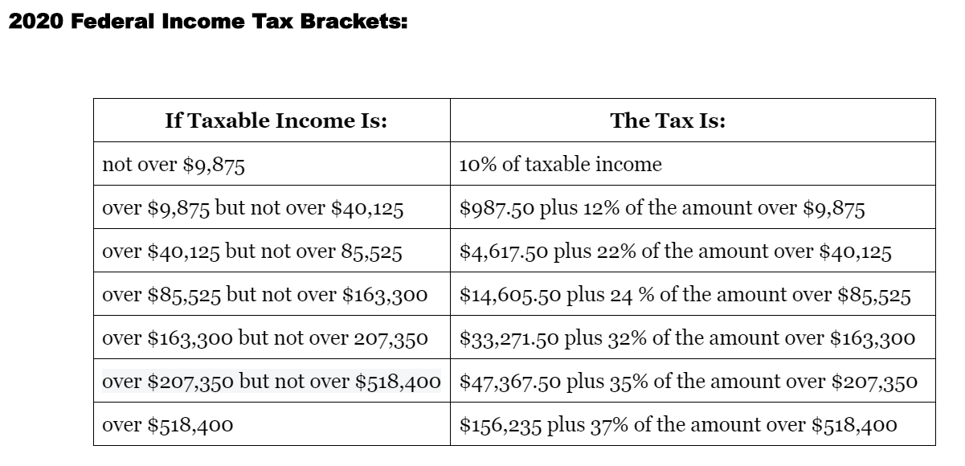
Calculating Federal Income Taxes

Slide 9
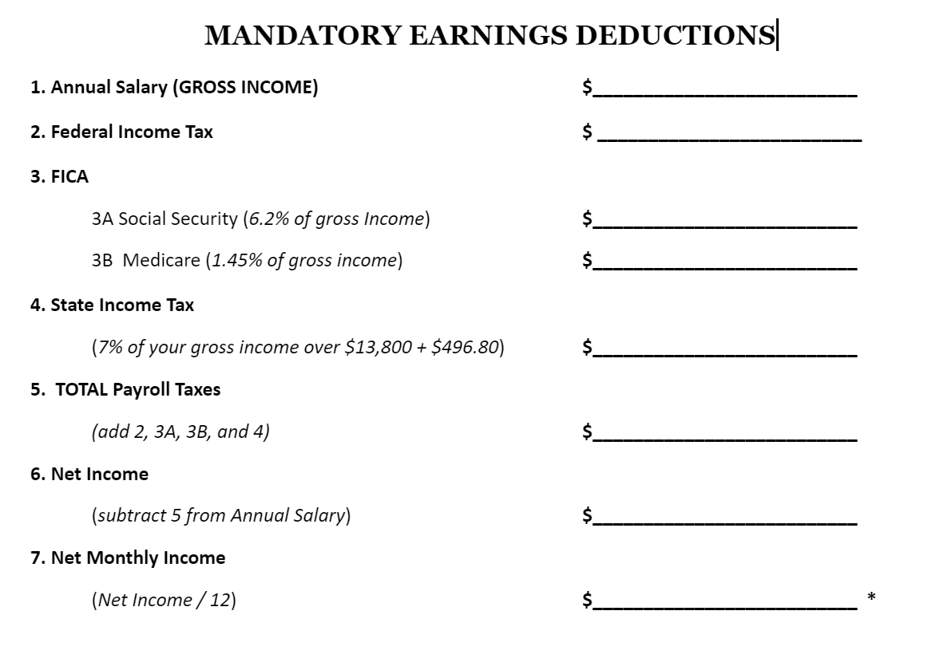

Slide 10
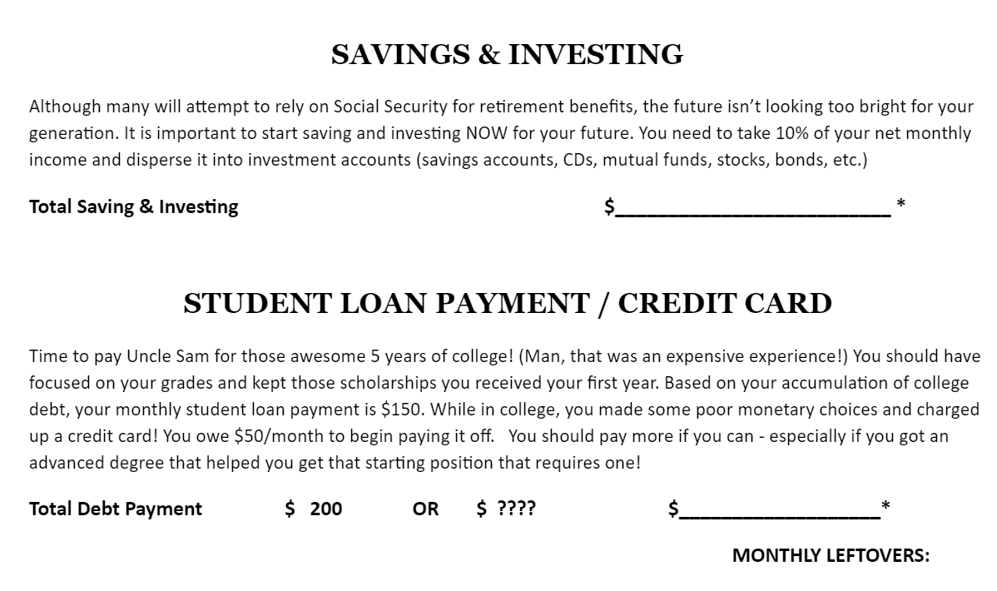

Slide 11
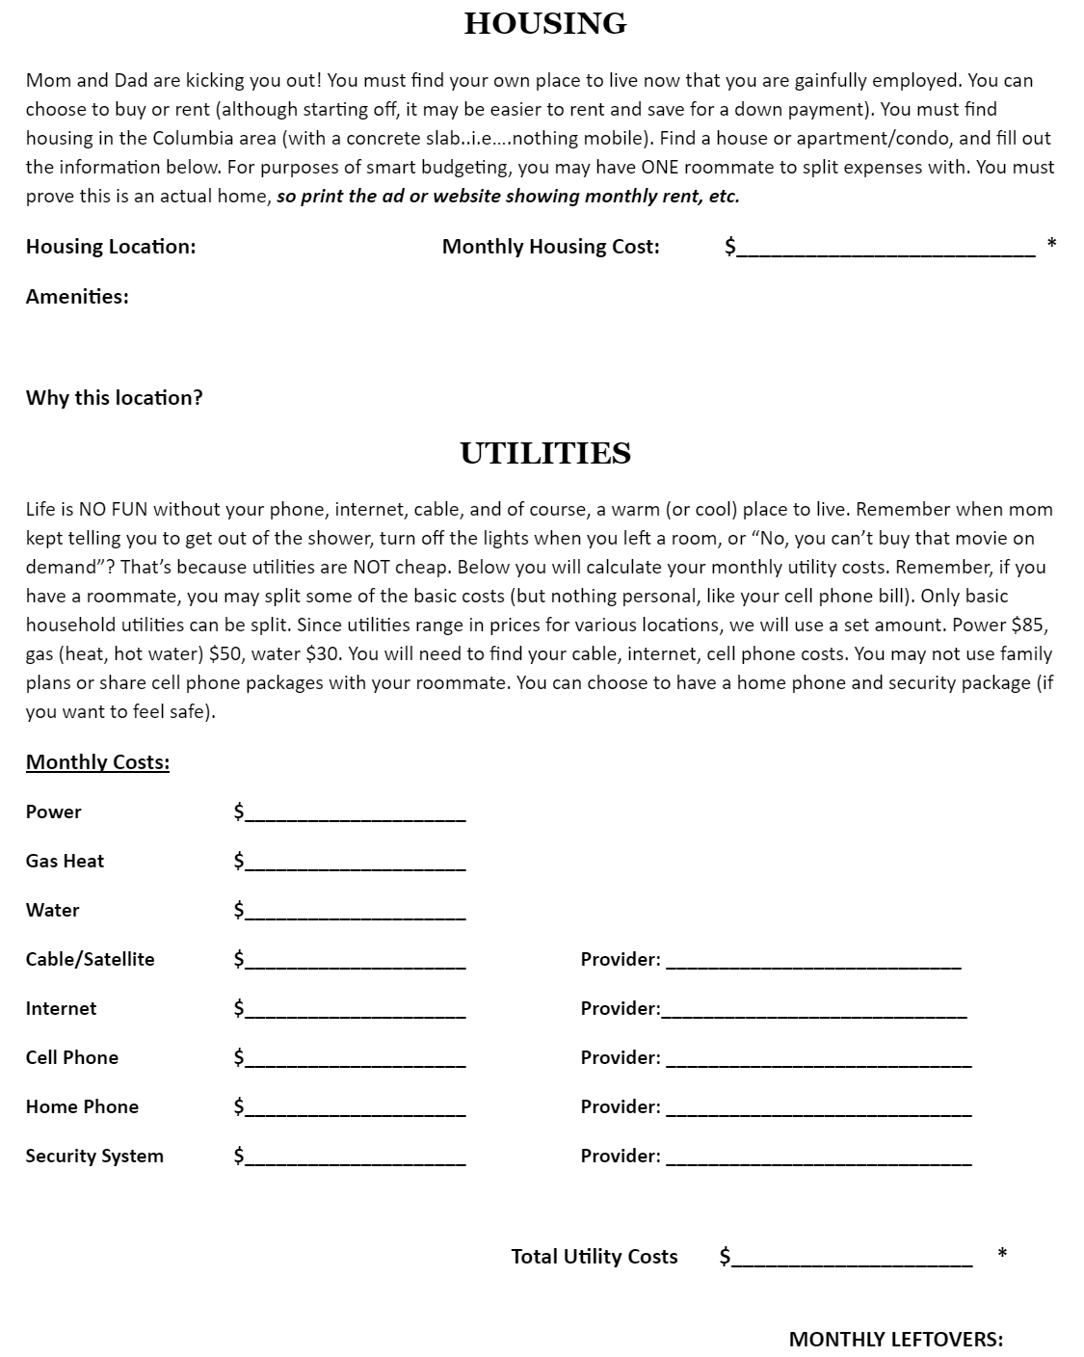
Housing & Utilities

Slide 12
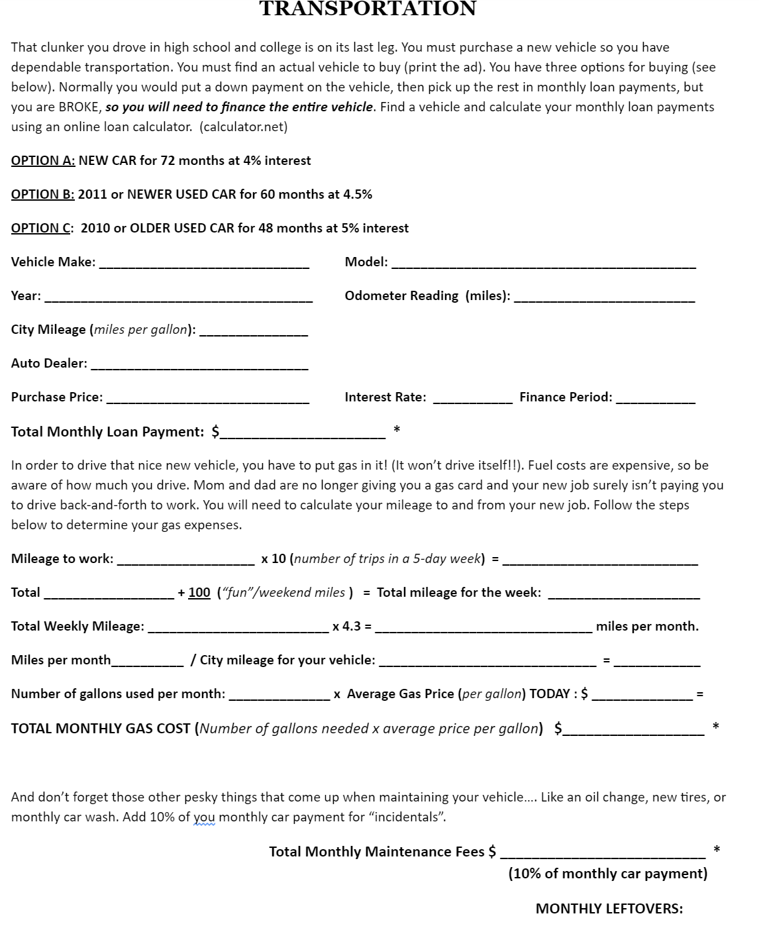
Buying a Car & Other Transportation Costs

Slide 13
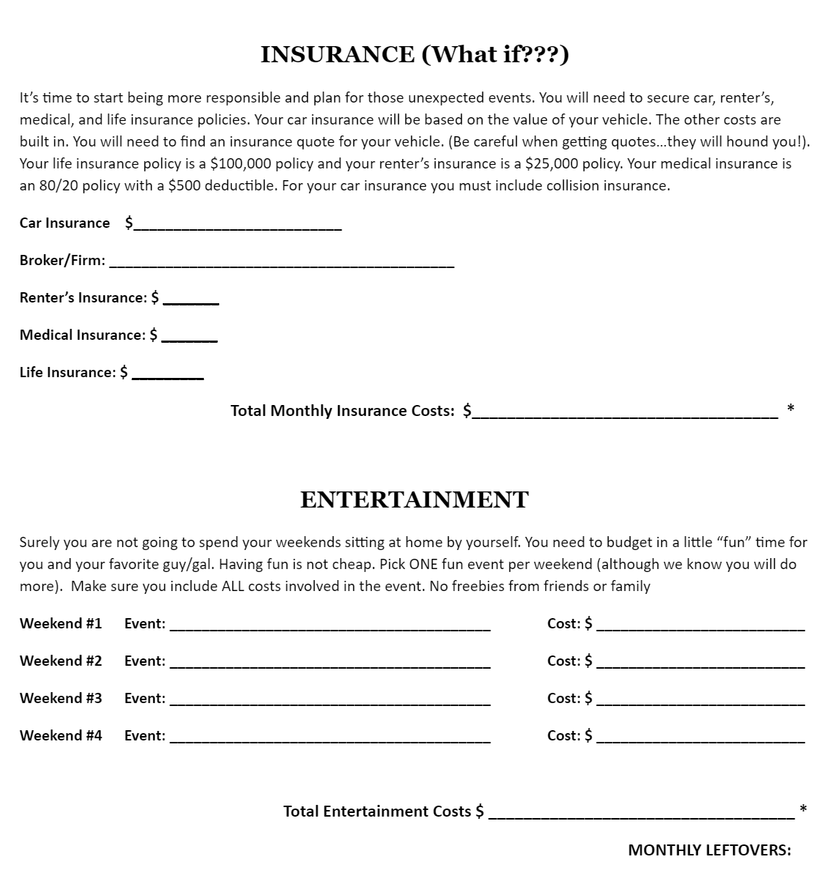
Insurance & Entertainment

Slide 14
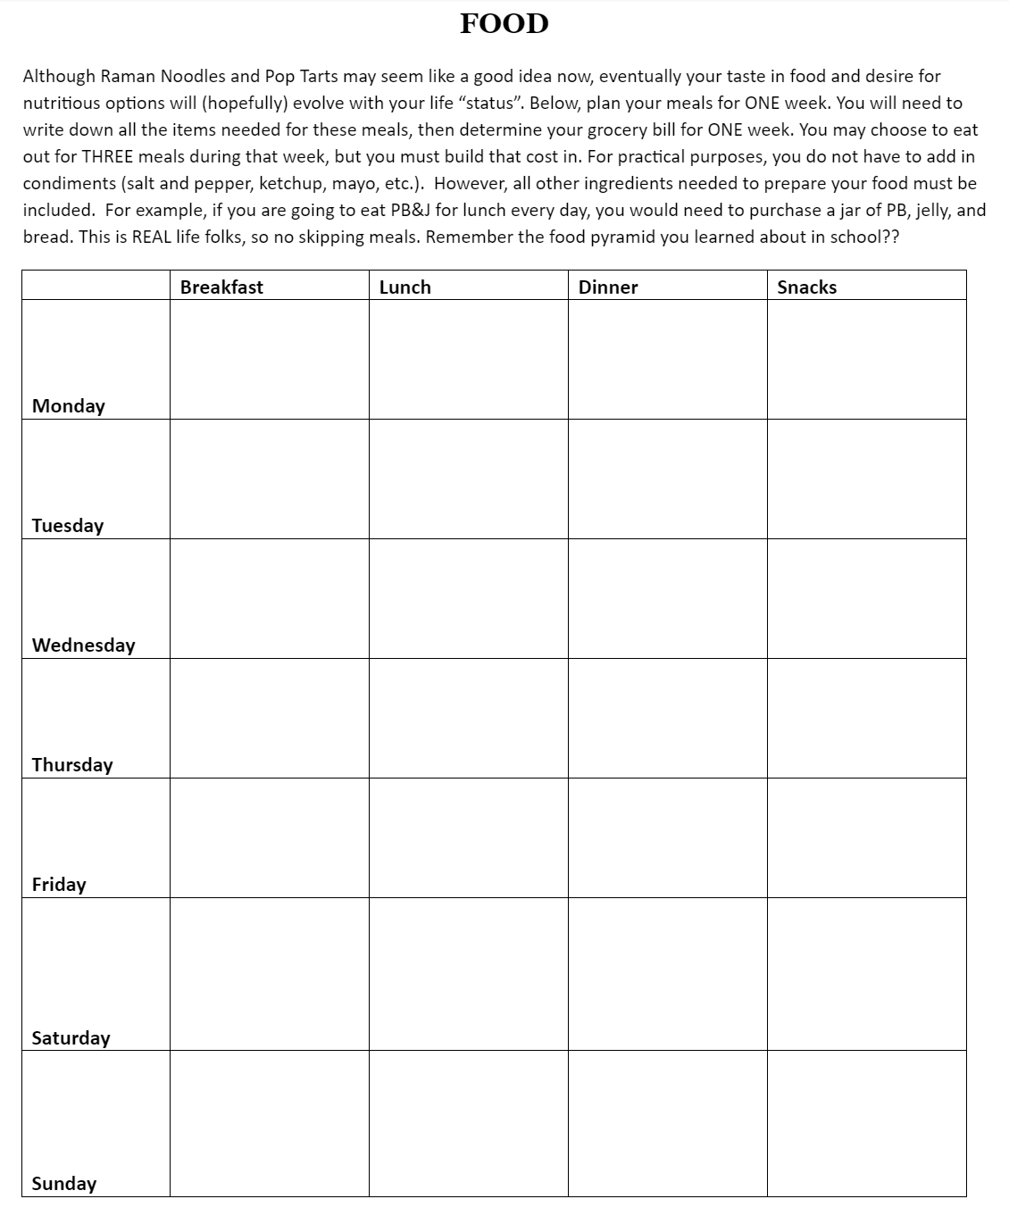
Meal Planning

Slide 15
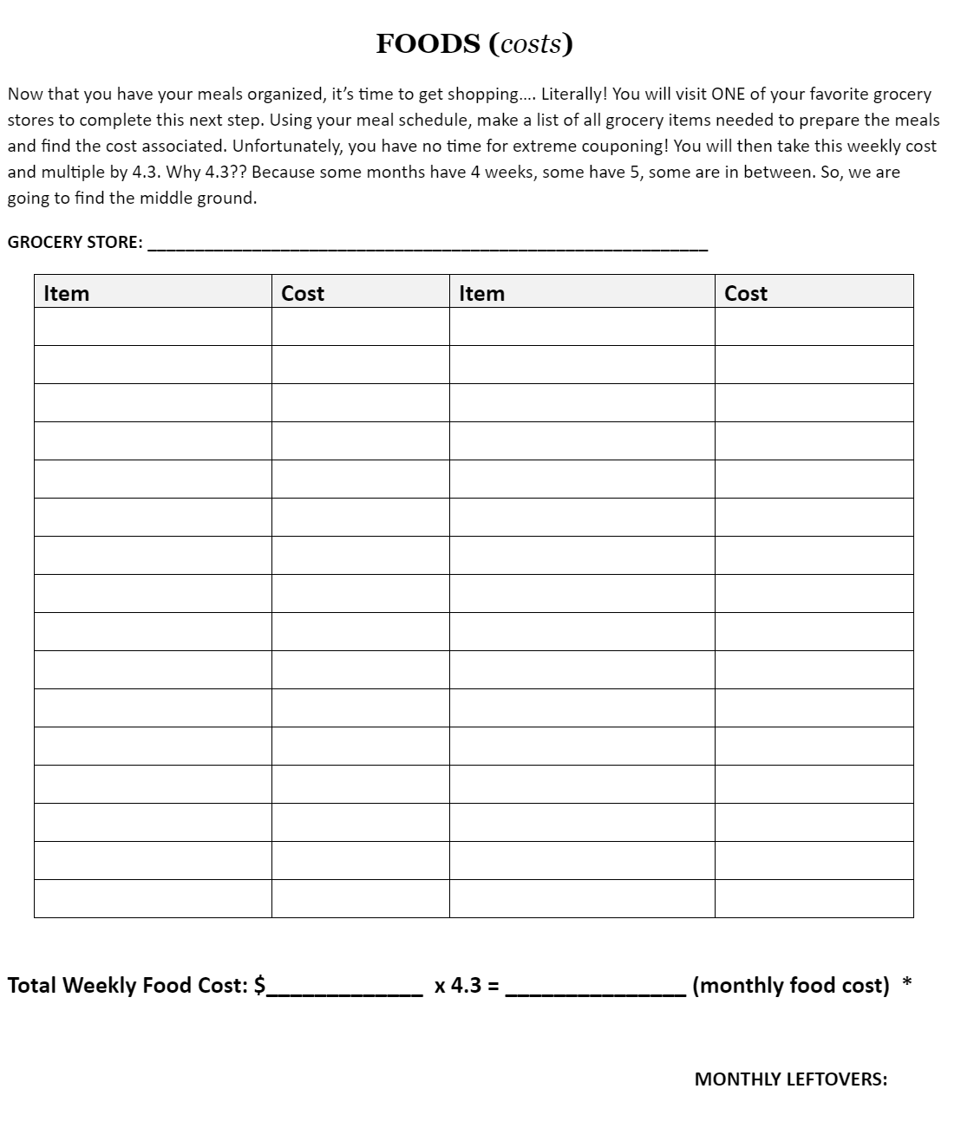
Grocery Shopping

Slide 16
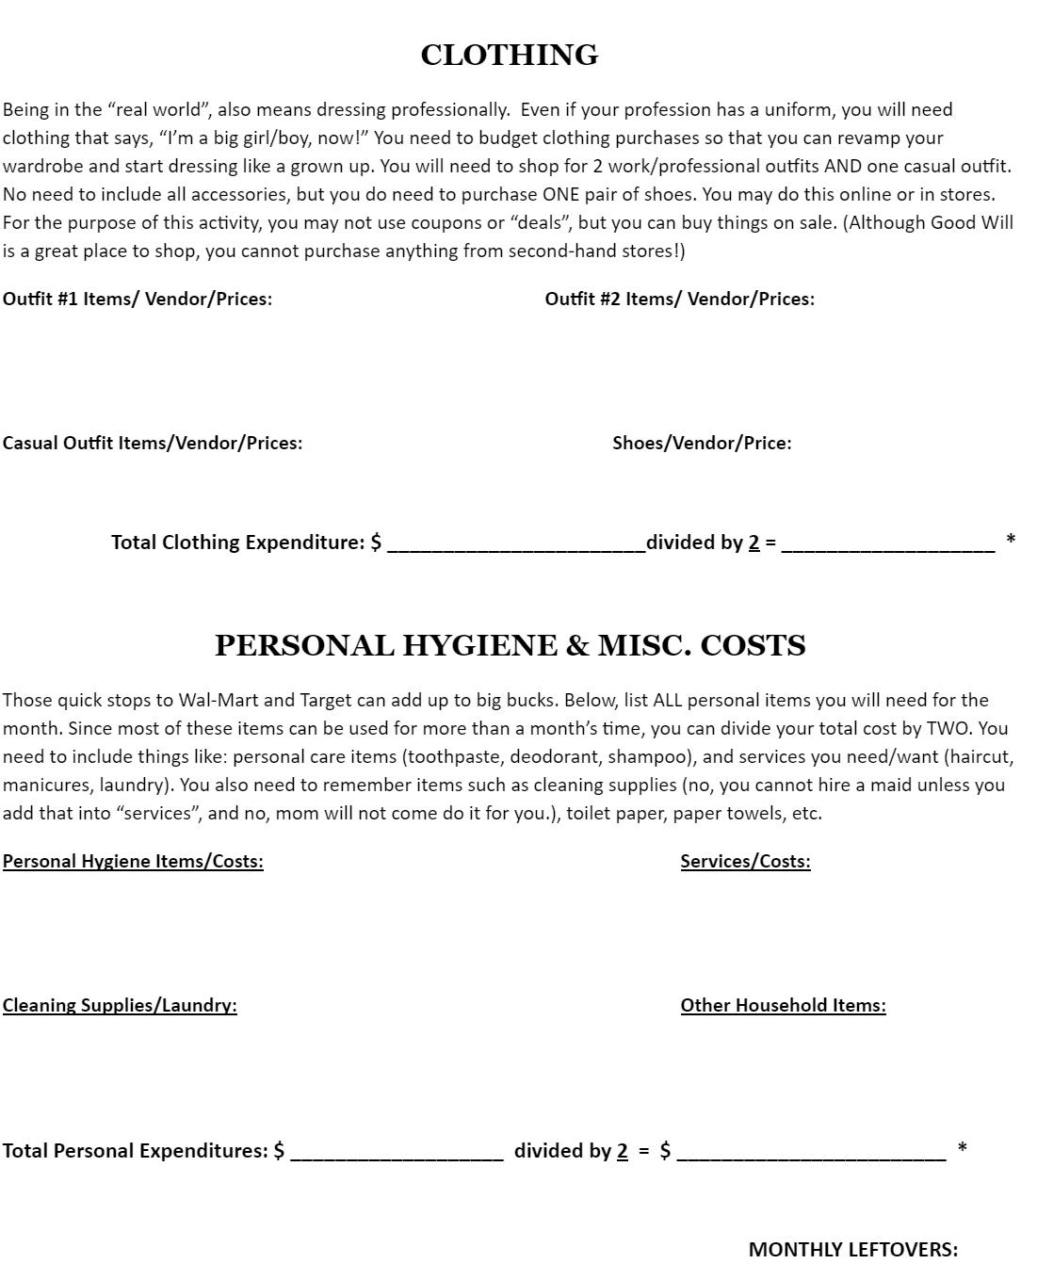
Clothing & Other Personal Items

Slide 17
Resources for Personal Finance Case Study
Career Exploration | Student Loan Payments | Housing and Utilities | Buying a Car & Insurance | Groceries
BLS Better Futures The Balance | BankRate Motley Fool | Apartments.com | Cars.com CarMax Progressive | Walmart.com Publix.com

Slide 18
Notes:
One of the most common items students list for improvement – Books, Games, Pets, Subscriptions (gym, Hulu, etc)

Slide 19
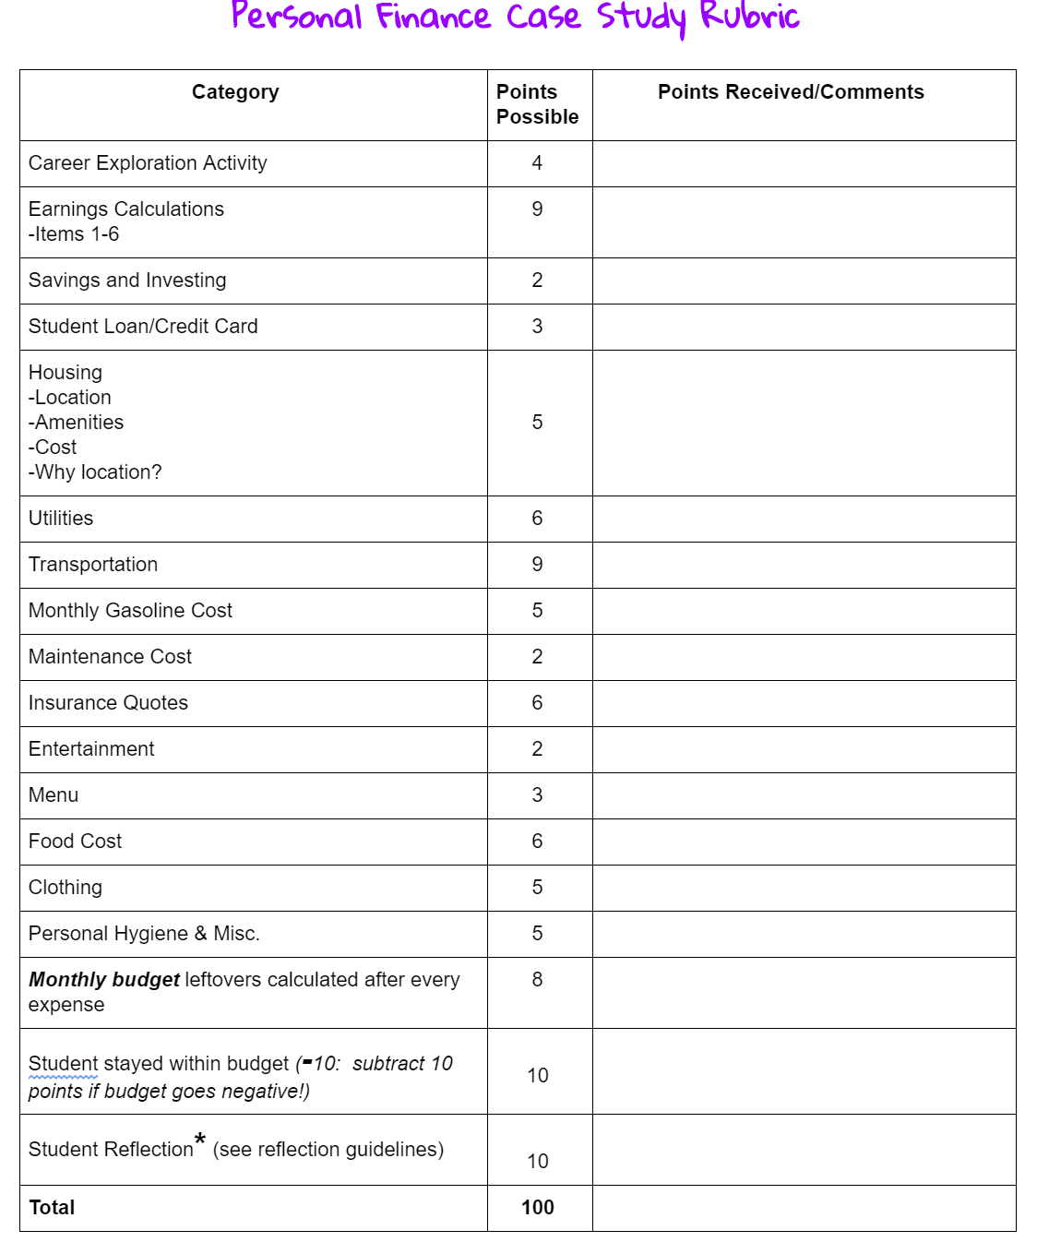

Slide 20
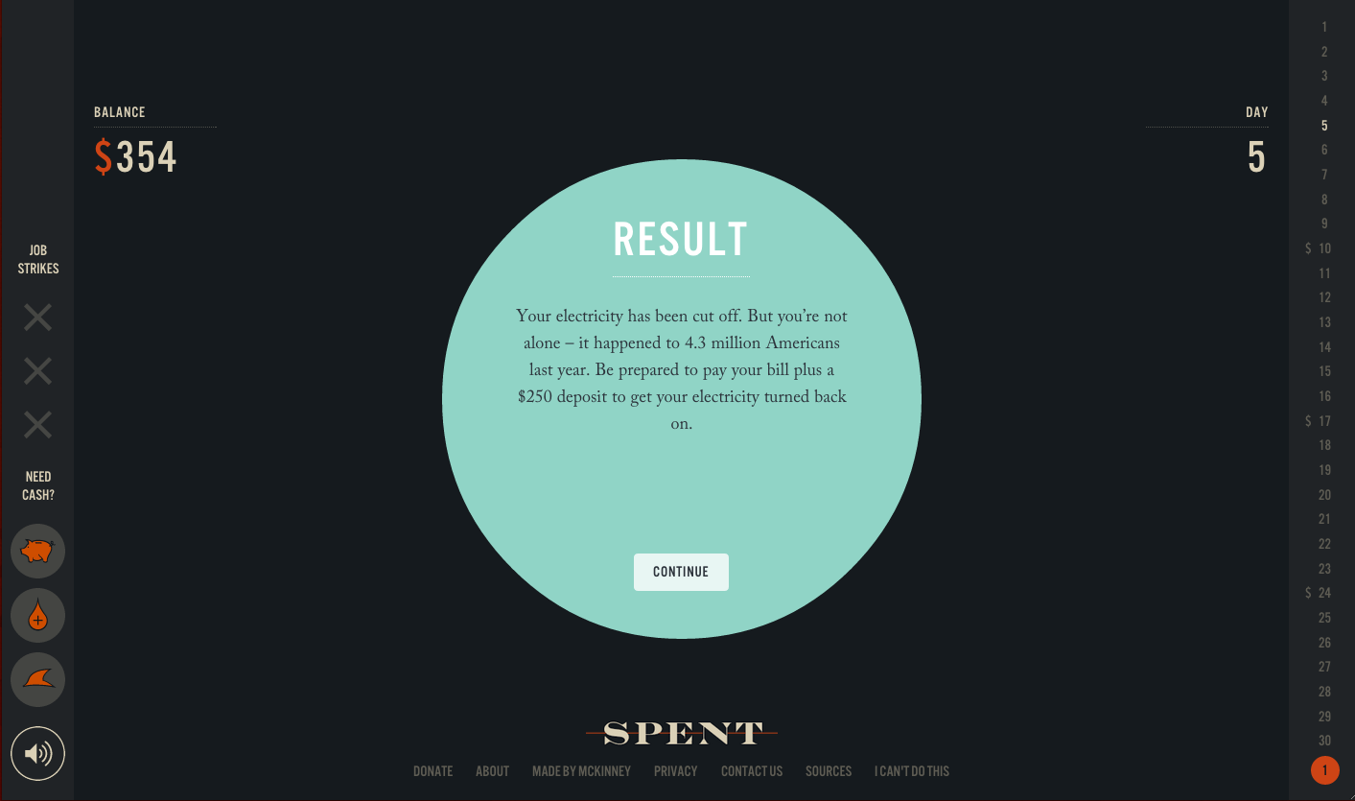

Slide 21
Should I Choose a Bank or Credit Union?
Great overview for students
Kahoot! Code in Chat Box
https://create.kahoot.it/share/cee-webinar-bank-or-credit-union/d03f6aea-2b38-40cc-a616-e68ae15b736d

Slide 22
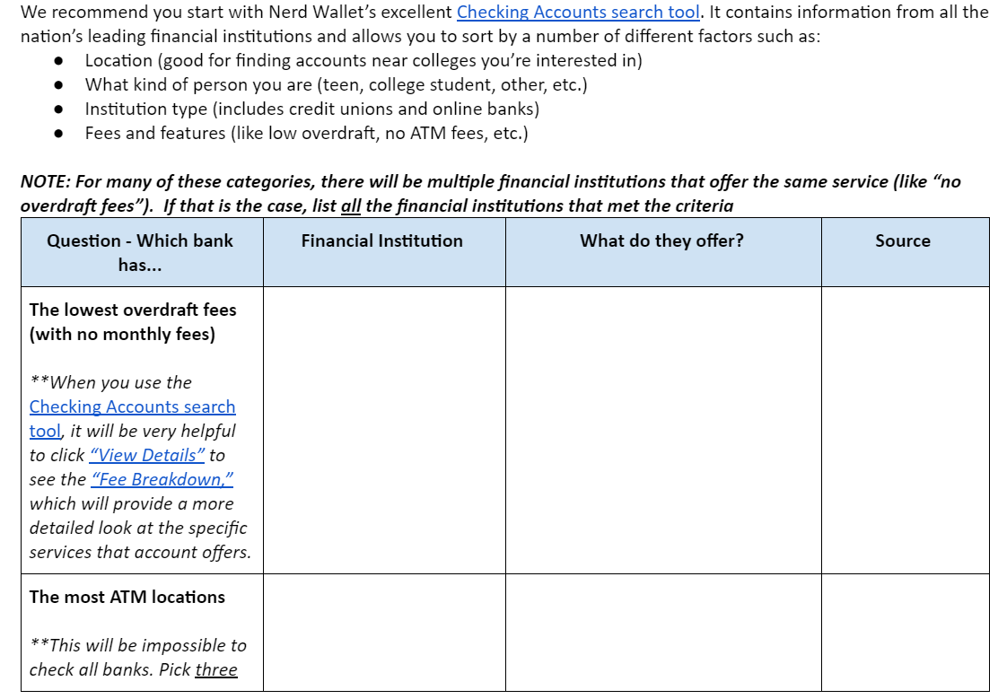

Slide 23
Nerd Wallet’s Checking Account Search Tool
Location
What kind of person you are
Institution type (credit union, commercial, or online bank)
Fees and features (overdraft, no ATM fees, etc.)
Lowest overdraft fees
Most ATM locations
Most branches within 15 miles of home
Location on/near college campus

Slide 24
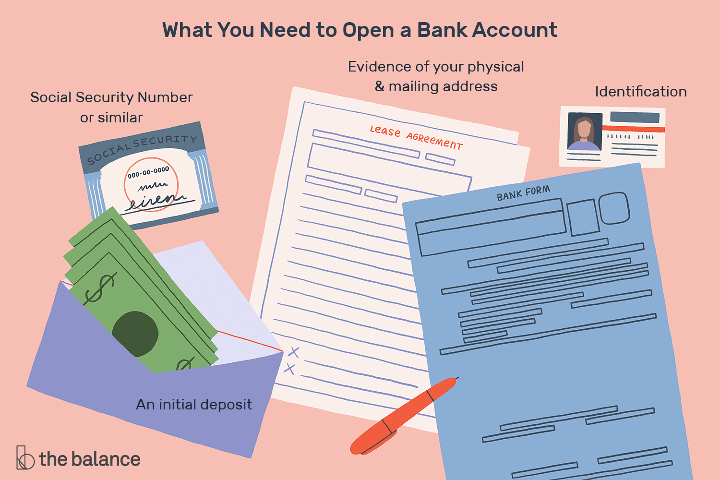
Notes:
Minimum Initial deposit
Government issued ID
Co-owner if under 18
Date of birth
Documentation of physical address
SSN
Proof

Slide 25
Questions to Ask
What type of account do I need? Does it pay interest?
Can I use an ATM for free?
Will my money be safe?
What happens if I try to withdraw more money than I have in my account?
Is there a fee?
Is there a minimum balance requirement?
Can I access my account information online?
Is mobile banking available?
Will it cost me to transfer money?

Slide 26
Collaborate via Chat Box
What other tools for teaching budgeting and banking that you have found useful in the era of e-learning?

Slide 27
Personal Finance 101: Budgeting and Banking Presented by Amanda Stiglbauer SC Economics Blythewood High School Amanda.Stiglbauer@moore.sc.edu April 6, 2020

