Slide 1
Activating an Entrepreneurial Mindset
Presented by: Joi Cobb
March 19, 2020 jcobb@schools.nyc.gov

Slide 2
EconEdLink Membership
You can now access CEE’s professional development webinars directly on EconEdLink.org! To receive these new professional development benefits, become an EconEdLink member. As a member, you will now be able to:
Automatically receive a professional development certificate via e-mail within 24 hours after viewing any webinar for a minimum of 45 minutes
Register for upcoming webinars with a simple one-click process
Easily download presentations, lesson plan materials, and activities for each webinar
Search and view all webinars at your convenience
Save webinars to your EconEdLink dashboard for easy access to the event
You may access our new Professional Development page here

Slide 3
Professional Development Certificate
To earn your professional development certificate for this webinar, you must:
Watch a minimum of 45-minutes and you will automatically receive a professional development certificate via e-mail within 24 hours.
Accessing resources:
You can now easily download presentations, lesson plan materials, and activities for each webinar from EconEdLink.org/professional-development/

Slide 4
Bio of Presenter
Years of Teaching: 13 years
  New York City Department of Education (2012-Present)
  Fulton County, Atlanta, GA (2007-2012)
Courses Taught: Career and Financial Management, General Business Management, Introduction to Computers, Principles of Hospitality and Tourism, Entrepreneurship
Education
  B.S. in Marketing from Hampton University
  M.ED in Business Education from the University of West Georgia
Mother of two teenage sons and a young daughter
Entrepreneur/Owner of Mahogany Mommies

Slide 5
Agenda
Address various Lesson Components and Activities
  Objectives
  Standards
  Lessons
    Essential Questions Aims
    Lesson Activities/Projects
    Discussion Questions
  Additional Topics covered in Entrepreneurship
  Assessment Questions

Slide 6
Key Objectives
Description: This webinar will provide lessons and activities that are geared at encouraging students to open their minds to the possibility of entrepreneurship and teaching them the needed skills to effectively launch a business.
Teachers will be able to:
  Learn how to implement activities to teach students entrepreneurial concepts.
  Examine different lesson plans in entrepreneurship.
  Learn how to evaluate soft skills in a classroom for business start ups.

Slide 7
National Standards
Know unique characteristics of an entrepreneur (McREL Business Education Standards 1999, Standard 15)
Recognize that entrepreneurs possess unique characteristics and examine the role of innovation in entrepreneurial opportunities (NBEA National Standards for Business Education 2013, Entrepreneurship I. Entrepreneurs and Entrepreneurial Opportunities)
Recognize trends and social responsibilities can lead to entrepreneurial opportunities (NBEA National Standards for Business Education 2013, Entrepreneurship II. Entrepreneurial Trends)

Slide 8
National Standards
Know unique characteristics of an entrepreneur (McREL Business Education Standards 1999, Standard 15)
Recognize that entrepreneurs possess unique characteristics and examine the role of innovation in entrepreneurial opportunities (NBEA National Standards for Business Education 2013, Entrepreneurship I. Entrepreneurs and Entrepreneurial Opportunities)
Recognize trends and social responsibilities can lead to entrepreneurial opportunities (NBEA National Standards for Business Education 2013, Entrepreneurship II. Entrepreneurial Trends)

Slide 9
New York State Standards
Standard 1: Career Development Students will be knowledgeable about the world of work, explore career options, and relate personal skills, aptitudes, and abilities to future career decisions.
Standard 2: Integrated Learning Students will demonstrate how academic knowledge and skills are applied in the workplace and other settings.
Standard 3a: Universal Foundation Skills Students will demonstrate mastery of the foundation skills and competencies essential for success in the workplace.
Standard 3b: Career Majors Students who choose a career major will acquire the career-specific technical knowledge/skills necessary to progress toward gainful employment, career advancement, and success in postsecondary programs.

Slide 10
Importance of Teaching Entrepreneurship
Entrepreneurship encourages students to be doers, makers and cutting-edge thinkers the world needs. Entrepreneurship education assist students from all socioeconomic backgrounds to think outside the box and nurture talents and skills considered unconventional. It creates opportunities, promotes social justice, encourages confidence and boost the economy.
https://www.entrepreneur.com/article/245038

Slide 11
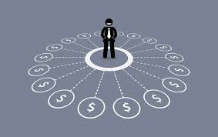
Reasons for Multiple Streams of Income
Job Security
Unique Opportunities
You can take risks
Tax Benefits
Pensions are the things of the pas
Social Security
Building Wealth Long-Term
Pay Down Debt
https://money.usnews.com/money/blogs/my-money/2010/11/03/10-reasons-to-have-multiple-income-streams

Slide 12

Lesson: Visualize Your Future
Objective: SWBAT explain the importance of visualization in achieving their personal and professional goals.
Essential Question or Aim: Why is a visual representation important when achieving your personal and professional goals?

Slide 13
Lesson: Visualize Your Future
Activity : Visualize Your Future
Discussion Questions:
1. Why is visualization an important aspect of goal setting?
2. How did seeing your dreams, impact your desire to take action?

Slide 14

Lesson: Visualize Your Future
Article: THE IMPORTANCE OF VISUALIZING YOUR GOALS

Slide 15
Lesson: Goal Setting & Vision Boards
Standard:
- Identify and demonstrate processes for making short and long term goals.
- Develop a career and education plan that includes short and long-term goals, high school program of study, and postsecondary/career goals.
Objective: SWBAT identify what is important to them and begin setting educational and personal goals.
Essential Question or Aim: How can a vision board be used to help visualize your goals to ultimately inspire and encourage you to meet your goals?

Slide 16
Lesson: Goal Setting and Vision Boards
Activity: Short Term& Long Terms Goal Setting, Digital Vision Board, Vision Board Project, My Dream Life
Discussion Questions:
1. In times of stress, it is important to remember WHY you are doing what you do. What motivates you? How do you remember what’s really important in your life?
2. What are your values and how do they influence your goals?

Slide 17
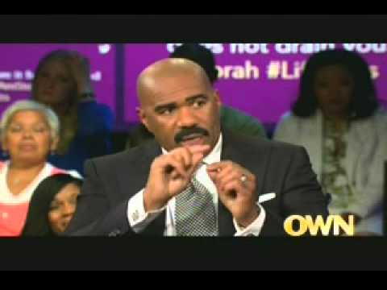
Lesson: Vision Boards
Steve Harvey’s Vision Board

Slide 18
Lesson: Growth Mindset
Objectives:
SWBAT understand the differences between a fixed and growth mindset.
SWBAT share a story of a time they struggled to learn a new concept/skill.
Essential Question or Aim: How does failure play a part in one’s success?

Slide 19
Lesson: Growth Mindset
Essential Question or Aim: How does failure play a part in one’s success?
Activities: Famous Failures, Fixed Mindset & Growth Mindset
Discussion Questions:
1. Can you think of a time you faced an important opportunity or challenge with a fixed mindset? What were your thoughts and worries – about your abilities? About other people’s judgments? About the possibility of failure? Describe them vividly.
2. How do you respond to “constructive criticism”?

Slide 20

Lesson: Growth Mindset
Identify: Growth or Fixed Mindset?

Slide 21
Lesson: What is Entrepreneurship?
Standard: Know the characteristics of the major types of business organizations (McREL Business Education Standards 1999, Standard 7)
Objectives:
- SWBAT define entrepreneurship and describe its impact on a free-market economy*
- SWBAT display understanding of the reasons for becoming an entrepreneur
Essential Question or Aim: How does Entrepreneurship impact a free-market economy?

Slide 22
Lesson: What is Entrepreneurship?
Essential Question or Aim: How does Entrepreneurship impact a free-market economy?
Activities: Entrepreneurship and the Entrepreneur , What is an Entrepreneur? , Entrepreneur & Entrepreneurship, Entrepreneurship: If You Started a Business
Discussion Questions:
1. Why entrepreneurship important in the US economy?
2. What types of businesses are currently missing from your own community?

Slide 23
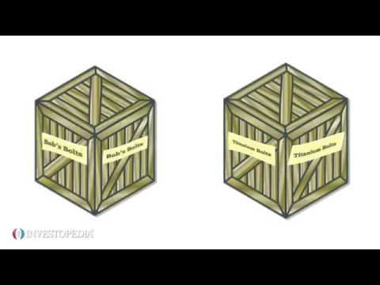
Lesson: What is Entrepreneurship?
Why Entrepreneurs Are Important for the Economy?

Slide 24
Lesson: Characteristics of an Entrepreneur
Standards:
- Know unique characteristics of an entrepreneur (McREL Business Education Standards 1999, Standard 15)
Recognize that entrepreneurs possess unique characteristics and examine the role of innovation in entrepreneurial opportunities (NBEA National Standards for Business Education 2013, Entrepreneurship I. Entrepreneurs and Entrepreneurial Opportunities)
Objective: SWBAT Identify key qualities of successful business leaders*
Essential Question or Aim: How does the characteristics of an entrepreneur help to determine their success in business?

Slide 25
Lesson: Characteristics of an Entrepreneur
Essential Question or Aim: How does the characteristics of an entrepreneur help to determine their success in business?
Activities: Four Corners, What Motivates Entrepreneurs?, Autobiography, Characteristics of an Entrepreneur, What Makes an Entrepreneur?
Discussion Questions:
1. What qualities make an entrepreneur successful?
2. What motivates entrepreneurs?

Slide 26

Lesson: Characteristics of an Entrepreneur
The Life of an Entrepreneur in 90 Seconds- Best Motivational Video for Entrepreneurs

Slide 27
Lesson: Are you an Entrepreneur?
Standard: NES Economics
- Identify the skills entrepreneurs need
- Assess your suitability for Entrepreneurship
Objective: SWBAT determine whether they have the personal characteristics necessary for success as an entrepreneur.
Essential Question or Aim: How can you determine if you have the personal characteristics necessary to become a successful entrepreneur?

Slide 28
Lesson: Are you an Entrepreneur?
Essential Question or Aim: How can you determine if you have the personal characteristics necessary to become a successful entrepreneur?
Activities: Entrepreneurial Self-Assessment Survey, The Student As Entrepreneur: A Self-Evaluation, The Entrepreneur in You, Be Your Own Boss
Discussion Questions:
1. Have you ever thought about owning your own business? If so, what would the business be?
2. How does one know if he or she is cut out to be an entrepreneur?
3. Have you ever considered yourself an entrepreneur? Why or why not?

Slide 29
Lesson: Are you an Entrepreneur?
Quiz: Do You Have What It Takes to Be an Entrepreneur?

Slide 30
Lesson: Creating a Business Idea
Standard: Know characteristics and features of viable business opportunities (McREL Business Education Standards 1999, Standard 16)
Objectives:
- Describe where business ideas come from and how they are evaluated
- Identify business opportunities that best match entrepreneurs’ skills and abilities
Essential Question or Aim: How do you generate business ideas and evaluate their possibilities?

Slide 31
Lesson: Creating a Business Idea
Essential Question or Aim: How do you generate business ideas and evaluate their possibilities?
Activities: How to Start a Business, Entrepreneurship Card Set Activity, Idea Guide, Pitch Your Business Idea
Discussion Questions:
1. Is this a product/service you think people will need or want? Explain.
2. What improvements would you suggest?
3. Would you invest time or money in this product or service? Explain.

Slide 32

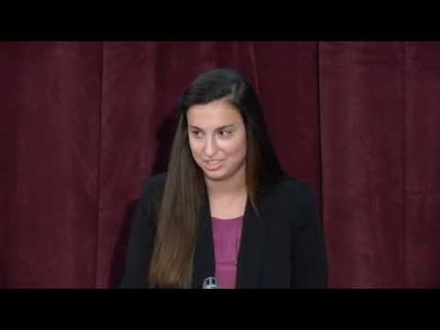
Lesson: Creating a Business Idea
Example Elevator Pitches:

Slide 33
Lesson: Preparing a Business Plan
Standards:
- Describe the risks, costs and rewards of starting a business.
- Outline the main components of a business plan.
Objectives:
- Identify possible first steps in starting a business after developing an idea
- Understand the importance and purpose of a business plan
Essential Question or Aim: Why is a creating business plan a vital of component of starting a new business venture?

Slide 34
Lesson: Preparing a Business Plan
Activities: How to Start a Business, Opportunity or Idea
Discussion Questions:
1. Why is it important to talk to trusted allies after developing a business idea? Who in your life do you trust to talk about your future business?
2. Why are business plans important, even for small businesses or side hustles?

Slide 35

Lesson: Preparing a Business Plan
Starbucks SWOT Analysis

Slide 36
Additional Topics for Entrepreneurship
Establishing Your Market (Target Audience)
The Role of Marketing
Funding Your Business Venture
Mitigating Risks
Legal Issues

Slide 37
Assessment Questions
How important, in reaching a personal goal, is it for someone to engage in goal setting activities?
Should profit be the most important measure in determining whether or not a business is “successful”?
How would you describe an entrepreneur to someone who had never heard the term?
Do you think anybody can be taught the skills to be a successful entrepreneur or does one have to be born with those skills?

Slide 38
Assessment Questions
How does a business plan help an entrepreneur determine when a business opportunity exists?
How would you describe an entrepreneur to someone who had never heard the term?

Slide 39
References
Entrepreneurship Introduction Course Lesson https://veinternational.org/wp-content/uploads/2015/11/Unit-1-Intro-to-Entrepreneurship1.pdf
Next Gen Personal Finance https://docs.google.com/document/d/1VFAENhmWeOQiw4EgZA9aBAyf-8ANF7jXq8ak9XGwTDY/edit
NAF https://naf.org/
Econed Link https://www.econedlink.org/resources/what-makes-an-entrepreneur/
Entrepreneurship Activities Bundle https://www.teacherspayteachers.com/Product/Entrepreneurship-Activities-BUNDLE-3436902

Slide 40
References
https://www.entrepreneur.com/article/245038
https://money.usnews.com/money/blogs/my-money/2010/11/03/10-reasonst
https://www.unfinishedsuccess.com/the-importance-of-visualizing-your-goals/
Short-term and Long-term Activity: http://www.fldoe.org/core/fileparse.php/7531/urlt/short-long-term-goal-setting.pdf
https://sharemylesson.com/teaching-resource/vision-board-252228

Slide 41
References
Famous Failures Activity: https://www.teacherspayteachers.com/Product/Growth-Mindset-Lesson-Famous-Failures-2604022

Slide 42

CEE Affiliates
https://www.councilforeconed.org/resources/local-affiliates/

