Slide 1
Personal Finance
Savings, Checking, and
Digital Accounts
April 30, 2020
Presenter: Robert F. Massimi
The Bronx High School of Science email: massimi@bxscience.edu

Slide 2
TEACHING GOALS:
Transfer content literacy the students
  Build on existing knowledge
  Provide relatable & relevant resources/activities
Foster high-level student engagement
  Organize lesson around well-developed questions
  Utilize Small Groups (discussions, activities, projects)

Slide 3
Financial Literacy in the Classroom
AP and non-AP Economics & Government, 12th Grade
Integrate financial literacy into curriculum
  Overlapping curriculum (interest rates, inflation, government policies, etc.)
  Mini - Financial Literacy Modules (Personal Finance and Investing, Budgeting, Credit, Taxes, Banking & Capital Markets)

Slide 4
Lesson: Savings, Checking, and Digital Banking
Suggested pre-requisite lessons/topic areas:
Types of Investments/financial assets
Interest Rates
Inflation
Money / currency (M1 and M2)
FDIC Insured Accounts
TEACHERS: Consider administering a short diagnostic quiz/test prior to starting a personal finance unit to assess the appropriate instruction materials and resources required to design your lesson.

Slide 5
Personal Finance & Investment “Warm-Up”
What are different ways in which people can save (or invest) their money?
What are possible investment goals?
TEACHERS: Students can work in groups of 2-4 and generate a list of responses amongst themselves. After a few minutes have all the groups in the room share out to the whole class. Compile a comprehensive list of student responses on the board.
Teachers should help to organize the “assets” on the list into different investment groupings (i.e.: bank accounts, stocks, bonds…); Ask students copy and save the list into their notebooks, as it can serve as a reference throughout the entire personal finance unit/course.
Notes:
You can use this for this lesson, or for an into to personal finance and investing lesson or when introducing the unit to your students.

Slide 6
Sample list generated by students on board:
Piggy bank
Bank (Commercial)
Stocks
Bonds
Real Estate
Small business
Gold
Bitcoin
Teachers:
For each of these terms on the board, think about related questions that you can ask your students.
Example: Why is it not a good idea to put your money in a piggy bank? (Inflation, security, etc.)
Each question that you ask should be designed to draw on prior knowledge, and to promote critical thinking, as well as to help develop a framework for students to help fit the pieces on this list together.

Slide 7
Lesson: Savings, Checking, and Digital Banking
AIM: How can we use different types of bank accounts to help manage our money?
DO NOW: Do you or anyone in your family have a bank checking or savings account? Does anyone use a mobile banking app??
Pivotal Questions: TEACHERS: Please see my lesson plan and additional materials: essential questions, related articles, video links, activities, and a mini-assessment.
Why do people need bank accounts?
How is a checking account different from a savings account?
How has technology and digital banking changed the way people store and move money?
Summary/Exit Question: Why do rates of return vary on different types of bank accounts?

Slide 8




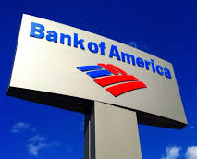

Pivotal Question #1:
Why do people need bank accounts?
Do you recognize any of these banks your city or community?
What role do these banks play?
What are different types of bank accounts?
What services do they provide customers? Explain why this is important.
Teachers: You may want to define what a ‘commercial bank’ is for your students, and/or explain the difference between a commercial bank and an investment bank.
Notes:
Roles: check cashing, checking, savings, ATM, lending (Mortgages, etc.)
HANDOUT: Role of banks

Slide 9
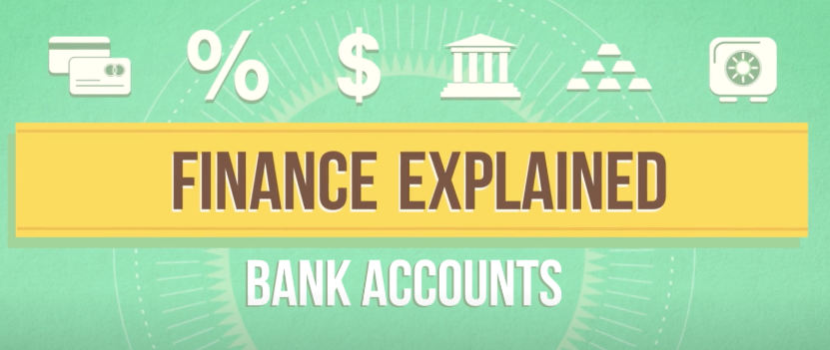
Pivotal Question #2:
How is a checking account different from a savings account?
Watch the video link that explains the difference between a checking and savings account (Source: Mashable.com) (Time: 2m:49s) TEACHERS: See my handout with guided questions.
https://mashable.com/2015/12/10/finance-explained-checking-savings-video/?jwsource=cl
Teachers:
Differentiate material for individual students. Ex: Provide students with either a note sheet, Venn diagram, or graphic organizer to fill out and/or guided questions while/after they watch the video.
See my resource page for more in-depth videos and articles about checking and savings accounts. Many short excerpts can be spliced from articles and can be adapted for DO NOWs, homework, group discussion, the “flipped” classroom, activities/projects; either in-class or with remote learning.

Slide 10
Video Discussion Questions:
Q1: Why isn’t my checking account collecting interest?
Q2: Which type of account makes your money more accessible, and easier to pay bills with? Explain.
TEACHERS: An AP Econ class might build on the Financial Sector Unit, with a question about M1 or M2: “Which type of account is more liquid? Explain.”
Q3: Why is a bank more willing to pay you a higher rate of interest on a savings account?
Q4: How should decide how much money I should hold in my checking account vs. my savings account?

Slide 11
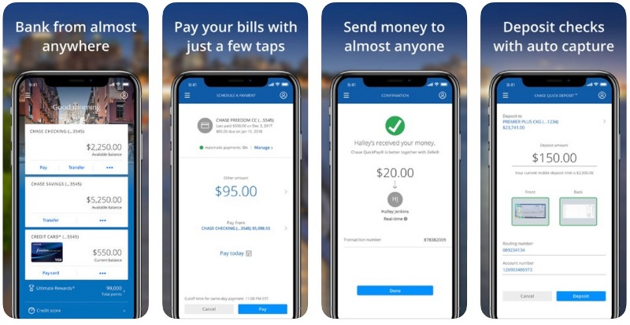
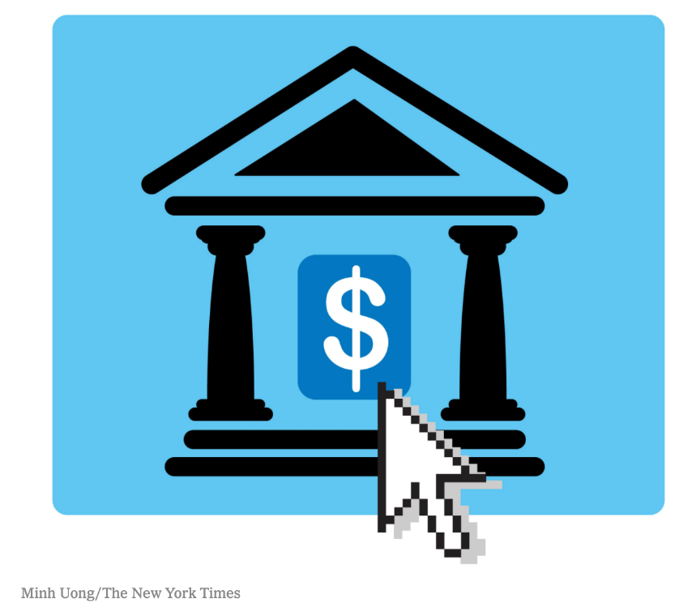
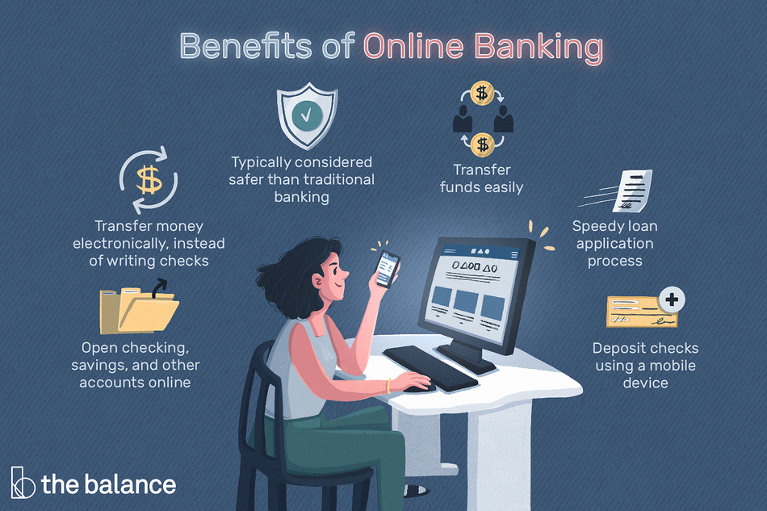
Pivotal Question #3:
How has technology and digital banking changed the way people store and move money?
Define ‘digital banking’
Notes:
Mobile banking apps, bill pay, P2P, etc.
Also, online savings bank accounts (differentiate from big banks).

Slide 12
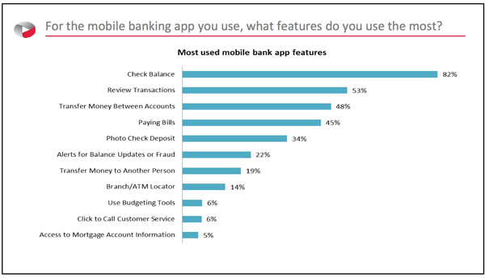
Discuss:
How are people using their mobile banking apps?

Slide 13
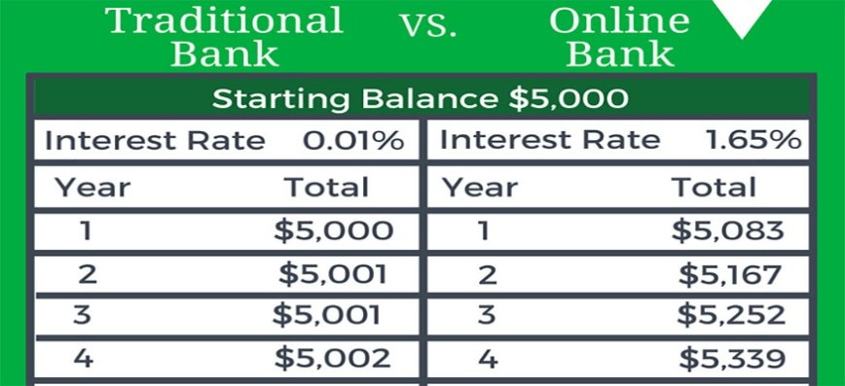

How have online savings accounts changed the way people bank?
1. What are these rates based on?
2. How much interest could you be earning?
ONLINE SAVINGS CALCULATOR:
https://www.nerdwallet.com/blog/banking/savings-calculator/
Notes:
Give students interest rate data to analyze (online savings vs. brick-and-mortar bank commercial banks).

Slide 14
And, one step beyond online banks… Neobanks!
Neobanks are digital or mobile-only banks with NO physical locations; provides users with basic financial services such as checking and savings accounts and money transfer services.
Strategically target tech-savvy millennials with their cost-effective structures such as no monthly fees, no withdrawal or overdraft costs
“An August 2019 Finder.com survey states that 21.4% of US internet users ages 18 to 91 already use neobanks. About 57% of the same respondents said they believe digital banking is more convenient than brick-and-mortars…” (Source: Jeane Han, emarketer.com)

Slide 15


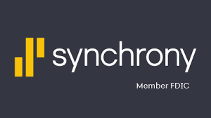
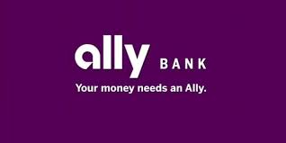

Group Activity – Look up your bank!
TEACHERS: Arrange students into groups of 3-4
Each student in the group gets a card with the name of a bank written on it. For each group, ensure that 1 or 2 cards have traditional banks, and 1 or 2 cards are online only banks/per group.
Give each student some time on their mobile device to look up his/her assigned bank and answer the corresponding questions (See handout w. questions and cards).
After 5-8 minutes, let the students share what they learned with their group. The students will compare and analyze similarities & differences between the banks; and evaluate the pros and cons of different types of banks.

Slide 16
Group Activity – Look Up Your Bank! (Handout Questions)
TEACHERS: Students can use mobile devices to look up assigned bank. Students respond to the following questions, as if opening a savings account with that bank:
  What is the current interest rate that the bank pays for a “savings account?”
  Identify if “your” bank is a traditional, online, or neobank.
  How can you make deposits into the account?
  How can you access your money from this account? (Give at least 1-2 ways)
  Is your account at this bank FDIC insured?
  Are you limited in how many transactions you can make in a month?
  In a t-chart, list the pros and cons of opening an account with this bank?

Slide 17
Summary / Exit Questions:
Why do online bank savings accounts pay a higher (yield) interest rate than traditional branch banks?
Write down one thing about this lesson that you would like to learn more about.

Slide 18
Additional topic ideas for student projects and advanced lessons:
Why is bank lending important?
How to get a job in banking?
How to diversify your investment portfolio?
Issues in banking: redlining, protected lending, etc.
The history of banking
Banking & Financial Crisis
Banking systems in other countries/emerging markets
Microfinance and microlending
The Federal Reserve System
Investment banking and hedge funds
Emerging Technology in Banking (Fintech, AI, Blockchain, Robotics)
Security issues in the banking sector
The future of digital currency
Banking Laws, Regulation and Deregulation

Slide 19
Essential questions to consider for your lesson
Why is it important to have a bank account?
How do we save our money?
What kind of accounts do banks offer? How are they different?
Why do some banks and accounts offer higher rates of return than others?
What are bank rates of return based on? (*Make connection to the Fed Funds Rate and the Discount Rate)
What do banks do with deposited money?
Why is having a checking and savings account important if I only want to borrow money from a bank?
What does a checking account help me to do?
Why is not good to “hold” a lot of cash in your pocket?
What benefits do I get from having direct deposit on my checking account?
How can I withdraw my money from the bank? (list at least 4 ways)
How can mobile ban king apps make my life easier?
How often should I monitor my checking/savings/credit card accounts?
What should I look out for on my monthly bank statement? What should we analyze?
What mobile banking app alerts should I activate? (i.e. low balance, mobile deposit, unusual activity)
Why is it important to understand the fees that my bank may charge me on my accounts (and how to avoid them)?
Did you know that you can deposit a check into your bank account by taking a picture of it on your bank’s mobile app?
What government regulations protect me as a consumer?

Slide 20
Essential questions to consider for your lesson
What are of the advantages and disadvantages of having a checking account? (suggest having the students make a T-chart)
What are of the advantages and disadvantages of having a savings account?
What are 4 methods of withdrawing money from your checking account?
List reasons why having a checking account is important for paying people, bills, and businesses.
Why is it important to manage (“balance”) your checking account?
How much money do you recommend keeping in your checking account?
How can you avoid taking more money out of your bank account than you have in it?
What is overdraft protection?
Why is it important to have an emergency fund savings account?
Why don’t checking accounts pay interest?
How can I avoid paying checking account fees?
What is the average fee to take money out of a non-network ATM?
How can I avoid paying ATM fees?
Why do checking accounts offer debit cards?
What is a debit card?
How are debit cards different from credit cards?
Why are checking accounts more “liquid” than savings accounts (M1 vs M2)?
What is a money market account?

Slide 21
Essential questions to consider for your lesson
Why do online savings banks (ex: Synchrony, Ally, Marcus, etc.) pay higher rates of return than traditional big banks (ex: Chase, Citi, Wells Fargo, BofA)?
Why is it important to always check that your bank accounts are FDIC insured?
What are the FDIC insurance limits? How can these be maximized?
How are money market and online savings accounts regulated?
How can I move money from an online savings account to my checking account?
What are P2P payments?
Who provides P2P services?
How is a digital wallet payment similar to using a credit card?
How safe are online and mobile bill payments?
What fees and security issues should you be aware of when using a mobile pay app?
Does my bank offer P2P and online/mobile bill pay services?
How secure is online banking?
How do thieves target bank cards?
How is my information being collected by banks and distributed to third parties?
How is fintech going to change the way we bank and use our currency over the next 5 years?
When can I open a checking or savings account?
When is a good time for me to get a bank credit card?
Why do we want to maintain a diversified investment portfolio (FDIC bank accounts, stocks, bonds, etc.)?

Slide 22
Resources for teachers:
Checking and (Online) Savings:
5 Reasons Why You Need A Checking Account (Source: NerdCredit.com)
https://www.netcredit.com/blog/5-reasons-why-you-need-a-checking-account/
How to Start Using Your Checking Account Properly, by Lauren Ver Hage, July 6, 2016 (Source: The Financial Diet)
https://thefinancialdiet.com/5-ways-to-actually-start-using-your-checking-account-properly/
How to Squeeze Higher Returns From Your Savings, by Kevin McAllister, February 10, 2019 (Source: WSJ.com)
https://www.wsj.com/articles/how-to-squeeze-higher-returns-from-your-savings-11549825201?shareToken=stc5e0fc0ea68245dba88e958691571fde
At Least Online, Interest Rates on Savings Finally Move Up, by Ann Carrns, July 20, 2018 (Source: NYTimes.com)
https://www.nytimes.com/2018/07/20/your-money/online-interest-rates-savings.html?searchResultPosition=1
Kal Penn explains the difference between checking and savings accounts (Source: mashable.com)
Video: https://mashable.com/2015/12/10/finance-explained-checking-savings-video
Avoiding Bank Fees (Source: ConsumerReports.org)
Video: https://www.consumerreports.org/video/view/money/banking/1439202383001/avoiding-bank-fees/
Bank Overdraft Fees (Source: ConsumerReports.org)
Video: https://www.consumerreports.org/video/view/money/banking/1674383787001/bank-overdraft-fees/

Slide 23
Digital Banking and Mobile Pay:
Cash Faces a New Challenger in Zelle, a Mobile Banking Service, by Stacy Cowley, June 12, 2017 (Source: NYTimes.com)
https://www.nytimes.com/2017/06/12/business/dealbook/mobile-banking-zelle-venmo-apple-pay.html?searchResultPosition=10
Which Payment App is Best for You: Venmo, Apple, ‘Zelle’? by Peter Rudegeair, June 26, 2017 (Source: WSJ.com)
https://www.wsj.com/articles/how-should-you-play-the-digital-payment-boom-1498469582?shareToken=st2cd2945d39184f7b9ed1e49e2fde42b2
Venmo Has 40 Million Users, Outnumbering Most Big banks by Peter Rudegeair, April 24, 2019 (Source: WSJ.com)
https://www.wsj.com/articles/venmo-has-40-million-users-outnumbering-most-big-banks-11556142906?shareToken=st504e9ebdc4ea4cb58be4d1ffa737cdd4
The New Rules of Conduct in a World Without Cash by Steven Melendez, May 23, 2019 (Source: WSJ.com)
https://www.wsj.com/articles/the-new-rules-of-conduct-in-a-world-without-cash-11558635593?shareToken=std2c09e371cf74ea4b28c1d70add024f2
Beware the Fees That Come With Some Money Transfer Apps by Ann Carrns, April 24, 2020, (Source: NYTimes.com)
https://nyti.ms/2zsGbwN
9 Best Apps for Accepting Mobile Payments (Reviewed with Pros and Cons) by Danielle Antosz, January 7, 2020, (Source: Digital.com)
https://digital.com/blog/mobile-payments/
Most Americans Go Mobile With Payment Apps – Here’s How They Roll by Erin El Issa, February 26, 2020, (Source: nerdwallet.com)
https://www.nerdwallet.com/blog/banking/mobile-payment-app-survey/
10 Online and Mobile Security Tips (Source: Bank of America)
https://bettermoneyhabits.bankofamerica.com/en/privacy-security/online-security-privacy-tips

Slide 24
(NEW!) Remote Learning
Communicate
Education Technology
‘Modified’ Flipped Classroom
  Provide students with excellent resources and guided questions
  Differentiate material for individual students
  Alternative assessment opportunities (open-ended questions)
Small collaboration groups for students (Google Classroom)

Slide 25
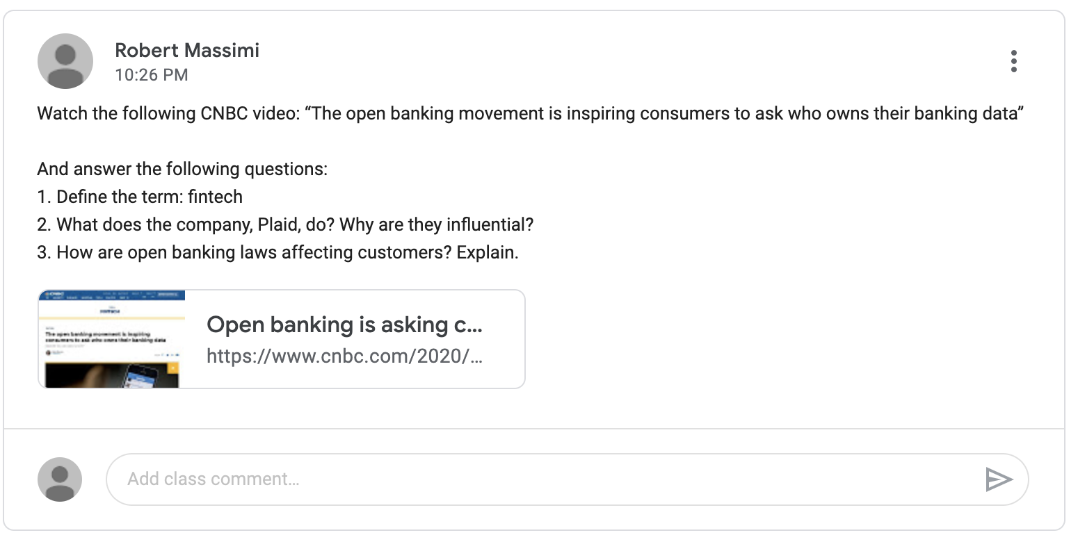
REMOTE LEARNING – SAMPLE ASSIGNMENT
Notes:
Here is an example of an assignment posted on my Google Classroom stream. It can be given to students as homework, class participation, or as an extra credit opportunity.
Note: I often use shorter video links and questions for daily DO NOWs.

Slide 26
Financial Literacy End-Goal:
We want to provide students with basic information and knowledge to understand money and how it works.
We want students to acquire basic financial tools and skills to help their families make better and more informed individual economic decisions.
We want to give ALL STUDENTS the depth of knowledge and understanding needed in financial literacy that will give them the confidence and ability to pursue higher level careers in capital markets and business.

