Slide 1
Understanding Fiscal Responsibility: Revisions to U.S. History Lessons
The History of Social Security
Presented by Amanda Stiglbauer
SC Economics
Blythewood High School
Amanda.Stiglbauer@moore.sc.edu
April 14, 2020

Slide 2

Objectives
I can examine primary and secondary sources for information and interpretations.
I can outline the reasons for establishing Social Security in 1935.

Slide 3
Essential Dilemma
Social Security Act of 1935: Did the creation of a federally administered old-age pension program support or threaten American values and traditions?

Slide 4
Agenda
Overview - Background and Status of Social Security
  History Channel Video Clip
  Kahoot!
Political Cartoon Analysis
Primary Source Analysis & Collaboration
Discussion of Plans - Townsend, Long, Roosevelt
  Student Activity Intro
Debrief

Slide 5

History Channel Overview
https://www.youtube.com/watch?v=cdE_EV3wnXM

Slide 6
Overview
Social Security - topic of frequent debate
Historically: Social Security Act of 1935
  Created by Congress at the height of the Great Depression in 1935
  guaranteed that workers would receive benefits after they retired.
  funded by payroll taxes that went into a trust fund used to pay out the benefits
Presently: about 25% of the federal budget
  At first, more healthy workers paying into the fund than retirees taking benefits.
  In 2008, the first of 78 million baby boomers turned 62 and eligible to draw benefits.
  Until 2010, Social Security collected more in tax revenues than it paid out in benefits. That's because for every beneficiary withdrawing from the fund, there were 3.3 younger workers paying into it.
Future outlook
  Over the next 30 years - fewer and fewer workers per retiree to support Social Security
  Surplus will be depleted by 2034.
  Social Security payroll taxes and interest from the trust fund will only be able to pay 79% of the projected benefits.
  Experts believe shortfall could be covered by a 2.22% increase in payroll taxes.

Slide 7
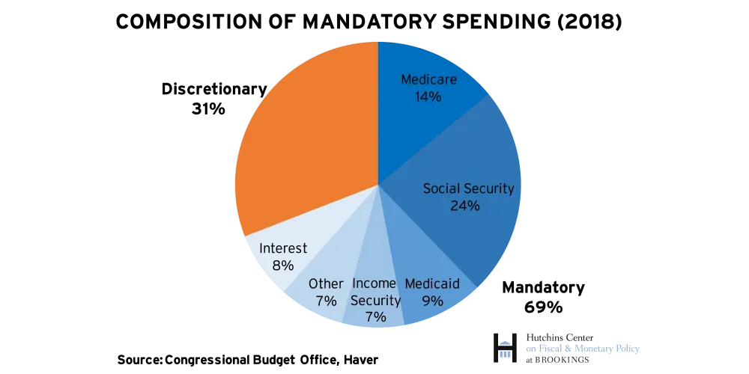

Slide 8
Potential Results of Boomers Entering Retirement
By 2025, those over 65 will comprise 20% of the population.
Labor force age 55 and under will not provide enough income to fund Social Security benefits.
Slowdown in economic growth, as government spending will be focused more on paying benefits to these mandated programs.
Increase in U.S. debt to GDP ratio.
Weakening of the dollar, which may lead investors to switch to countries with more promising growth prospects.
Source: The Balance https://www.thebalance.com/current-federal-mandatory-spending-3305772

Slide 9
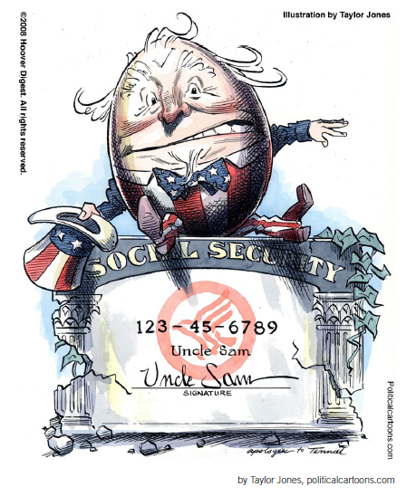
Social Security: Visualizing the Debate

Slide 10
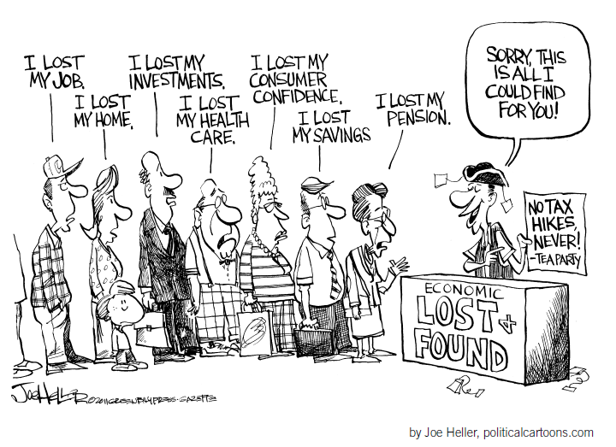
Social Security: Visualizing the Debate

Slide 11
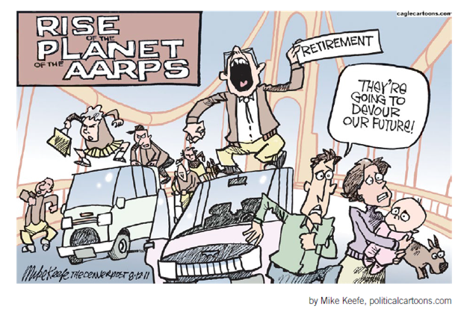
Social Security: Visualizing the Debate

Slide 12
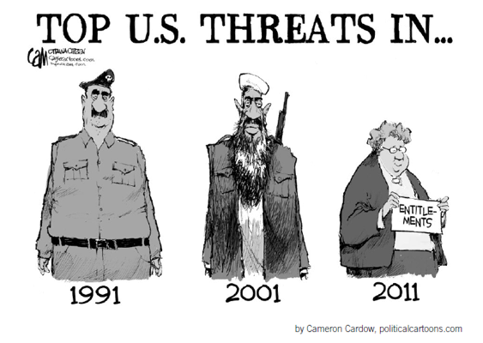
Social Security: Visualizing the Debate

Slide 13
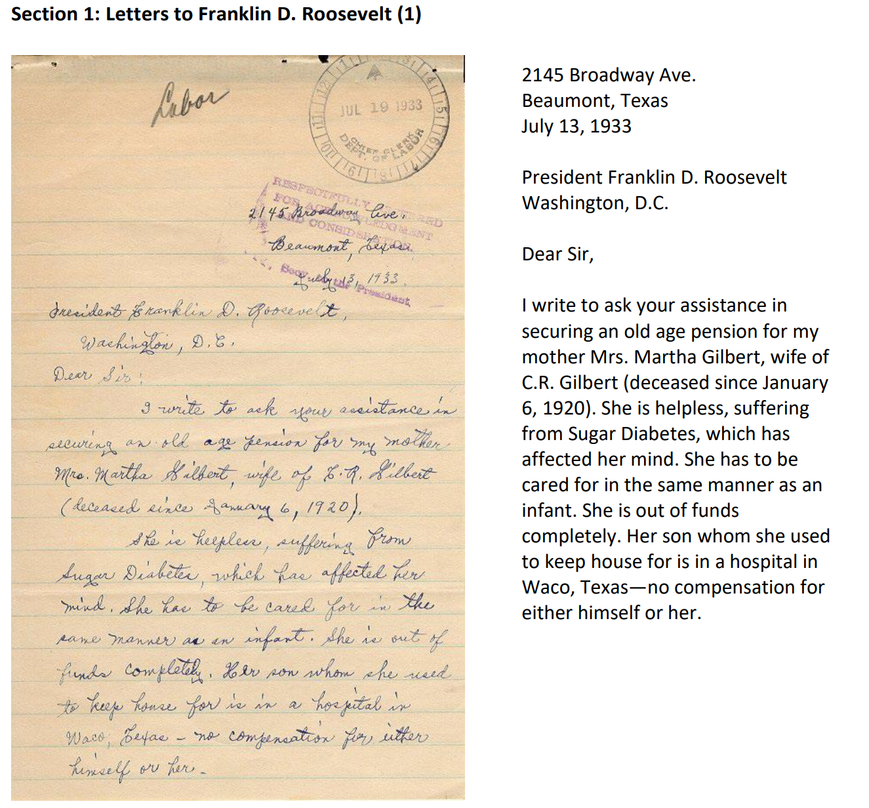
Mrs. Zoller is begging President FDR for assistance in establishing old age pension.
Sole caretaker for mother who must be cared for like an infant.
Out of funds, has tried to help herself by renting rooms to boarders
Depleted savings taking care of her.
Evokes sense of empathy

Slide 14
Primary Source #2
Social Security Pamphlet 1936
What it means: . Retired workers 65 years old or older will receive a government check every month
Amount of checks: Depends on how much you earn. As much as $85, as little as $10 per month.
New taxes will be paid to the U.S. Government
Your portion:
  beginning 1937 - 1% of wages by employee and employer
  beginning 1940 - 1.5% of wages by employee and employer
  graduated to 3% in 1949
  All of these are capped at $3,000

Slide 15
Alternative Plans
Share Our Wealth Plan
Townsend Plan
immediate payments in 1935
did not require that people work and make contributions - incentivized people to quit jobs and free up opportunities
funded by a 2% national sales tax
everyone eligible for $200 a month
must be spent within the month
2.2 million people supported - Townsend Clubs
Cap wealth at $50 million each (later $5-$8 million)
Limit annual income to $1 million
guarantee every family annual income of $2,000 (⅓ of national average)
free college & vocational education
veterans benefits
pensions for 60+
30 hour work week
4 weeks vacation

Slide 16
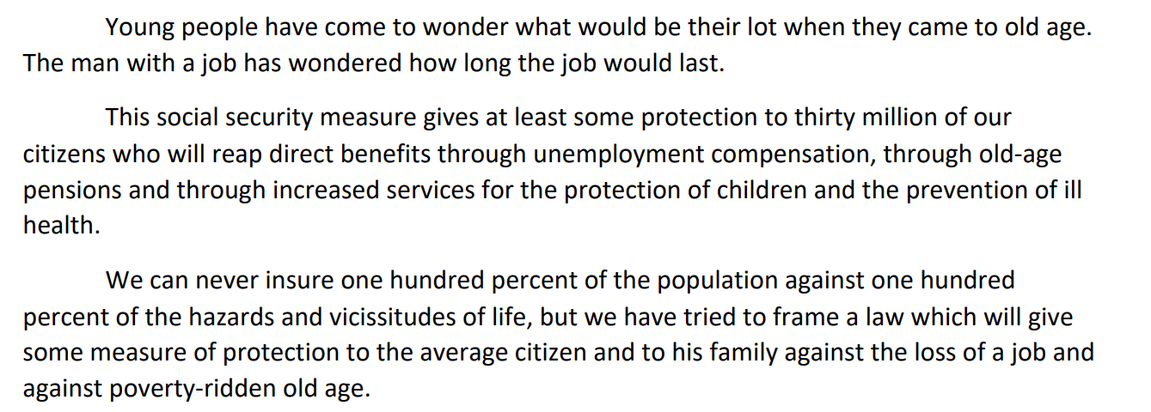
FDR’s Speech on August 14, 1935

Slide 17
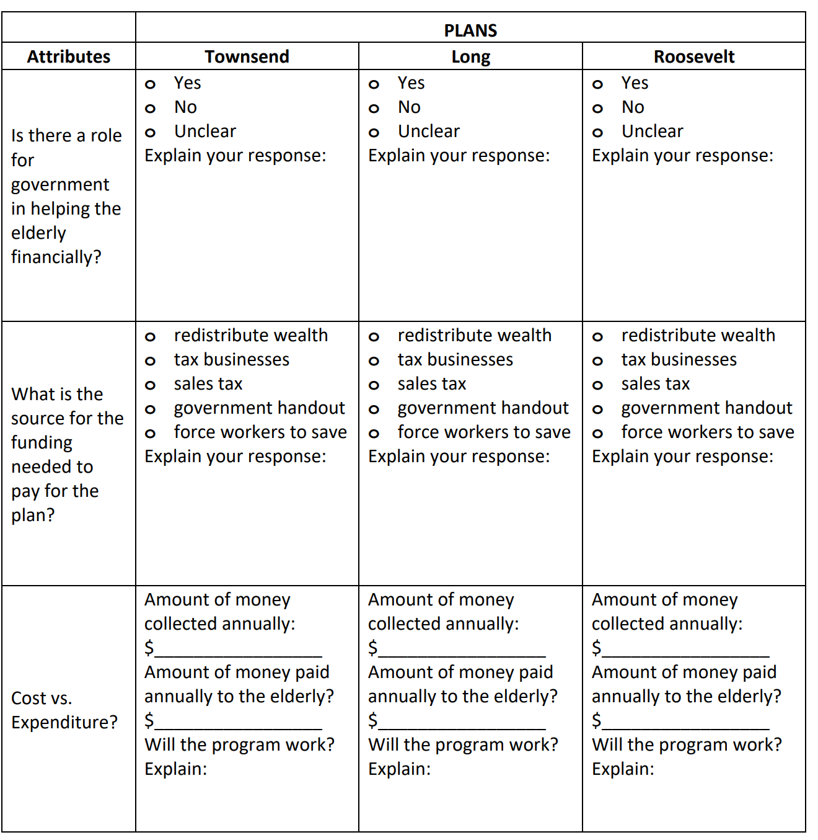
Comparing the Plans

Slide 18
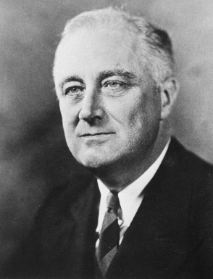
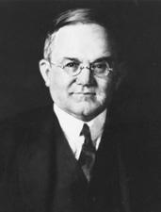
Conflicting Points of View
…security was attained in the earlier days through the interdependence of members of families upon each other and of the families within a small community upon each other. The complexities of great communities and of organized industry make less real these simple means of security. Therefore, we are compelled to employ the active interest of the Nation as a whole through government in order to encourage a greater security for each individual who composes it.
  —President Franklin Roosevelt, Message to Congress, June 8, 1934 (Social Security Administration, n.d.e.)
I fear [Roosevelt’s Social Security policies] may end the progress of a great country and bring its people to the level of the average European… It will discourage and defeat the American trait of thrift. It will go a long way toward destroying American initiative and courage.
  —Senator Daniel O. Hastings (R-DE), 1935
  (Williams, 2011)

Slide 19
Additional Resources
Your Social Security (1940s Film)
Crash Course- Social Security
Huey Long’s Share our Wealth Program

Slide 20
Understanding Fiscal Responsibility: Revisions to U.S. History Lessons
The History of Social Security
Presented by Amanda Stiglbauer
SC Economics
Blythewood High School
Amanda.Stiglbauer@moore.sc.edu
April 14, 2020

