Slide 1
Career and Financial Management:
Workplace Regulations
July 24, 2019
Joi Cobb

Slide 2
Joi Cobb: Bio
Years of Teaching: 12 years
The High School for Enterprise, Business, and Technology (2012-Present)
Brooklyn, NY
Benjamin Banneker High School (2007-2012) in Atlanta, GA
Courses Taught: Career and Financial Management, General Business Management, Introduction to Computers, Principles of Hospitality and Tourism, Hospitality Marketing, Delivering Great Customer Service, and Event Planning
B.S. in Marketing from Hampton University
M.ED in Business Education from the University of West Georgia
Mother of two teenage sons and a young daughter

Slide 3
Key Ideas
Unit CM.4: Workplace Regulations
This unit outlines employment regulations and federal, state, and local laws that affect employers. Students will gain an understanding of how workplace regulations assist and protect employees and employers.
Based on this unit, the key ideas that will be explored for this presentation are as follows:
Child Labor
Labor Movement and Its Impact on Legislation
Labor Unions and Working Conditions
Job Discrimination
Social Security

Slide 4
Agenda
Address Various Lesson Components and Activities:
Key Terms
Essential Questions and Aims
Lesson Resources
Lesson Activities
Additional resources

Slide 5
Unit: Workplace Regulations
Unit Key Terms:
Union Collective Bargaining Grievance
Arbitration Child Labor Minimum Wage “Right to Work”
Discrimination Workers’ Compensation “Blue Collar”
“White Collar” Sweatshop Social Security

Slide 6
Unit: Workplace Regulations
Lessons
Child Labor in America
Labor Unions and Working Conditions: United We Stand
Labor Organization and Detroit Sit-Down Strikes, 1937
Job Discrimination

Slide 7
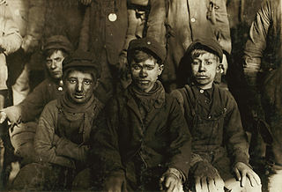
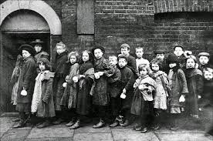
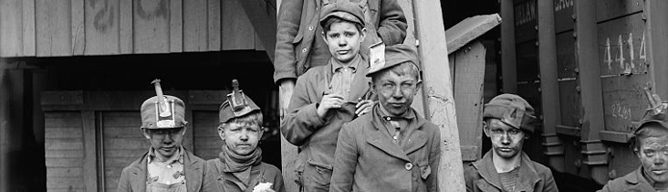
Key Idea: Child Labor
https://www.loc.gov/pictures/item/2016801353/

Slide 8
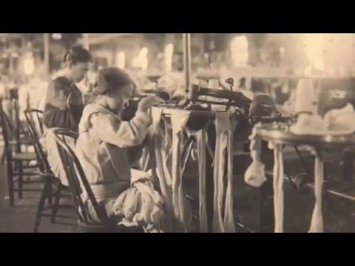
Key Idea: Child Labor
https://youtu.be/KHmqEqJN59o

Slide 9
Key Idea: Child Labor
Essential Questions or Aims
Who worked in labor factories during the Industrial Revolution?
What conditions were children forced to work under in factories?
What legislation did the government enact to regulate child labor and why?

Slide 10
Unit: Workplace Regulations
Lesson: Child Labor In America
Overview:
Children have always worked, often exploited and under less than healthy conditions. Industrialization, the Great Depression and the vast influx of poor immigrants in the 19th and 20th centuries, made it easy to justify the work of young children.
Purpose of this Lesson:
For students to gain a better understanding of this idea by examining the historical and social issue of child labor through examining photographs and historical evidence.

Slide 11
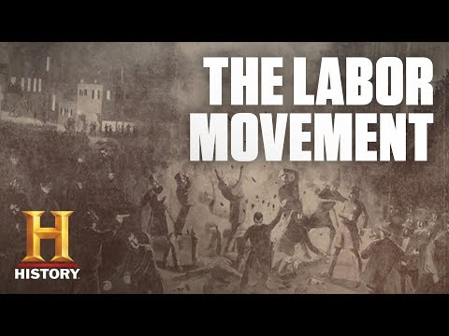
Key Idea: Labor Movement and Its Impact on Legislation
Turn of the 20th Century Labor Simulation Activity

Slide 12
Key Idea: Labor Movement and Its Impact on Legislation
Essential Questions or Aims
What role did women play in the Labor Movement in the early 1900’s?
What gains did the Labor movement make during the 1930’s? Why?
What legislative goals has the labor movement historically fought for? How successful have they been? Who has benefited from their legislative victories?
What are some current issues facing organized labor?

Slide 13
Unit: Work Regulations
Lesson: Labor Organization and Detroit Sit-Down Strikes, 1937
Overview:
The right to organize had been granted by the National Labor relations Act of 1935. The right to organize was won by workers in a series of confrontations known as sit-down strikes.
Purpose of this Lesson:
Through this lesson, students will gain a better understanding of this process.

Slide 14
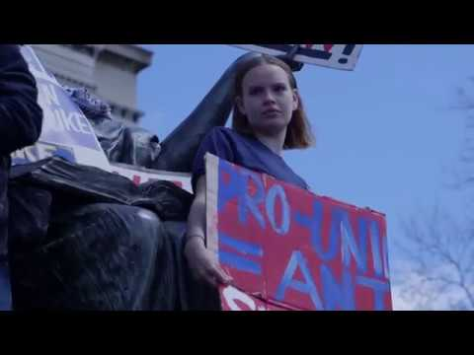
Key Idea: Labor Unions and Working Conditions
Article: The History of Unions in the United States
Game: Labor Negotiation Game
https://www.youtube.com/watch?v=ldywTT7_0Rg

Slide 15
Key Idea: Labor Unions and Working Conditions
Essential Questions or Aims:
What workers formed the earliest unions and why did they form them?
How did the Progressive Movement play a part in changing the negative effects of industrialization in terms of child labor, unsafe conditions, low wages and long hours?

Slide 16
Unit: Workplace Regulations
Lesson: Labor Unions and Working Conditions
Overview:
Think about your work environment…are you allowed to rest periodically? Do you earn a decent wage? Can you voice your concerns without losing your job? There was a time when workers in the United States did not have basic rights such as a minimum wage or time for a break.
Purpose of this Lesson:
For students to gain a better understanding of the working conditions of U.S. laborers at the turn of the century.

Slide 17
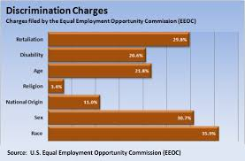
Key Idea: Job Discrimination

Slide 18

Key Idea: Job Discrimination

Slide 19
Key Idea: Job Discrimination
Essential Questions or Aims
Why do people discriminate?
What happens when you judge someone based on how they look?
Should all people—regardless of race, ethnic background, religion, gender, disability or socioeconomic status—have the same opportunities to apply for and be hired for jobs?
Should businesses be allowed to hire based on an image or message they are trying to promote?

Slide 20
Unit: Workplace Regulations
Lesson: Job Discrimination
Objective:
To educate students and young workers about their rights and responsibilities in the workplace under the laws enforced by the U.S. Equal Employment Opportunity Commission (EEOC).
Procedure:
1. Give participants a brief overview of EEOC and the federal employment laws (see attached). 2. Show the video. The video has three scenarios. After each scenario, stop the video and have participants discuss the incidents using the questions provided. 3. As homework, have participants complete the Challenge Yourself! assignment (optional). 4. During the next class period, discuss the answers to the homework assignment.

Slide 21
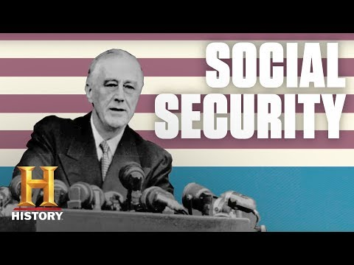
Key Idea: Social Security
https://www.youtube.com/watch?v=cdE_EV3wnXM

Slide 22
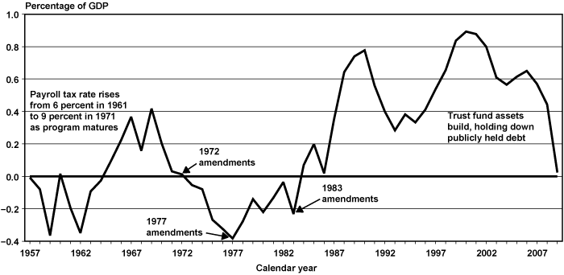
Key Idea: Social Security
The Financial Status of Social Security

Slide 23
Key Idea: Social Security
Essential Questions or Aims
How did the passage of the 1935 Social Security Act transform the role the federal government plays in the lives of the American people?
Social Security Act of 1935: Did the creation of a federally administered old-age pension program support or threaten American values and traditions?

Slide 24
Unit: Workplace Regulations
Lesson: The History of the Social Security Act
Objective:
Social Security began during the Depression, a time when one in four Americans were out of work and over half of the elderly lacked sufficient income to be self-supporting. Then, as now, views differed on whether the welfare of the elderly should be the responsibility of the federal government.
Procedure:
Students will read and analyze various histroical documents related to the Social Security Act for information and interpretations. Then, students will write a letter to President Roosevelt either supporting or opposing him based on what they argue are American values and traditions.

Slide 25
Unit: Workplace Regulations
Additional Lessons Plans and Activities:
Exploring Bias and Discrimination in Hiring Practices
Child Labor Today and Yesterday
Child Labor Gallery Walk
US Labor Movement Mixer
American Labor Studies Center: Labor History Lesson Plans
Labor Day Lesson Plan: Unions Today
Labor Matters
The Social Security Act

Slide 26
Resources
www.econedlink.org resources:
    https://www.econedlink.org/resources/the-history-of-social-security/
http://www.loc.gov/ resources:
    http://www.loc.gov/teachers/classroommaterials/lessons/labor/index.html
    http://www.loc.gov/teachers/classroommaterials/lessons/child-labor/procedure.html
Additional Resources:
https://www.rethinkingschools.org/static/archive/29_02/RS29-2_Swalwell_LaborMixer.pdf
https://www.eeoc.gov/youth/downloads/teacher_manual.pdf
https://www.labor-studies.org/featured-resources/labor-history-lesson-plans/
http://www.laborandindustrymuseum.org/pdf/Labor%20and%20Industry%20Lessons/Child%20Labor%20Lessons/Child%20Labor%20Gallery%20Walk%20Lesson%20Plan%20PDF.pdf
https://www.investopedia.com/financial-edge/0113/the-history-of-unions-in-the-united-states.aspx
https://www.lsrhs.net/sites/cooker/files/2013/10/Labor-Negotiation-Game.pdf
https://www.tolerance.org/classroom-resources/tolerance-lessons/exploring-bias-and-discrimination-in-hiring-practices
http://teacherlink.ed.usu.edu/tlresources/units/Gallagher2003Fall/DMARTIN/INDEX.HTM

Slide 27
Resources
Additional Resources:
https://www.youtube.com/watch?v=KHmqEqJN59o
https://www.tolerance.org/classroom-resources/tolerance-lessons/labor-matters
http://www.christophercmartell.com/LaborSimulationActivityMartell.pdf
https://edsitement.neh.gov/lesson-plans/lesson-2-social-security-act
https://www.youtube.com/watch?v=cdE_EV3wnXM
https://detroithistorical.org/sites/default/files/lessonPlans/SIT%20DOWN%20STRIKES.pdf

Slide 28
Thank you!
If you have any questions, feel free to contact me at:
Email: jcobbbrown@gmail.com

