Slide 1
Lifelong Learning:
How much education do you need?
July 17, 2019
Zaileen Washington

Slide 2
Zaileen Washington - Bio
Since 1996 my experiences within New York City Department of Education have ranged from food service manager, business teacher, CTE liaison for the borough of Brooklyn, Instructional Technology staff developer, and back to classroom teacher
My degreed background is in management, education, and educational administration
I am connected to CUNY as an alumnus and more recently an instructor with the College Now Program
Throughout my life experiences I have held the title of entrepreneur, employee, and parent. My longest tenure is as a student and this June I attended Champlain College’s (Vermont) Teacher’s Financial Literacy Summer Institute (highly recommended)

Slide 3
Agenda
Unit: CM.6 Lifelong Learning
This unit introduces students to sources of professional development opportunities. Students will develop an appreciation for the value of professional development to an individual’s career growth, advancement, and/or lifelong learning.
New York State Career and Financial Management Curriculum Framework
Preliminary Release June 2018

Slide 4
Goals (Learning Objectives) for this webinar
Students will be able to identify professional development opportunities
Students will be able to connect learning opportunities to career interest
Students will be able to assess the value of targeted professional development
Students will be able to reflect on their aptitude as a life-long learner

Slide 5
Define: Professional Development
PD may be used in reference to a wide variety of specialized training, formal education, or advanced professional learning intended to help administrators, teachers, and other educators improve their professional knowledge, competence, skill, and effectiveness.
https://www.edglossary.org/professional-development/
PD is the process of improving and increasing capabilities of staff through access to education and training opportunities in the workplace, through outside organization, or through watching others perform the job.
Read more: http://www.businessdictionary.com/definition/professional-development.html

Slide 6
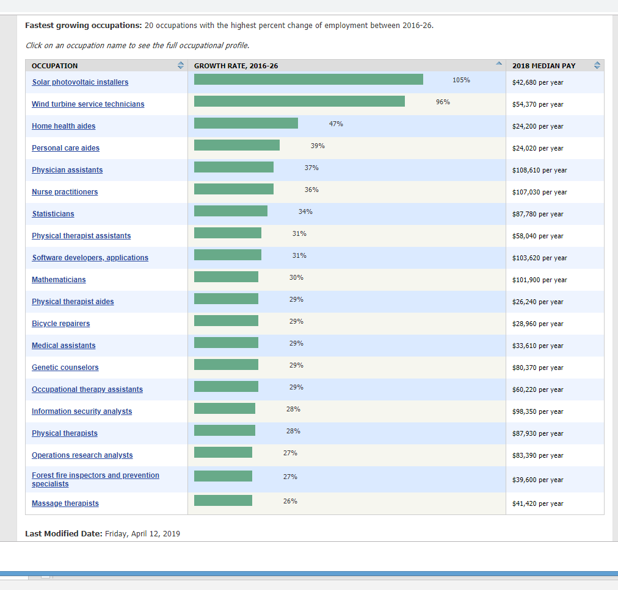
Career Outlook
https://www.bls.gov/ooh/fastest-growing.htm

Slide 7
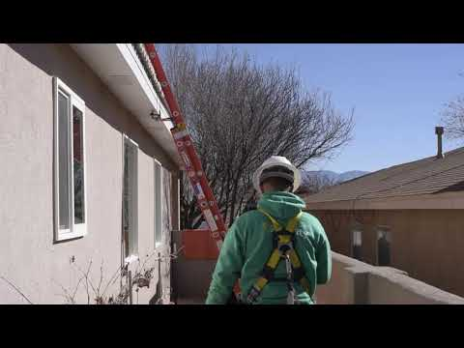
Degree/License – PD requirements
Quick Facts: Solar Photovoltaic Installers
2018 Median Pay | $42,680 per year $20.52 per hour
Typical Entry-Level Education | High school diploma or equivalent
Work Experience in a Related Occupation | None
On-the-job Training | Moderate-term on-the-job training
Number of Jobs, 2016 | 11,300
Job Outlook, 2016-26 | 105% (Much faster than average)
Employment Change, 2016-26 | 11,800
Licensing (PV)
New York State does not issue license at state level. Licensure is regulated at county level.
Licensing (Solar thermal)
New York State does not issue license at state level. Licensure is regulated at county level.
NYC.gov
The equipment vendor does not need to be registered or licensed by the department. Contractors performing installation must be registered. Plumbing work for solar thermal systems must be installed by a licensed master plumber registered in NYC. Electrical work including installation of panels and wiring must be installed by Licensed Electricians registered in NYC.

Slide 8

Degree/License – PD requirements
Quick Facts: Massage Therapists
2018 Median Pay | $41,420 per year $19.92 per hour
Typical Entry-Level Education | Postsecondary nondegree award
Work Experience in a Related Occupation | None
On-the-job Training | None
Number of Jobs, 2016 | 160,300
Job Outlook, 2016-26 | 26% (Much faster than average)
Employment Change, 2016-26 | 42,100
Licenses, Certifications, and Registrations
In 2016, 45 states and the District of Columbia regulated massage therapy. Although not all states license massage therapy, they may have regulations at the local level.
The exam may be a state-specific exam or the Massage and Bodywork Licensing Examination (MBLEx) licensure exam, offered by the Federation of State
NYS Education: have received an education, including high school graduation and graduation from a school or institute of massage therapy with a program registered by the department, or its substantial equivalent in both subject matter and extent of training, provided that the program in such school or institute shall consist of classroom instruction of a total of not less than five hundred hours in subjects satisfactory to the department;
Massage Therapy Boards.
Massage therapists also may need to pass a background check, have liability insurance, and be certified in cardiopulmonary resuscitation (CPR). Many states require massage therapists to complete continuing education credits and to renew their license periodically. Those wishing to practice massage therapy should look into legal requirements for the state and locality in which they intend to practice. (http://www.op.nysed.gov/prof/mt/article155.htm)

Slide 9
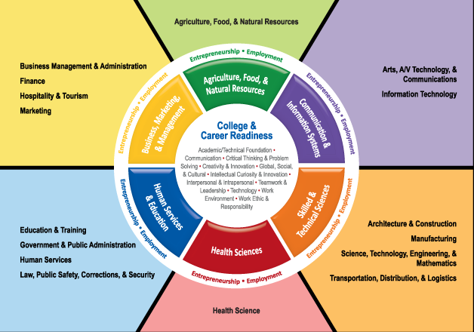
Where do I fit?
Career Clusters
https://www.google.com/search?q=career+clusters&rlz=1C1CHFX_enUS757US765&source=lnms&tbm=isch&sa=X&ved=0ahUKEwjJmKHX8LDjAhWOG80KHX5jDZ8Q_AUIECgB&biw=1904&bih=903#imgdii=qVnOH7LQeVitzM:&imgrc=_syNMascZum_CM:

Slide 10

Training programs and the ‘Gap Year’,
Training programs
Resource: https://labor.ny.gov/careerservices/planyourcareer/training.shtm
    http://www.cb14brooklyn.com/community-directory/job-resources/job-training-programs/
    https://www.yearup.org/
Gap Year – the break between secondary school and higher education
Resource: https://www.gapyearassociation.org/about.php
Americorp https://www.nationalservice.gov/programs/americorps/what-americorps

Slide 11
Benefits of AmeriCorps
In addition to the reward of serving your country and giving back? Yes, the benefits of service include, but are not limited to:
Student loan deferment
Skills and training
Living allowance
Limited health benefit options
Education Award upon completion of service to help pay for college, graduate school, or vocational training, or to repay student loans
Career opportunities with leading employers from the private, public and nonprofit sectors

Slide 12
Types of Lifelong Learners
Marker, Donald W., and George E. Spear. “Lifelong Learning: Formal, Informal, Nonformal. and Self-Directed .” ed220723.Tif.pdf, The National Center for Research in Vocational Education, 1982, files.eric.ed.gov/fulltext/ED220723.pdf.
Formal (learners have little control over the objectives or means of learning)
This type of learning is most closely associated with elementary and secondary education and most degree and certificate programs offered by colleges and universities. Other educational programs from cosmetology to the military also fall into this category. As previously stated, the learner has little, responsibility in this form of learning.

Slide 13
Types of Lifelong Learners
Marker, Donald W., and George E. Spear. “Lifelong Learning: Formal, Informal, Nonformal. and Self-Directed .” ed220723.Tif.pdf, The National Center for Research in Vocational Education, 1982, files.eric.ed.gov/fulltext/ED220723.pdf.
Nonformal (learners control the objectives but not the means of learning)
In this type of lifelong learning, the individual has some responsibility in the decision-making process. Learners make decisions on what is to be learned, but seek help on the how or means of the learning activity.

Slide 14
Types of Lifelong Learners
Marker, Donald W., and George E. Spear. “Lifelong Learning: Formal, Informal, Nonformal. and Self-Directed .” ed220723.Tif.pdf, The National Center for Research in Vocational Education, 1982, files.eric.ed.gov/fulltext/ED220723.pdf.
Informal (learners control the means but not the objectives of learning)
Within the definitional framework of this review, much, and perhaps most, of the literature from North America dealing with instruction describes informal rather than self-directed learning. With few exceptions, the research reports activities in which an institution maintains control of the goals of the learning activity while permitting or assigning a degree of responsibility for the means for achieving those goals to the learners.

Slide 15
Types of Lifelong Learners
Marker, Donald W., and George E. Spear. “Lifelong Learning: Formal, Informal, Nonformal. and Self-Directed .” ed220723.Tif.pdf, The National Center for Research in Vocational Education, 1982, files.eric.ed.gov/fulltext/ED220723.pdf.
Self-Directed (learners control both the objectives and means of learning)
Self-directed learning, as defined here, represents the ultimate state of learner autonomy, i.e., the learner exercises control over and major responsibility for choosing both the goals and the means of the learning. Tough (1971) and Cross (1981) place approximately 70 percent of all adult learning projects in this category. Broadly, the definition suggests that the learner decides what and how to learn, but that other decisions, such as when and where to learn and how much to learn at any given time are implicit. The learner not only selects but may also reject, add, or change resources at will, decide to continue or terminate the project, and finally determine the satisfaction or adequacy of the outcomes.

Slide 16
How valuable is education?
Concept: Human Capital

Slide 17

Jot your questions down
We are more than half way there

Slide 18
Show you the money
Teacher
Bachelors Degree---------------------------------------------------------------------------------------------Master’s Degree+30 credits+C6+PD: This is the second differential. It can be achieved in several ways:
Plumber
The current rate for licensed Journeypersons as of August 1st, 2018 is $42.92 an hour or $85,840.00 a year in your pocket.
This does not include the fringe benefit package which raises the total wage of a licensed journeyperson plumber to $61.33 an hour or $122,660.00.
The annual wages are based on a 2,000 hour year. In addition to these wages the Apprentice receives benefits including Medical Coverage and Pension Plan.
By providing a structured wage progression the apprentice is able to plan out their future and receive the benefits of hard work and determination. http://www.local5plumbers.org/training.aspx?zone=Training&pID=4576
 | BA C1 | C1 + PD | BA + 30 C2 | C2 + ID | MA C2 + PD | C2 + ID + PD | MA + 30 C6 | MA + 30 C6 + PD
1A | 56,711 | 61,847 | 58,614 | 62,134 | 63,751 | 67,267 | 65,656 | 70,789

Slide 19
The cost of a formal education
Though this can be considered ‘opportunity cost’ this expense can be deferred based on affiliation. Explanation coming up….
Type of College | Average Published Yearly Tuition and Fees
Public Two-Year College (in-district students) | $3,440
Public Four-Year College (in-state students) | $9,410
Public Four-Year College (out-of-state students) | $23,890
Private Four-Year College | $32,410
data from Collegeboard.com

Slide 20
Who’s paying?
Unions
Teamsters
AFSCME
UFCW
Eastern Gateway Community College
Open to employee and family members
Private Business
Starbucks
UPS
Bank of America
Intel
Fidelity
Procter & Gamble
Comcast
AT&T
BP
Verizon Wireless
Home Depot
Chipotle
Wells Fargo
Reimbursement or grant/scholarship

Slide 21

The Gig Economy

Slide 22
Gigging ain’t easy
Myth No. 1: Millennials love to gig
Myth No. 2: We’re all going to be giggers
Myth No. 3: Gig is better
Inevitable growth?
https://hbr.org/2018/10/myths-of-the-gig-economy-corrected

Slide 23
Invest in Yourself
A Demo Lesson (from the Council for Economic Education)

Slide 24
Summary of Key Ideas
Education is an investment
Lifelong learning can take place outside of the traditional classroom setting
There are many organizations that want to invest in your education
Invest in yourself because you are worth it
More knowledge, More money (human capital)
If you are here, then you are on the road to lifelong learning

Slide 25

Next Steps
Take an inventory of your interest
– click on the mirror

Slide 26

Have fun along the way
Network, Network
Network
https://education.cu-portland.edu/blog/lifestyle/building-network/

Slide 27
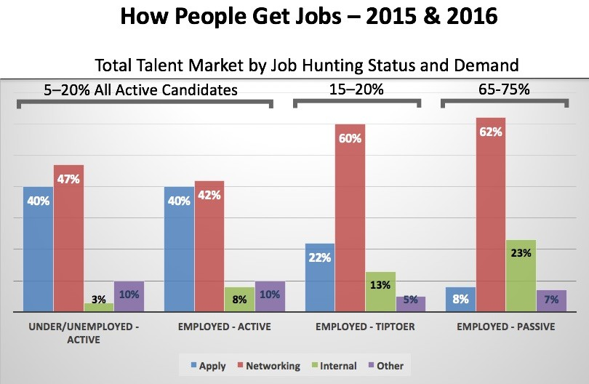
Have fun along the way
Network, Network
Network
https://www.linkedin.com/pulse/new-survey-reveals-85-all-jobs-filled-via-networking-lou-adler

Slide 28
Resources
www.econedlink.org
Resources from CEE, with links to specific lessons and videos
    Choosing a Career - https://www.econedlink.org/resources/choosing-a-career/
    The Economic Way of Thinking - https://www.econedlink.org/resources/the-economic-way-of-thinking/
    Decision Making - https://www.econedlink.org/resources/decision-making/
    Capital Investments “Human vs Physical” - https://www.econedlink.org/resources/capital-investments-human-v-physical/
Online resources
  8 Lessons to promote lifelong learning
    https://www.mindmeister.com/blog/8-lesson-plans-promote-lifelong-learning/
    Cluster, Pathways, and BLS – Connecting Career Information
    https://www.bls.gov/careeroutlook/2015/article/career-clusters.htm
Books
Stretch for Change: How To Improve Your Change Fitness And Thrive In Life -by Gustavo Razzetti
Other sources
  https://www.econlowdown.org/ - St. Louis Fed
    Education vs Unemployment

Slide 29


Thank you!
contact information
zwashin@schools.nyc.gov or bergtraumbusiness@gmail.com
718-408-0970
Twitter thinking about it
Instagram not yet

