Slide 1
Financial Management, Module 5: Investing
August 7, 2019
Doug Kramer

Slide 2
Doug Kramer
Social Studies teacher at Herricks High School, in New Hyde Park, NY since 2001.
Before teaching I was Vice President of Portfolio Acquisitions and Regional Manager for Arbor Commercial Mortgage.
Helped develop the Career and Financial Management Resource Guide for the NYS Career and Management Curriculum Framework.
Co-Advisor of Euro Challenge and Fed Challenge Economic Competition Teams
I coach Cross Country in the fall and Girls Spring Track in the Spring
I enjoy traveling, playing volleyball and basketball, cycling, running.
Notes:
My background is more economics so I embed this in a non-AP economics course. I connect macro/micro concepts with personal finance. I use some in my AP class too.
For this presentation I stayed with the personal finance presentation but if you would like to hear ideas on how to incorporate these ideas in a more standard economics class, I’ll be happy to go over them in the Q&A at the end.
Lastly, most plans and resources are targeted to grades 9-12. Most of the resources I will go through have younger categories available. These, especially pieces are great for lesson differentiation.

Slide 3
Key Ideas
Why do we invest?
Types of investments
    Stocks
    Bonds
    Real Estate [income producing]
Where do I invest?
    Mutual Funds
    ETF’s
    401K / 403B
    IRA’s [Roth, other]
    Brokers
Speculation

Slide 4

Why Do We Invest?

Slide 5

Why Do We Invest?
To achieve financial goals
Flexibility
  Take the opportunity vs the paycheck
  Work part time
  Stay at home parenting
  Retire
Security
  Less/No worries
  Independence

Slide 6
Investing vs Savings
Investing is using your money to buy an asset or to lend money to someone else. The goal is to earn more money by using your own money.
Saving is simply not spending your money. Investments are funded by savings.
Emergency Funds
3-6 mo.'s of living expenses.
Short Term Funds
Car
Vacations
Special occasions
Mid-term Funds
House
Start a business
Wedding
College
Long Term Funds
Flexibility
Security

Slide 7

Types of Investments / Stocks

Slide 8
Types of Investments
Stocks
A stock is a form of security that indicates the holder has proportionate ownership in the issuing corporation.
Corporations issue (sell) stock to raise funds to operate their businesses. There are two main types of stock: common and preferred.
Stocks are bought and sold predominantly on stock exchanges, though there can be private sales as well, and they are the foundation of nearly every portfolio.
Historically, they have outperformed most other investments over the long run.

Slide 9
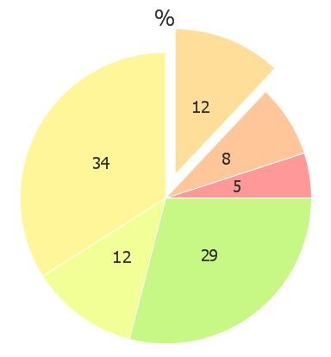
Types of Investments / Stocks
Think of shares as how much of the corporation you own.
In this example there are 100 shares. If I own 12 shares I would own 12% of the company.
51% controls the company.

Slide 10
Types of Investments / Stocks
Risk
  You are the owner [Equity]. You bear the risk.
  Think of Risk vs Reward. Once bills are paid, you keep the rest [or at least you are entitled to your share.
    The upside is unlimited. [Bill Gates, Jeff Bezos, Warren Buffet, etc.]
  Downside: You could lose your investment. If things go bad, you are last in line for your money.
  Stocks are riskier and usually long term investments.
  Note: Corporations limit your loss to your investment, nothing more.

Slide 11

Types of Investments “Lets Move On To Bonds”

Slide 12
Types of Investments / Bonds
Bonds are units of corporate or government debt.
A bond is referred to as a fixed income instrument since bonds traditionally pay a fixed interest rate (coupon) to debtholders.
  Variable or floating interest rates are also now quite common.
Bonds have maturity dates at which point the principal amount must be paid back in full or risk default.
Bond prices are inversely correlated with interest rates: when rates go up, bond prices fall and vice-versa.

Slide 13
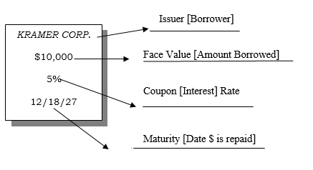
Types of Investments / Bonds

Slide 14
Types of Investments / Bonds
Risk
  You are the lender [debt].
  Think of Risk vs Reward.
    Advantage:
      Your income is predictable.
      Bondholders get paid first or the company can be forced into bankruptcy.
      If things go bad, you are first in line to get your money back.

Slide 15
Types of Investments / Bonds
Risk
    Downside:
    Rates on Bonds are often fixed. Inflation would make the money you receive less valuable.
    If the company does really well [think Microsoft, Apple, Amazon, etc.] you get your interest and nothing else.
    Bonds are typically lower risk and good for shorter term investments.

Slide 16
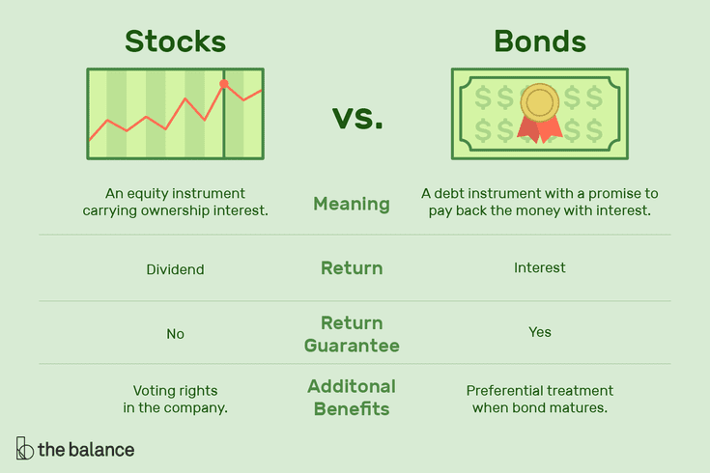
Types of Investments / Stocks vs Bonds

Slide 17
Types of Investments / Stocks and Bonds
Know your goals and your risk tolerance.
Goals:
  Income
    Dividends [stocks]
    Interest [Bonds]
  Growth [Buy low – sell high]

Slide 18

Types of Investments / Real Estate
Income Producing Real Estate
Income [rent & fees]
-Expenses
Profit before taxes

Slide 19

Where Do I Invest?
What are mutual funds?
Mutual funds are investments that are professionally managed and consist of a variety of investment types including stocks, bonds, options, commodities, real estate and money market securities.

Slide 20
Where Do I Invest? / Mutual Funds
Advantage:
Affordable professional management, low minimum investments required.
Diversification provides greater safety and reduces risk.
Disadvantage:
Fee for management reduces long term growth. This can be significant depending upon the fund.
Diversification reduces risk but by definition also reduces reward.

Slide 21

Where Do I Invest?
ETF’s [Exchange Traded Funds

Slide 22
Where Do I Invest?
Retirement Accounts
IRA [Individual Retirement Account]
  Pre tax
401k /403b
  Pre tax
  Don’t forget the match!!
Roth
  After tax

Slide 23
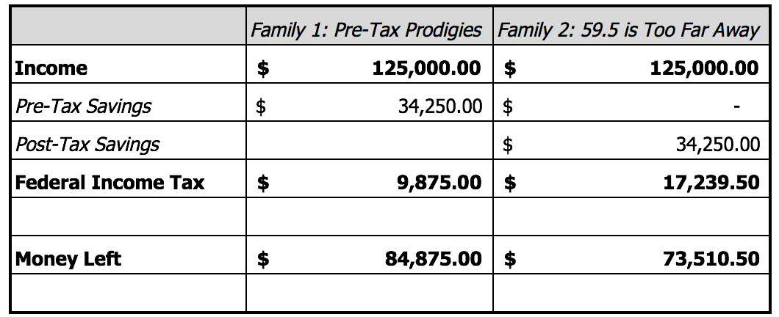
Pre Tax vs Post Tax

Slide 24
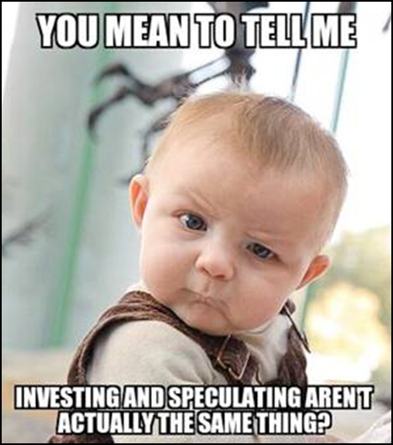
Speculation
Speculation is basically hoping and guessing.
It can be an educated guess but there is no underlying business or ability to make money like stocks and bonds or real estate.
Instead it relies solely on shifting supply and demand.
Examples: collectables [cars, art, etc.], gold.

Slide 25

Lesson Ideas
https://www.econedlink.org/resources/the-five-stages-of-investing/
https://www.econedlink.org/resources/financial-markets-concept-video-and-quiz/

Slide 26

More Lesson Resources
https://docs.google.com/document/d/1hB2Jo0TO-VuJ_7xucBgwpggCM9hStKcDls75TuJiW4w/edit
https://docs.google.com/document/d/1lIwWAylj5tYeNxIOIdGR9IYnumM5HvRzxtv-NWB49Ts/edit

Slide 27

More Lesson Resources
https://www.stlouisfed.org/~/media/Education/Lessons/pdf/Diversification-and-Risk.pdf
https://www.stlouisfed.org/education/no-frills-money-skills-video-series/episode-3-get-into-stocks

Slide 28
Thank you!
If you have any questions, feel free to contact me @
Dougkramer1@gmail.com

