Slide 1
Financial Management, Module 4: Interest
August 6, 2019
Doug Kramer

Slide 2
Doug Kramer
Social Studies teacher at Herricks High School, in New Hyde Park, NY since 2001.
Before teaching I was Vice President of Portfolio Acquisitions and Regional Manager for Arbor Commercial Mortgage.
Helped develop the Career and Financial Management Resource Guide for the NYS Career and Management Curriculum Framework.
Co-Advisor of Euro Challenge and Fed Challenge Economic Competition Teams
I coach Cross Country in the fall and Girls Spring Track in the Spring
I enjoy traveling, playing volleyball and basketball, cycling, running.
Notes:
My background is more economics so I embed this in a non-AP economics course. I connect macro/micro concepts with personal finance. I use some in my AP class too.
For this presentation I stayed with the personal finance presentation but if you would like to hear ideas on how to incorporate these ideas in a more standard economics class, I’ll be happy to go over them in the Q&A at the end.
Lastly, most plans and resources are targeted to grades 9-12. Most of the resources I will go through have younger categories available. These, especially pieces are great for lesson differentiation.

Slide 3
Key Ideas
What is interest?
How Does Inflation Interfere With Our Money?
How is interest calculated?
How are interest rates determined?
Ways to pay less interest.
Bonus ☺
Notes:
Idea of budgeting is boring and tedious, so why?
Needs a hook to their reality or aspirations…

Slide 4

What is Interest?
Interest is essentially a rental or leasing charge to the borrower for the use of an asset.

Slide 5

How Inflation Effects the Value of Money
Inflation is the overall rise in prices.
Consequence is a reduced purchasing power in the future.
Scrooge McDuck loses money when it sits in his vault!

Slide 6

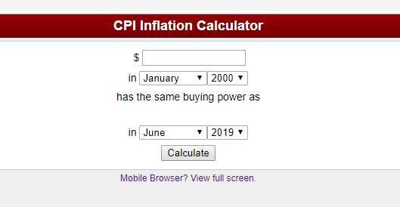
How Inflation Effects the Value of Money

Slide 7
How Inflation Effects the Value of Money

Slide 8
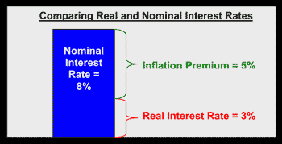
How Inflation Effects Interest Rates
A minimum priority for a lender [any investor]…
Keep up with inflation!
Nominal vs Real Rates
Nominal is the actual number.
Real is the rate adjusted [taking out] for inflation.
https://www.youtube.com/watch?v=VYcgcWS_NBQ

Slide 9
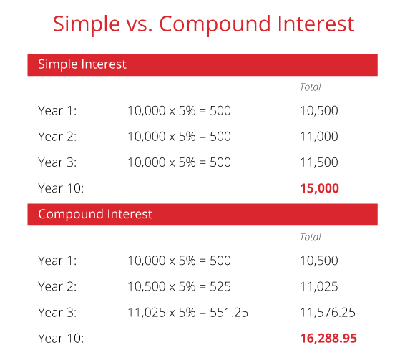
Simple vs Compound Interest
Simple interest is based on the principal [amount of a loan or deposit].
Compound interest is based on the principal amount and the interest that accumulates on it in every period.

Slide 10

Simple vs Compound Interest
https://www.youtube.com/watch?v=LYll6Q0BrXY

Slide 11

Simple vs Compound Interest
https://econ.video/2018/08/10/hard-knocks-carl-nassib-teaches-compound-interest/

Slide 12
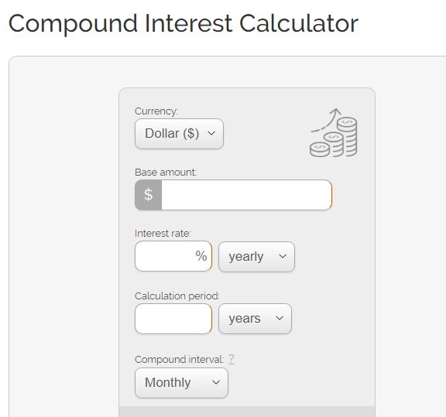
Simple vs Compound Interest
https://www.thecalculatorsite.com/finance/calculators/compoundinterestcalculator.php

Slide 13
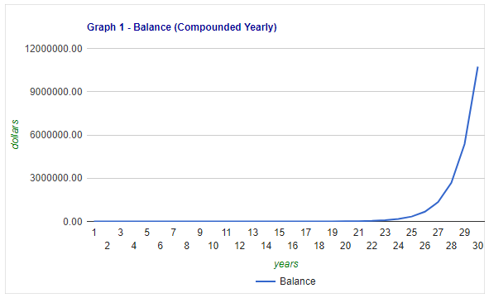
Simple vs Compound Interest

Slide 14
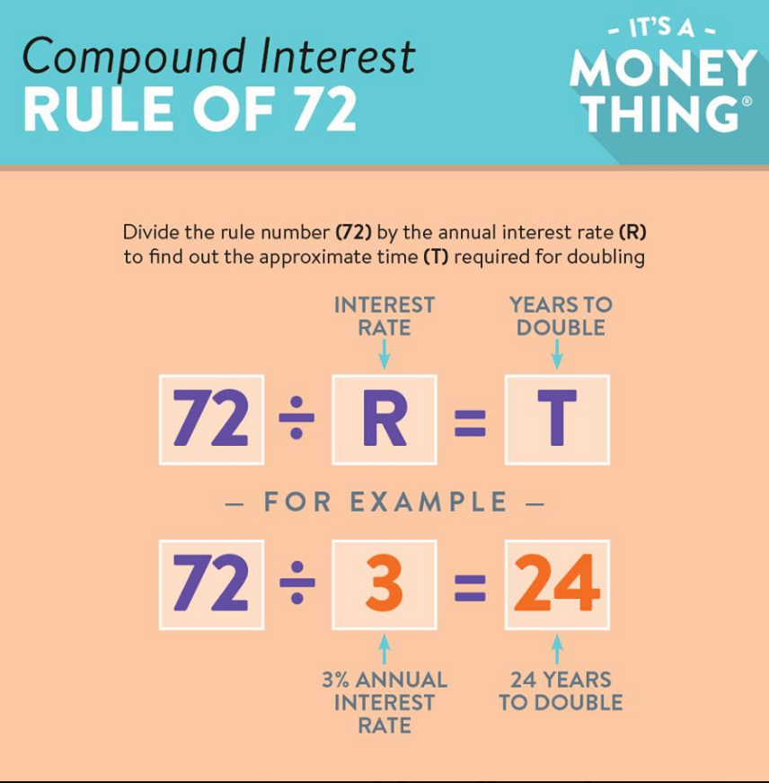
Simple vs Compound Interest

Slide 15
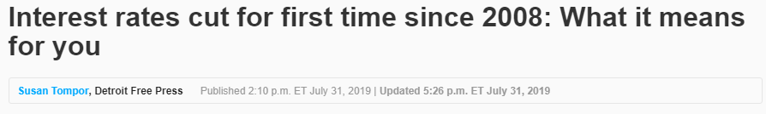
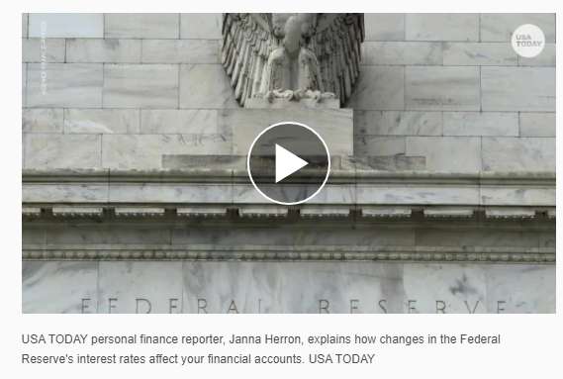
What Determines the Interest Rate?

Slide 16
What Determines the Interest Rate?
Supply & Demand
  Consumer Demand
  Fed = Monetary Policy = Money Supply
Risk
Simply put: The higher the perceived risk of a loan, the higher the rate.

Slide 17
What Determines the Interest Rate?
There are three components of any financial transaction:
$ principal [how much]
% rate [how fast]
t term [time – how long]

Slide 18
What Determines the Interest Rate?
% rate [how fast]
    The rate prices the risk.
    The higher the risk, the higher the rate.

Slide 19
What Determines the Interest Rate?
$ principal [how much]
  All else the same, the larger the loan the more at risk, the more expensive.
    Ex: Jumbo Mortgage

Slide 20
What Determines the Interest Rate?
t term [time – how long]
    How long will it take to get my money back?
    Risk?

Slide 21
What Determines the Interest Rate?
    Nancy Packes, who heads Feathered Nest, a residential broker, said the Wall Street area ''has come of age'' because ''people no longer question whether or not to live there'' and choose to because ''it is well priced for its convenience to transportation and work.''
    NY Times Real Estate Section, February 2001
    Cannot predict the future.
    The longer the term, the greater the risk.

Slide 22
What Determines the Interest Rate?
YOU!
5 C’s
  Character [credit score]
  Capacity [do you have money to repay?]
  Collateral [assets to secure debt]
  Capital [Net worth]
  Conditions [the overall economy]

Slide 23
What Determines the Interest Rate?
Credit Score
  Created by software [FICO –Fair Isaac Co.] that evaluates your financial data.
  Three companies do this
    Equifax
    Transunion
    Experian
  Get your free report
  https://www.consumer.ftc.gov/articles/0155-free-credit-reports

Slide 24
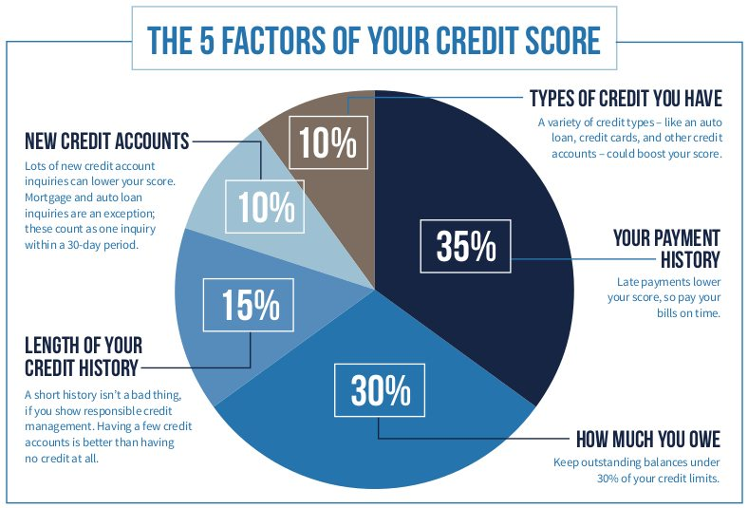
What Determines the Interest Rate?

Slide 25
Ways to Pay Less Interest
Look at the details!
    Compare Rates [APR]
    Truth in Lending
Make a larger down payment.
Borrow for a shorter period of time.
Improve your credit score first.
Prepay your loan.
Pay on time
    Many lenders will give you a discount if go on autopay from a checking account or a credit card.

Slide 26
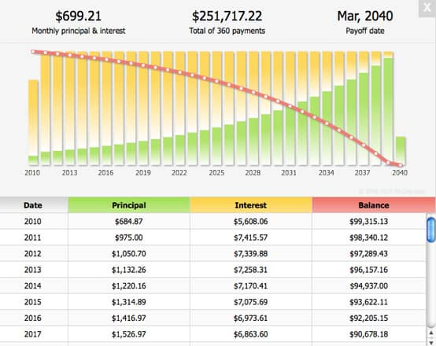
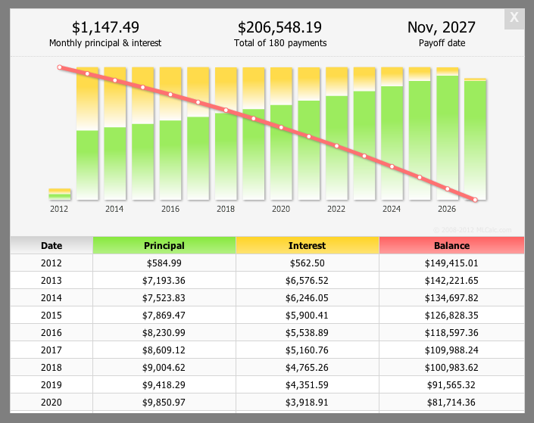
Bonus: The 30 Year Mortgage
Amortization: How much of your payment pays interest and how much pays off principal.
Note: Payment is not intuitive. Payment Cost

Slide 27

Lesson Ideas
https://www.econedlink.org/resources/whats-the-cost-of-spending-and-saving/
Cost of Spending [Rule of 72]
https://www.econedlink.org/resources/whats-the-cost-of-spending-and-saving/
Credit for Beginners
https://www.econedlink.org/resources/credit-for-beginners/

Slide 28

More Lesson Resources
Credit Score
https://www.practicalmoneyskills.com/teach/lesson_plans/grades_9_12

Slide 29

More Lesson Resources
Credit Score
https://docs.google.com/document/d/1J48rIolDSOEoN7NRH958iaL-XnLQcwUe2ZqMcU8amEM/edit

Slide 30
Thank you!
If you have any questions, feel free to contact me @
Dougkramer1@gmail.com

