Slide 1
Career and Financial Management:
Career Readiness Skills
July 30, 2019
Joi Cobb

Slide 2
Joi Cobb: Bio
Years of Teaching: 12 years
The High School for Enterprise, Business, and Technology (2012-Present)
Brooklyn, NY
Benjamin Banneker High School (2007-2012) Atlanta, GA
Courses Taught: Career and Financial Management, General Business Management, Introduction to Computers, Principles of Hospitality and Tourism, Hospitality Marketing, Delivering Great Customer Service, and Event Planning
B.S. in Marketing from Hampton University
M.ED in Business Education from the University of West Georgia
Mother of two teenage sons and a young daughter

Slide 3
Unit
Unit CM.5: Career Readiness Skills
This unit introduces students to the importance of developing career readiness skills (transferable skills) and the role they play in a individual’s personal and professional success.

Slide 4
Objective
At the end of the session, participants will:
-Utilize the resources provided to develop a plan for teaching a specific soft skill in their classroom.

Slide 5
Key Ideas
What are soft skills ?
What is the difference between Hard Skills and Soft Skills?
Why are soft skills important?
What soft skills do employers want?

Slide 6
Key Ideas
What are soft skills ?
What is the difference between Hard Skills and Soft Skills?
“Soft skills are personality traits and behaviors. Unlike technical or “hard” skills, soft skills are not about the knowledge you possess but rather behaviors you display in different situations.”
https://www.indeed.com/career-advice/resumes-cover-letters/soft-skills

Slide 7
Key Ideas
Why are soft skills important?
“Soft skills play an important role in resume writing, interviewing, and finding success in communicating with people at work and in other areas of your life.”
https://www.indeed.com/career-advice/resumes-cover-letters/soft-skills

Slide 8
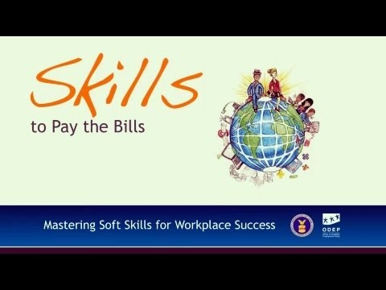
Key Ideas
Why are Soft Skills important?
https://youtu.be/OwPArMTI9i8
https://youtu.be/OwPArMTI9i8

Slide 9
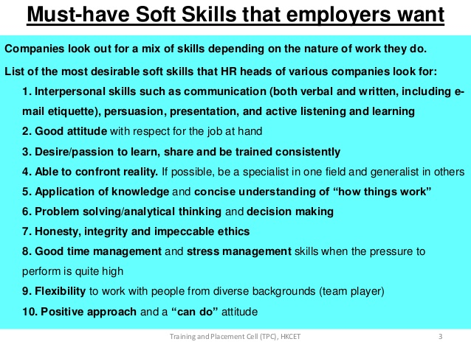
Key Ideas
https://simplebooklet.com/publish.php?wpKey=DVnVSr9zINC7TU9SnJv5j2

Slide 10
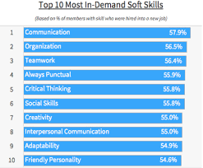
Key Ideas
https://business.linkedin.com/talent-solutions/blog/trends-and-research/2016/most-indemand-soft-skills

Slide 11
Agenda
Address Various Lesson Components and Activities:
Key Terms
Active Learning Strategies
Essential Questions
Lesson Activities and Resources

Slide 12
Unit: Career Readiness Skills
Unit Key Terms:
Attitude Career Management Skills Conflict Resolution
Interpersonal Skills Personality Traits Soft Skills
Time Management Work Ethic Hard Skills

Slide 13
Unit: Career Readiness Skills
Active Learning Strategies
Role-Play (Examples: Job Interview, Handling Customer Complaints )
Video
Group Discussion
Debate
Journaling
Gallery Walk

Slide 14
Unit: Career Readiness Skills
Essential Questions:
What factors and special skills need to be considered when selecting and preparing for employment or career paths for future success?
What positive and negative work habits impact success?
What characteristics and skills are employers looking for when hiring workers?
How do your personal qualities affect your success on the job?
How do I in an individual or group setting, accept feedback and redirection from team members?
How do I use my social skills to achieve a common goal?
https://sites.google.com/a/fmcsd.org/ms-ferguson-s-classroom/home/essential-questions-and-standards-life-skills-social-skills-and-work-experience
https://www.bracken.k12.ky.us/userfiles/-12/My%20Files/Curriculum%20Guides%201/Practical%20Living%20&%20Voational/Vocational%20-Grade%209-12%20-4.1.pdf?id=182

Slide 15
Unit: Career Readiness Skills
Soft Skills Lesson Activities
Capital Investments: Human vs. Physical (Hard Skills vs. Soft Skills)
Communication
Enthusiasm and Attitude
Teamwork
Networking
Problem-Solving
Professionalism

Slide 16
Unit: Career Readiness Skills
Lesson: Capital Investments: Human vs. Physical
Overview:
For this lesson, students will assess their strength in soft skills through a written conversation.
Objectives:
Students will be able to:
Describe human capital.
Understand the difference between hard skills and soft skills.
Explore the ways in which human capital can be developed.

Slide 17
Unit: Career Readiness Skills
Lesson: Communication Skills
Overview:
The activities in this section will not only help participants practice and recognize how they provide information to others, but also help them consider how others may prefer to receive information. It is important to reinforce with participants that communication skills involve give and take — and they can, indeed, be learned and strengthened over time.
Lesson Activities:
What’s Your Point
Flipping the Switch

Slide 18
Unit: Career Readiness Skills
Lesson Activities: Communication Skills
Activity: What’s the Point
This activity helps participants understand the importance of being specific when offering and receiving communication.These role plays are designed to demonstrate the value of being specific in communication…TO others and in what is received FROM others.
Activity: Flipping the Switch
The purpose of this activity is to encourage youth to discuss the different types of communication they might use in different situations and environments.

Slide 19
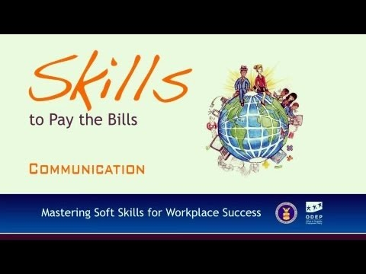
Unit: Career Readiness Skills
Communication Skills Video
https://youtu.be/X0voPlW2pSs

Slide 20
Unit: Career Readiness Skills
Lesson: Enthusiasm and Attitude
Overview:
The activities in this section seek to teach participants about the importance of enthusiasm and a positive attitude in the workplace. Participants will hear strategies for turning negative thinking into positive thinking and displaying and discussing enthusiasm during an interview and on the job.
Lesson Activities:
Never Underestimate the Power of PMA
Life is Full of Hard Knocks

Slide 21
Unit: Career Readiness Skills
Lesson Activities: Enthusiasm and Attitude
Activity: Never Underestimate the Power of PMA
This activity will help participants take difficult situations and find ways to EMPOWER themselves to turn negative thinking into positive thinking
Activity: Life is Full of Hard Knocks
This activity helps participants understand that failure is not something to fear and in fact often a necessary step on the path to success.

Slide 22
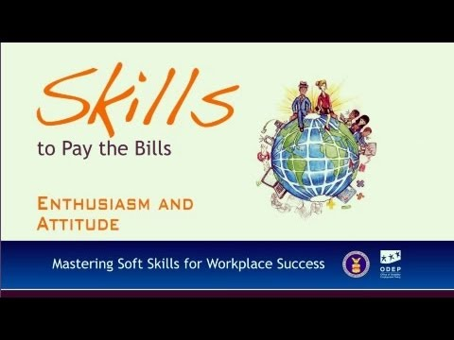
Unit: Career Readiness Skills
Enthusiasm and Attitude Skills Video
https://youtu.be/-vk-99seC_I

Slide 23
Unit: Career Readiness Skills
Lesson: Teamwork
Overview:
The activities in this section seek to teach participants about the importance of teamwork to workplace success and the specific role each individual on a team may play. Participants will learn about positive teamwork behavior and discover how their own conduct can impact others on a team.
Lesson Activities:
There is No “I” in Team
The Good, the Bad, and the Reasonable

Slide 24
Unit: Career Readiness Skills
Lesson Activities: Teamwork
Activity: There is No “I” in Team
The purpose of this activity is to enrich participants’ understanding of what it means to be part of a team and why being a good team player is important for career success.
Activity: The Good, the Bad, and the Reasonable
The purpose of this activity is to engage participants in a discussion of some of the barriers to effective teamwork and the strategies they may be able to put in place to create positive outcomes.

Slide 25
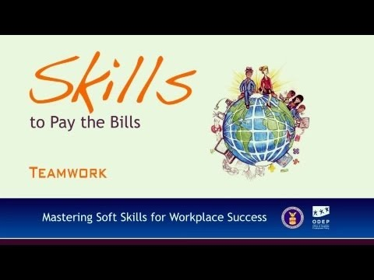
Unit: Career Readiness Skills
Teamwork Skills Video
https://youtu.be/sMFh9QYFh2I

Slide 26
Unit: Career Readiness Skills
Lesson: Networking
Overview:
The activities in this section focus on the process of networking and its relevance and importance to career development. Participants will learn about taking initiative and overcoming fear, informational interviewing, as well as potential guidelines to consider when using social networks, texting, and email for networking purposes.
Lesson Activities:
An Introduction to Networking
Text Vs. Email...Does it Really Matter?

Slide 27
Unit: Career Readiness Skills
Lesson Activities: Networking
Activity: An Introduction to Networking
The purpose of this activity is to introduce participants to the process of networking and to help them begin to understand its relevance to the career development process.
Activity: Text Vs. Email...Does it Really Matter?
This activity will offer participants the chance to challenge themselves to translate text to English and then discuss some of the classic rules of email.

Slide 28

Unit: Career Readiness Skills
Networking Skills Video
https://youtu.be/ZcOCJbvUY-w

Slide 29
Unit: Career Readiness Skills
Lesson: Problem-Solving & Critical Thinking
Overview:
The activities in this section focus on learning how to solve problems in a variety of ways in the workplace. The section will also review strategies for making ethical decisions, solving problems on a team with others, and learning how to take into account others' perceptions when assessing actions or statements in the workplace.
Lesson Activities:
Praise, Criticism, or Feedback
Workplace Ethics

Slide 30
Unit: Career Readiness Skills
Lesson Activities: Problem Solving & Critical Thinking
Activity: Praise, Criticism, or Feedback
The purpose of this activity is to help participants determine the differences between criticism, praise, and feedback – not only how to offer it, but how to receive it as well.
Activity: Workplace Ethics
The purpose of this lesson is to help participants learn some of the steps necessary to make ethical decisions on the job.

Slide 31
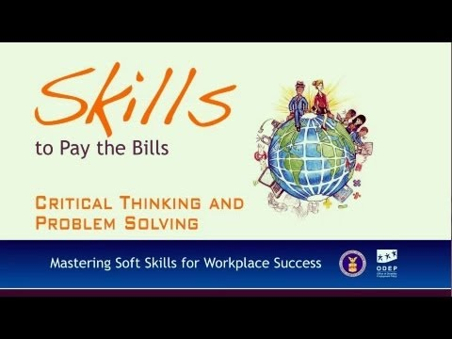
Unit: Career Readiness Skills
Problem-Solving and Critical Thinking Skills Video
https://youtu.be/hPiI44XEKgs

Slide 32
Unit: Career Readiness Skills
Lesson: Professionalism
Overview:
The activities in this section focus on each of the five individual soft skills presented in this publication (communication, enthusiasm/attitude, teamwork, networking, and problem solving/critical thinking), but in a broader framework.
Lesson Activities:
Professionalism in Today's Workforce
Professional Work Attitudes

Slide 33
Unit: Career Readiness Skills
Lesson Activities: Professionalism
Activity: Professionalism in Today's Workforce
The purpose of this activity is to have participants discuss how to bridge generational, cultural, and other diversity gaps in order to build a new standard for professionalism in the workplace.
Activity: Professional Work Attitudes
The purpose of this activity is to generate a discussion about workplace attitudes (of both supervisors and co-workers) and how these attitudes impact those around us.

Slide 34
Unit: Career Readiness Skills
Professionalism Skills Video
https://youtu.be/hPiI44XEKgss

Slide 35
Resources
www.econedlink.org resource:
https://www.econedlink.org/resources/capital-investments-human-v-physical/
Soft Skills to Pay the BIlls Curriculum (Department of Labor)
https://www.dol.gov/odep/topics/youth/softskills/
Additional Resources:
https://www.indeed.com/career-advice/resumes-cover-letters/soft-skills
https://simplebooklet.com/publish.php?wpKey=DVnVSr9zINC7TU9SnJv5j2
https://www.bracken.k12.ky.us/userfiles/-12/My%20Files/Curriculum%20Guides%201/Practical%20Living%20&%20Vocational/Vocational%20-Grade%209-12%20-4.1.pdf?id=182
https://sites.google.com/a/fmcsd.org/ms-ferguson-s-classroom/home/essential-questions-and-standards-life-skills-social-skills-and-work-experience

Slide 36
Thank you!
If you have any questions, feel free to contact me at:
Email: jcobbbrown@gmail.com

