Slide 1
Module 1: Budgeting
July 9, 2019
Doug Kramer

Slide 2
Doug Kramer
Social Studies teacher at Herricks High School, in New Hyde Park, NY since 2001.
Before teaching I was Vice President of Portfolio Acquisitions and Regional Manager for Arbor Commercial Mortgage.
Helped develop the Career and Financial Management Resource Guide for the NYS Career and Management Curriculum Framework.
Co-Advisor of Euro Challenge and Fed Challenge Economic Competition Teams
I coach Cross Country in the fall and Girls Spring Track in the Spring
I enjoy traveling, playing volleyball and basketball, cycling, running.
Notes:
My background is more economics so I embed this in a non-AP economics course. I connect macro/micro concepts with personal finance. I use some in my AP class too.
For this presentation I stayed with the personal finance presentation but if you would like to hear ideas on how to incorporate these ideas in a more standard economics class, I’ll be happy to go over them in the Q&A at the end.
Lastly, most plans and resources are targeted to grades 9-12. Most of the resources I will go through have younger categories available. These, especially pieces are great for lesson differentiation.

Slide 3
Key Ideas
Why is it important to budget?
How do budgets apply to financial goals?
What factors need to be considered when developing a budget?
The importance of saving.
How do we practice good decision making?
Why do so many goals go unmet?
Notes:
Idea of budgeting is boring and tedious, so why?
Needs a hook to their reality or aspirations…

Slide 4
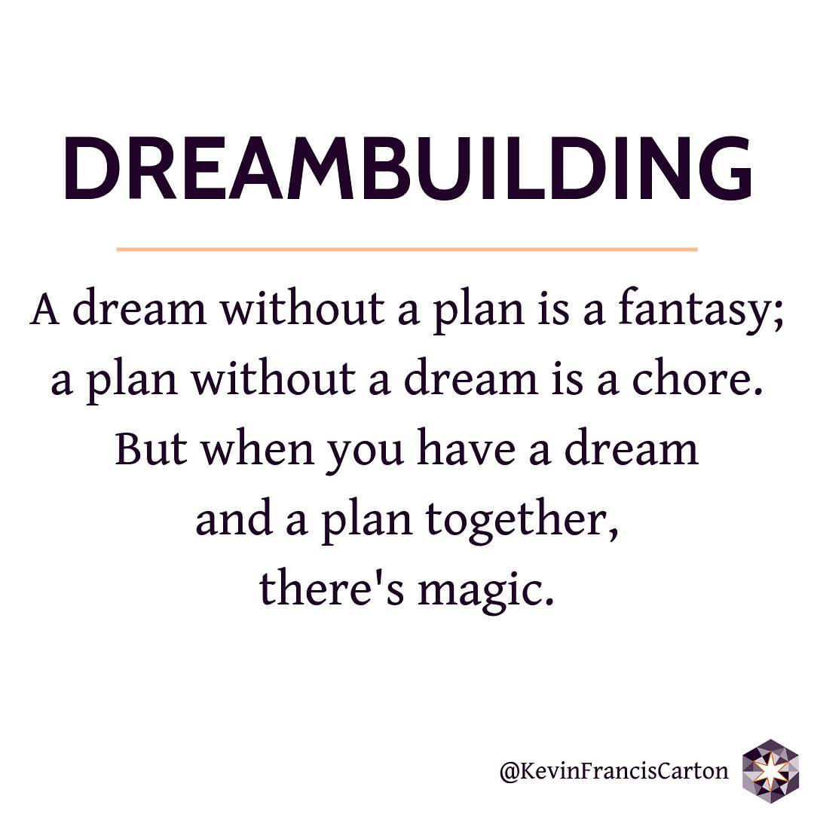
Why Budget?

Slide 5
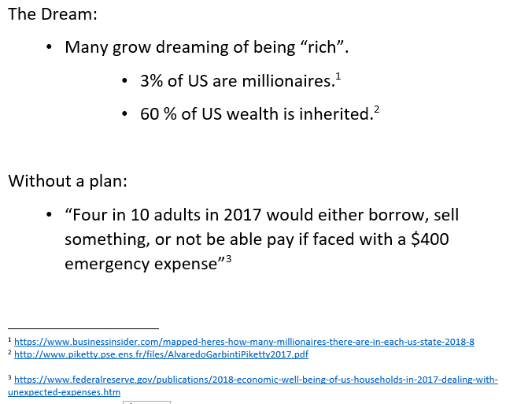
Understanding Financial Goals
Notes:
Budgeting, Money Management, Financial Planning.. All the same goal. We need money for our lives and our plans.
In the industry..
“Live like you will die tomorrow but plan like you will live to 100”
Enter trade-offs and opportunity costs.

Slide 6
Purpose of a Budget
Budgets allow people to quantify their goals.
Many goals seem out of reach without the details.
Once they start making money they can feel like there is always enough and run out quickly.
Do you like report cards?
    Yes if you do well, no if you do not meet your expectations.
    Reviewing your budget regularly keeps you on track.
Notes:
Think of it as your financial GPS.

Slide 7

Purpose of a Budget
Examples of the importance:
Answer students’ skepticism!
“Yeah, but I will be a professional athlete and not have to worry about money!”
    5 Reasons Why 80% Of Retired NFL Players Go Broke
Notes:
In our society, so many want to be rich.
The fact is it takes work and focus. The internet story that quickly, a start up goes public and I am worth millions or billions is barely a tiny fraction of the economy. Most wealthy people that have not inherited their money work at it carefully and most importantly, learn how to control it.
Here are examples behind the “easy” thoughts.
30 for 30 is an ESPN documentary. Well done. If you have access can be used as an extension activity, extra credit etc.
Article highlights the reality vs the myth most young people have about celebrity and money.

Slide 8

Purpose of a Budget
Examples of the importance:
“Yeah, but I will be an entrepreneur like Jeff Bezos and not have to worry about money!”
    5 Successful Companies That Didn't Make a Dollar for 5 Years
Notes:
Five popular large companies like FedEx, Amazon, Tesla

Slide 9
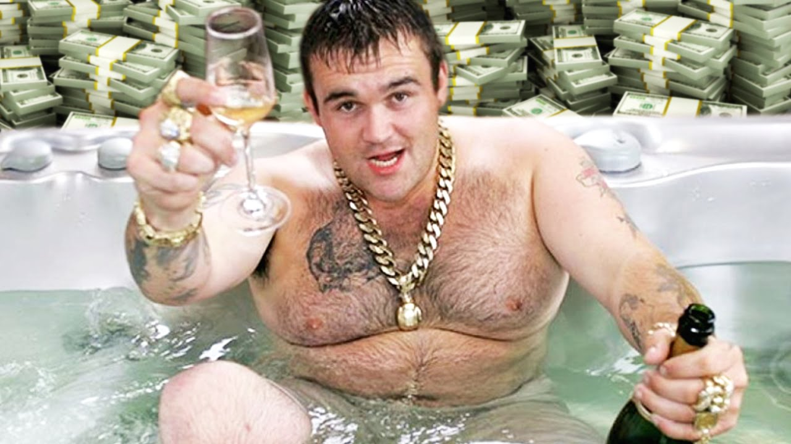
Purpose of a Budget
Examples of the importance:
“Yeah, I’ll just win the lottery and not have to worry about money!”
  Why do 70 percent of lottery winners end up bankrupt?
Notes:
The Curse of the Lottery!
But really and windfall, that first mega music deal, inheritance, etc.

Slide 10
Budget Factors
Scarcity: The cornerstone of economics.
We have limited resources and unlimited wants.
What factors must we consider?
What are needs vs. wants?
What about emergencies?
Do I have flexibility?
  Emergency funds
  Fixed vs. variable expenses

Slide 11
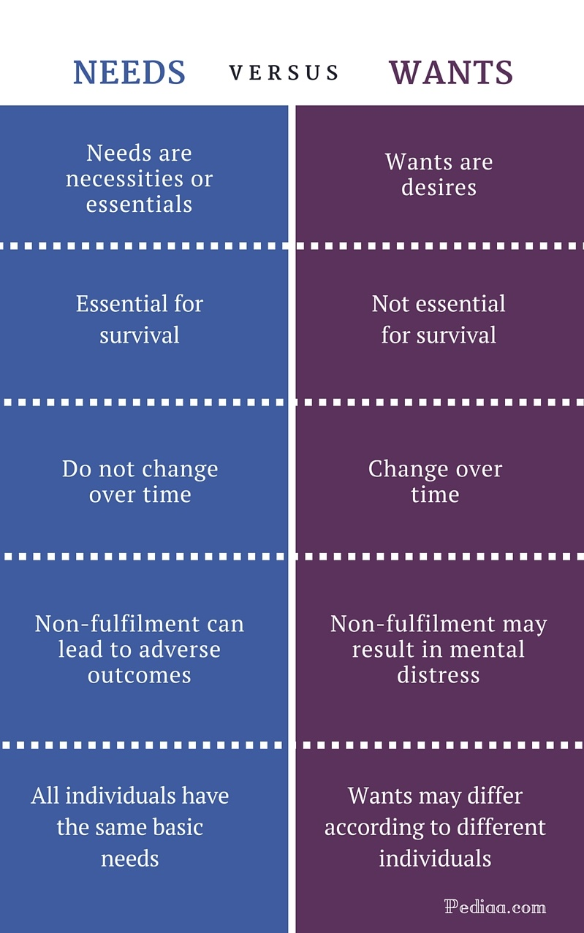
Budget Factors
Notes:
How many of us had THIS conversation with our own parents?!

Slide 12
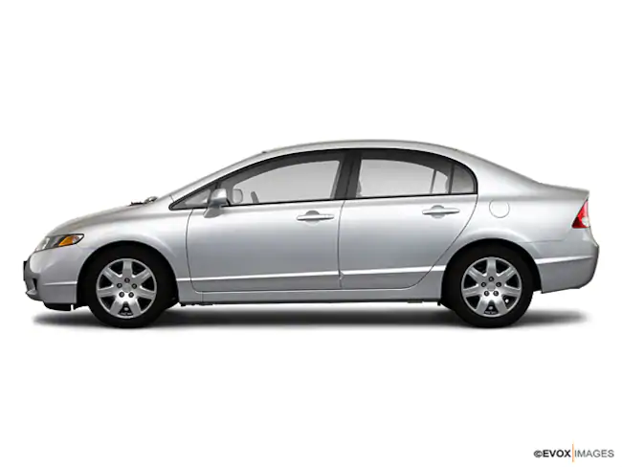
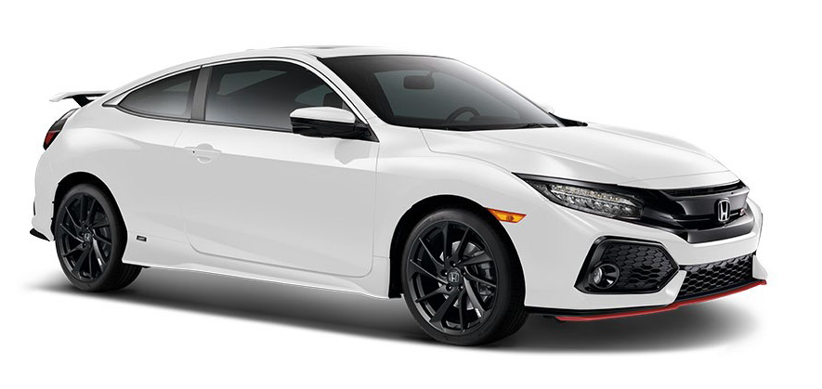

What are needs vs. wants?
This is interesting with students. The easy answers are rent, etc.
It is in the detail that students realize it becomes a very personal process.
Lesson Idea
Suzie Orman
Can I afford it?
Notes:
It is all personal. What makes so much sense to one makes none to another [Suzie Orman]. This doesn’t even go to the concepts of future value of money.

Slide 13
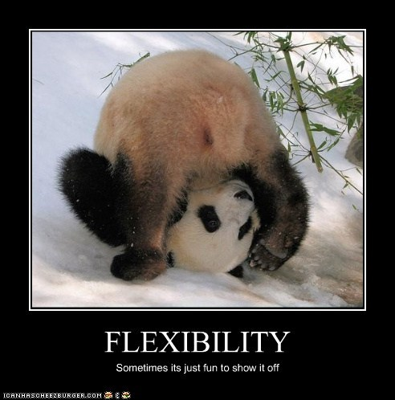
Fixed vs. Variable Expenses
Knowing where you have
flexibility in your budget
is important.
Fixed vs Variable
Income (salary vs overtime, commissions, tips, bonuses)
Expenses (Rent vs. Electric)
Lesson Idea
Notes:
Flexibility = Path to happiness / Emotional and Financial
Note: Dreams and ideas only get more expensive!!

Slide 14
Savings
“Pay Yourself First”
Premier concept in budgeting. Waiting until after, it never happens.
Emergency Fund
[3-6 months of expenses]
Short Term Goals
[up to 12 months]
Mid Term Goals
[up to 5 + years]
Long Term Goals
[Financial Security/Retirement]
Notes:
Emergency 1st
Short term
Mid-term
Long Term – NEVER TOUCH!
Brief discussion why / Time value of money

Slide 15
Savings
First savings goal is an Emergency Fund
Needs to be safe.
Example insured bank deposits by FDIC.
Liquid or easily turned into cash.
Review your emergency needs regularly, i.e. annually.
Notes:
Think: 2008 Financial crisis, Sandy, etc.
[not always a bad reason – trip of life time comes up, etc.]

Slide 16
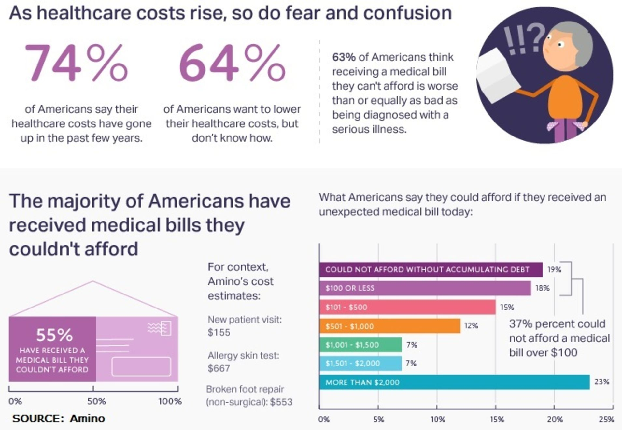
Emergency Fund

Slide 17

Lesson Ideas
https://www.econedlink.org/resources/budgeting-video-and-quiz/
https://www.econedlink.org/resources/budgeting-basics/

Slide 18
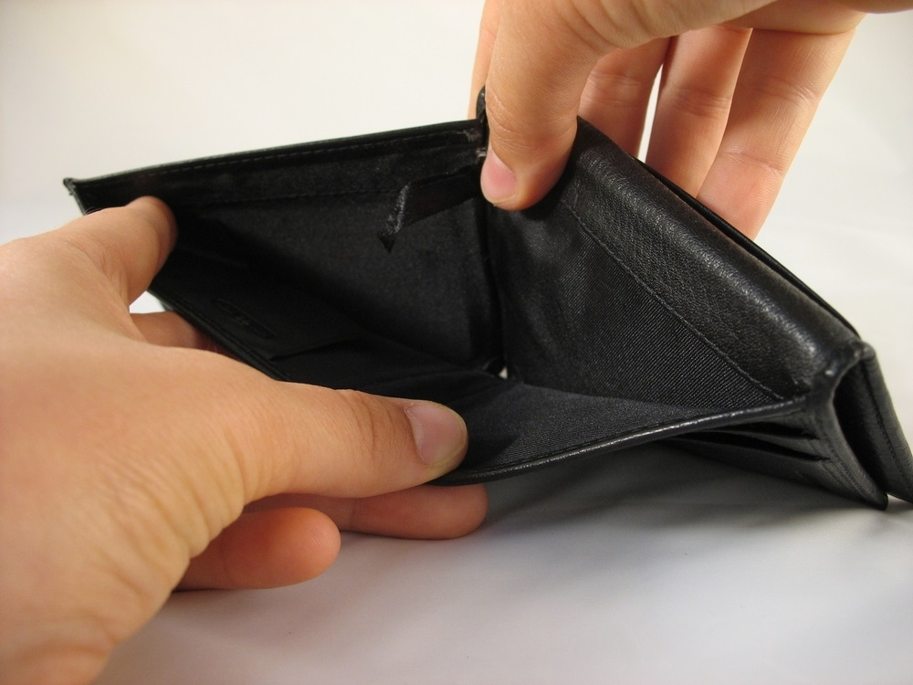
Balancing a Budget
the 3R’s behind purchase decision making.
Reality
Responsibility
Restraint
Example: College Budget

Slide 19
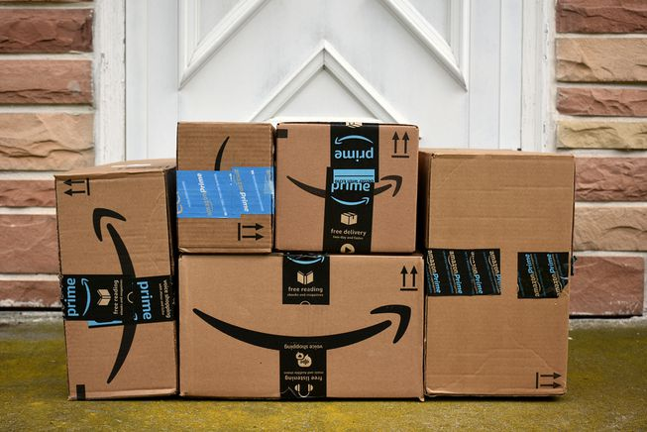

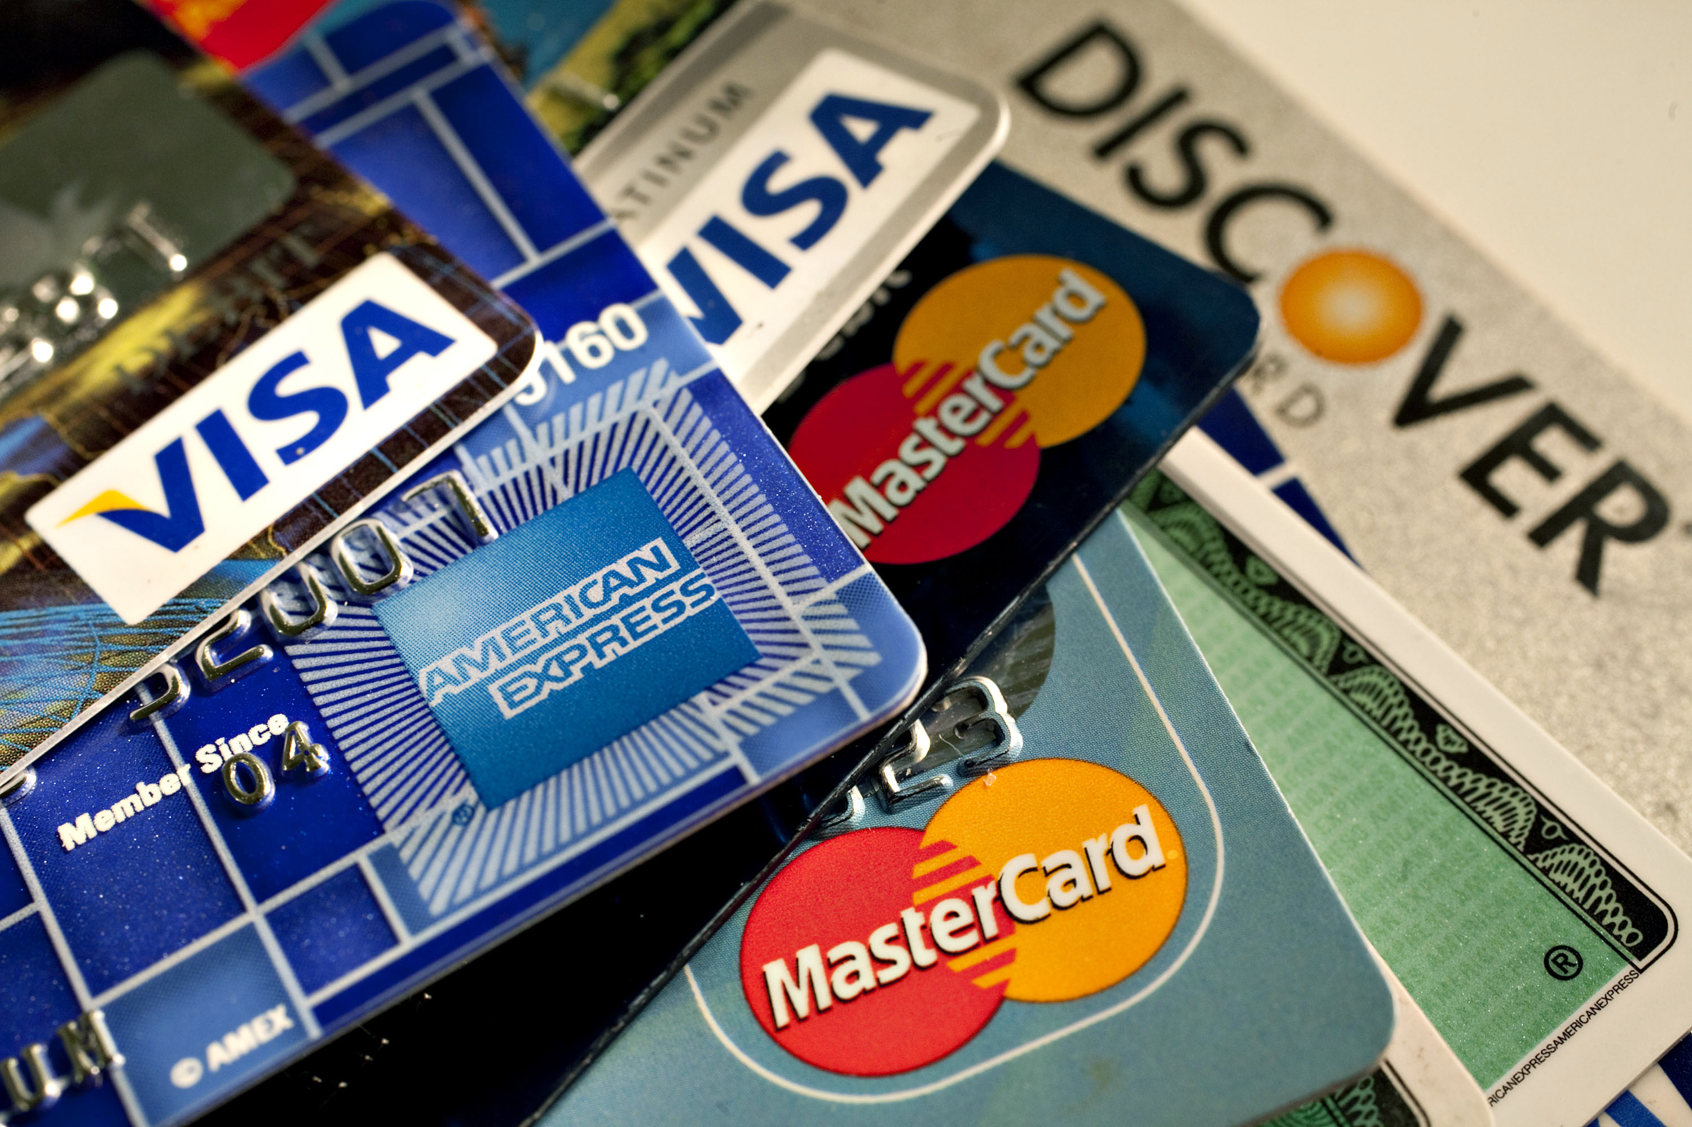
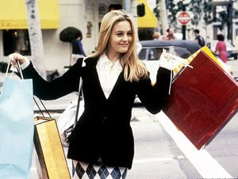
Balancing a Budget
Distractions that will take you off budget

Slide 20
Balance a Budget
Software / Apps the want to help.
Top 9 Personal Budget Software Apps
Top Free Personal Finance Software Choices

Slide 21

More Lesson Resources
Lesson Plan
Student Resources

Slide 22

More Lesson Resources
https://docs.google.com/document/d/1tH4AbGQP-e1AXxwDmD-lN8_yLVxd5yuz2HEWFcHivA0/edit#

Slide 23
Extension / Culminating Project
Get a Life!
Work sheet

Slide 24
Thank you!
If you have any questions, feel free to contact me @
Dougkramer1@gmail.com

