Slide 1
The History of Medicare
ESSENTIAL DILEMMA
Medicare 1966: President Lyndon Johnson’s “American way” or Ronald Reagan’s “advance wave of socialism”?

Slide 2
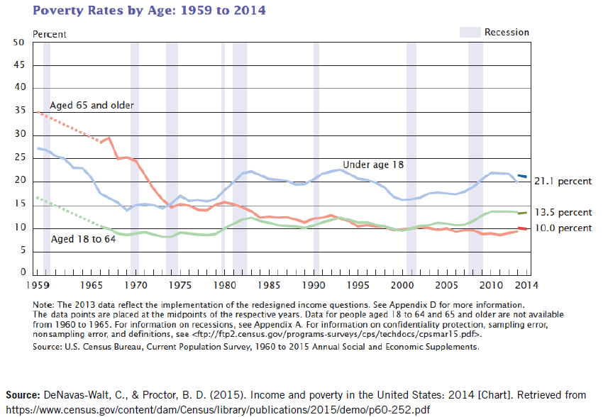
Resource 1
Poverty Rates by Age: 1959 to 2014

Slide 3
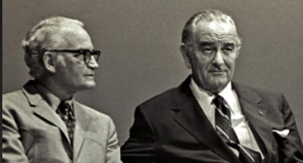
Resource 2
Points of View from Presidential Contenders
Don’t ever argue with me [about health care]. I’ll go a hundred million or billion on health or education. I don’t argue about that any more than I argue with Lady Bird [Mrs. Johnson] about buying flour. You got to have flour and coffee in your house. Education and health. I’ll spend the … money. I may cut back some tanks. But not on health.
  —Lyndon B. Johnson, 1965 (New York Times, 2009)
Having given our pensioners their medical care in kind, why not food baskets, why not public housing accommodations, why not vacation resorts, why not a ration of cigarettes for those who smoke and of beer for those who drink?
  —Barry Goldwater 1964 (Nichols, 2011, p.16)

Slide 4
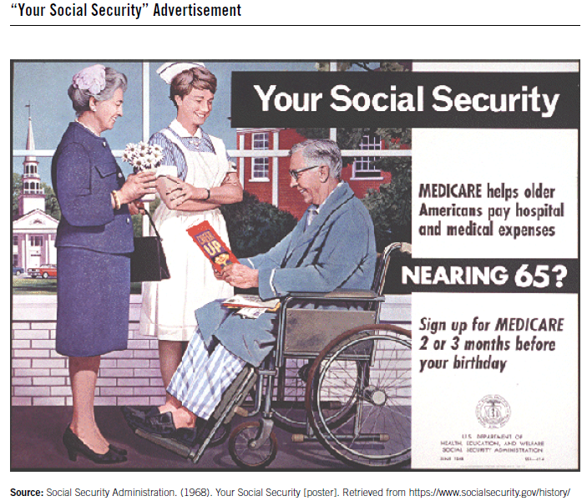
Resource 3
Your Social Security (Poster)

Slide 5

Resource 4
President Lyndon B. Johnson’s Remarks on the Medicare Bill
Why might the older population need health insurance, such as Medicare?
How is the Medicare program going to be funded?
According to President Johnson, what will be the benefits of the program?
What role is the government playing in providing Medicare?
Why would President Johnson refer to this program as
“the American way”?

Slide 6
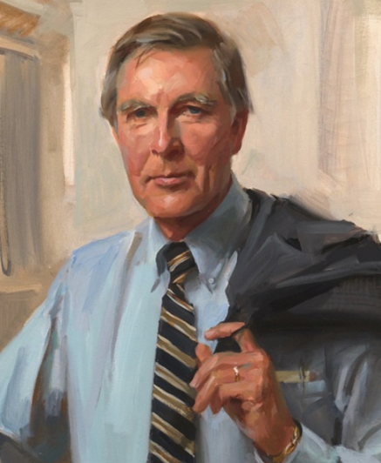
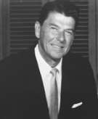
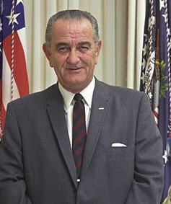
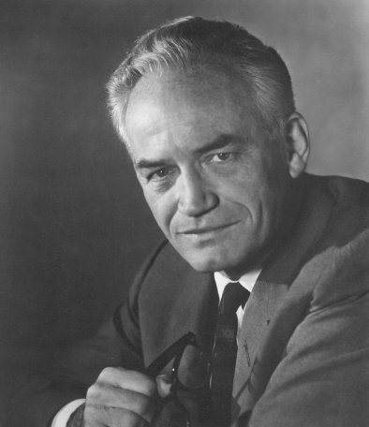
Resource 5
Varying Points of View
Congressman Morris Udall
President
Lyndon Johnson
Governor
Ronald Reagan
Senator
Barry Goldwater

Slide 7
Resource 6
The American Way: Two Perspectives
Perspective 1
The American way is:
allowing people to achieve as much as they can for themselves.
being free from government interference with individual rights.
being allowed to run a business free from government regulation.
allowing people to keep what they have earned.
helping poor people on a voluntary basis.
Perspective 2
The American way is:
making sure that laws and policies do what is best for the greatest number of people.
making sure that no one is allowed to be successful by taking unfair advantage of others.
knowing that poor people are not usually poor because they deserve to be poor and that rich people are not always rich because they deserve to be rich.
treating good health care and a good standard of living as basic human rights.
using tax money to help poor people.

Slide 8
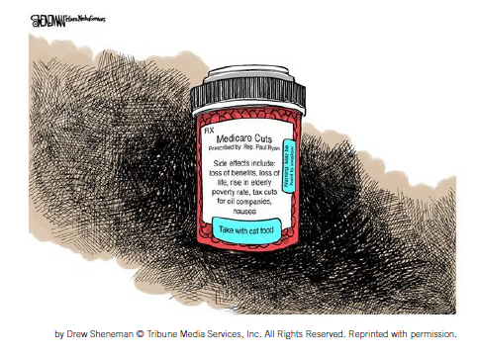
Resource 7
Medicare: Visualizing the Debate
Medicare Cuts
Prescribed by Rep. Paul Ryan
Side effects include:
loss of benefits, loss of life, rise in elderly
poverty rate, tax cuts for oil companies,
nausea
Take with cat food
Ol’ Rockin’ Chair

