Slide 1
Social Security and the National Debt
ESSENTIAL DILEMMA
What costs and trade-offs are we willing to accept to ensure the benefits of income security to Social Security recipients?

Slide 2
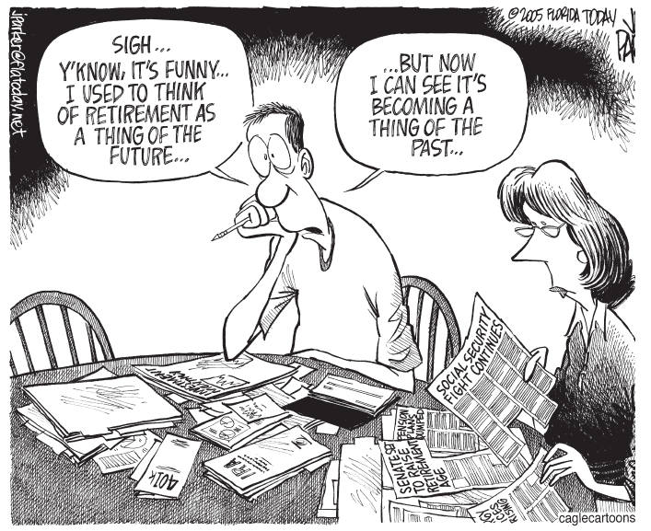
Notes:
If they are stuck or confused, prompt them with the following: What terms and images have you seen before? In what context? [Have them define words they are familiar with, including retirement and Social Security.] With which terms are you unfamiliar? [This will likely include IRA and 401(k).] Describe how the people in the cartoon may be feeling, based on what they are saying, facial expressions, body language, and other context clues.[Students will probably realize that the two people in the cartoon, although not yet elderly, are afraid they won’t have enough money in the future to retire. Students may need help understanding that “a thing of the past” refers to the fact that the recession has reduced the size of the couple’s retirement savings and that they are reading in the news that Social Security, the government-administered pension plan, is the subject of controversy and may raise the age at which the couple would be eligible for benefits.]

Slide 3
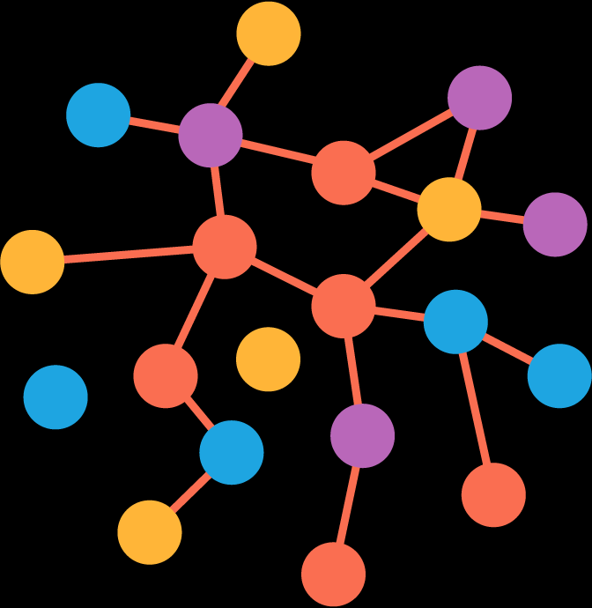
Word Association
On a scratch sheet of paper, write down the first 5 words that come to mind when you think of retirement.
How many ways can you think of to fund retirement?
Notes:
Give students 30-60 seconds to make their brainstormed lists of word association. Discuss these words. Then display the yellow box and have students call out as many ways as they can think of to fund a person’s retirement.

Slide 4

Retirement Funding Options
Gifted funds (inheritance, trusts, etc)
Employer sponsored/supported investment plan (401k/403b)
Pension (defined contribution vs.
defined benefit)
Personal savings/investments
(IRA/Roth IRA)
Keep working
Real Estate/Property sales
Social Security
Notes:
These pop up one by one so you can maximize discussion on each one if time permits. Inform students that IRAs and 401(k)s are private accounts that people can use to save their own money for retirement. They are like Social Security, but there is an individual risk of losing that money, whereas Social Security is meant to be insured by the government.

Slide 5
How does Social Security work?
SOCIAL SECURITY
FUND (Managed by Federal Government)
PAYCHECKS
ENTITLTED RECIPIENTS
Retirees, widows, children, disabled, etc. based on complex formulas and payouts
12.4%
6.2%
6.2%
From YOU!
(FICA)
From employer
Notes:
This simplistic diagram shows the very basic premise of the mechanics behind social security. People with jobs pay a percentage, matched by their employer, into a fund. This fund is then used to pay benefits to people who have met eligibility requirements and are now “entitled” to receive those payments. You may also wish to point out that self-employed people are responsible for all 12.4%. It may also be worth mentioning the word “entitled” to students who may have heard of “entitlements” in public discourse. Explain that certain segments of the population are entitled to receive SS benefits if they meet certain criteria.

Slide 6
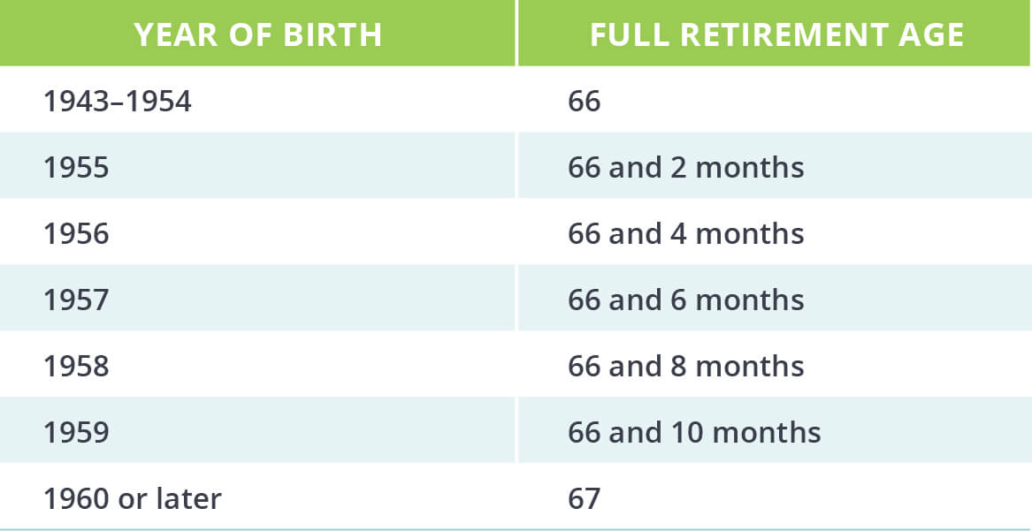
Notes:
This chart simply shows how the retirement and eligibility age for Social Security has increased over time. Briefly discuss this with students, but don’t spend too much time here. Later the students are going to deal with raising the retirement age as a possible solution to the budget problem of SS.

Slide 7
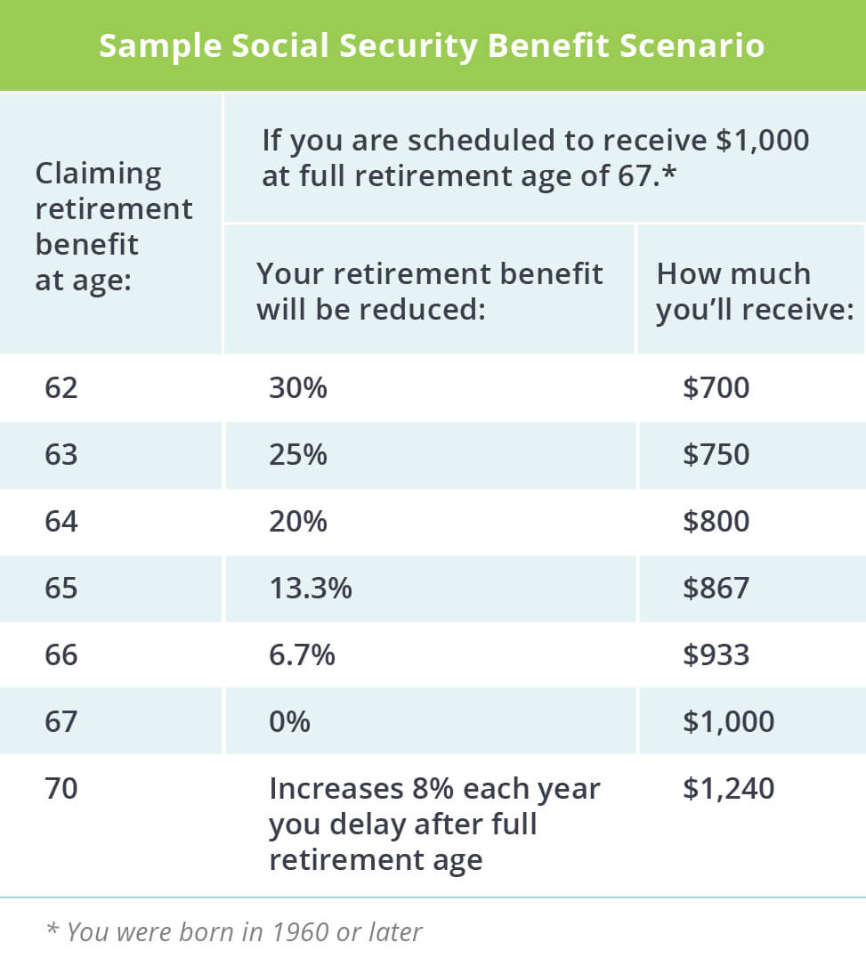
Notes:
This slide essentially continues the information from slide six regarding raising the retirement age. The Federal Government provides incentives for people to delay retirement by a few years by increasing their benefits. Whether or not this is “worth” it is an individual decision, of course, and involves multiple pieces of information including other retirement income, desire to work, health, family health, cost of living, lifestyle, etc.

Slide 8
Social Security is more than a retirement program

Slide 9
Social Security dramatically cuts poverty among seniors
Using data from the 2014 U.S. Census, this chart was created by the Center on Budget and Policy Priorities, a policy organization that works on fiscal policy and public programs that affect low- and moderate-income families and individuals. This graph compares the percentage of seniors who would be in poverty without the income from Social Security to those who are in poverty with Social Security, all else being equal.
Source: Center on Budget and Policy Priorities. (2015). Social Security helps millions of elderly Americans. Retrieved from www.cbpp.org/blog/social-security-helps-millions-of-elderly-americans
Notes:
These numbers have held true for a long time and the most recent numbers can be found here: https://www.cbpp.org/research/social-security/social-security-keeps-22-million-americans-out-of-poverty-a-state-by-state

Slide 10
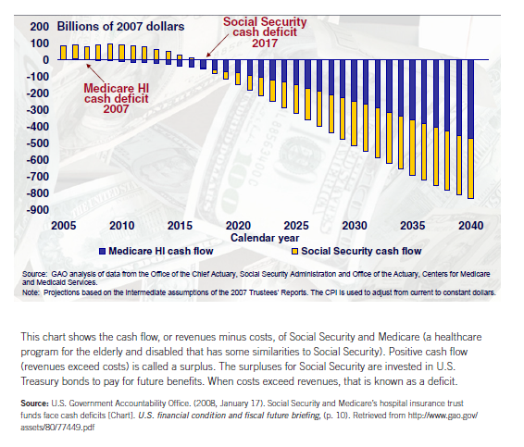
Notes:
This chart is sometimes hard for students to follow. The yellow line represents Medicare Health Insurance. The Blue line represents Social Security. The line is showing cash flow, meaning a comparison of the money coming into the program against the costs to operate. It’s interesting for a host of reasons, but one of them is to look at forecasting. This chart was created in 2008 and that that time, the program was expected to run a cash deficit in 2017. We now know that did not happen until 2018. This page provides the most up to date information regarding Social Security’s Solvency. https://www.ssa.gov/policy/trust-funds-summary.html

Slide 11
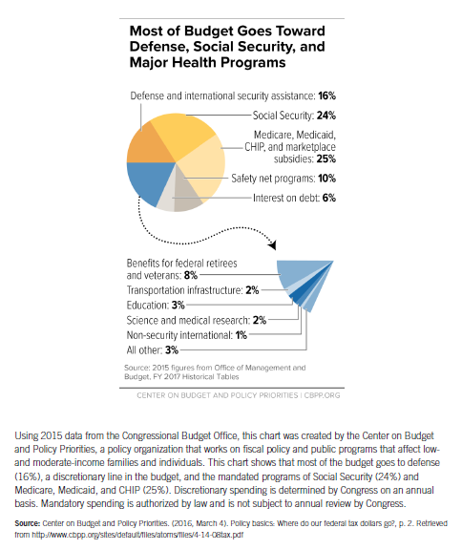
Most of budget goes toward defense, Social Security, and major health programs
Notes:
Specific to the title of this lesson, this chart is arguably the most important. It shows that Social Security takes up about 24% of the federal budget. Depending on one’s outlook, this can be extremely gracious and supportive of the population or appalling that the Federal Government collects trillions of dollars from taxpayers and spends about ¼ of it supporting retirees, disabled folks, and other beneficiaries.

Slide 12
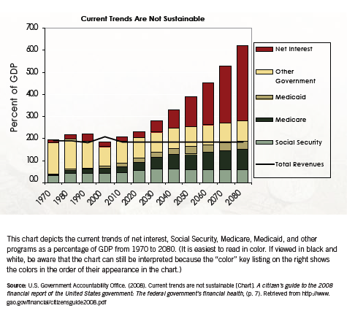
Current trends are not sustainable
Notes:
Projecting anything out to 2080 is somewhat naïve and may be argued is just done for shock value. It is extremely important to point out the Y axis on this graph. It is NOT dollars, rather percentage of GDP. This makes a big difference in interpretation. In reality, so many political and economic decisions will be made during the time period shown on this graph that it’s almost not worth spending significant time on. The one takeaway, however, should be that IF things were left just as they are, the percentage paid out in social security would eventually normalize and even start to decrease slightly as a percentage of GDP.

Slide 13
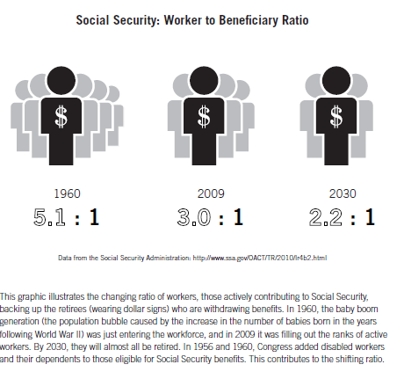
Social Security: Worker to Beneficiary Ratio
Notes:
While simple to read, make sure students understand the number on the LEFT of the colon is how many people are working per beneficiary. In some ways, this is the scariest of the five charts because it really drives home the point of the unsustainability of the current program.

Slide 14
So what?
What, if anything, does the data suggest about Social Security?
Solutions?
  Raise retirement age
  Longevity Index
  Recalculate COLA from CIP to chained CPI or elderly CPI
  Increase/Eliminate Payroll Tax Cap
  Increase Payroll Tax Rate
  Reduce benefits
  Force all state/local government workers into system
  “Means Test” individuals
https://www.aarp.org/work/social-security/info-05-2012/future-of-social-security-proposals.html
https://www.aarp.org/content/dam/aarp/work/social_security/2012-05/four-social-security-options-aarp.pdf

