Slide 1
Keynes vs. Hayek: The Rise of the Chicago School of Economics

Slide 2
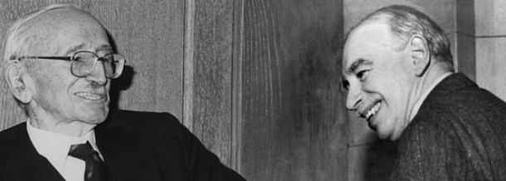
Friedrich von Hayek (left) and John Maynard Keynes (right)
Following World War II, one major economic question dealt with the appropriate role for government in the economy – a debate dominated by the ideas of John Maynard Keynes and Friedrich von Hayek. Both of these influential economists had distinct ideas about economic freedom, ideas that were very clearly in opposition to each other.

Slide 3
John Maynard Keynes, an English economist, developed theories that called for a large role for government in the economy.
“The government would borrow money to spend on such things as public works; and that deficit spending, in turn, would create jobs and increase purchasing power. Striving to balance the government's budget during a slump would make things worse, not better. Keynes's analysis laid the basis for the field of macroeconomics, which treats the economy as a whole and focuses on government’s use of fiscal policy –spending, deficits, and tax. These tools could be used to manage aggregate demand and thus ensure full employment. As a corollary, the government would cut back its spending during times of recovery and expansion.”
– Daniel Yergin and Joseph Stanislaw (in The Commanding Heights: The Battle for the World Economy)
Notes:
For more information about Keynes' ideas, read about Keynesian Economics.

Slide 4
Austrian economist Friedrich von Hayek argued for limiting the role of government. He maintained that government was to restrict itself to doing what it does best – protect rights, evenhandedly enforce laws and contracts, and provide a few public goods.
To Hayek, less government intervention meant more economic freedom across households and businesses. He believed that when people are free to choose, the economy runs more efficiently because they can best identify solutions to problems, quickly respond to changes, and learn by doing.
“The problem was that under central planning, there was no economic calculation – no way to make a rational decision to put this resource here or buy that good there, because there was no price system to weigh the alternatives.”
– Daniel Yergin and Joseph Stanislaw (in The Commanding Heights: The Battle for the World Economy)
Notes:
For more information on the Austrian School of Economics read more and for further reading critiquing the Keynesian philosophy read here about The Chicago School.

Slide 5
In the United States, the strongest supporters of Hayek’s ideas were a group of economists at the University of Chicago. Known as the “Chicago School of Economics,” this loosely formed unofficial group of economists was generally associated with free market libertarianism.
The name refers to economists who received their schooling in the Economics Department at the University of Chicago.
To date, nearly half of all Nobel Prizes in Economics Sciences have been won by economists with ties to The University of Chicago.

