Slide 1
Where did that pencil come from? The Study of Natural Resources

Slide 2
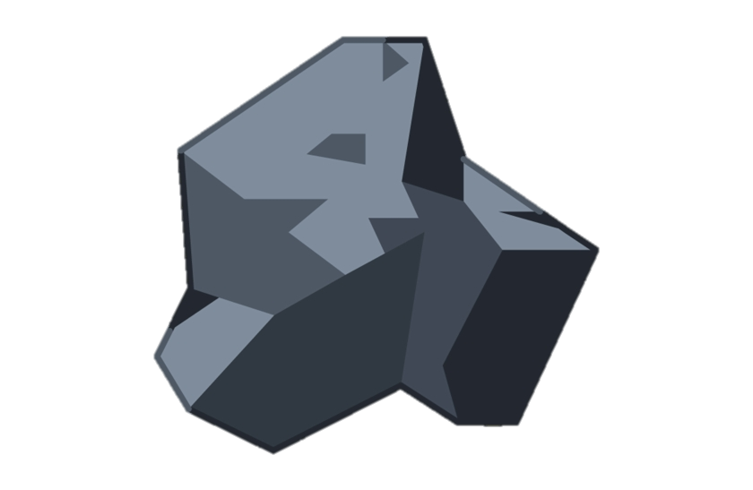
Trees
Coal
Water
Something to think about: What do these three things have in common?

Slide 3
Definitions:
Natural Resources: “Gifts of nature” that can be used to make goods or provide services people want.
Goods: Things you can touch that people want.
Services: Things you can do for someone to help them get what they want.

Slide 4
Which natural resources are used to make all the different parts of this wooden pencil?

Slide 5
Let's break down the natural resources found in a wooden pencil:
Eraser: Rubber can be made from the sap of rubber trees. Man-made rubber is made from petroleum, or oil.
Metal: There is a strip of metal used to hold eraser on the pencil. Metal can be smelted from ore found in the ground.
Wood: Lumber is harvested from trees and cut to size in a sawmill.
Graphite: The part of the pencil that writes is made from graphite. Graphite, like metal, can be found in mines in the ground.

Slide 6
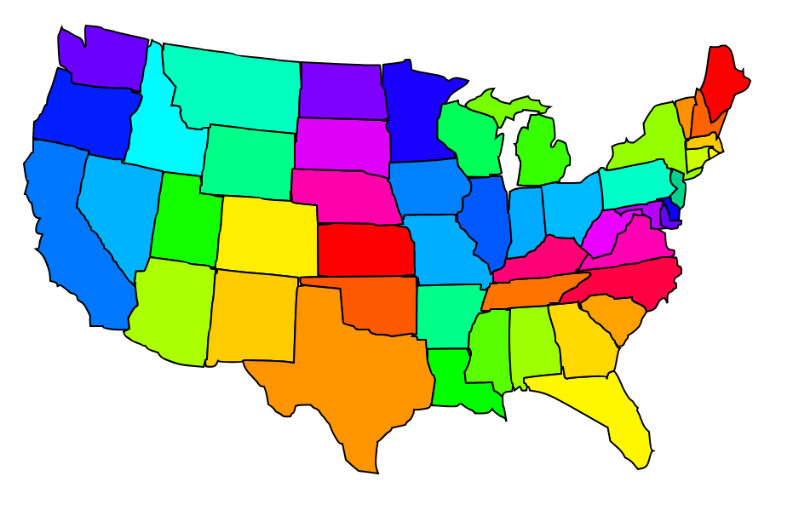
The United States of natural resources!
Let’s investigate the different types of natural resources located in different states.
Pick a state from this site:
Find out which natural resources are in your state.
List the natural resources located in that state.
Think of three goods or services that can be made from those natural resources.

