Slide 1
What is a fair share of the pie?
Notes:
Start the lesson by stating: Imagine you have four siblings. All five of you have been working hard in the house and yard all day. When you come into the kitchen at the end of the day, you find that your mom has baked an apple pie for all of you. How can you share the pie?

Slide 2
Income inequality
A $4 million home in South Africa
Kliptown in South Africa
Notes:
Explain to students that economists and politicians become concerned about income inequality when it is extreme. In other words, when many individuals in a population have a very small share of the income and most income goes to a few wealthy individuals. Most governments, including the U.S. make some attempt to redistribute income to help the least fortunate – meaning they take tax dollars from high-earning individuals to provide money and services to low-income earners. In order to make these decisions, it’s important first to measure the income distribution in a nation. In this lesson, students will learn two such measures: the Lorenz Curve and the Gini coefficient.

Slide 3
Creating a Lorenz Curve: Step 1
Name | Income
Adrian | $90
Bob | $15
Cathy | $70
Derek | $200
Eddie | $125
Notes:
Explain to students that the first step in graphing a Lorenz Curve is collecting income data for a population. For this lesson, we will imagine a small country, Alpha, with just five citizens: Adrian, Bob, Cathy, Derek and Eddie. Their income data is provided on the slide and in Activity 1. **Students should NOT copy the data from Slide 3 onto Activity 1. Note that the citizens of Alpha do not have equal income. Ask students to add up the total income for these five residents ($500). Ask students: If there were equal distribution of income, how much would each citizen of Alpha earn? ($100)
Ask students to sort the individuals and put them in the table on Activity 1 in ascending order. In other words, Bob – who is earning the least at $15 – goes in the top row of the table. Move to the next slide so students can check their work.

Slide 4
Creating a Lorenz Curve: Step 2
Name | Income (ascending)
Bob | $15
Cathy | $70
Adrian | $90
Eddie | $125
Derek | $200
TOTAL | $500
Notes:
Then explain that next, students need to calculate each individual’s share of the total income. Ask students: How will you calculate Bob’s share of the total income? ($15/$500 = 3%) Ask students to repeat this procedure for each individual and fill in the third column of the table on Activity 1. Move to the next slide so students can check their work.

Slide 5
Creating a Lorenz Curve: Step 3
Name | Income | Share of total income
Bob | $15 | $15/$500 = 3%
Cathy | $70 | $70/$500 = 14%
Adrian | $90 | $90/$500 = 18%
Eddie | $125 | $125/$500 = 25%
Derek | $200 | $200/$500 = 40%
TOTAL | $500 | $500/$500 = 100%
Notes:
Explain that the final column on the table represents the cumulative share of income going to 1 worker or 2 workers or 5 workers. The lowest paid worker, Bob, receives 3% of the income. The lowest paid two workers, Bob and Cathy, earn 3% + 14% of the income, so cumulatively (together) they earn 17% of the income. All of the workers, together, earn 100% of the income. This might seem strange to students, but explain that this column is important for graphing a Lorenz Curve. Ask students to calculate the cumulative share of the income for 3 and 4 workers and fill in the final column on Activity 1. Once students are done, show Slide 6 so they can check their work.

Slide 6
Creating a Lorenz Curve: Step 4
Name | Income | Share of total income | Cumulative share of total income
Bob | $15 | $15/$500 = 3% | 3%
Cathy | $70 | $70/$500 = 14% | 17%
Adrian | $90 | $90/$500 = 18% | 35%
Eddie | $125 | $125/$500 = 25% | 60%
Derek | $200 | $200/$500 = 40% | 100%
TOTAL | $500
Notes:
Direct students to the graph at the bottom of Activity 1) Ask students what they think the bright purple line on the graph represents. (It represents perfectly equal distribution of income. The lowest 1% of income earners have 1% of the income. The lowest 20% have 20% of the income. The lowest 50% have 50% of the income, etc.) Show students the red dot above 20% on the X-axis. Explain that this data point is Bob. He represents 20% of the income earners in Alpha, and he earns 3% of the income. Ask students to draw this point on their graphs on Activity 1, then plot the points representing the cumulative income of the lowest 40% (Bob + Cathy), 60%, 80% and then 100%.

Slide 7
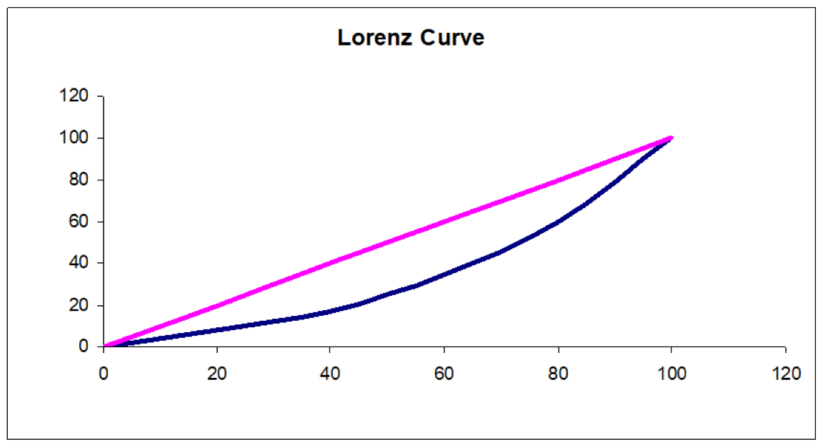
Plotting the Lorenz Curve
Cumulative Percent of Income
Cumulative Percent of Households

Slide 8
Lorenz Curve and Gini Coefficient – Measures of Income Inequality

