Slide 1
Stock Market Lookup

Slide 2
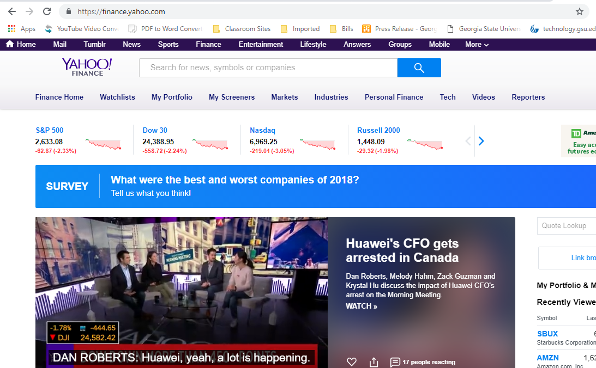
Enter the company name or ticker symbol here
Notes:
Slides 19 – 22 simply visually show how to go about getting stock information on Yahoo Finance’s new pages. Just follow the directions in the yellow boxes.

Slide 3
Click here to enlarge the graph

Slide 4
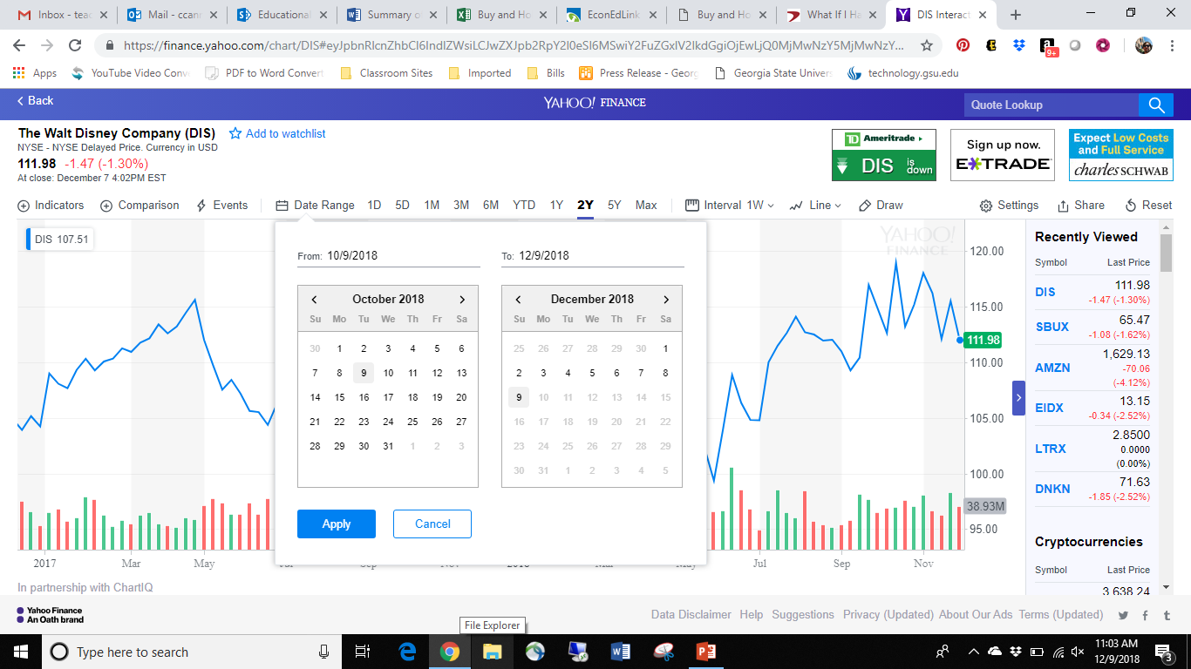
Click here to extend the date range and select 10/1/2007 as the end range in the “to” box. The “from” box can be any date prior to 10/1/2007, but recommended to use January 1, 2000

Slide 5
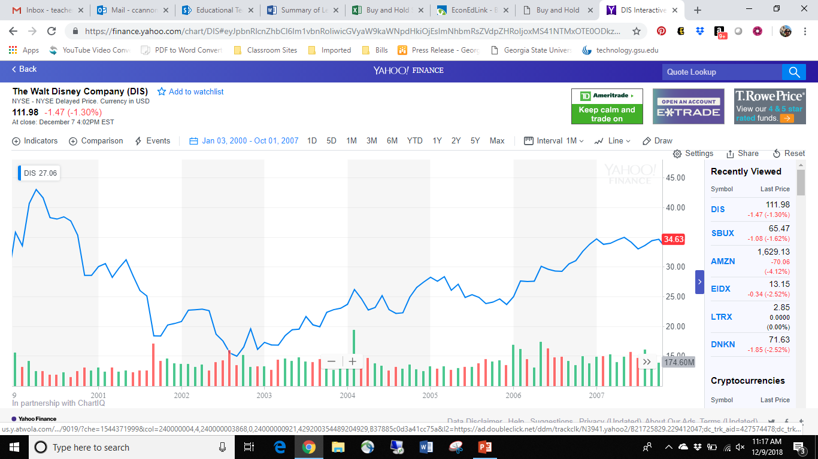
The number that shows up in red on the right side is the price on the last date entered.

