Slide 1
﻿Buy and Hold: The Stock Market Game

Slide 2
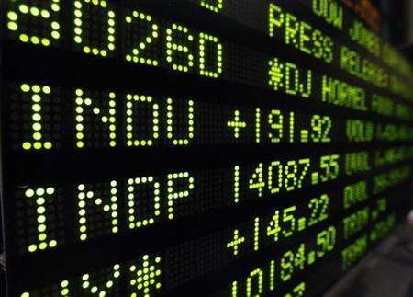
What happens at the stock market?
Notes:
Ask students to work with their neighbor and/or small group to come up with an explanation for what happens at the Stock Market. They’ve probably heard of the Stock Market, but many high schoolers do not fully understand how it works. Source of image: www.ipprospective.com

Slide 3
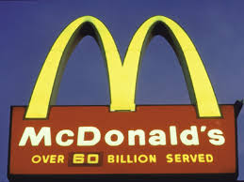
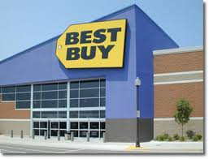
A business firm is an entity that buys productive resources and uses them to create goods and services for sale to consumers, governments and other business firms.
Notes:
The word “firm” is commonly used in economics, accounting and business classes to refer to a single business. The businesses seen on this slide would all be examples of “firms” even though they provide drastically different goods and services. In order to expand and acquire greater resources, firms often sell shares of stock to people who wish to own a little piece of the firm. Image sources: howstuffworks.com, examiner.com, routesrentals.com, logospictures.blogspot.com, stores.bestbuy.com
Define a firm as an entity that buys productive resources (or raw materials) and uses them to create goods and services for sale. Explain that McDonald’s, Schwinn, Best Buy and Facebook are all firms producing food, bicycles, technology items, and social media, respectively. Ask students to name other firms they are familiar with. (Answers will vary. Most students will be aware of major clothing brands, tech firms, and restaurants.)
Tell students that most firms start out small with just one or two owners. If unincorporated, these types of firms are called sole proprietorships or partnerships. You may want to name a few examples in your area, such as a family-owned restaurant (sole proprietorship) and a law firm (partnership). Explain that these types of firms find it difficult to expand because the owners don’t have a lot of money to invest and banks are unwilling to lend them large sums. In order to become larger, many firms become corporations. A firm can become a corporation by applying for a state charter to incorporate. The firm becomes a separate legal entity from its original owner, and it can raise money by issuing stock or bonds. A corporation can remain privately owned or the board of directors may choose to sell stock to the public. This process is called an “Initial Public Offering (IPO)” or “going public.”

Slide 4
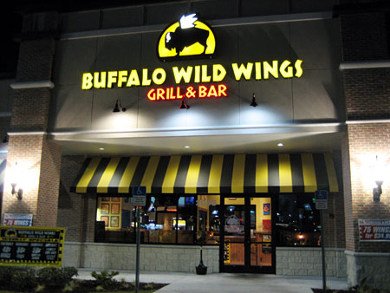
1982: First restaurant founded in Columbus, OH
1994: 35 locations open
2003: Initial Public Offering
2008: More than 500 restaurants open
Notes:
This slide helps explain the Buffalo Wild Wings story and the role that selling stock can play in helping a company expand. An “initial public offering” is when a company allows the general public the opportunity to own shares of the company. Once a company does this, they have practically no control over the price of their shares. Image sources: ngc-group.com, levoy.net
Ask students, "Have you ever heard of Buffalo Wild Wings?" (Many students will have seen or eaten at this restaurant.) Explain that in 1982, two business partners opened the first Buffalo Wild Wings restaurant. Thirteen years later, they had 35 locations. They knew they wanted to expand more, and they borrowed lots of money to open more restaurants, but that still wasn’t enough. In 2003, Buffalo Wild Wings held an Initial Public Offering, and this allowed them to expand rapidly.

Slide 5
Initial Public Offering Nov. 18, 2003
Offered 3 million shares
Expected price of $14-$16/share
Estimated value: 3 million x $15 = $45 million
Net proceeds: $47.4 million
Day 1 Closing Price: $22.95/share
Notes:
For Buffalo Wild Wings, the opening day of their IPO was a great success. This, however, is not guaranteed and many companies close their opening day below expectations. There is also a tendency to sell off shares soon after an IPO. Image sources: ngc-group.com, levoy.net
Explain that before issuing public stock, the company’s founders will meet with an investment banker who will help prepare a lengthy document called a “prospectus,” which explains what the firm does and how it expects to perform in the future. The investment banker will also estimate the total value or “market capitalization” of the firm. The value includes any patents, trademarks, trade secrets or recipes, as well as all of the firm’s assets, such as buildings, ovens and trucks, and an estimate of future earnings. If the founders are selling all of the stock, then the number of shares for sale multiplied by the price of each share should equal the market capitalization. In many cases, the owners may choose to retain some shares and sell some. In the case of Buffalo Wild Wings, the owners decided to sell 3 million of a total of 8 million shares, expecting to sell them for about $15/share. Their estimates were fairly accurate and the stock sale earned them $47.4 million, slightly more than expected, which was used to expand.

Slide 6
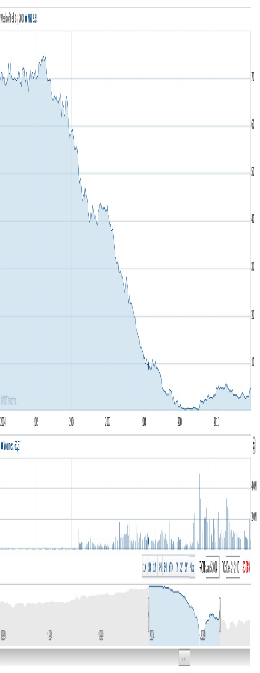
McClatchy Co.
Between 1990 and 2004, McClatchy stock rose from $15/share to $70/share. This was no guarantee it would continue to rise.
Notes:
Explain to students that investing in the stock market can be very risky. McClatchy Co. is a firm that owned a large chain of newspapers. Explain that in a period of 15 years, its stock price had gone up more than 400%. Many individuals owned McClatchy stock and thought it was a safe investment. In 2005, as the Internet began to replace newspapers for both advertisers and news readers, the stock price began to fall. Remove the white text box covering part of the graph and show what happened to McClatchy stock. It bottomed out at 40 cents/share in 2009. Ask students: How would you feel if you had bought McClatchy stock for $70/share? (Very upset, worried, broke.) On the board, calculate the percent loss. Percent change = [(.40 – 70) / 70] x 100 = -99.43 Explain that many expected the company to go out of business, but as of 2015 it is still in business. Explain that when a company does go out of business, its bond holders are repaid first. Stockholders receive money only if there is any left after repaying all of the debt owed to the bond holders – one more reason why bonds are safer than stocks.

Slide 7
Stock Game
Work in teams of 2-4
$100,000 to invest
One opportunity to invest
Maximum 500 shares of one stock
Your team will have access to stock charts and basic information about each company.
You may not access any unauthorized websites during this activity, or you will be immediately disqualified.
Notes:
Explain that they are going to participate in a stock market simulation, but that it will be different from other “Stock Market games” because you are going to emphasize the long-term nature of buying and investing. A typical game lasts a semester or perhaps a year. This game will "begin" in January 2000, so it could last 1 year, 2 years, 5 years, 10 years, 15 years or even more. Students will not know in advance when the game will end.
Explain the rules seen on slide: You will form a team of 2-4. Your team has $100,000 to invest. Your team is not required to invest all of the money, but you will have only one opportunity to invest (in 2000). You will have no opportunity to sell. You may purchase a maximum of 500 shares of any specific company’s stock, and you may purchase a maximum of 500 bonds. Your team will have access to stock charts and basic information about each of the available companies. You may not access any unauthorized websites during this activity or you will be immediately disqualified.

Slide 8
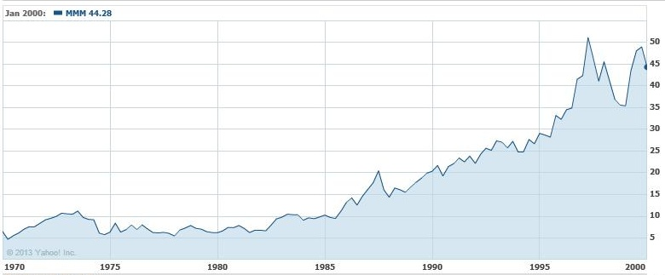
3M (MMM) $44.28
3M, based in Minnesota, may be best known for its Scotch tape and Post-It Notes, but it also produces sand paper, adhesives, medical products, computer screen filters, food safety items, stationery products and many products used in automotive, marine, and aircraft industries.
Notes:
This is an example of the kind of information the students will have access to in the simulation.

Slide 9
3M (MMM)
A trend line
Notes:
In math, a trend line has an equal number of points above the line as it does below the line. It is particularly useful for scatterplot graphs. Different periods of time can show different trend lines.

Slide 10
3M (MMM)
Resistance line
Support line
Notes:
The resistance line joins the two highest highs of whatever time period the trader is looking at. The support line connects the two lowest lows. The trend is for the stock to trade in between these highs and lows. Traders often look at trends in one year or a few months, but some study trends on a weekly or even daily basis. The more points on either line, the stronger the trend is considered to be. This example shows a weak resistance line with only two points but a strong support line. Many traders believe that if the support line has many points showing an upward slope, the stock is a good buy.

Slide 11
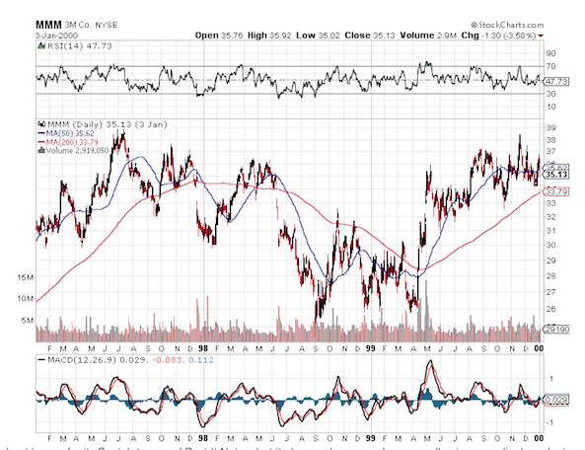
Buy and Hold Interactive
Resistance line
Support line
Notes:
This is what the graphs in the “Research” section of the interactive will look like, although the resistance and support lines have been added for demonstration purposes. Explain that the red and blue lines are “moving averages.” The blue line (MA50) is a moving average of the price over a 50-day period, while the red line (MA200) is a moving average of the prices over a 200-day period. These lines smooth out the highs and lows. The red line puts less emphasis on the most recent changes and is meant to be a more accurate reflection of the longer-run trend in prices. Students may also use these lines to help them decide which stocks to select.

Slide 12
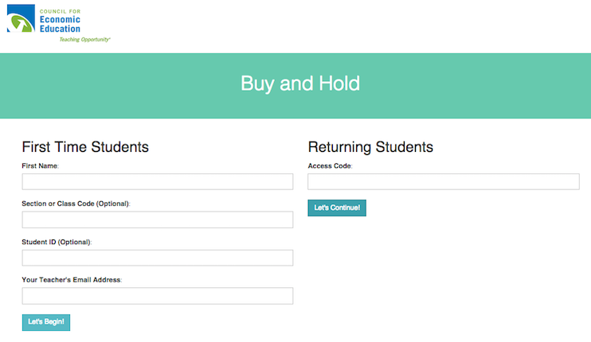
Log in screen
Notes:
Ask students to move into groups of 2-4 students, and distribute one Internet-ready device and multiple calculators to each group. Ensure that any other Internet-accessible devices are stowed. Ask students to connect to the Buy and Hold interactive at http://buyandhold.interactives.councilforeconed.org/
Tell students to put in one student’s name to represent their group.
You simply need to provide the students your e-mail address in order for them to be able to login to the system. They will receive an access code upon their first login. They need to write this down for future reference. You may also choose to have them provide this code to you. If you are doing the alternative version of this lesson, you can delete slides 10 – 13 or skip them.

Slide 13
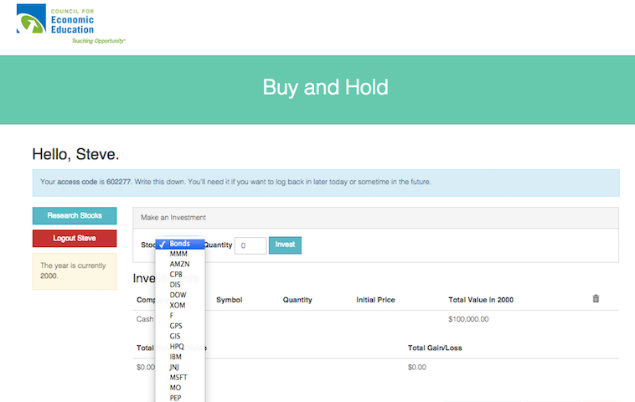
How to research and buy
Notes:
Draw students’ attention to the “Research” button, which will bring them to a page with graphs and basic information on all of the companies. Also draw students’ attention to the selection box where they can choose a stock, then choose a quantity and click “Invest” to purchase the stock. Remind students they are limited to 500 shares of any one stock. They will buy the stock only in January 2000 and they will not have the opportunity to sell, although they will track which stocks they would sell or buy later if they were able to.
They will have the opportunity to delete the stock by clicking “Destroy” if they change their minds. If they choose to buy more of a stock, they must delete the existing purchase and buy the larger amount. They will not be permitted to buy the same stock twice. They will also not be permitted to spend more than $100,000. Instruct students to make their selections and click “Submit” when they are done. Once a student clicks submit, they may not make any changes. The teacher, however, can undo submissions by clicking on the “yes” button in the “Submitted” column on the teacher dashboard. In addition, the teacher can submit for students if they fail to do so. You may wish to have students print their portfolios and turn them in. Students must make all of their selections and submit before the end of Day 1.

Slide 14
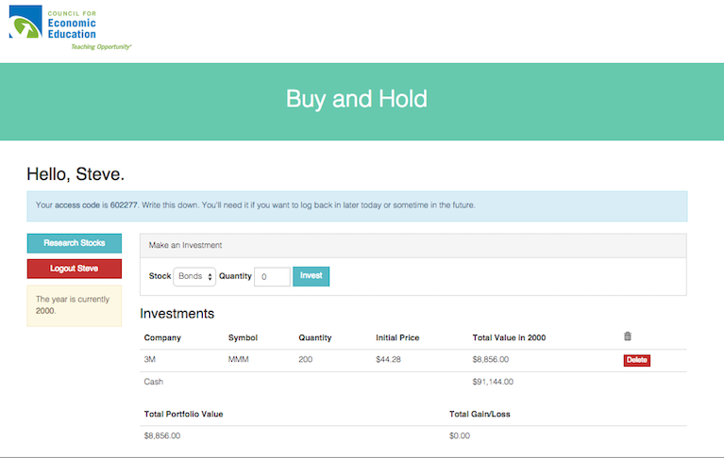
Your portfolio

Slide 15
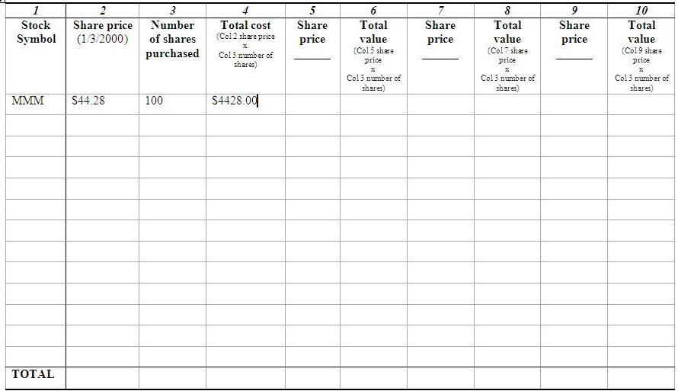
Make sure total does not exceed $100,000
Notes:
IF STUDENTS DO NOT HAVE INTERNET ACCESS, USE THIS ALTERNATIVE HANDOUT. Tell students they are to fill in only Columns 1-4, as shown on Slide 14. They should keep a running total to make sure they do not spend more than their allotted $100,000. At the bottom of the page, each group should also note how much they will spend on bonds and how much they will retain as cash. The one big point to make here is the total cost should not exceed$100,000. If you are doing the online version, you will not need this slide.

Slide 16
Sept. 23, 2002
Stock Price
MMM $56.27 AMZN $17.01 CPB $22.27 DIS $15.24 DOW $27.65 XOM $32.82 F $ 9.63 GPS $11.56 GIS $22.10 HPQ $12.03 IBM $60.36
Stock Price
JNJ $52.30 MSFT $22.62 MON $ 7.20 PEP $36.69 SBUX $10.50 TXN $15.58 TWX $36.36 UNH $21.85 WMT $50.51 WHR $46.82 XRX $ 5.26

Slide 17
Oct. 1, 2007
Stock Price
MMM $95.85 AMZN $93.43 CPB $36.40 DIS $35.47 DOW $44.67 XOM $91.36 F $ 8.37 GPS $18.90 GIS $28.76 HPQ $50.90 IBM $116.30
Stock Price
JNJ $66.25 MSFT $29.84 MON $86.93 PEP $73.74 SBUX $26.84 TXN $36.54 TWX $57.18 UNH $47.70 WMT $47.53 WHR $94.29 XRX $17.54

Slide 18
What is my “return on investment”?
Asset Value – Initial Investment
Initial Investment
$115,200-$100,000
$100,000
100
X
100
X
Notes:
To determine the return on investment between January 2000 and October 2007, you will calculate the change in value, then divide by the initial value. Multiply by 100 to arrive at a percentage. As an example, imagine that you had invested all $100,000 in the stock market, and now your total shares of stock are worth $115,200. Ask students, "What is the percentage return on the investment?" (15.2%)

Slide 19
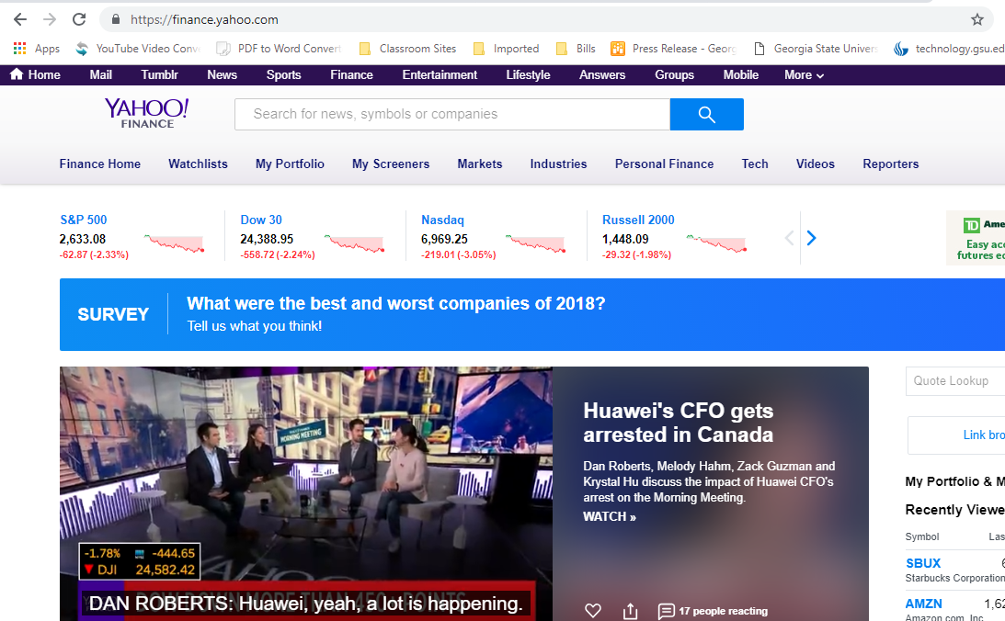
Enter the company name or ticker symbol here
Notes:
Slides 19 – 22 simply visually show how to go about getting stock information on Yahoo Finance’s new pages. Just follow the directions in the yellow boxes.

Slide 20
Click here to enlarge the graph

Slide 21
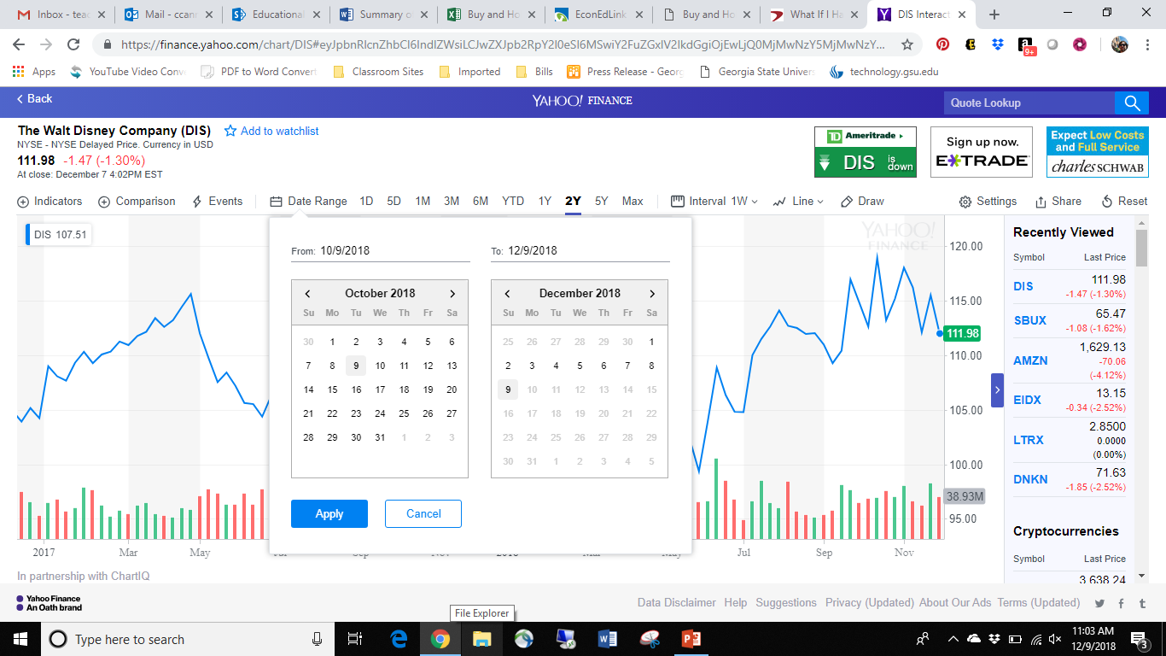
Click here to extend the date range and select 10/1/2007 as the end range in the “to” box. The “from” box can be any date prior to 10/1/2007, but recommended to use January 1, 2000

Slide 22
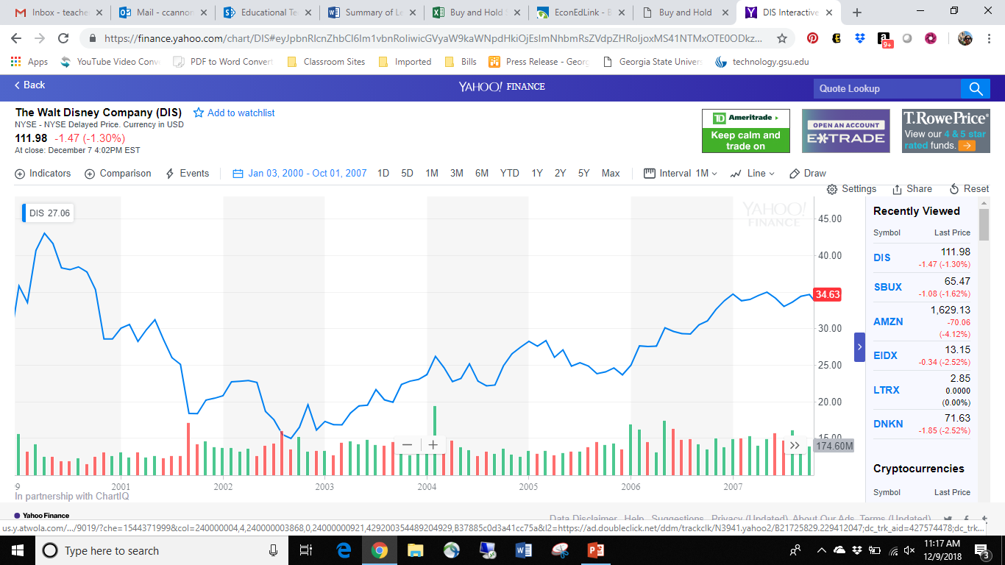
The number that shows up in red on the right side is the price on the last date entered.

