Slide 1
﻿Unemployment
“It’s a recession when your neighbor loses his job; it’s a depression when you lose your own.” – Harry Truman
What are the costs of unemployment?
Notes:
Costs: Loss of paycheck, loss of self-esteem, stress, crime, suicide, mental illness, loss of output.

Slide 2
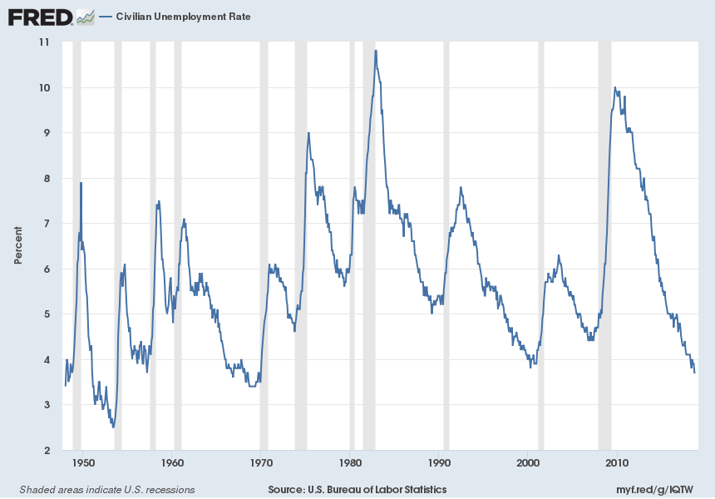
Unemployment Over Time

Slide 3
Question 1
True or false:
Employed people are people with jobs.

Slide 4
Answer 1
True
The Bureau of Labor Statistics (BLS) conducts a monthly survey of 60,000 households.
People are considered employed if they did any work for pay:
  Part time
  Full time

Slide 5
Question 2
True or false:
Unemployed people are people without jobs.

Slide 6
Answer 2
Not completely true!
Individuals are unemployed if they:
  Do not have a job.
  Have looked for a job in the past 4 weeks.
To be considered part of the labor force, you must be working or looking for a job.

Slide 7
Question 3
True or false:
The labor force is the number of people aged
16 years and older who are not in the armed forces
or institutionalized.

Slide 8
Answer 3
False
To be counted in the labor force individuals must be:
  Civilians and not institutionalized.
  16 years or older.
  Have a job (Employed).
  Be looking for a job (Unemployed).

Slide 9
Summary
Adult Population: Everyone 16 years old or older and who is not in the military, not in jail or prison, not living permanently in nursing homes, and not in other “institutions.”
Labor Force: The total number of adults who are either employed OR unemployed.
Employed: The number of adults who are working.
Unemployed: The number of adults who are not working but are actively seeking work.

Slide 10
A Review
Is your retired grandfather unemployed?
Is a mom or dad that stays home with her kids unemployed?
Is someone who lost their job at a local factory and started looking for a new job unemployed?
Is a full-time college student unemployed?
Are you unemployed?
Notes:
1. No. While he is not working, he is also not looking for work.
2. No. While she may not be working outside the home, she is also not looking for work.
3. Yes, they are not working but looking for work.
4. Not unless he or she is not working and looking for a job.
5. Accept a variety of answers.

Slide 11
Unemployment Statistics
Unemployment Rate = Unemployed/Labor Force
  Example: Unemployed = 8.2 M; Labor Force =
  146.8 M; Unemployment Rate = 8.2 M/146.8 M = 5.6%
Labor Force Participation Rate = Labor Force/Adult Population
  Example: Adult Population = 222.8 M; Labor Force = 146.8 M; Labor Force Participation Rate = 146.8 M/222.8 M = 65.9%

Slide 12
Current Data and Unemployment Map
Labor Force Statistics from the monthly
Current Population Survey Bureau of Census
  https://www.bls.gov/cps/
Unemployment Map for 2007 - 2013
  http://www.latoyaegwuekwe.com/geographyofarecession.html

