Slide 1
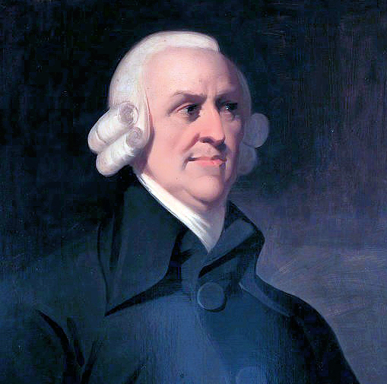
Adam Smith on Trade
  “It is a maxim of every prudent mast of a
  family, never to attempt to make at home
  what will cost him more to make than to
  buy. The tailor does not attempt to make
  his own shoes, but buys them of the
  shoemaker. The shoemaker does not
  attempt to make his own clothes but employs a tailor.”
  From An Inquiry in the Nature and
  Causes of the Wealth of Nations (1776)
Notes:
Use this slide to make the point that the benefits of trade have been understood for a long time, going all the way back to Adam Smith's seminal work that created the field of economics in 1776.

Slide 2
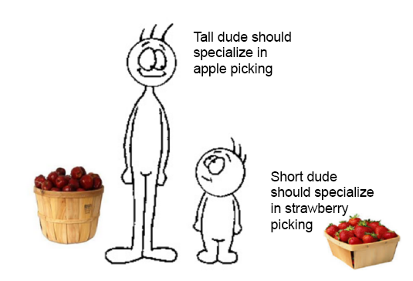
The Theory of Absolute and Comparative Advantage
Absolute Advantage: The comparison among
producers of a good according to their
productivity.
  Who can produce using fewer
  resources?
Comparative Advantage: The comparison among producers of a good according to their opportunity cost.
  Who can produce with a lower opportunity cost?
Notes:
Use this slide to explain the difference between absolute and comparative advantage. Make the point that if a person (or country) has an absolute advantage in some activity they can perform it using less resources (like time) or simply that they are better at it. It might be true that the United States has an absolute advantage in producing most products over Mexico due to our more educated workforce, more established business climate and legal system, etc. However, then explain that comparative advantage is a very different concept. This term refers to the person (or country) that can do something at a lower opportunity cost (or they give up less when they do it). If the United States chooses to produce t-shirts, we may be giving up the opportunity to produce iPhones or airplanes.

Slide 3
LeBron James: Absolute and Comparative Advantage
LeBron James is a great basketball player
and a great lawn mower.
James can mow his lawn in 2 hours.
  What is his opportunity cost?
Little Neighbor Scotty can mow James’
lawn in 4 hours.
  What is his opportunity cost?
Notes:
Lead the class through the thought experiment in slide 2. Make it clear that Lebron is better at BOTH activities.

Slide 4
LeBron James: Absolute and Comparative Advantage
Who has the absolute advantage in
mowing grass?
Who has the comparative advantage
in mowing grass?
If we are seeking the most efficient
solution, who should mow James’ lawn?
Notes:
Have the students answer the questions in slide 3. While they will all see that Scotty should mow the grass, make the important point that what they are saying is that the person that is worse at the activity (actually twice as bad) should do the task. Because nations or people cannot do everything (even if they have an absolute advantage in everything) they should specialize in the activities where they have a comparative advantage. For LeBron James this means basketball, for Scotty this means grass mowing, for you it means teaching.

Slide 5
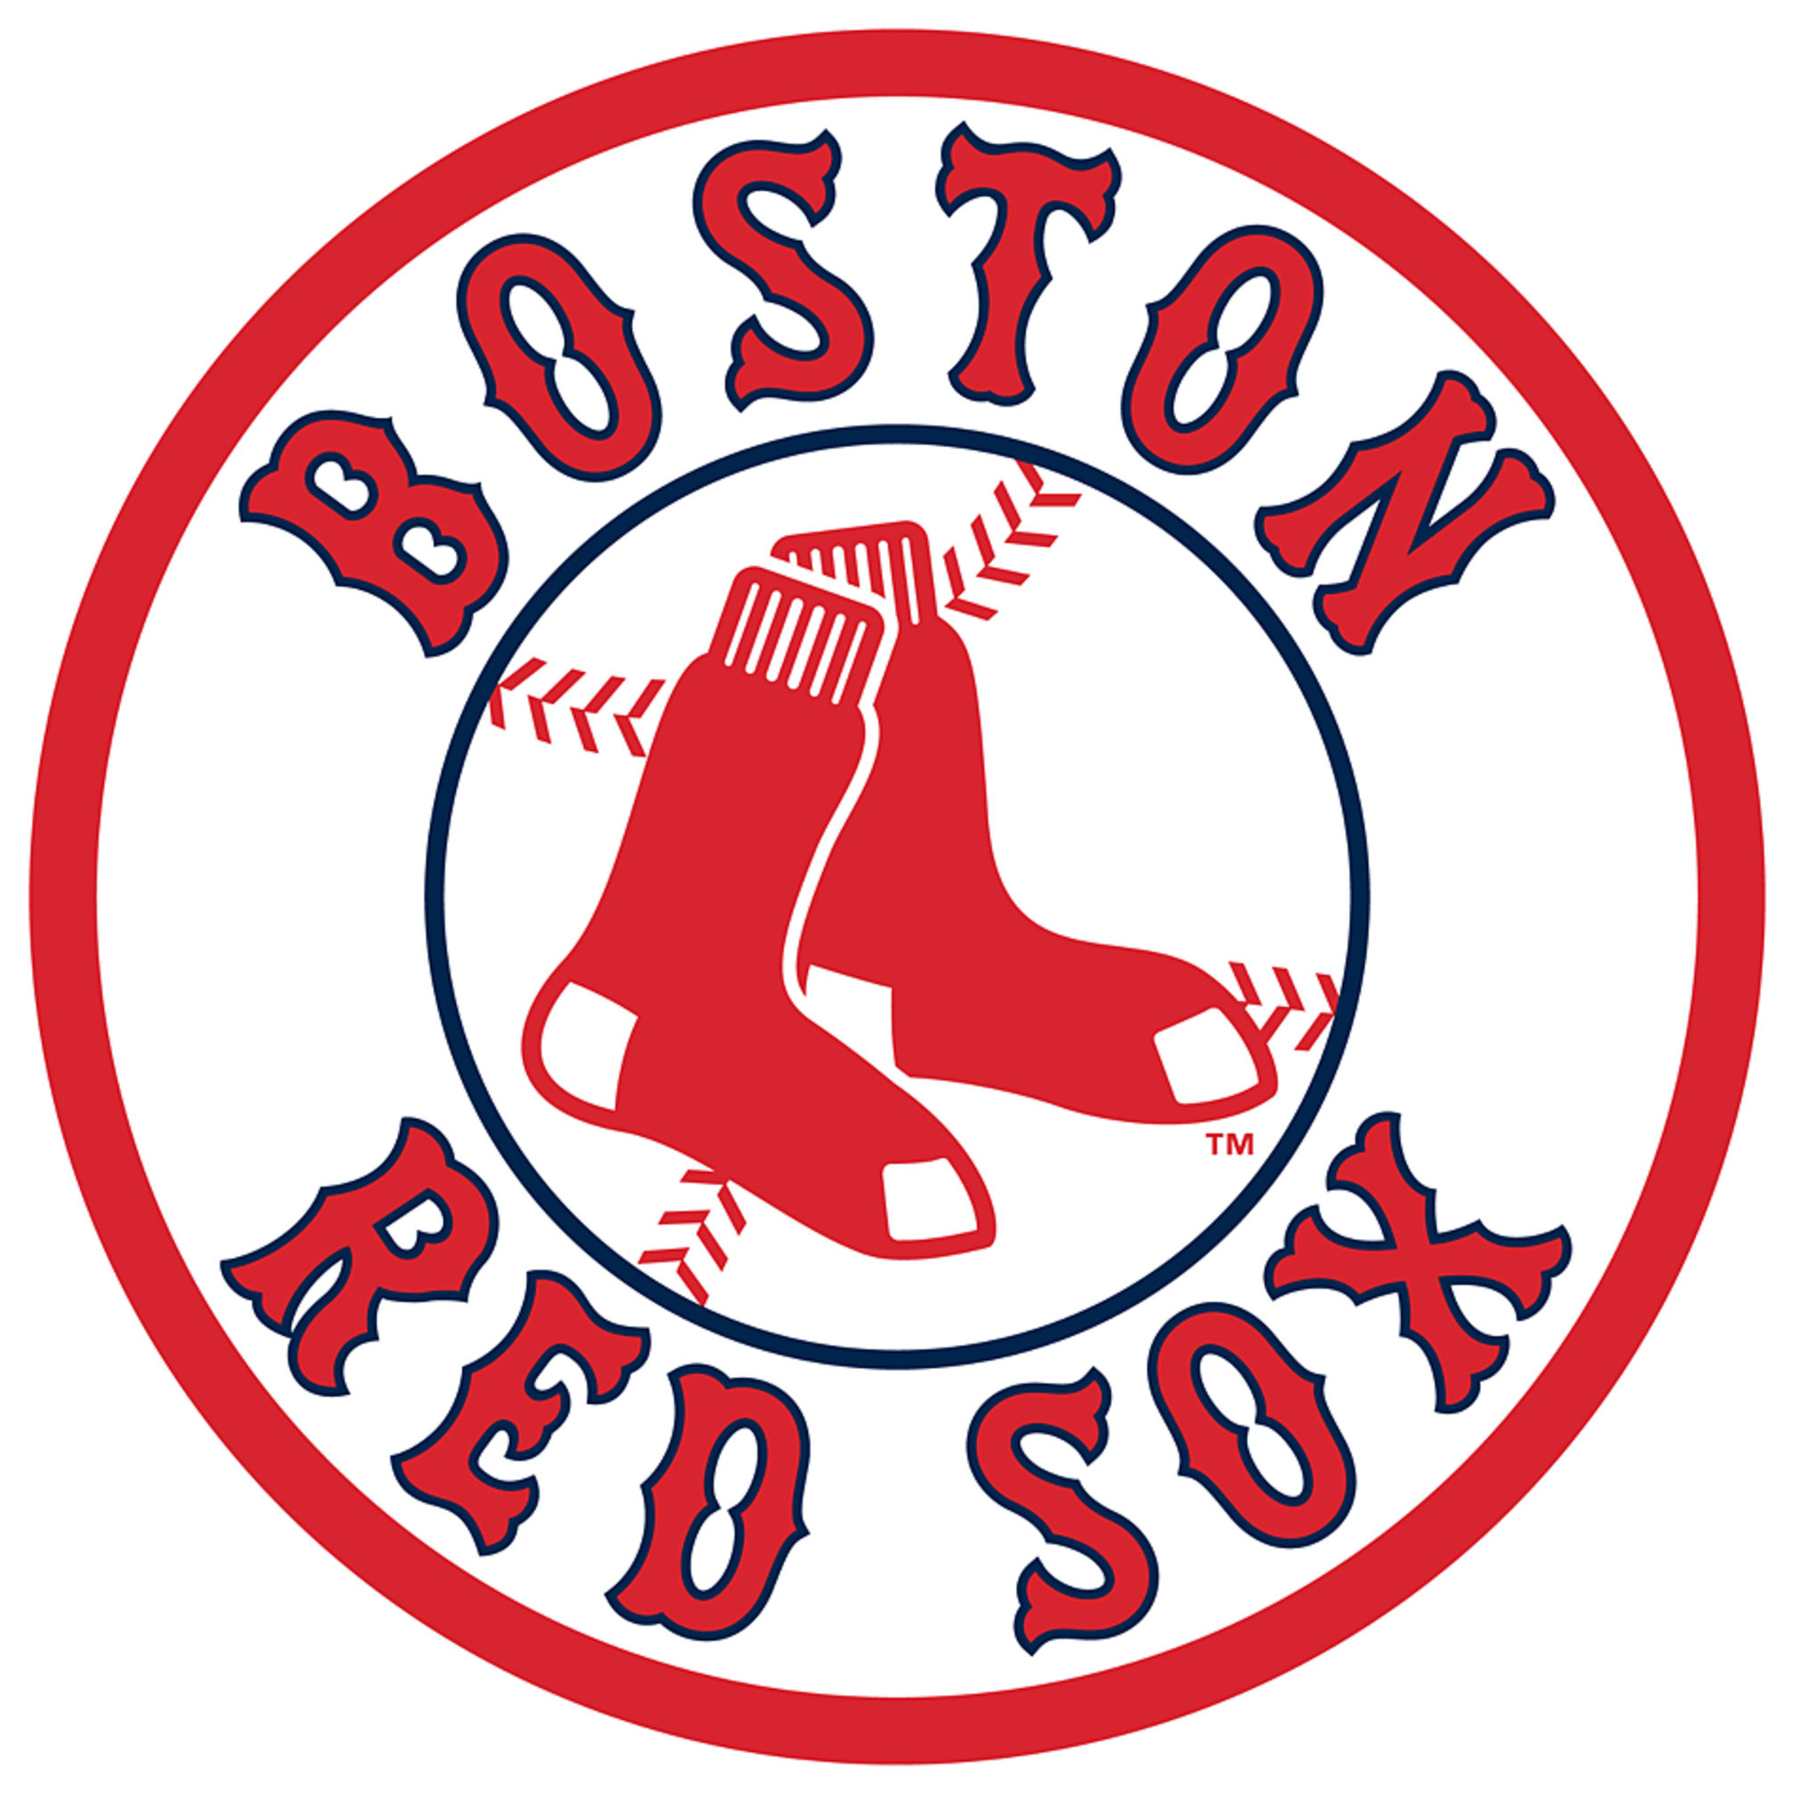
A Sports Economic Mystery
Why did the Boston Red Sox stop using the best
left-handed pitcher in baseball in 1918?
  He helped win World Series in 1916 and 1918.
  In the 1918 World Series, he won two games
  and set a record for consecutive scoreless
  innings (a record not broken until 1961.)
  From 1915 to 1918, he was 78-40 with an ERA
  under 2.00.
  He played until 1935 but rarely pitched again.
  Who was this player?

Slide 6
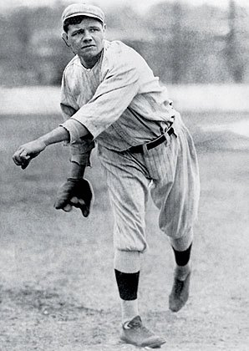
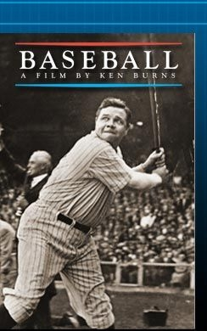
Who Was this Player?
Herman “Babe” Ruth
“Best pitcher in the American League of his time, no doubt.”
– Ken Burns

Slide 7
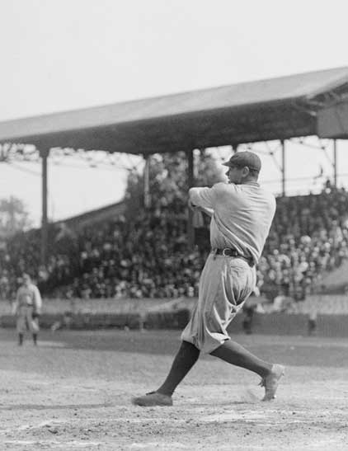
To Trade or Not to Trade?
If you have an absolute advantage in everything, can you still benefit from specialization and trade?
  Specialize where you have
  a comparative advantage.
  Babe Ruth: The best hitter and
  best pitcher of his generation.
Notes:
Use the example of the last slides of Babe Ruth to show that he had an absolute advantage in both hitting and pitching (he was the best at both) but his comparative advantage was in hitting so that is where he chose to specialize.

Slide 8
The Man Could Hit!
In 1920, Ruth hit 54 home runs.
  Baseball historians suggest this is equivalent to hitting 136 today.
  It was more home runs than any other team in the American League.
  Only the Phillies hit more in the NL—64.
3rd on home run list – 714
10th in batting average – .342
2nd on RBI list – 2,213
2nd on all-time slugging % – .690
2nd on all-time on-base % – .474
1st on all-time OPS – 1.164
4th on all-time runs list – 2,174
6th on all-time total bases list – 5,793
3rd on all-time walks list – 2,062

