Slide 1
Entrepreneurs:
In the Business of Goods and Services
Notes:
Entrepreneurs recognize opportunities, like working for themselves, and accept challenges.
Ask students what they think might be some risks an entrepreneur might take in starting a business. [Answers may vary, but examples of possible answers include: Entrepreneurs don't know if consumers would demand their product, they may have to work many hours, and it is up to them as to whether the business they start is successful.]
Ask students what they think might be some rewards an entrepreneur might enjoy in starting a business. [Answers may vary, but examples of possible answers include: Entrepreneurs get to select the business they begin, they can show they are responsible, they can earn a lot of money, and they can achieve personal goals.]

Slide 2
Entrepreneur
An entrepreneur is a person who takes a risk to start
a business.
An entrepreneur looks at the risks and rewards and then determines the business that he or she wants to start.
Some entrepreneurs produce goods and some produce services.
Notes:
Entrepreneurs produce goods and provide services to satisfy consumers' wants. Remember that consumers are shoppers, those whose wants are satisfied by using goods and services. What are goods and services?

Slide 3
Goods
A business that produces a good is producing something that a consumer can touch, feel, or use to satisfy his or her wants.
Example:
If Sally is hungry for pizza, she may decide to go eat at Paula’s Pizza. Paula is the entrepreneur. She produces a good, pizza.
Notes:
Goods are things that people enjoy and use that can be touched, held, or used. Goods might include food, toys, books, clothes, electronics, bikes, and cars. Encourage students to identify other goods.

Slide 4
Services
A business that produces a service is providing an action to satisfy a consumer’s wants.
Example:
If Mrs. Smith wants her lawn mowed, she might contact Larry’s Lawn Service. Larry is the entrepreneur who owns the business. He produces a service by mowing, raking and cleaning Mrs. Smith’s lawn.
Notes:
Services are actions that satisfy people's wants. Services might include mowing someone's lawn, washing someone's clothes, cutting someone's hair, or babysitting. Encourage students to name other examples of services.
Arthur was going to start a pet business. Would he be producing a good or providing a service? [a service] How did you know? [He was going to take care of others' pets by walking them, feeding them, giving them baths, and taking care of them.]

Slide 5
Good or Service?
You are about to see the name of several pet businesses. Just like Arthur, each of these business owners is an entrepreneur.
Arthur produced a service by feeding, walking and caring for pets. Those are all actions.
You decide whether the business produces a good or a service. Click on the answer to show your choice.

Slide 6
Now, it's your turn to decide whether the business produces a good or a service.

Slide 7
Pet Groomers
good
service

Slide 8
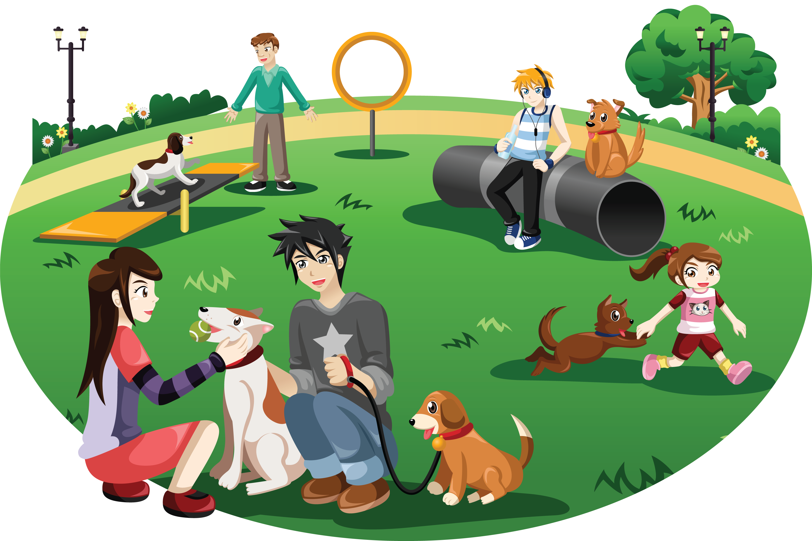
Dog Daycare
good
service

Slide 9
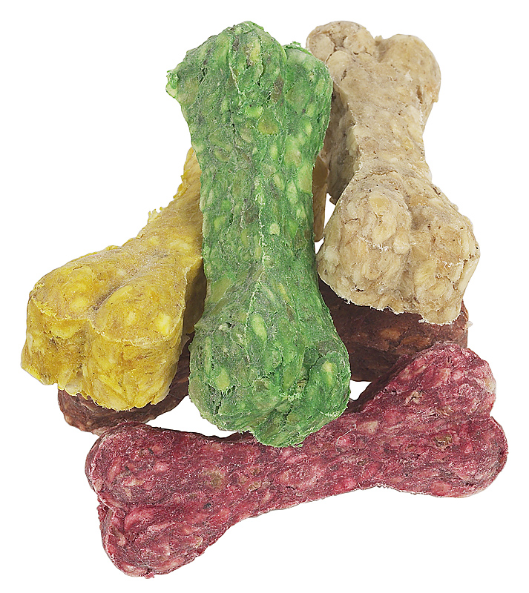
Lucky Dog Bakery
good
service

Slide 10

See Spot Dog Training
good
service

Slide 11
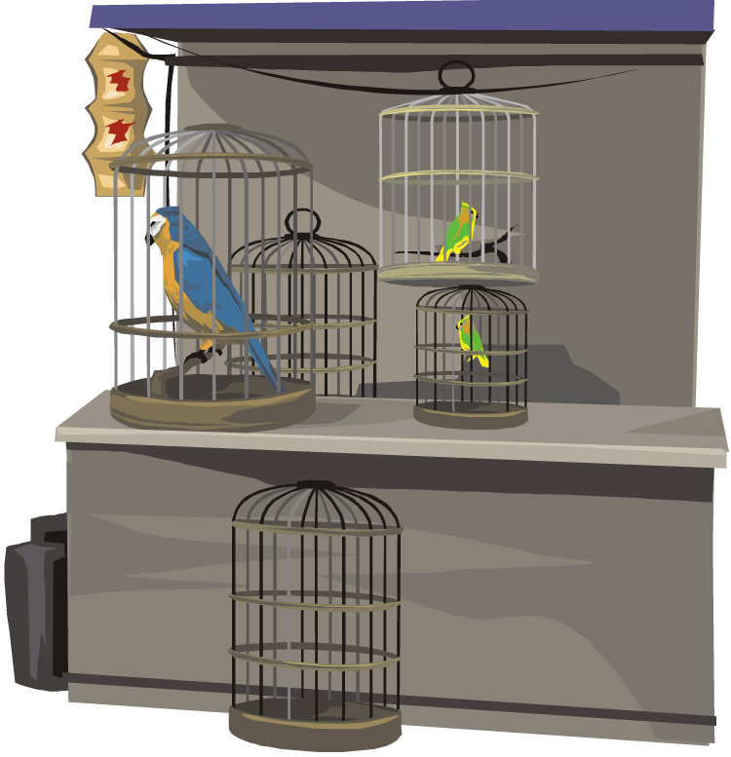
Bird Store
good
service

Slide 12
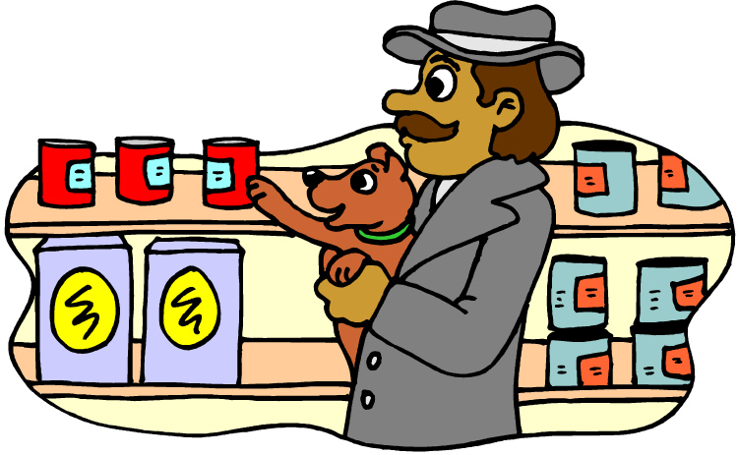
Pet Smart Store
good
service

